Slide 1





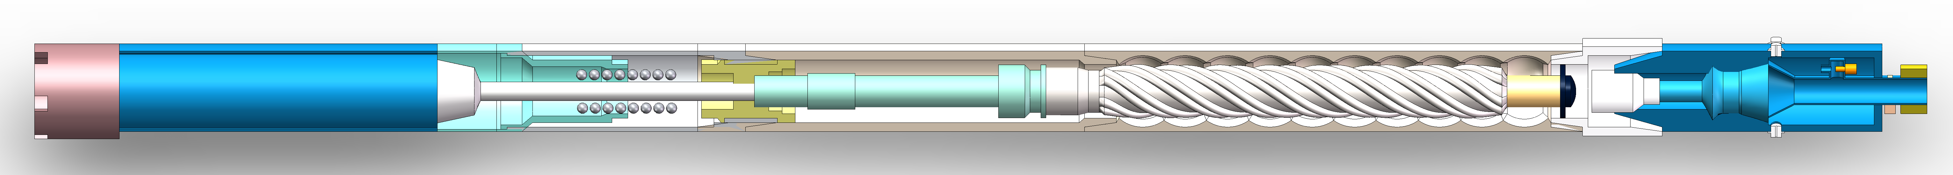
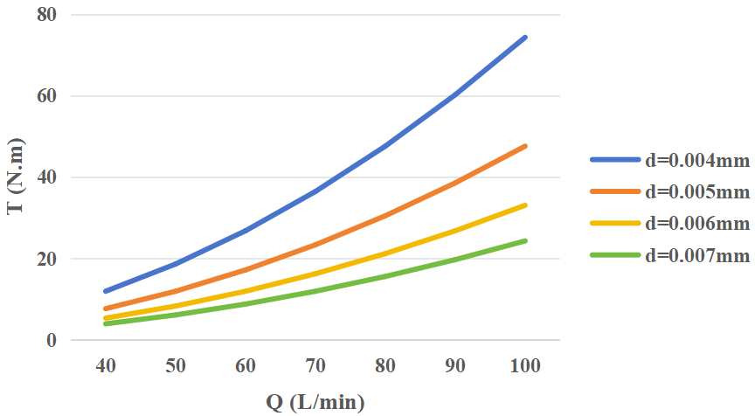
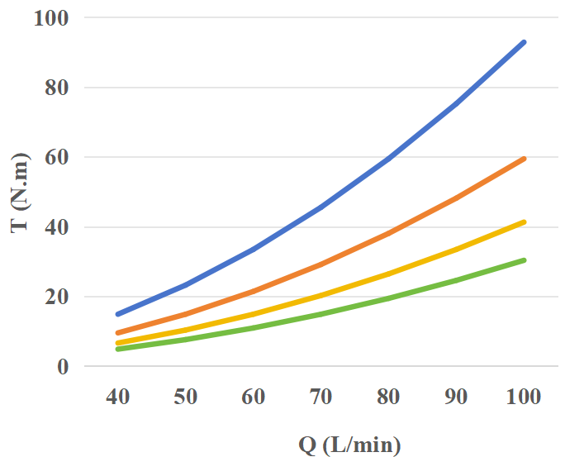
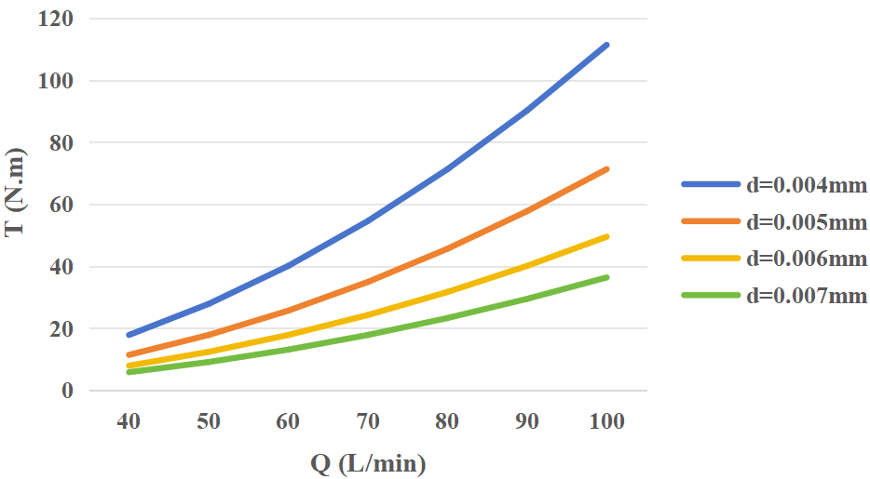
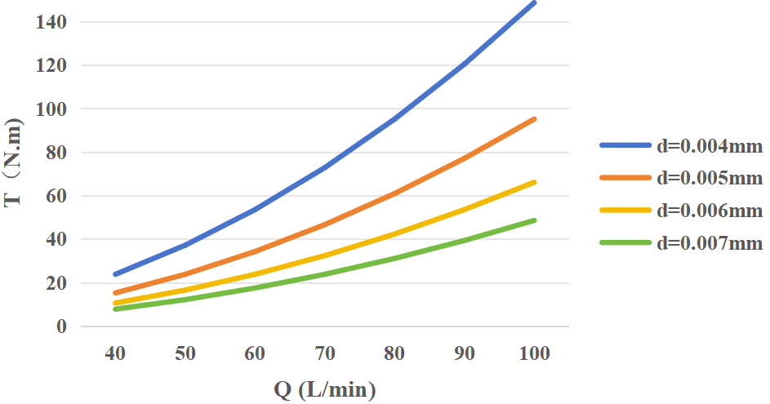
ANTI-TORQUE SYSTEMS OF HOT-WATER ICE-CORING DRILLS WITH POSITIVE DISPLACEMENT MOTOR
Yang Yang, Pavel Talalay (Jilin University, China)
Magnetic valve
Slip ring
Attitude sensor
Shaft (rotor)
Nozzle
Versatile spindle
Torque, Required for Drilling
Strata | Torque
Bedrock | 50-65 N·m
Sedimentary rocks | 11-18 N·m
Ice | 10-36 N·m
Core barrel
Drill bit
Housing (stator)
Nozzle numbers = 8
Nozzle numbers =10
Nozzle numbers =12
Nozzle numbers =16

