Slide 1
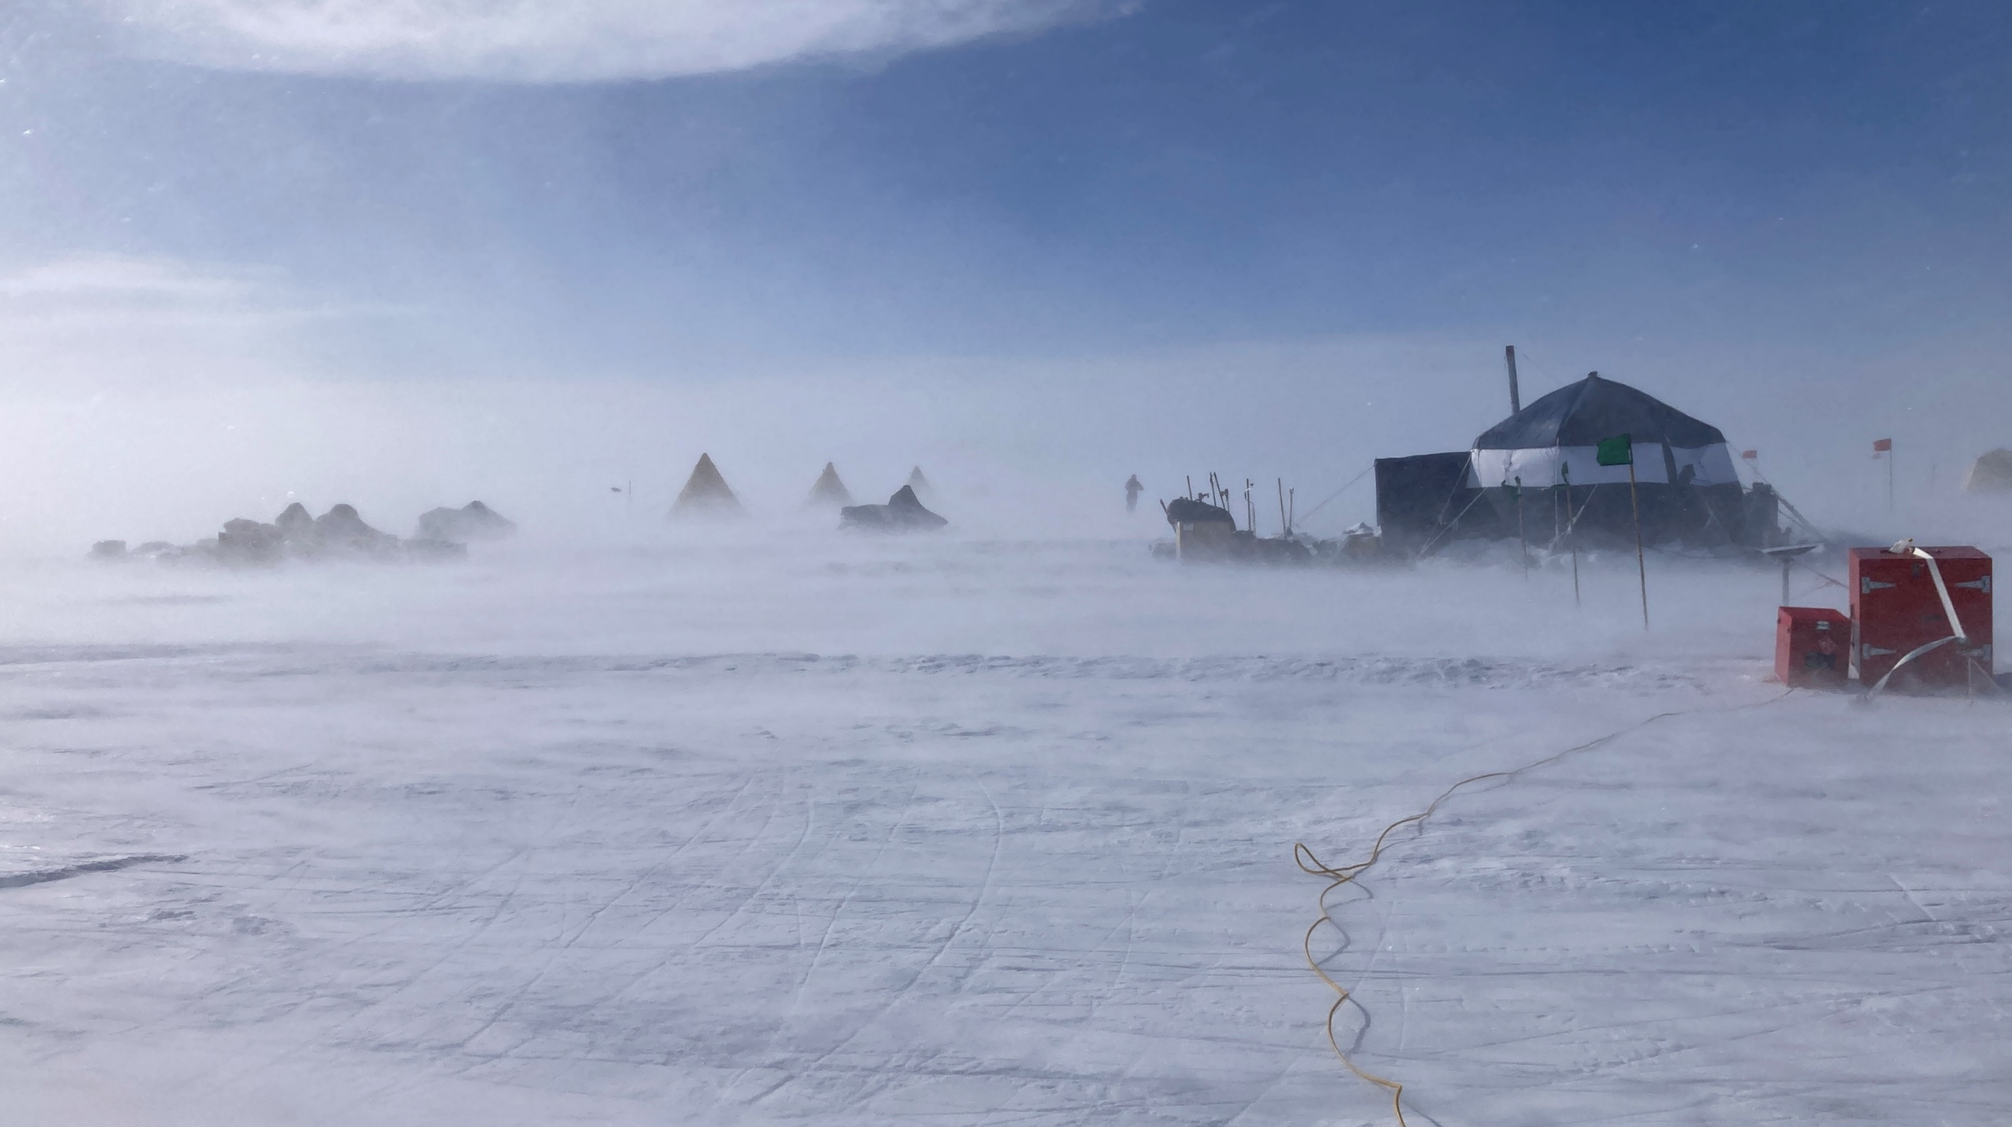



UNIQUE CHALLENGES OF DRILLING OLD, SHALLOW ICE AT ALLAN HILLS
Andrew Haala¹, Tanner Kuhl¹, Elizabeth Morton¹
¹NSF Ice Drilling Program (IDP), University of Wisconsin-Madison, United States

Slide 2
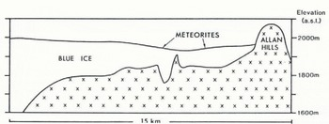
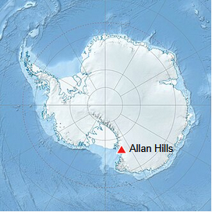
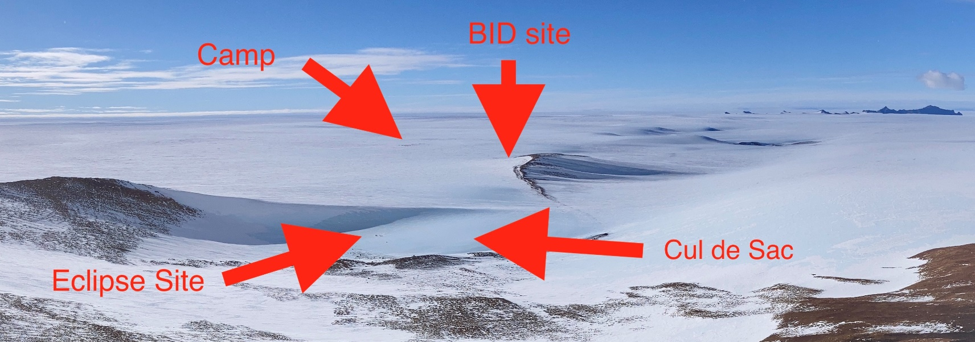
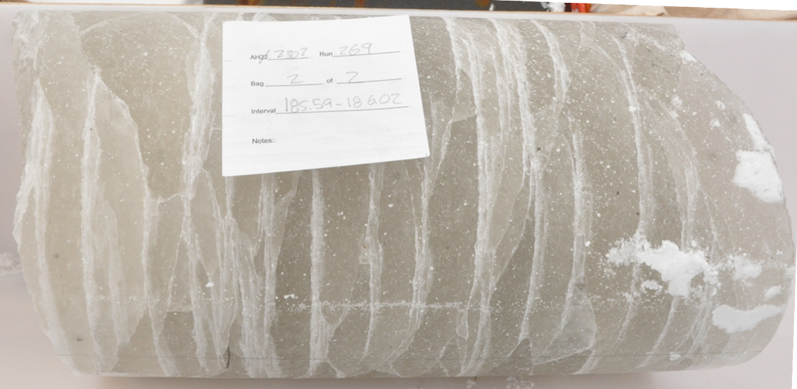
Why Allan Hills?
Low snow accumulation glacier flowing into an ablation zone
  6.7 million year old ice found within 200m of the surface
  Likely continuous ice record from 800,000 to 1.2 million years covering the MPT
  1hr Twin Otter flight from McMurdo Station
Since all holes have been <200m all drilling has been dry, but core quality is much worse than expected
Nunatak

Slide 3
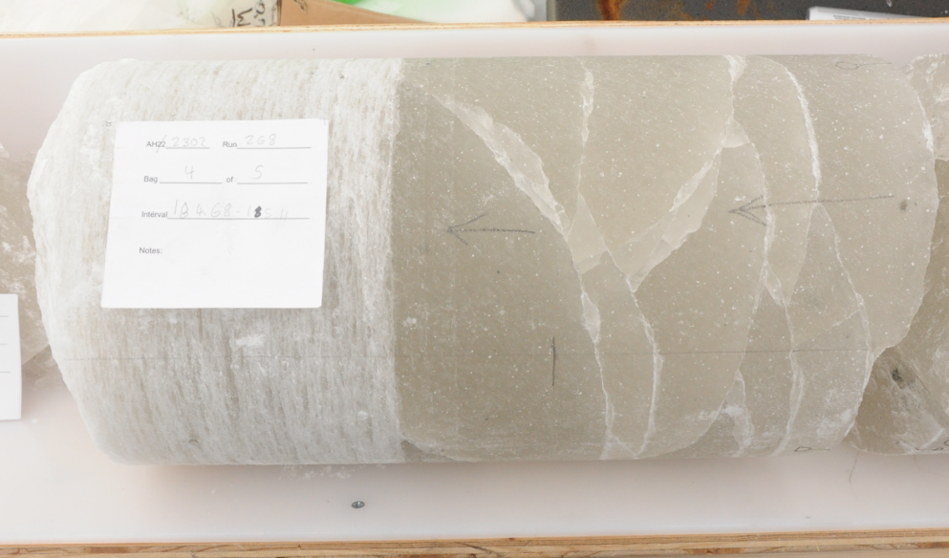
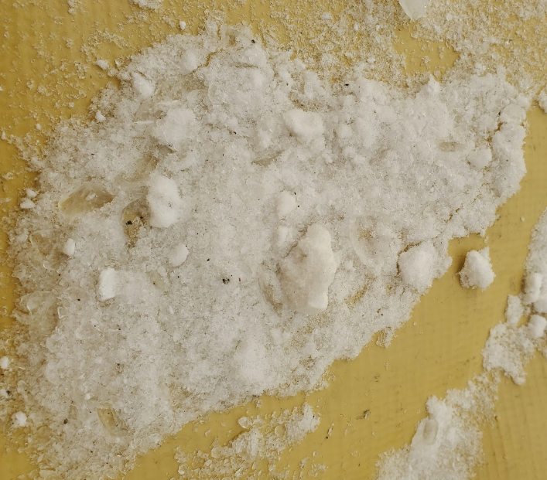
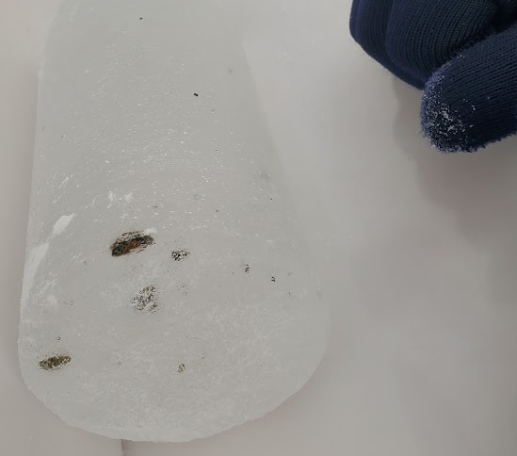
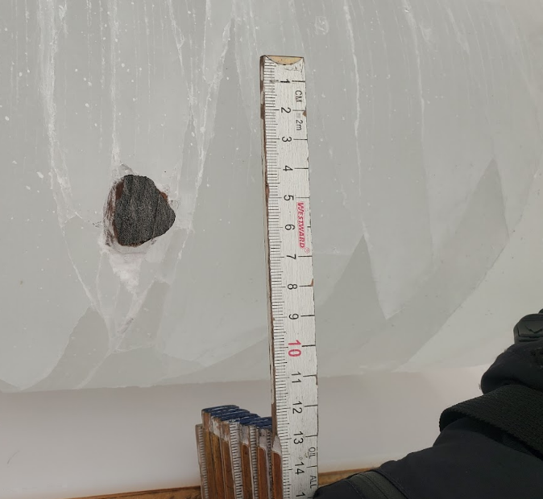
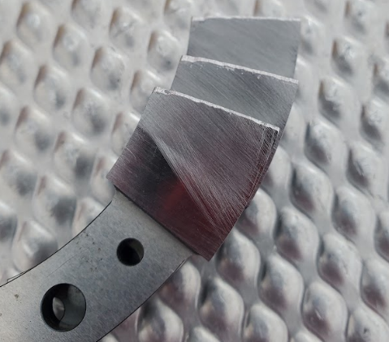
Challenge 1: Rocks
  Allan Hills ice contains embedded grit and visible rocks, causing significant cutter wear every run
  Most rock cuts are only noticed after examining the core and cutters post-run
  As shown in the top right image, hitting a rock can create a cutter defect that instantly causes core quality issues
  Cutter dulling is usually noticed as an increase in Weight On Bit (WOB) while coring, with most runs having a 100-200N increase in WOB from start to finish

Slide 4
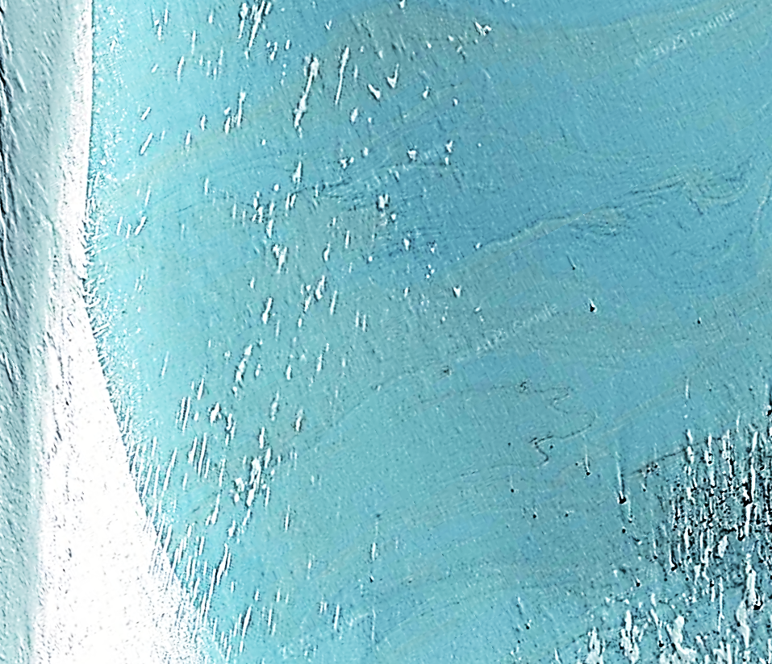
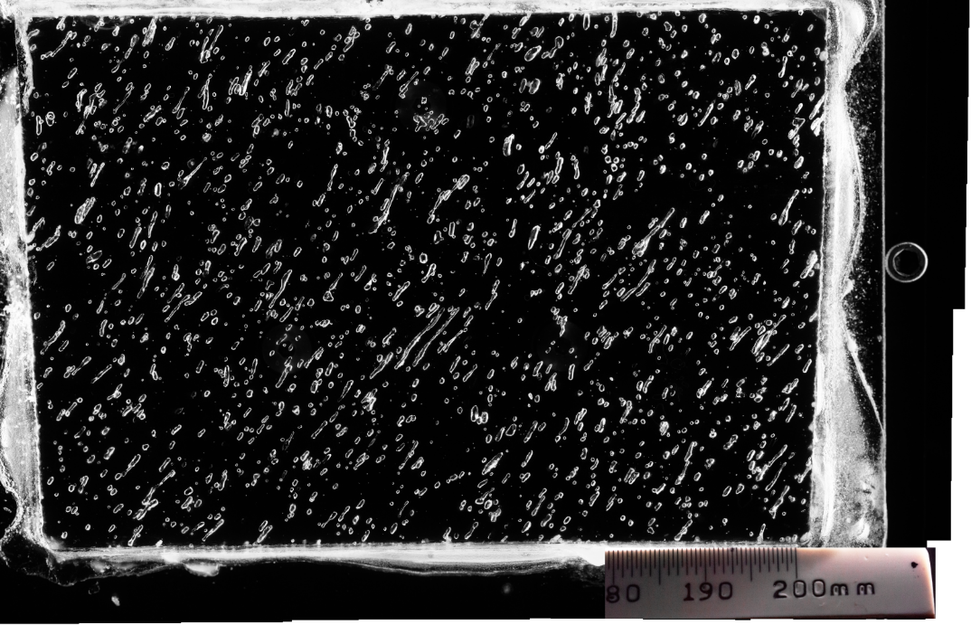
Challenge 2: Ice Structure
Layered ice
  In the Cul de Sac there is a full reversal of ice age, going from 3MA to 1MA to 4MA as depth increases from 0m to 30m. This large-scale folding is also found on a small scale, with folds found across a 30cm core.
  Annual layering as steep as 60 degrees has been measured via electrical conductivity measurement
  Combined with the high WOB, hole inclination is common
Ice Bubbles
  Allan Hills ice has notably more bubbles than recently formed ice
  The ice can be cleanly shaved with a sharp knife. However, if the knife approaches a bubble in the ice, the bubble will violently pop and fracture the nearby ice surface
  This is happening hundreds of time over the course of a drill run, shocking the ice and possibly contributing to core fractures
A Google Earth image of the Cul de Sac, rebalanced to better show Tephra layers
PC: Margot Shaya, University of Washington, USA

Slide 5
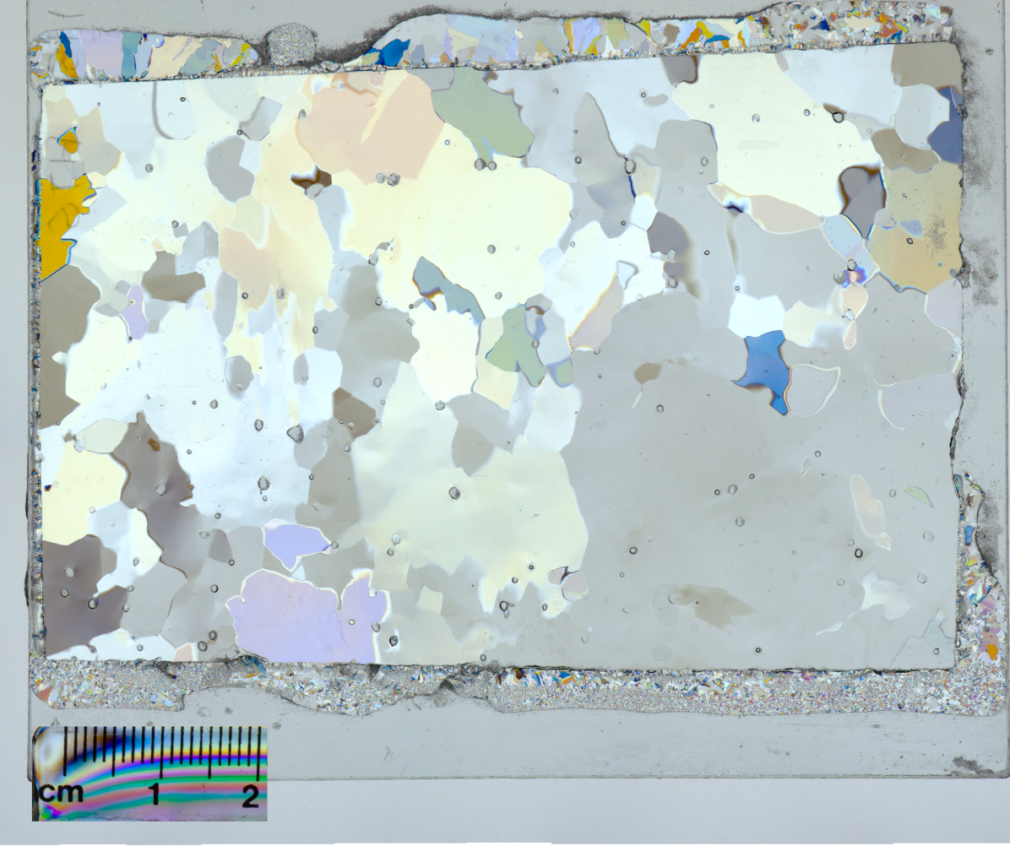
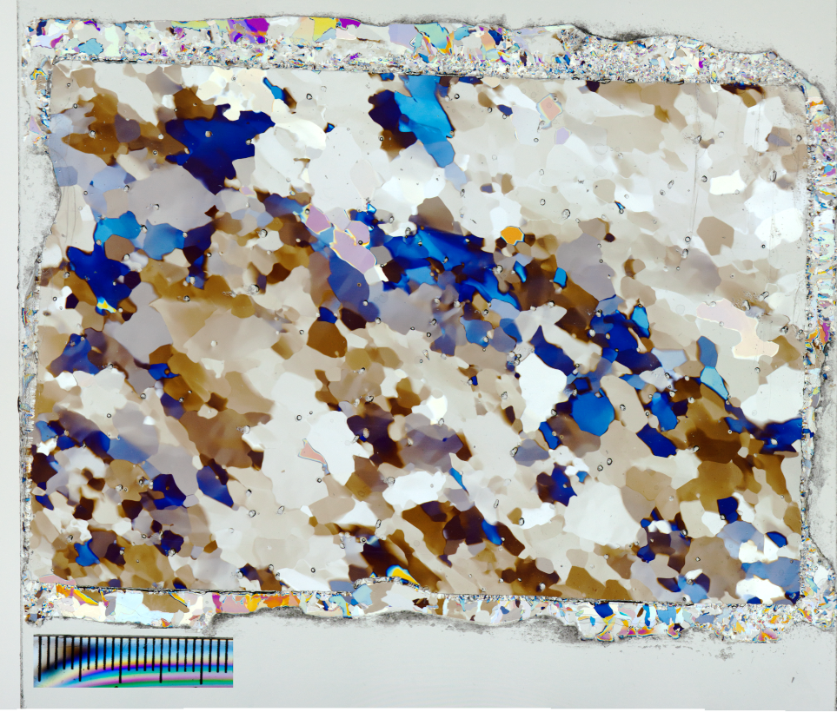
Challenge 2: Ice Structure
Ice crystal size varies far more than expected within a borehole
  This is likely due to folding, but the mechanism isn’t currently understood
  Large (>2cm) crystals are apparent and may cause core quality problems, as they need to be cut apart which is much more energy intensive than simply breaking the crystals apart from each other
Grain structure from 116m depth - Margot Shaya, University of Washington, USA
Grain structure from 119m depth - Margot Shaya, University of Washington, USA

Slide 6
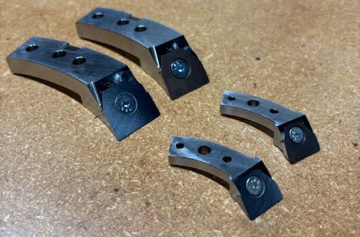
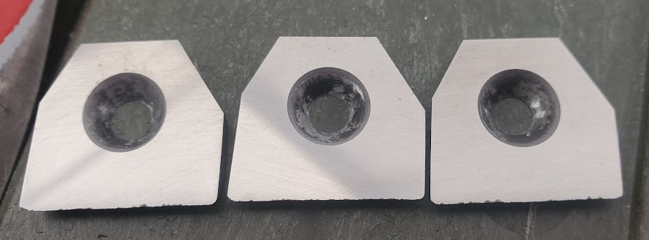
Challenge 1 and 2 mitigation
Even though it causes other issues, slow drilling feed is required to obtain acceptable core
  <1mm pitch is common for our large diameter drill
IDP designed insert-style cutters, testing them at Allan Hills in 2024-25
  Replacing inserts is much faster than whole cutters, which increases production rate and prevents drill warming at the surface
  Significant improvements were seen in run length, production rate, and average piece length
  Carbide inserts are 1/3 the per-use cost of our standard steel cutters when resharpening is accounted for
We will be testing a shallow wet drill in the 2025-26 season at Allan Hills
Do you have experience drilling rocky, old ice?
 |  | Average cm/min | cm/min std dev | Average Run (cm) | Average Longest Piece (cm)
BID | Carbide | 1.07 | 0.469 | 54.9 | 26.7
 | Steel | 0.89 | 0.838 | 39.4 | 20.9
 | % Improv | 20% |  | 39% | 28%
Eclipse | Carbide | 4.37 | 2.06 | 68.9 | 65.9
 | Steel | 3.70 | 2.24 | 63.8 | 59.8
 | % Improv | 18% |  | 8% | 10%

Slide 7
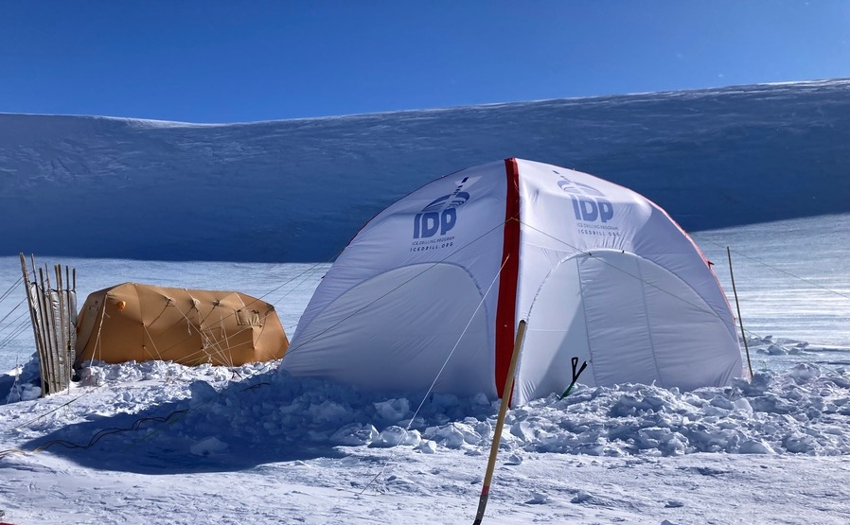
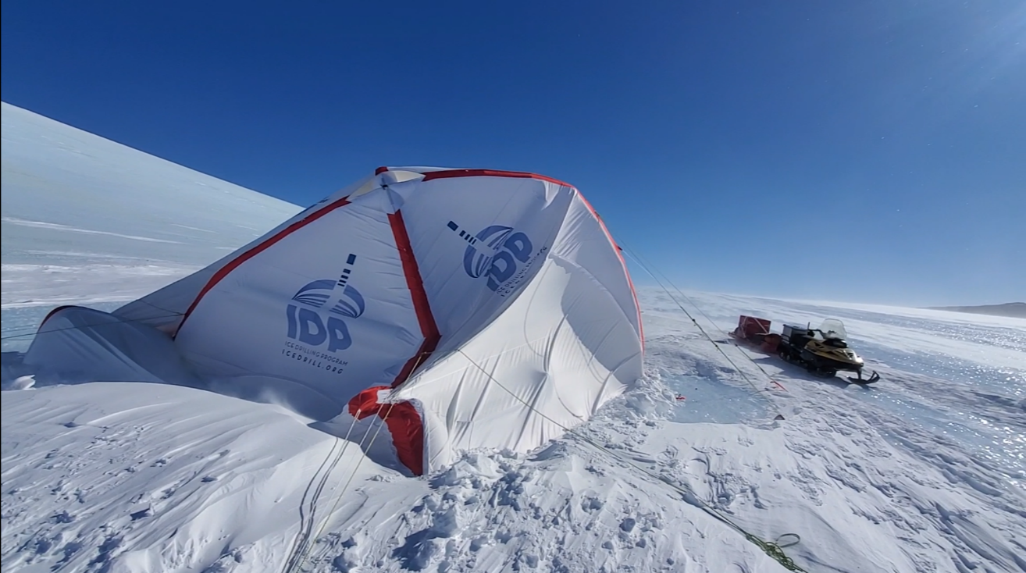
Challenge 3: Tent Durability
Average wind speed in the 2024-25 field season was 40kph with maximums of 90+kph
We were unable to set up either of our drill tents for the first 2 weeks, as average wind speeds were 50kph
We tested an Axion 6m x 6m inflatable tent as an option
  The design and construction of the tent were not suitable for use in windy areas
  Notably, the walls are unsupported by the inflatable frame and do not have rope tie-out points, allowing them to buckle inwards under wind loads and collapse the tent
  Low-pressure tubes do not have the rigidity necessary to resist highwind loads

Slide 8
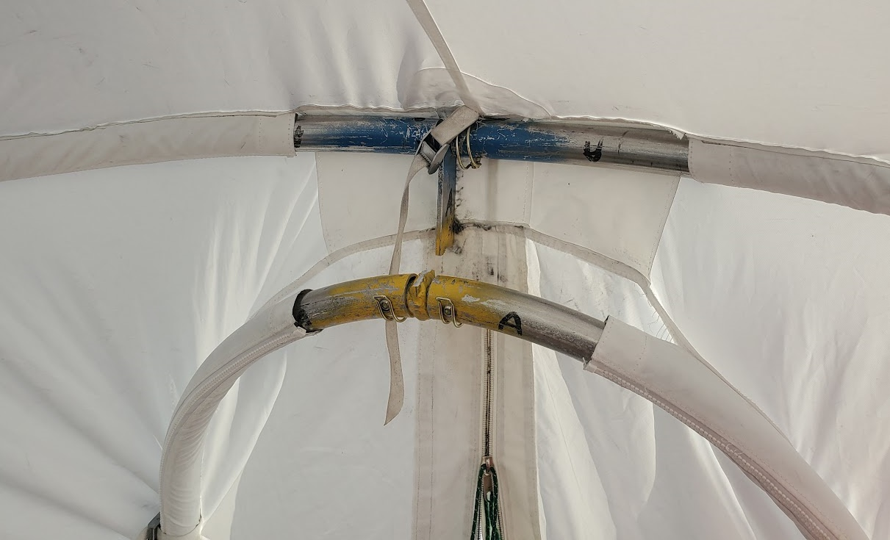
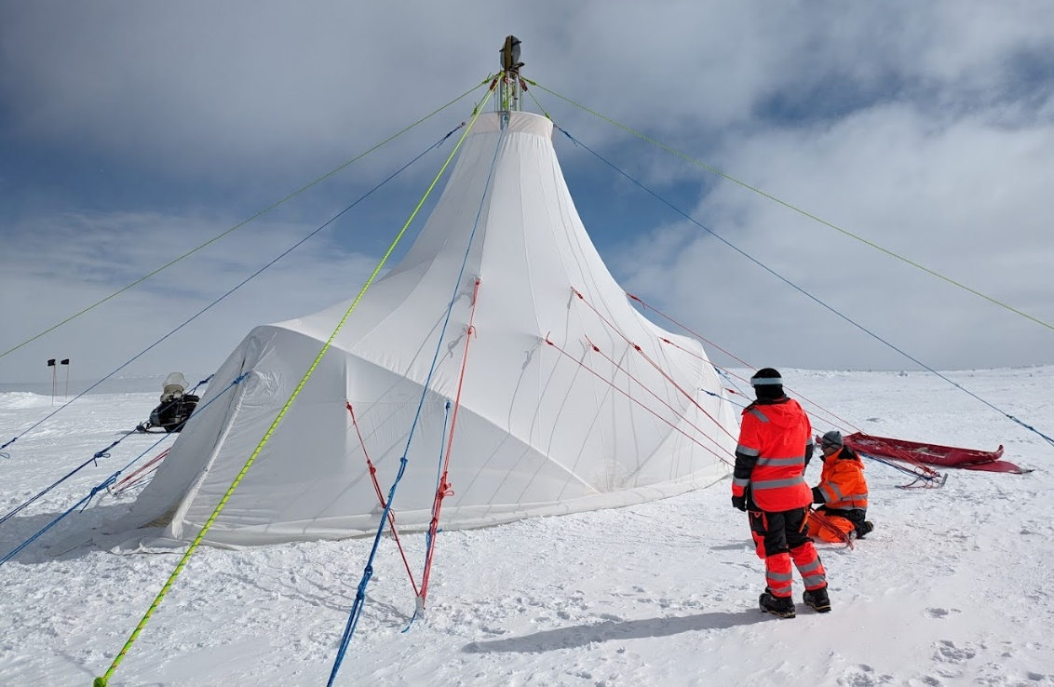
Challenge 3: Tent Durability
Our standard drill tent is 9m x 3.5m with an Aluminum frame. The top ring hangs from the drill tower.
  32 ropes tension the tent and there is a full snow skirt
  This tent has proved generally reliable at Allan Hills. During 2024-25 an Aluminum link broke and allowed seams to tear out during a 2 day 50-70kph event
What tents can be setup in 35+ kph winds and will withstand 90kph winds without damage?

Slide 9
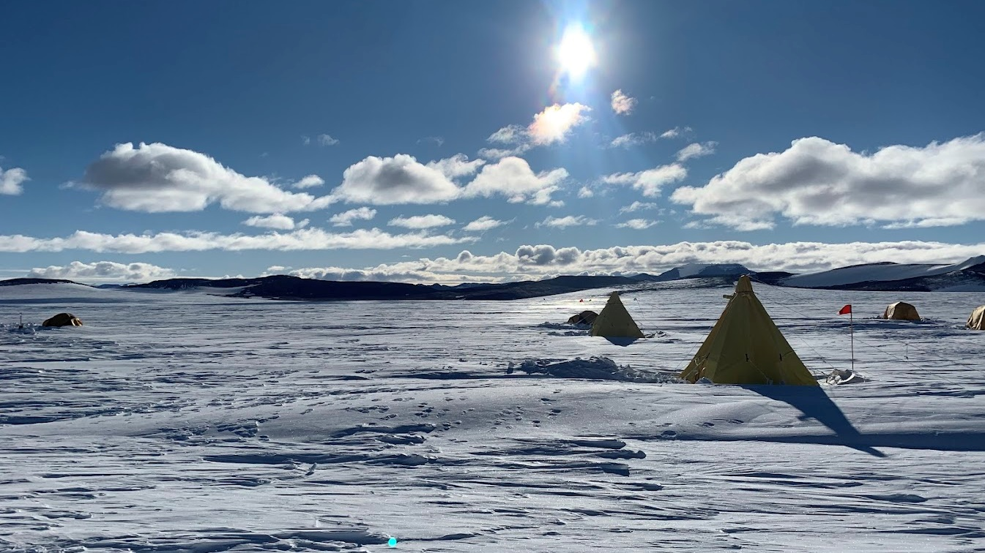
Questions/Comments
Feel free to reach out to ajhaala@wisc.edu!
This material is based upon work supported by the U.S. National Science Foundation
under Cooperative Agreement No. 1836328 and Continuing Grant 2318480.

