Slide 1
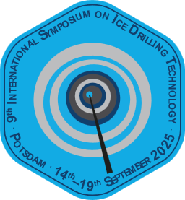

High-Altitude Thermal Drilling
9th International workshop on ice Drilling Technology
9/17/2025
Elliot Moravec, Krissy Slawny, Elizabeth Morton, James Koehler

Slide 2
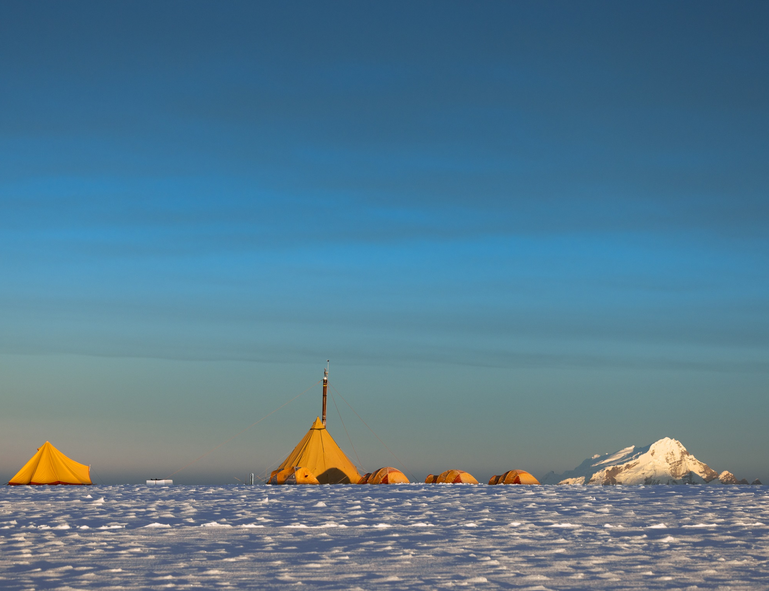
Agenda
Thermal drill specifications
Quelccaya Ice Cap coring project (Peru)
Mt. Waddington ice coring project (Canada)
Sediment Challenges
Opportunity for discussion
Photo Credit: Mariusz Potocki

Slide 3
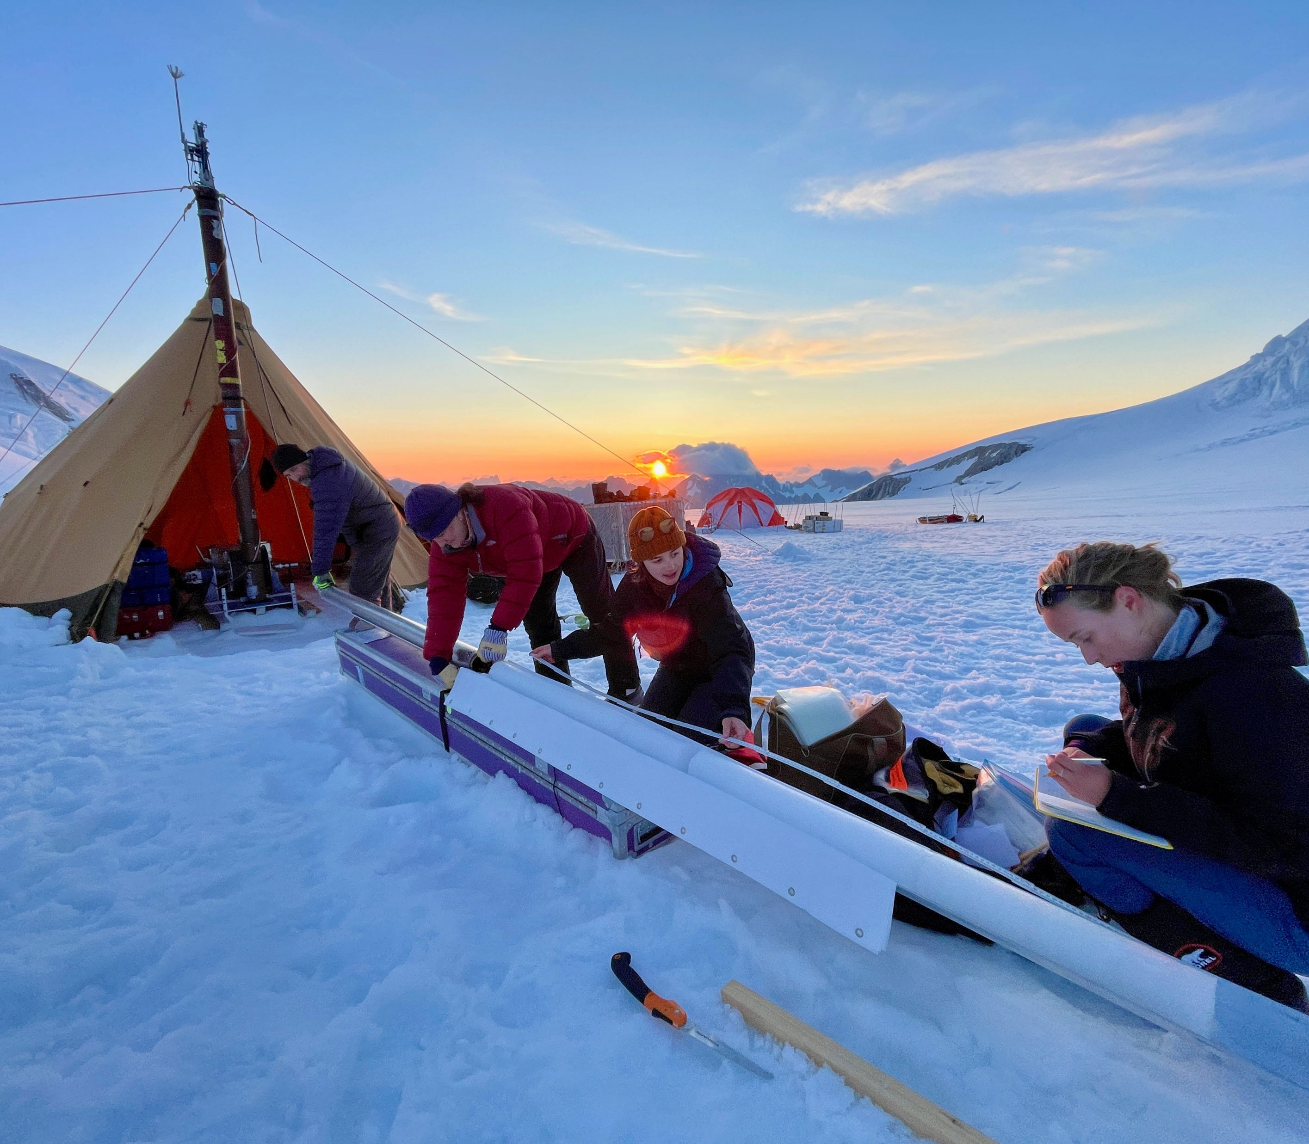
Thermal Drill Specifications
1800w heat ring melts 86mm (3.4”) core
Normally paired with IDP 4-Inch winch and tower.
Intended for use in isothermal glaciers (ice warmer than -10C)
Requires pooling melt water in borehole
Collects ~2m core/per run
300m water shedding cable implemented in 2019

Slide 4
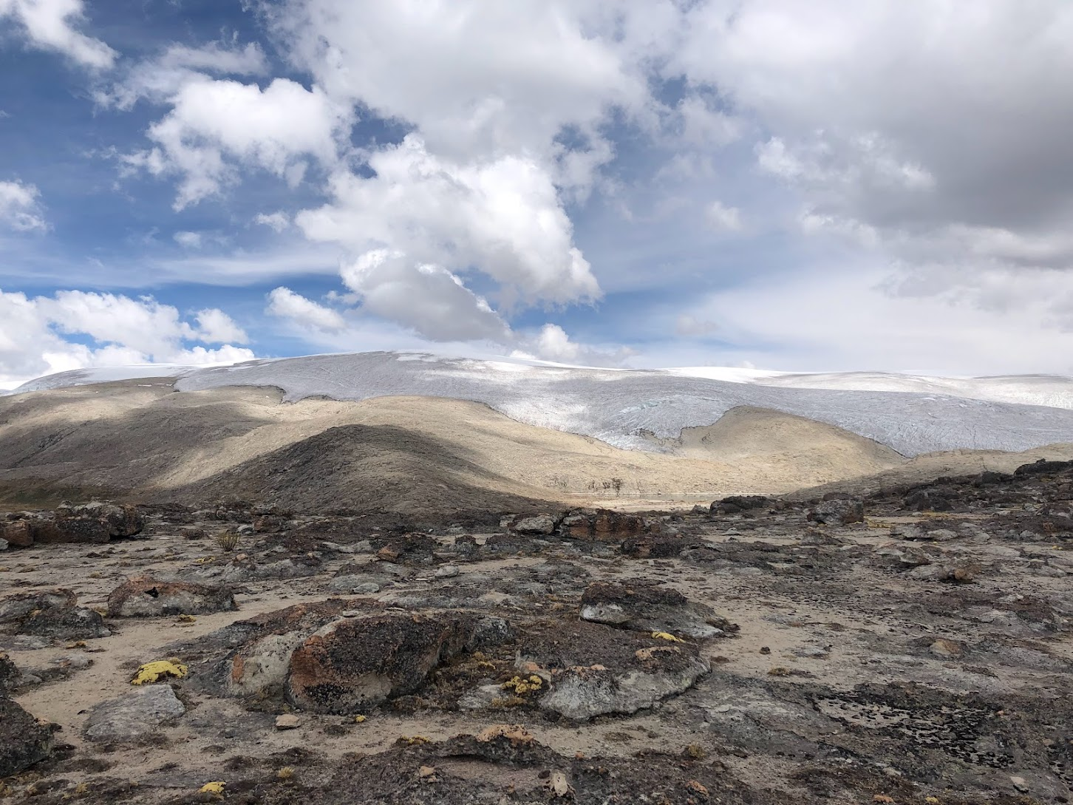
Investigation of High Andean Snow and Ice Chemistry to Improve Paleoclimatic Reconstruction and Enhance Climate Prediction - 2022
Project PI
Paul Mayewski (Climate Change Institute - University of Maine)
Location
Quelccaya Ice Cap in Peru
Drilling Objectives
Thermal drill 130m ice core to bedrock from summit of ice cap (5700m elevation)
Field test new debris vacuum and ethanol deployment systems
Photo Credit: Elliot Moravec

Slide 5
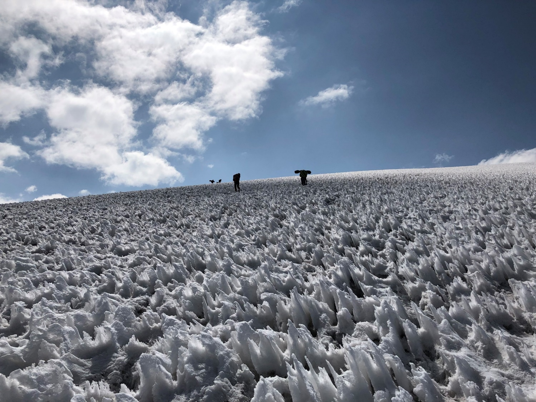
Drill Disassembled for Transport to Summit
Project relied on porters and horses for cargo transport
Max cargo piece weight of 90lbs
Drill, winch, generator (6.5kW) disassembled for transport
All ice cores transported by porters off summit
Photo Credit: Elliot Moravec

Slide 6
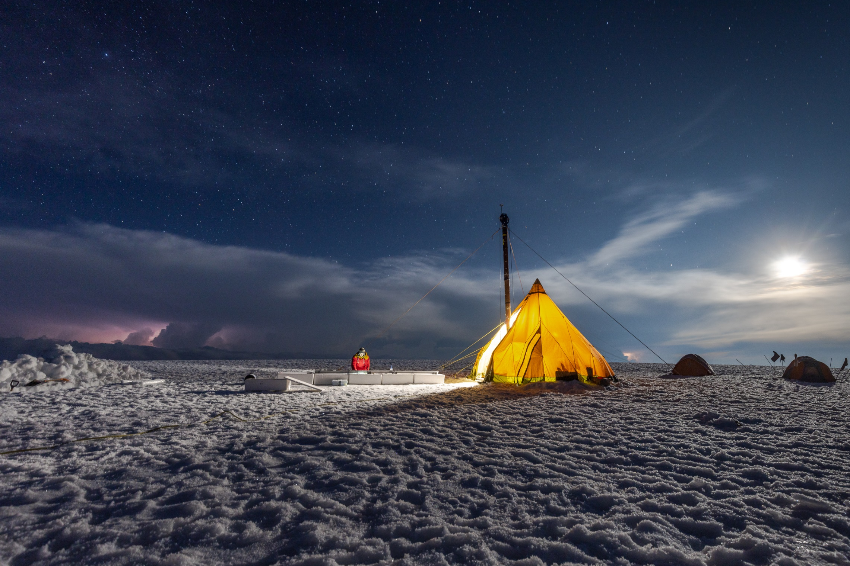
128.3 m Core Drilled Over 5 Days
Excellent core quality (almost no breaks)
Warm daytime conditions required night operations while in firn
1.5m/hr core production rate in firn
50% heat ring power max in firn
3m/hr core production rate in ice when pooling water present
53.8hrs drilling required to reach a depth of 128.3m
Photo Credit: Mariusz Potocki

Slide 7
Ethanol Added Daily to Borehole to Prevent Refreezing
Ethanol “shots” contained in layflat tubing.
Shots deployed to bottom of borehole in drill sonde
Pointed plunger punctures layflat and forces ethanol into borehole
Ethanol deployed once per night, ~1gal per shot
Limited issues with sonde sticking in borehole while tripping
Section View of Ethanol Deployment System

Slide 8
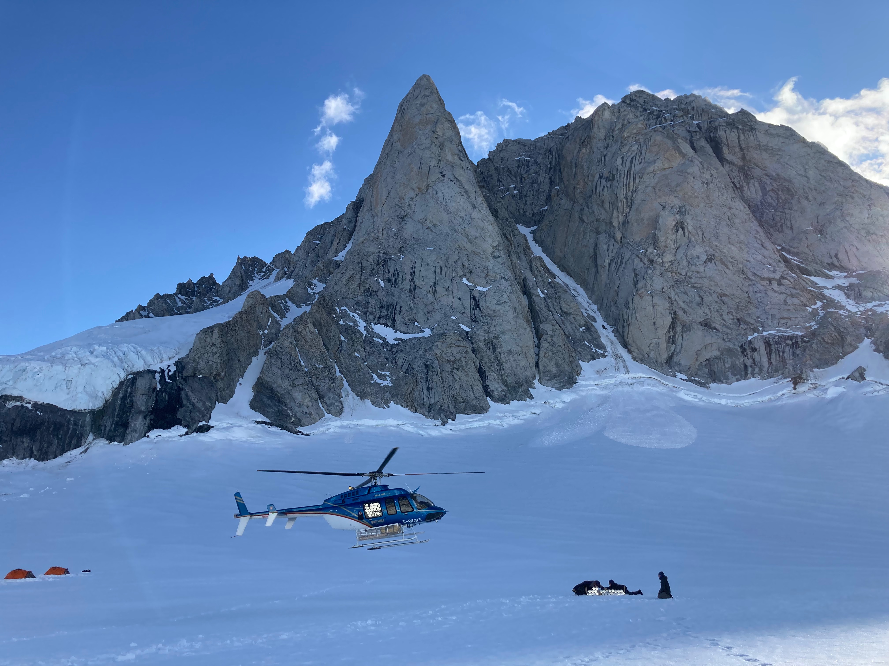
Collaborative Research: P2C2-- Ice Core and Firn Aquifer Studies - 2023
Project PIs
Peter Neff, Eric Steig, Knut Christianson
Location
Mt. Waddington, British Colombia
Drilling Objectives
To collect a ~240 m ice core to bedrock at Mt. Waddington for development of the southern-most annually-resolved ice core paleoclimate record in North America.
Photo Credit: Elizabeth Morton

Slide 9
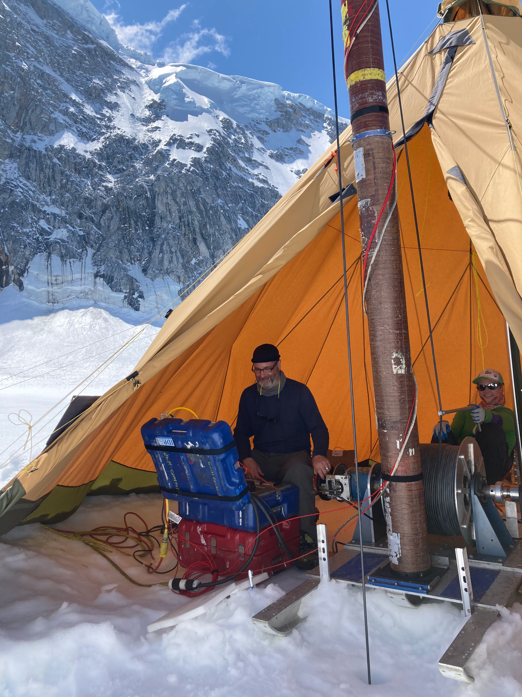
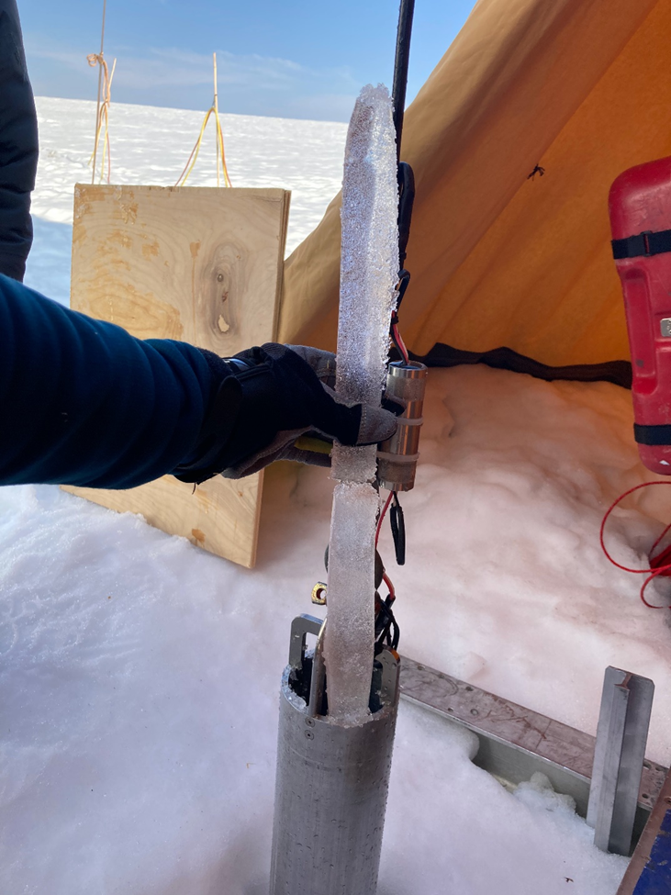
247 m ice core drilled over 15 days
Borehole #1 cored to 208 m depth
Rock at-depth prevented further progress
Deviated from borehole #1 between 174-180 m over two coring runs.
Replicate coring progressed to 219 m depth.
Accumulated sediment prevented further progress
Additional deviation not successful
Not enough inclination
Photo Credit: Elizabeth Morton

Slide 10
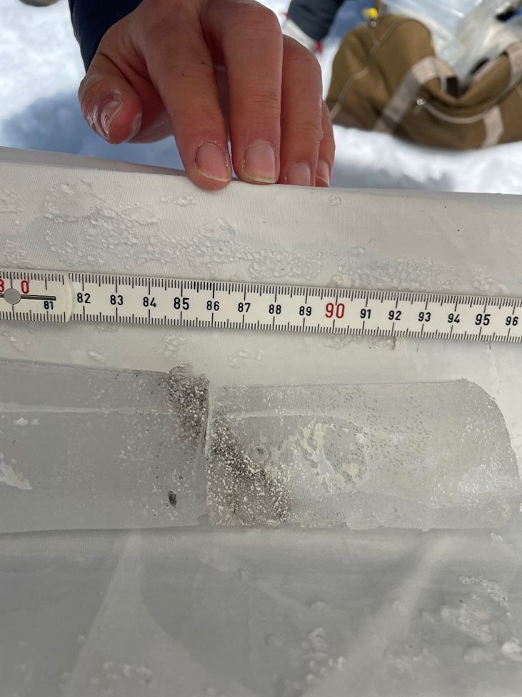
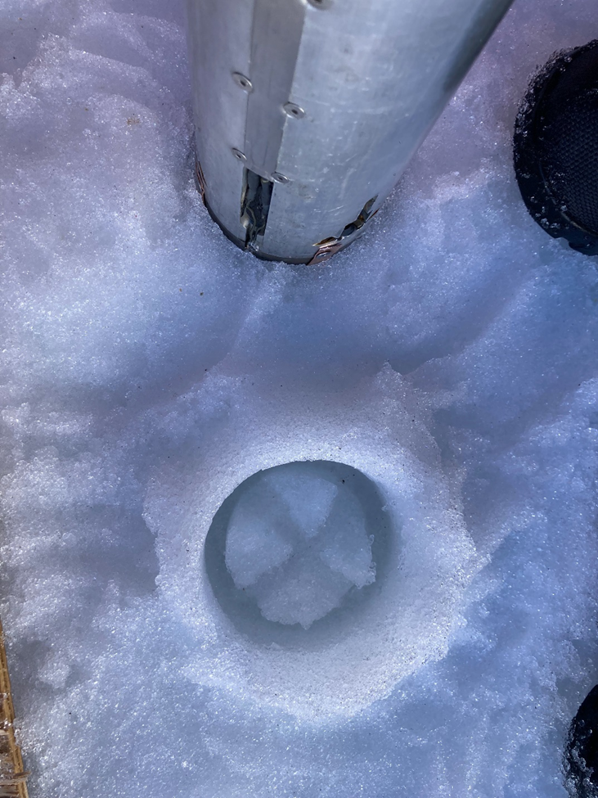
Challenges – Mt. Waddington
Debris layers caused slow penetration and core necking
Small diameter core caused recovery issues
Sediment and rocks accumulated in melted annulus stopping drill penetration
Future Work – Design conical melter head for debris recovery.
Melt debris into center of borehole
Core around debris with traditional coring setup.
Photo Credit: Elizabeth Morton

Slide 11
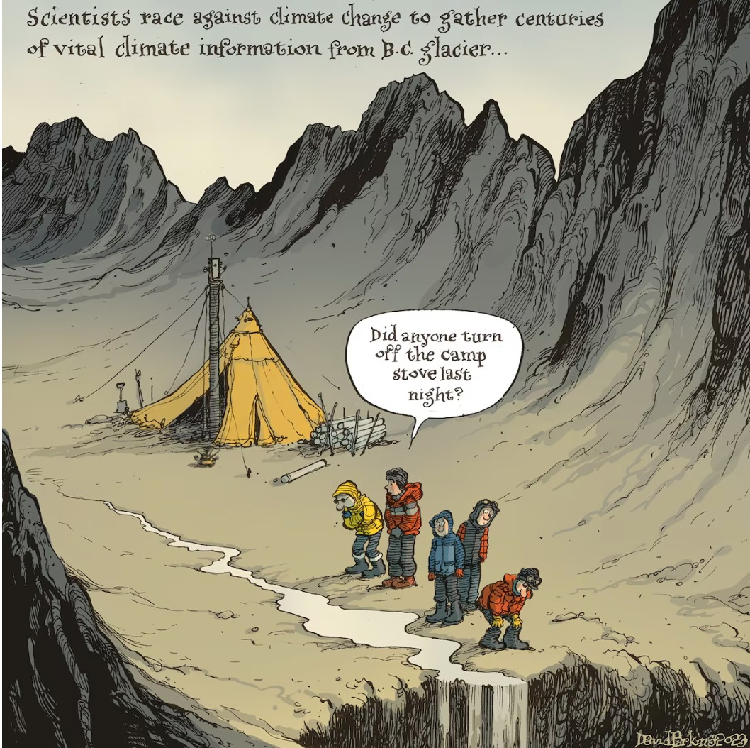
Opportunity for Questions
Potential Discussion Topics
Pressure rated electrical connectors
Solutions for downhole rock and sediment accumulation
Thank you for your time!
This material is based upon work supported by the U.S. National Science Foundation under Cooperative Agreement No. 1836328 and Continuing Grant 2318480.

