Slide 1
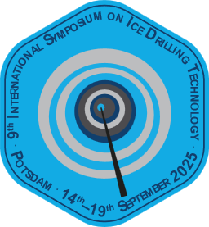

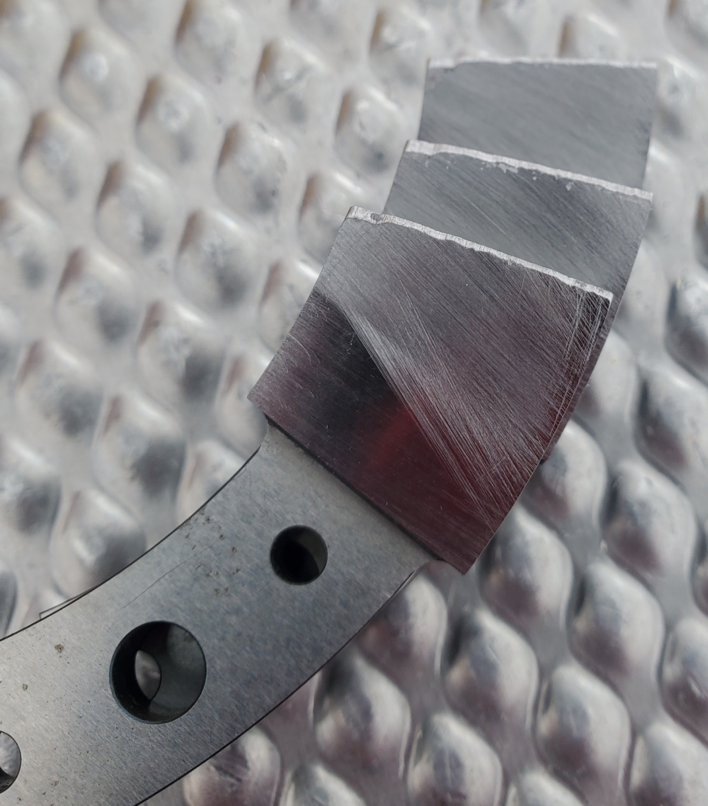
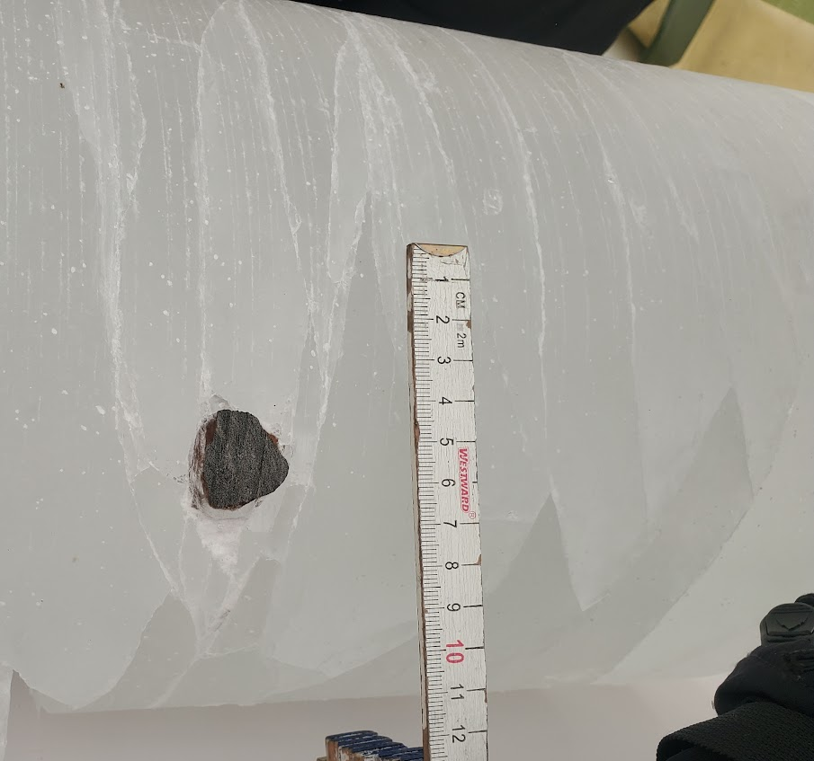
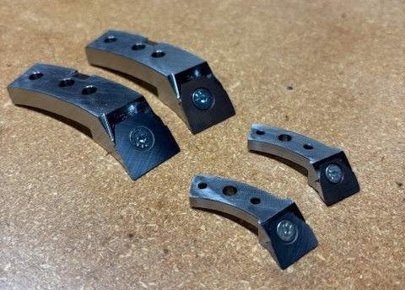
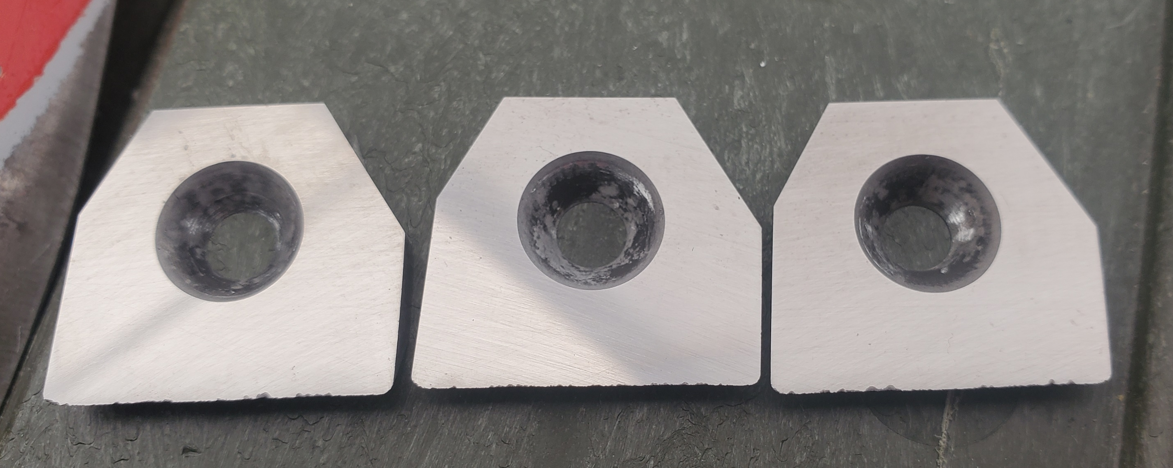
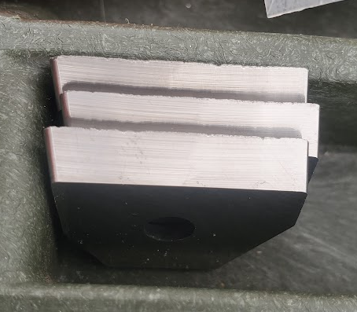
Replaceable Cutter Inserts – Preliminary Results
Andrew Haala¹, Jay Johnson ¹, Elliot Moravec¹, Elizabeth Morton¹
¹NSF Ice Drilling Program (IDP), University of Wisconsin-Madison, United States
Problem: Extreme Cutter Wear
The NSF Ice Drilling Program has drilled shallow (<200m) ice cores for 6 seasons in the Allan Hills, an area where grit and rocks are embedded within the very old ice
The embedded particulate causes incredible wear on the cutters, with cutter replacement every 1-4m
This dulling contributes to poor core quality, reducing the scientific value of the cores
Cutter resharpening is possible but takes up valuable field time, and the wear on the cutters is so severe that regrinding and remachining is further required once the cutters return to the USA
Three of our cutters stacked on top of each other to show the cutting edge, which has been eroded by grit and rocks
The largest rock we drilled through last season at 2cm. Cutting macro-scale rocks was a common occurrence
Solution: What is done in similar industries?
Replaceable cutter inserts are an excellent tool in the machining industry, providing cheap, fast, and high quality replacement of cutting edges
IDP designed and procured cutter inserts and insert holders for our Blue Ice Drill (BID) and Eclipse drill
Carbide inserts cost ~$30 USD, which is ~1/2 the labor cost of resharpening an existing cutter
Carbide cannot be sharpened to the same edge sharpness as steel, so there is a concern that the cutters are only useful when core quality expectations are already low
Material | Hardness Rockwell C | Notes
A2 Tool Steel | 58-60 | Standard cutter material
CPM 4V Tool Steel | 62-64 | Previously tested powder metallurgy material
QC-100 Carbide | 72-74 | Designed for wear and heavy shock
QC-20 Carbide | 79-81 | General purpose machining grade
Results: Good!
17 sets of BID inserts and 9 sets of Eclipse inserts were brought to Allan Hills in 2024-25 in addition to the existing steel cutters
A new core logging sheet was implemented, helping us track the core quality (spalling, wafering, internal fractures) and the length of the longest continuous piece of ice from each run
All core and drilling metrics showed improvement from the carbide cutters, with the BID seeing the most benefit
One of the highest benefits was consistency, with run and core length both improving greatly when using Carbide cutters
Much of this consistency appears to be due to how Carbide and Steel fail. Steel cutters often developed a dulled or rolled edge that acts as a skate, preventing penetration. Carbide fails in a brittle manner, so every chip still has a sharp edge that can penetrate
 |  | Average cm/min* | cm/min std dev | Average Run (cm) | Average Longest Piece (cm)
BID | Carbide | 1.07 | 0.469 | 54.9 | 26.7
 | Steel | 0.89 | 0.838 | 39.4 | 20.9
 | % Improv | 20% |  | 39% | 28%
Eclipse | Carbide | 4.37 | 2.06 | 68.9 | 65.9
 | Steel | 3.70 | 2.24 | 63.8 | 59.8
 | % Improv | 18% |  | 8% | 10%
*Average cm/min refers to the distance drilled over the time needed for an entire drill run including tripping and surface operations . It is thus an accurate gauge of core production rate.
A set of BID inserts worn out after two runs, totaling 1.10m of drilling
Next Steps: Allan Hills 2025-26
360 BID inserts, 600 shallow wet drill (98mm core) inserts, and 286 hand auger inserts were shipped. This should allow all drilling to be done with inserts
Two different carbide variants are being brought with differing carbide grain sizes to see if wear or shock resistance is most important
Some inserts have been TIALN coated to determine if the reduced friction and increased wear resistance prove beneficial in rocky environments
We will also be testing steel inserts to determine if they are a feasible solution for non-rocky drilling
This material is based upon work supported by the U.S. National Science Foundation under Cooperative Agreement No. 1836328 and Continuing Grant 2318480.

