Slide 1
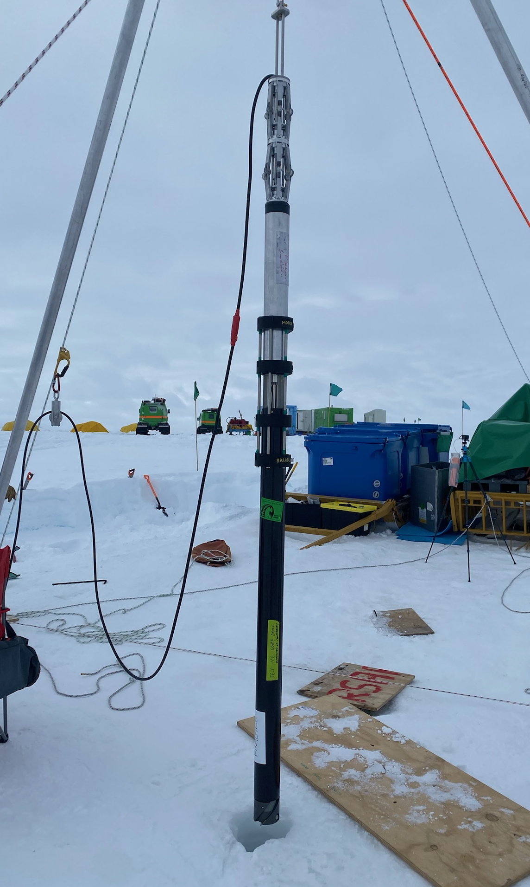
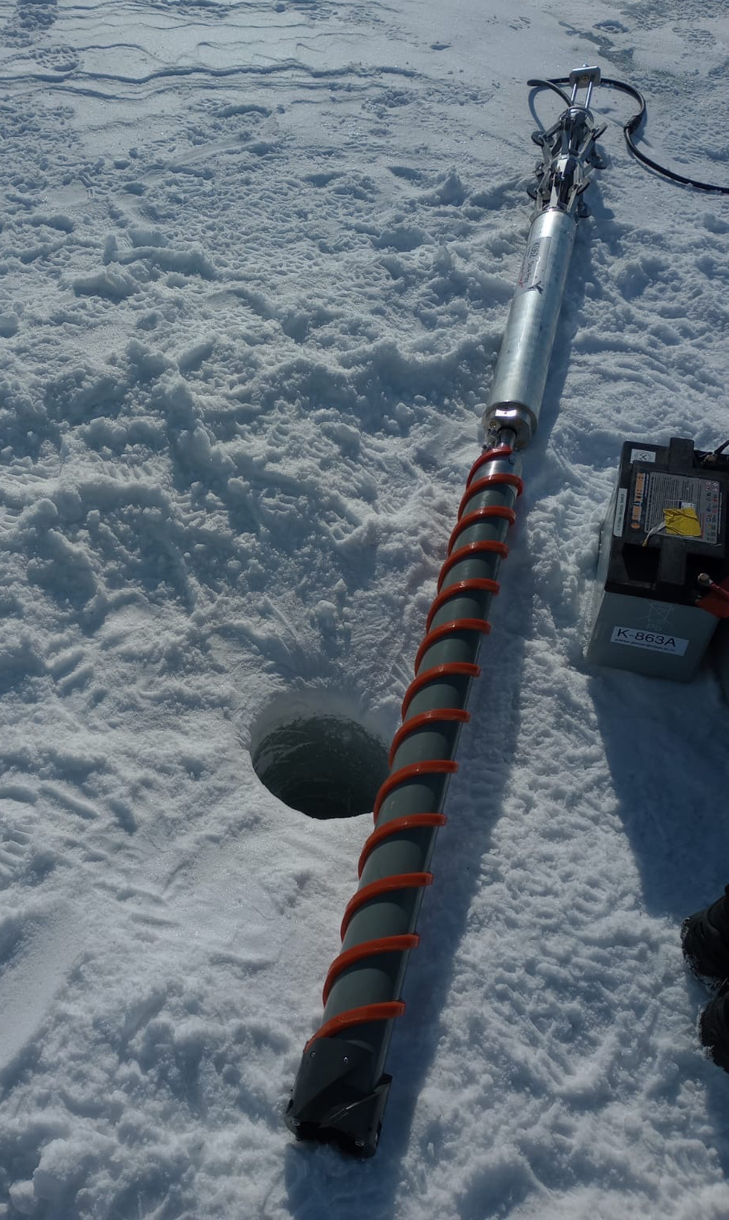
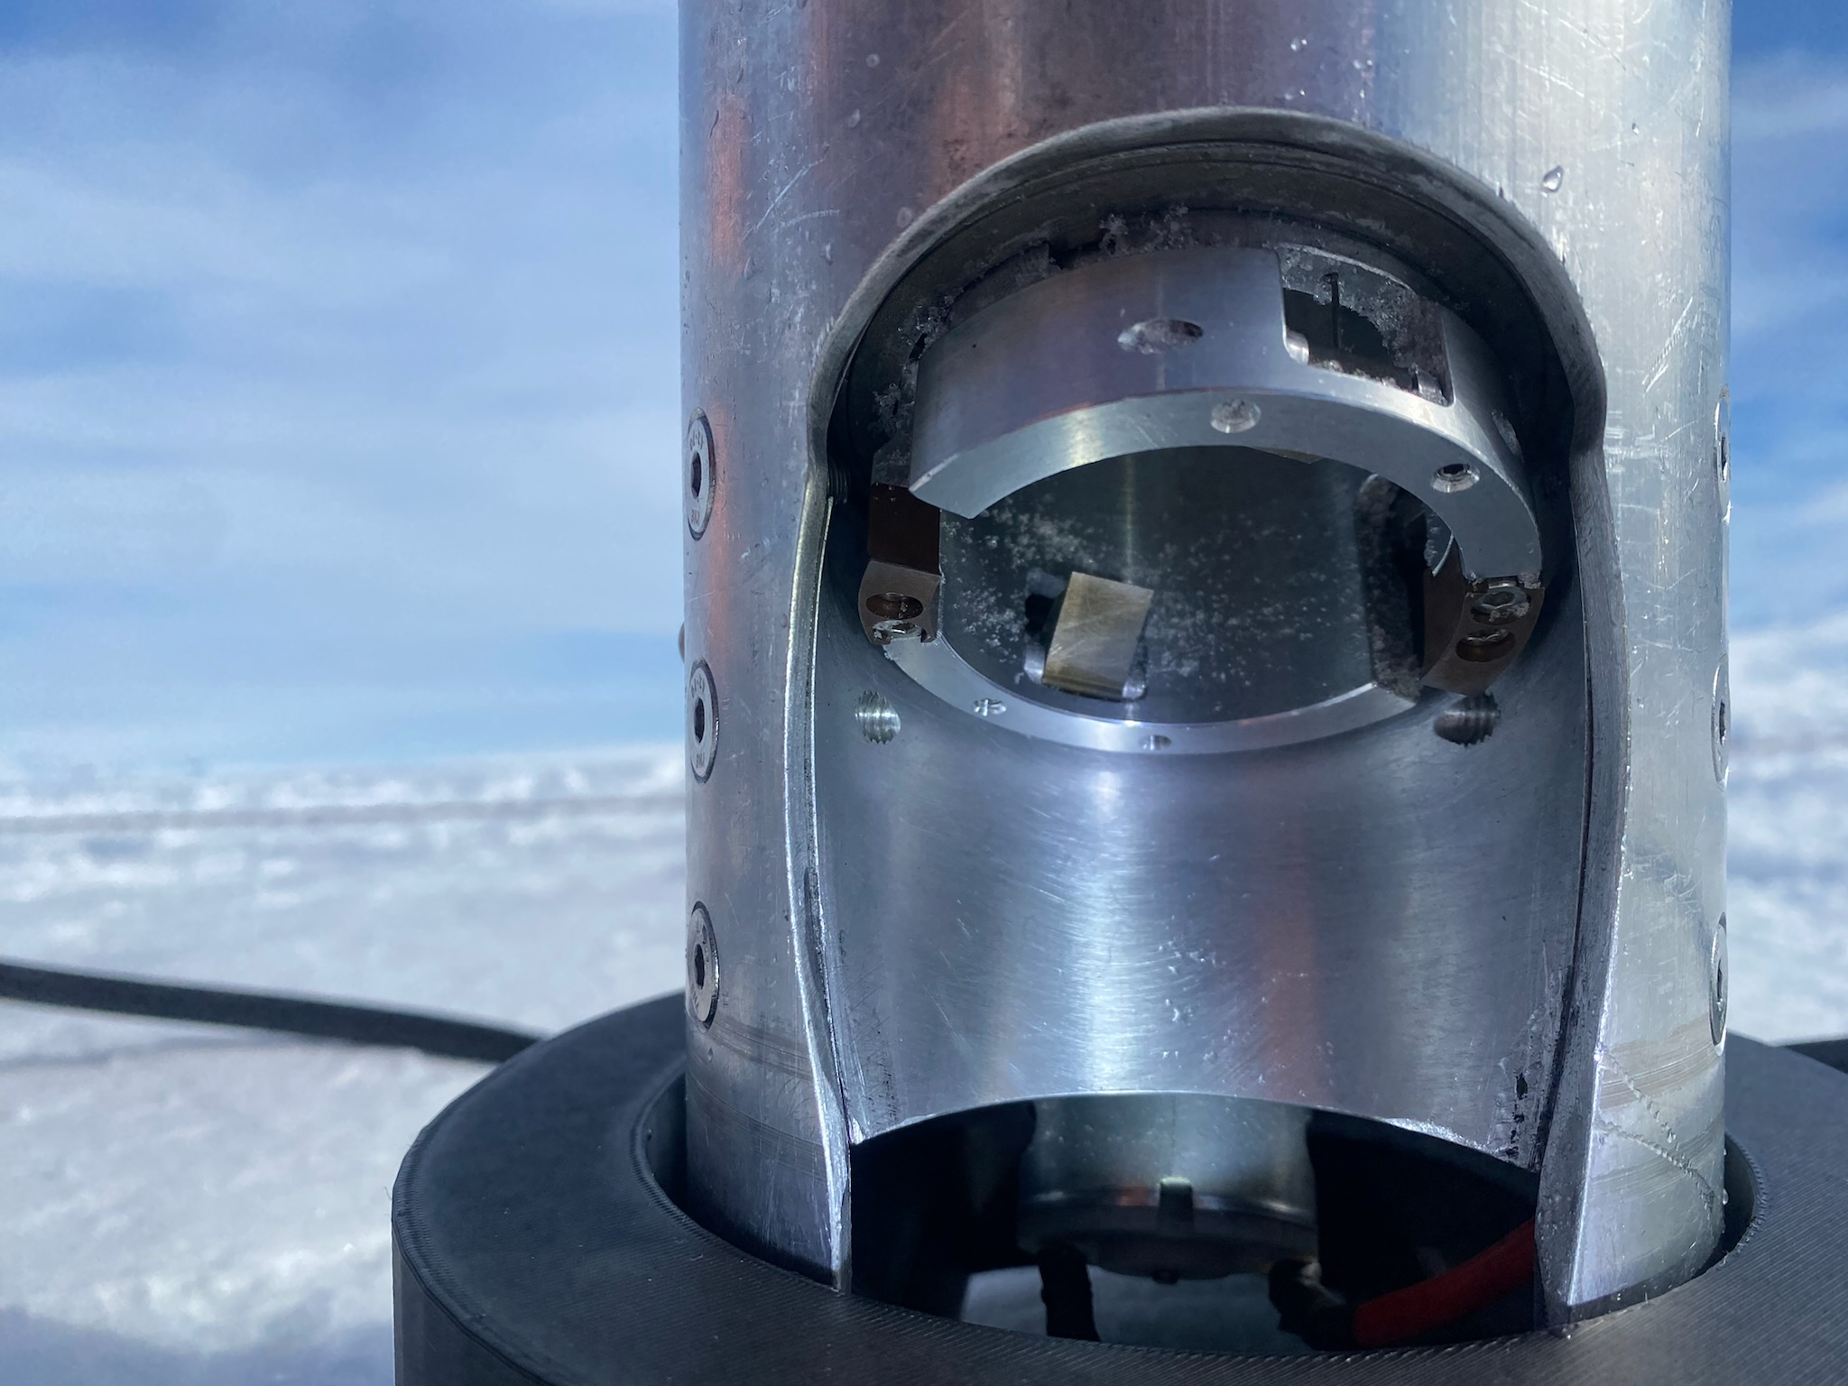
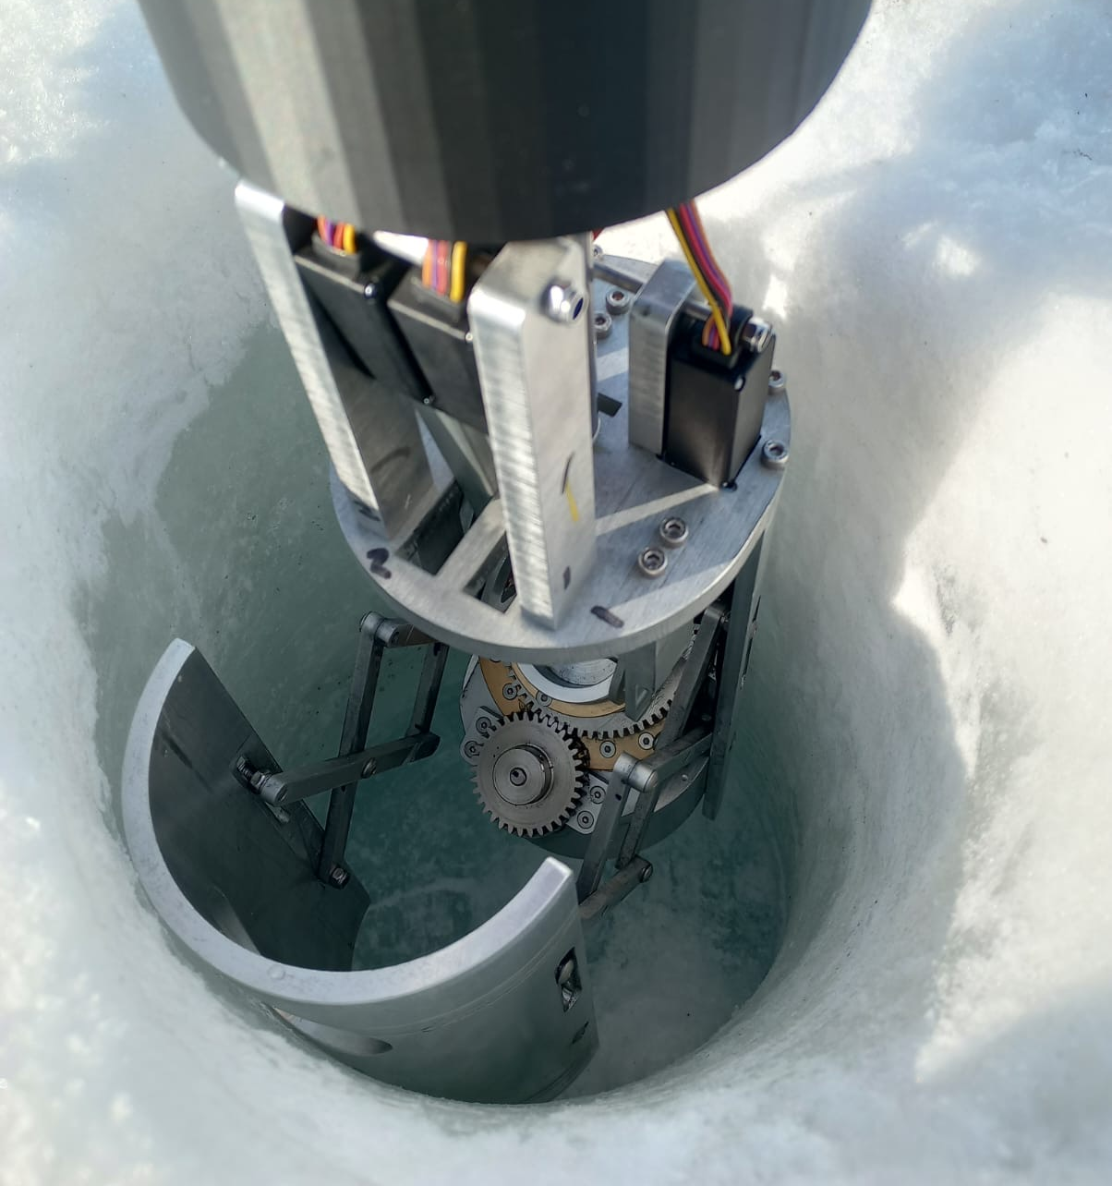
Design and Development of Rapid Ice Sampling Devices
Jessica MacFarquhar¹, David Prior², Geoff Rodgers¹, Darcy Mandeno³
¹University of Canterbury, Christchurch, New Zealand, ²University of Otago, Dunedin, New Zealand, ³Antarctic Research Centre, Victoria University of Wellington, Wellington, New Zealand, ⁶Lancaster University, Lancaster, England

Slide 2
Sidewall Ice Sampler
Bottom Hole Ice Sampler
DIRECT CORE BARREL CONFIGURTION
SAMPLING CONFIGURTION
TRIPPING CONFIGURTION
OUTER BARREL CONFIGURTION
Jessica MacFarquhar jessica.macfarquhar@pg.canterbury.ac.nz

