Slide 1

CoreCaster
A Probabilistic Campaign Simulator and other tools for Ice (Core) Drilling Planning
James Veale
JAMLE@BAS.AC.UK
Notes:
Hello! For those of you I haven’t met, I’m James and I’ve worked at BAS doing ice core drilling for almost 6 years now. I’ve been involved in a few drilling campaigns now (and some other engineering in the polar regions) – in particular, I’ve been lucky enough to take part in the drilling for some of the recent major international ice coring projects (EGRIP, BE-OIC).
I’m an engineer, and my interests (for the purposes of this conference) are ice coring, instrumentation, and automation.

Slide 2
I’m not a logistics expert.
I like designing and doing things
- not so much planning them.
But logistics and planning are crucial to what we do.
Notes:
I’ll preface this short talk by saying Logistics is not my thing, I won’t pretend to be a logistics expert – but it’s something we all have to do to make our projects happen.

Slide 3
1.
Scenario Planning
2.
Probabilistic Ice Drilling Campaign Simulator
CoreCaster
Notes:
I offered to give this talk (as opposed to a fun field report with loads of pretty photos) because I want to show you –and get your opinions on– a couple of tools I’ve made recently that I’ve been using while planning and preparing for BAS’ current deep ice coring project – REWIND – which you’ll be able to hear about in Emma Fisher’s talk later. I’m interested to hear how you do your planning, and what you think of this approach. The tools I’m going to show you are built based on my experience, but lean heavily on the experience of those who’ve done many more seasons than me, and operational data they collected during their projects.

Slide 4
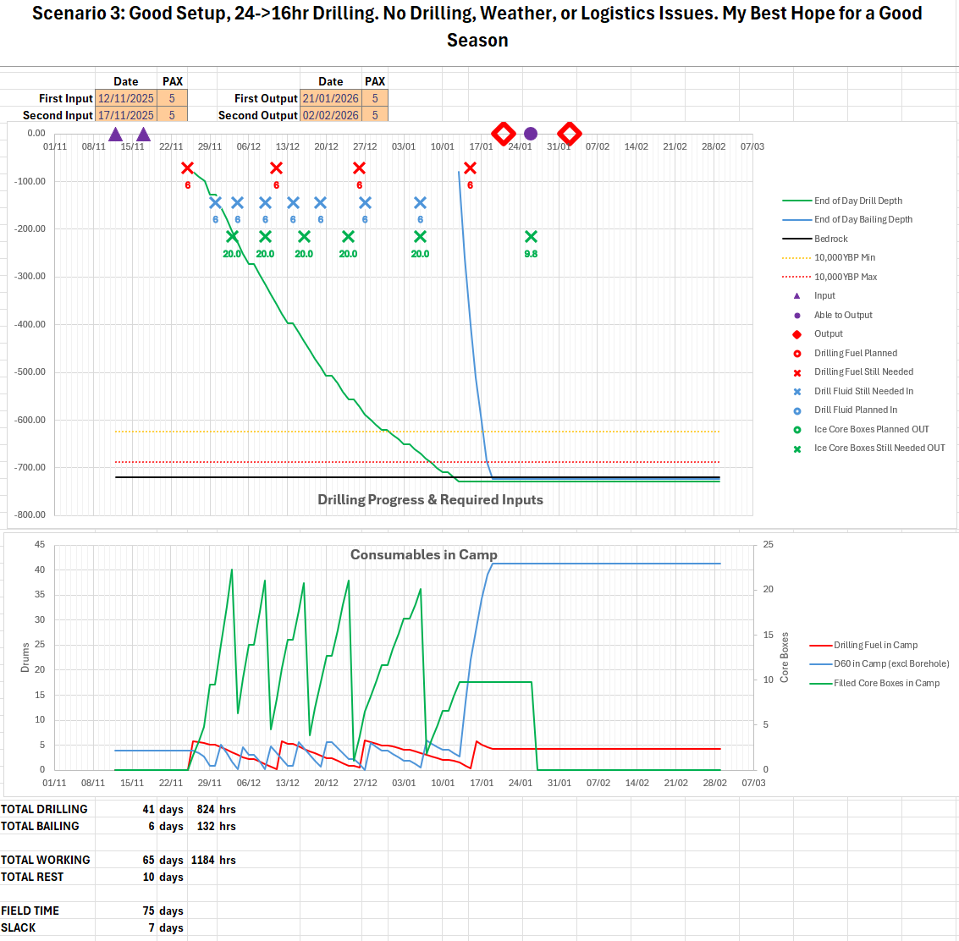
Scenario Planning Spreadsheets
Flexible
Collaborative
Exploratory
Adaptive
Notes:
Anyone who’s planned a field campaign will have made planning spreadsheets. Here’s a quick look at mine.
It’s designed to be very flexible, and to let us work with our operations and logistics teams to make a successful season. It allows us to quickly answer questions like: what happens if our input is delayed by x days, what happens if our generator fails and we need to fly in the backup from station, how much slack do our current plans allow for, how long can we keep working if cargo stops coming in, when (if at all) can we switch to shorter working hours? Etc.

Slide 5
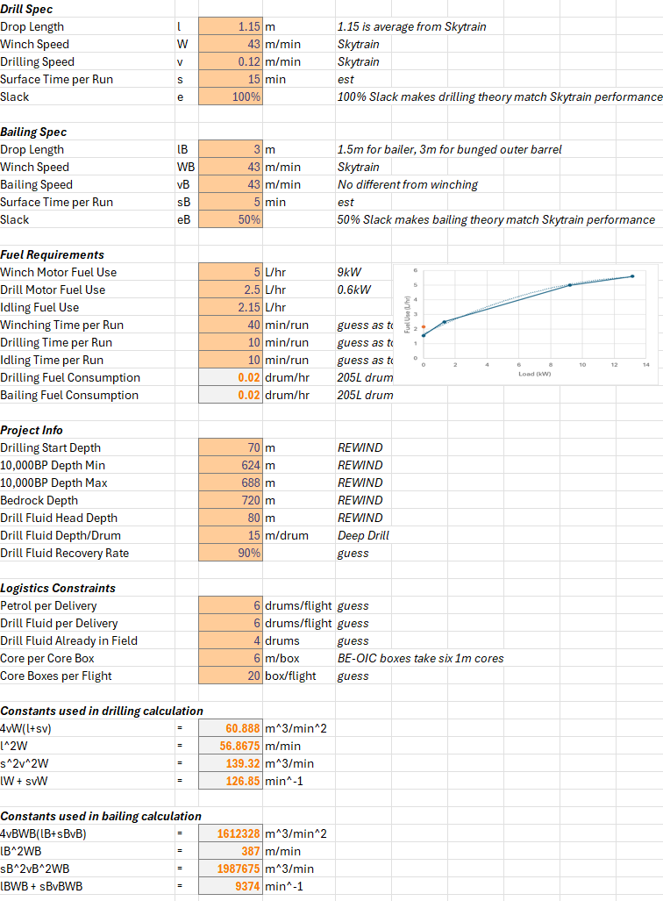
Scenario Planning Spreadsheets
Flexible
Collaborative
Exploratory
Adaptive
Notes:
It has a background sheet that all the calculations are based on – here you can input the specification of the drill system being used, as well as stuff like the expected fuel efficiency of your generators, start and target depths, logistics constraints, etc

Slide 6
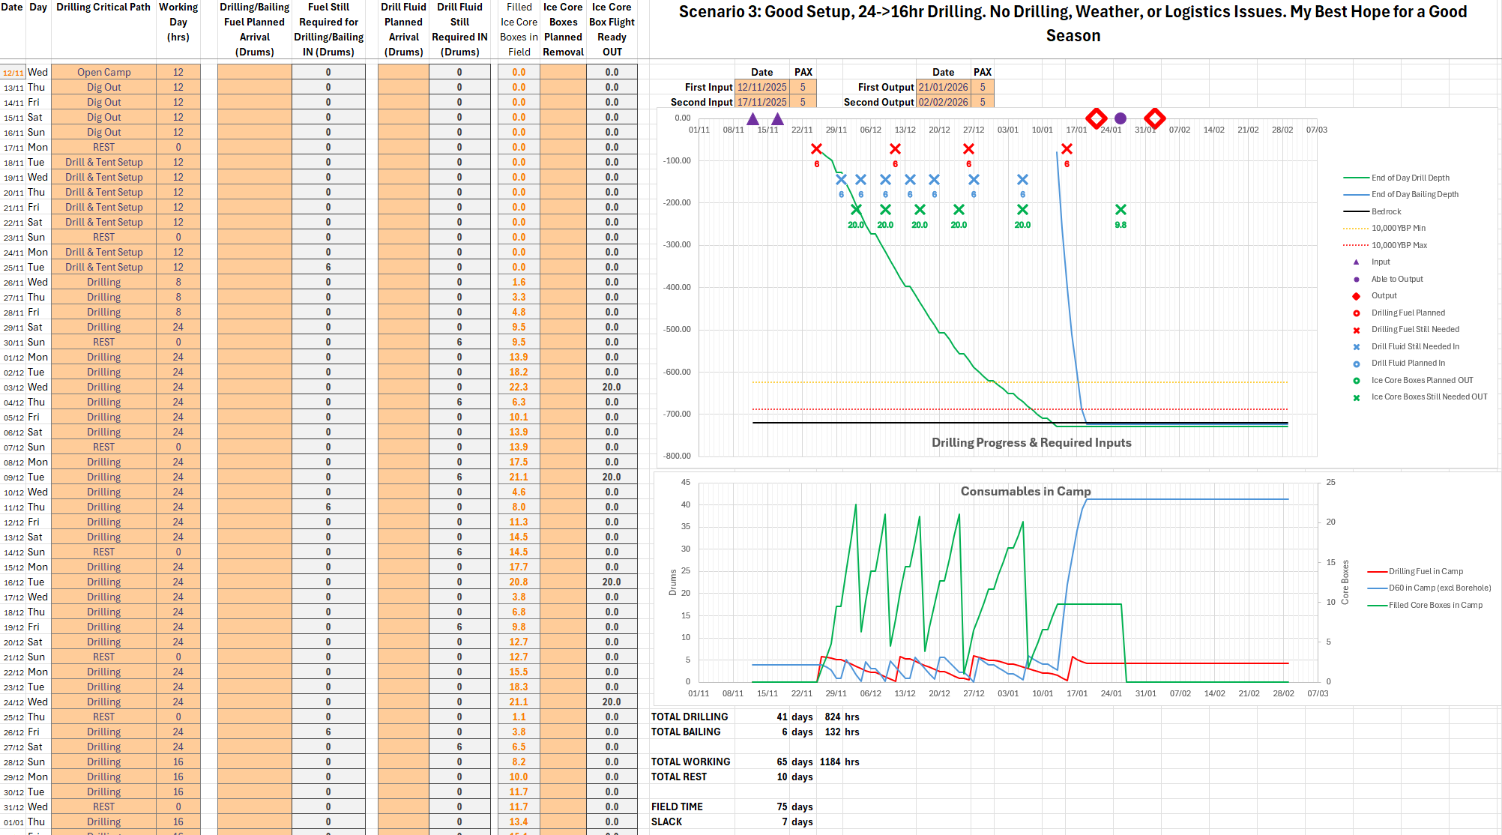
Scenario Planning Spreadsheets
Flexible
Collaborative
Exploratory
Adaptive
Notes:
In the scenario planning sheet I input general info about the project (our input dates, last possible output dates) and then can fill in tasks on the left. The sheet automatically calculates expected progress in operations like drilling and bailing with a resolution of one day – using the standard formula for wireline drilling operations. It also gives key cargo related info – showing expected usage of fuel and drilling fluid, and production of filled ice core boxes. What’s useful here is I can show this to logistics people to figure out when we need cargo flights/traverses.

Slide 7

Scenario Planning Spreadsheets
Flexible
Collaborative
Exploratory
Adaptive
Notes:
Here I’ve added some drill fluid inputs that our logistics team have planned, and you can see them added to the visualisations on the right. Importantly, it will also show as crosses on the chart here when we need more input than we have planned if we are to prevent drilling operations from being halted. So it’s simple to foresee logistics issues. This is really easy to update in the field as progress is made and conditions change, and streamlines the planning process. This is important, as if we can’t update our planning in the field…

Slide 8

Season Plan
Time in the field
Notes:
… we’ll charge on blindly. We might still succeed, we might not. But if it’s easy to update plans, we’ll bother to, and we’ll have a better chance of sorting things out.

Slide 9
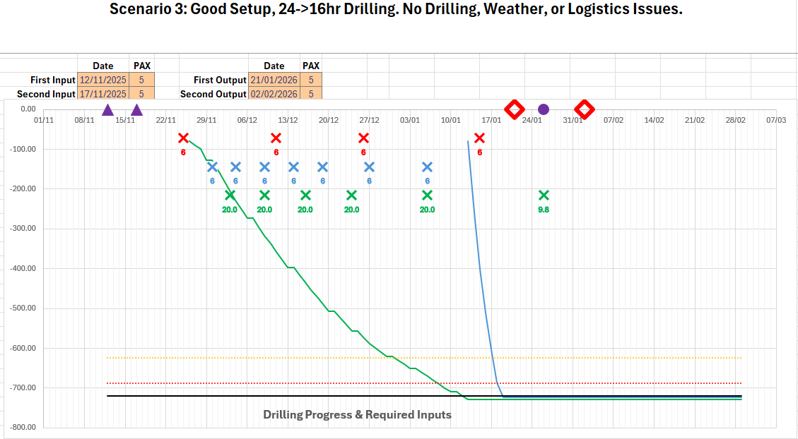
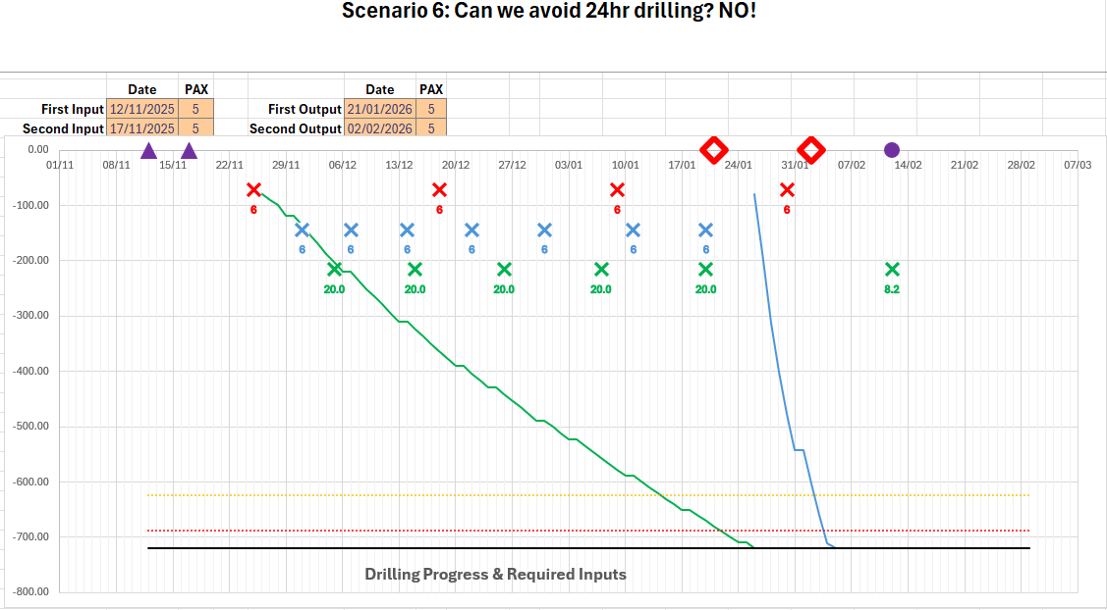
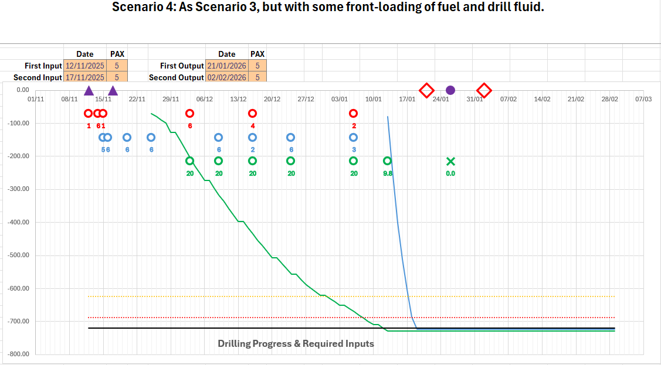
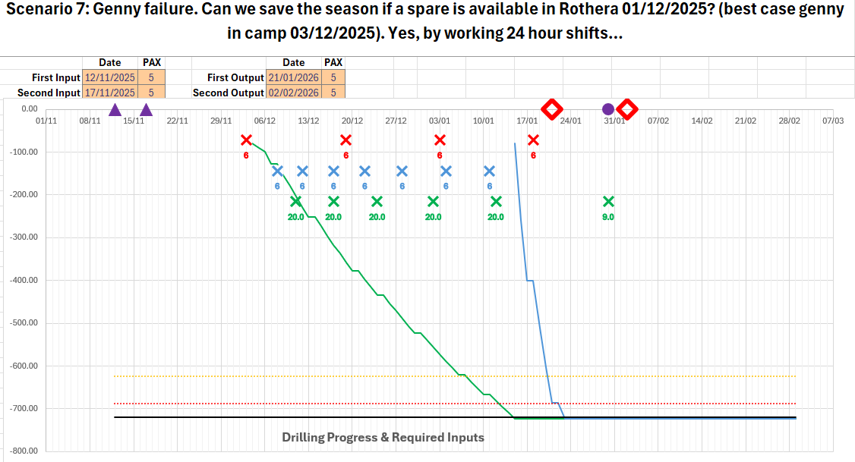
Scenario Planning Spreadsheets
Flexible
Collaborative
Exploratory
Adaptive
Notes:
If I want to plan for a new scenario I make a copy of the sheet and start changing things, and I can immediately see any operational or logistics issues that arise or are solved.
The major benefit here besides advance planning is reducing the complexity of dealing with logistical changes when you’re sat cold in a tent and need to get on with operational or engineering tasks. Of course, it relies on the application of common sense and experience – you can’t trust the numbers implicitly unless they match what seems realistic to you.

Slide 10
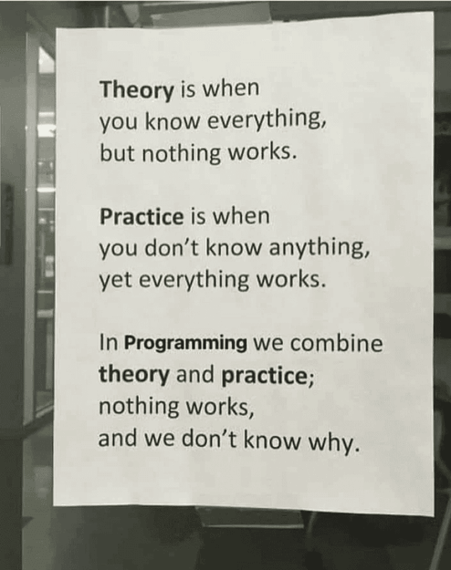

Scenario Planning Sheet - Limitations
Notes:
There are some major limitations, however, to this approach.
Drilling operations aren’t as fast as the theory says. We take time to make decisions, we’re slowed by issues, etc. I deal with this by simply applying a fudge factor to the results of the theory. I chose these fudge factors by looking at data from past seasons. For example, Rob Mulvaney kept good drilling records at the Skytrain project, which allowed me to easily compare the drill system’s actual performance there to what the theory says. There’s still obviously a large margin for error in this approach.
Assessing safety margins, and how much slack is needed in the plan, is an entirely qualitative decision under this system. It’s based on your personal risk appetite. I don’t like basing something so important on gut feeling, which is where my second tool comes in.

Slide 11
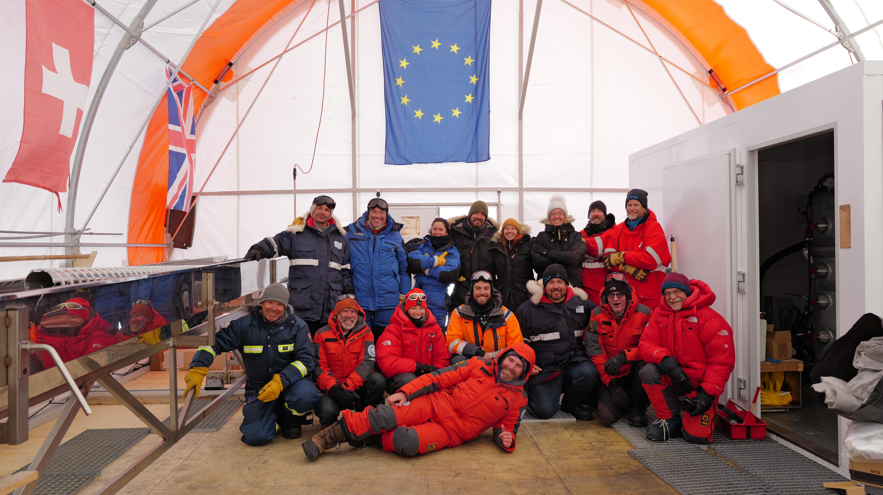

2023/24
CoreCaster
Notes:
While at LDC in the 2023/24 season, drilling was running so smoothly that I needed something to occupy my mind during the slow winching down and up and down and up….

Slide 12
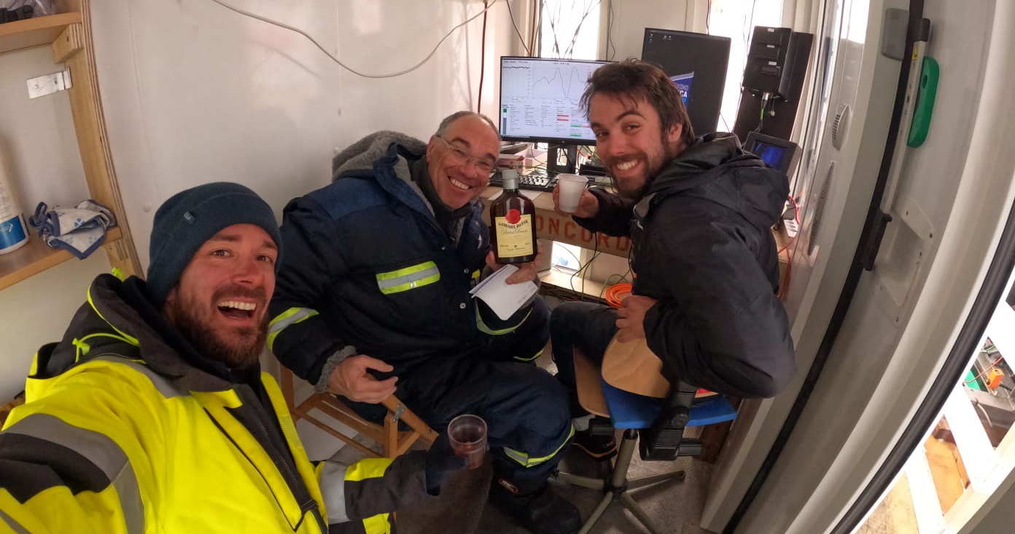
CoreCaster
Notes:
No, something more than Gammel Dansk…

Slide 13


2023/24
CoreCaster
Notes:
So I started playing in an excel sheet looking for patterns in the drilling process – how variable was the time taken for runs? how different were they from the ‘perfect’ runs? How much did each part of the run contribute to this variation? I realised that the little bit of extra data I was collecting to do this could go a long way in being able to make statistical predictions of the rest of the season, and maybe the following season too.

Slide 14

2023/24
CoreCaster
Notes:
So I started making a Python module for ice coring forecasting – which I now call CoreCaster as you need a name for these things if you want to do a talk about them at a conference... Don’t worry, I won’t make you look at code, but I’ll talk you through how it works.

Slide 15
CoreCaster
Theoretical Spec
Winch Speed
Penetration Rate
Max Depth per Run
Surface Time
Etc.
Drill Performance Probability Density Functions
Run Data
Notes:
You input some key information about the drill you’re using and if you have some previous run data for that drill, you can put that in, and it automatically generates …

Slide 16
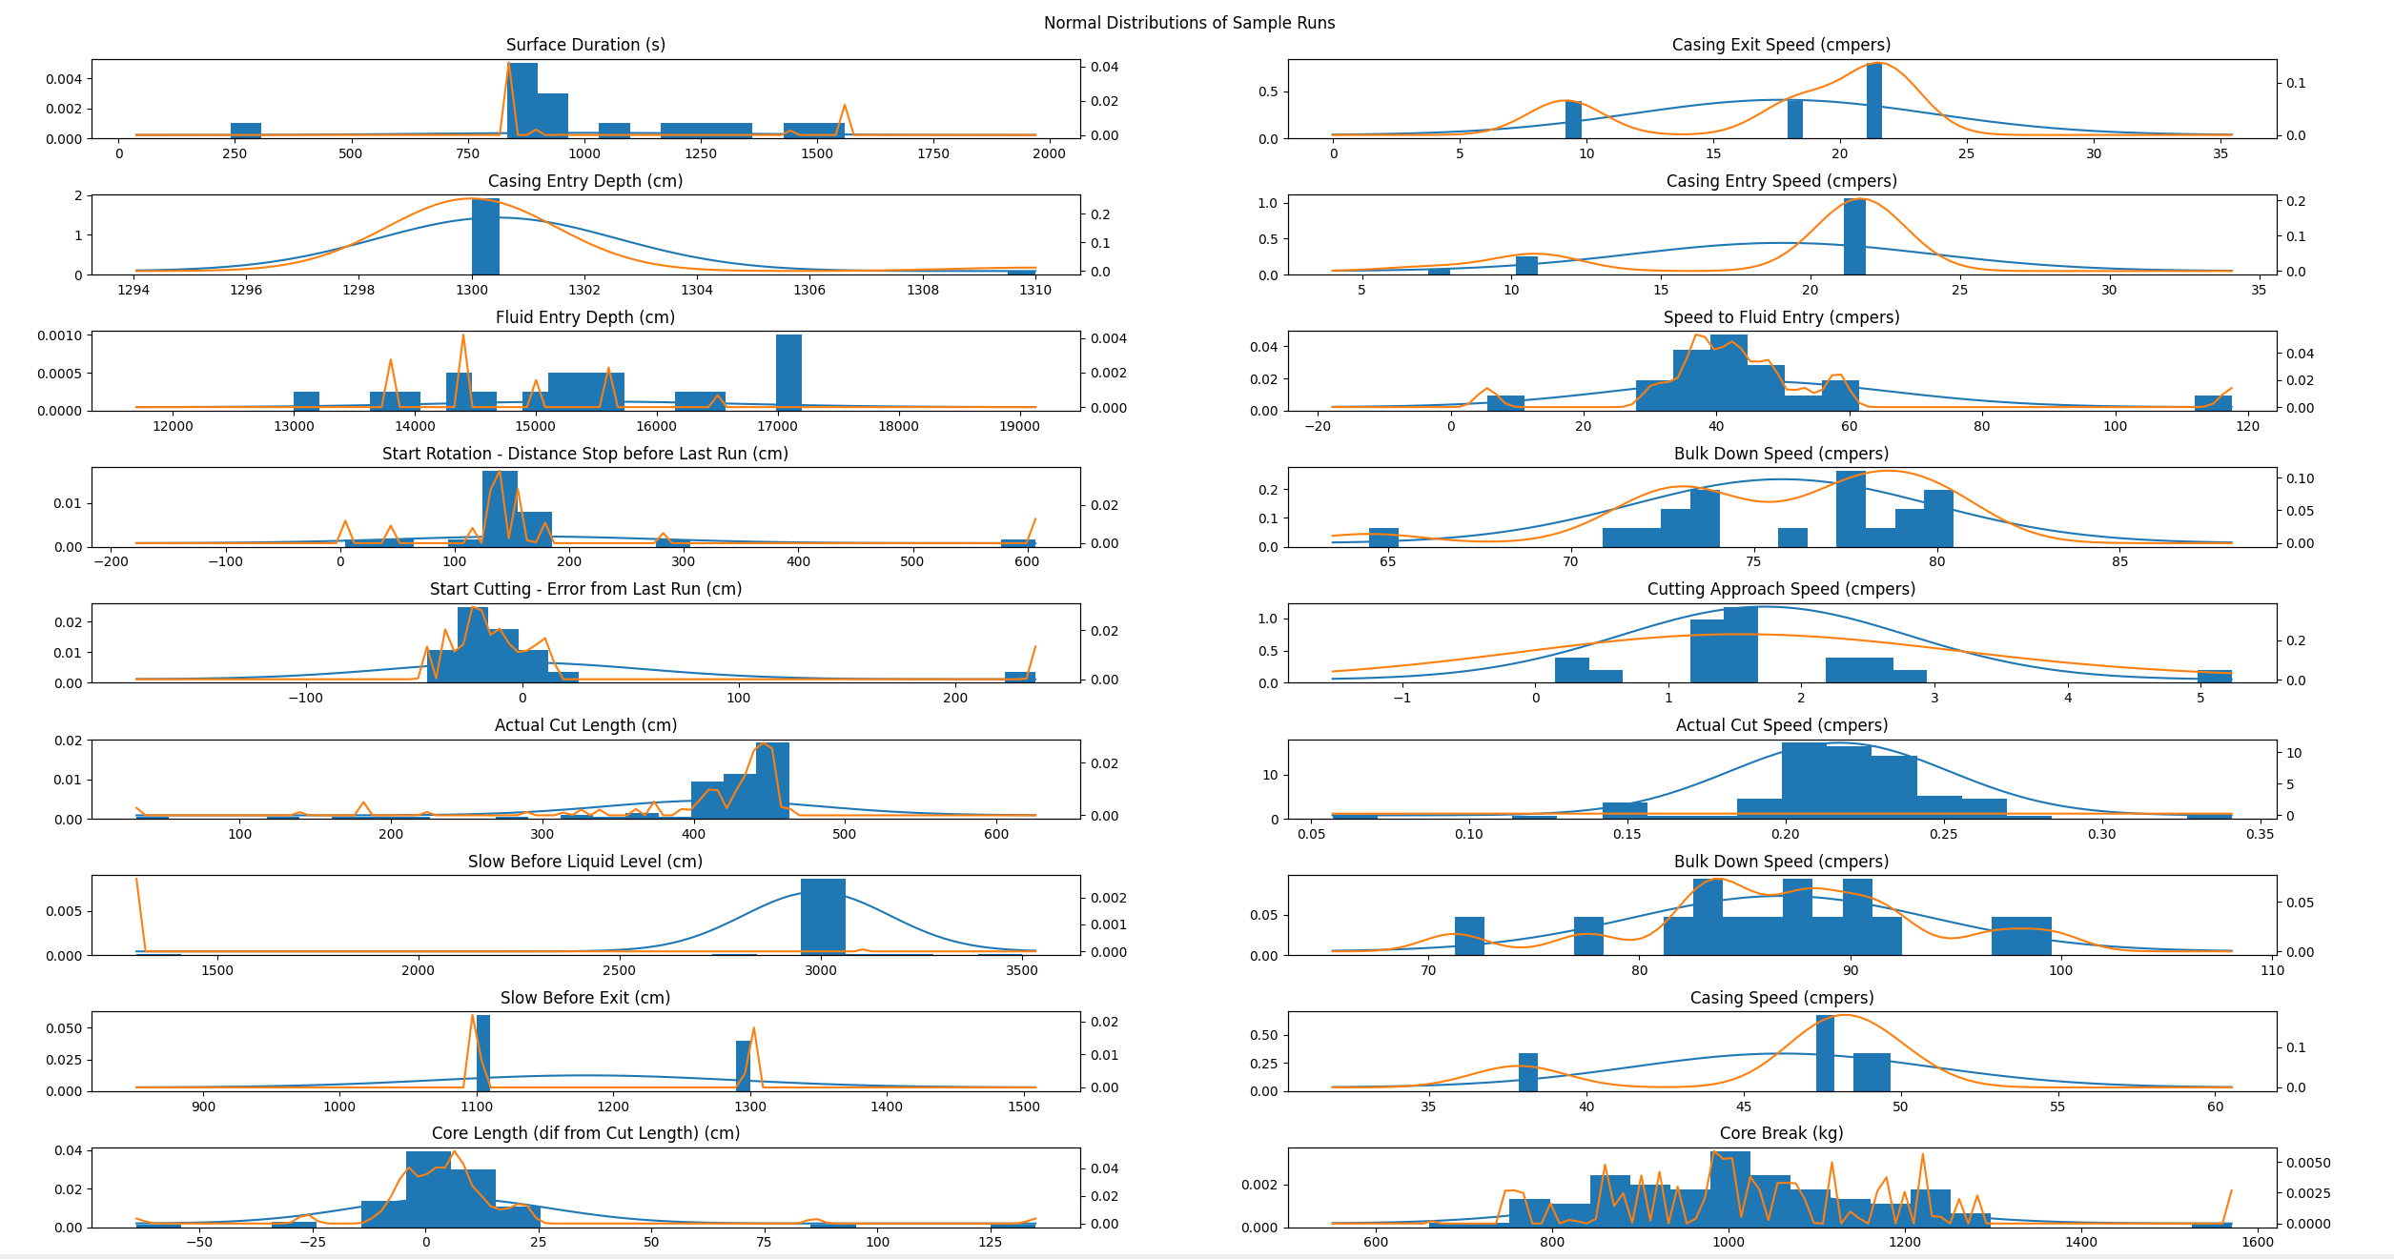
CoreCaster
Theoretical Spec
Winch Speed
Penetration Rate
Max Depth per Run
Surface Time
Etc.
Drill Performance Probability Density Functions
Run Data
Notes:
…probability distributions for the performance of all stages of the drilling process. If you don’t have real run data for your particular drill, you can give it the theory and real data for another drill, and it will reshape the probability distributions for the other drill to suit your current one.

Slide 17
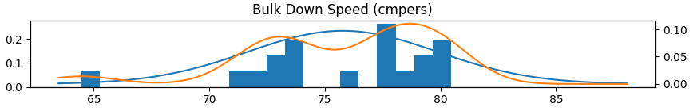
CoreCaster
Theoretical Spec
Winch Speed
Penetration Rate
Max Depth per Run
Surface Time
Etc.
Drill Performance Probability Density Functions
Run Data
Notes:
For example, one aspect of the drilling is the time taken to trip down each run. So here is the downwards winching speed (once in the drilling fluid) across just 19 runs where I happened to collect data. You can see in blue a histogram of the actual speeds measured from the runs, and a curve showing the normal distribution which matches the data best. In orange is more ‘shaped’ continuous probability density function (generated by kernel density estimation). You can see two peaks there, maybe showing two drillers with different risk appetites when lowering the drill. We could use either of these functions to make our predictions.

Slide 18
Theoretical Spec
Winch Speed
Penetration Rate
Max Depth per Run
Surface Time
Etc.
Drill Performance PDFs
Run Data
Predict DrillRun
Notes:
So all these functions, representing statistical models of our drill’s performance, can be used to simulate a drill run. Cool, but nothing new here really.

Slide 19
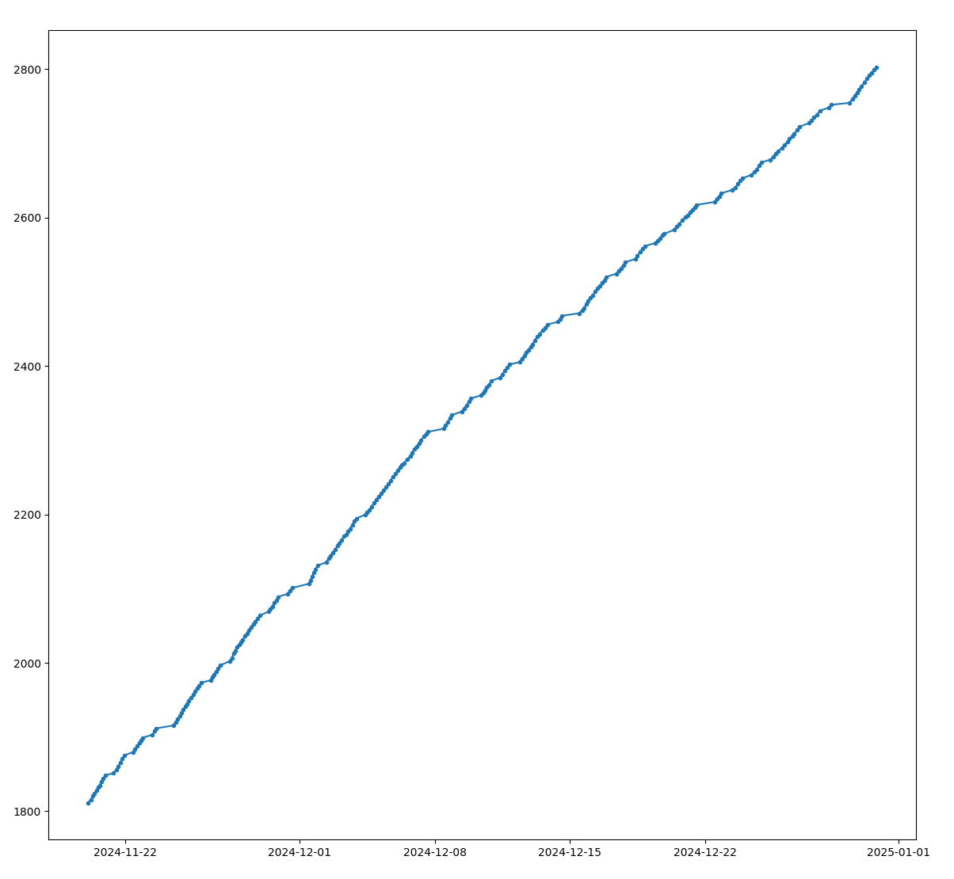
Drill Performance PDFs
Theoretical Spec
Run Data
Predict DrillRun
Season Constraints
Start Date & Depth
Shift Patterns
End Date
Target Depth
etc
Predict DrillSeason
Notes:
The next thing you can do is put in shift patterns, season working dates, a start depth, and a target end depth, and you can then simulate an entire season of drill runs, one after the other. And see how your season might go. You can even input special days off so you can go celebrate new years eve at Concordia!

Slide 20
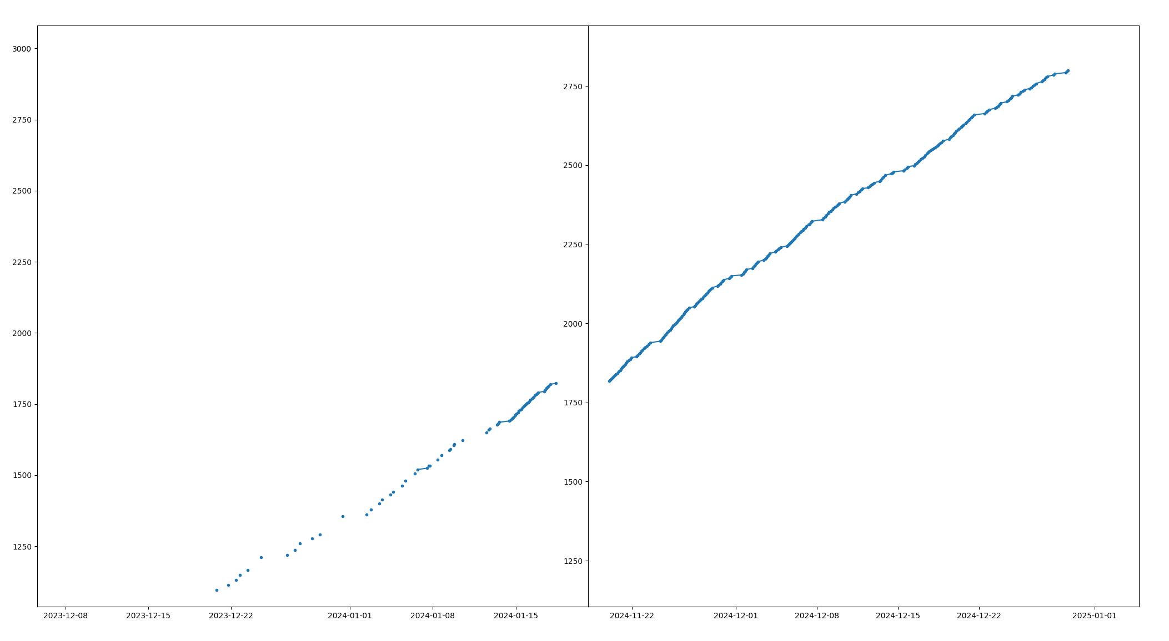
Drill Performance PDFs
Theoretical Spec
Run Data
Predict DrillRun
Predict DrillSeason
Season Constraints
Predict DrillCampaign
Notes:
If you’re running a long project, you can also simulate `DrillCampaign`s by running `DrillSeason`s one after another.
The thing I really like here is that because the simulation is based on probabilistic simulation, you get a slightly different outcome each time you run the simulation.

Slide 21
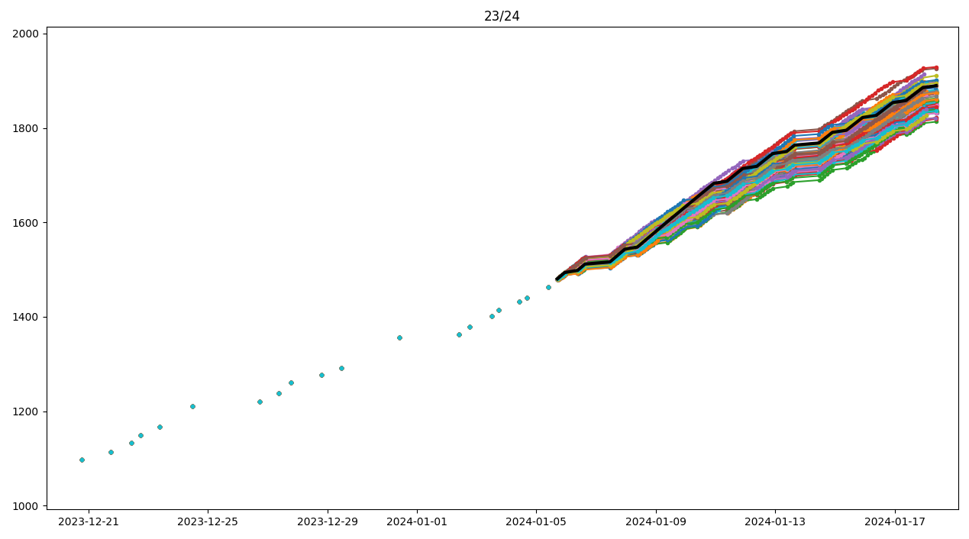
Notes:
So you can very easily run the simulation 100s of times for a particular season, and get a good idea of the spread of potential outcomes for your season of drilling. Here’s the prediction I made at LDC halfway through the 2023/24 season for how the rest of the season might go. My actual data points are the blue dots (you can see I didn’t actually collect data on many of our runs). The black line is the theoretical best case if we ran the system as a perfect automated machine. The remaining lines are all simulations of how the season could have gone using the probabilistically generated runs.

Slide 22
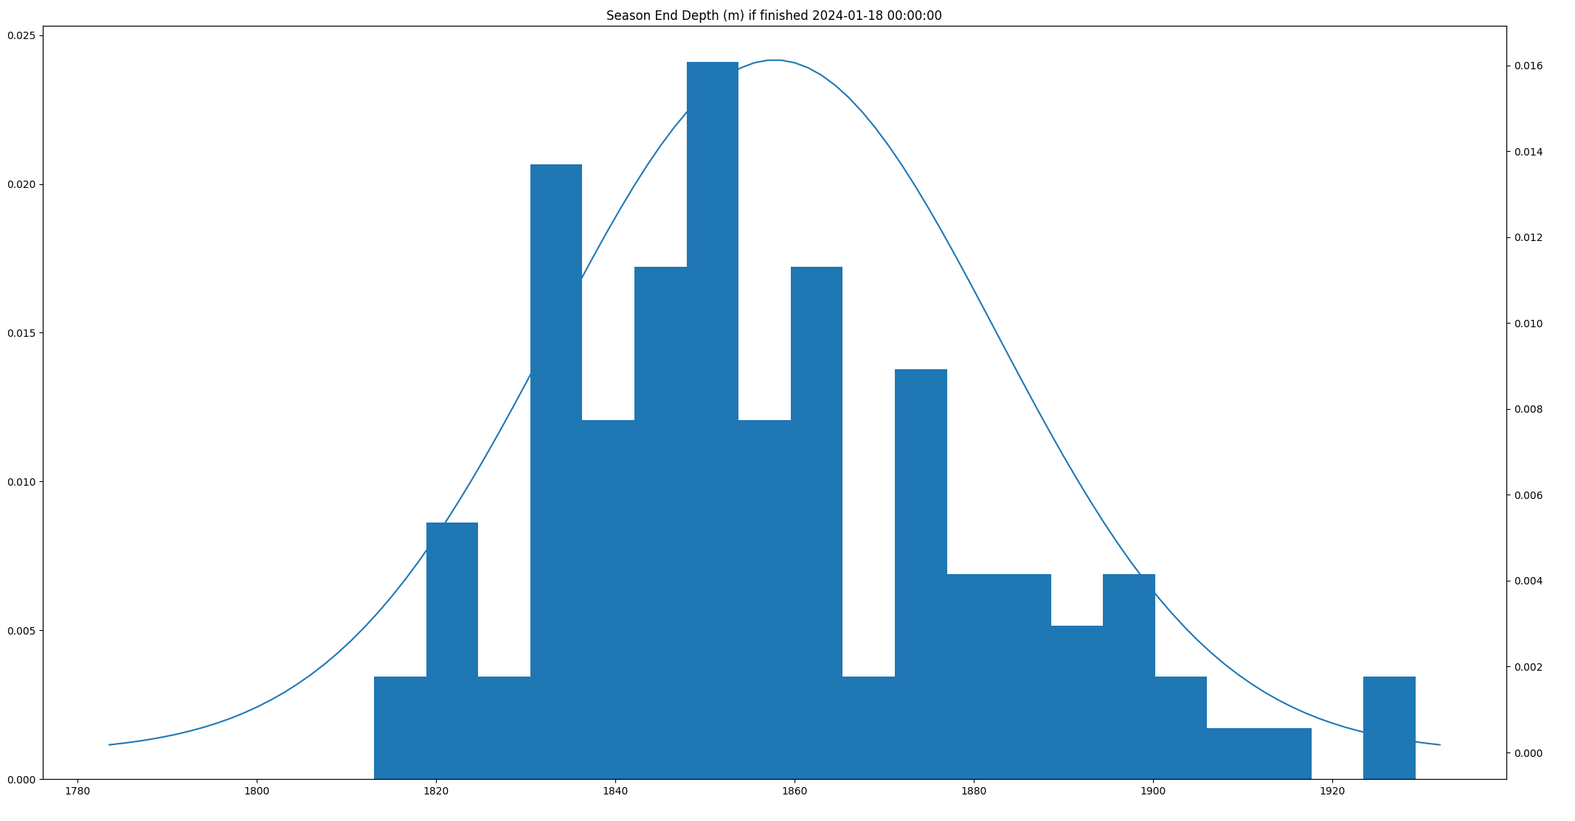
Notes:
It also gives a distribution, summarising the depths reached in all of our simulated seasons. Some simulations had us only reaching 1815m, others had us getting as far as 1925m. The mean was reported as 1875.77m, with a stddev of 24.7m. That’s quite a range considering there were only two week left to go, but not outside the realms of possibilities. The important thing is these are hard numbers, actual stats!
So, if you have a fairly representative input dataset, this, for me, gives a much clearer view of how much slack I should put in when planning my fieldwork.

Slide 23
2024-01-18 @ 1836.18m
Notes:
In the end, we actually stopped drilling on the 18th of January 2024 at 1836m. So not a bad set of predictions. I shouldn’t get too excited though, with only 2 weeks of drilling left there’s not a lot of time for the simulation to go wrong.
But the next year, while I was at REWIND, I got a message from Julien Westhoff, asking what CoreCaster thought about their current progress partway through the 24/25 season.

Slide 24
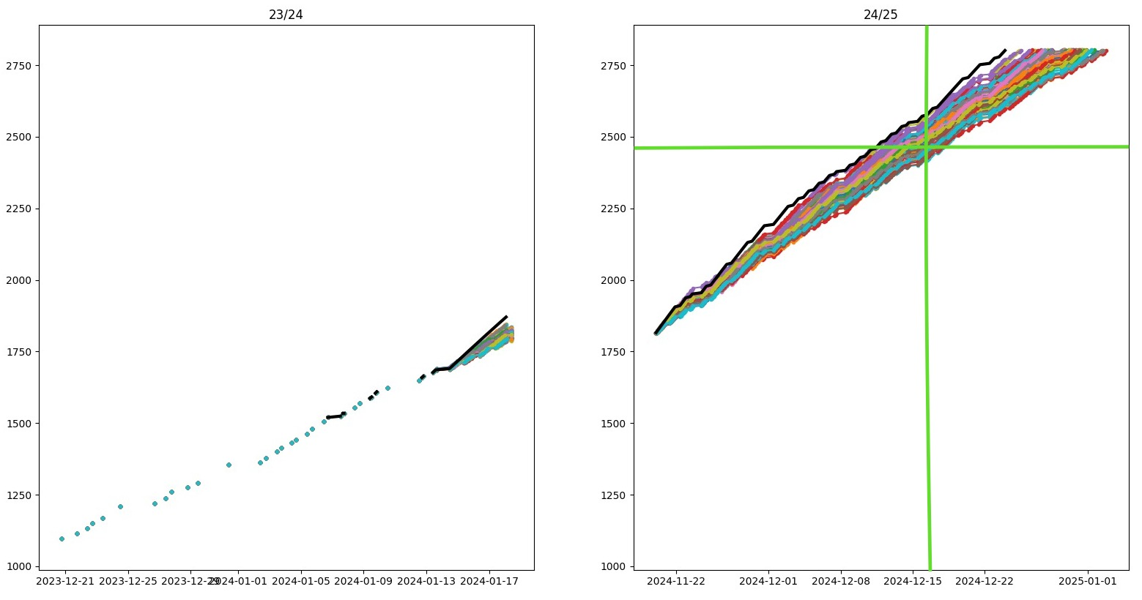
Notes:
I got out my laptop, gave CoreCaster the 2024/25 start date and all the data I’d gathered in 2023/24 - and a few seconds later, here’s what it showed. For comparison, the green crosshairs show their progress at the time – I’d say it matched very well! Perhaps the model was a little optimistic, or perhaps they’d had a slightly unlucky start compared to the previous season. I haven’t had a chance, but I’d really like to improve my probabilistic model of the BE drill’s performance with more data from the drill logs and see how different the simulations look.
I must stress how easy this all is to setup for a particular project, I’ve done all of the hard work already, and the scripts to do the simulations run in just a few seconds - outputting graphs and stats of potential season progress. All you need is good data from your previous seasons.
It allows this statistical approach. With enough input data, we can answer, quantitatively, questions like: What are my odds, given past performance, of reaching this depth within this time frame? What’s my expected depth, at this time?

Slide 25
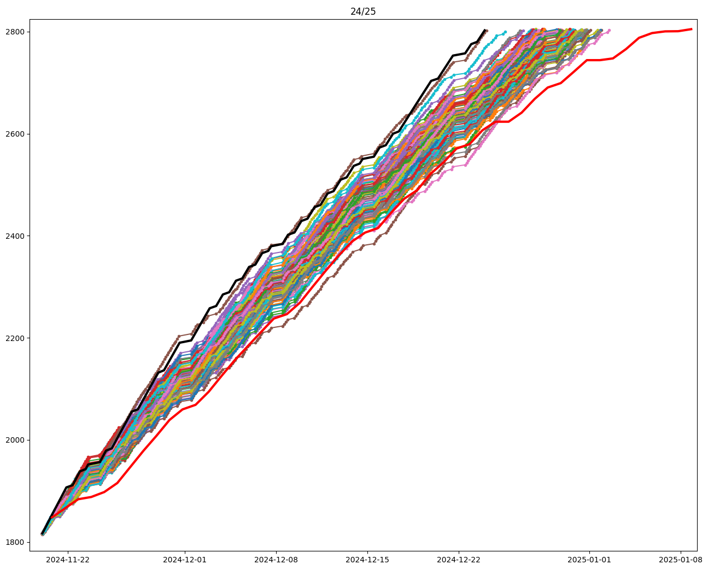
Notes:
For interest I ran CoreCaster again last night with the same data in, but now that the season is over I’ve added in red the actual reported drillers depth as taken from the sitreps. You can see my model doesn’t quite align.
It doesn’t have data from the beginning of any season, so it can’t account for the inevitable slower start as people get trained up. Also, You can see in reality the last few metres were a lot slower than the previous (which is expected as you start to drill through rocky bits, and are fiddling with extracting cores while keeping them covered using only red-lights), but the model had no way of accounting for this when it only had data from a ‘middle season’.
In its defence, I only gave it 34 runs of data from the previous season to go off of. Nonetheless it was optimistic through the whole season, so this does highlight some of the limitations of this approach.

Slide 26
Limitations
Garbage in - garbage out
Need input data from a whole campaign
Logistical delays and major breakages missing
Notes:
without good input data, it’s meaningless.
You need your input data to cover an entire campaign in order to capture differences in operations as progress is made
It’s hard to capture logistical delays or just major delays such as breakages.

Slide 27
Notes:
I think, these two types of tools are quite powerful though in combination. They complement each other, and for me at least, make it much easier to think about the logistical nightmare that is planning a drilling campaign.
CoreCaster, and my Scenario Planning Spreadsheets, are not fully tidied up and ready to share – but if anyone thinks they’re interesting or useful let me know and I’ll be happy to put them online somewhere.

Slide 28
Thank you
JAMLE@BAS.AC.UK
Notes:
This ends my foray into logistics and planning. It might seem like a lot of thought going into a niche aspect of what we do to make our drilling projects happen. We’ll never plan a season perfectly, but for me, it’s useful to make sure we’ve thought through our backup plans and quantify our chances of success for a given project. The less laborious making on-the-fly adjustments to our plans are, the better. Anyway, thanks for humouring me, I hope it was of some interest to you. I’m very interested to hear what any of you think and any suggestions or critiques you might have.

Slide 29
Standard wireline drilling formula
Drill Spec
Drop Length | l
Winch Speed | W
Drilling Speed | v
Surface Time per Run | s
Slack | e
Time to drill from 0 m to d m;
Td = d^2/lW + d/v + ds/l

