Slide 1
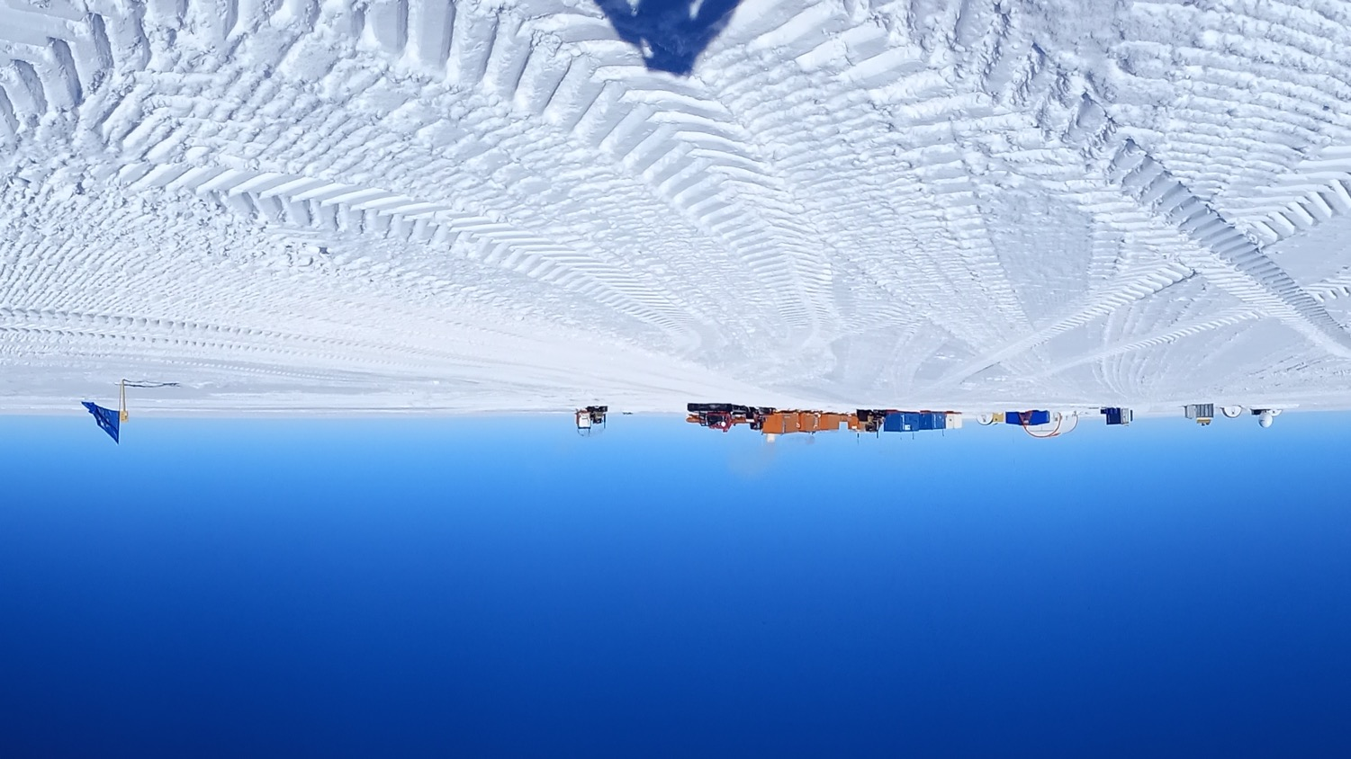


9th International Symposium on Ice Drilling Technology,
Telegrafenberg Potsdam September 14th–19th, 2025
The BELDC deep drilling operation to bedrock
Frank.Wilhelms@awi.de, Frank Wilhelms^{1,2}, Julien Westhoff³, Robert Mulvaney⁴,
Matthias Hüther¹ Olivier Alemany⁵, Steffen Bo Hansen³, Dorthe Dahl-Jensen^{3,6},
Hubertus Fischer⁷, Amaelle Landais⁸, Ailsa Chung⁵, Frédéric Parrenin⁵, Carlo Barbante^{9,10},
Saverio Panichi¹¹, Gianluca Bianchi Fasani¹², Lisa Ardoin¹³, Melanie Behrens¹, Nicolas Bienville⁸, Grant Boeckmann³, Marie Bouchet⁸, Pierre Henri Blard^{13,14}, Andrea Ceinini¹¹, Giuditta Celli¹⁰, Justin Chaillot⁸, Danilo Collino¹¹, Rémi Dallmayr¹, Andrea De Vito¹¹, Giuliano Dreossi¹⁰, Romain Duphil⁵, Olaf Eisen^{1,15}, François Fripiat¹³, Inès Gay¹⁶, Tamara Gerber^{3*}, Vasileios Gkinis³, Markus Grimmer⁷, Romilly Harris-Stuart⁸⁺, Maria Hörhold¹, Fortunat Joos⁷, Iben Koldtoft³, Florian Krauß⁷, Manuela Krebs¹, Thom Laepple¹, Gunther Lawer¹, Johannes Lemburg¹, Martin Leonhardt¹, Carlos Martin⁴, Hanno Meyer¹, Bénédicte Minster⁸, Michaela Mühl^{7#}, Luc Piard⁵, Trevor Popp³, Philippe Possenti⁵, Catherine Ritz⁵, Michele Scalet¹¹, Jakob Schwander⁷, Federico Scoto^{10,17}, Barbara Seth⁷, Lison Soussaintjean⁷, Hans Christian Steen-Larsen¹⁸, Barbara Stenni¹⁰, Thomas Stocker⁷, Jean-Louis Tison¹³, James Veale⁴,
Ilka Weikusat^{1,19}, Eric Wolff²⁰,Daniele Zannoni¹⁰
Notes:
00:40 00:40
Affiliations:
¹Alfred-Wegener-Institut Helmholtz-Zentrum für Polar- und Meeresforschung, Glaziologie, Bremerhaven, Germany ²Georg-August-Universität, Geowissenschaftliches Zentrum, Geochemie und Isotopengeologie, Göttingen, Germany ³Section for the Physics of Ice, Climate and Earth, Niels Bohr Institute, University of Copenhagen, Copenhagen, Denmark ⁴Ice Dynamics and Palaeoclimate, British Antarctic Survey, Cambridge, United Kingdom ⁵Université Grenoble Alpes, CNRS, IRD, Grenoble INP, IGE, Grenoble, France ⁶Centre for Earth Observation Science, University of Manitoba, Winnipeg, MB, Canada ⁷Climate and Environmental Physics, Physics Institute, Oeschger Centre for Climate Change Research, University of Bern, Bern, Switzerland ⁸Laboratoire des Sciences du Climat et de l'Environnement, LSCE/IPSL, CEA-CNRS-UVSQ, Université Paris-Saclay, Gif-sur-Yvette, France ⁹CNR-Institute of Polar Sciences (CNR-ISP), Mestre, Venice, Italy ¹⁰Ca'Foscari University of Venice, Department of Environmental Sciences, Informatics and Statistics, Mestre, Venice, Italy ¹¹ENEA-National Agency for New Technologies, Energy and Sustainable Economic Development, Brasimone Research Center, Camugnano, BO, Italy ¹²ENEA-National Agency for New Technologies, Energy and Sustainable Economic Development, Casaccia, RM, Italy
¹³Université Libre de Bruxelles, Laboratoire de Glaciologie (GLACIOL), Faculté des Sciences, Bruxelles, Belgium ¹⁴CRPG, CNRS, Université de Lorraine, Nancy, France ¹⁵Department of Geosciences, University of Bremen, Bremen, Germany ¹⁶Institut polaire français Paul-Emile Victor, Technopôle Brest-Iroise, Plouzané, France ¹⁷Institute of Atmospheric Sciences and Climate (CNR-ISAC), Lecce, Italy ¹⁸Geofysisk institutt, Universitetet i Bergen, Bergen, Norway ¹⁹Department of Geosciences, Eberhard Karls University, Tübingen, Germany ²⁰Department of Earth Sciences, University of Cambridge, Cambridge, United Kingdom *now at: Institute of Earth Surface Dynamics, University of Lausanne, Lausanne, Switzerland ⁺now at: College of Earth, Ocean, and lAtmospheric Sciences, Oregon State University, Corvallis, OR, USA #now at: Université Grenoble Alpes, CNRS, IRD, Grenoble INP, IGE, Grenoble, France

Slide 2
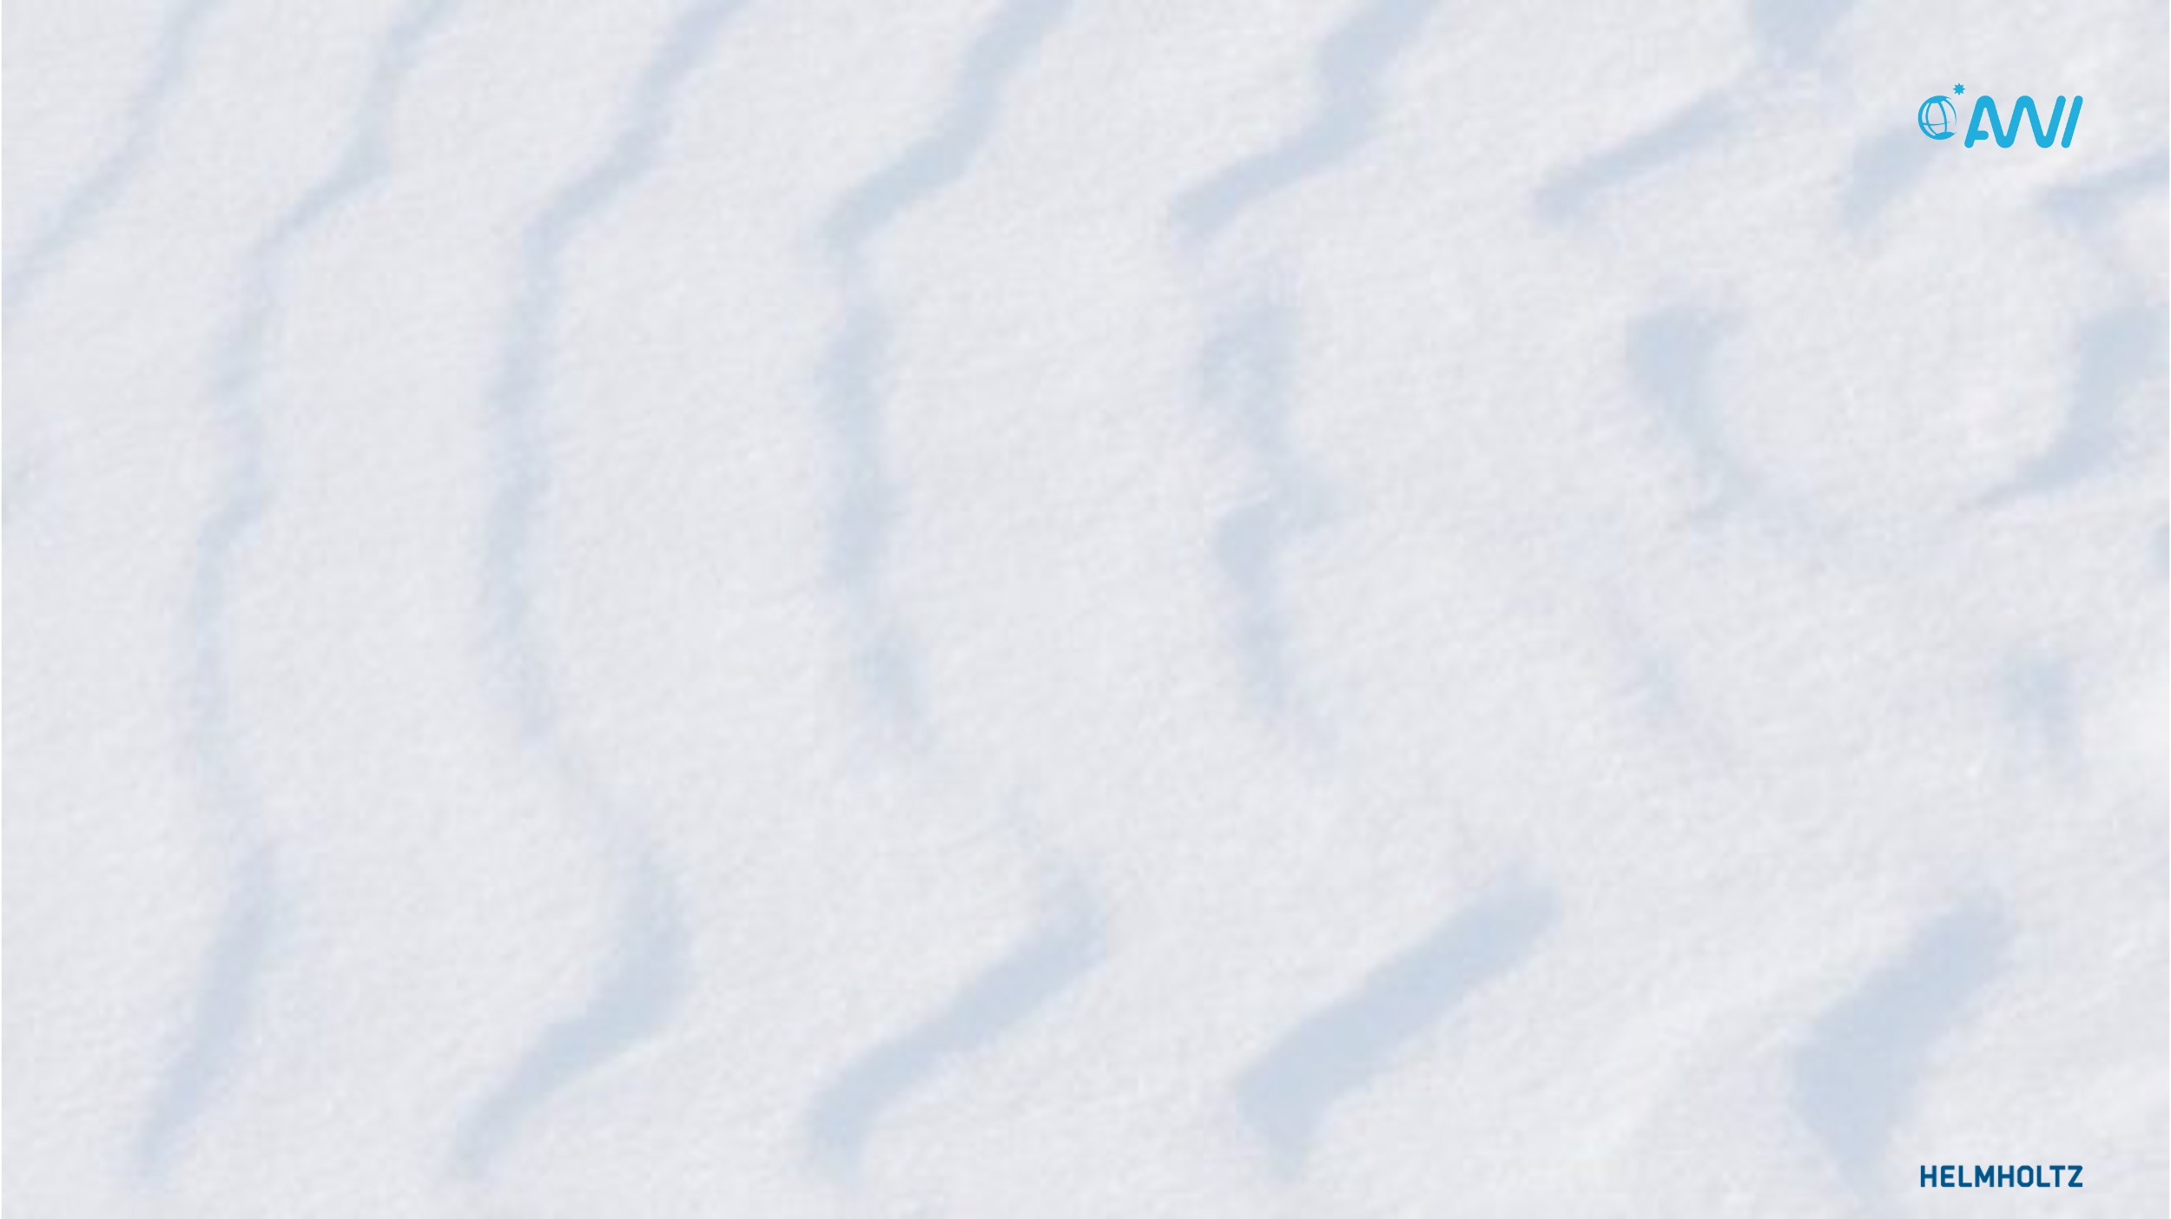
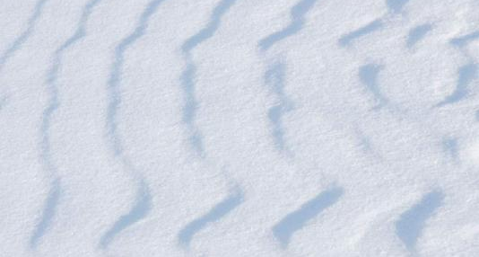
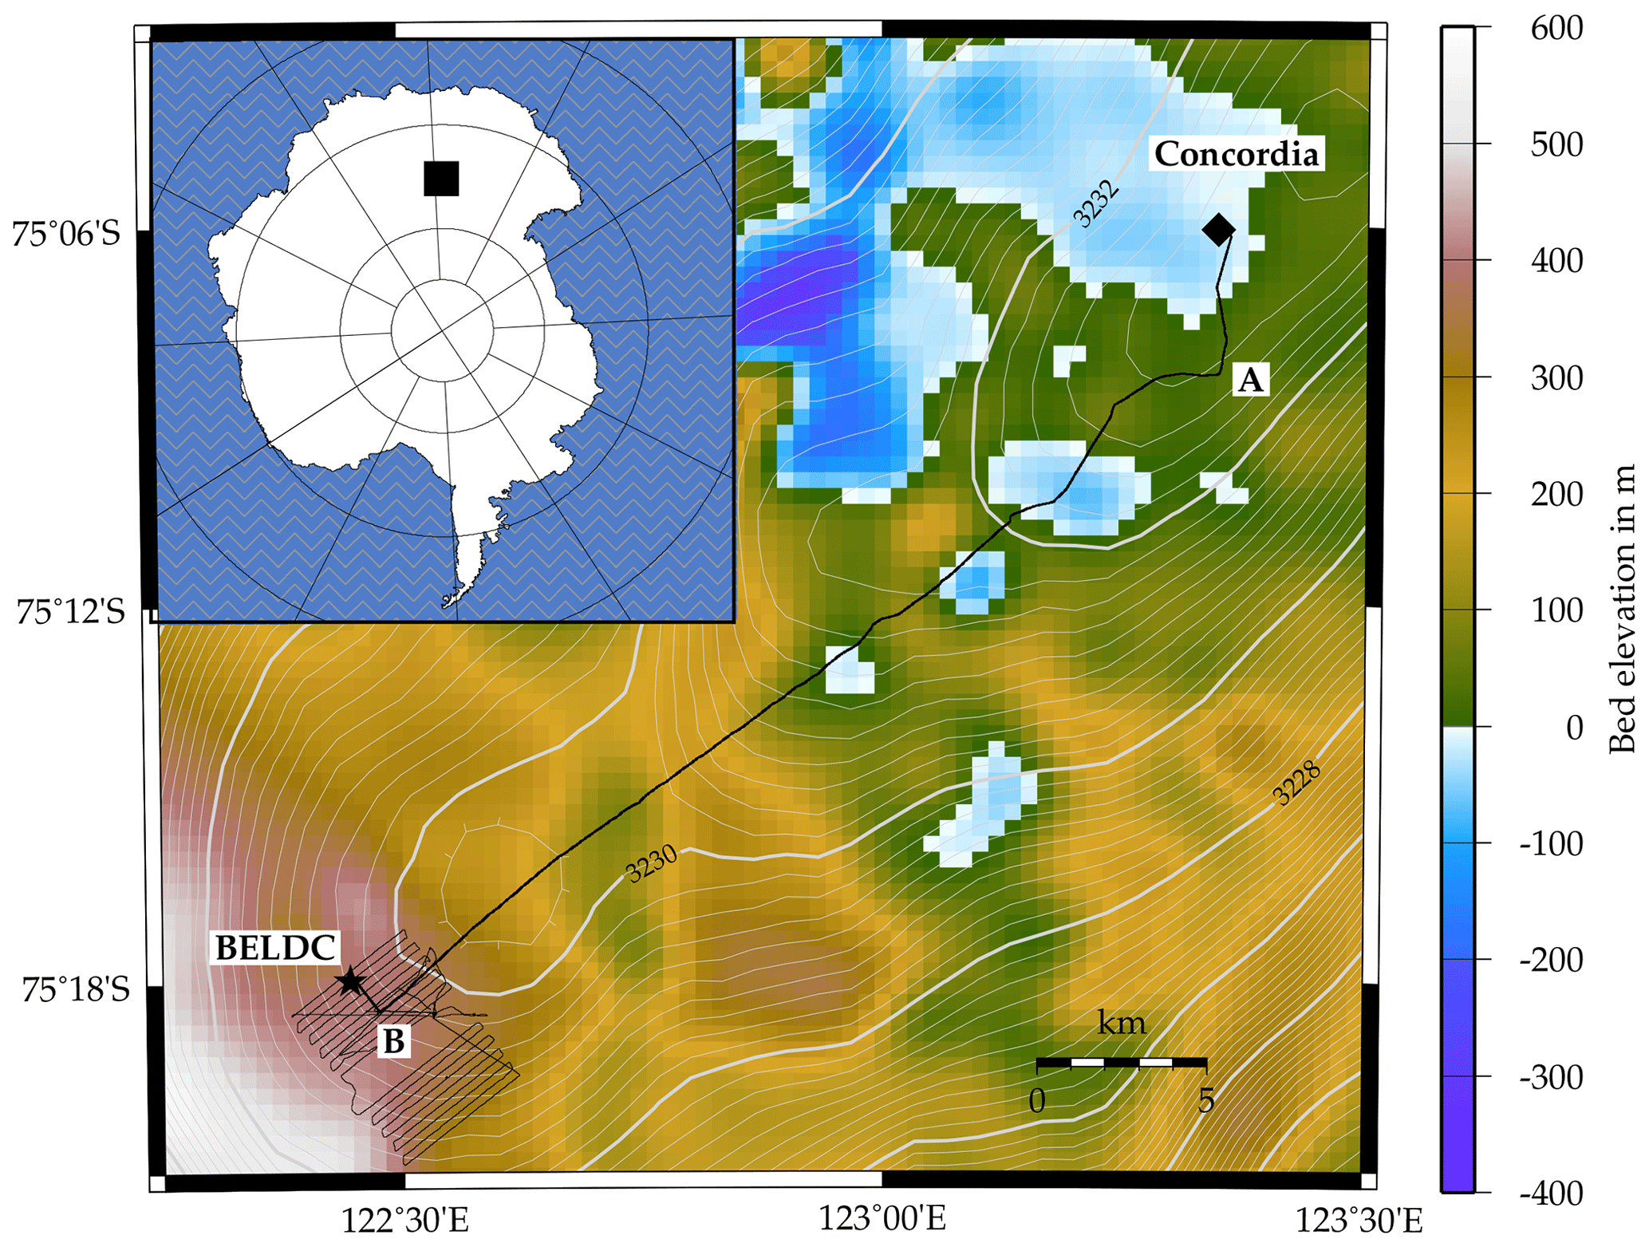
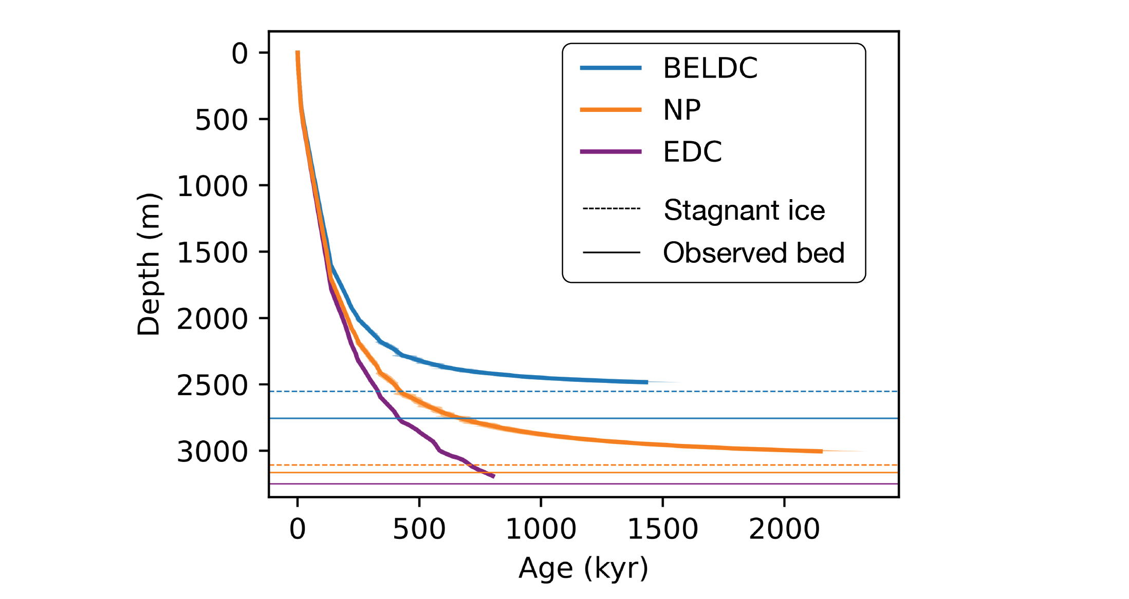


Beyond EPICA Little Dome C (BELDC)
Lilien, D. A. et al., TC, 15, 1881–1888, 2021
Chung, A. et al., Past Global Changes Magazine, 31(2), 60–61, 2023
Notes:
01:50 02:30
01:30
To identify a suitable site to drill 1.5 million year old ice with a satisfactory resolution of less than 20 kiloyear per m we carried out intensive pre-site surveys by observing lateral (strain-nets) and vertical (aPRES) ice deformation, and mapped the internal structure of the ice sheet by radar. From the publication of one of the important radar surveys I took this map showing the region close to Concordia station in interior East Antarctica. The map is northed and Concordia station, where the EPICA (EDC) core was drilled, is emphasized by the purple circle in the upper right corner of the map. The Beyond EPICA oldest ice Little Dome C site is 38 km south-west of Concordia station in the lower left corner. Modelling work by Fréd Parrenin predicted we find the targeted ice there. His PhD student Ailsa Chung updated the runs and predicts now that we find 1.5 million year old ice in at least 20 kiloyear resolution even shallower at around 2570 m. The lowermost section is a stagnant ice body of 186 m thickness.

Slide 3

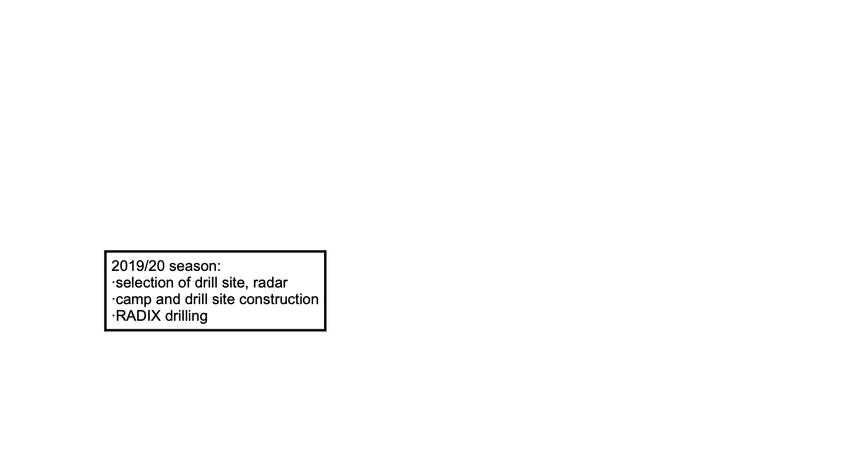
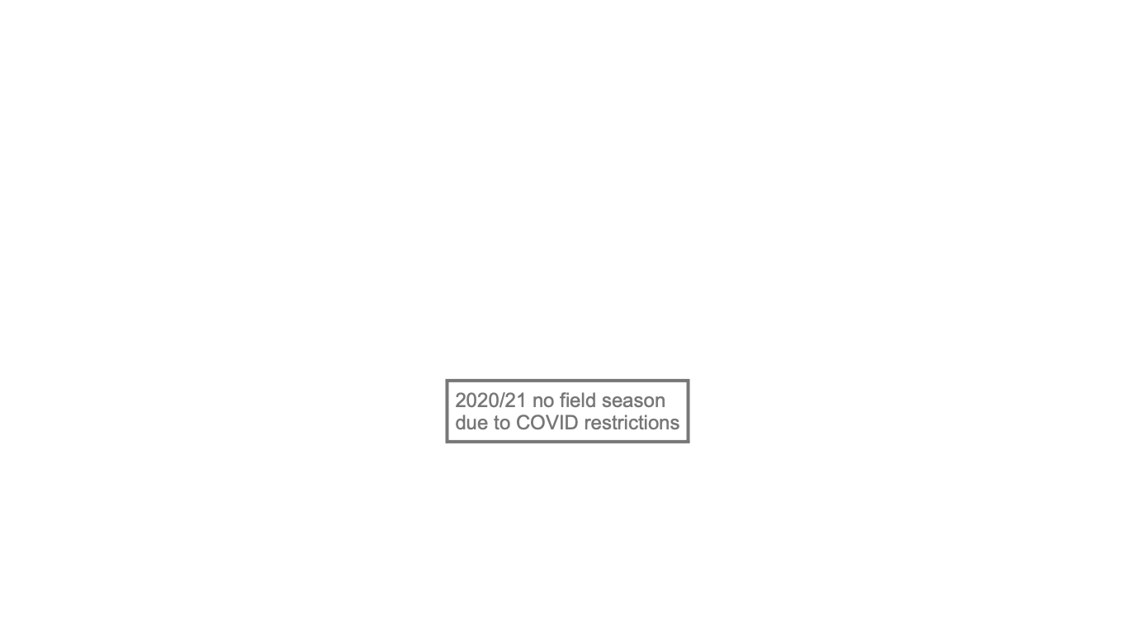
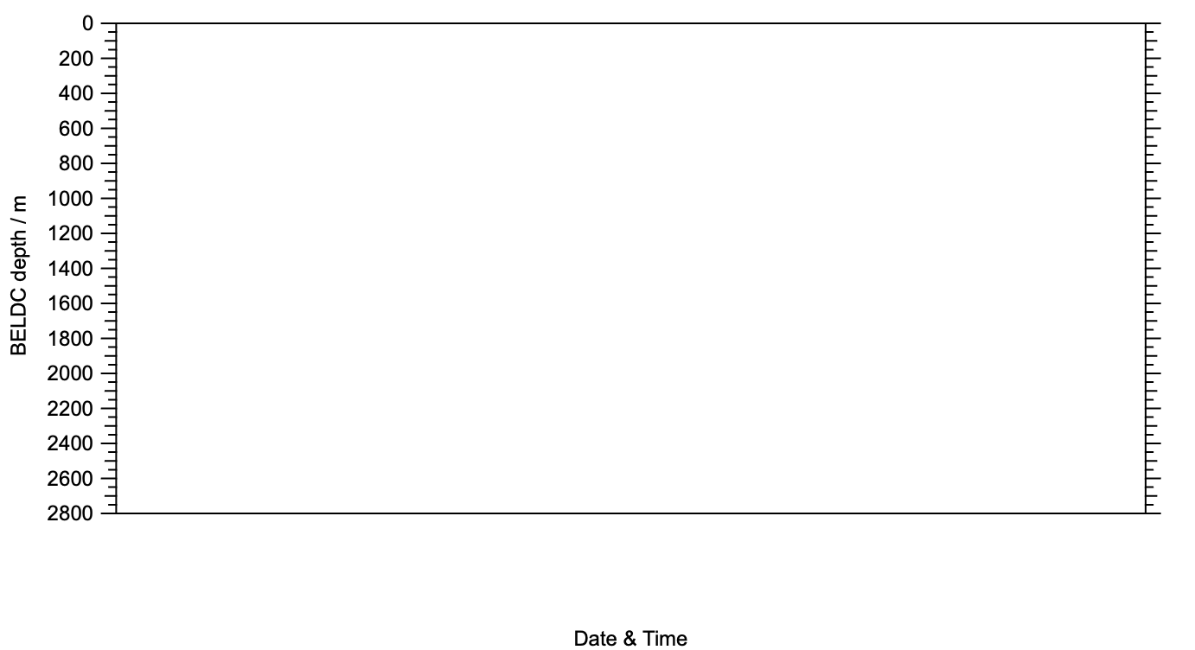
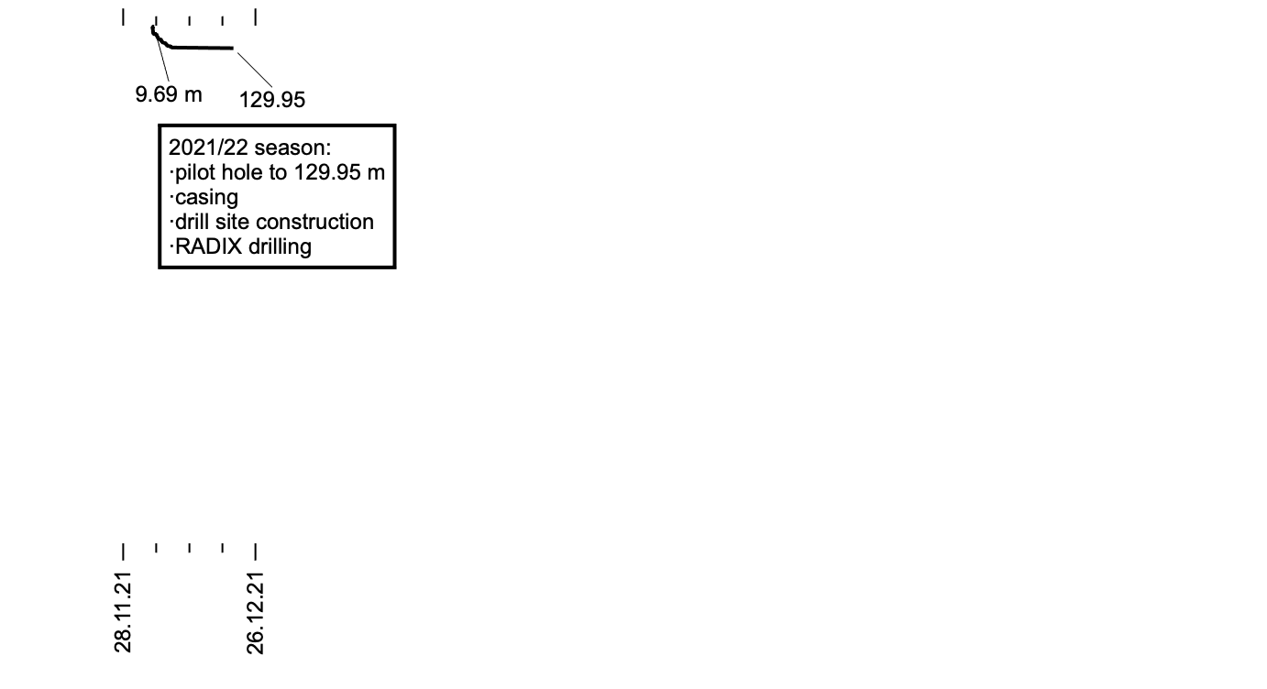
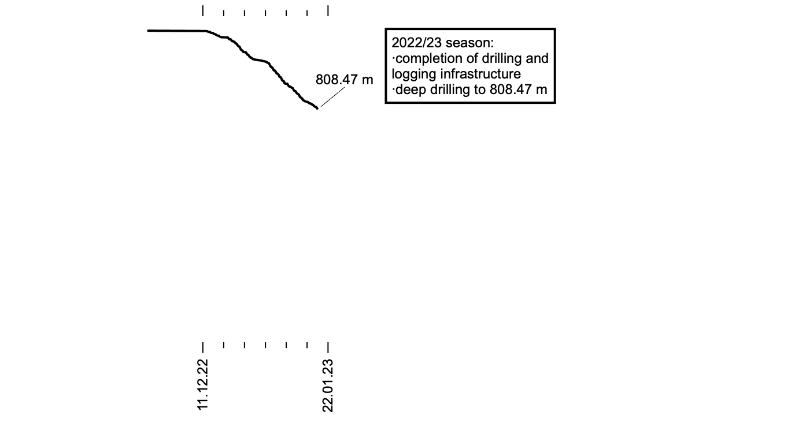
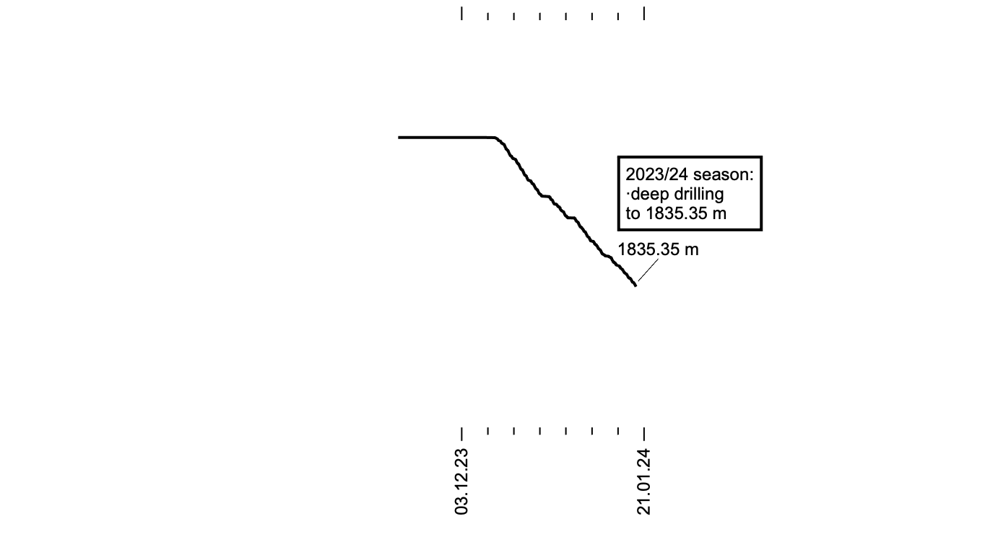
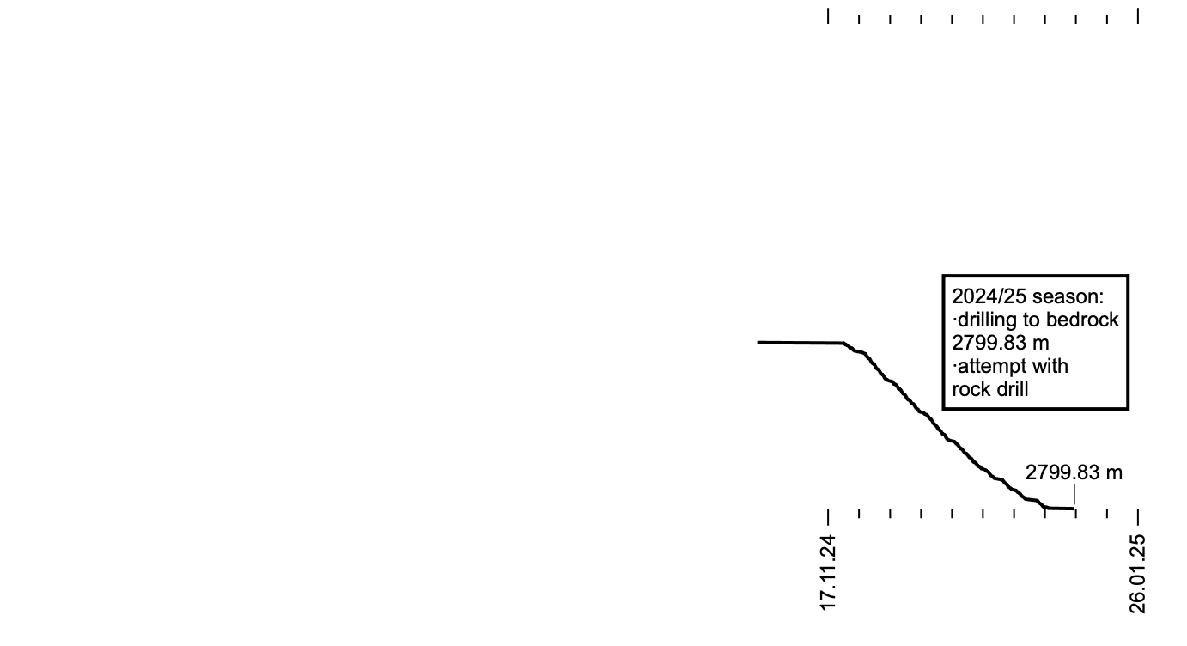
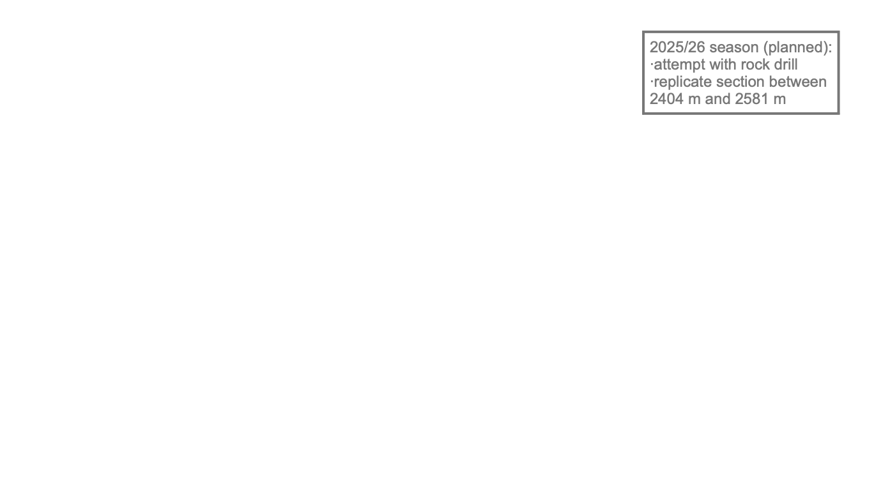
(Four +) Five seasons to bedrock
Notes:
02:50 05:20

Slide 4
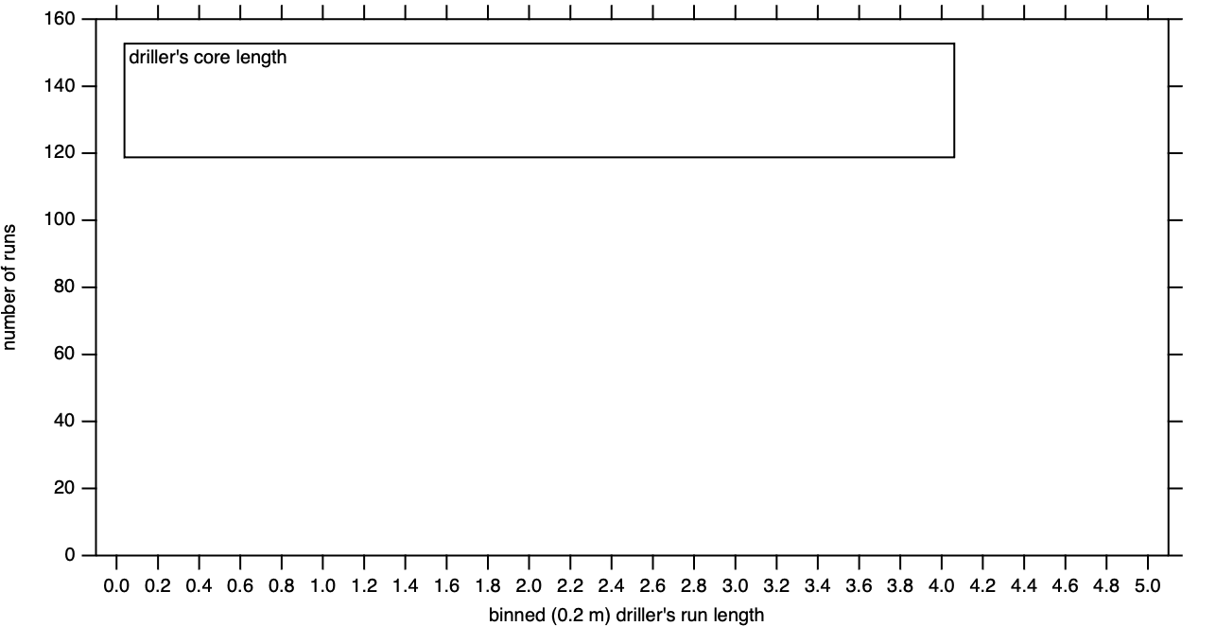
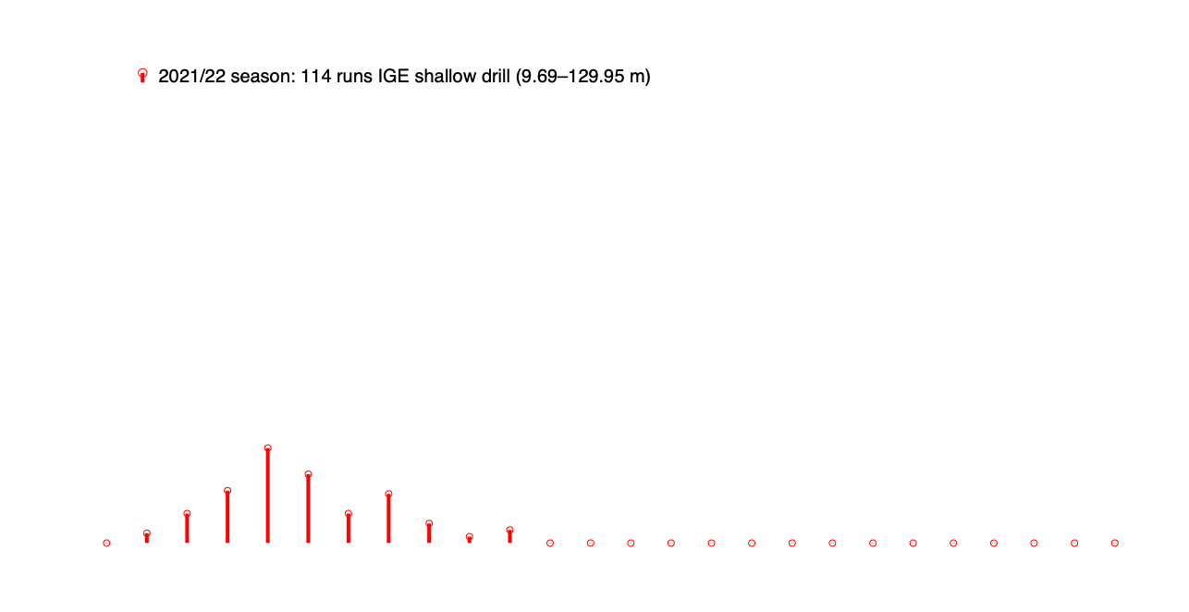
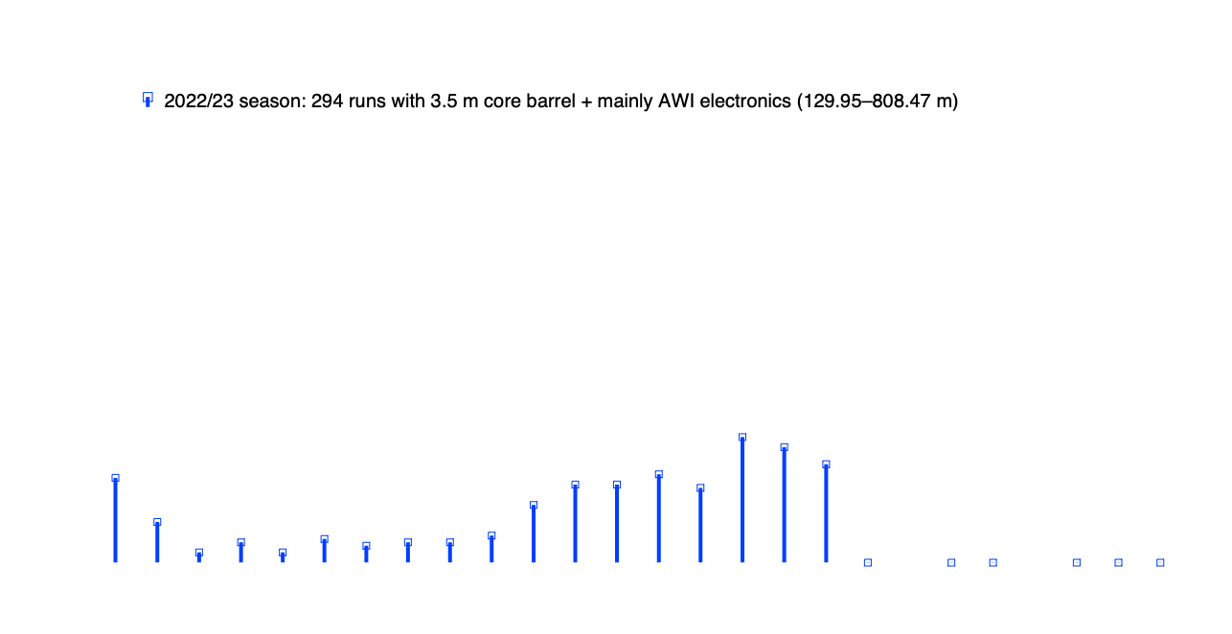


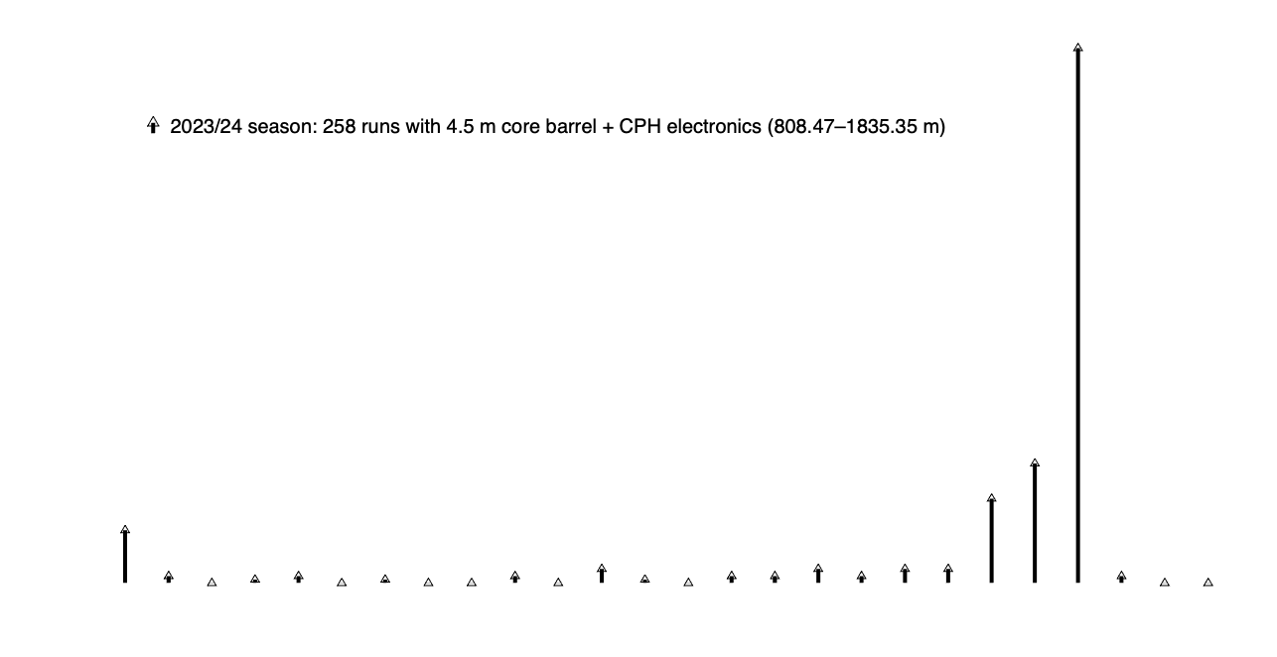
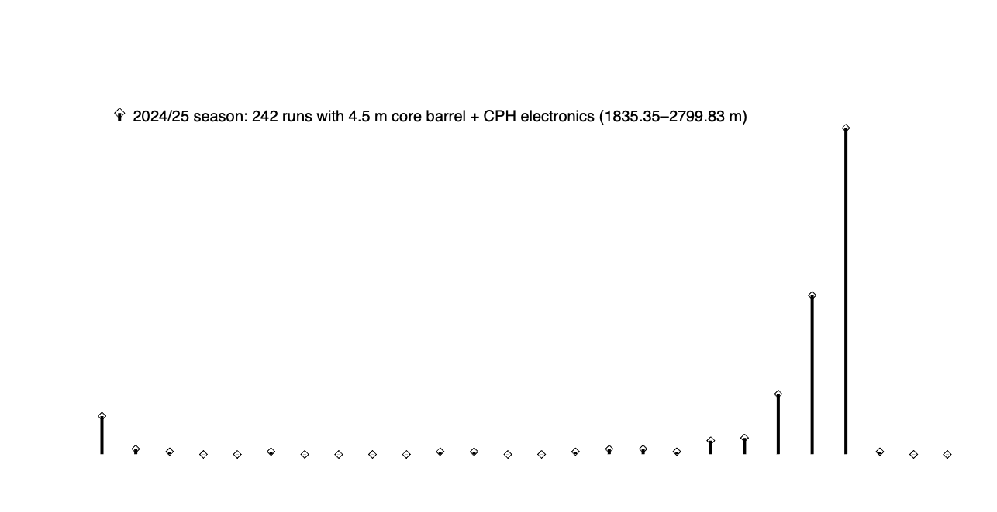
Driller’s run length
Notes:
03:30 8:50
Wilhelms, F. et al., Precise dielectric profiling of ice cores: a new device with improved guarding and its theory. Journal of Glaciology. 1998;44(146):171-174. doi:10.3189/S002214300000246X
Wilhelms, F. , Explaining the dielectric properties of firn as a density-and-conductivity mixed permittivity (DECOMP), Geophys. Res. Lett., 32, L16501, 2005. https://doi.org/10.1029/2005GL022808
EPICA community members, Eight glacial cycles from an Antarctic ice core. Nature 429, 623–628, 2004. https://doi.org/10.1038/nature02599
Parrenin, F. et al., Volcanic synchronisation between the EPICA Dome C and Vostok ice cores (Antarctica) 0–145 kyr BP, Clim. Past, 8, 1031–1045, 2012. https://doi.org10.5194/cp-8-1031-2012
Bouchet, M. et al., The Antarctic Ice Core Chronology 2023 (AICC2023) chronological framework and associated timescale for the European Project for Ice Coring in Antarctica (EPICA) Dome C ice core, Clim. Past, 19, 2257–2286, 2023. https://doi.org/10.5194/cp-19-2257-2023

Slide 5
Talks on more details
Increasing the drilling speed in BEOI deep ice coring by drilling ice cores of up to 4.5 meters in length (Matthias Hüther)
Iterative improvements to the chip transport pump used in the BEOI‘s deep ice core drilling project (Matthias Hüther)
Technical Innovations of the BEOI Field Seasons (Johannes Lemburg)
The BELDC ice core processing work flow (Manuela Krebs)
Notes:
Wilhelms, F. et al., Precise dielectric profiling of ice cores: a new device with improved guarding and its theory. Journal of Glaciology. 1998;44(146):171-174. doi:10.3189/S002214300000246X
Wilhelms, F. , Explaining the dielectric properties of firn as a density-and-conductivity mixed permittivity (DECOMP), Geophys. Res. Lett., 32, L16501, 2005. https://doi.org/10.1029/2005GL022808
EPICA community members, Eight glacial cycles from an Antarctic ice core. Nature 429, 623–628, 2004. https://doi.org/10.1038/nature02599
Parrenin, F. et al., Volcanic synchronisation between the EPICA Dome C and Vostok ice cores (Antarctica) 0–145 kyr BP, Clim. Past, 8, 1031–1045, 2012. https://doi.org10.5194/cp-8-1031-2012
Bouchet, M. et al., The Antarctic Ice Core Chronology 2023 (AICC2023) chronological framework and associated timescale for the European Project for Ice Coring in Antarctica (EPICA) Dome C ice core, Clim. Past, 19, 2257–2286, 2023. https://doi.org/10.5194/cp-19-2257-2023

Slide 6
Ongoing developments that serve the BELDC drilling
A new dynamometer for testing ice core drill motors an gears (Matthias Hüther)
Resilient gear design for deep ice drilling systems (Johannes Lemburg)
The challenges involved in developing a power supply, communication system and drive unit for a deep ice core drilling rig (Matthias Hüther)
Drillhead configurations and maintenance in the BEOI‘s deep ice core drilling project (Gunther Lawer)
The Danish Replicate Drilling System – Results from the First Field Test (Grant Boeckmann)
Notes:
02:20 11:10
Wilhelms, F. et al., Precise dielectric profiling of ice cores: a new device with improved guarding and its theory. Journal of Glaciology. 1998;44(146):171-174. doi:10.3189/S002214300000246X
Wilhelms, F. , Explaining the dielectric properties of firn as a density-and-conductivity mixed permittivity (DECOMP), Geophys. Res. Lett., 32, L16501, 2005. https://doi.org/10.1029/2005GL022808
EPICA community members, Eight glacial cycles from an Antarctic ice core. Nature 429, 623–628, 2004. https://doi.org/10.1038/nature02599
Parrenin, F. et al., Volcanic synchronisation between the EPICA Dome C and Vostok ice cores (Antarctica) 0–145 kyr BP, Clim. Past, 8, 1031–1045, 2012. https://doi.org10.5194/cp-8-1031-2012
Bouchet, M. et al., The Antarctic Ice Core Chronology 2023 (AICC2023) chronological framework and associated timescale for the European Project for Ice Coring in Antarctica (EPICA) Dome C ice core, Clim. Past, 19, 2257–2286, 2023. https://doi.org/10.5194/cp-19-2257-2023

Slide 7
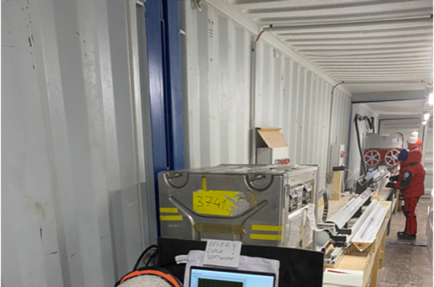
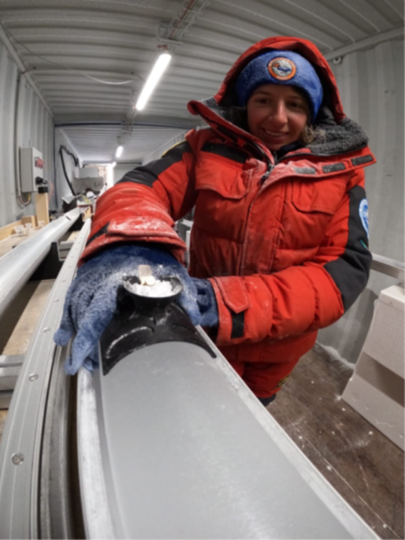
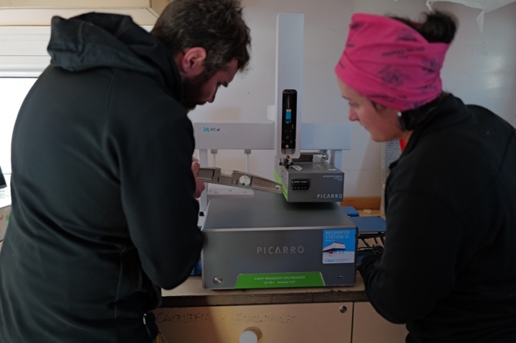
Field campaigns (DEP, cutting, δD / δ¹⁸O )
O. Alemany © PNRA/IPEV
F.Wilhelms © PNRA/IPEV
J. Westhoff © PNRA/IPEV
Notes:
00:40 / 11:50
We are past the second deep drilling season. After reaching 804 meters the winter before we brought up core from 1836 m end of this January. The core is logged, then scanned by dielectric profiling and split into archive samples that are stored at Concordia. The other aliquot is brought home for the analyses. We desire to monitor which time intervals we cover and as DEP alone might be ambiguous when we are further down we also measure stable water isotopes from bag means that we scratch from the surface. The core is scanned and split to 1695, so the lowermost 136 meters and the section between 847 and 950 that was still slightly brittle at the beginning of the season are still stored on site.

Slide 8
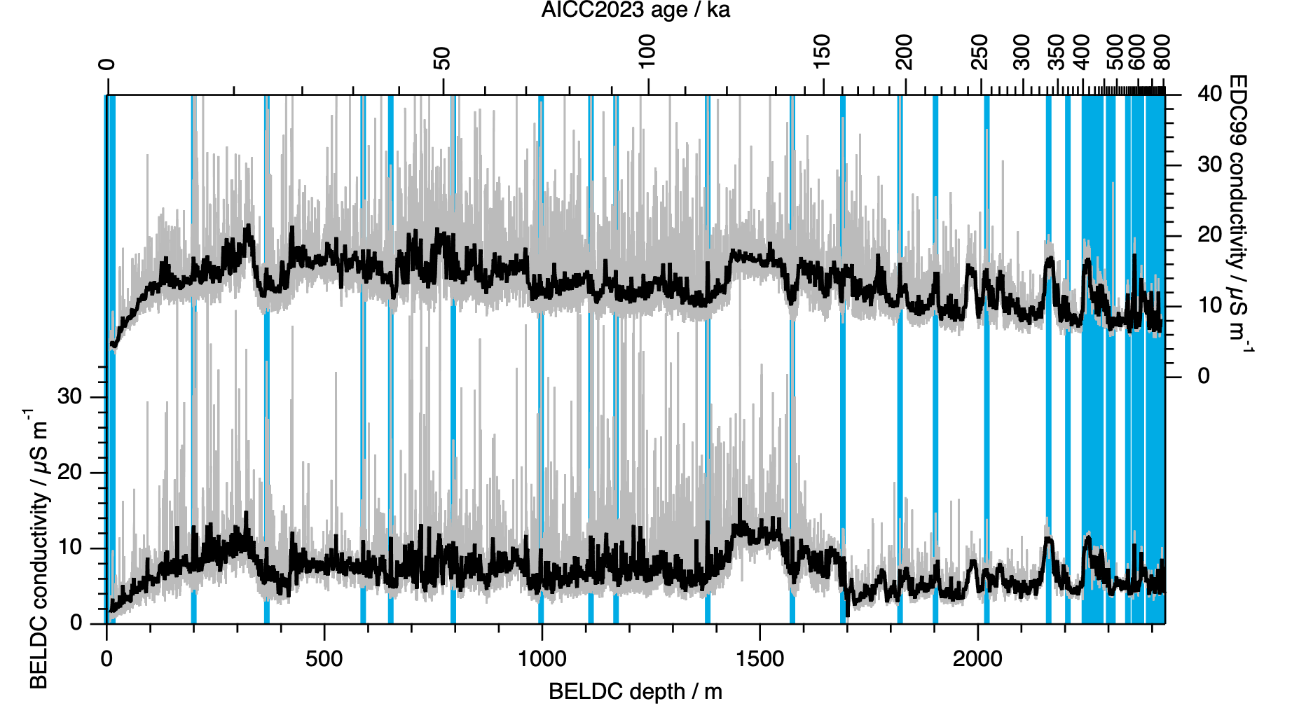
DEP match with EDC for last 800 ka
Wilhelms, F. et al., 1998; EPICA community members, 2004; Parrenin, F. et al., 2012; Bouchet, M. et al., 2023
Notes:
00:30 12:20
Wilhelms, F. et al., Precise dielectric profiling of ice cores: a new device with improved guarding and its theory. Journal of Glaciology. 1998;44(146):171-174. doi:10.3189/S002214300000246X
Wilhelms, F. , Explaining the dielectric properties of firn as a density-and-conductivity mixed permittivity (DECOMP), Geophys. Res. Lett., 32, L16501, 2005. https://doi.org/10.1029/2005GL022808
EPICA community members, Eight glacial cycles from an Antarctic ice core. Nature 429, 623–628, 2004. https://doi.org/10.1038/nature02599
Parrenin, F. et al., Volcanic synchronisation between the EPICA Dome C and Vostok ice cores (Antarctica) 0–145 kyr BP, Clim. Past, 8, 1031–1045, 2012. https://doi.org10.5194/cp-8-1031-2012
Bouchet, M. et al., The Antarctic Ice Core Chronology 2023 (AICC2023) chronological framework and associated timescale for the European Project for Ice Coring in Antarctica (EPICA) Dome C ice core, Clim. Past, 19, 2257–2286, 2023. https://doi.org/10.5194/cp-19-2257-2023

Slide 9
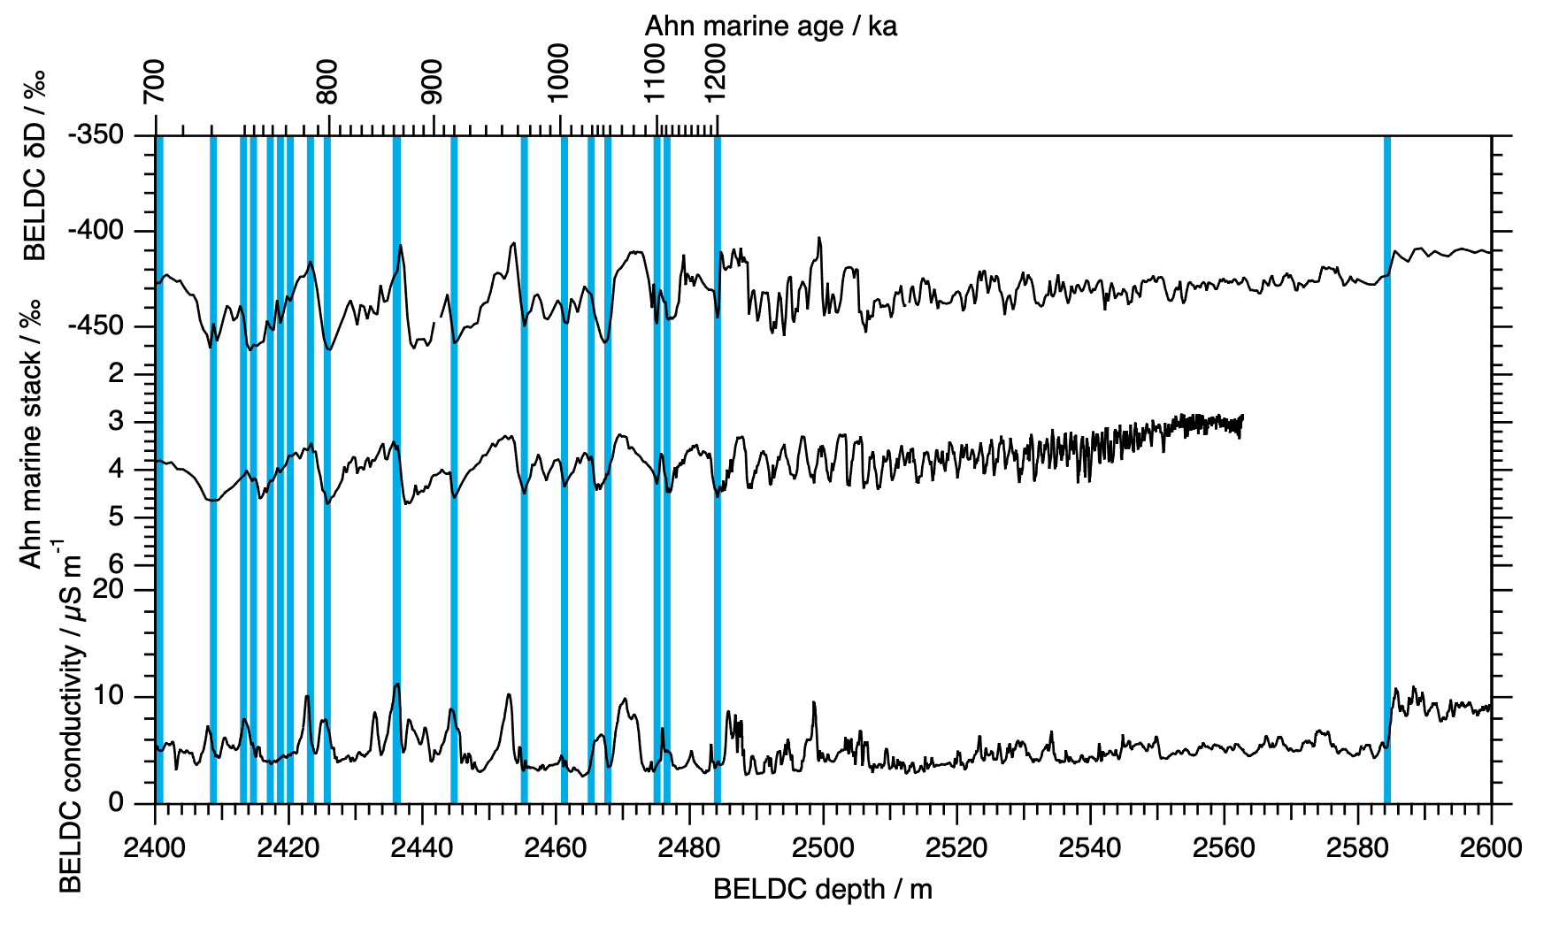
δ¹⁸O/δD match with marine record before 700 ka + flow model before 1200 ka
Ahn, S. et al., 2017; Chung, A. et al., 2023
Notes:
02:00 14:20
Ahn, S. et al., A probabilistic Pliocene–Pleistocene stack of benthic δ¹⁸O using a profile hidden Markov model, Dynamics and Statistics of the Climate System, Volume 2, Issue 1, 2017, dzx002, https://doi.org/10.1093/climsys/dzx002
Chung, A. et al., Stagnant ice and age modelling in the Dome C region, Antarctica, The Cryosphere, 17, 3461–3483, , 2023. https://doi.org/10.5194/tc-17-3461-2023

Slide 10
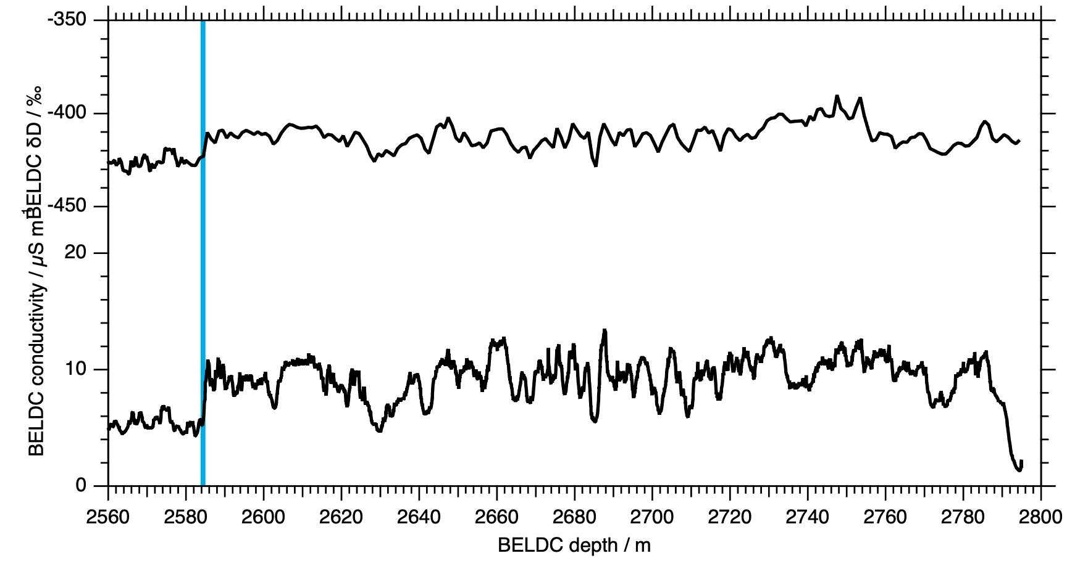
Stagnant ice below 2584 m
Notes:
00:30 14:50
Ahn, S. et al., A probabilistic Pliocene–Pleistocene stack of benthic δ¹⁸O using a profile hidden Markov model, Dynamics and Statistics of the Climate System, Volume 2, Issue 1, 2017, dzx002, https://doi.org/10.1093/climsys/dzx002
Chung, A. et al., Stagnant ice and age modelling in the Dome C region, Antarctica, The Cryosphere, 17, 3461–3483, , 2023. https://doi.org/10.5194/tc-17-3461-2023

Slide 11
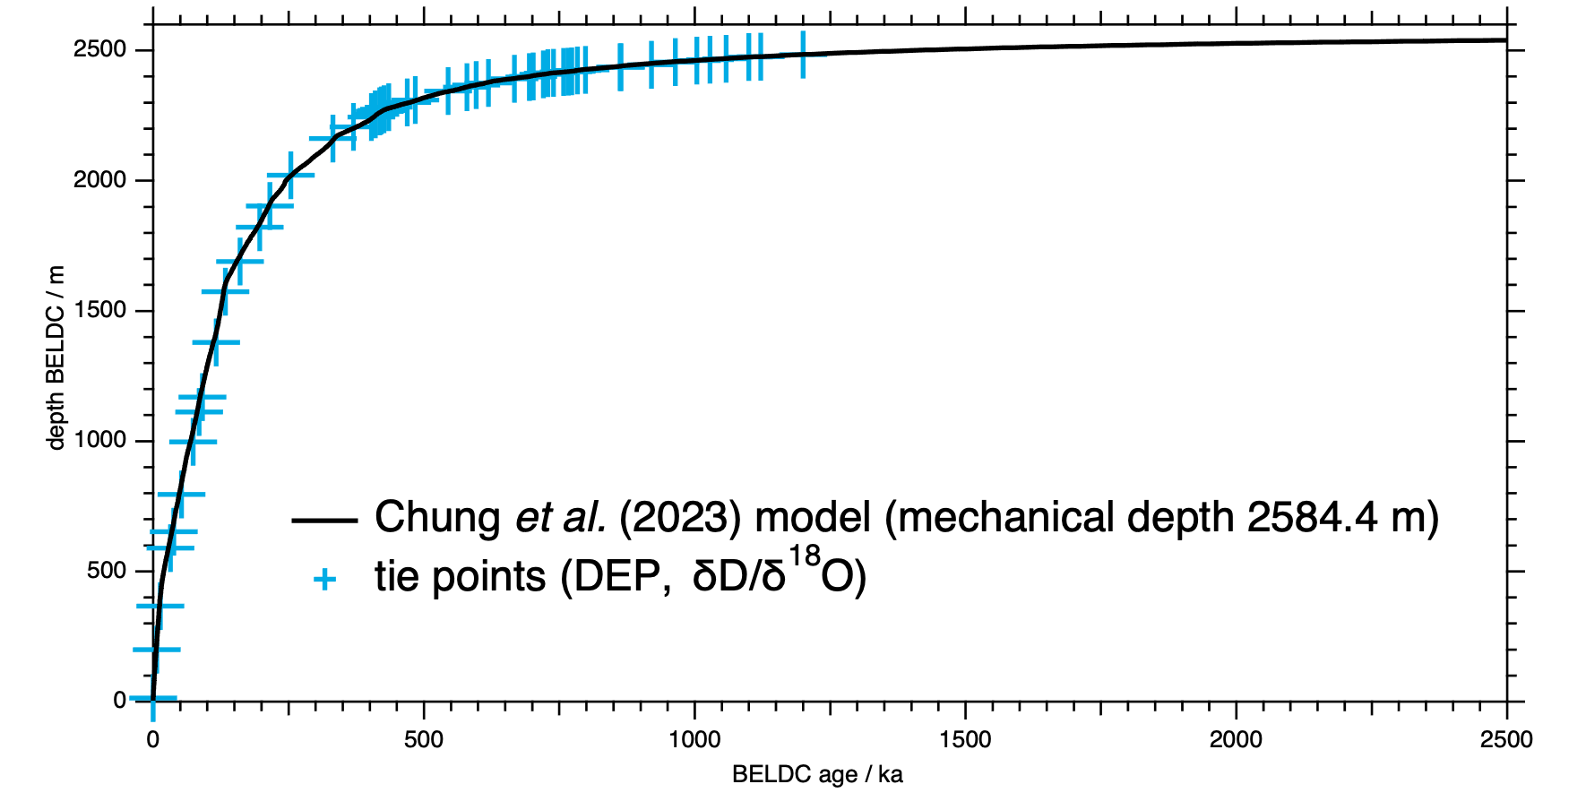
Stagnant ice below 2584 m
Notes:
00:50 15:40
Ahn, S. et al., A probabilistic Pliocene–Pleistocene stack of benthic δ¹⁸O using a profile hidden Markov model, Dynamics and Statistics of the Climate System, Volume 2, Issue 1, 2017, dzx002, https://doi.org/10.1093/climsys/dzx002
Chung, A. et al., Stagnant ice and age modelling in the Dome C region, Antarctica, The Cryosphere, 17, 3461–3483, , 2023. https://doi.org/10.5194/tc-17-3461-2023

Slide 12
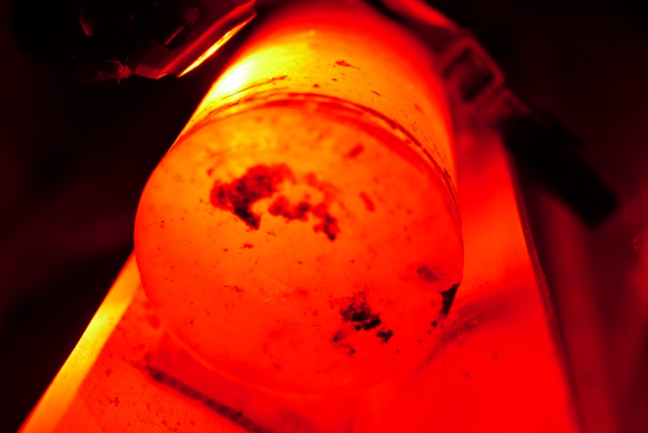
Debris laden lowermost 5 m
Notes:
01:10 16:50
Ahn, S. et al., A probabilistic Pliocene–Pleistocene stack of benthic δ¹⁸O using a profile hidden Markov model, Dynamics and Statistics of the Climate System, Volume 2, Issue 1, 2017, dzx002, https://doi.org/10.1093/climsys/dzx002
Chung, A. et al., Stagnant ice and age modelling in the Dome C region, Antarctica, The Cryosphere, 17, 3461–3483, , 2023. https://doi.org/10.5194/tc-17-3461-2023

Slide 13

Predicted and observed setting at Little Dome C
parameter | predicted | observed
Observed ice thickness H_{obs} | 2757 m | 2799.83 m
Mechanical H_{m} | 2571 m | 2584.4 m
stagnant ice thickness | 186 m | 215.43 m
Obs. basal unit | 154 m
resolution at 1.2 Ma | 12.2 ka/m | ~10 ka/m
depth of 1.2 Ma ice | 2486 m | 2484.12 m
maximum age at 20 ka/m | 1.49 ± 0.21 Ma
depth of max age ice | 2505 m
Chung, A., et al., TC, 17, 3461–3483,
https://doi.org/10.5194/tc-17-3461-2023, 2023.
Notes:
03:30 / 20:20
06:58 / 07:58
As an outlook I first estimate we old the already drilled but not yet analysed section to 1836 meters might be. I extend the trend of the depth match of EDC99 over BEOILDC presented in the left panel and yield roughly 200 kiloyears before present. In terms of drilling: Let's have a look to Ailsa Chung's results, summarized in the right panel. While drilling 920 m to bedrock 2757 m in a season that deep down is very optimistic to plan for, I consider a good chance to get the old ice, which is about 750 m further down to around 2571 m. Or simply in relation to the 1.5 million years being the scope of this session, it is getting interesting now! To be continued!

