Slide 1
Laser-Particle Acceleration at HZDR
Semantic x-Lab Kick-off
Institute of Radiation Physics· Laser-Particle Acceleration · Dr. Hans-Peter Schlenvoigt · hp.schlenvoigt@hzdr.de · www.hzdr.de

Slide 2
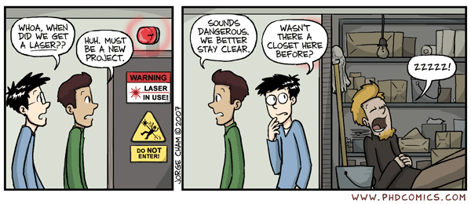
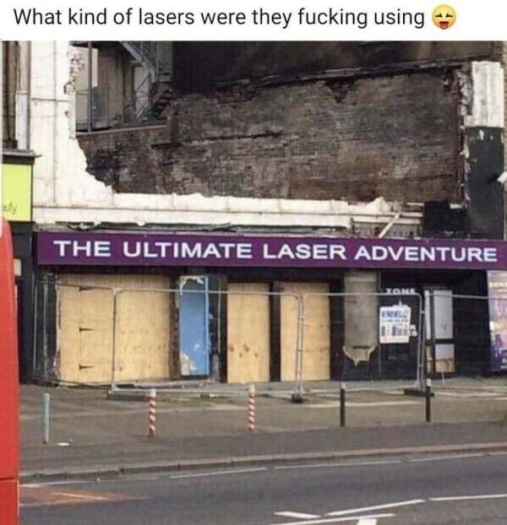
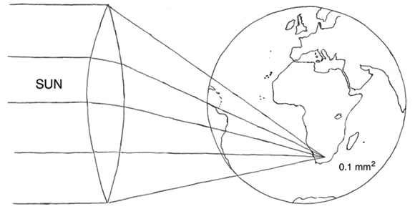
Laser-driven particle acceleration
Schwoerer H. (2008). Particle acceleration with lasers. S. Afr. J. Sci. 104, 299-304.

Slide 3
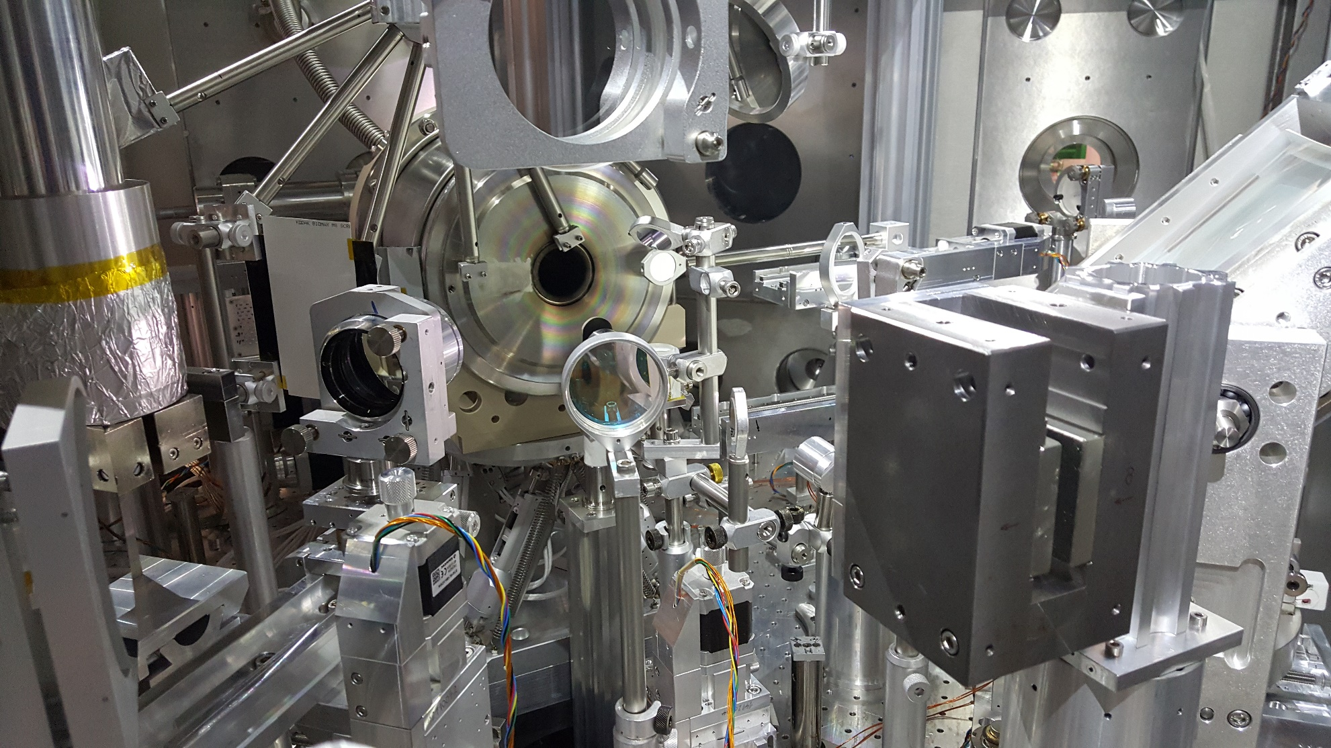
Laser-driven particle acceleration in reality
Drive laser
Particles
Particles
Optical plasma diagnostics

Slide 4
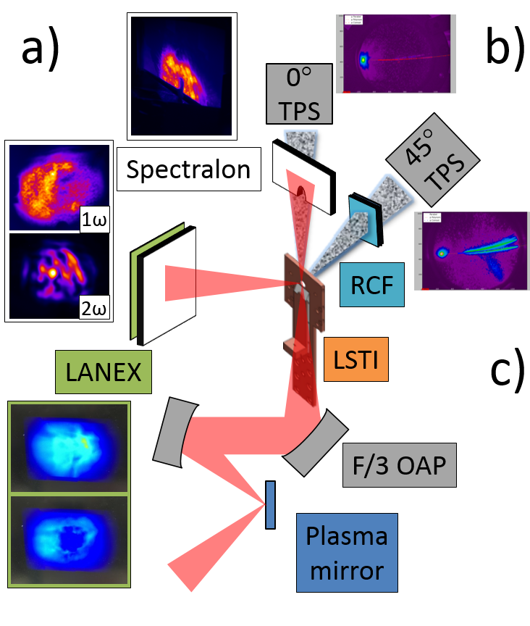
User experiments: Theory and reality
Example on solid-density plasma experiments
2020 roadmap on plasma accelerators (New J. Phys. 23 031101) , Courtesy of L. Obst-Huebl

Slide 5
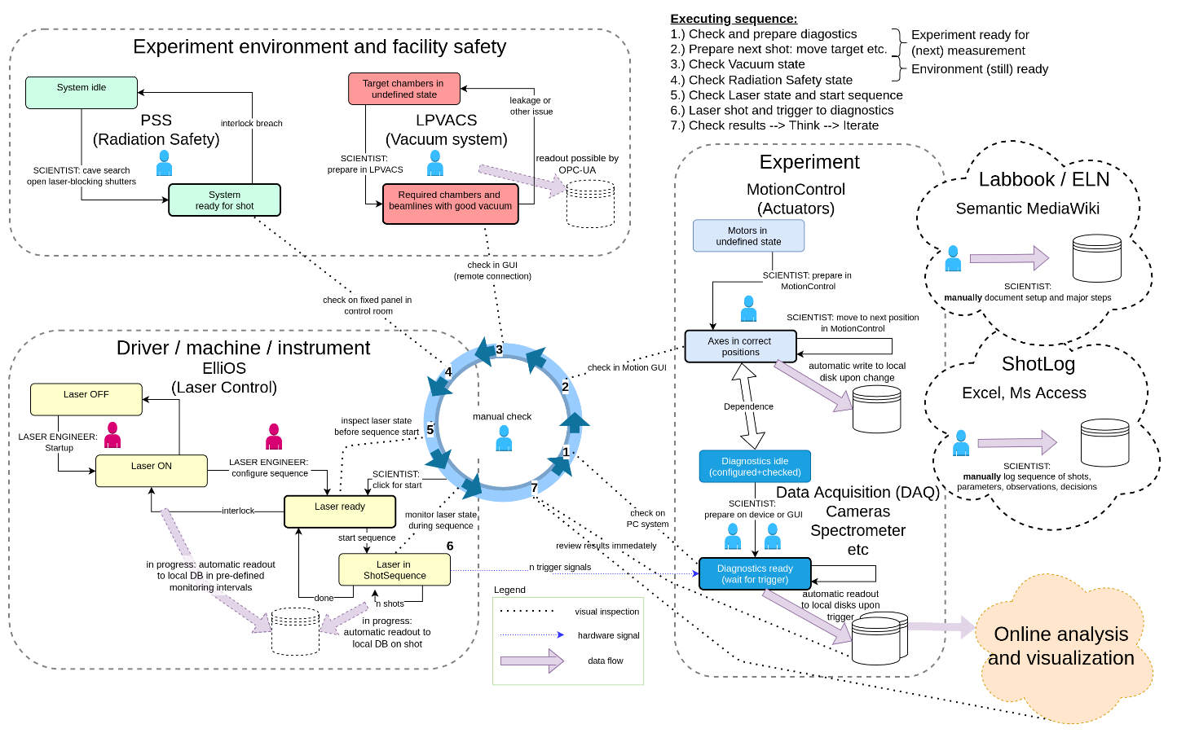
Experiment laser shot cycle and data flow

Slide 6
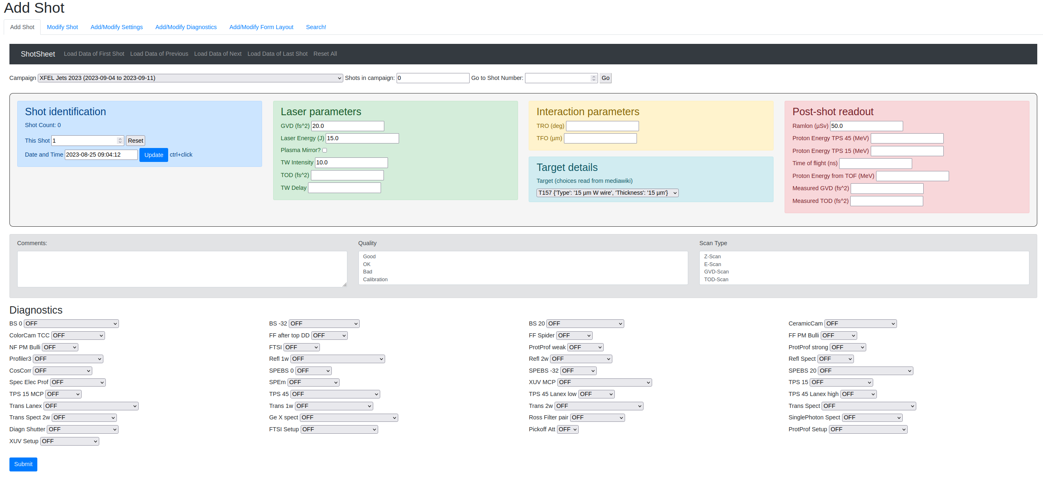
Customized Meta/Data-Logging
Tabs for tasks
Data fields, in groups
Metadata fields
Annotations: Comments and tags
States of each device

Slide 7
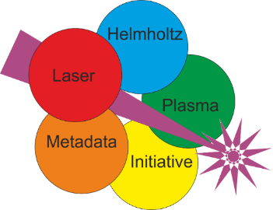
LPA data-management efforts
Data
Tools
and
automation
Domain-specific standard
Data repository
Electronic Lab Documentation
Simulations
Experiments
Metadata
Metadata catalogue

Slide 8
Metadata at LPA
Experiments
raw data often images
no experimental technique ontology yet, but plan to add to PANET (in DAPHNE 2.0)
draft glossary of experiment metadata in HELPMI, trials to match with NeXus ontology items
also trials to find existing ontologies for reuse / to identify LPA-specific terms
laser system (meta)data
timing data, setup data, data conversion/calibration (2D image of dispersed beam to 1D spectra of species)
samples (cold target)
Simulations
openPMD exists, developed also at HZDR
ontology is drafted (from drawing board, needs community involvement)
PICMI is developed further, describing simulation input/setup → methods ontology?

