Slide 1



Quadruplexes in DNA Nanotechnology for non-enzymatic nucleic acid diagnostics
"GGSB 2025 meeting@HZDR: QUALI-Start-Up Lectures“. HZDR, Dresden, Germany
Nika Chakhunashvili
about the author:
4th year bachelor Biophysics student of Ilia State University
2022 – 2024: Worked as an assistant researcher in the Center for Theoretical Astrophysics of Iliauni, specializing in spectral analysis for the x-ray emissions by pulsars with XSpec program. Research circulated around developing synchrotronic models for high energy emission generations by pulsars.
2024 – Present: Currently Work as an assistant researcher in the Institute of Biophysics of Iliauni. My specialty revolves around the spectrophotometric analysis, mainly in UV/Vis region, followed by fluorescence spectroscopy. Studied the applications of quadruplexes in diagnostics.
2025 – Present: Currently participating in practical astronomy projects at Abastumani Observatory in Georgia, working on the development of the new assessment method for exoplanets that tells us if they can possibly sustain life.
nika.chakhunashvili.1@iliauni.edu.ge
Fields of interest: Biophysics, Therapeutics, Diagnostics, Astrobiology.

Slide 2
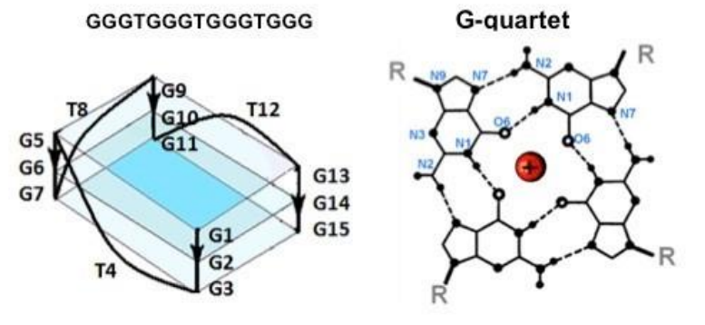
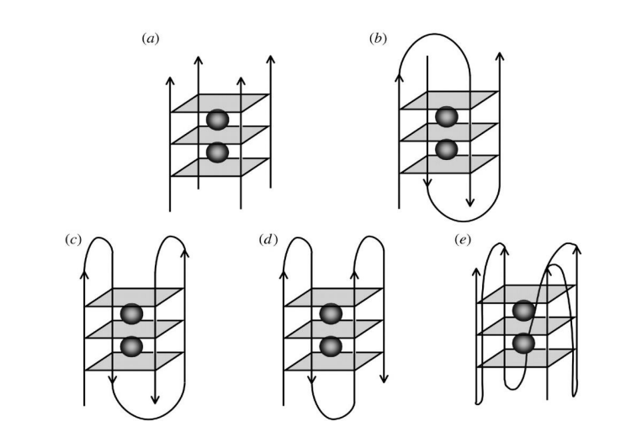
Quadruplexes and their structures:
The sequence determines the structure of DNA/RNA.
Quadruplexes are guanine rich secondary structures made of G-quartets.
Cations (such as potassium) determine the folding on nucleic acids.
Study of secondary structures are conducted by spectrometric studies. Nucleic acids are best seen in UV region. Quadruplexes are studied at 295 nm.
Quadruplexes can be parallel or antiparallel in structure. Can be formed with one or multiple strands or DNA.
Nika Chakhunashvili (Ilia State University). 21/08/2025; nika.chakhunashvili.1@iliauni.edu.ge

Slide 3
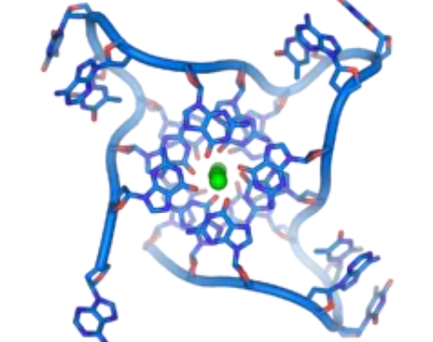
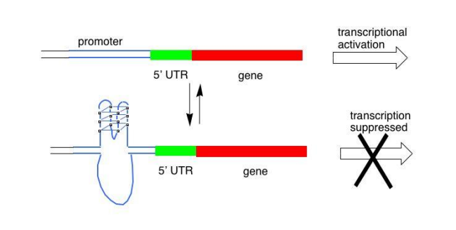
Quadruplexes and their biological role:
Quadruplexes are mainly detected in telomeric regions due to guanine rich requence: TTAGGG.
Takes part in gene regulation and expression.
Bugaut A, Balasubramanian S (2012). "5'-UTR RNA G-quadruplexes: translation regulation and targeting.". Nucleic Acids Res. 40 (11): 4727–41.
Nika Chakhunashvili (Ilia State University). 21/08/2025; nika.chakhunashvili.1@iliauni.edu.ge

Slide 4
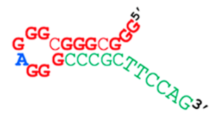
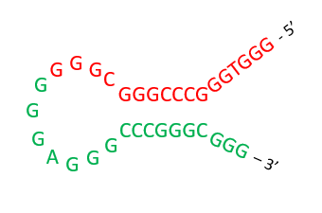
Hairpins and their structures:
N/N05: 5’ –GGGCGGGCGGGAGGGCCCGCTTCCAG – 3’
Hairpin represents the structure that can fold onto itself, creating the loop.
The hairpin consists of thee parts: loop, stem and toehold.
They are studied in spectrometry within UV region, 260 nm.
N/N02: 5’ – GGGTGGGCCCGGGCGGGGGGAGGGCCCGGGCGGG – 3’
Nika Chakhunashvili (Ilia State University). 21/08/2025; nika.chakhunashvili.1@iliauni.edu.ge

Slide 5
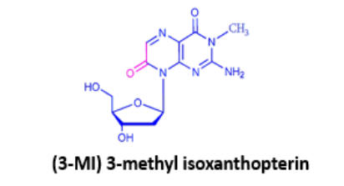
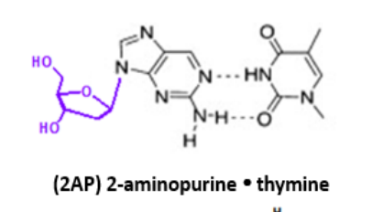
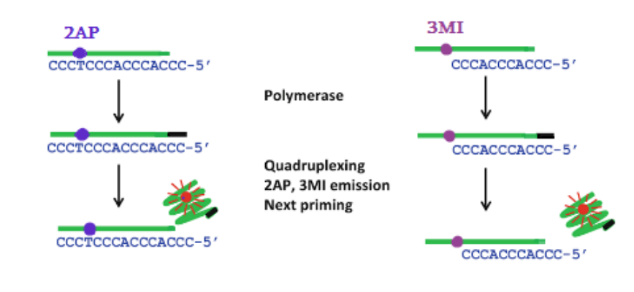
QPA (Quadruplex Primer Amplification)
G3T sequence is used for QPA . It self-forms into a quadruplex in the presence of potassium, as it is preferred over duplexes . The primer, which is a truncated version of G3T , was designed to self-fold into a quadruplex.
For detection, 3-methyl isoxanthopterin (3MI ) or 2-aminopurine ( 2AP ) is used . It is inserted into the fourth position of the primer.
The target molecule, CCCACCACCCC , is required . which is complementary to the primer and binds to the primer and deoxyguanosine triphosphate ( dGTP ) .
Buffers ( e.g., magnesium and potassium ions) are also needed.
Nika Chakhunashvili (Ilia State University). 21/08/2025; nika.chakhunashvili.1@iliauni.edu.ge

Slide 6
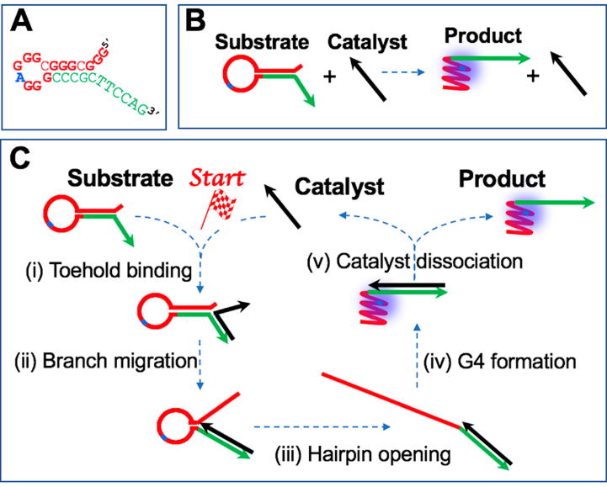
Quadruplexes in non-enzymatic diagnostics
Current research is focused on non-enzymatic, isothermal diagnostic methods.
Based on structural transformation ( ST ) from herpin to quadruplex.
is a thermodynamically irreversible process.
Kankia , B. (2020) Quadruplex -Based Reactions for Dynamic DNA Nanotechnology. J. Phys. Chem. B 2020, 124, 4263-4269.
Nika Chakhunashvili (Ilia State University). 21/08/2025; nika.chakhunashvili.1@iliauni.edu.ge

Slide 7
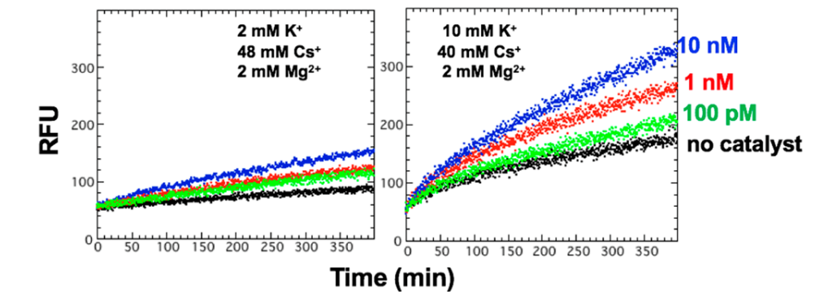
Quadruplexes in non-enzymatic diagnostics
The graph shows fluorometric studies of the ST reaction.
The reaction is a linear reaction, which is why it takes a long time to obtain a strong signal, unlike PCR .
In the absence of catalyst, signal leakage is evident, especially at high potassium.
Kankia , B. (2020) Quadruplex -Based Reactions for Dynamic DNA Nanotechnology. J. Phys. Chem. B 2020, 124, 4263-4269.
Nika Chakhunashvili (Ilia State University). 21/08/2025; nika.chakhunashvili.1@iliauni.edu.ge

Slide 8
Quadruplexes in non-enzymatic diagnostics
N/N05: 5’ –GGGCGGGCGGGAGGGCCCGCTTCCAG – 3’
Hairpin represents the structure that can fold onto itself, creating the loop.
The hairpin consists of thee parts: loop, stem and toehold.
The difference is that N/N05 It forms a quadruplex only from the red region and the green region does not participate, while in N/N02 , the entire part of the herpin participates and two quadruplexes are obtained.
Blue adenine represents 2 - aminopurine (2AP), a fluorescent nucleotide, analog of adenine.
N/N02: 5’ – GGGTGGGCCCGGGCGGGGGGAGGGCCCGGGCGGG – 3’
Nika Chakhunashvili (Ilia State University). 21/08/2025; nika.chakhunashvili.1@iliauni.edu.ge

Slide 9
Quadruplexes in non-enzymatic diagnostics
Melting experiments were performed on a Varian Cary 100 Bio UV-Vis spectrophotometer . DNA concentration 4 µM , buffer 10 mM Tris-HCL , [Mg ²⁺ ] = 2 mM remains unchanged, while the concentrations of potassium and cesium are varied so that the ratio between them is always the same and the total concentration is 50 mM. DNAs were purchased from Integrated DNA Technologies .
The temperature change was 1 ⁰ C per minute, from 35 ^{0 C} to 95 ⁰ C. And then going down again. During this change, absorption measurements were taken.
Nika Chakhunashvili (Ilia State University). 21/08/2025; nika.chakhunashvili.1@iliauni.edu.ge

Slide 10
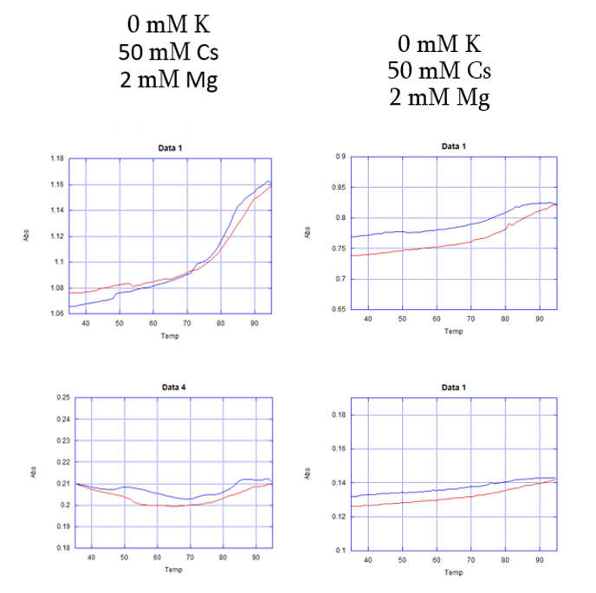

Quadruplexes in non-enzymatic diagnostics
N/N02 N/N05
+
+
2+
+
+
2+
The red curve represents the melting curve, while the blue curve represents the cooling curve.
was performed without potassium, resulting in no significant Significant changes in melting .
260 nm
295 nm
Nika Chakhunashvili (Ilia State University). 21/08/2025; nika.chakhunashvili.1@iliauni.edu.ge

Slide 11
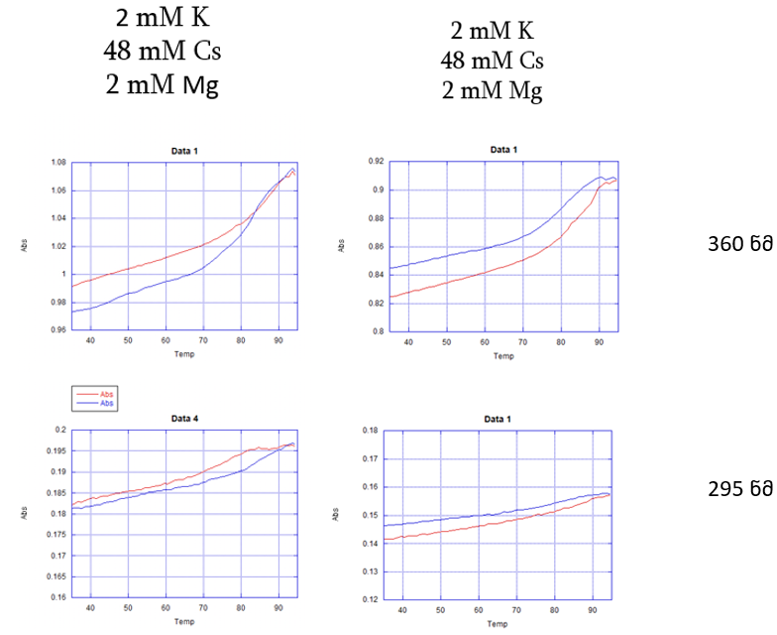
Quadruplexes in non-enzymatic diagnostics
N/N02 N/N05
+
+
2+
+
+
2+
260 nm
295 nm
The red curve represents the melting curve, while the blue curve represents the cooling curve.
the potassium level of 2 mM, no significant changes are visible yet.
Nika Chakhunashvili (Ilia State University). 21/08/2025; nika.chakhunashvili.1@iliauni.edu.ge

Slide 12
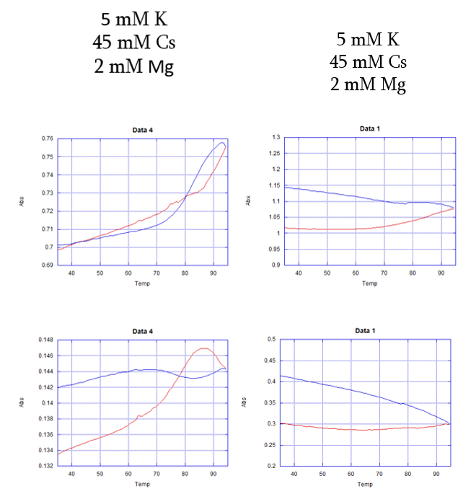
Quadruplexes in non-enzymatic diagnostics
N/N02 N/N05
+
+
2+
+
+
2+
The red curve represents the melting curve, while the blue curve represents the cooling curve.
5 mM potassium. significant changes in absorbance are already visible, especially at 295 nm, as the quadruplexes begin to fold.
260 nm
295 nm
Nika Chakhunashvili (Ilia State University). 21/08/2025; nika.chakhunashvili.1@iliauni.edu.ge

Slide 13
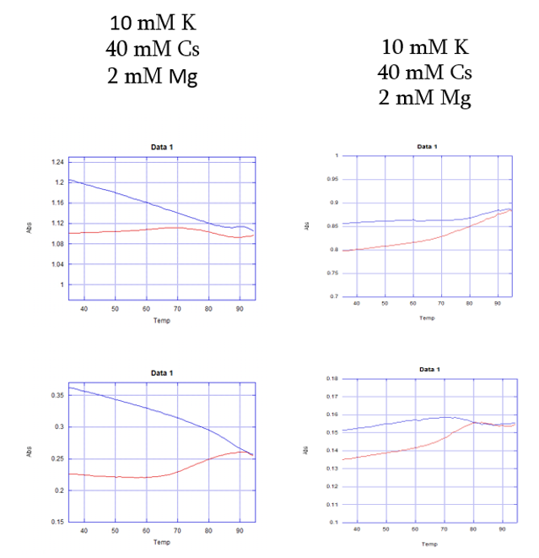
Quadruplexes in non-enzymatic diagnostics
N/N02 N/N05
+
+
2+
+
+
2+
260 nm
295 nm
The red curve represents the melting curve, while the blue curve represents the cooling curve.
Potassium 10 mM .
The absorptions increases, hence we have more stable folding of the quadruplex.
Nika Chakhunashvili (Ilia State University). 21/08/2025; nika.chakhunashvili.1@iliauni.edu.ge

Slide 14
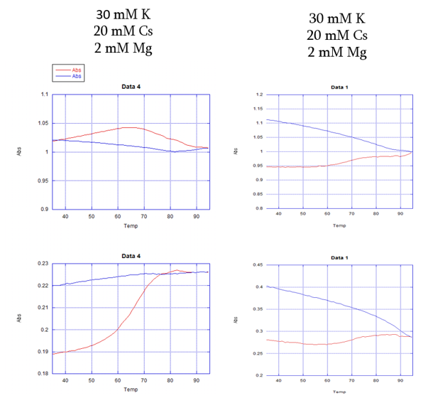
Quadruplexes in non-enzymatic diagnostics
N/N02 N/N05
+
+
2+
+
+
2+
The red curve represents the melting curve, while the blue curve represents the cooling curve.
Potassium 30 mM.
It is already apparent that the N/N02 absorptions at 295 nm are already starting to plateau, indicating that most of the quadruplexes are already folded .
260 nm
295 nm
Nika Chakhunashvili (Ilia State University). 21/08/2025; nika.chakhunashvili.1@iliauni.edu.ge

Slide 15
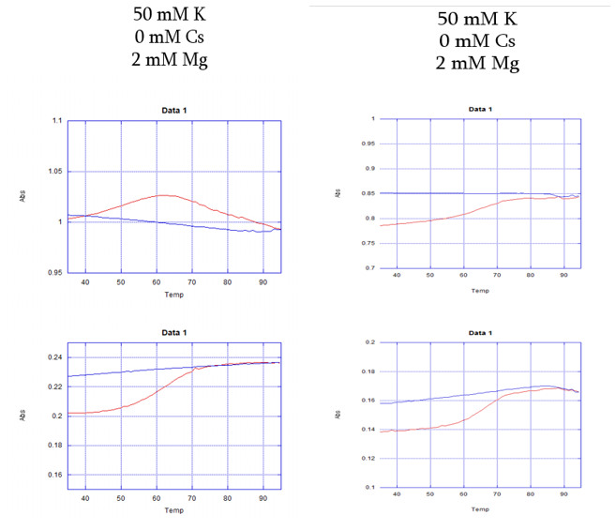
Quadruplexes in non-enzymatic diagnostics
N/N02 N/N05
+
+
2+
+
+
2+
The red curve represents the melting curve, while the blue curve represents the cooling curve.
Potassium 50 mM .
For both herpins, a plateau in the cooling curves is observed at 295 nm, which means that all possible herpins have folded into a quadruplex, hence no change in absorbance is observed.
260 nm
295 nm
Nika Chakhunashvili (Ilia State University). 21/08/2025; nika.chakhunashvili.1@iliauni.edu.ge

Slide 16
Quadruplexes in non-enzymatic diagnostics
Conclusion: The double quadruplex structure of N/N02 is a thermally more stable structure than N/N05. Therefore, it has the potential to accelerate the linear ST reaction.
ST reaction of N/N02 with an appropriate catalyst should be investigated . It should be investigated what the signal leakage would be in the absence of a catalyst.
The non-enzymatic reaction has the potential to be used in Point-of-Care (POC) diagnostics as an efficient and inexpensive method.
Nika Chakhunashvili (Ilia State University). 21/08/2025; nika.chakhunashvili.1@iliauni.edu.ge

Slide 17
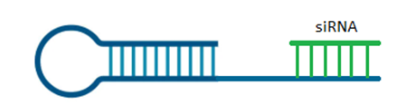
Future prospects – Exponential diagnostics
Modification of DNA hairpin is needed to turn the reaction into exponential.
Idea is about adding artificial catalyst to the DNA hairpin. Once the pathogen is found in the sample, both will be released.
Modification of DNA hairpin is needed to turn the reaction into exponential.
Idea is about adding artificial pathogen to the DNA hairpin. Once the pathogen is found in the sample, both will be released.
catalyst
G3N catalyst comp
Nika Chakhunashvili (Ilia State University). 21/08/2025; nika.chakhunashvili.1@iliauni.edu.ge

Slide 18
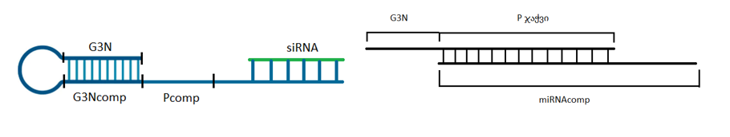
Future prospects – Therapeutic applications
The same ST reaction can be used for therapeutic applications if we modify the DNA structures to suit them for specific miRNAs and siRNAs.
G3N miRNA comp
Nika Chakhunashvili (Ilia State University). 21/08/2025; nika.chakhunashvili.1@iliauni.edu.ge

Slide 19

Future prospects – Biological role
It is possible to study the biological roles of quadruplexes at Iliauni labs. Specifically in neurodevelopmental disorders, like Rett’s syndrome.
Rett’s syndrome is caused by the mutation in MECP2 gene.
MECP2 protein is needed for appropriate function of neuron cells.
Quadruplex forming sequence in the promoter region of MECP2 gene.
Bagga, J. S., & D’Antonio, L. A. (2013). Role of conserved cis-regulatory elements in the post-transcriptional regulation of the human MECP2 gene involved in autism. Human Genomics, 7(1). https://doi.org/10.1186/1479-7364-7-19
Nika Chakhunashvili (Ilia State University). 21/08/2025; nika.chakhunashvili.1@iliauni.edu.ge

Slide 20
Thank you for your attention!
Nika Chakhunashvili (Ilia State University). 21/08/2025; nika.chakhunashvili.1@iliauni.edu.ge

