Slide 1




Developing an Air Quality and Ecological Monitoring Network in Georgia
Kato Melikidze

Slide 2
Education
Ilia State University, Tbilisi, Georgia
3rd year Bachelor student in Ecology
Warsaw University of Life Sciences, Poland
Erasmus+ Exchange Program
Tbilisi State Conservatoire, Seminary
Musical theory, piano performance
Creative Education Studio (CES), Tbilisi, Georgia
Audio Engineering
National Technical Training Program
Installation and Maintenance of Automatically
Controlled Hybrid Energy Systems

Slide 3

Projects
Ilia State University
Entomology Lab – volunteer
Science Popularisation Project- mobile lab in regions
Determination of Wood Density and Related Parameters for Tree Genera
Assessment of Red List Forest Species of Georgia
Check list for Georgian flora
National Forest Inventory in Georgia
Member of NARI - (Network of Amateur Researchers Inquiry)
Green Pole
Eco Tips Book - Part 1,2,3,4
Monitoring of Stone Dry Cutting in Tbilisi
Civil Air Quality Monitoring System Setup

Slide 4
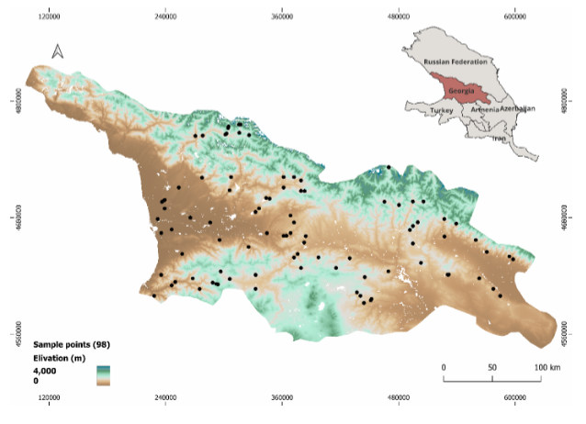
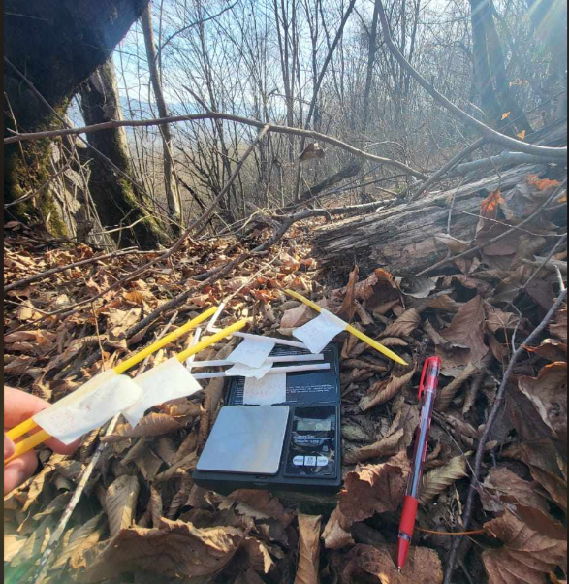

Slide 5
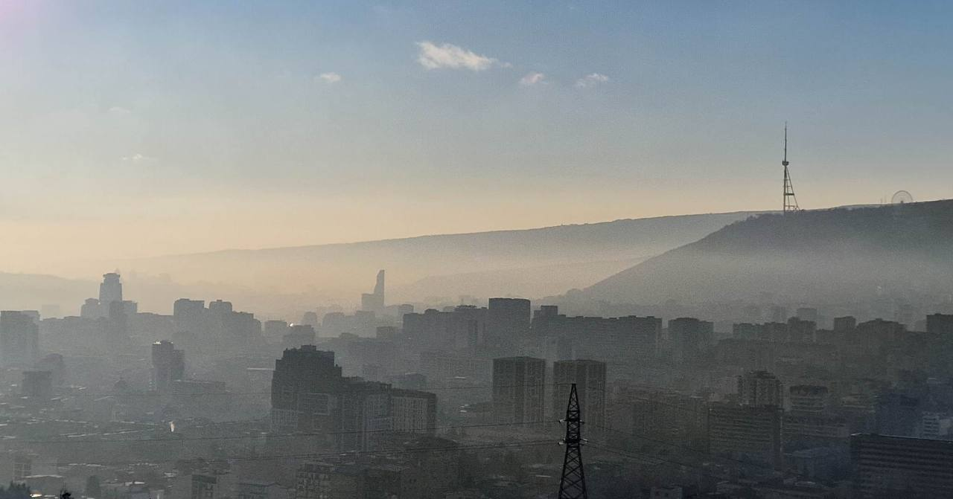
Tbilisi
Photo by: my city kills
Main source of pollution - industrial activities, construction, vehicle emmisions
1.3 million citizen -
721,992 registered vehicles
Main pollutant - PM

Slide 6
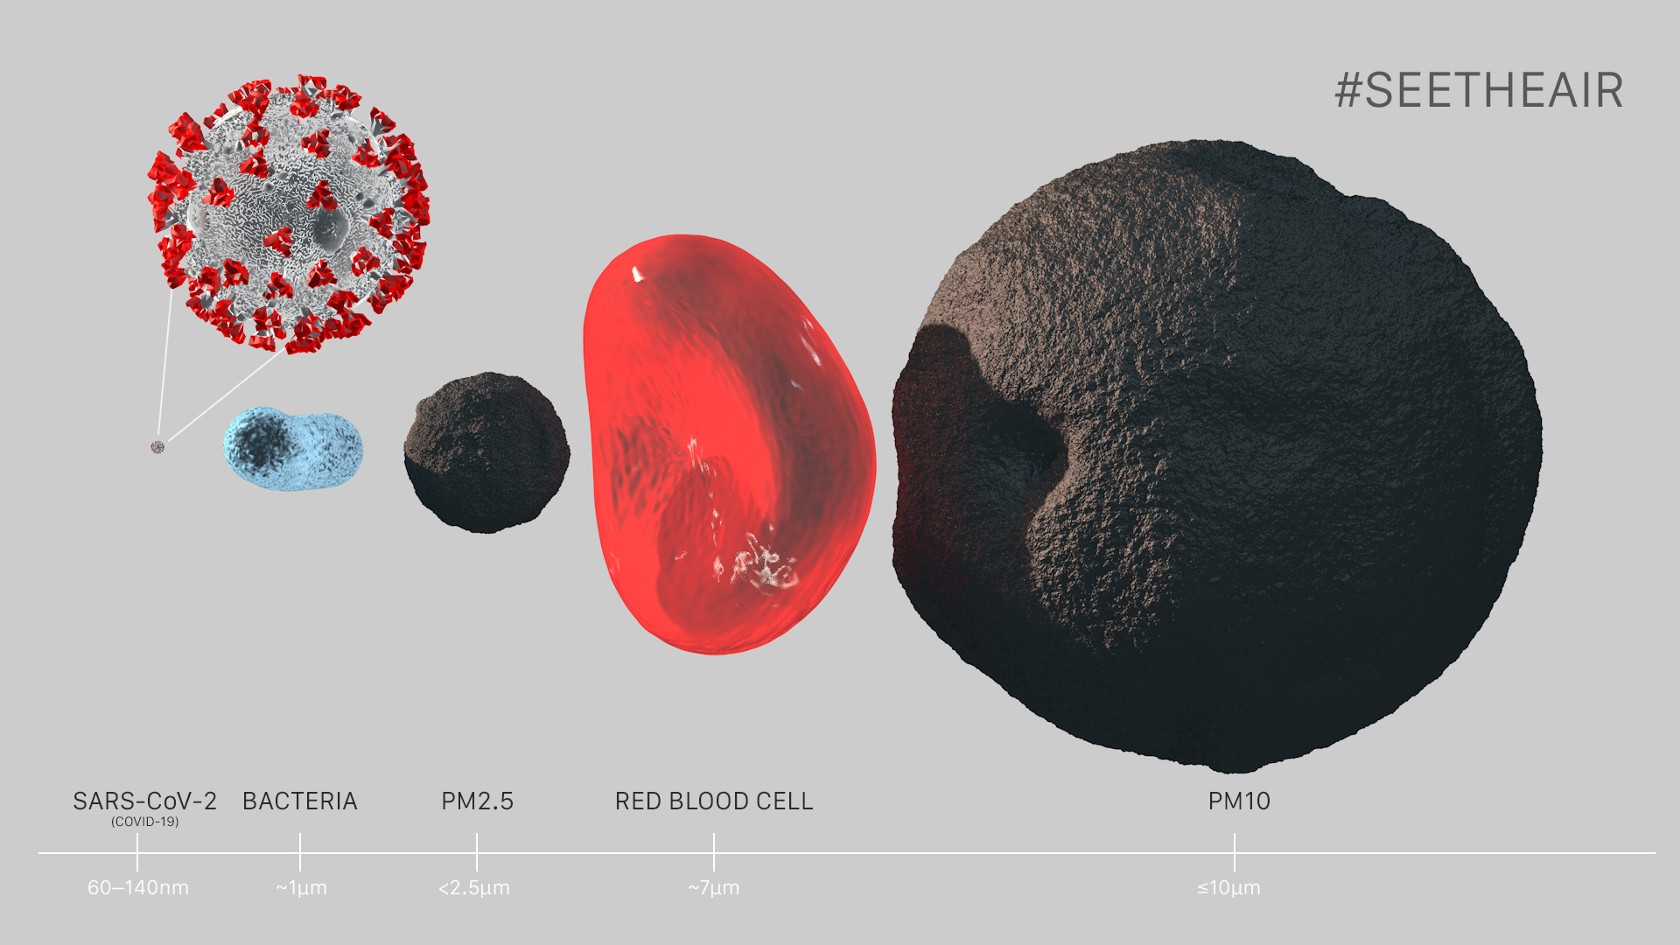
Concentration of PM2.5 in the air exceeds the WHO's norm by 7.6 times
https://seetheair.org/2022/05/16/particulate-matter-pm2-5-mega-guide/

Slide 7
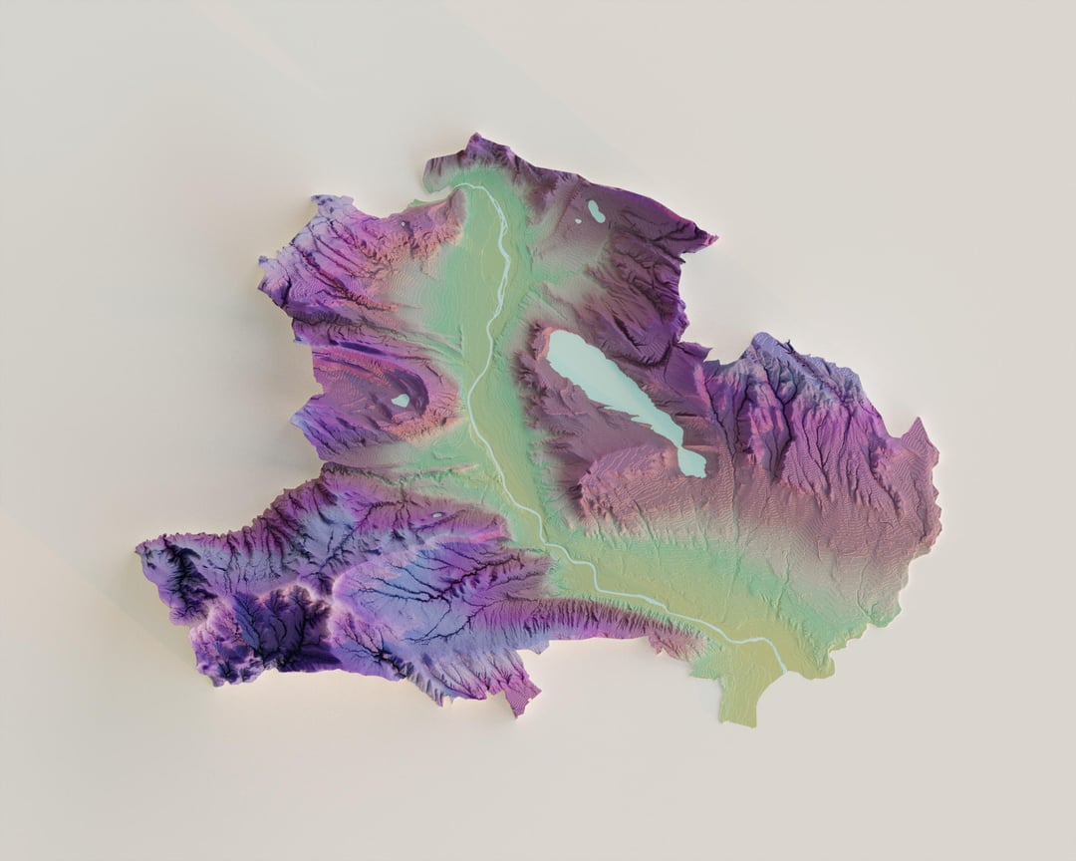
Tbilisi
https://www.reddit.com/r/tbilisi/comments/14qgdef/tbilisi_shaded_relief_map_highlights_the_terrain/#lightbox

Slide 8
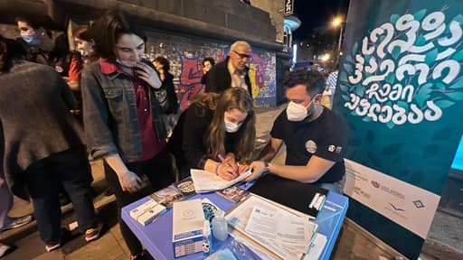
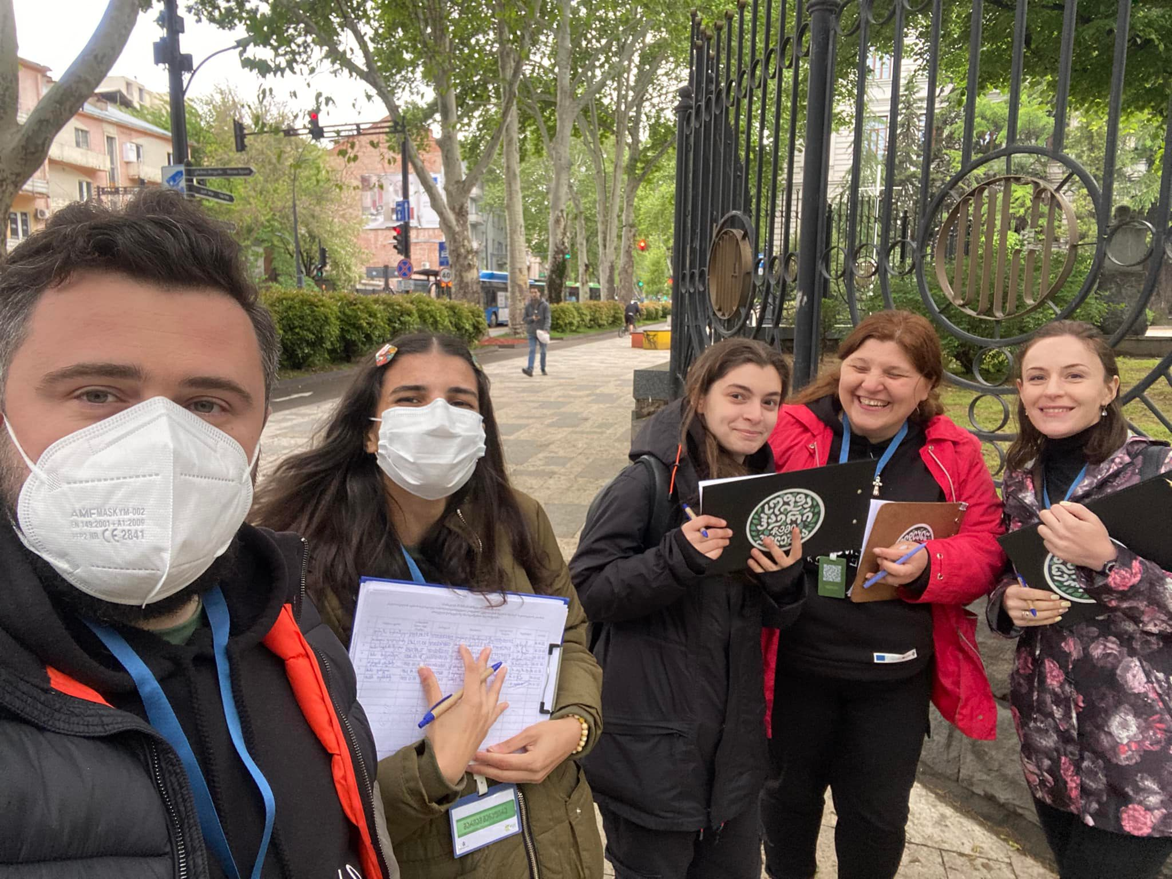
Enforcement Mechanism

Slide 9
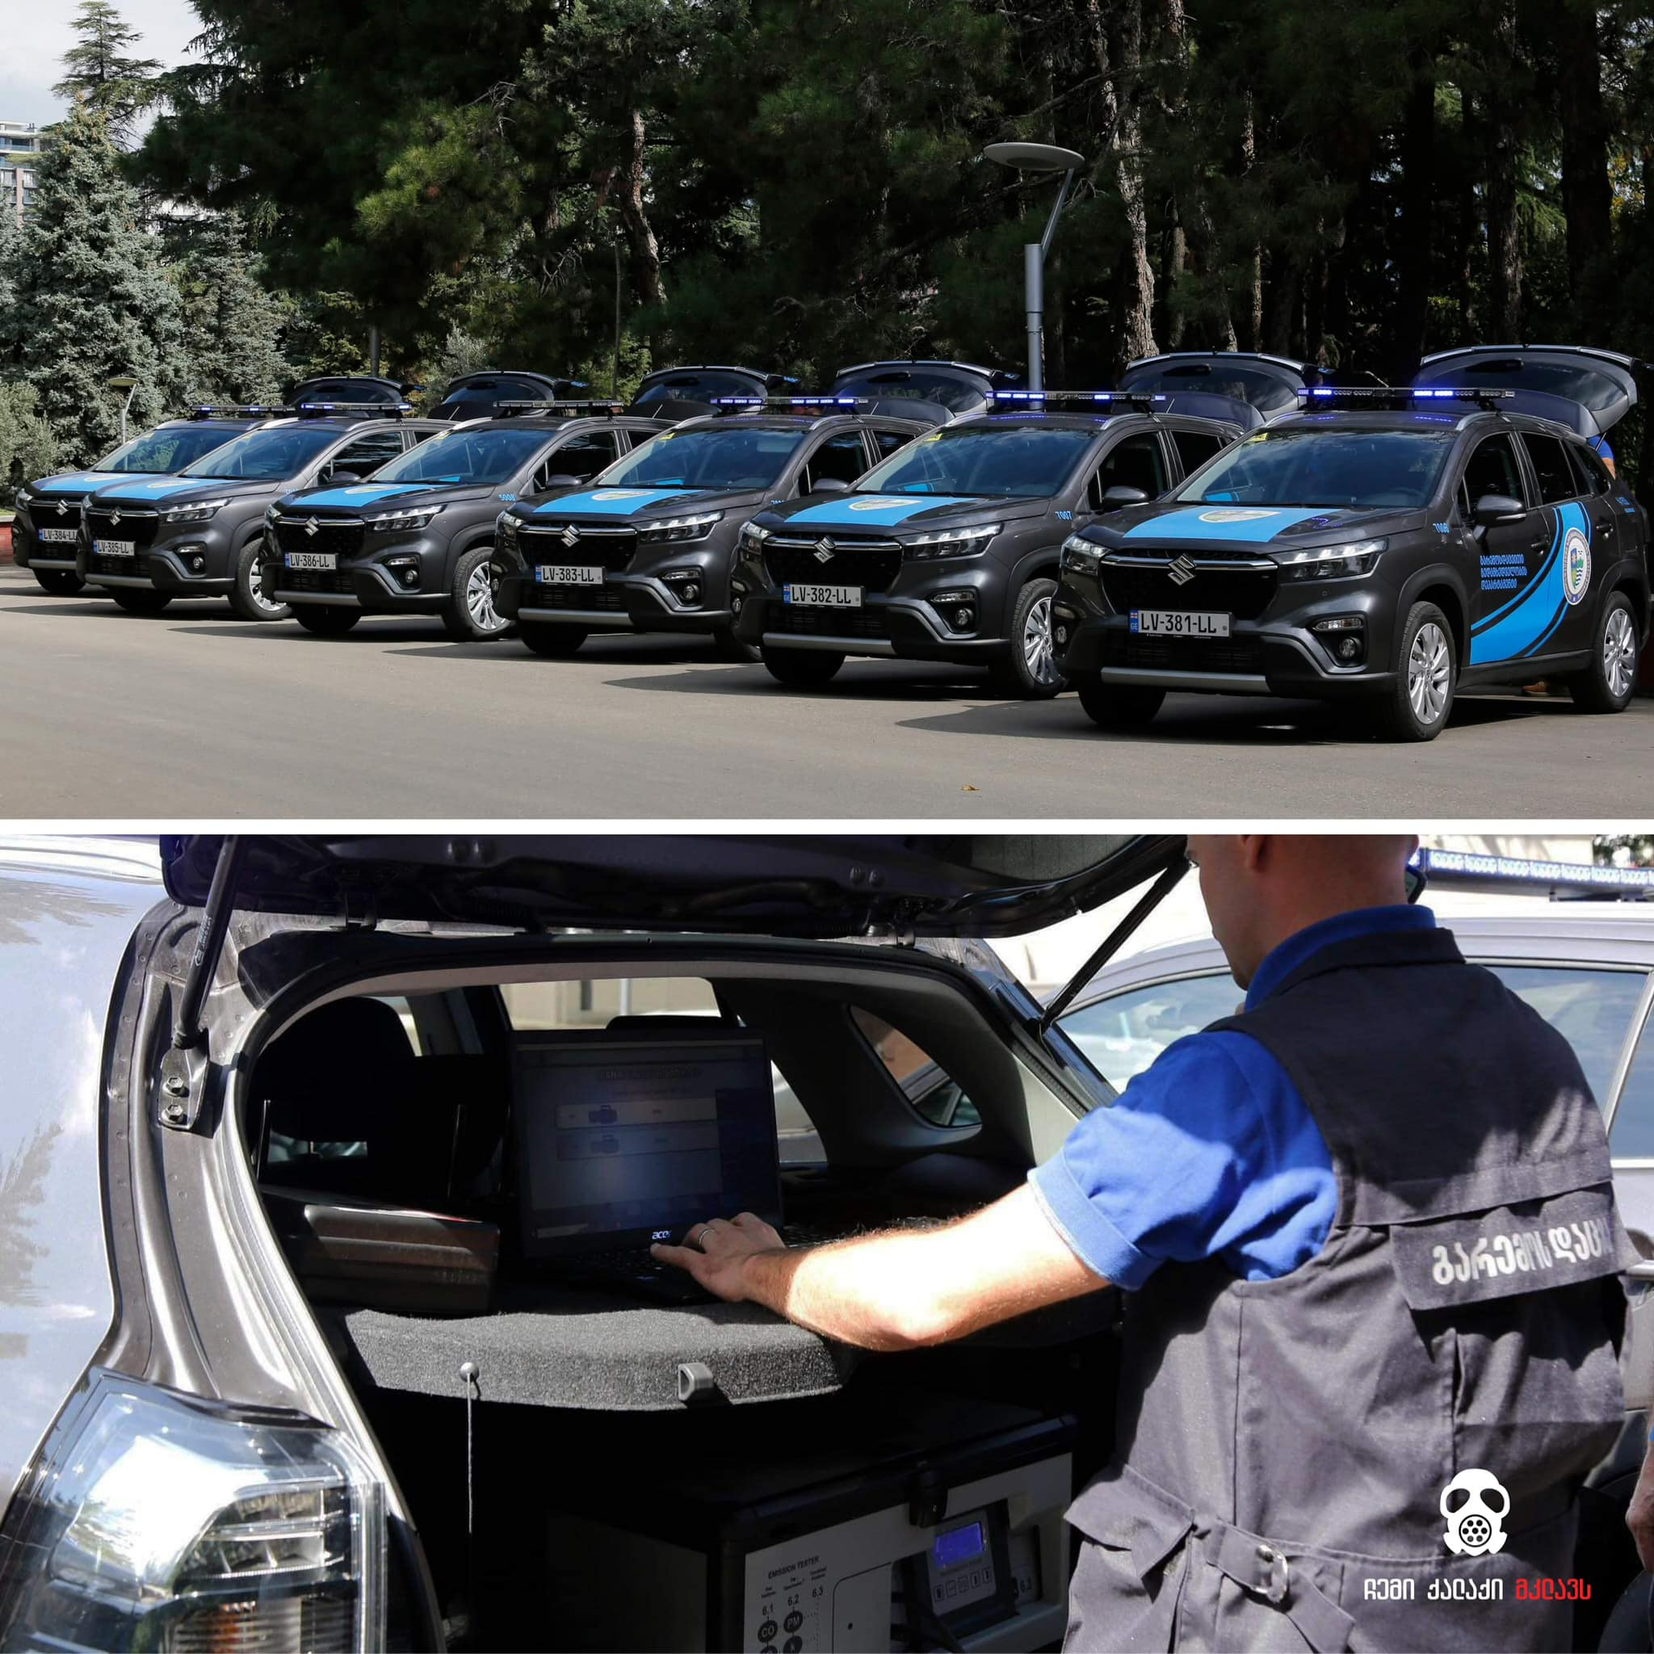
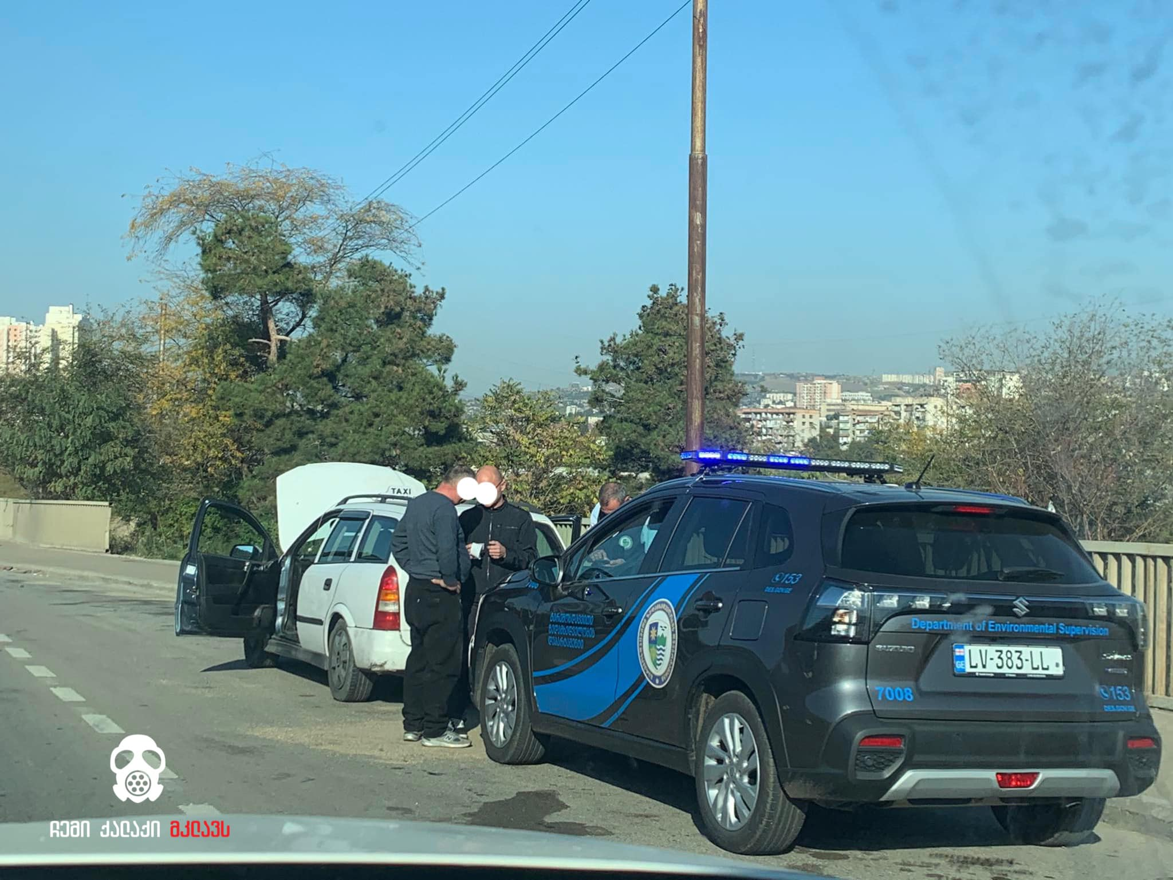
Enforcement Mechanism

Slide 10
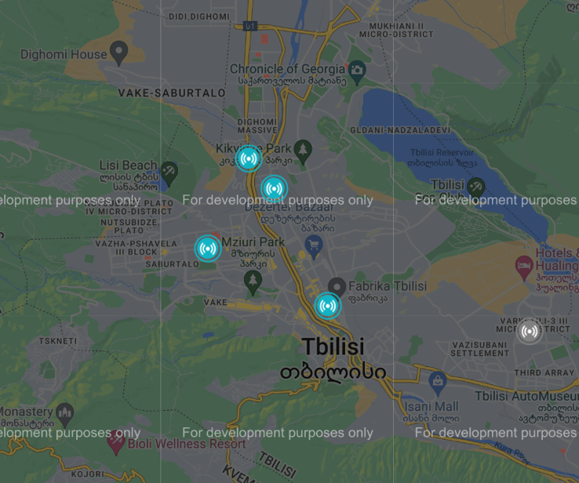
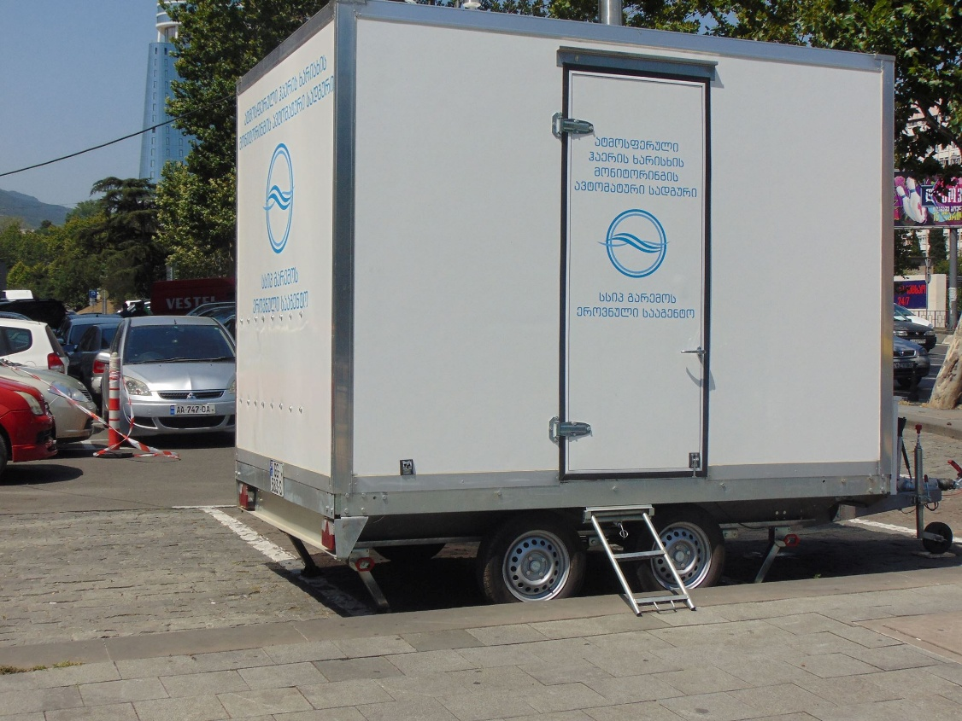
Govermental Emission Monitoring Stations
Govermental Emission Monitoring Stations
7 Stations in Georgia
4 in Capital – Tbilisi
https://air.gov.ge/

Slide 11
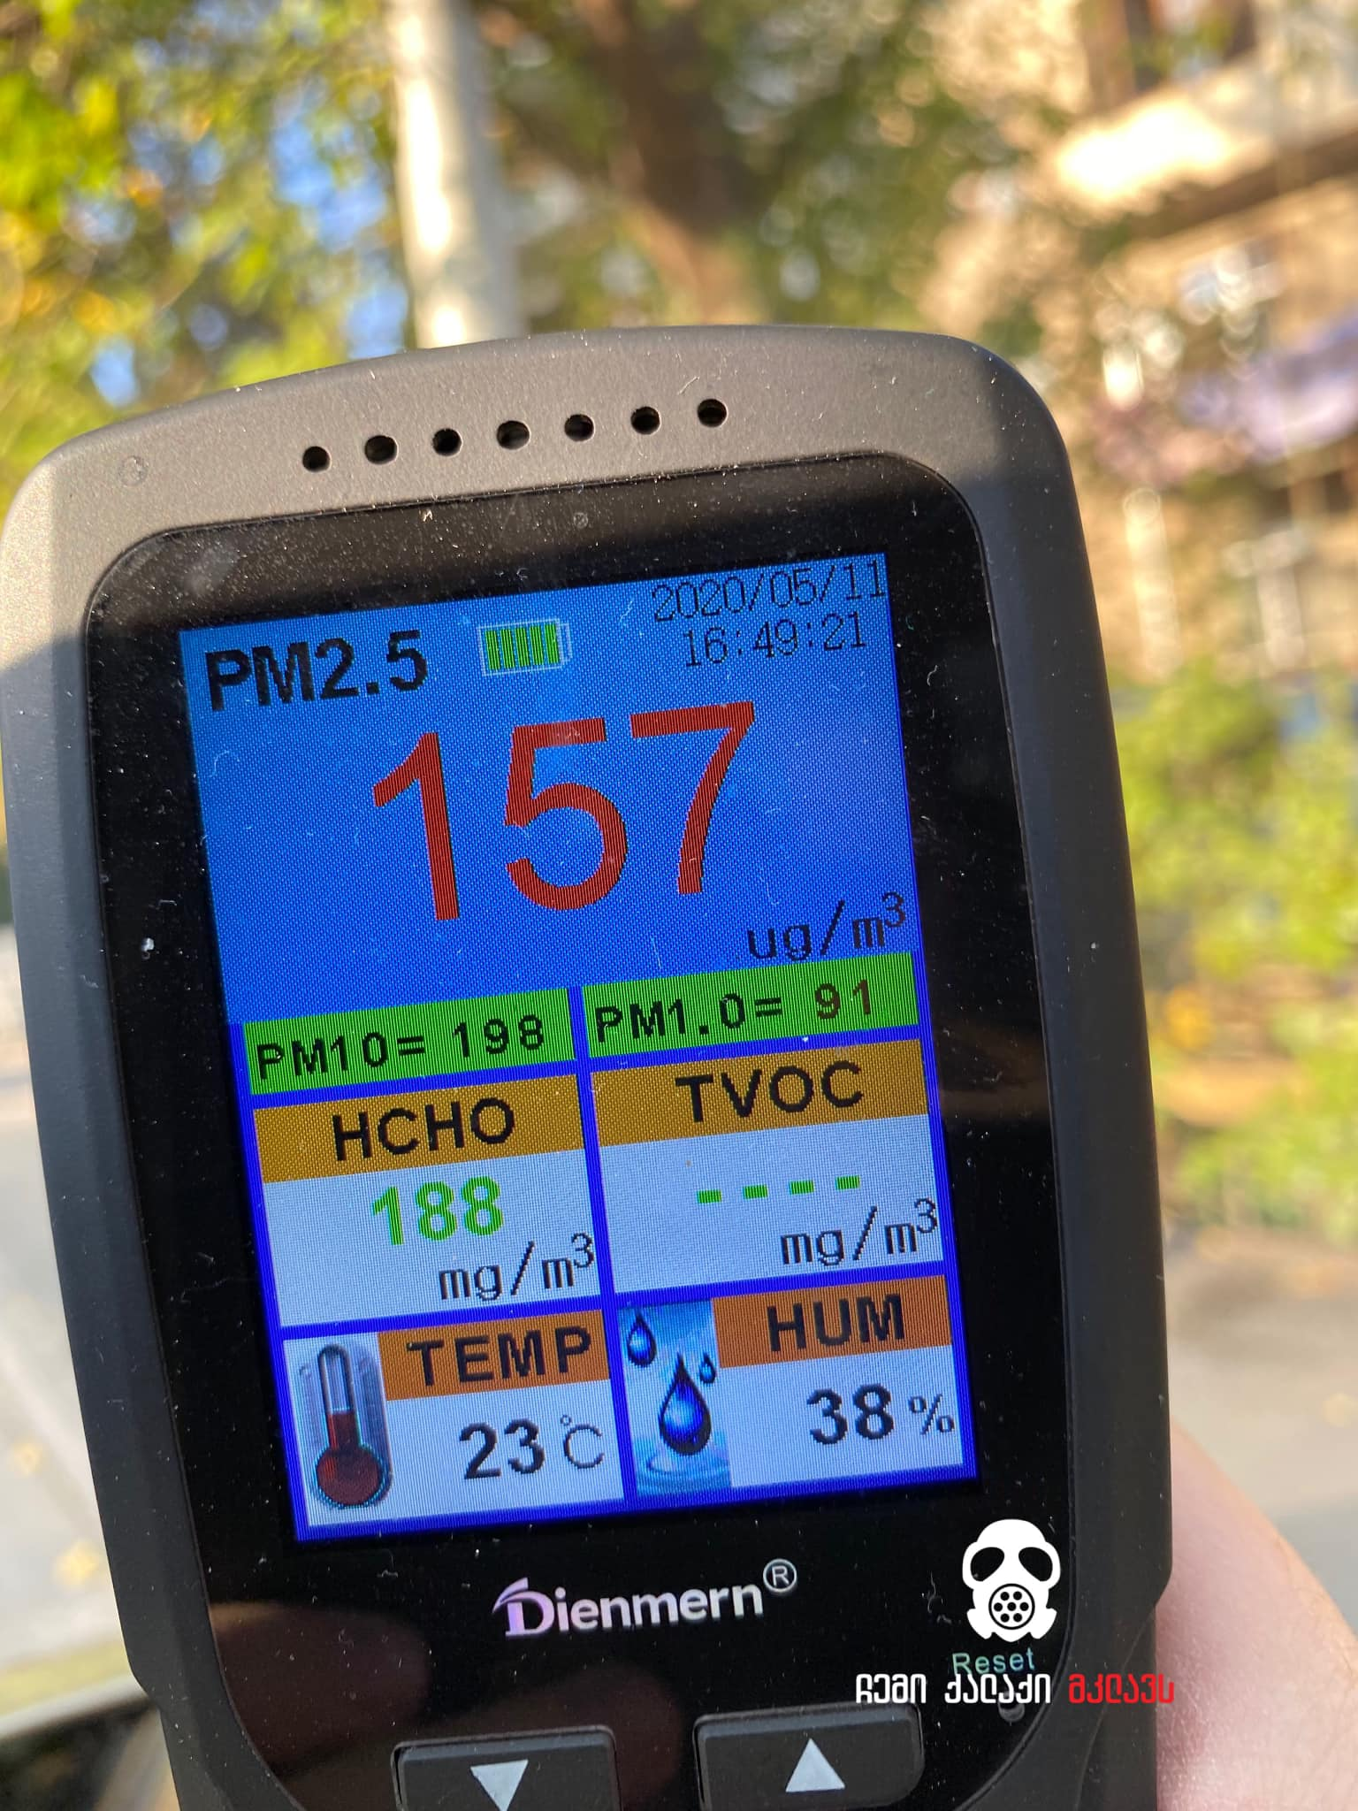
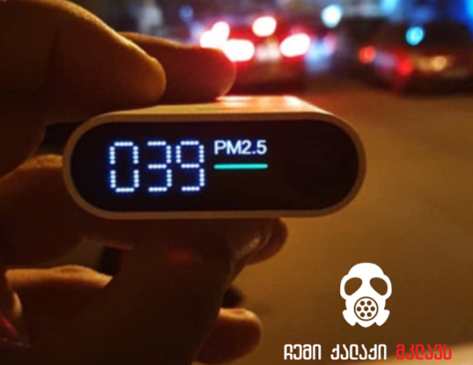

Slide 12

Cometer
An air quality monitoring device, developed by volunteers in Georgia
Measures:
PM1, PM2.5, PM10
VOC (Volatile Organic Compounds)
Nox
Temperature
Humidity
Pressure
3D-printed box
Microcontroller mainboard
SEN55 sensor

Slide 13
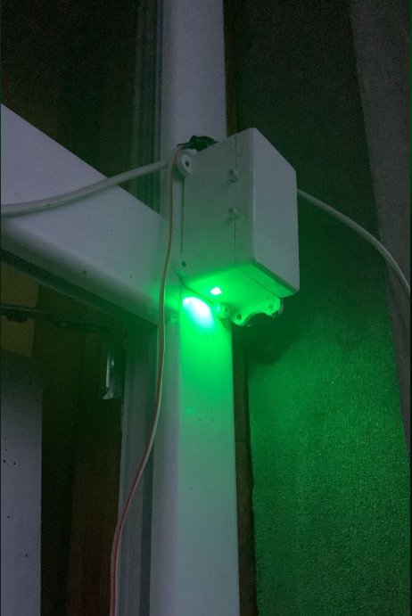
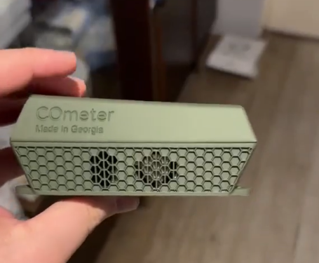
Our “COmeter“

Slide 14
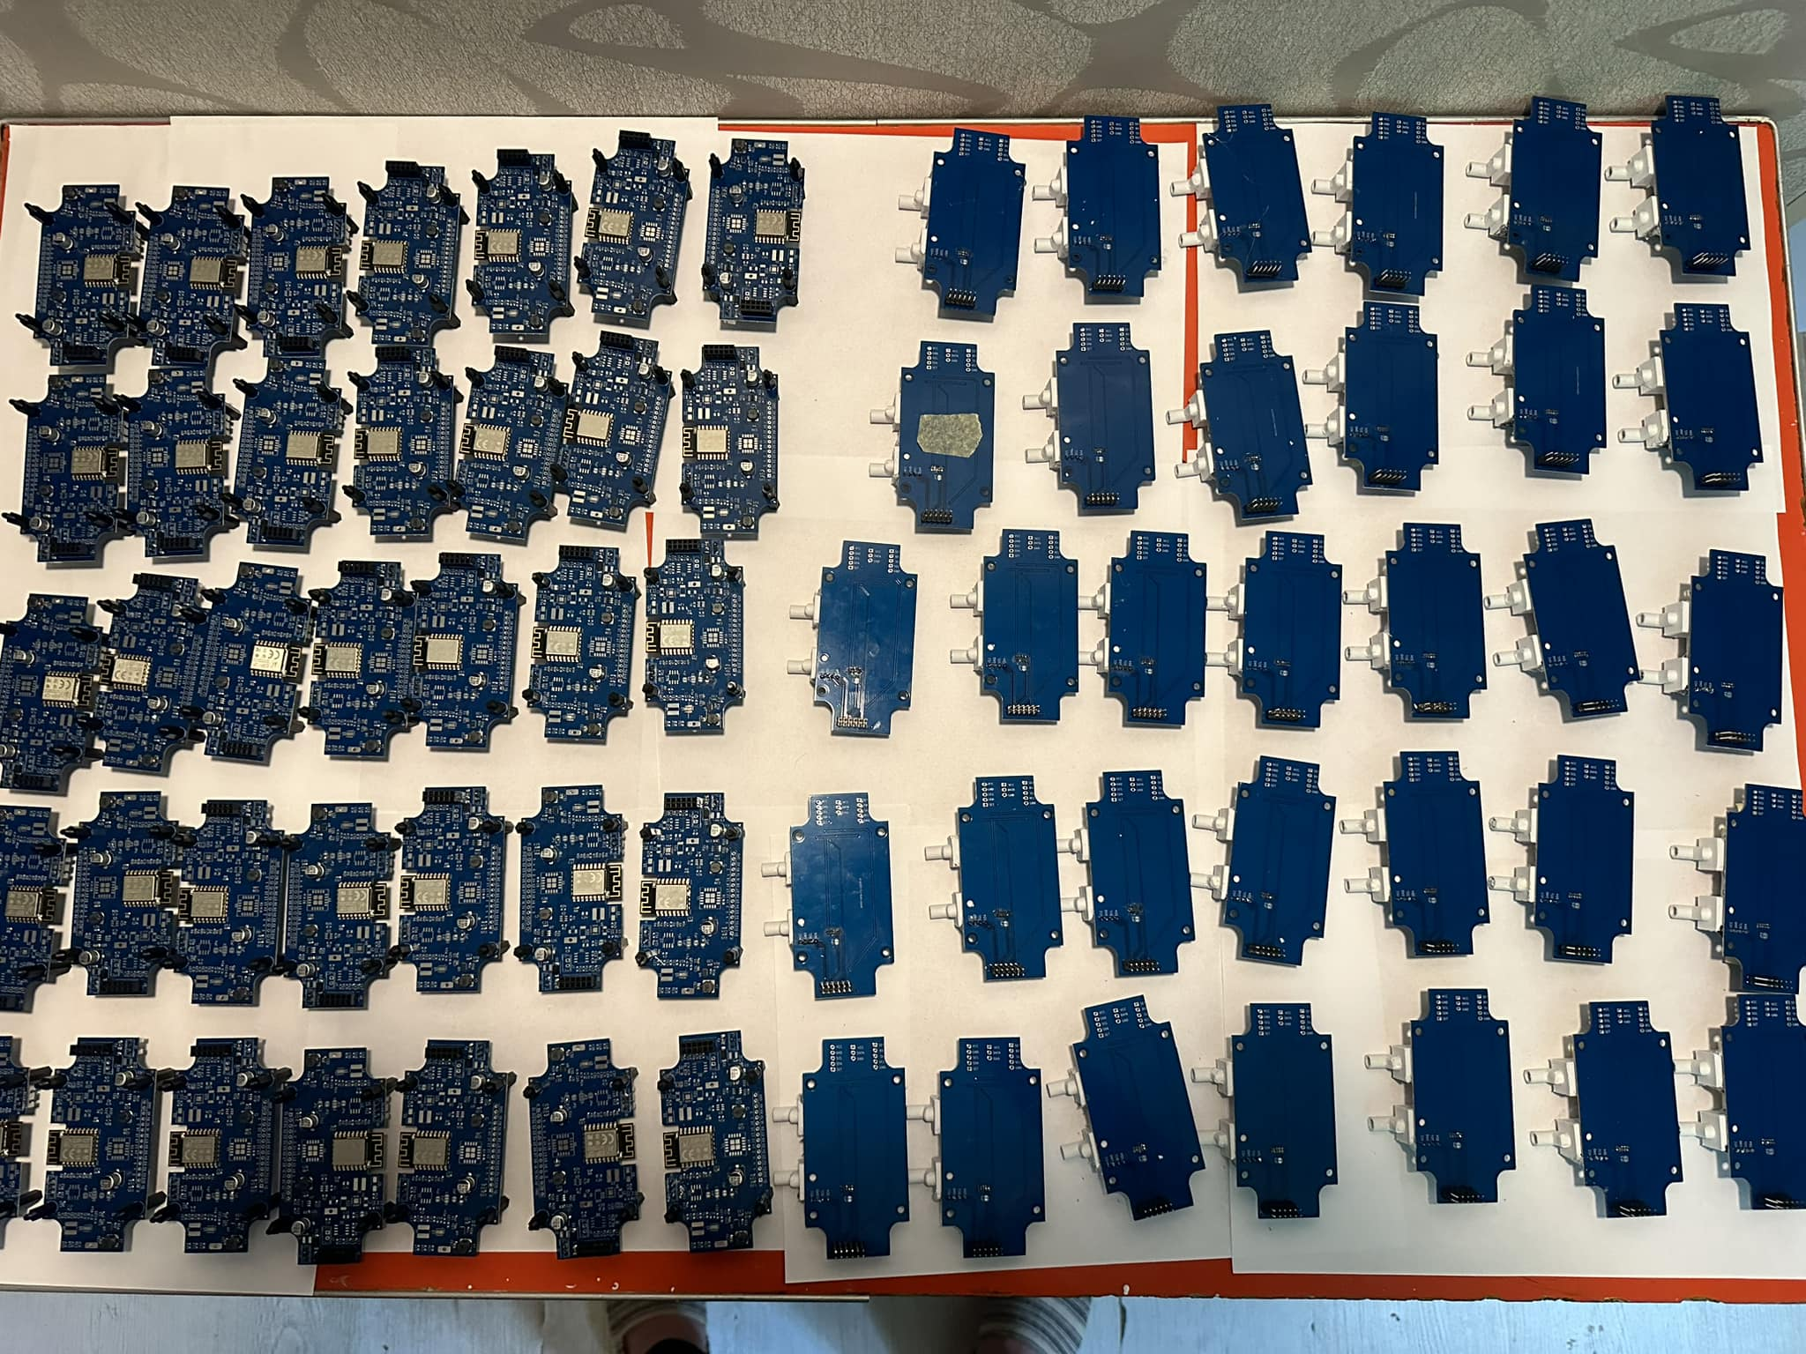
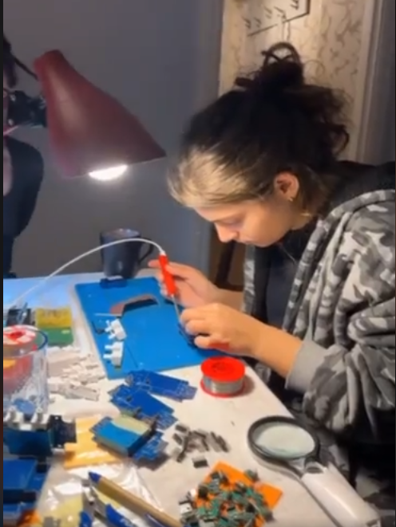
Our sensors

Slide 15
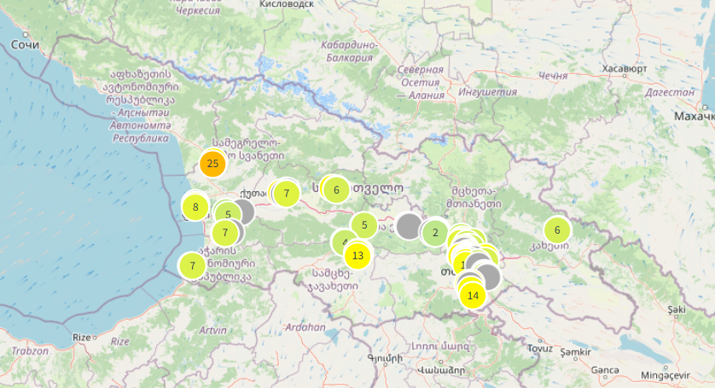
Air Quality Map
Installed in 14 cities
Total of 113 devices
https://greenpole.org/en/ruka-2/#pll_switcher

Slide 16
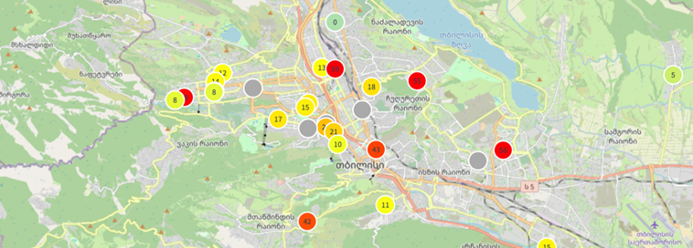
Air Quality Map
https://greenpole.org/en/ruka-2/#pll_switcher

Slide 17
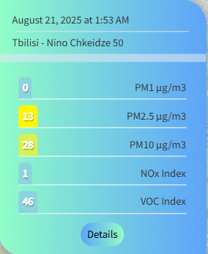
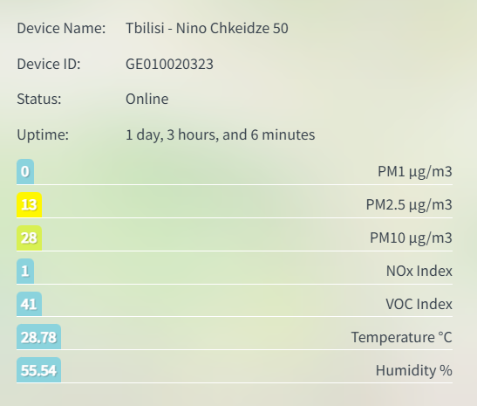
The Results
https://greenpole.org/en/ruka-2/#pll_switcher

Slide 18
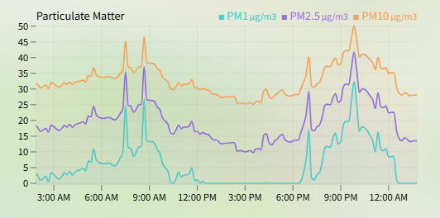
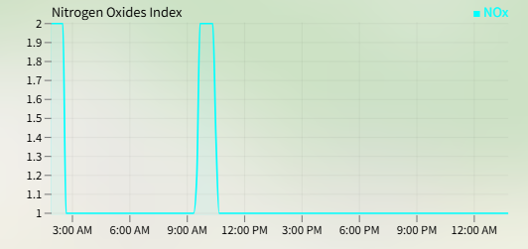
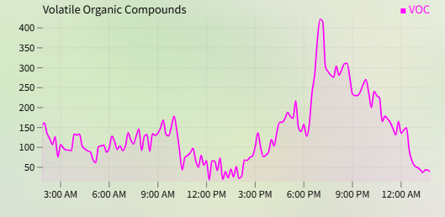
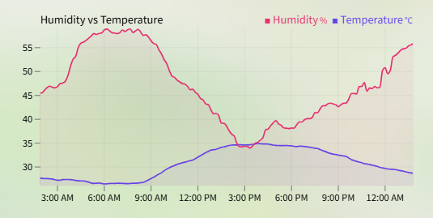
The Results
https://greenpole.org/en/ruka-2/#pll_switcher

Slide 19
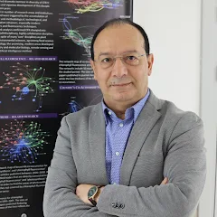
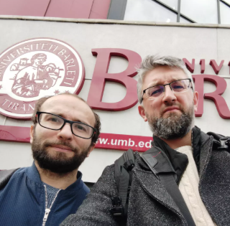

Warsaw University of Life Sciences
Prof. Dr Hab. Hazem M. Kalaji
Dr hab. inż. Robert Popek,
Dr hab. Arkadiusz Przybysz

Slide 20
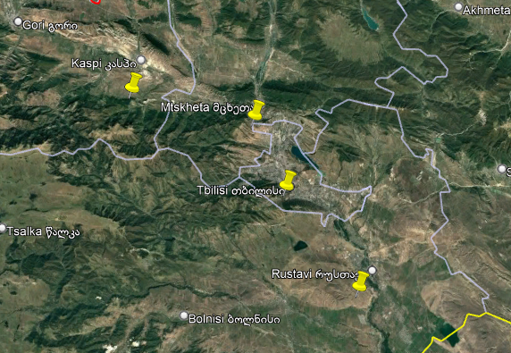
Selected cities
Tbilisi
Mtskheta
Rustavi
Kaspi

Slide 21
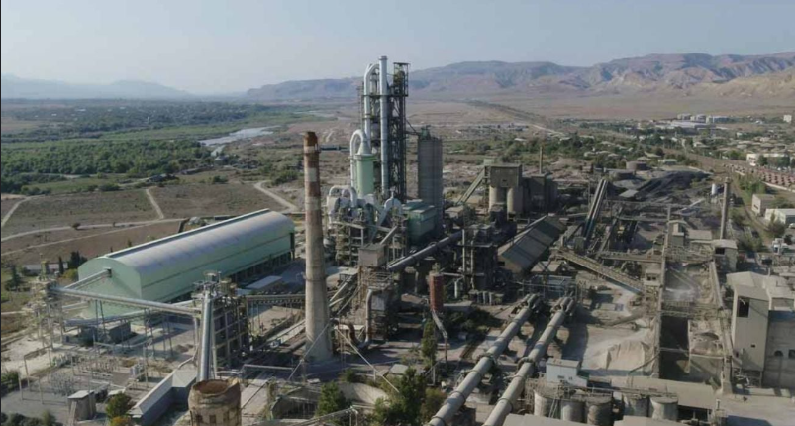
HeidelbergCement Plant in Kaspi

Slide 22
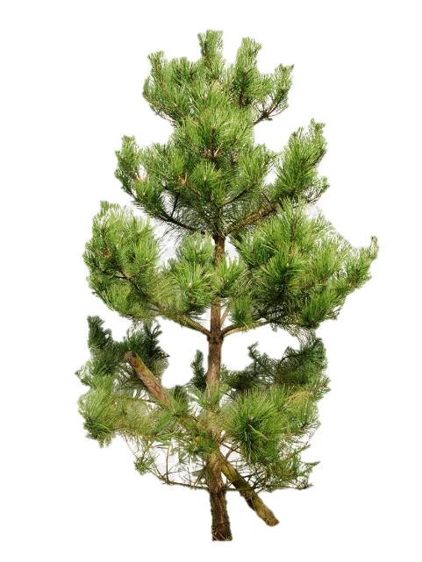
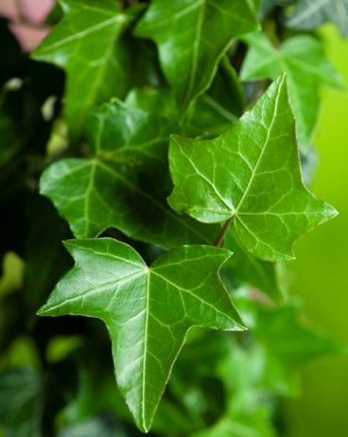
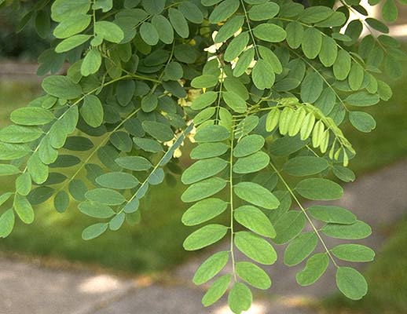
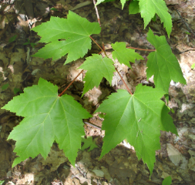
Plant Species
Pinus nigra (black pine)
Robinia pseudoacacia (black locust)
Hedera helix (common ivy)
Acer (maple)
Widespread occurrence
Good air filtration
Deciduous, evergreen conifer, climbing plants

Slide 23
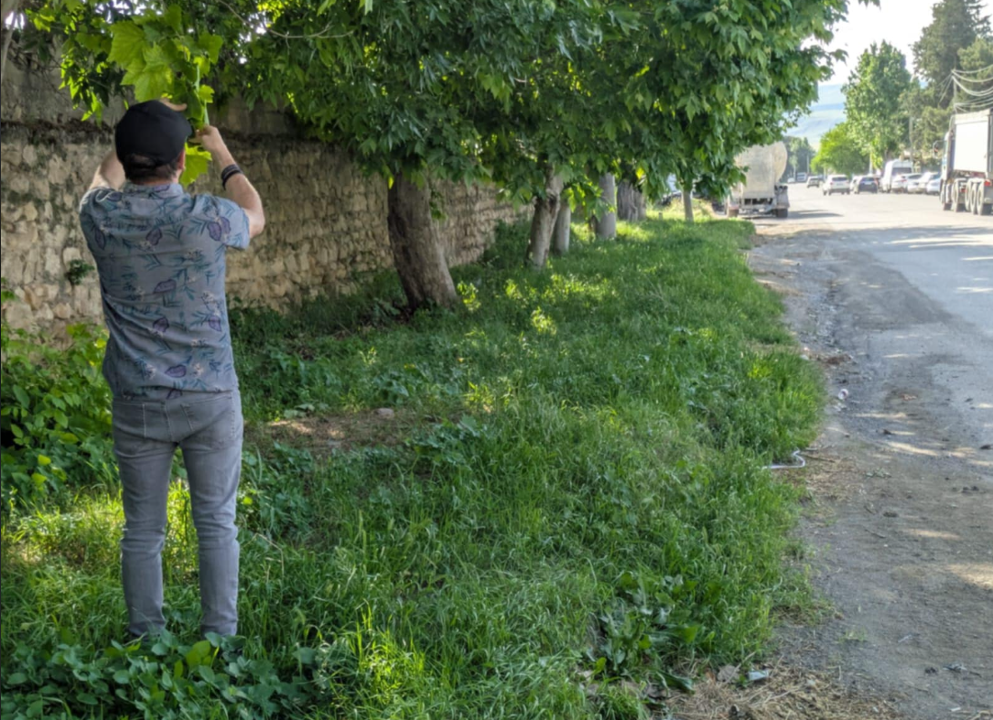
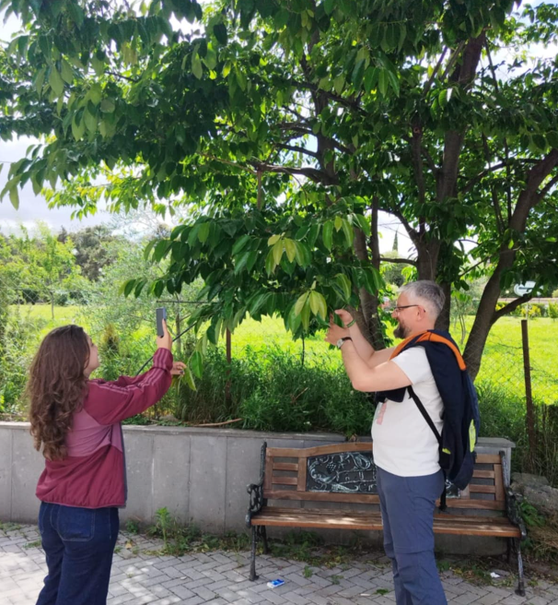
Collecting Leaves

Slide 24
Examined Parameters
PM (0.2-2.5, 2.5-10 and 10-100 µm)
1. deposited directly on the leaf surface
2. migrated to plant waxes
Trace elements – all heavy metals (Cu, Fe, Mn…)
Microplastic on leaf surface

Slide 25
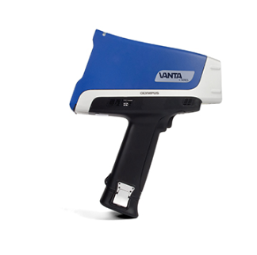
Methods
PM - filtration-weighing method
Elements – XRF (X-ray fluorescence)
Plastic – FTIR

Slide 26
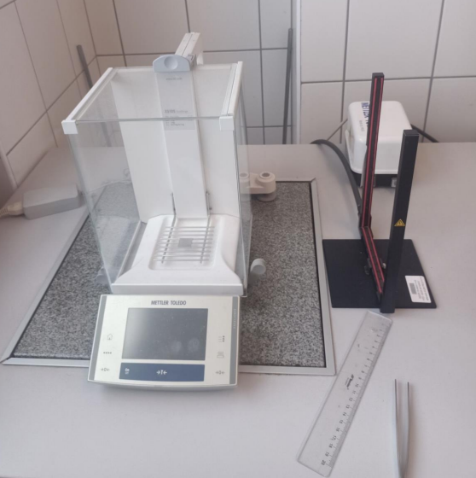
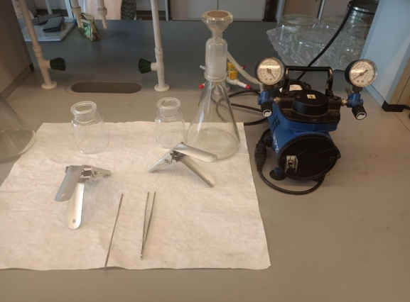
PM filtration-weighing method

Slide 27
Results?
https://www.atecorp.com/

Slide 28
Thank you for attention!

Slide 29
Used sources
Legislative Herald of Georgia
https://www.matsne.gov.ge/ (21.05.2024)
“Air pollution in Georgia as seen from Space” - Study based on satellite imagery & Copernicus data, 2023, Prague – Tbilisi.
Air Pollution Monitoring (IQAir) address
https://www.iqair.com/ (21.05.2024)
National Environmental Protection Action Program of Georgia. 2000. Issued by the Ministry of Environment and Natural Resources Protection of Georgia
Bhatia S.C. 2013. Environmental Chemistry. Delhi: CBS Publishers & Distributors Pvt. Ltd.
University of California
https://news.ucmerced.edu/news/2019/air-pollution-impacts-childhood-development-new-study-shows (21.05.2024)
https://seetheair.org/2022/05/16/particulate-matter-pm2-5-mega-guide/ (21.05.2024)

Slide 30
Used sources
Wnorowski, Łukasz 2024. Removal potential of particulate matter and trace elements of selected shrub species commonly grown in urban parks in Wuhan, China. Szkoła Główna Gospodarstwa Wiejskiego
Win Ariga Mansur Malonga, 2020. Microplastics contamination in the mangrove
ecosystem in Bima City Bay, Indonesia. Szkoła Główna Gospodarstwa Wiejskiego
Ilia State University,2024. Definition of basic national wood density for the main tree genera of
Georgian forests.

