Slide 1

Evaluating Viability Of MFI Zeolites As A Methane Capture Device
Nika Kikvadze
3rd year Bachelor tudent
FUT

Slide 2


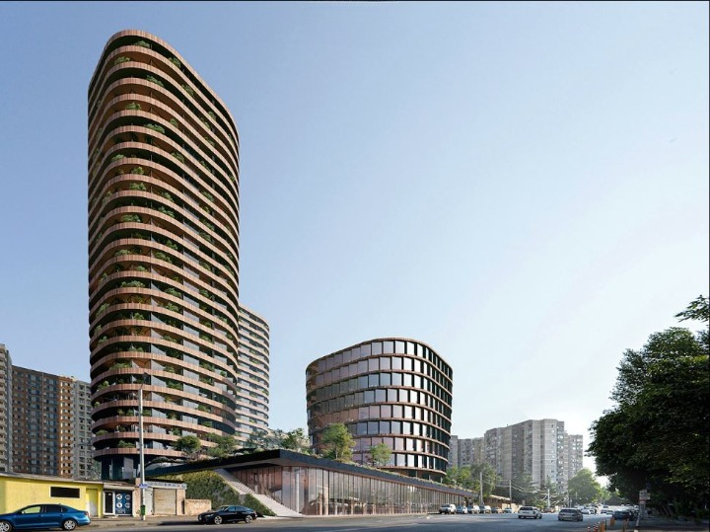
About Me
Finished 3rd year of bachelor's degree BSE
6 months working experience in my field
Worked on several key projects in tbilisi
2022 knowledge fund grant for BSE recipient
2025 CQM grant recipient for Junior project

Slide 3
Overview
Where It Started?
MOOTHANE Project
Zeolite
Raspa2/IRaspa
Simulation Parameters/Results
What can be improved

Slide 4


Where It Started?

Slide 5
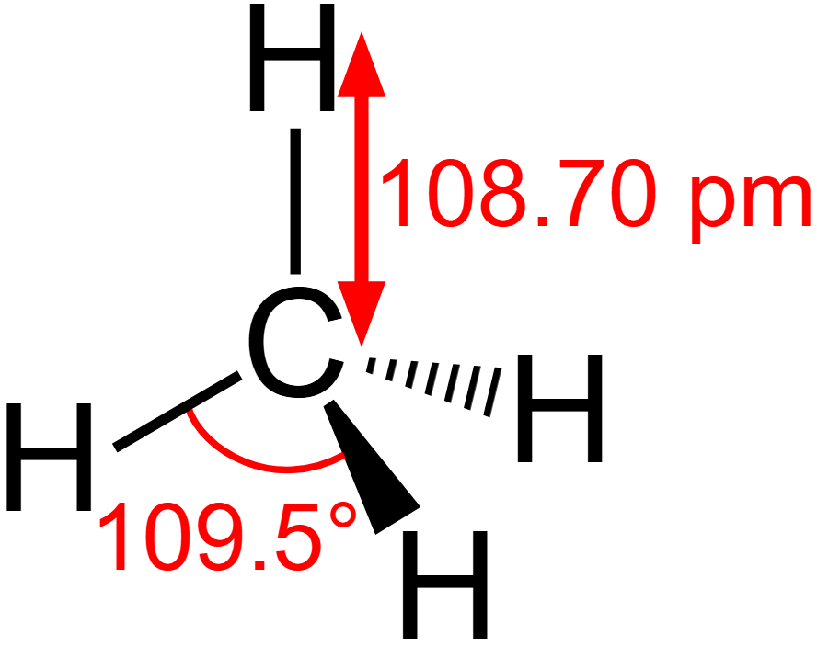
Where It Started?
22 Times more potent than .
CO2.
But has nuclear half life of only 10 years.

Slide 6
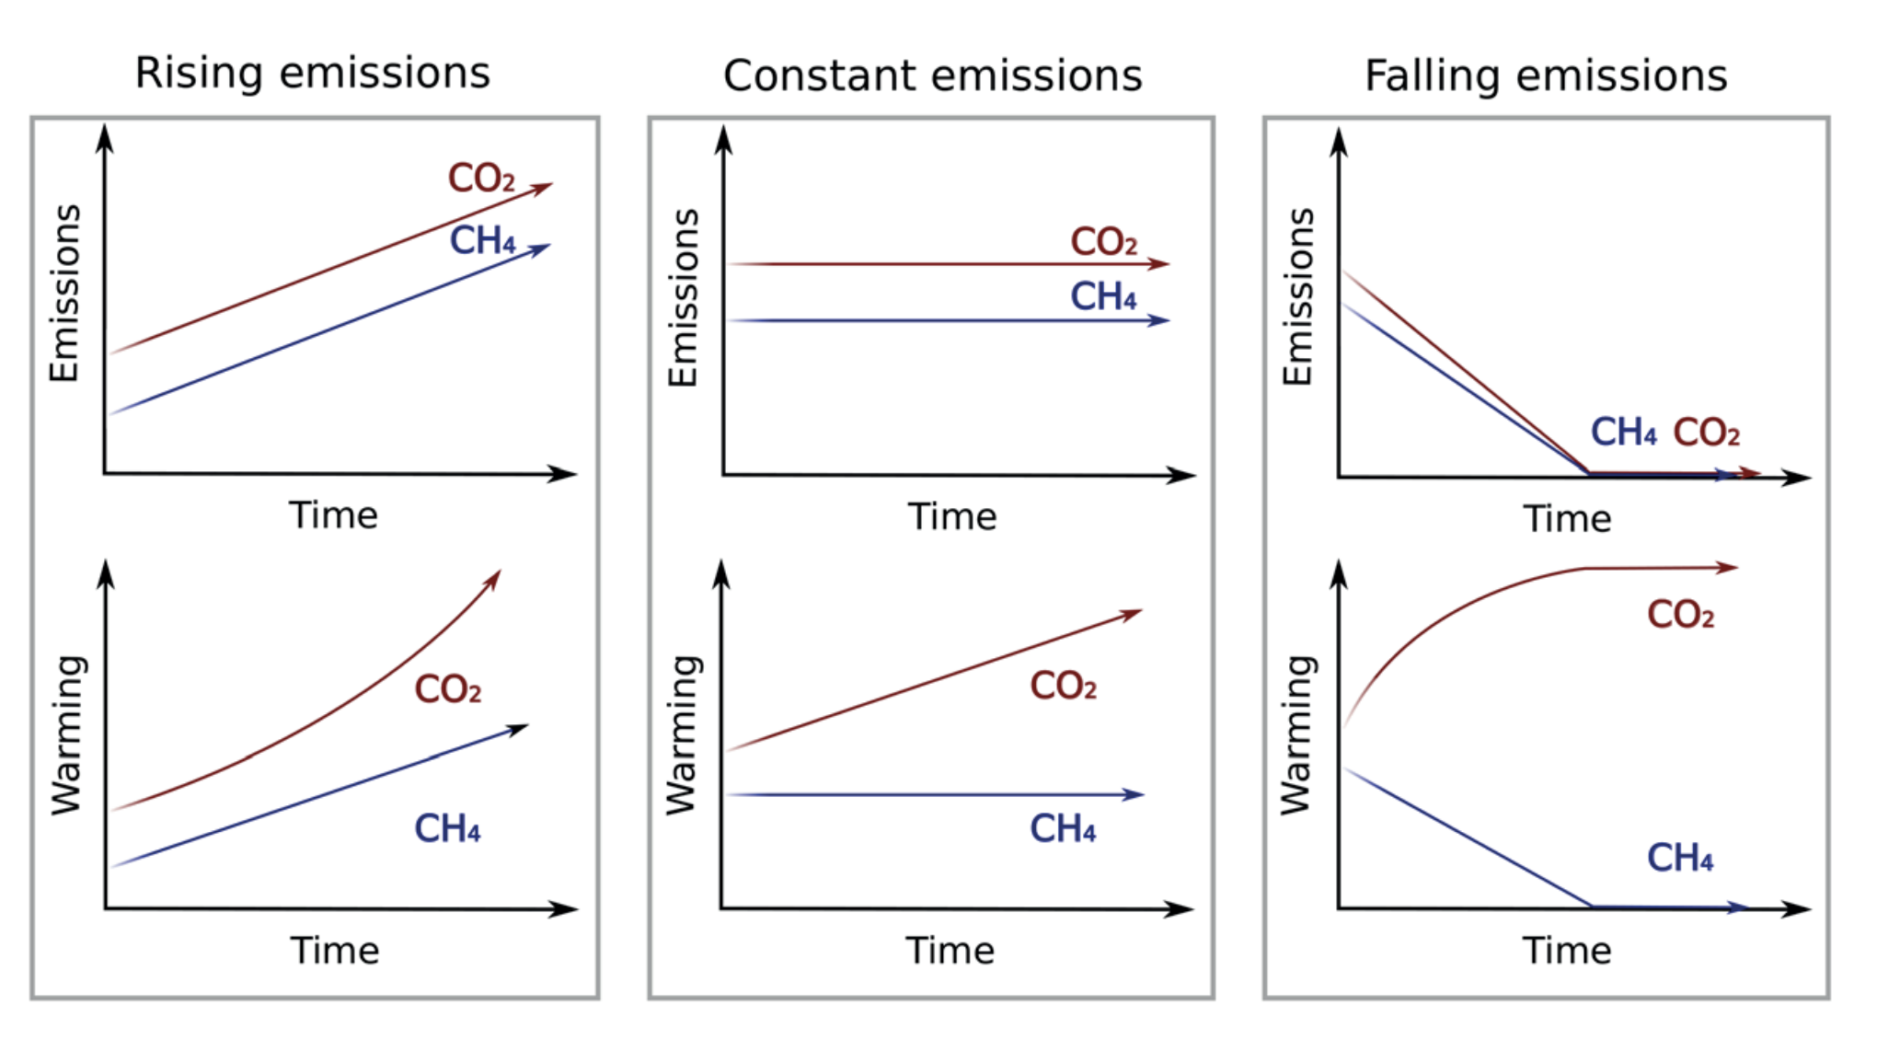

Slide 7
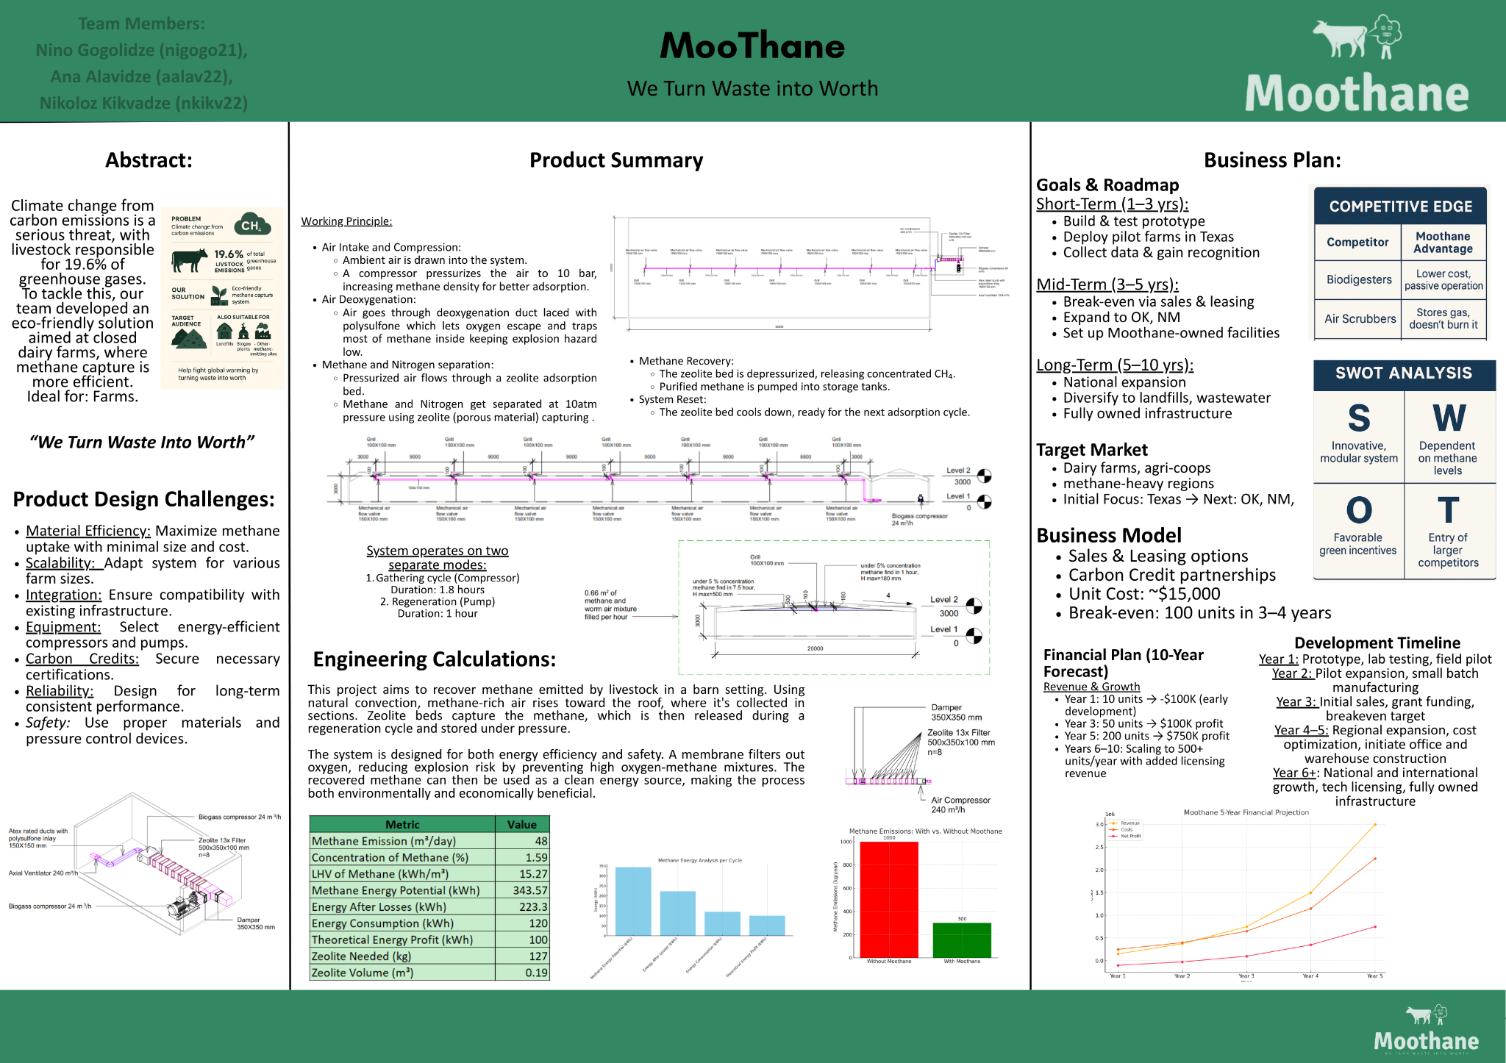
Where It Started?

Slide 8
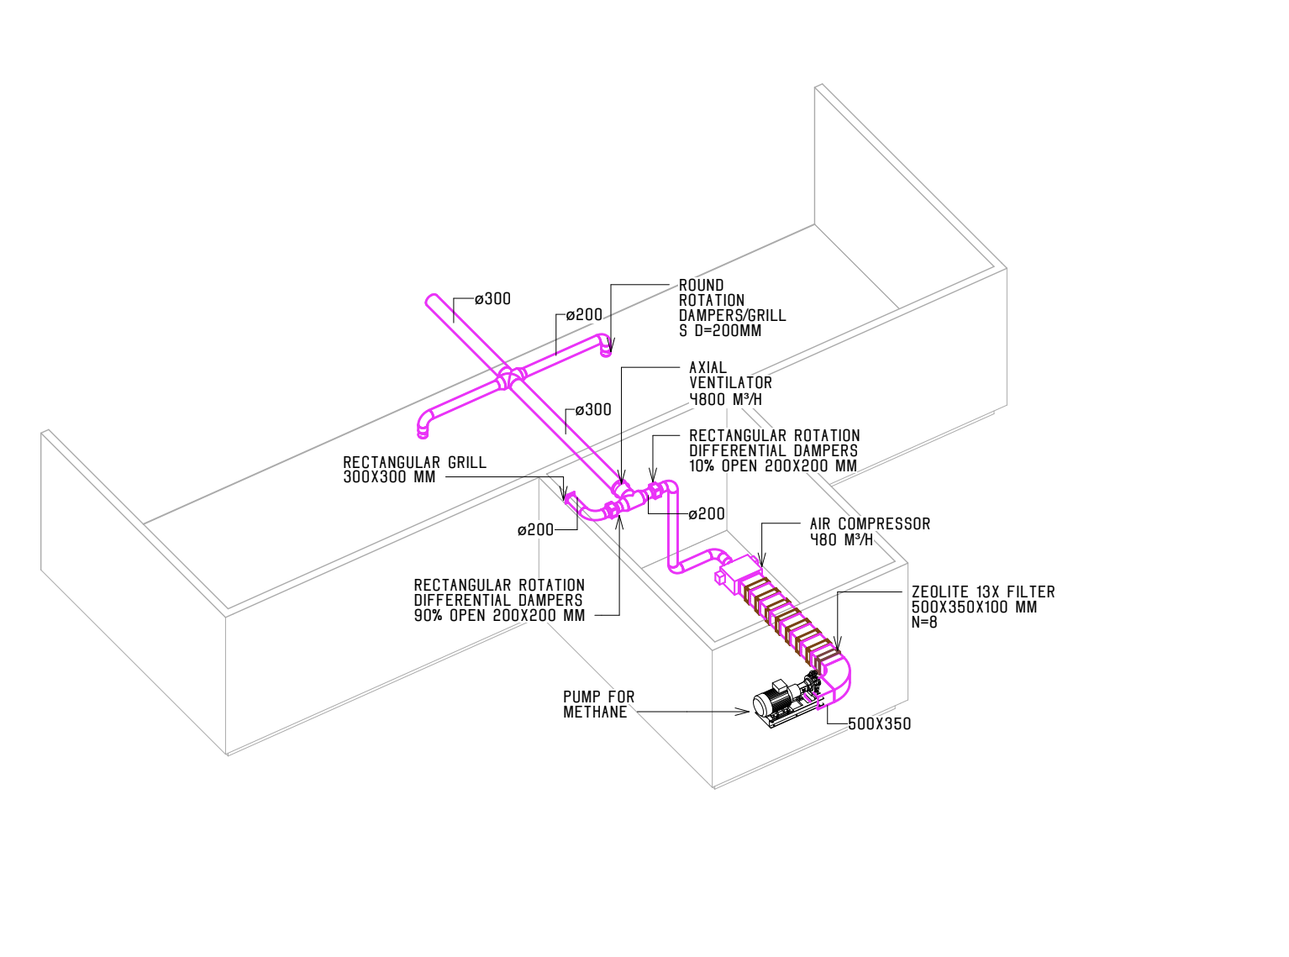
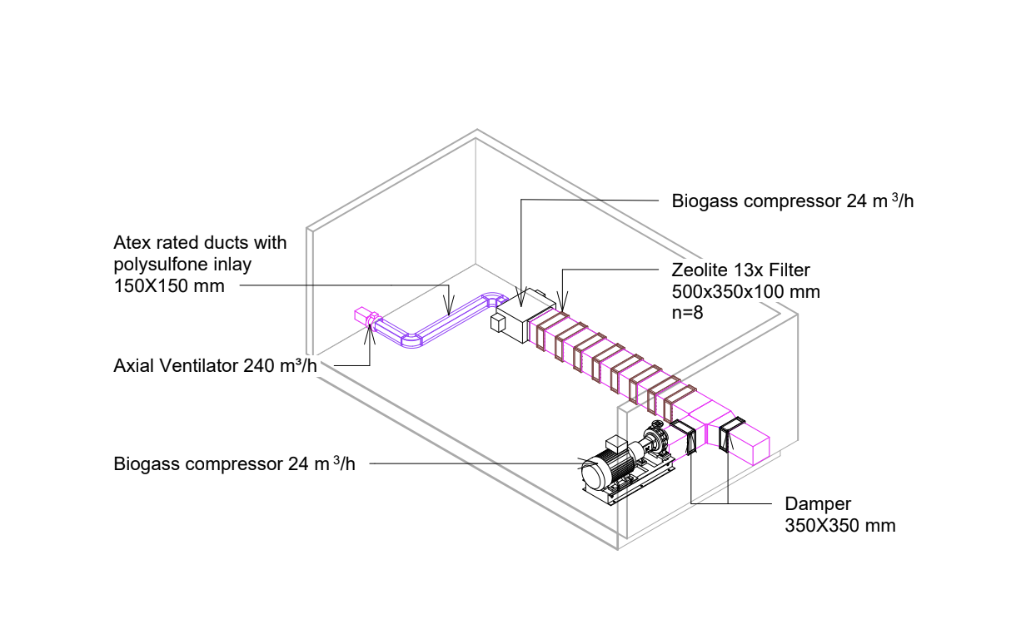

Slide 9
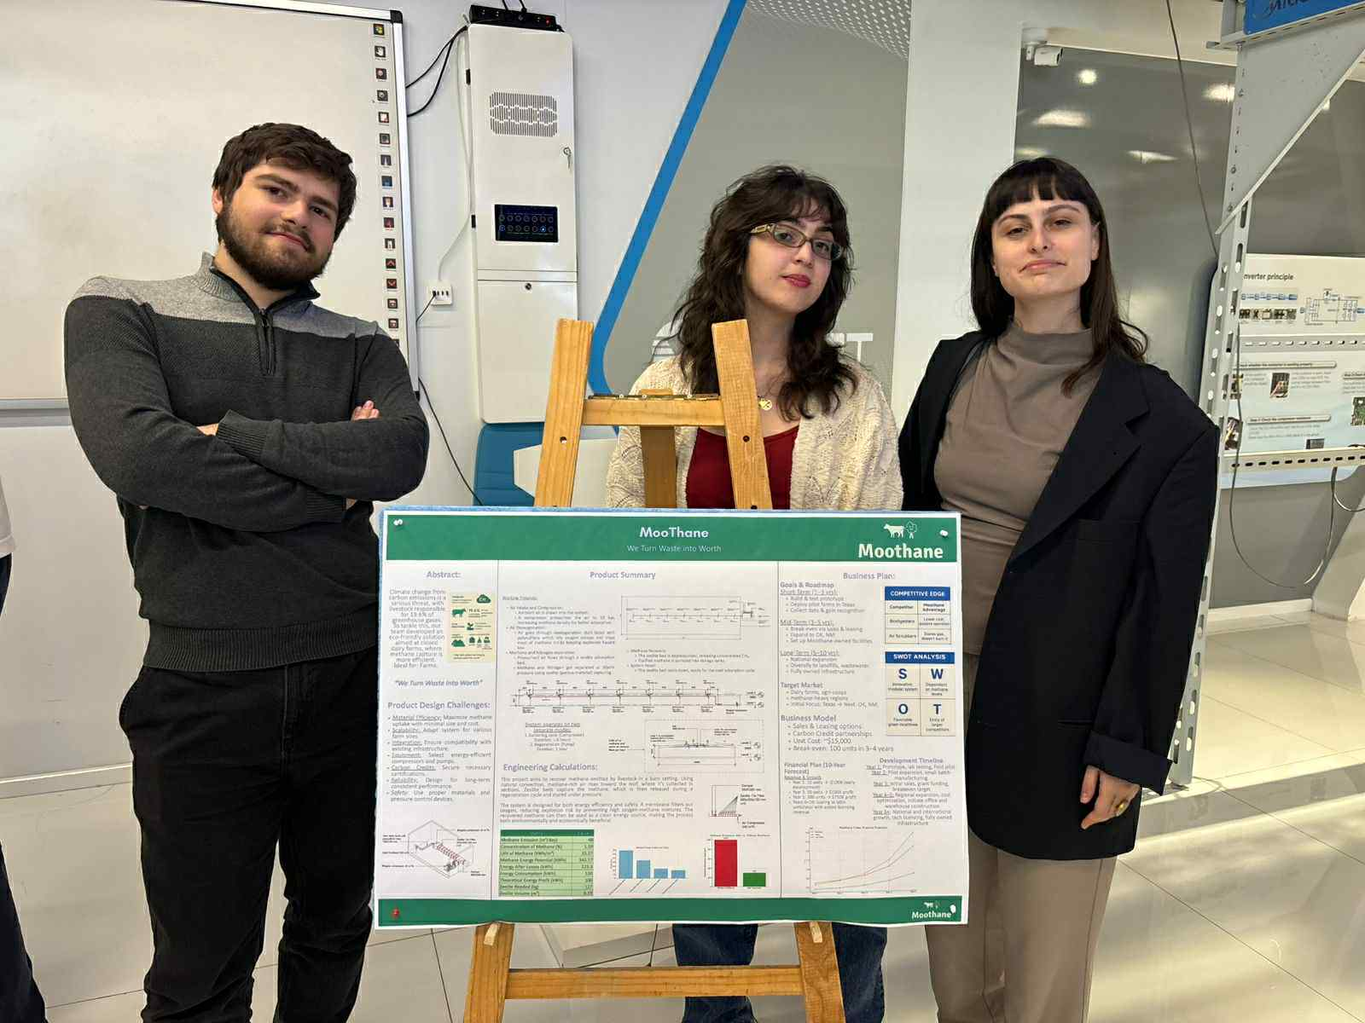
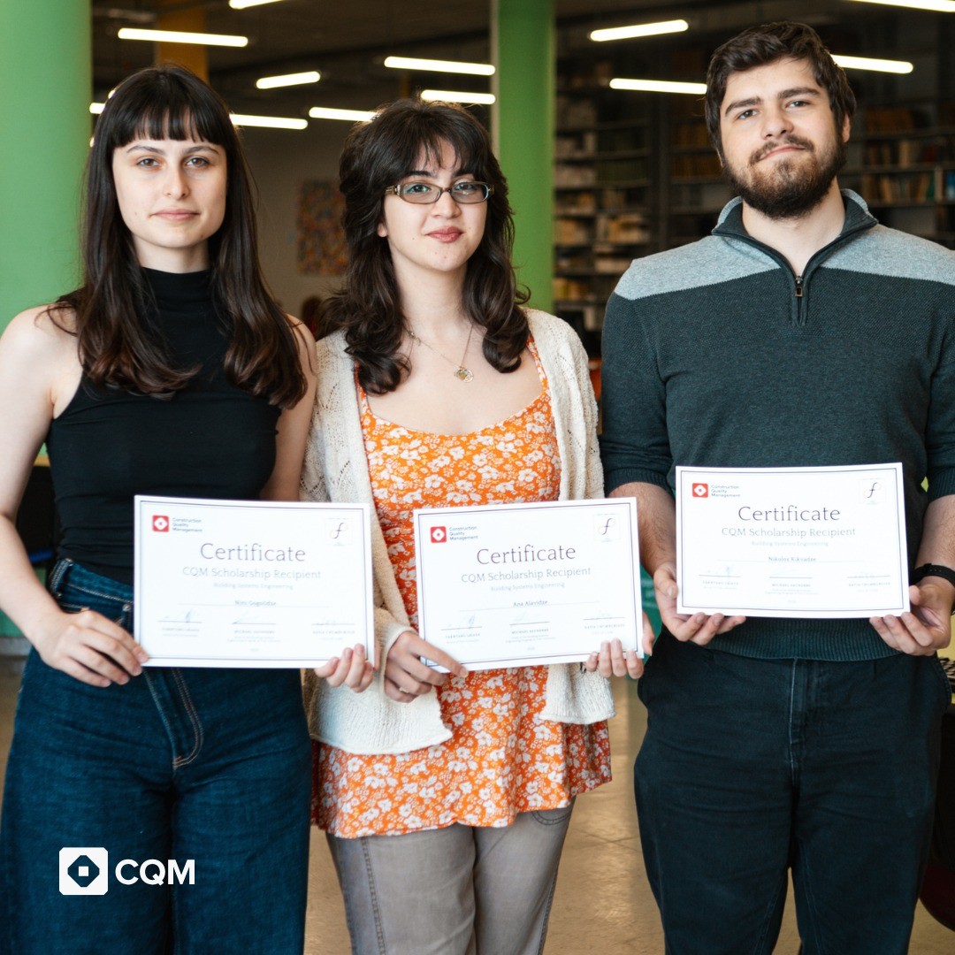
Moothane Project

Slide 10
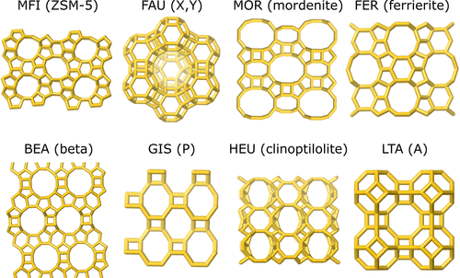
Zeolite
Catalysis
Adsorption and Separation
Agriculture and Horticulture
Environmental Remediation
Biomedicine and Healthcare

Slide 11
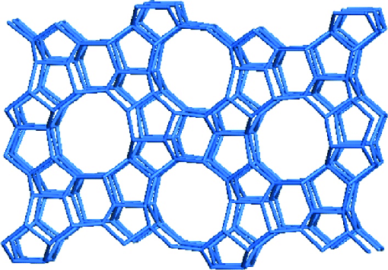
MFI Zeolite

Slide 12
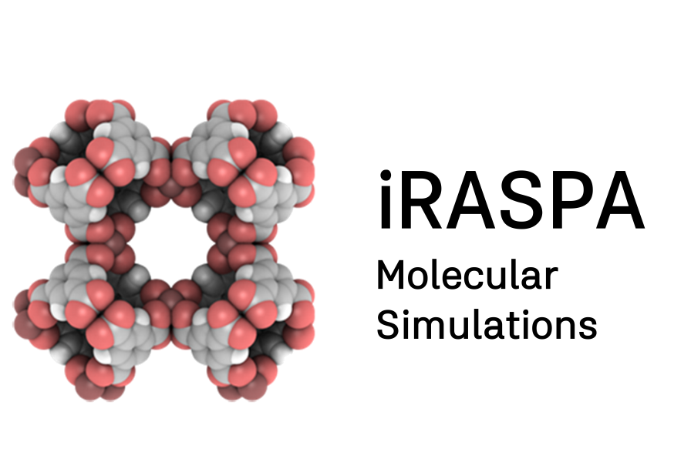

Raspa/IRaspa

Slide 13
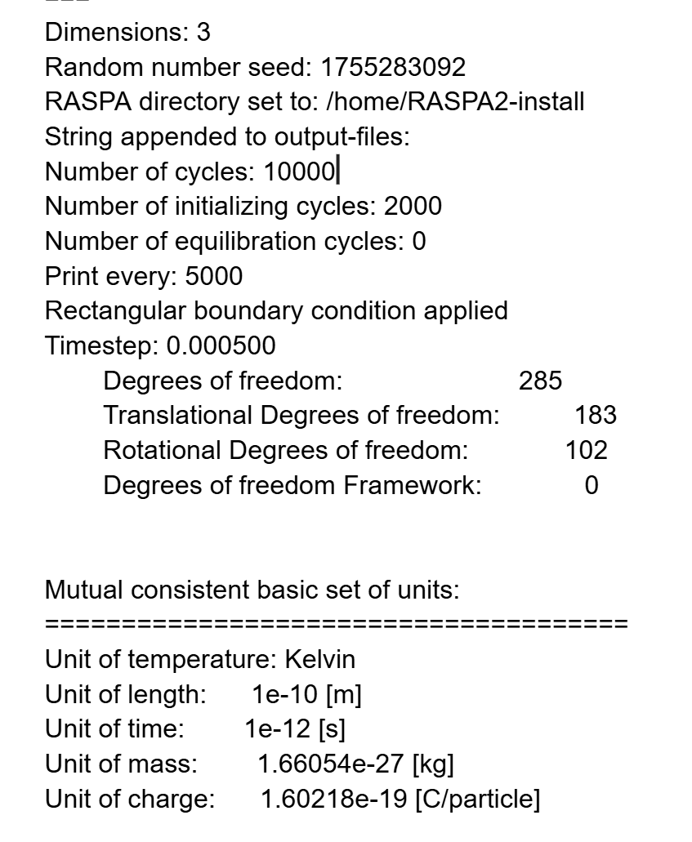
Simulation Parameters
Simulation Type: Monte Carlo
Due to hardware limitations only about 150 molecules were simulated
CH4 concentration: 500-1500 PPm
Only mixture of standard air with added CH4 was used
Pressure: 10 bar for increased absorptivity

Slide 14
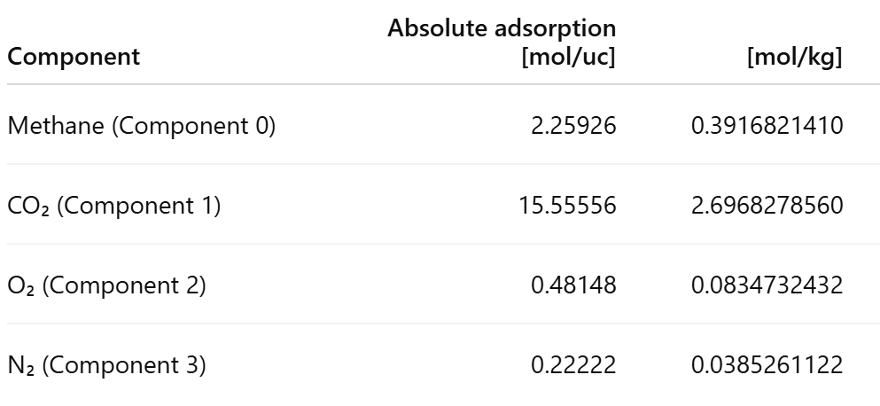
Simulation Results
Absolute adsorption

Slide 15
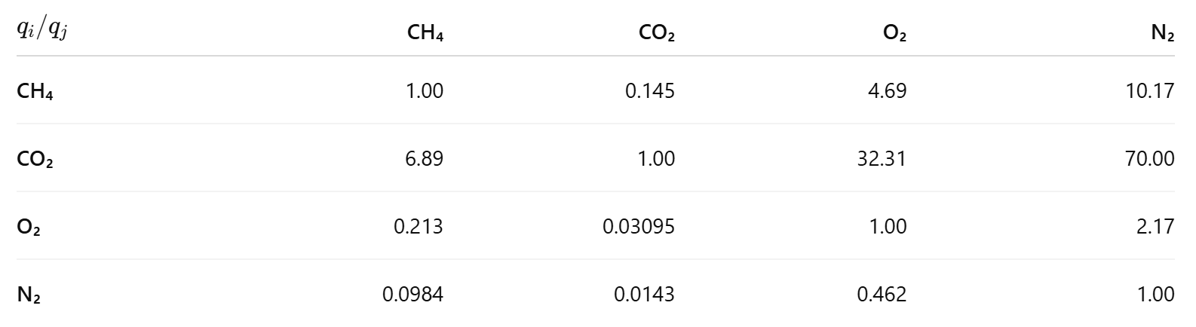
Simulation Results
Selectivity

Slide 16
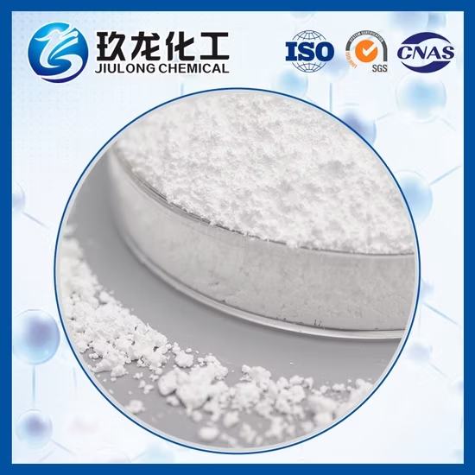
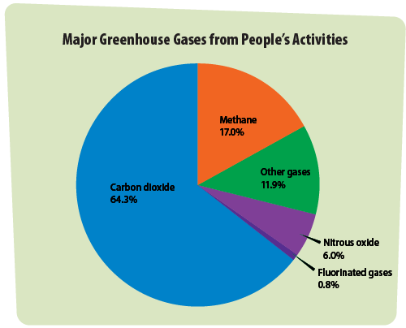
What Can Be Improved

Slide 17
THANK YOU!

