Slide 1
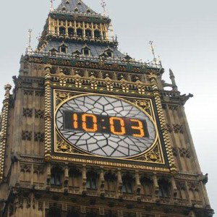

Implementation of a Digital Clock on an AVR 8-Bit Microcontroller with External Quartz Oscillator
Nikoloz Kalichava – Third-year student bachelor of Electrical and Computer Engineering at the Agricultural University of Georgia.

Slide 2


About me
Third-year student bachelor of Electrical and Computer Engineering at the Agricultural University of Georgia.
Professional experience includes fire alarm systems, AutoCAD design , Security systems, DAS systems, and theoretical knowledge of HVAC.
Completed additional technology courses in computer architecture and computer networking.
Interests and hobbies : New technologies , Electronics , Chess , Art

Slide 3
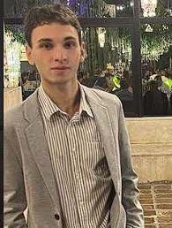

LEADERSHIP & COMMUNITY INVOLVEMENT 33rd Budapest Wine Festival, Hungary, Budapest, Georgian Tourism and Wine Association Member: • Presentation of Georgian cheese, dried fruit, nuts, and wine to the festival attendees. • Helping Embassy of Georgia to Hungary • Attract international attendees • Ensure effective communication with Native September 11-14, 2025 Buda Castle
Certifications & Achievements • FIDE Registered Chess Player • Federation: Georgia | FIDE ID: 13640437 • Rating Record: 1452 (Blitz) • FIDE Certification • Qualification: V Order, IV Order, III Order • School Olympiad Champion (2nd to 6th grade) • Team Chess Championship Winner (First Table) • Chess.com Ratings: 1504 (Bullet), 1440 (Rapid), 1226 (Blitz)
Programming Languages: Java (Beginner), Python (Beginner), C++, AVR assembler (Experienced) Software and Tools: NI Multisim, Proteus, AutoCAD, ArchiCAD, Adobe illustrator (Beginner), Cisco Packet Tracer, MATLAB/Simulink for Simulation Technical skills: Microcontroller Programming (AVR 8-bit Microcontrollers, ATmega, ATtiny), Networking and Cybersecurity Basics, Circuit Design (Digital and Analogic), Simulation & Hardware Software Integration
SKILLS
WORK EXPERIENCE
GT Group Technologies Tbilisi, Georgia Junior Engineer Worked with fire alarm and low-current systems Designed using AutoCAD Studied HVAC systems (theoretical part) Research on Distributed Acoustic Sensing (DAS) Systems Assisted with security solutions for critical infrastructure
UGT - TECH HUB: Computer Architecture (Hardware and Software)Computer Network Cloud Cybersecurity March 2024 -February 2025
COURSES
Agricultural University, University, Tbilisi, Georgia September 2022 –Present Bachelor of Electrical and Computer Engineering, GPA: 3.77
V. Komarovi Physics and Math N199 Public School, Tbilisi, Georgia September 2015 – June 2019
EDUCATION

Slide 4
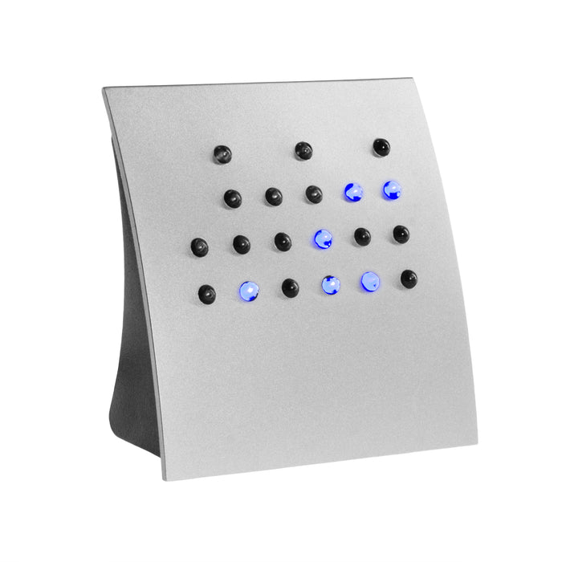
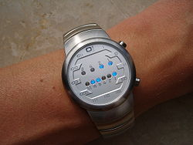
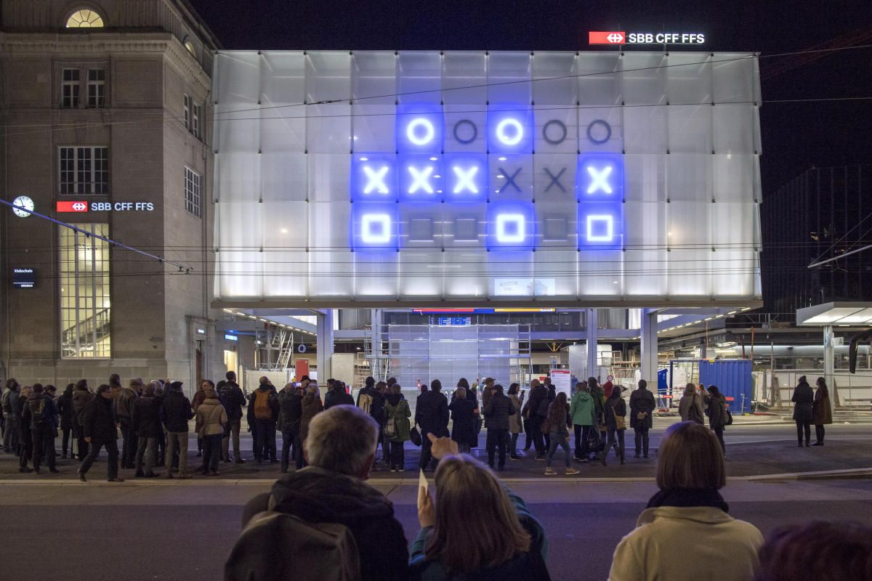
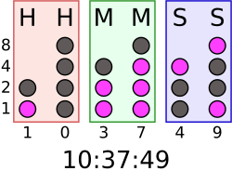
Source of motivation for my project

Slide 5
Source of motivation for my project

Slide 6
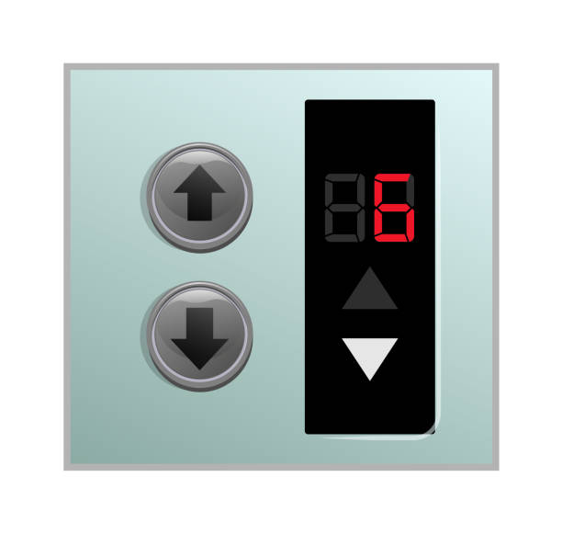
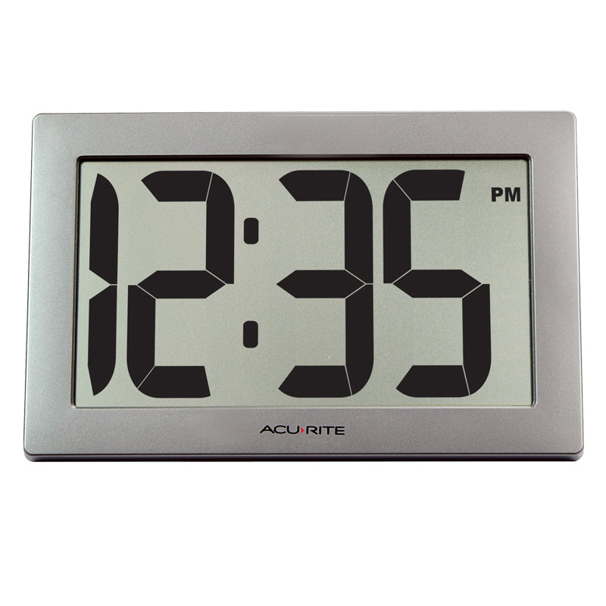
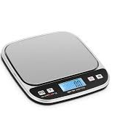
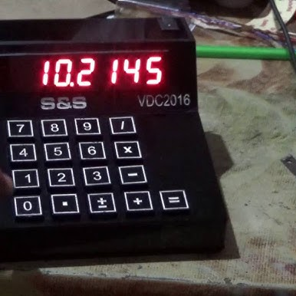
7 segment display

Slide 7
Annotation
Primary task
Key nodes
Issues under consideration
Problems that have arisen

Slide 8

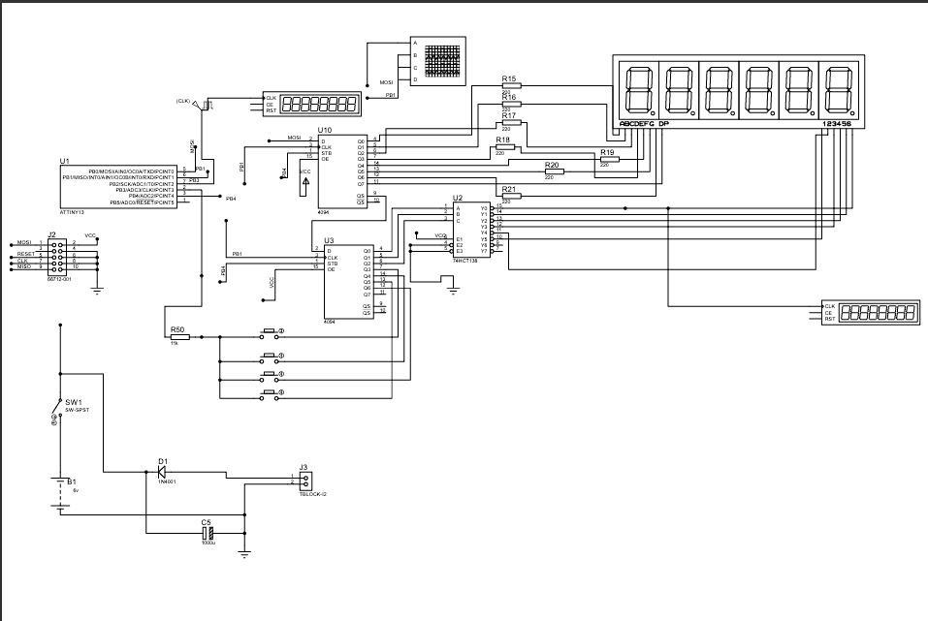
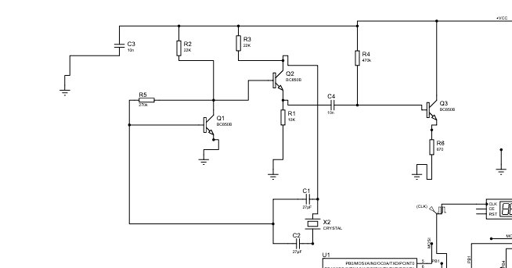
Electrical circuit of a model featuring a clock generator operating at a quartz frequency of 32 768 Hz.

Slide 9
Clock generator with a quartz frequency of 32 768 Hz.

Slide 10
Electrical circuit of a model featuring a clock generator operating at a quartz frequency of 32 768 Hz.

Slide 11
Electrical circuit of a model featuring a clock generator operating at a quartz frequency of 32 768 Hz.

Slide 12
Electrical circuit of a model featuring a clock generator operating at a quartz frequency of 32 768 Hz.

Slide 14
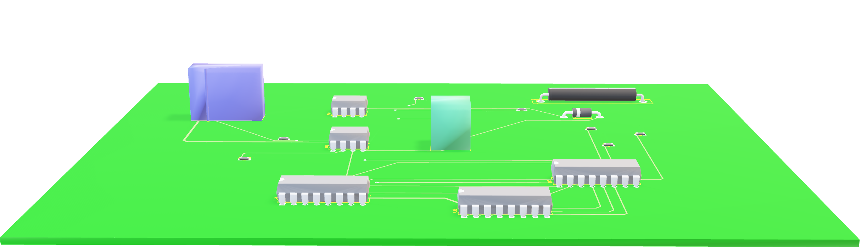
3D visualizer of PCB layout

Slide 15
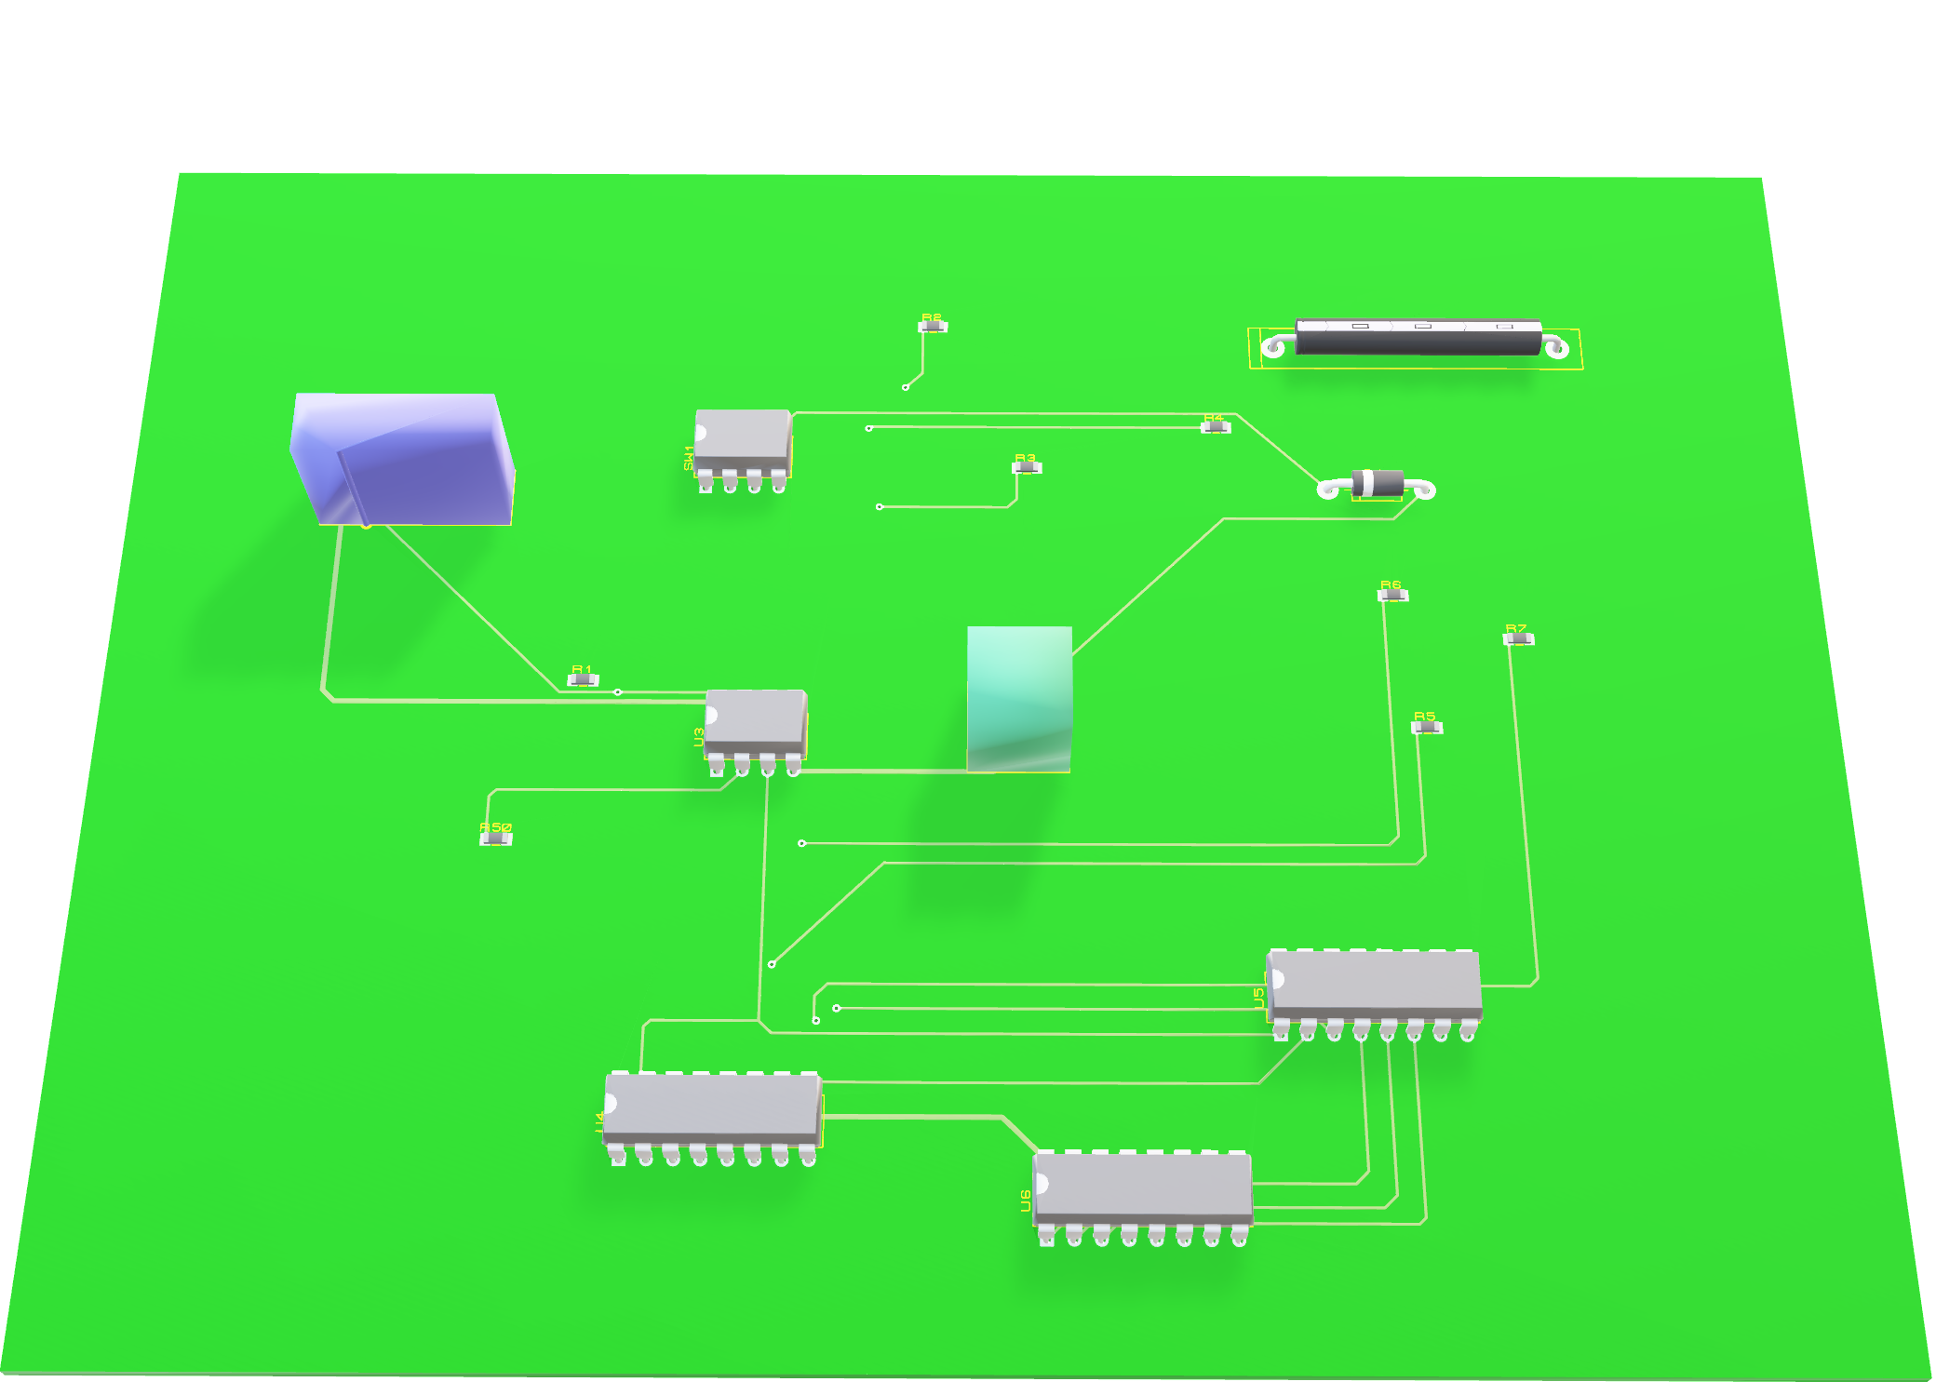
ELECTICAL COMPONENTS

Slide 16
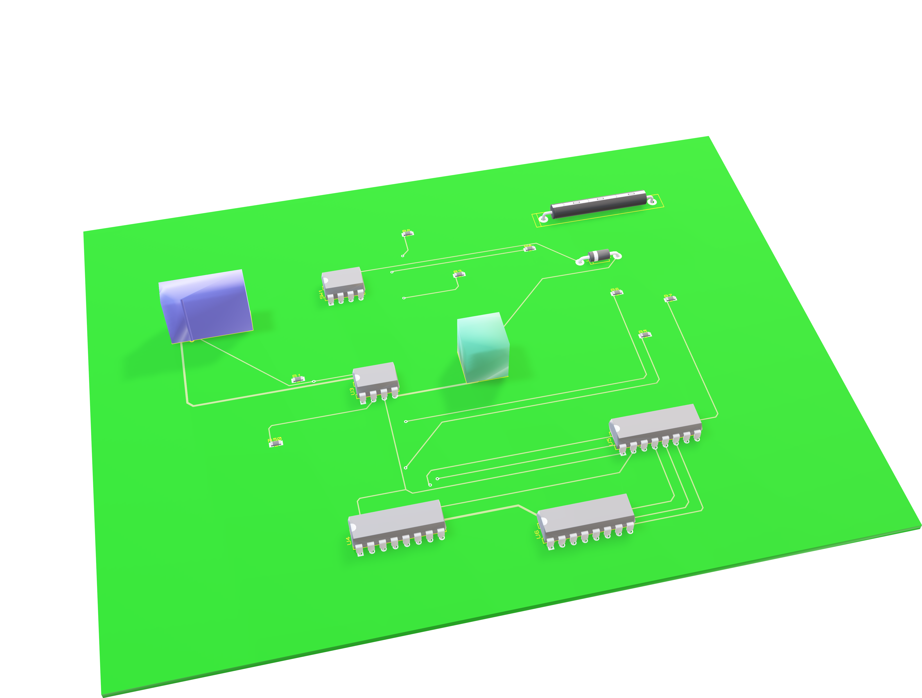
Power Switch

Slide 17
ATTINY 13 MCU

Slide 18
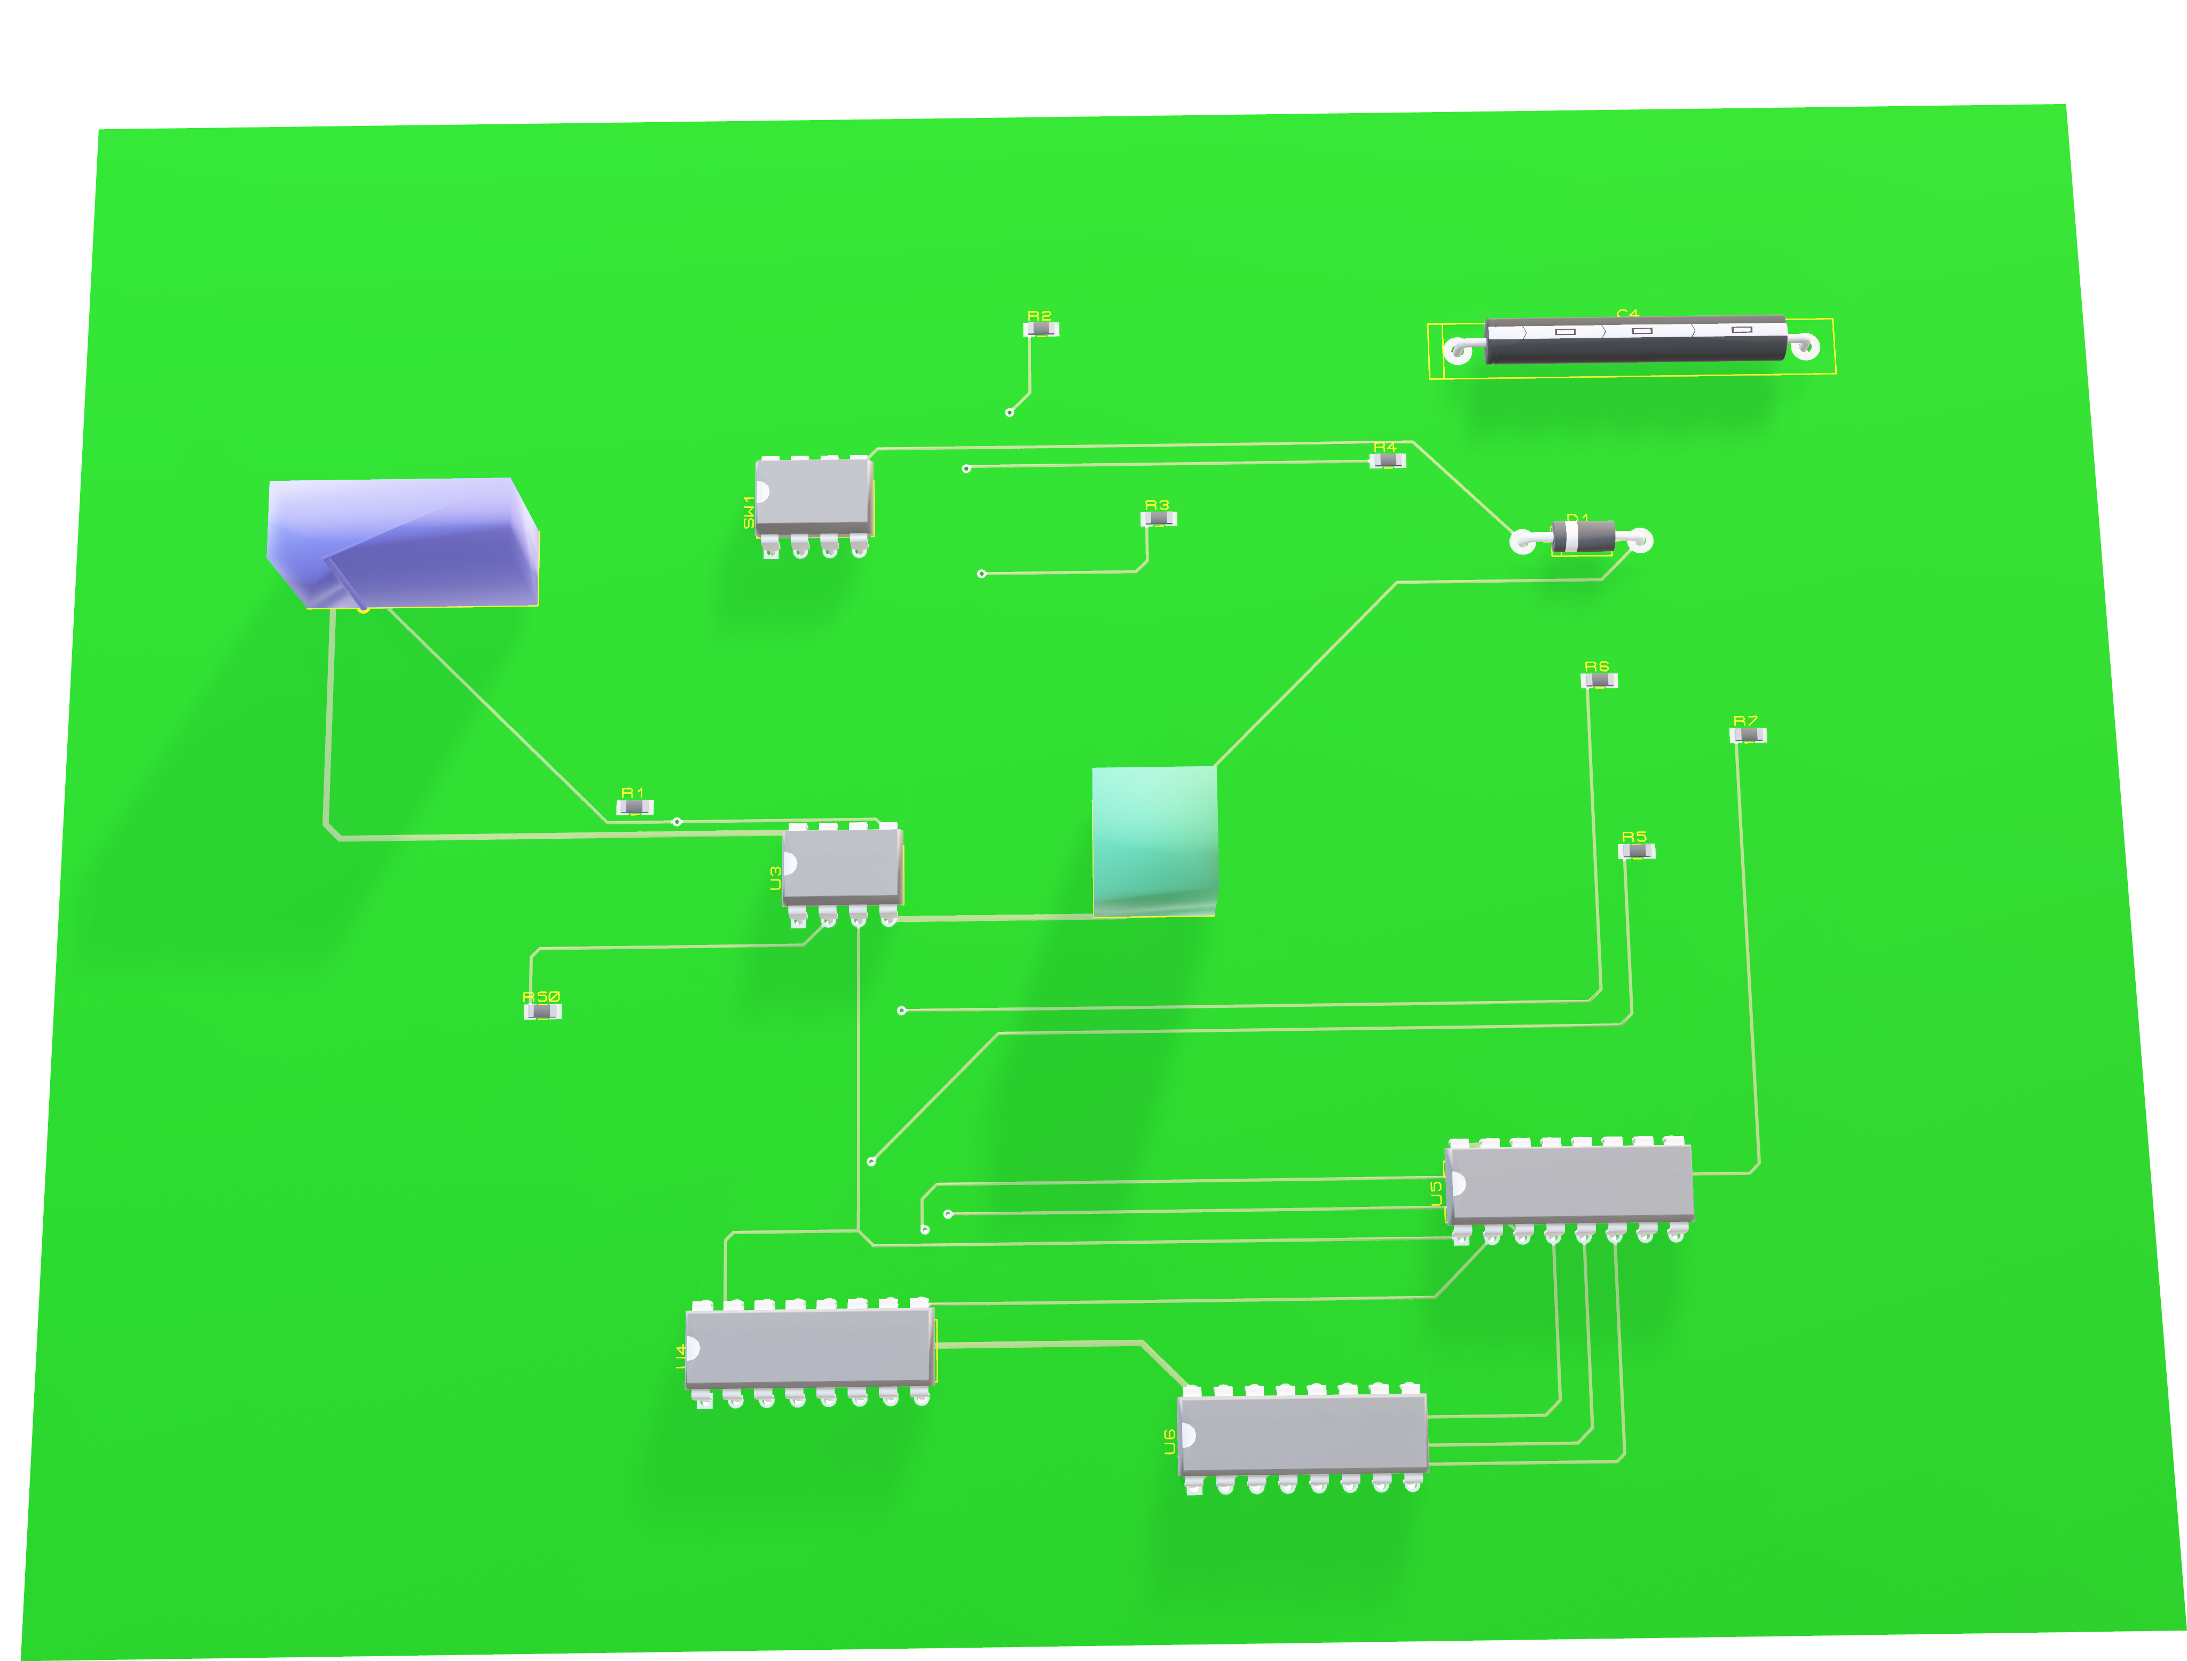
IC4094 Parallel Shift Register

Slide 19
IC4094 Parallel Shift Register

Slide 20
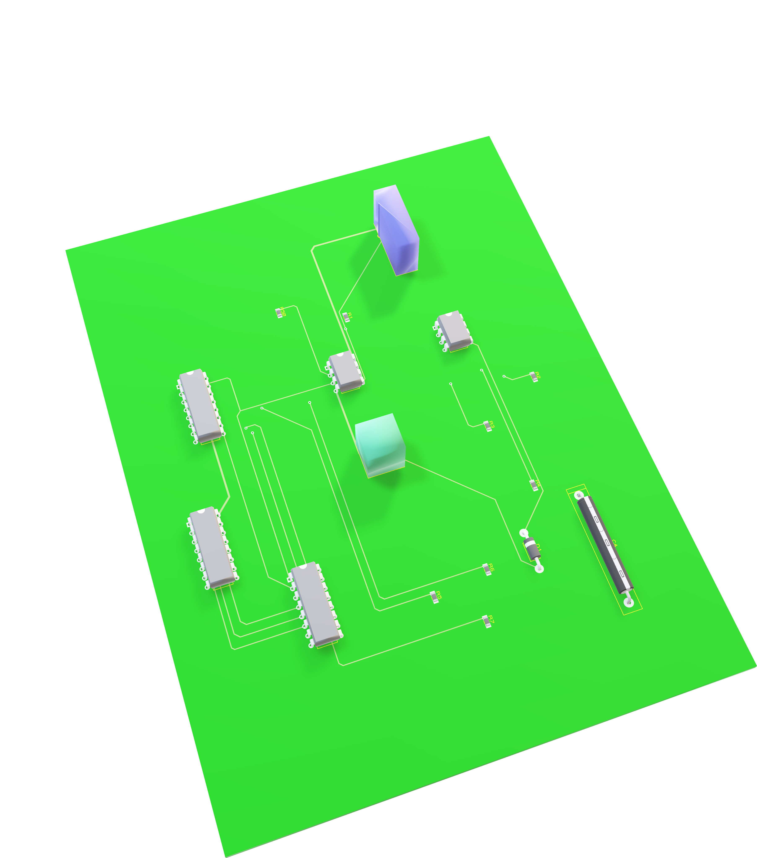
74HCT137 Demultiplexer

Slide 21
74HCT137 Demultiplexer

Slide 22
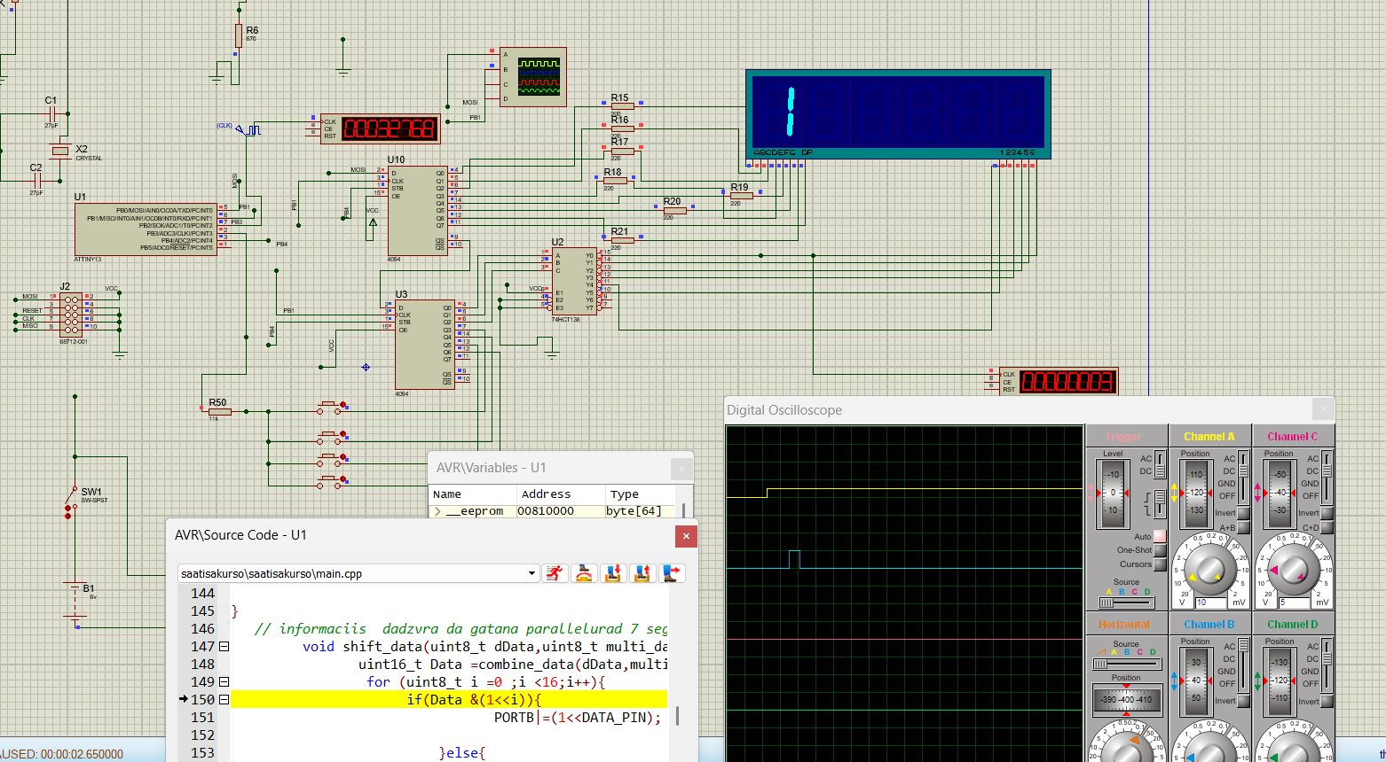
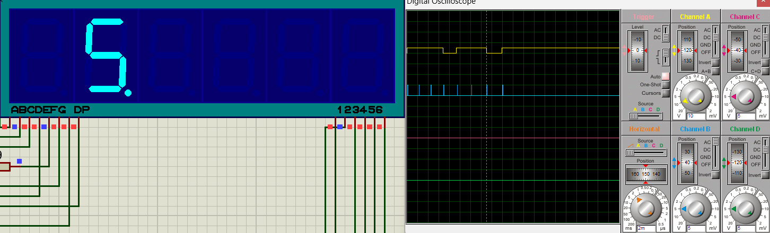
Digital representation of Circuit

Slide 23
Working Algorithm
Power
Arrangement of ports in microprocessor
Generating impulses by the generator
Stir up interruptions every second
Withdrawing time on seven segments through the shift registers
Infinite loop
Counting and setting the desired time

Slide 24
Program algorithm
MAIN
FUNCTIONS
DEFINE
Initialization of Pins and Variables
TIMER preparation of CTC
Prescaling
Subprogram of Shift registers
Vector of interrupts
Subprogram of display
Subprogram of buttons
Initialization of PORT
Endless Loop : recalling of subprograms

Slide 25
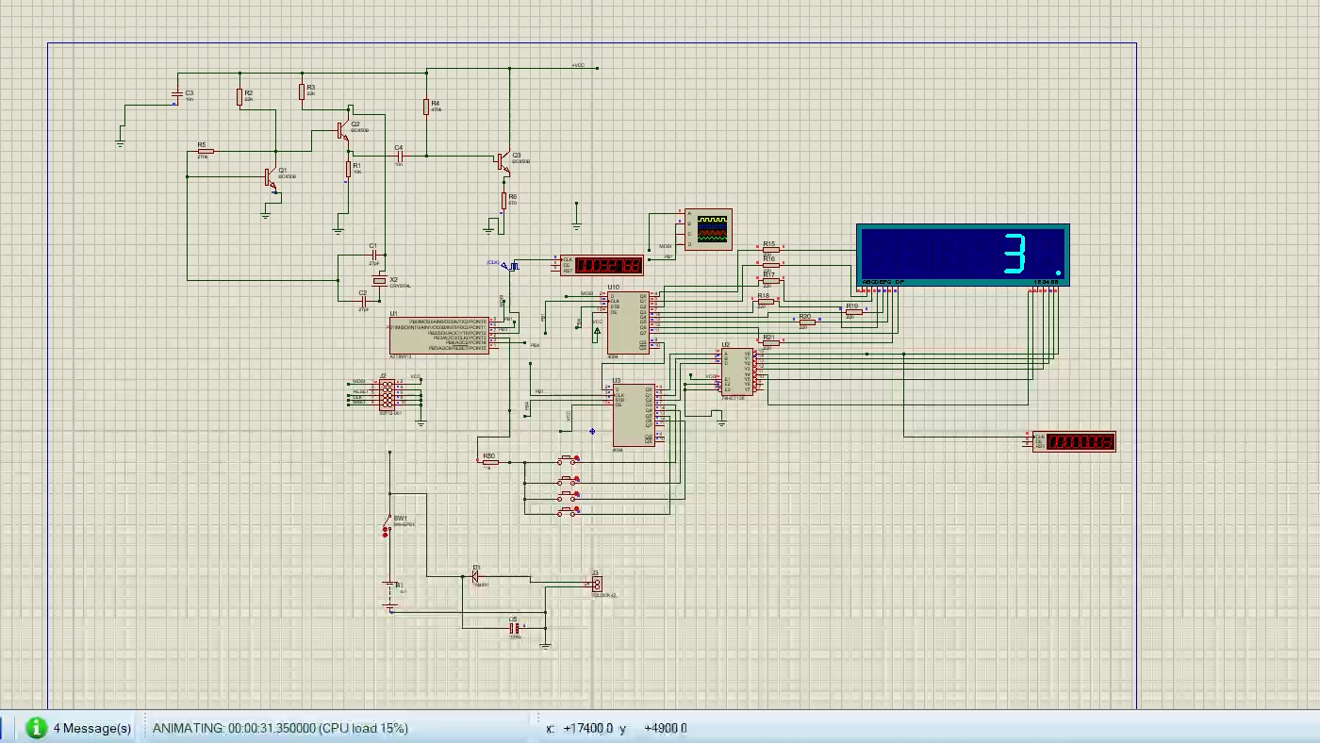
Simulation results

Slide 26
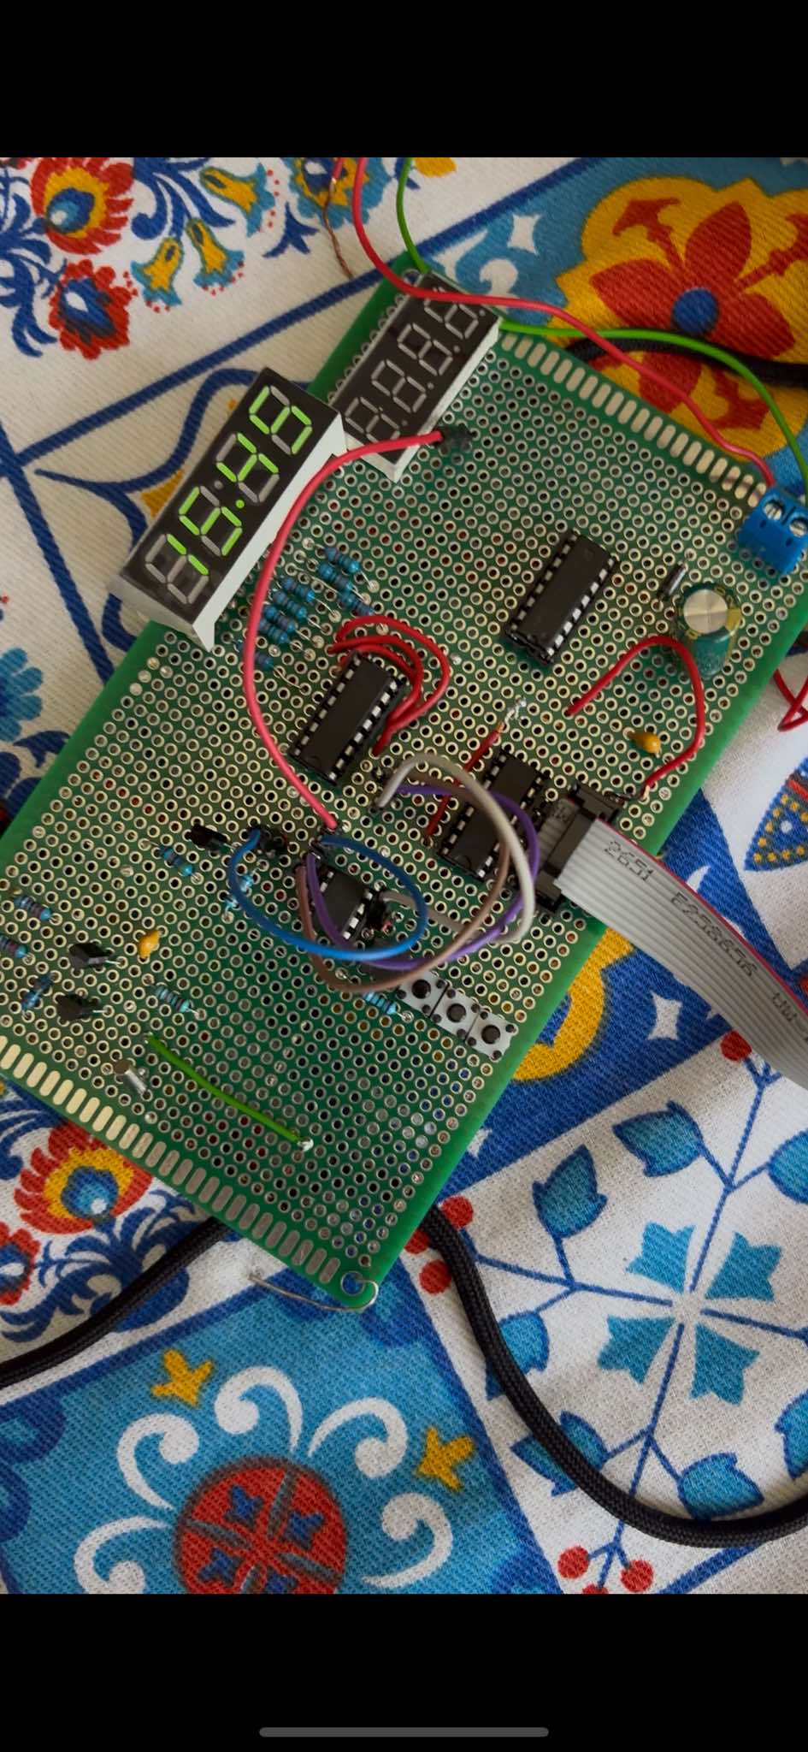
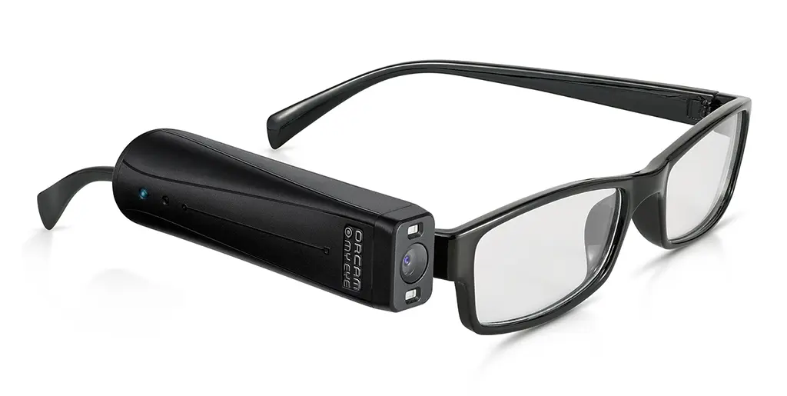
Results and future plans

Slide 27
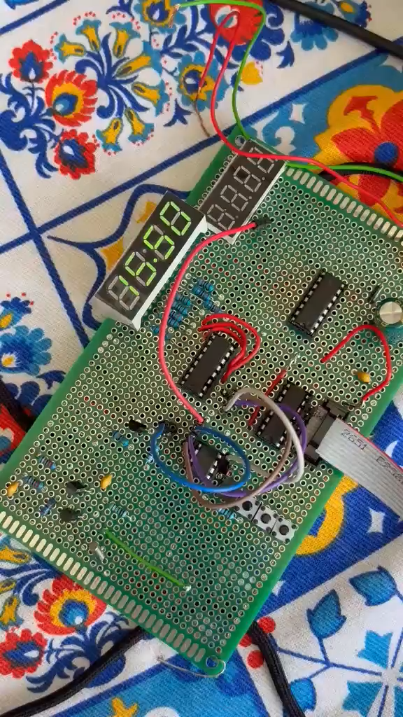

Slide 28
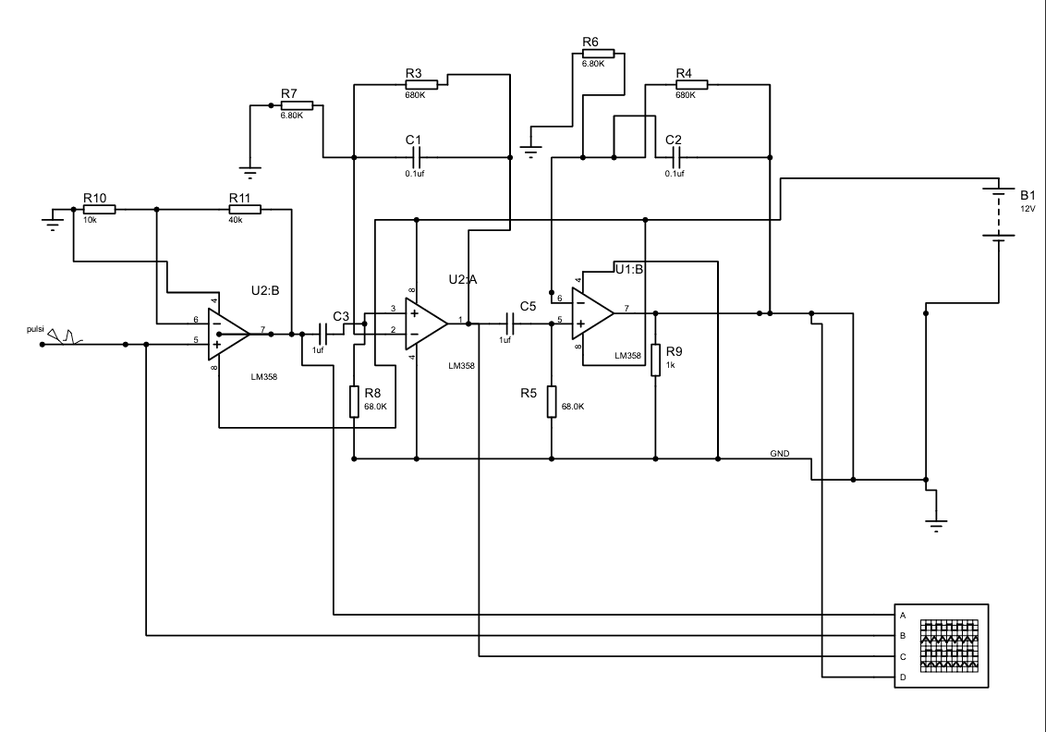
My other Projects (1st junior project)
Pulse oximeter

Slide 29
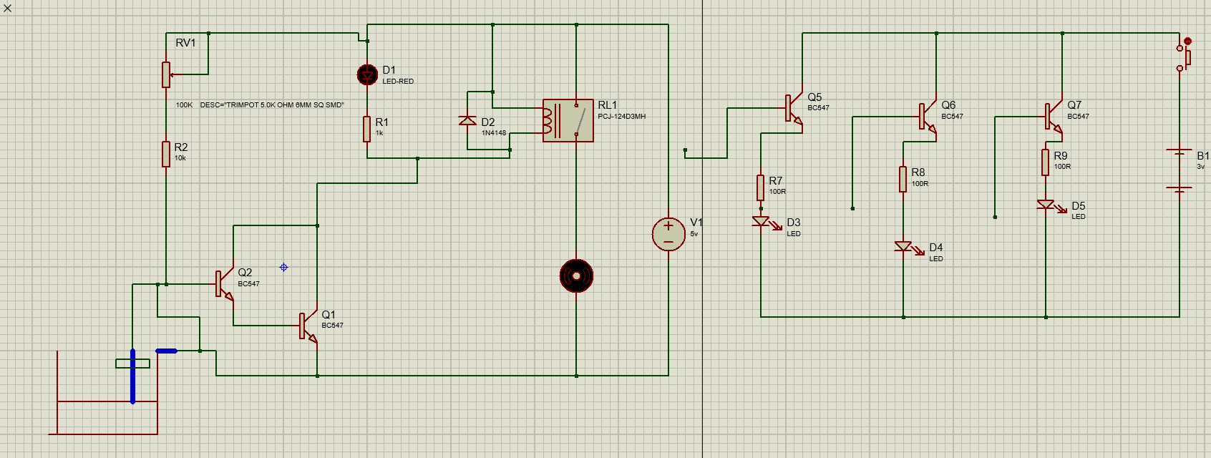
Water relay (1st project)

Slide 30
Thank you for attention
Nikoloz Kalichava – Third-year student bachelor of Electrical and Computer Engineering at the Agricultural University of Georgia.
https://en.wikipedia.org/wiki/Binary_clock

