Slide 1
Obtaining various magnetic fields with a two-dimensional system of currents
John Toidze

Slide 2



Slide 3
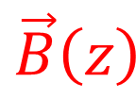
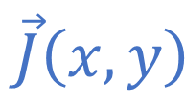
Some magnetic field at Z axis created by any type of system of currents on XY plane
z
$$\vec{B}\left(z\right)$$
y
$$\vec{J}\left(x,y\right)$$
x
Notes:
To solve the problem analytically, let's narrow down the search spectrum and consider the magnetic fields that can be obtained by special cases of two-dimensional current system.
The currents are distributed in the XY plane. Along Z axis, we observe the function of the direction and value of the magnetic field induction vector.

Slide 4
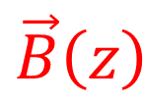


1. Infinitely long constant currents (parallel to Y axis)
2. Magnetic field induction is perpendicular to Y axis
3. The whole picture including currents and field doesn’t change along the Y axis
z
$$\vec{B}\left(z\right)$$
y
$$\vec{J}\left(x\right)$$
x
$$J\left(x\right)=ⅆI/ⅆx$$
Notes:
As a first special case, let's consider the distribution of currents, where the current density is collinear at all points, that means, the currents are parallel to each other everywhere.
J is the current density in a non-classical sense since we need it as the derivative of the current with the length, not with the area.
Along with this, let's add the condition that these parallel currents are infinitely long constant currents, that is, the current density does not change along the Y axis.
This will result in the magnetic field induction at any point being parallel to the XZ plane and not varying along the Y axis.

Slide 5

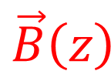
For odd current density functions magnetic field on the YZ plane would be colinear to the Z axis
z
y
$$\vec{B}\left(z\right)$$
$$Odd \vec{J}\left(x\right)$$
x
Notes:
And if the function of the current density is odd, we will get a magnetic induction parallel to the Z axis.

Slide 6
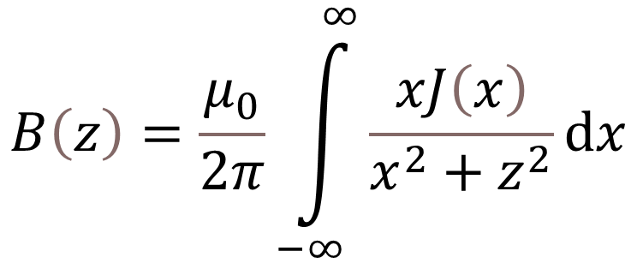
$$B\left(z\right)=\frac{μ_{0}}{2π}\int_{−∞}^{∞}{\frac{xJ\left(x\right)}{x^{2}+z^{2}}ⅆx}$$
Current flowing in the opposite direction of Y
(from the screen, to us)
Current flowing in the direction of Y
(from us, into the screen)
Two symmetrically corresponding currents canceling out the magnetic field projection on X axis
Notes:
It is easy to show that the magnetic field induction function is equal to this integral.
And this figure simply shows how the odd current density takes the upward direction B(z).
Obviously this integral represents the magnetic field created by the continuous current density, but I imagine the simplest and most practical arrangement of currents in a real device is to arrange discrete wires at small distances and draw corresponding currents through them.
To calculate the magnetic field created by this system, we have to use a different formula.

Slide 7

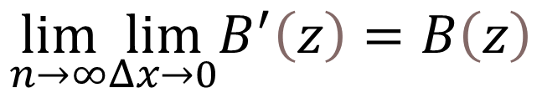
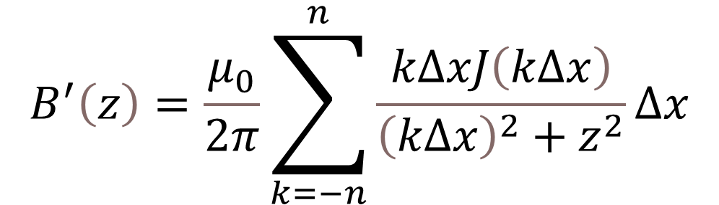

z
$$J\left(2Δx\right)Δx$$
x
y
$$2Δx$$
$$B^{′}\left(z\right)=\frac{μ_{0}}{2π}\sum_{k=−n}^{n}{\frac{kΔxJ\left(kΔx\right)}{{\left(kΔx\right)}^{2}+z^{2}}Δx}$$
$$\lim_{n→∞}\lim_{Δx→0}B^{′}\left(z\right)=B\left(z\right)$$
Discrete case
Discrete to continuous case
Notes:
As you can see, practically the formula is the same, only here we use discrete sum instead of integral.
The B prime represents the experimental magnetic field, which in the case of an ideal device is expressed by the limits given on the slide and is equal to the theoretical B.

Slide 8

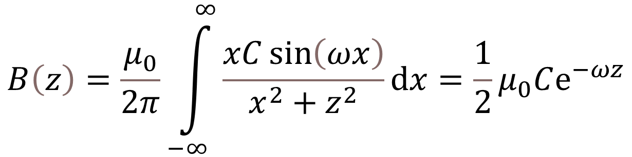
Sine as the odd function
y
$$J\left(x\right)=C\sin\left(ωx\right)$$
x
z
$$B\left(z\right)=\frac{μ_{0}}{2π}\int_{−∞}^{∞}{\frac{xC\sin\left(ωx\right)}{x^{2}+z^{2}}ⅆx}=\frac{1}{2}μ_{0}Cⅇ^{−ωz}$$
Corresponding magnetic field function
Notes:
To compare the results and build the graphs, let's choose any simple odd function, which in this case can be a sine with the corresponding coefficients, of course, because of the units.
Inserting the current density into the formula, we get the corresponding magnetic field.

Slide 9
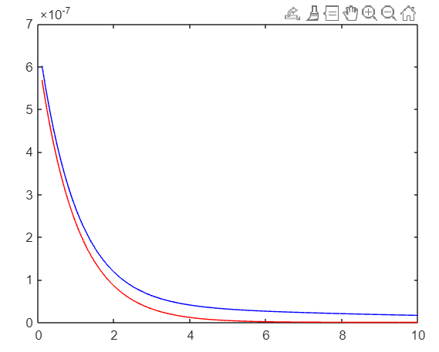






$$B\left(z\right)$$
$$C=1A/m$$
$$ω=1/m$$
$$L=20m$$
$$Δx=0,1m$$
Simulation based
Theoretical
$$z$$
Notes:
We equated the constants mentioned in the previous slide to one in the corresponding SI system units.
L is the distance between the two extreme wires of the experimental setup, and DX is the distance between the two nearest wires.
The red line represents the theoretical magnetic function, whose formula we derived on the previous slide, and the blue line represents the experimental magnetic function.

Slide 10
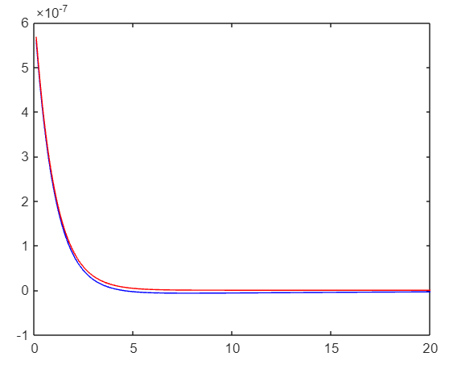

$$B\left(z\right)$$
$$L=40m$$
$$Δx=0,1m$$
$$z$$
Notes:
There is much less error in this graph than the previous one, even though we have also doubled the Z-axis observation distance, along with doubling the distance between the extreme wires.

Slide 11

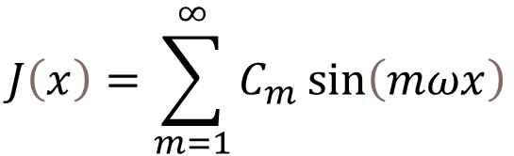

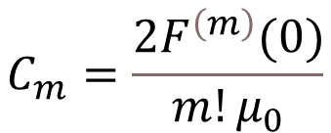
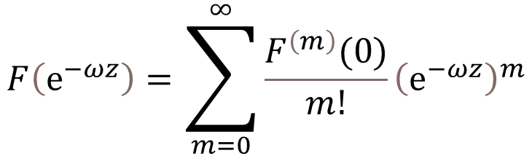
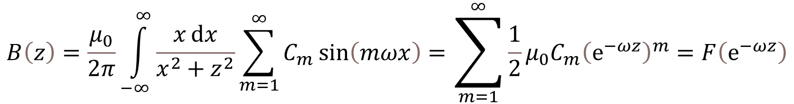
$$J\left(x\right)=\sum_{m=1}^{∞}{C_{m}\sin\left(mωx\right)}$$
$$B\left(z\right)=\frac{μ_{0}}{2π}\int_{−∞}^{∞}{\frac{xⅆx}{x^{2}+z^{2}}}\sum_{m=1}^{∞}{C_{m}\sin\left(mωx\right)}=\sum_{m=1}^{∞}{\frac{1}{2}μ_{0}C_{m}{\left(ⅇ^{−ωz}\right)}^{m}}=F\left(ⅇ^{−ωz}\right)$$
$$F\left(ⅇ^{−ωz}\right)=\sum_{m=0}^{∞}{\frac{F^{\left(m\right)}(0)}{m!}{\left(ⅇ^{−ωz}\right)}^{m}}$$
$$C_{m}=\frac{2F^{\left(m\right)}(0)}{m!μ_{0}}$$
$$F\left(0\right)=0$$
$$F\left(x\right) is analytic$$
Notes:
Now let's generalize the theoretical result and present the current density as a Fourier series or a linear combination of sinuses.
As a result, we get the magnetic field induction function, which can be any analytic function of any exponential decrease, which is equal to 0 in 0.

Slide 12



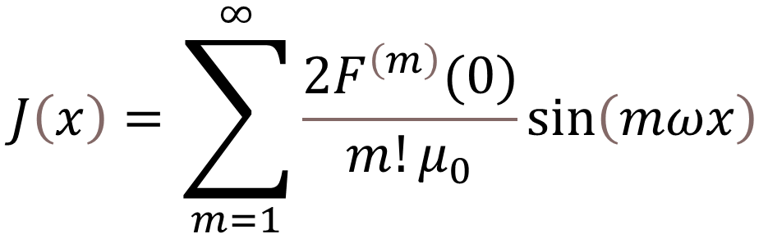
$$J\left(x\right)=\sum_{m=1}^{∞}{\frac{2F^{\left(m\right)}(0)}{m!μ_{0}}\sin\left(mωx\right)}$$
$$B\left(z\right)=F\left(ⅇ^{−ωz}\right)$$
z
y
$$\vec{B}\left(z\right)$$
$$Odd \vec{J}\left(x\right)$$
x
Notes:
Finally, it is easy to show that if the desired magnetic field function can be written as follows, then we can find the current density with which to create this magnetic field.
We can get this current density function by the formula shown on the slide.

Slide 13

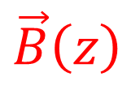
For even current density functions magnetic field on the YZ plane would be colinear to the X axis
z
$$\vec{B}\left(z\right)$$
y
$$Even \vec{J}\left(x\right)$$
x
Notes:
We have effectively solved our initial problem for odd current densities, now let's see what happens for even functions.
Obviously an even current density will give us a magnetic field that is parallel to the X axis.

Slide 14
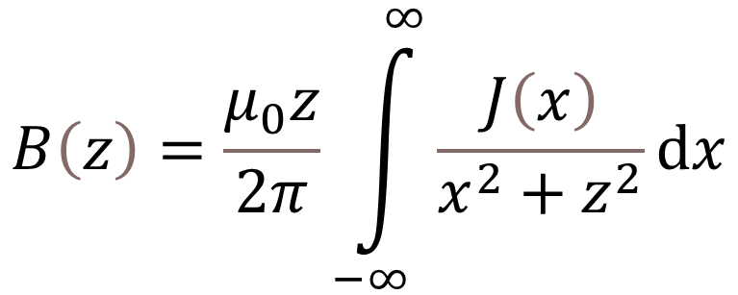
$$B\left(z\right)=\frac{μ_{0}z}{2π}\int_{−∞}^{∞}{\frac{J\left(x\right)}{x^{2}+z^{2}}ⅆx}$$
Current flowing in the direction of Y
(from us, into the screen)
Current flowing in the direction of Y
(from us, into the screen)
Two symmetrically corresponding currents canceling out the magnetic field projection on Z axis
Notes:
Along with the direction, the integral will also be slightly different.

Slide 15

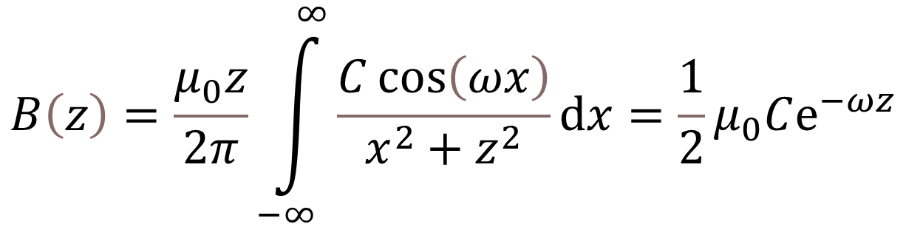
Cosine as the even function
y
$$J\left(x\right)=C\cos\left(ωx\right)$$
x
z
$$B\left(z\right)=\frac{μ_{0}z}{2π}\int_{−∞}^{∞}{\frac{C\cos\left(ωx\right)}{x^{2}+z^{2}}ⅆx}=\frac{1}{2}μ_{0}Cⅇ^{−ωz}$$
Corresponding magnetic field function
(same function as before)
Notes:
Despite the difference in the integral, when inserting the cosine, we get a familiar function, which we can conclude from this that it determines everything exactly as in the case of odd current density.

Slide 16
Parallel plane for the XZ

Slide 17
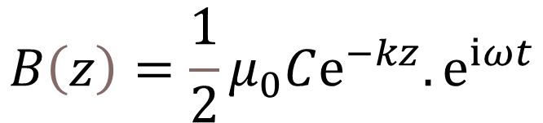

$$B\left(z\right)=\frac{1}{2}μ_{0}Cⅇ^{−kz}.ⅇ^{iωt}$$
$$J\left(x\right)=C\cos\left(kx−ωt\right)$$

Slide 18



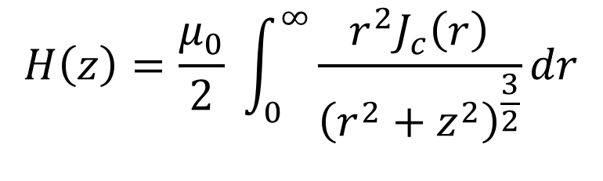


Circular currents and magnetic field with axial symmetry
$$H\left(z\right)=\frac{μ_{0}}{2} \int_{0}^{∞}{\frac{r^{2}J_{c}\left(r\right)}{{\left(r^{2}+z^{2}\right)}^{\frac{3}{2}}}}dr$$
z
$$\vec{H}\left(z\right)$$
$$J_{c}\left(r\right)$$
$$J_{c}\left(r\right)∼\frac{1}{r} B(z)∼\frac{1}{z}$$
$$J_{c}\left(r\right)∼\frac{1}{r^{2}} B(z)∼\frac{1}{z^{2}}$$
$$θ$$
$$r$$
Notes:
Now consider another special case involving concentric circular currents.
The general integral for the circular current density and the formula for the function of the value of the magnetic field induction along the Z axis are presented on the slide.
Obviously, the magnetic field will be symmetric about the Z axis.
In the circular case, it is denoted by the letter H and the current density by Jc.
The slide also shows two interesting cases, although they are less feasible in reality due to their non-analyticity.

Slide 19




$$B_{z}\left(z\right)=\vec{B}\left(z\right)⋅\vec{e_{z}}$$
z
$$\vec{B}\left(z\right)$$
$$\vec{J}\left(r,θ\right)$$
$$r$$
$$θ$$
Notes:
Now let's take a random distribution of currents and observe the projections of the magnetic vector obtained on the Z axis. And let’s call it Bz(z) as its written there.

Slide 20








$$\vec{H}\left(z\right) has axial symmetry$$
$$H\left(z\right)=B_{z}\left(z\right)$$
z
z
$$\vec{B}\left(z\right)$$
$$\vec{H}\left(z\right)$$
$$\vec{J}\left(r,θ\right)$$
$$J_{c}\left(r\right)$$
$$r$$
$$θ$$
$$θ$$
$$r$$
Notes:
If somehow we get the desired projection function along the Z axis, I can represent the circular current distribution to give me that magnetic field function while being axially symmetric.
Let’s call it “The circulating the current plane”.

Slide 21





$$\overline{J}\left(r\right)$$
$$\vec{J}\left(r,θ\right)$$
$${\overline{J}}_{r}\left(r\right)$$
$${\overline{J}}_{θ}\left(r\right)$$
$$θ$$
Notes:
Both figures show circles of some radius r, the left figure shows a random distribution of currents, and the right figure shows this random current density averaged along the contour of the circle.

Slide 22
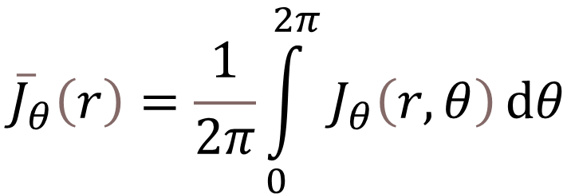
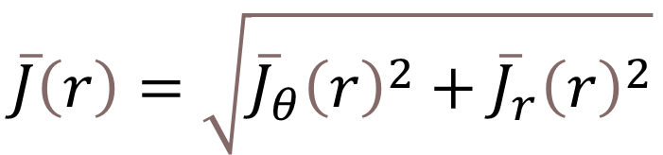
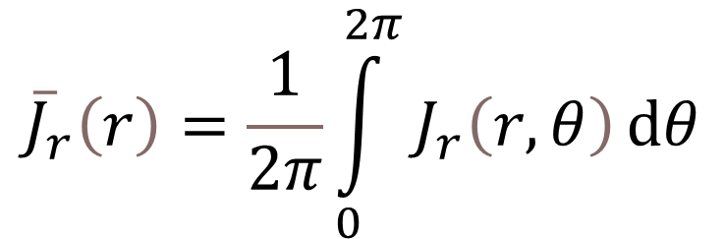
$${\overline{J}}_{θ}\left(r\right)=\frac{1}{2π}\int_{0}^{2π}{J_{θ}\left(r,θ\right)ⅆθ}$$
$${\overline{J}}_{r}\left(r\right)=\frac{1}{2π}\int_{0}^{2π}{J_{r}\left(r,θ\right)ⅆθ}$$
$$\overline{J}\left(r\right)=\sqrt{{\overline{J}}_{θ}{\left(r\right)}^{2}+{\overline{J}}_{r}{\left(r\right)}^{2}}$$
Notes:
The average angular current density along the angle and the average radial current density along the angle are shown.
Such averaging preserves the function of the magnetic field induction projected on the Z axis and makes the field itself axially symmetric.

Slide 23

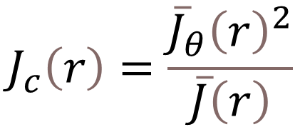



$$ⅆI={\overline{J}}_{θ}dr$$
$$ⅆI⋅\cos{α}=ⅆI⋅{{\overline{J}}_{θ}}/{\overline{J}}$$
$$r$$
$$r+dr$$
$$J_{c}\left(r\right)=\frac{{\overline{J}}_{θ}{\left(r\right)}^{2}}{\overline{J}\left(r\right)}$$
Notes:
In order to more easily assemble the experimental device and eliminate the currents that we do not need, we need to remove the radial current density, however, we cannot get the effect by simply leaving the angular component, so we need a new circular current density, the formula of which is presented on the slide.

Slide 24

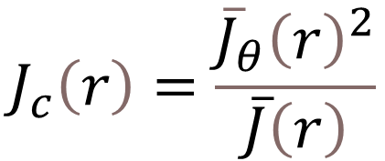
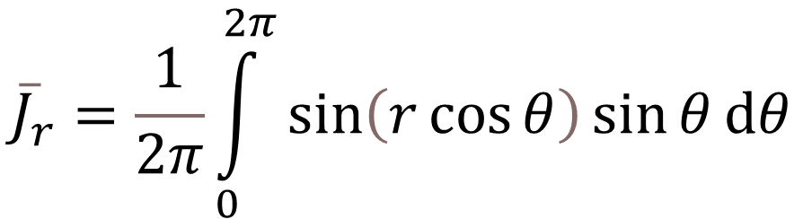
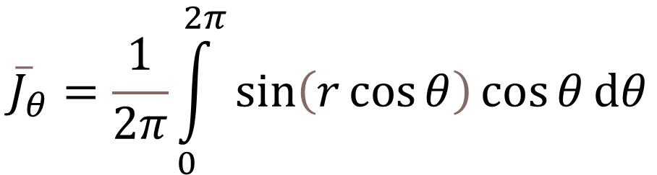
$$J\left(x\right)=C\sin\left(ωx\right)=\sin{x}$$
$${\overline{J}}_{θ}=\frac{1}{2π}\int_{0}^{2π}{\sin\left(r\cos{θ}\right)\cos{θ}ⅆθ}$$
$${\overline{J}}_{r}=\frac{1}{2π}\int_{0}^{2π}{\sin\left(r\cos{θ}\right)\sin{θ}ⅆθ}$$
$$J_{c}\left(r\right)=\frac{{\overline{J}}_{θ}{\left(r\right)}^{2}}{\overline{J}\left(r\right)}$$
Notes:
To test our theory and check the optimality of the device, let's take the already well-known sine current density and "circulate" it.

Slide 25
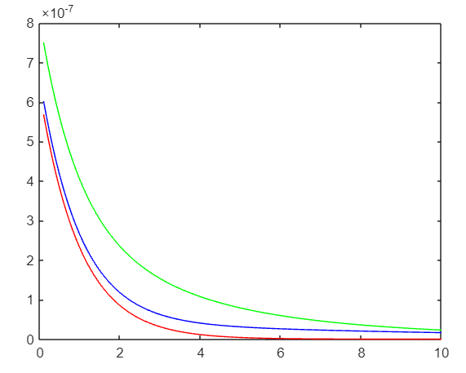
$$B\left(z\right)$$
$$L=20m$$
$$Δx=0,1m$$
$$z$$
Notes:
If we subtract the green line, we have already seen this graph, which we got as the sine current density. The green line shows the experimental magnetic field that we made with circular currents where the wires are circular.
L is, as it was, the distance between the furthest linear wires, but in the new device it represents the diameter of the largest circular wire.
And DX expresses the smallest difference between the radiuses of the circular wire.

Slide 26
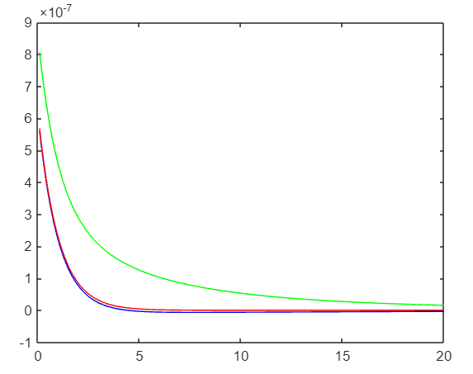
$$B\left(z\right)$$
$$L=40m$$
$$Δx=0,1m$$
$$z$$
Notes:
This is the second familiar graph where we increased L and automatically the number of wires, hoping that the circular experimental result would resemble the theoretical result like a linear one, however, as we can see, the circular device turned out to be more "stubborn" and increasing the distance in this way is not enough for it.

Slide 27
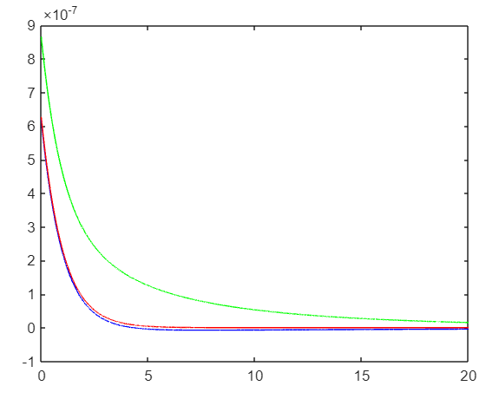

$$B\left(z\right)$$
$$L=40m$$
$$Δx=0,001m$$
$$z$$
Notes:
A decrease in DX did not cause the improvement of the setup either, although we can justify the error in the result of the circular experiment by saying that this machine has to repeat the feat of infinitely long wires while actually being in finite limits. Therefore, I believe that despite the existence of a large error, due to the similarity of the shape of the function, we can conclude that the "circulation" technique works.

Slide 28
Thanks for attention!!!

