Slide 1
Chaotic motion of a pendulum
Author: Alesandro Nonikashvili
Supervisor: Alexandre Gurchumelia

Slide 2
About me
Digital skills:
C++
Matlab
Python
Microsoft Office
LaTeX
Education:
Student at Tbilisi State University(TSU) 3rd year Physics Bachelor
Graduated from 21st public School of Tbilisi
Participated in youth exchange Erasmus+ project
“Whatever our differences, France, 2024
Language Skills:
English
German
Georgian
Working experience:
At international outsourcing company Teleperformance
Private tutoring
Research interests:
Condensed matter physics, Quantum physics,
High-Energy & Particle physics,
computational physics, Atomic physics,

Slide 3
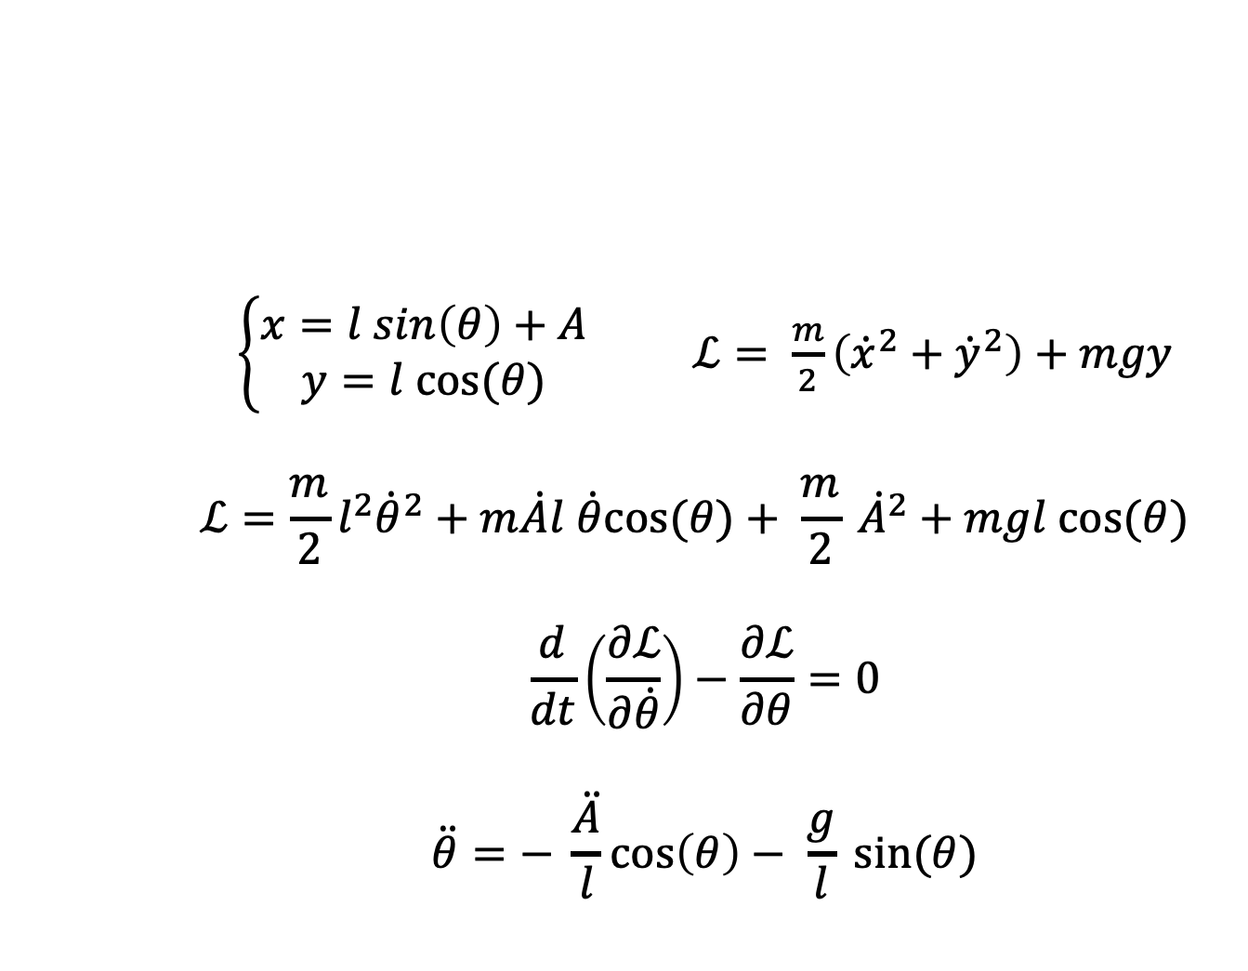
Equation of motion
$\left\{\begin{aligned}x=l sin\left(θ\right)+A \\ y=l cos⁡(θ)\end{aligned}\right.$ $ℒ= \frac{m}{2}\left({\dot{x}}^{2}+{\dot{y}}^{2}\right)+mgy$
$$ℒ=\frac{m}{2}l^{2}{\dot{θ}}^{2}+m\dot{A}l \dot{θ}cos⁡(θ)+ \frac{m}{2} {\dot{A}}^{2}+mgl cos⁡(θ)$$
$$\frac{d}{dt}\left(\frac{∂ℒ}{∂\dot{θ}}\right)−\frac{∂ℒ}{∂θ}=0$$
$$\ddot{θ}=− \frac{\ddot{A}}{l}\cos\left(θ\right)− \frac{g}{l} sin⁡(θ)$$

Slide 4
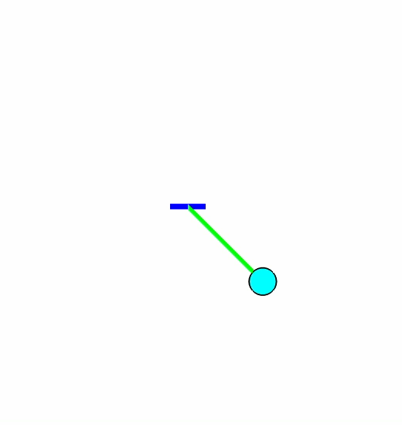

Equation of motion
$$A=r cos⁡(ωt)$$
$$\ddot{θ}=\frac{rω^{2}}{l}\cos\left(ωt\right)\cos\left(θ\right)− \frac{g}{l} sin⁡(θ)$$
$$\ddot{θ}=δ\cos{γt}\cos{θ}−\sin{θ}$$
$δ=\frac{rω^{2}}{g}$ $γ=ω\sqrt{\frac{l}{g}}$

Slide 5
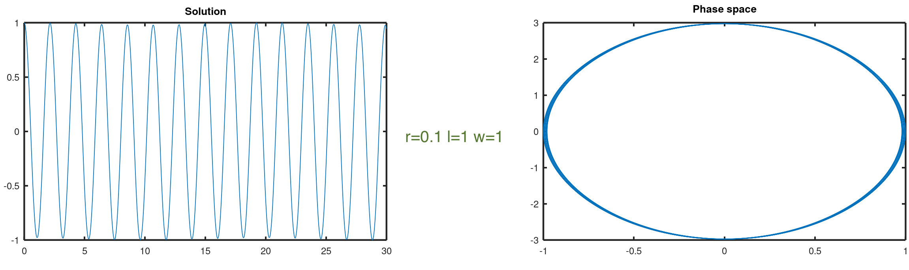
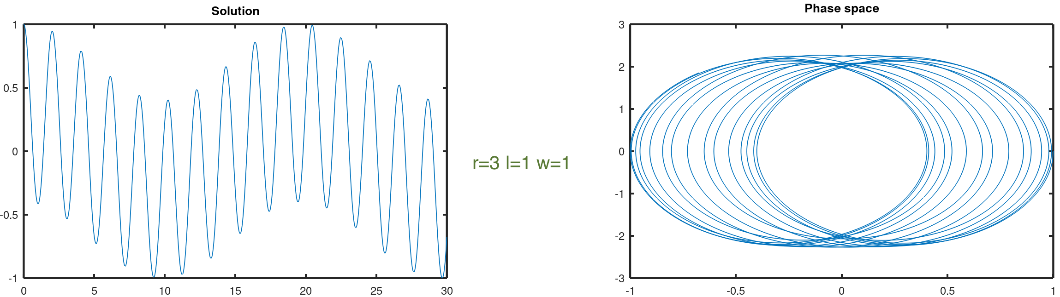
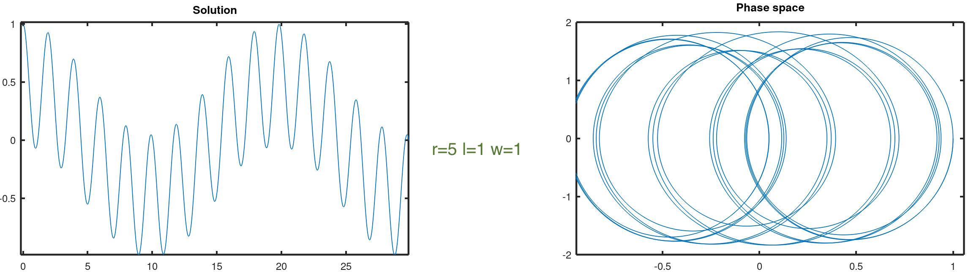
Amplitude of
Oscillation
(r)

Slide 6
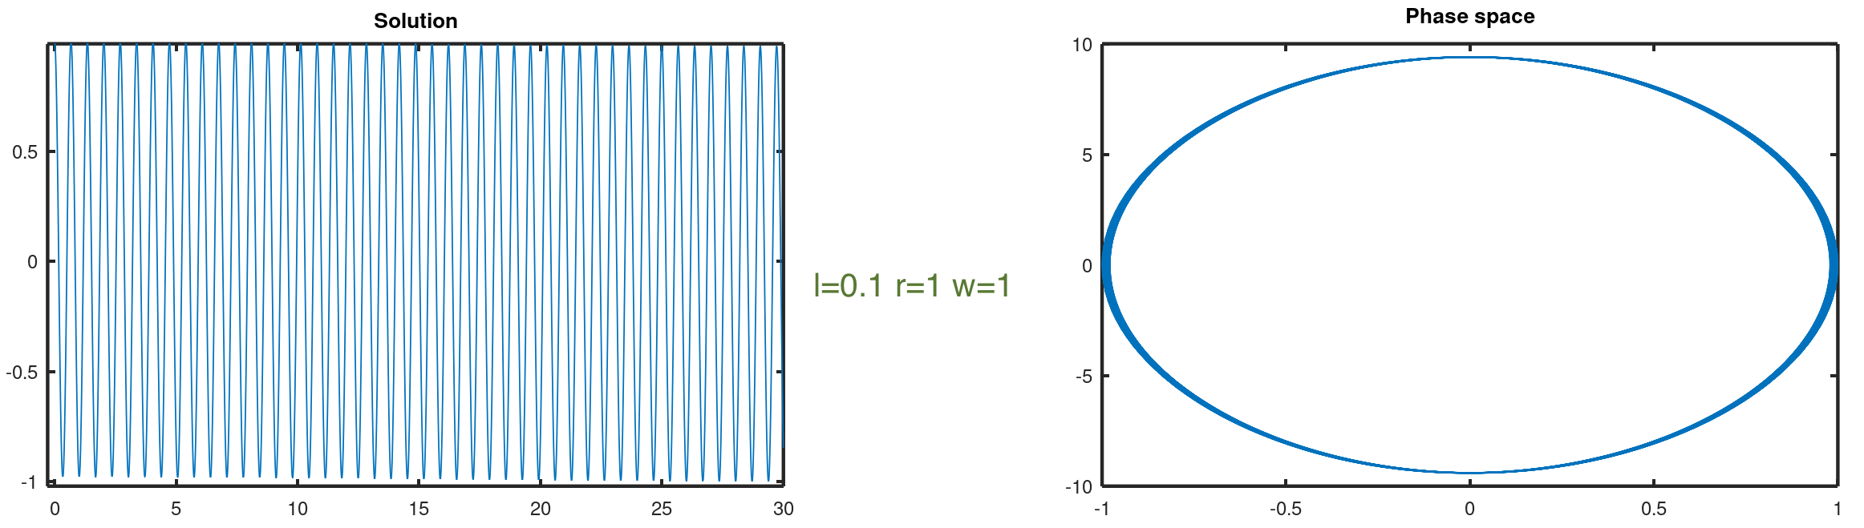
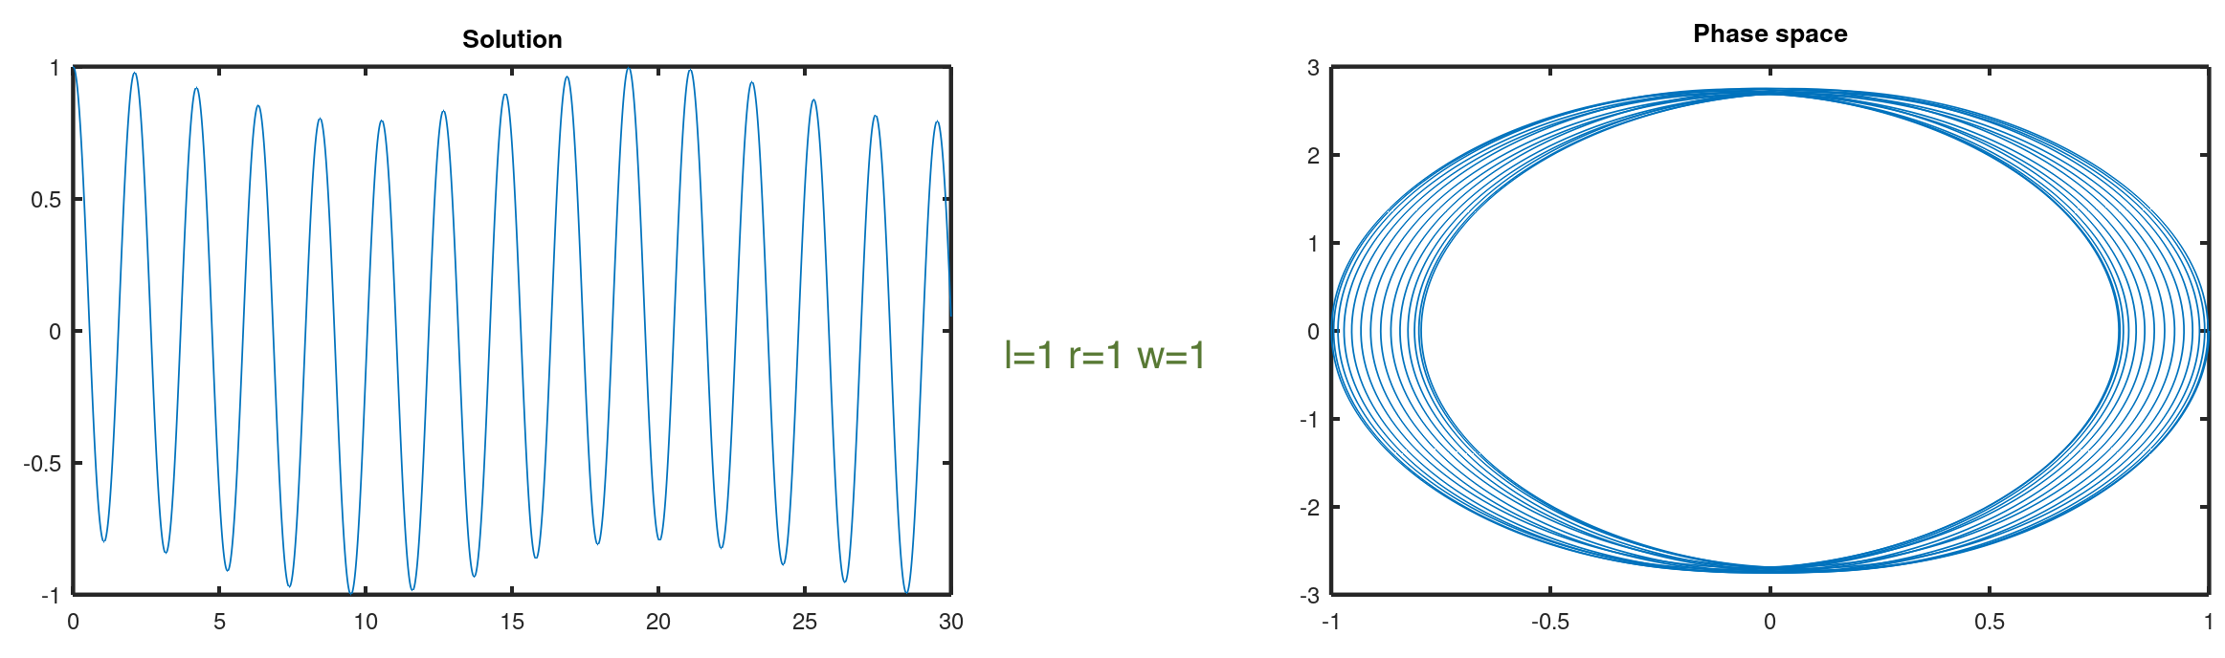
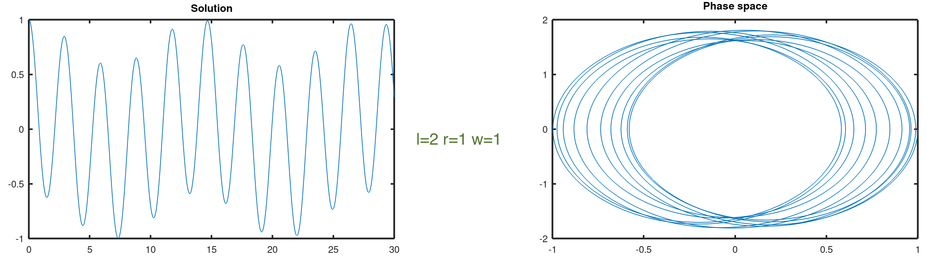
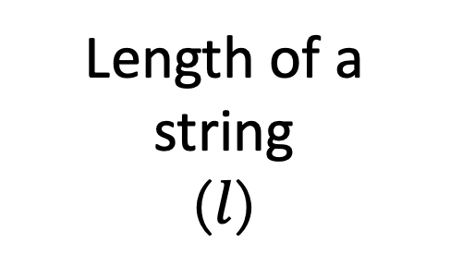
Length of a string
($l$)

Slide 7
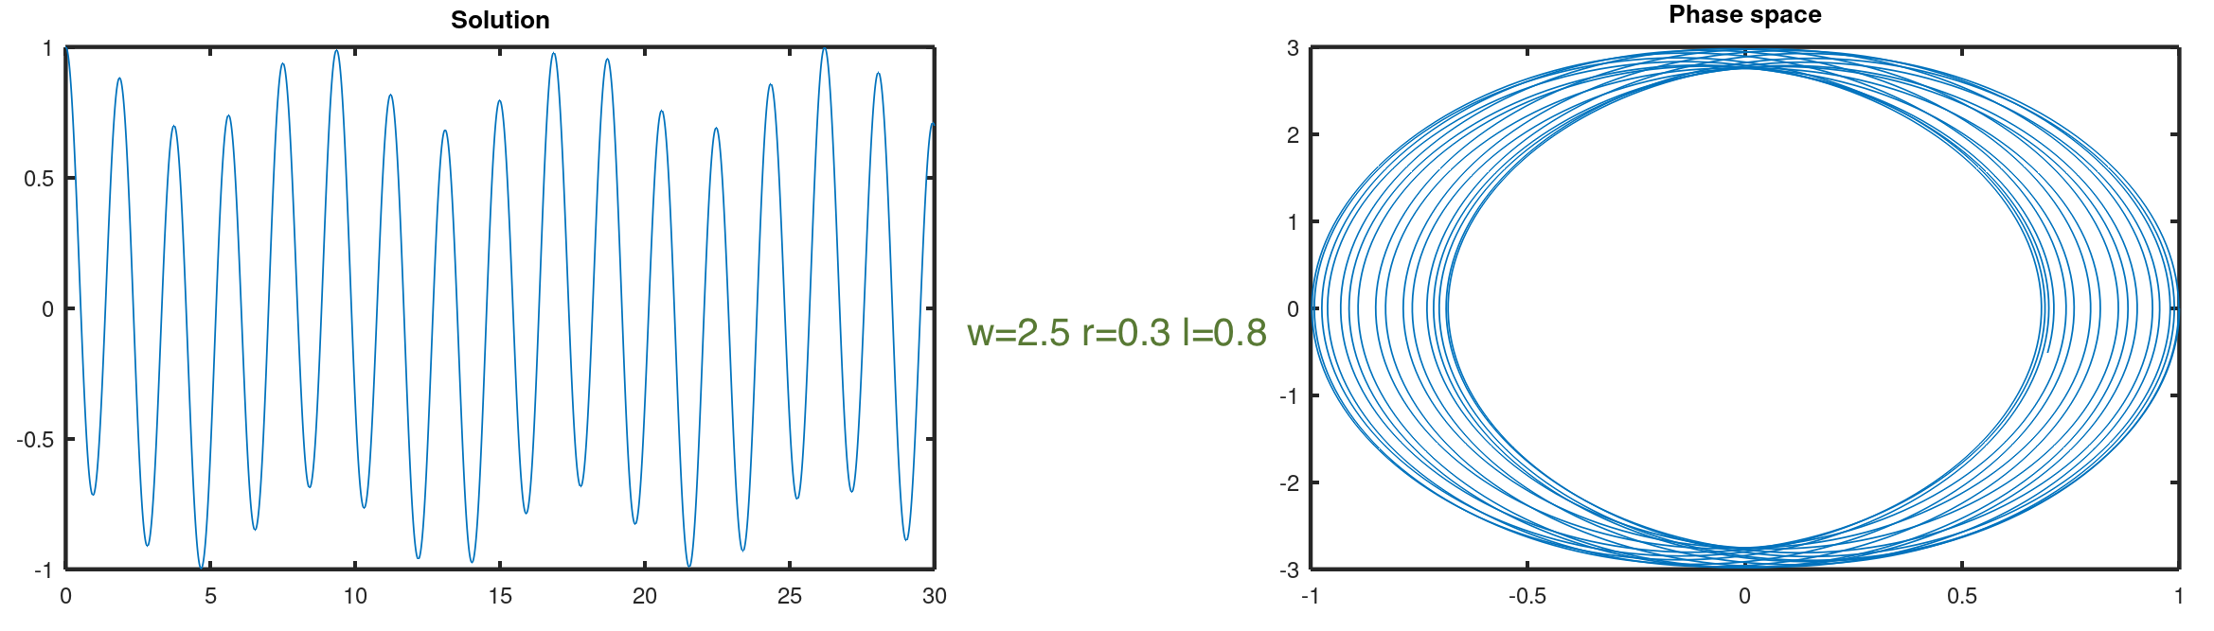
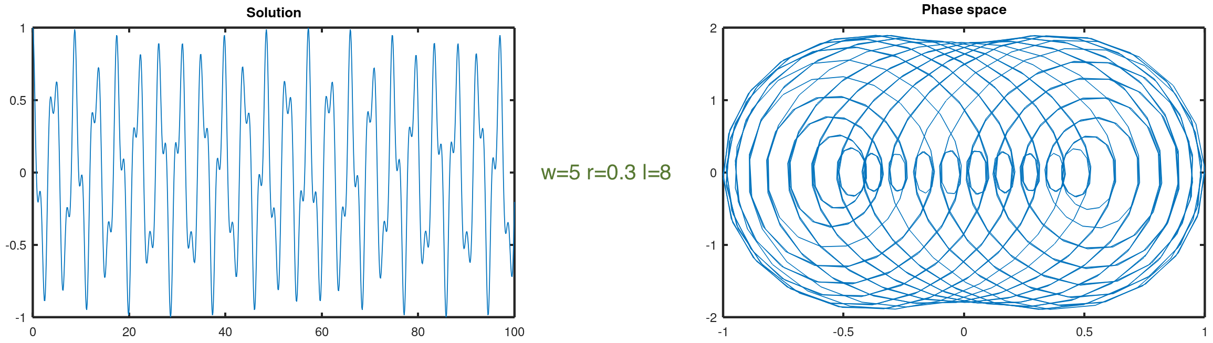
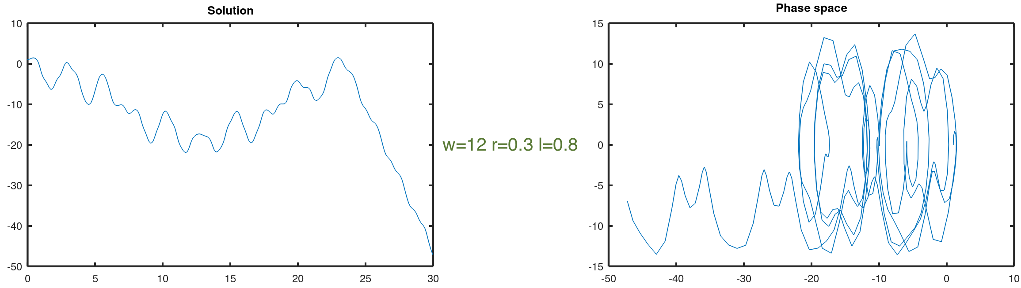

Angular frequency
($ω$)

Slide 8
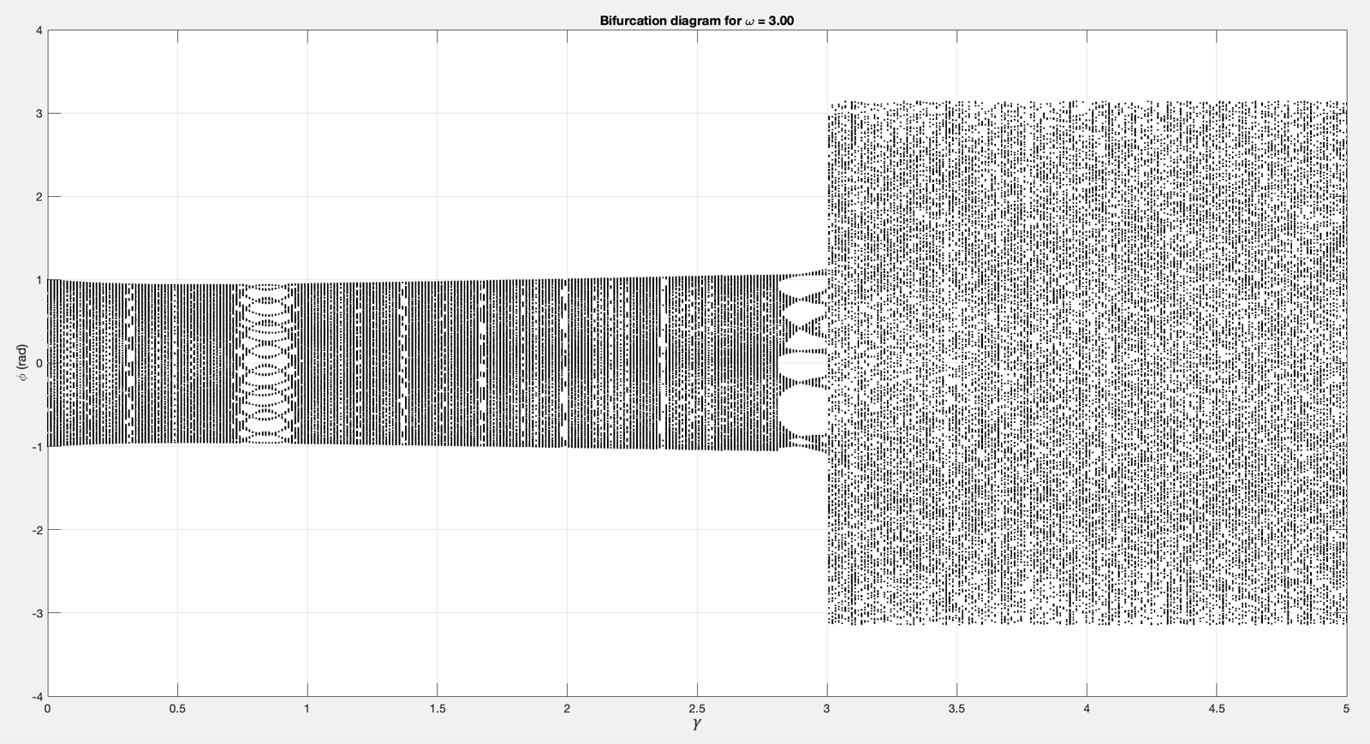
Bifurcation diagram

Slide 9
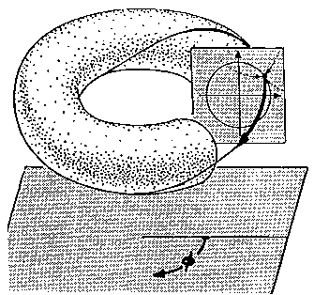
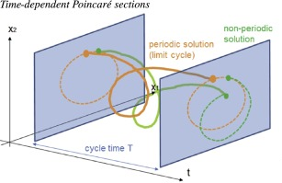
Poincaré section

Slide 10
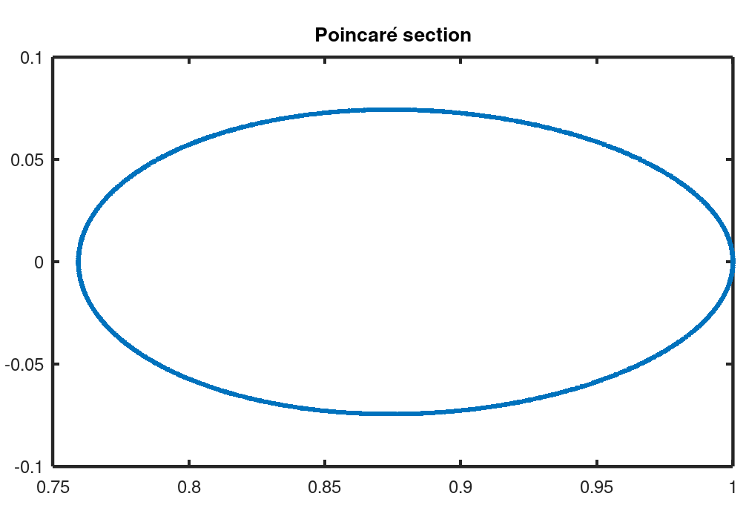
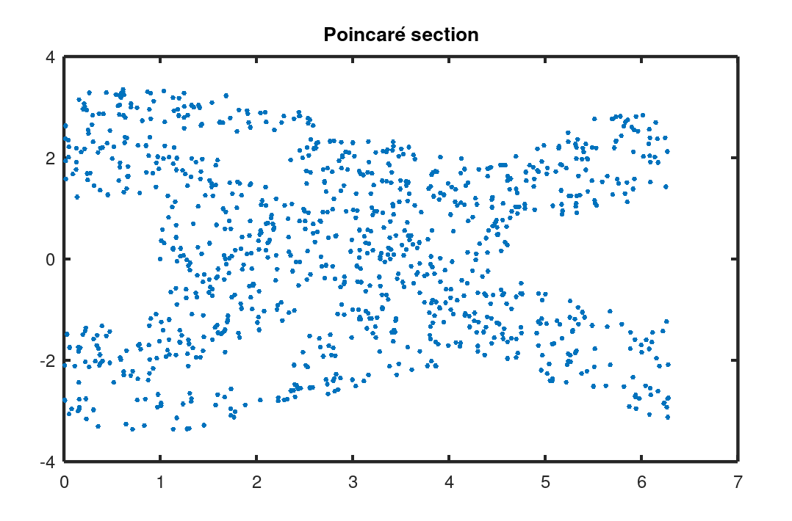
Poincaré section

Slide 11
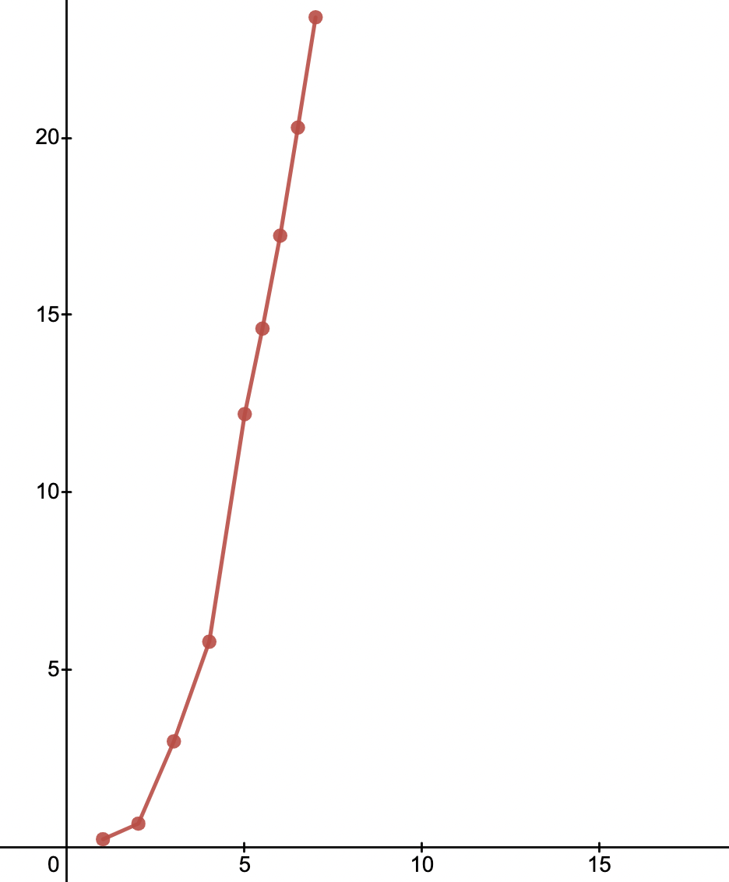


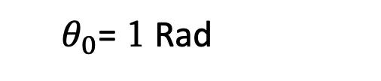

$$δ$$
Transition to chaos
$θ_{0}$= 1 Rad
Chaos
$δ=\frac{r}{g}$ $ω^{2}$
$$γ=ω\sqrt{\frac{l}{g}}$$
Stable
$$γ$$

Slide 12
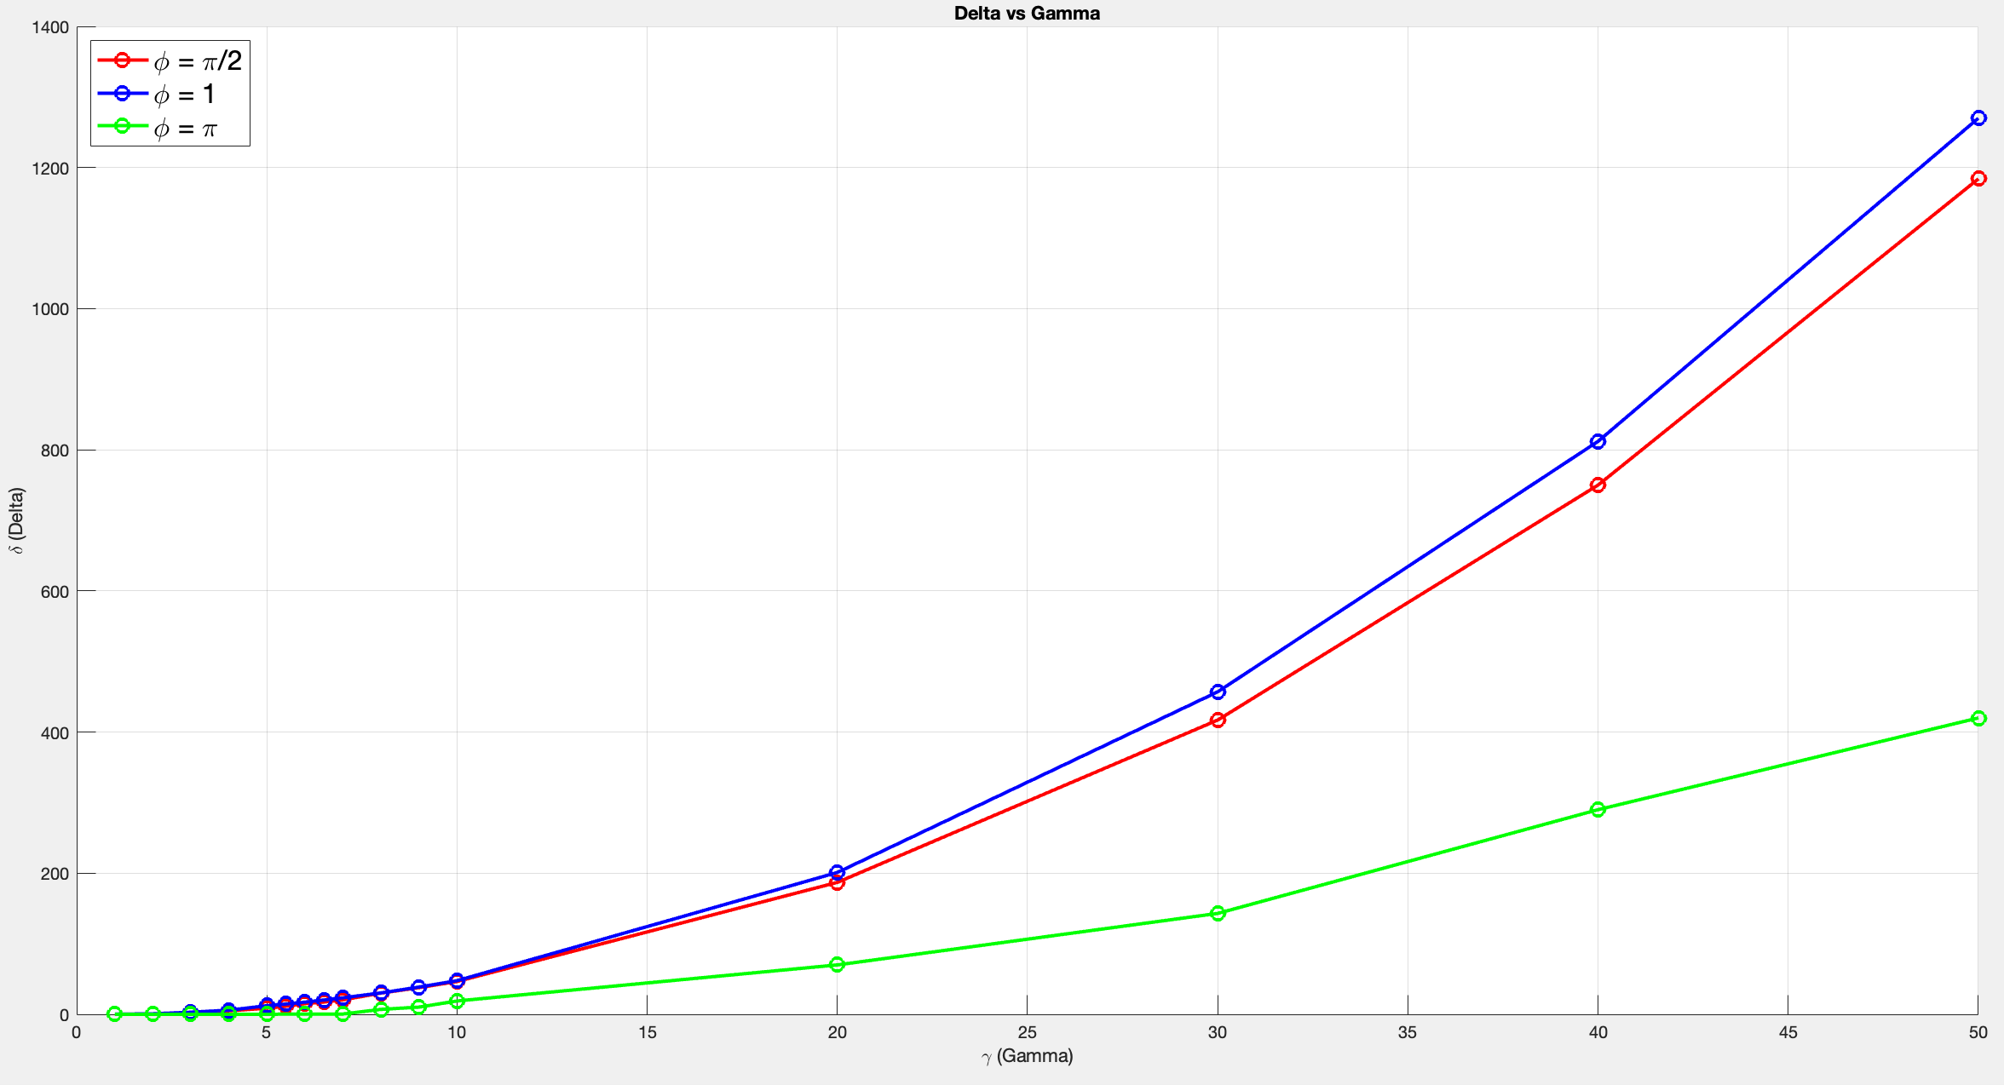
Dependence on angle

Slide 13
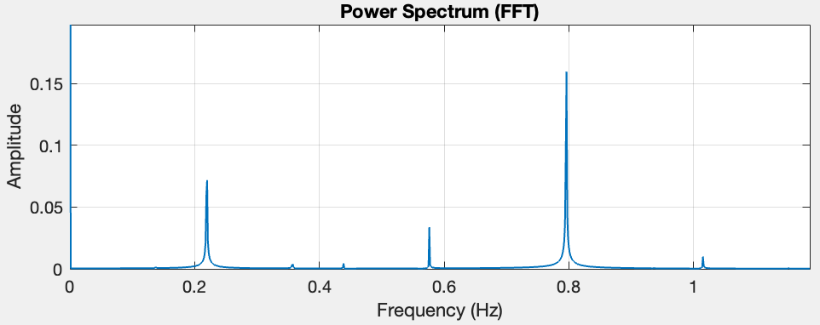
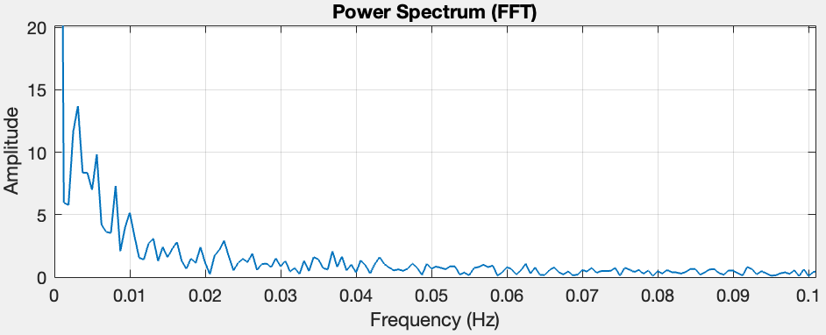
Fast-Fourier transform

Slide 14
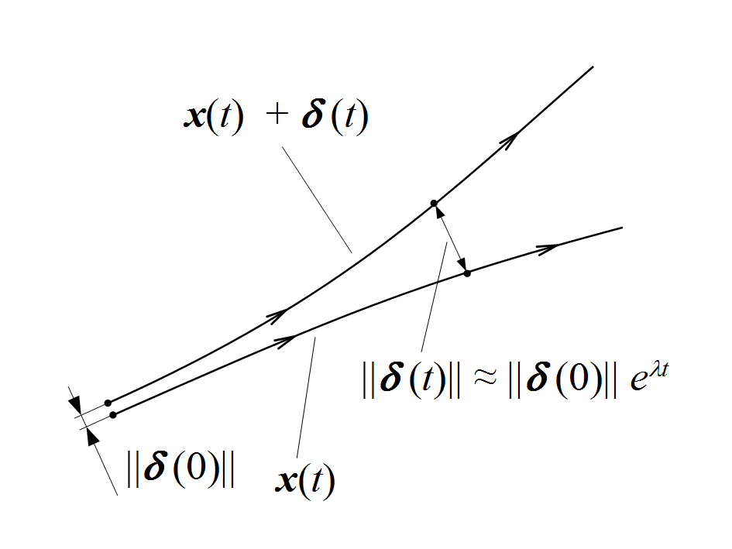
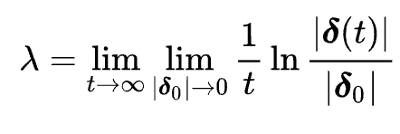
Lyapunov exponent
λ > 0 Chaotic
λ ≈ 0 Quasiperiodic
λ < 0 Stable

Slide 15
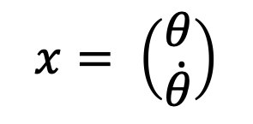
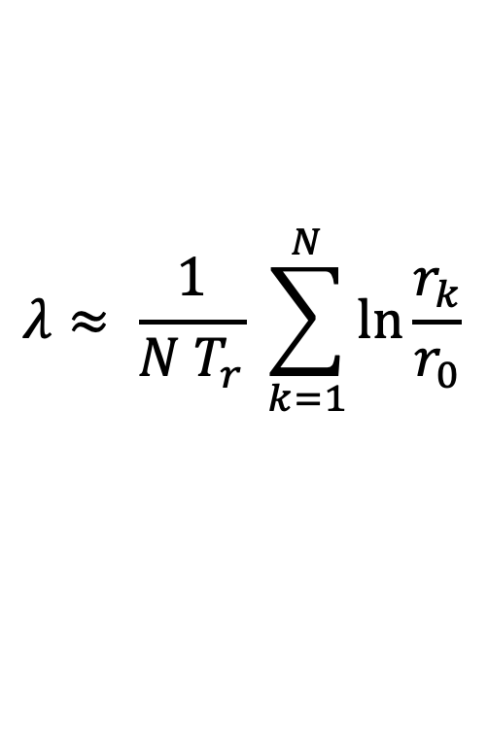
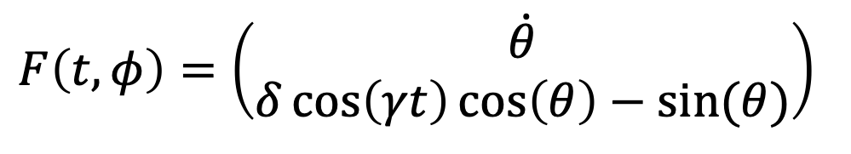
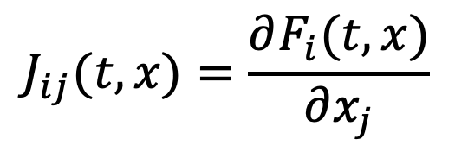
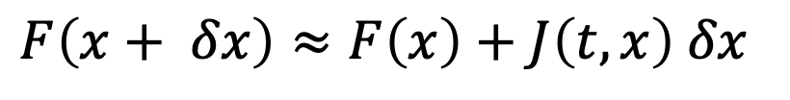
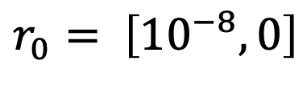
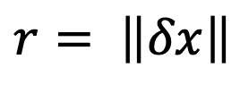
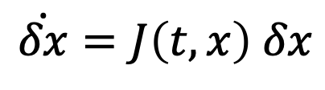
Computing LE
$$F\left(t, φ\right)=\left(\begin{matrix}\dot{θ} \\ δ\cos\left(γt\right)\cos\left(θ\right)−sin⁡(θ)\end{matrix}\right)$$
$$J_{ij}(t,x)=\frac{∂F_{i}(t, x)}{∂x_{j}}$$
$$x= \left(\begin{matrix}θ \\ \dot{θ}\end{matrix}\right)$$
$$F\left(x+ δx\right)≈F\left(x\right)+J\left(t, x\right) δx$$
$$\dot{δx}=J\left(t,x\right) δx$$
$$λ≈ \frac{1}{N T_{r}} \sum_{k=1}^{N}{\ln{\frac{r_{k}}{r_{0}}}}$$
$$r= \left\|δx\right\|$$
$$r_{0}= \left[{10}^{−8}, 0\right]$$

Slide 16
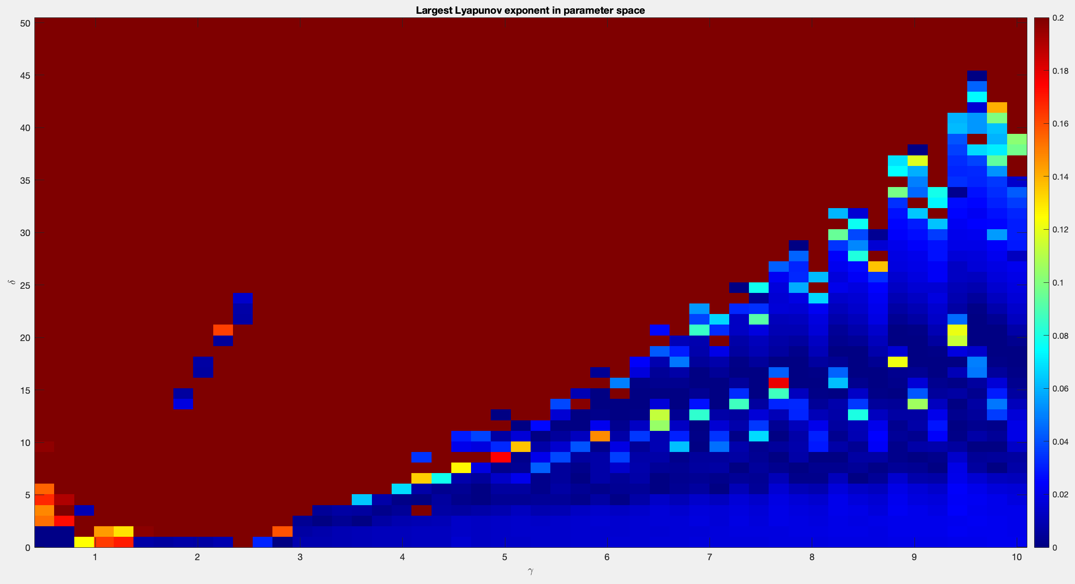
LLE in parameter space

Slide 17
Thank you for your attention!

