Slide 1
Computational modeling of aircraft flight and machine learning-based control
Author: Luka Gurasashvili

Slide 2
Agenda
Introduction
  About me and my university
  About my research
  Motivation for research
Computational modeling of aircraft flight
  CFD
  Mathematical modeling with Python and SciPy library
  Simulation using the RK4 method and Python
Machine learning based control
  Neuroevolution
  Neural network
  Training
  Flight!

Slide 3

About me
Computer Science
Fluid Dynamics
Computational Fluid Dynamics
Computational Mechanics
Machine Learning
Free and Open Source Software
CAD

Slide 4


About me and my University

Slide 5
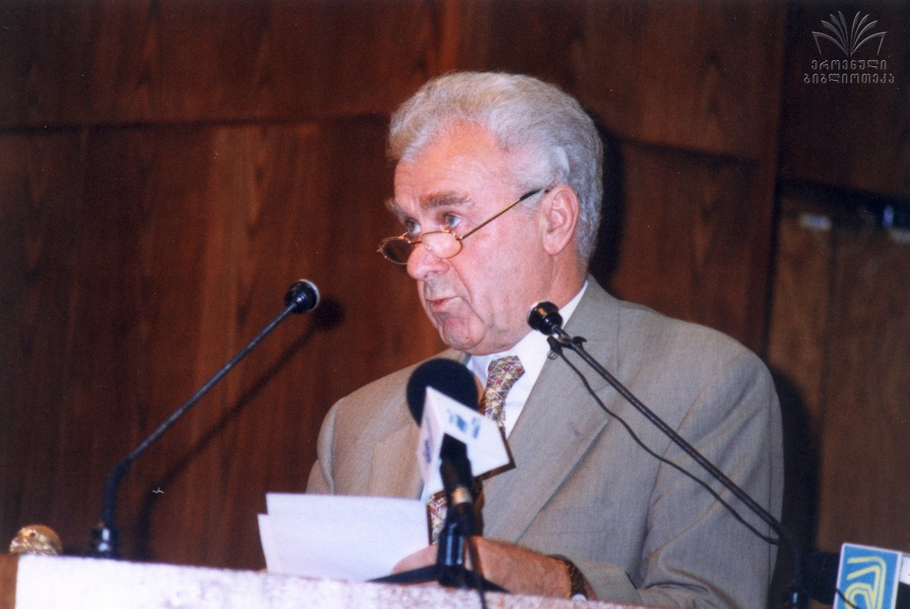
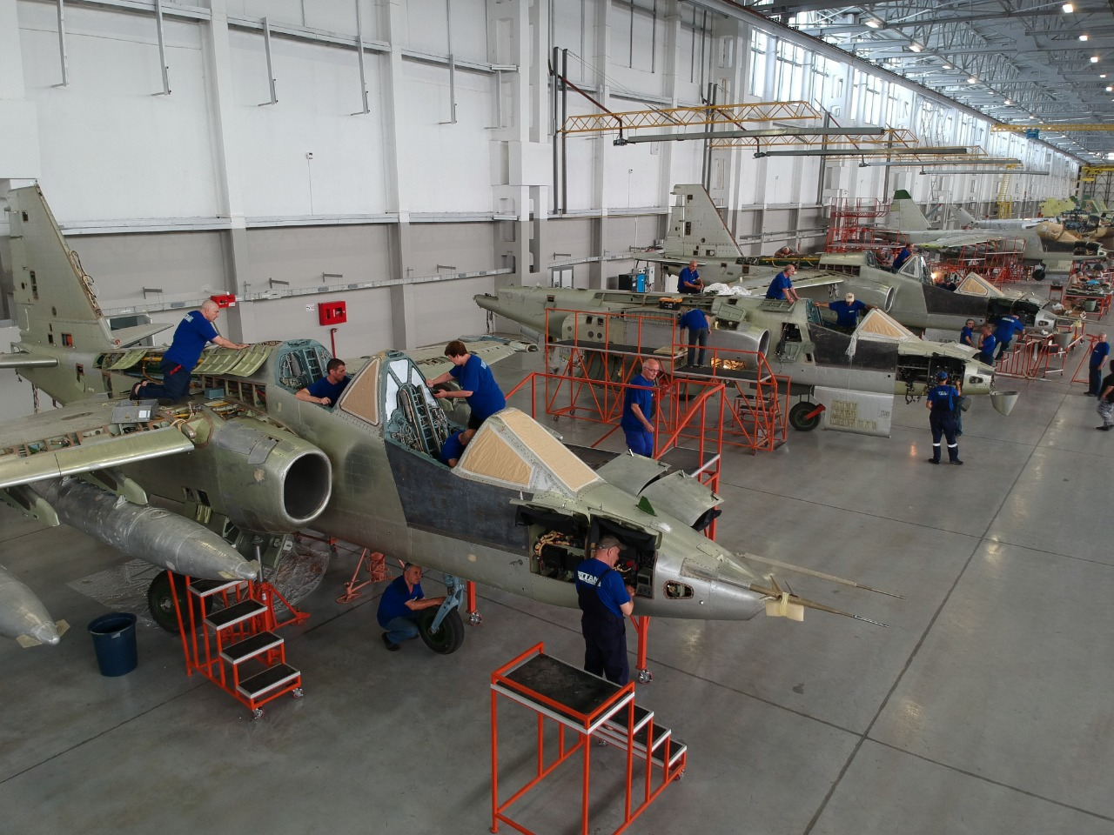
Thank you to TAM management
CEO: Vazha (Pantiko) Tordia

Slide 6
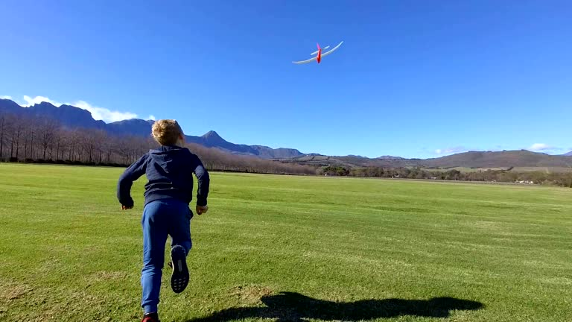
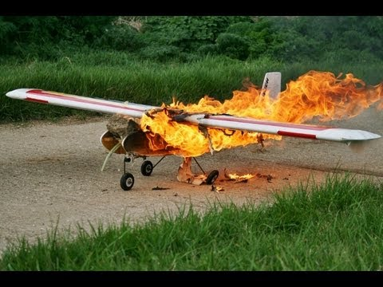
Motivation for my research

Slide 7



Computational Fluid Dynamics

Slide 8
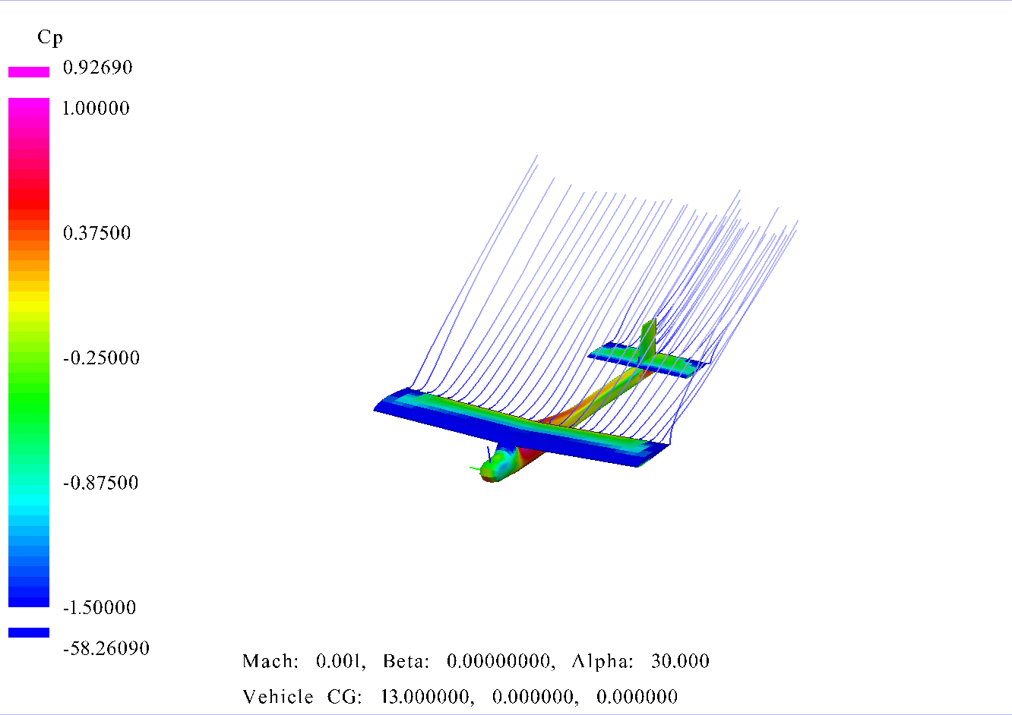
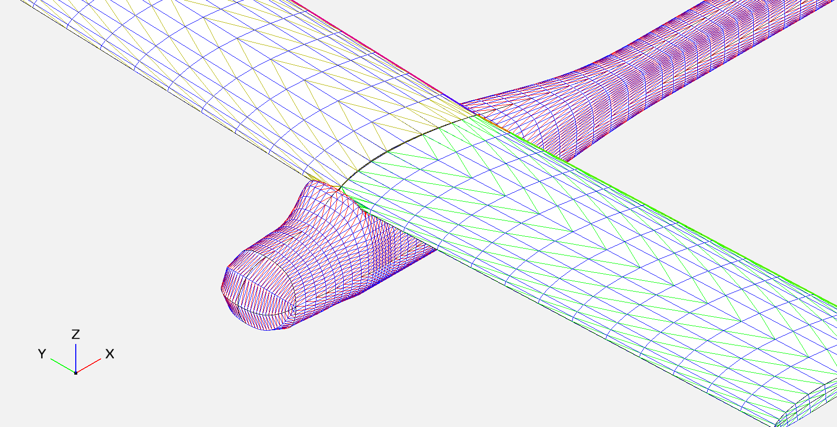
Simulation results

Slide 9
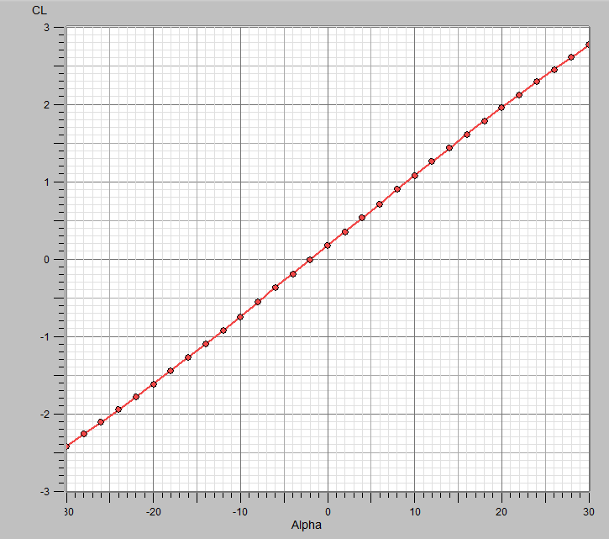
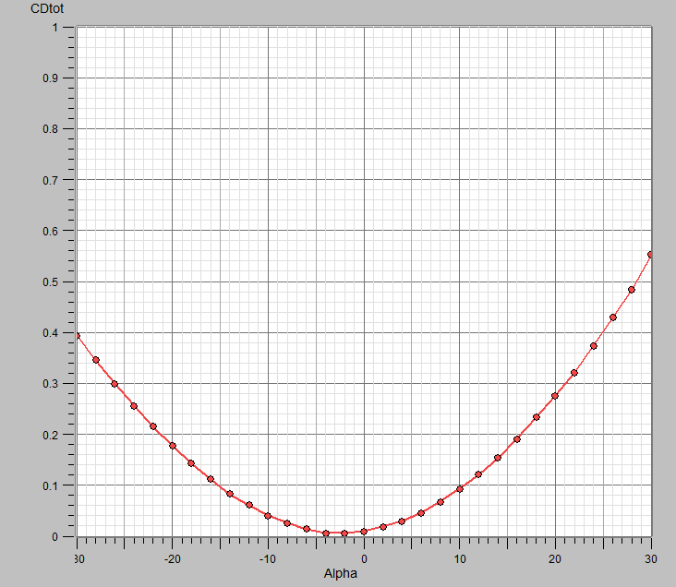
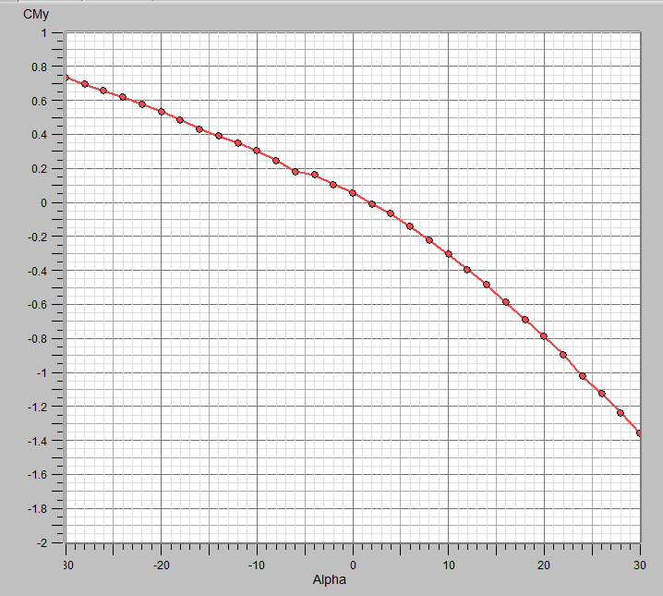
Simulation results
Lift Coefficient Graph
Drag Coefficient Graph
Moment Coefficient around y-axis

Slide 10
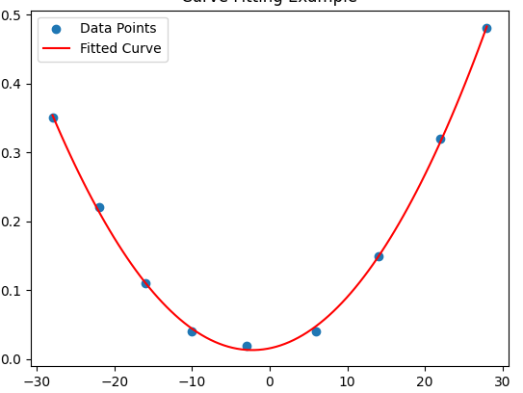
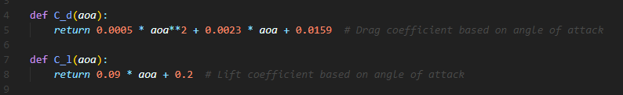

Mathematical modeling
Curve Fitting for Drag Coefficient

Slide 11
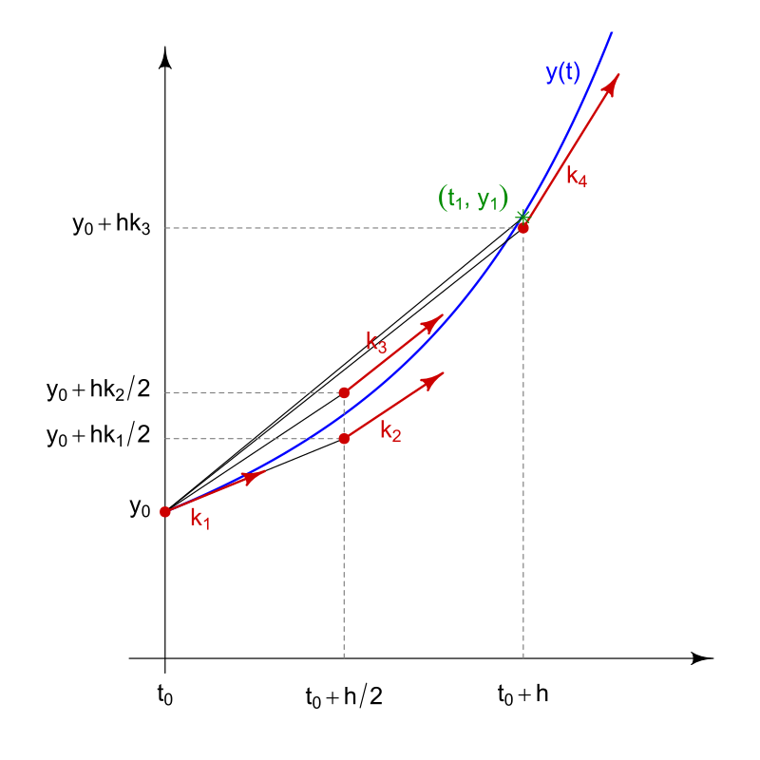
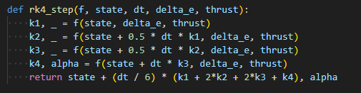
Simulation With the Mathematical Model
Runge-Kutta 4th order method and fail with Euler’s method

Slide 12
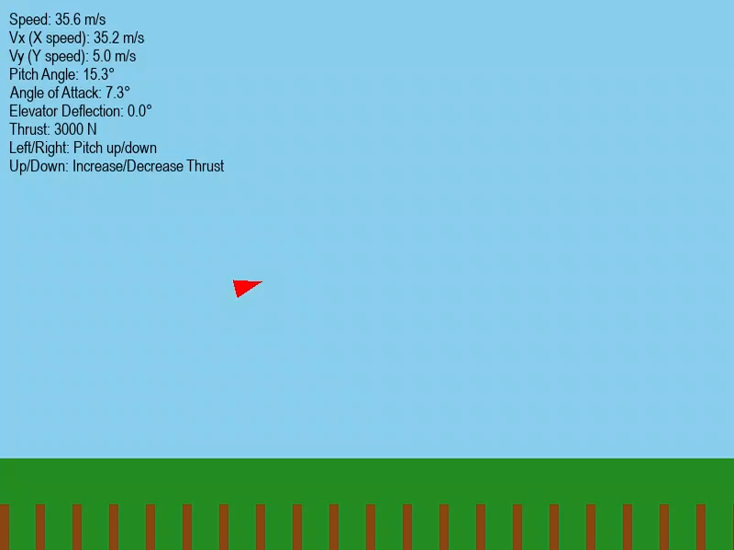

Slide 13
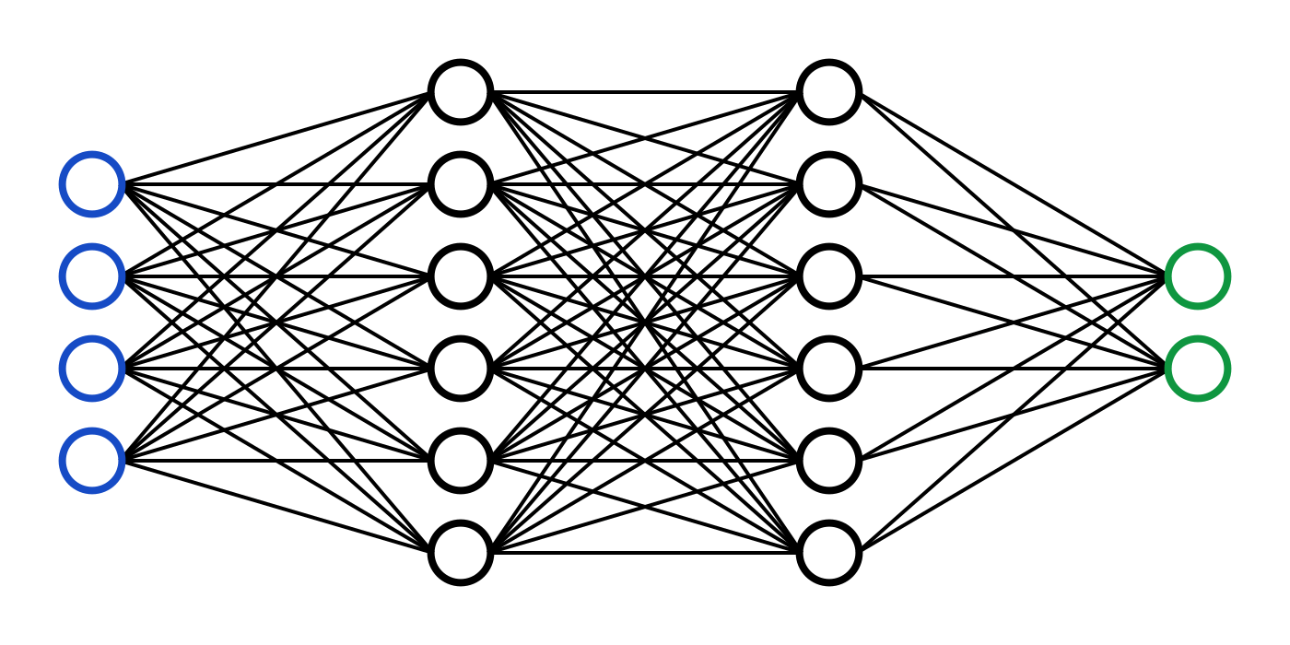
Machine Learning, Neuroevolution

Slide 14
Neural Network
7 inputs: the airplane’s current state and information about the target, like:
  Horizontal speed
  Vertical speed
  Current pitch angle
  Pitch rate (how fast the plane is rotating)
  Sine of angle to target
  Cosine of angle to target
  Distance to the target
2 outputs: the actions the airplane should take:
  Elevator angle (controls nose up/down)
  Thrust (engine power)

Slide 15
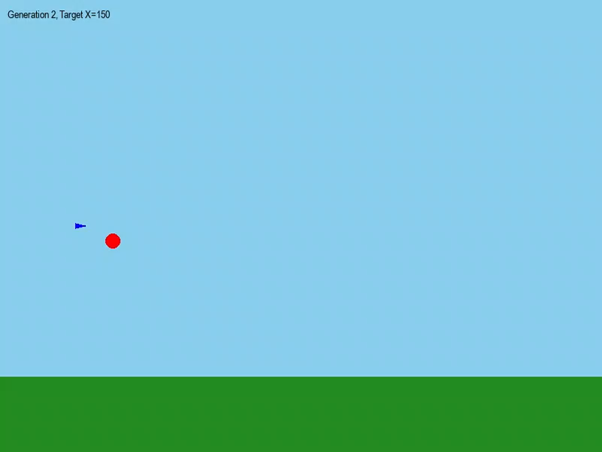
Training

Slide 16
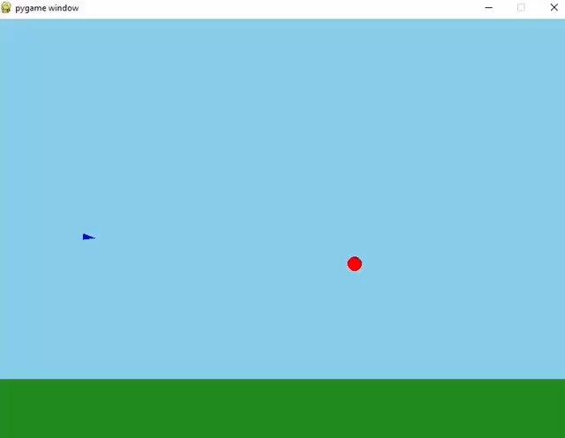
Flight

Slide 17
What can this be used for?
Automated UAV control
Safety features for aircrafts
Video games
Simulators
Flight analysis
Path selection

Slide 18
Thank you!
Author: Luka Guraspashvili

