Slide 1


CNB assisted DE model
Presenter: Mikheil Metivishvili
Supervisor Associate Professor Michael Maziashvili
Ilia State University, Tbilisi

Slide 2
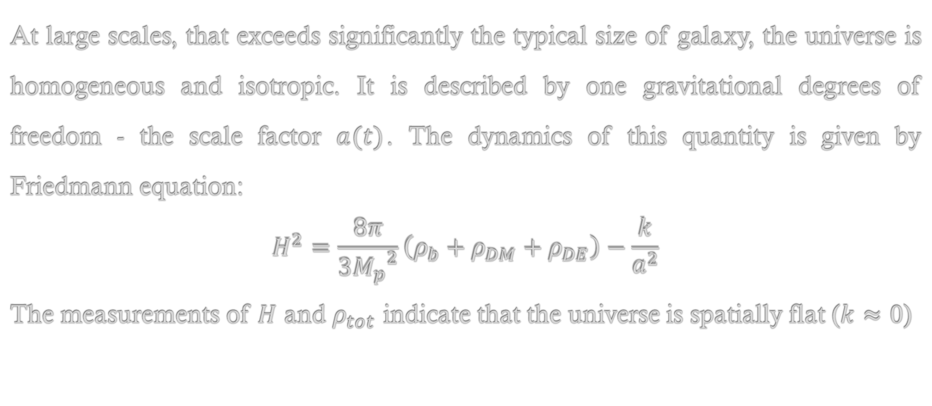
Friedmann Equation
At large scales, that exceeds significantly the typical size of galaxy, the universe is homogeneous and isotropic. It is described by one gravitational degrees of freedom - the scale factor $a(t)$. The dynamics of this quantity is given by Friedmann equation:
$$H^{2}=\frac{8π}{3{M_{p}}^{2}}\left(ρ_{b}+ρ_{DM}+ρ_{DE}\right)−\frac{k}{a^{2}}$$
The measurements of $H$ and $ρ_{tot}$ indicate that the universe is spatially flat ($k≈0$)

Slide 3
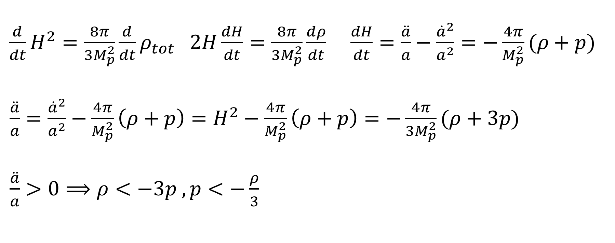
Accelerated expansion of the Universe
$\frac{d}{dt}H^{2}=\frac{8π}{3M_{p}^{2}}{\frac{d}{dt}ρ}_{tot}$ $2H\frac{dH}{dt}=\frac{8π}{{3M}_{p}^{2}}\frac{dρ}{dt}$ $\frac{dH}{dt}=\frac{\ddot{a}}{a}−\frac{{\dot{a}}^{2}}{a^{2}}=−\frac{4π}{M_{p}^{2}}(ρ+p)$
$\frac{\ddot{a}}{a}=\frac{{\dot{a}}^{2}}{a^{2}}−\frac{4π}{M_{p}^{2}}\left(ρ+p\right)=H^{2}−\frac{4π}{M_{p}^{2}}\left(ρ+p\right)=−\frac{4π}{{3M}_{p}^{2}}(ρ+3p)$
$\frac{\ddot{a}}{a}>0⟹ρ<−3p , p<−\frac{ρ}{3}$

Slide 4
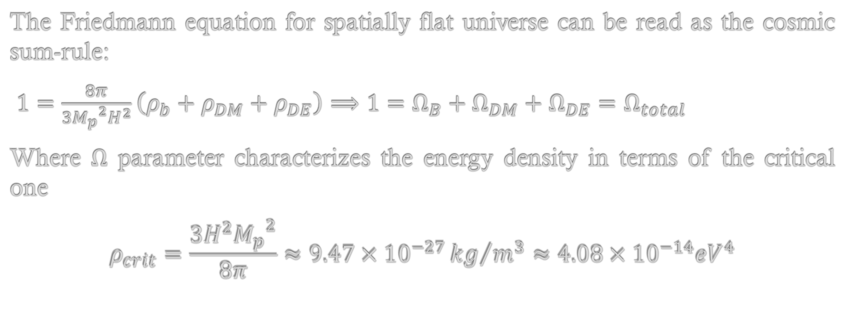
Cosmic sum-rule
The Friedmann equation for spatially flat universe can be read as the cosmic sum-rule:
$1=\frac{8π}{3{M_{p}}^{2}H^{2}}\left(ρ_{b}+ρ_{DM}+ρ_{DE}\right)⟹1=Ω_{B}+Ω_{DM}+Ω_{DE}=Ω_{total}$
Where $Ω$ parameter characterizes the energy density in terms of the critical one
$$ρ_{crit}=\frac{3H^{2}{M_{p}}^{2}}{8π}≈\text{9.47}×{10}^{−27}{kg}/{m^{3}}≈4.08×{10}^{−14}{eV}^{4}$$

Slide 5
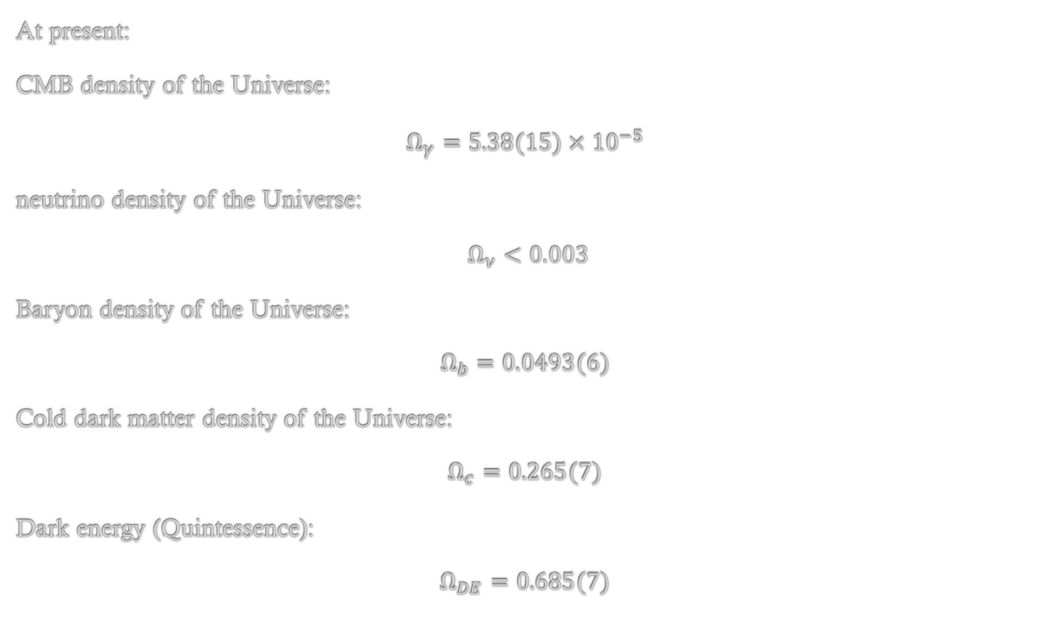
What we know about the composition of the universe?
At present:
CMB density of the Universe:
$$Ω_{γ}=5.38(15)×{10}^{−5}$$
neutrino density of the Universe:
$Ω_{ν}<0.003$
Baryon density of the Universe:
$$Ω_{b}=0.0493(6)$$
Cold dark matter density of the Universe:
$$Ω_{c}=0.265(7)$$
Dark energy (Quintessence):
$$Ω_{DE}=0.685(7)$$

Slide 6
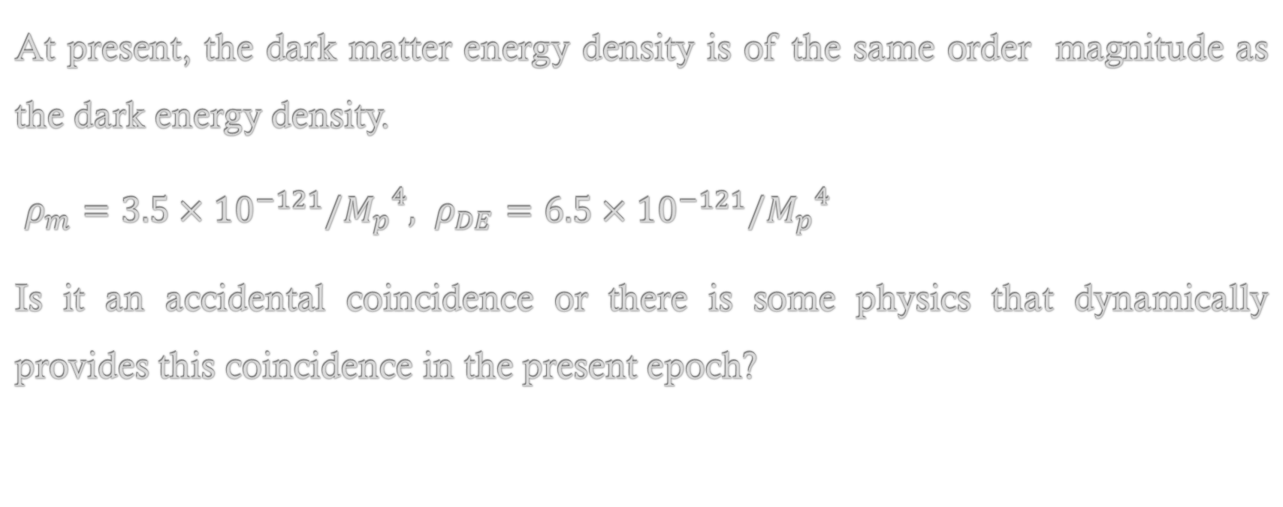
Coincidence issue
At present, the dark matter energy density is of the same order magnitude as the dark energy density.
$ρ_{m}=3.5×{10}^{−121}/{M_{p}}^{4},$ $ρ_{DE}=6.5×{10}^{−121}/{M_{p}}^{4}$
Is it an accidental coincidence or there is some physics that dynamically provides this coincidence in the present epoch?

Slide 7
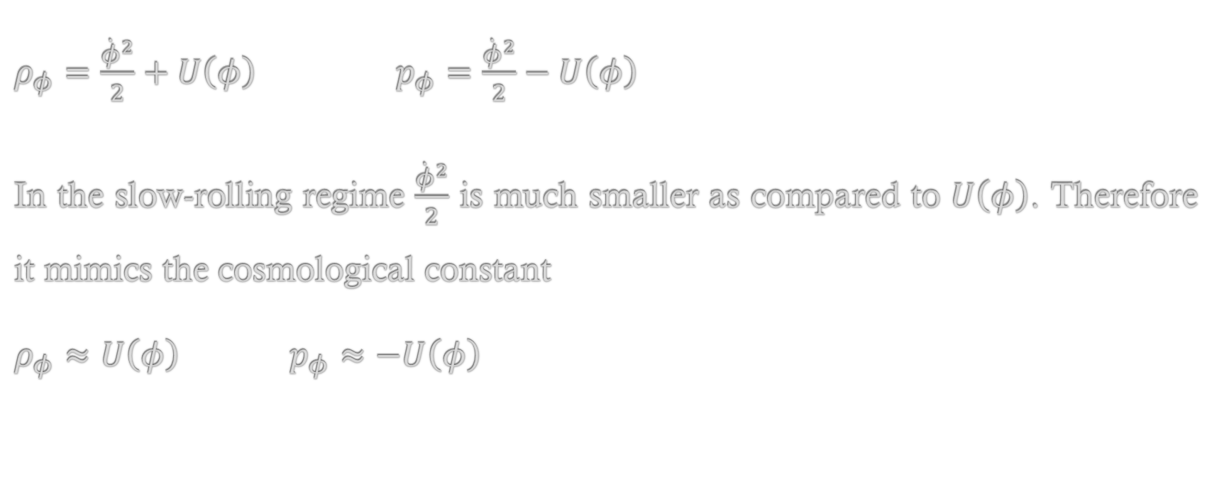
Quintessence/Cosmon
$ρ_{φ}=\frac{{\dot{φ}}^{2}}{2}+U\left(φ\right)$ $p_{φ}=\frac{{\dot{φ}}^{2}}{2}−U\left(φ\right)$
In the slow-rolling regime $\frac{{\dot{φ}}^{2}}{2}$ is much smaller as compared to $U\left(φ\right)$. Therefore it mimics the cosmological constant
$ρ_{φ}≈U\left(φ\right)$ $p_{φ}≈−U\left(φ\right)$

Slide 8
Cosmon/Quintessence
An important feature of the model is to admit an attractor like solution. That means that irrespective to the initial conditions, the solutions converge to one another sufficiently fast. Therefore, at later times any of the solutions can be used as an attractor. This feature ensures that late-time dynamics is almost independent of the initial conditions.

Slide 9
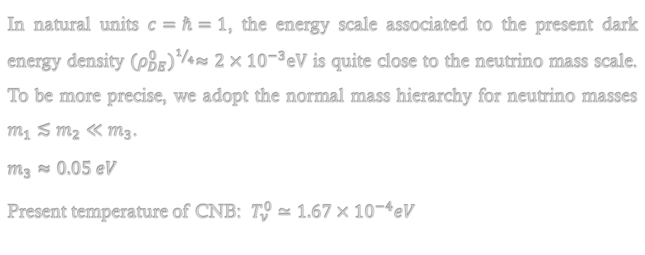
Motivation for the model
In natural units $c=ℏ=1$, the energy scale associated to the present dark energy density ${(ρ_{DE}^{0})}^{1/4}≈2×{10}^{−3}eV$ is quite close to the neutrino mass scale. To be more precise, we adopt the normal mass hierarchy for neutrino masses $m_{1}≲m_{2}≪m_{3}$.
$$m_{3}≈0.05 eV$$
Present temperature of CNB: $T_{ν}^{0}≃1.67×{10}^{−4}eV$

Slide 10
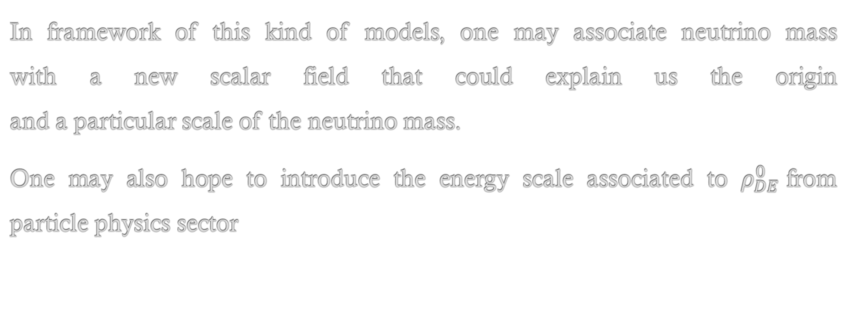
Motivation for the model
In framework of this kind of models, one may associate neutrino mass
with a new scalar field that could explain us the origin
and a particular scale of the neutrino mass.
One may also hope to introduce the energy scale associated to $ρ_{DE}^{0}$from particle physics sector

Slide 11
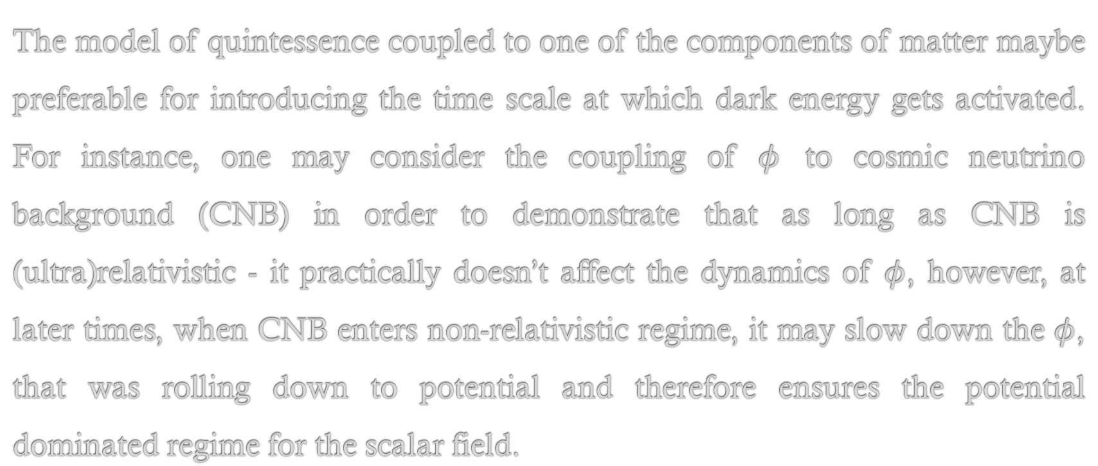
Coupled models of Cosmon/Quintessence
The model of quintessence coupled to one of the components of matter maybe preferable for introducing the time scale at which dark energy gets activated. For instance, one may consider the coupling of $φ$ to cosmic neutrino background (CNB) in order to demonstrate that as long as CNB is (ultra)relativistic - it practically doesn’t affect the dynamics of $φ$, however, at later times, when CNB enters non-relativistic regime, it may slow down the $φ$, that was rolling down to potential and therefore ensures the potential dominated regime for the scalar field.

Slide 12
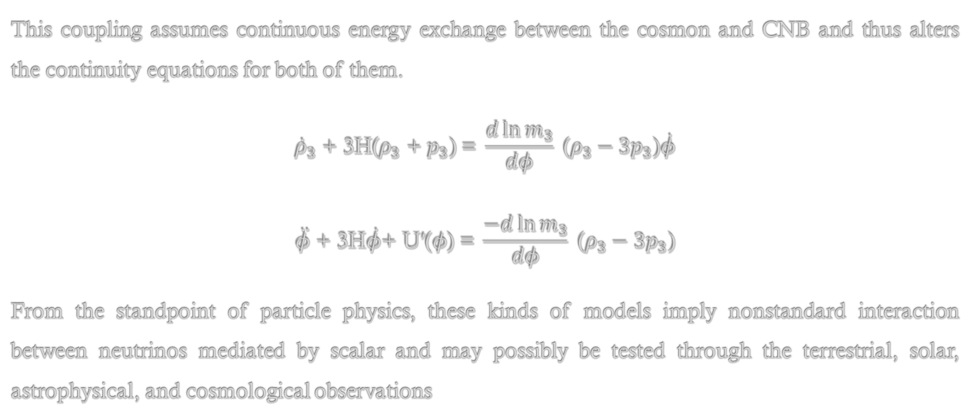
Equations of motion
This coupling assumes continuous energy exchange between the cosmon and CNB and thus alters the continuity equations for both of them.
$${\dot{ρ}}_{3}\text{ + 3}\text{H}\text{(}ρ_{3} \text{+} p_{3}\text{) = }\frac{d\ln{m_{3}}}{dφ} \text{(}ρ_{3}−3p_{3}\text{)}\dot{φ}$$
$$\ddot{φ}\text{ + 3}\text{H}\dot{φ}\text{+ }\text{U}\text{′(}φ\text{)}\text{ =} \frac{−d\ln{m_{3}}}{dφ} \text{(}ρ_{3}−3p_{3}\text{)}$$
From the standpoint of particle physics, these kinds of models imply nonstandard interaction between neutrinos mediated by scalar and may possibly be tested through the terrestrial, solar, astrophysical, and cosmological observations

Slide 13
Observational Signatures
F. Forastieri, M. Lattanzi, and P. Natoli, Phys. Rev. D
100, 103526 (2019), “Cosmological constraints on neutrino self-interactions with a light mediator”
J. Venzor, G. Garcia-Arroyo, A. Pérez-Lorenzana, and
J. De-Santiago, Phys. Rev. D 105, 123539 (2022),
“Massive neutrino self-interactions with a light mediator in cosmology”
C. D. Kreisch, F.-Y. Cyr-Racine, and O. Doré, Phys.
Rev. D 101, 123505 (2020), “The Neutrino Puzzle: Anomalies, Interactions, and Cosmological Tensions”

Slide 14
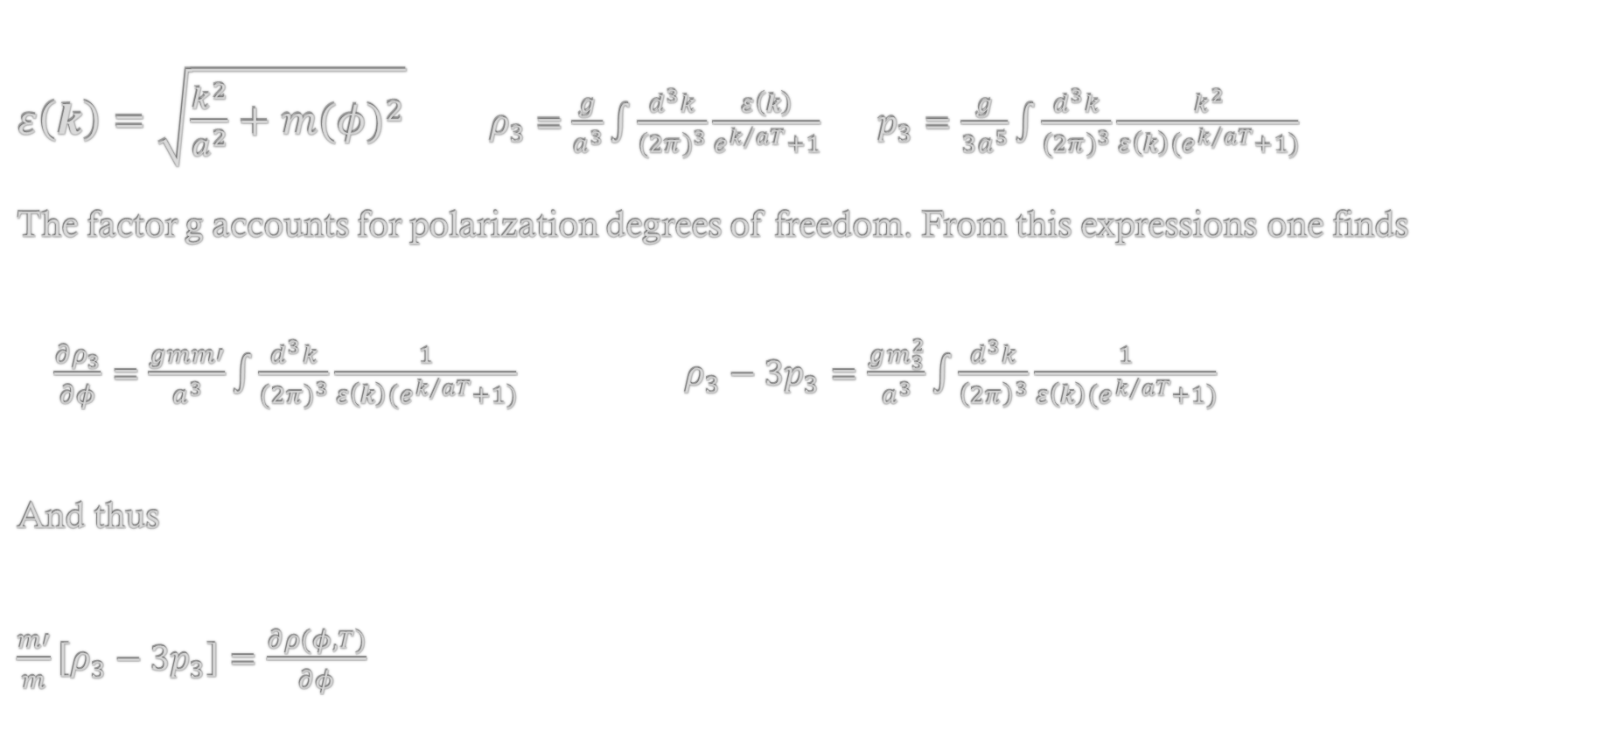
Free-streaming neutrinos
$ε\left(k\right)=\sqrt{\frac{k^{2}}{a^{2}}+{m(φ)}^{2}}$ $ρ_{3}=\frac{g}{a^{3}}\int{\frac{d^{3}k}{{(2π)}^{3}}\frac{ε\left(k\right)}{e^{k/{aT}}+1}}$ $p_{3}=\frac{g}{3a^{5}}\int{\frac{d^{3}k}{{(2π)}^{3}}\frac{k^{2}}{{ε\left(k\right)(e}^{k/{aT}}+1)}}$
The factor g accounts for polarization degrees of freedom. From this expressions one finds
$\frac{∂ρ_{3}}{∂φ}=\frac{gmm′}{a^{3}}\int{\frac{d^{3}k}{{(2π)}^{3}}\frac{1}{{ε\left(k\right)(e}^{k/{aT}}+1)}}$ $ρ_{3}−3p_{3}=\frac{gm_{3}^{2}}{a^{3}}\int{\frac{d^{3}k}{{\left(2π\right)}^{3}}\frac{1}{{ε\left(k\right)(e}^{k/{aT}}+1)}}$
And thus
$\frac{m′}{m}\left[ρ_{3}−3p_{3}\right]=\frac{∂ρ(φ,T)}{∂φ}$

Slide 15
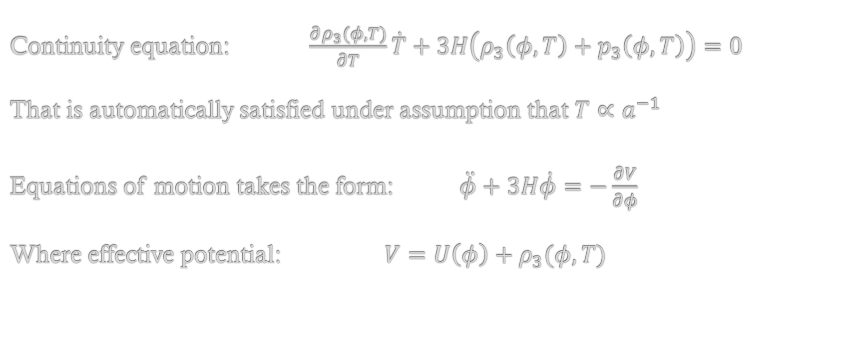
Free-streaming neutrinos
Continuity equation: $\frac{∂ρ_{3}(φ,T)}{∂T}\dot{T}+3H\left(ρ_{3}\left(φ,T\right)+p_{3}\left(φ,T\right)\right)=0$
That is automatically satisfied under assumption that $T∝a^{−1}$
Equations of motion takes the form: $\ddot{φ}+3H\dot{φ}=−\frac{∂V}{∂φ}$
Where effective potential: $V=U\left(φ\right)+ρ_{3}(φ,T)$

Slide 16
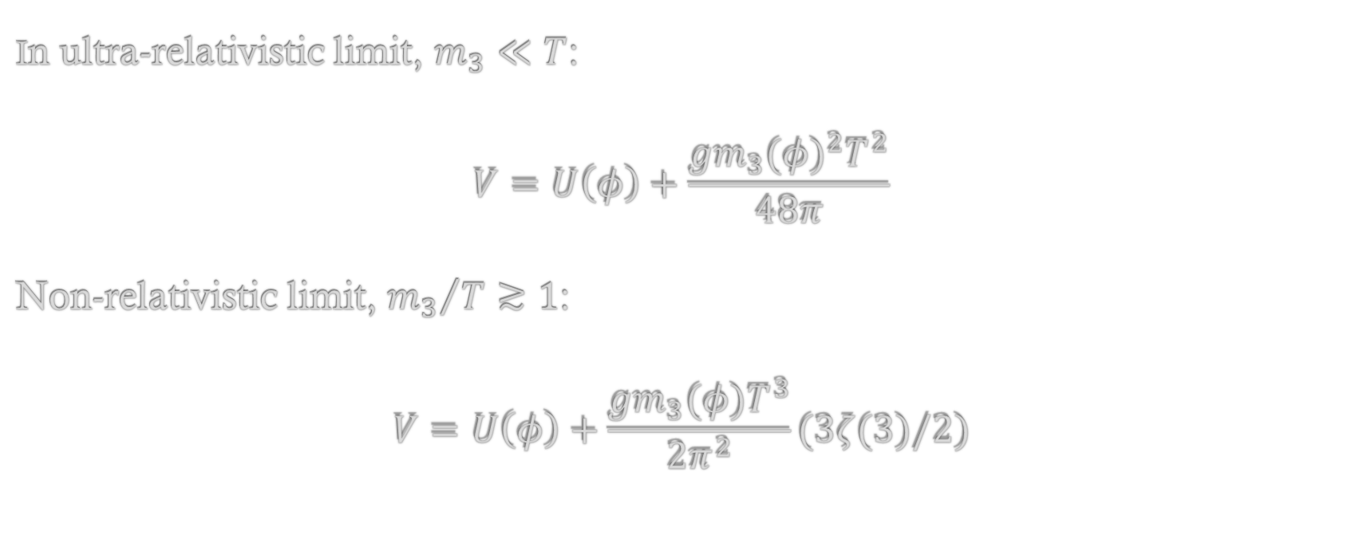
Free-streaming neutrinos
In ultra-relativistic limit, $m_{3}≪T$:
$$V=U\left(φ\right)+\frac{g{m_{3}(φ)}^{2}T^{2}}{48π}$$
Non-relativistic limit, ${m_{3}}/{T≳1}$:
$$V=U\left(φ\right)+\frac{gm_{3}(φ)T^{3}}{2π^{2}}(3ζ(3)/2)$$

Slide 17
What are we looking for?
We would like to have a slowdown of the scalar field due to back reaction of neutrinos whenever CNB enters the non-relativistic regime. The transition of CNB from relativistic to non-relativistic regime took place in the recent past, so we want to associate this timescale to the activation of dark energy. In most of the models this scenario is not realized. What happens instead is that the effective potential develops the minimum that evolves slowly with time. This minimum captures the field at early stages after which the field tracks this minimum. Therefore, the slowdown of the scalar field takes place much before the transition of CNB to the non-relativistic regime.

Slide 18
Thank You for Your Attention
I welcome any questions or feedback
Mikheil Metivishvili
Ilia State University

