Slide 1
Electrons’ motion outside a blackhole
Author: Nikoloz Kurtskhalia (nkurt22@freeuni.edu.ge)
Co-author: Nikoloz Maltsev (nmalt22@freeuni.edu.ge)
Academic advisor: Zaza Osmanov (z.osmanov@freeuni.edu.ge)

Slide 2
About me(Intrests):
Student of physics in Free University of Tbilisi
Topics of interest:
Quantum physics
Mathematical physics (analytical methods in theoretical models)
Numerical methods (developing simulations for complex systems)
Computer simulations (astrophysical plasmas, gravitational dynamics)
High-energy astrophysics (black holes, neutron stars, cosmic rays)
Cosmology (formation and evolution of large-scale structures)
Future plans:
Career in academia, preferably in condensed matter physics, computational physics, mathematical physics, High energy physics or cosmology and astrophysics.
Hobbies and interests:
Music: Classical (Sastakovich, Wagner), jazz (Jaco Pastorius, Mahanvishu orchestra), prog rock(king crimson, rush, Thank you scientist), avant-garde (Stockhausen, John Zorn).
Movies: Horror (psychological and atmospheric), drama (historical epics), experimental (surrealist and non-linear storytelling).
Reading: Horror (Lovecraft, Robert W. Chambers, Cormac McCarthy, Harlan Ellison), biographies (scientists, military leaders), philosophy (existentialism, metaphysics), military strategy (Sun Tzu, Clausewitz), and historical works (ancient civilizations, world wars), Art and Art history(H.R Giger).

Slide 3
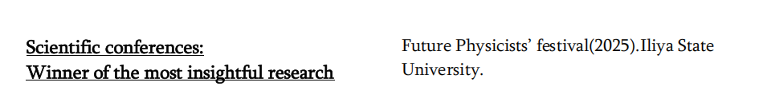
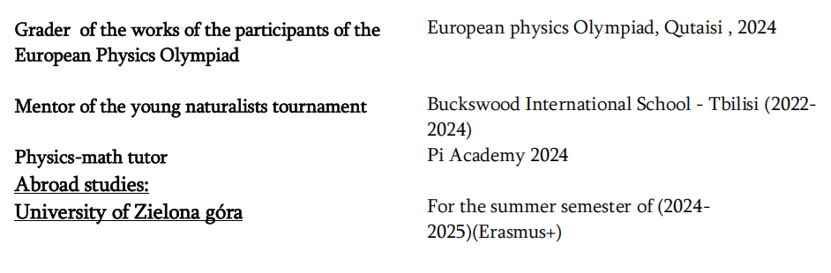
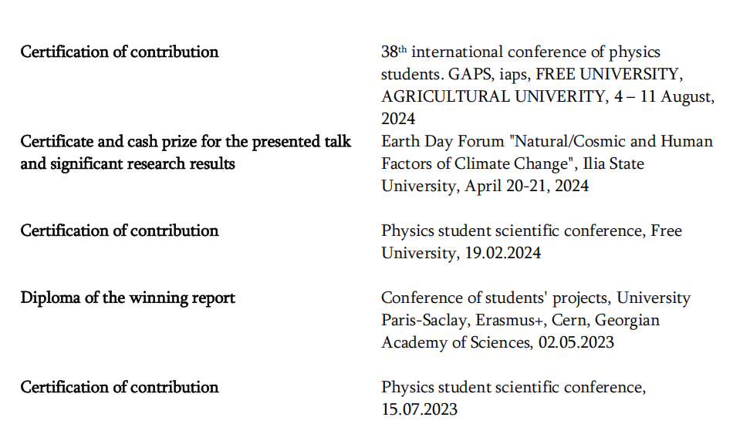
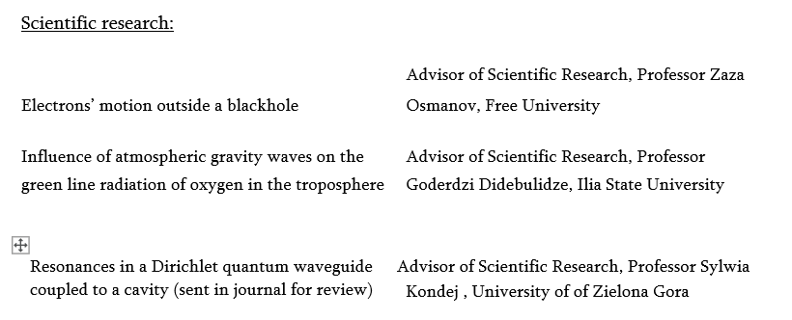

About me(work experience):

Slide 4
Presentation plan:
Defining our metric
Equation of particle’s motion
Radii of the light cylinders and steady orbit
Interpretation of distances
Calculating the maximum Lorenz factor

Slide 5
Defining our metric

Slide 6

Schwarzschild’s metric modification:
$$ds^{2}=−\left(1−\frac{r_{s}}{r}\right)c^{2}dt^{2}+\frac{{dr}^{2}}{1−\frac{r_{s}}{r}}+r^{2}(dθ^{2}+\sin^{2}\left(θ\right)dφ^{2})$$
$$+$$
$$θ=const→dθ=0$$
$$dφ=ωdt, ω=const$$
$$=$$
$$ds^{2}=−\left(1−\frac{r_{s}}{r}−\frac{ω^{2}r^{2}\sin^{2}(θ)}{c^{2}}\right)c^{2}dt^{2}+\frac{{dr}^{2}}{1−\frac{r_{s}}{r}}$$
Schwarzschild’s metrics:

Slide 7

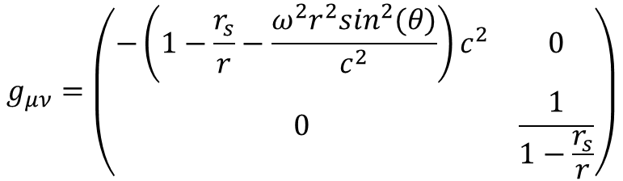
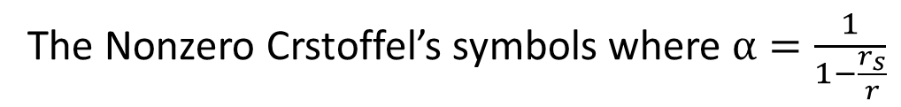
Metric tensor and nonzero Christoffel symbols:
$$g_{μν}=\left(\begin{matrix}−\left(1−\frac{r_{s}}{r}−\frac{ω^{2}r^{2}\sin^{2}(θ)}{c^{2}}\right)c^{2} & 0 \\ 0 & \frac{1}{1−\frac{r_{s}}{r}}\end{matrix}\right)$$
Our metric tensor
$$Γ_{tt}^{r}=−\frac{1}{α}\left(ω^{2}r\sin^{2}\left(θ\right)−\frac{GM}{r^{2}}\right)$$
$$Γ_{rr}^{r}=\frac{2r_{s}}{r^{2}}α^{3}$$
The Nonzero Crstoffel’s symbols where $α=\frac{1}{1−\frac{r_{s}}{r}}$

Slide 8
Equation of particle’s motion

Slide 9






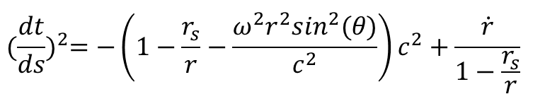
Equation of motion and Steady orbit :
$Γ_{tt}^{r}$, $Γ_{rr}^{r}$
$$\frac{d^{2}r}{ds^{2}}+Γ_{μν}^{γ}\frac{dr^{μ}}{ds}\frac{dr^{ν}}{ds}=0$$
Geodesic equation
$$\ddot{r}−\frac{1}{α}\left(ω^{2}r\sin^{2}\left(θ\right)−\frac{GM}{r^{2}}\right)+\frac{GM}{c^{2}r^{2}}α^{3}\dot{r}=0$$
$$+$$
$${(\frac{dt}{ds})}^{2}={−\left(1−\frac{r_{s}}{r}−\frac{ω^{2}r^{2}\sin^{2}(θ)}{c^{2}}\right)c^{2}+\frac{\dot{r}}{1−\frac{r_{s}}{r}}}^{}$$
$$\dot{r}=0,\ddot{r}=0$$
$$r_{orbit}={(\frac{GM}{ω^{2}\sin^{2}(θ)})}^{\frac{1}{3}}$$

Slide 10
Radii of the light cylinders and steady orbit and Interpretation of distances

Slide 11

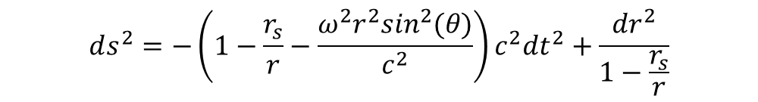
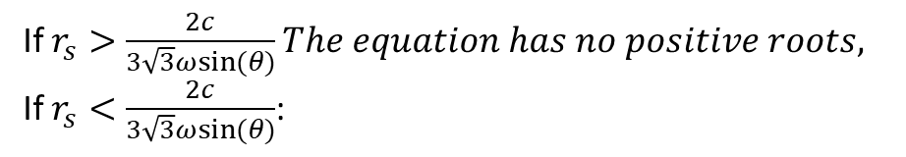
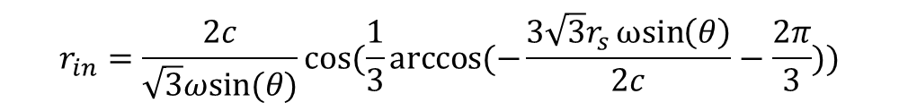
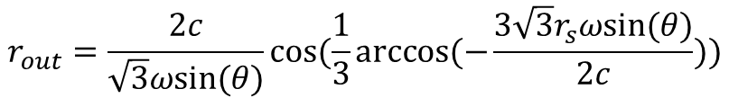
Radii of light cylinders:
$$ds^{2}=−\left(1−\frac{r_{s}}{r}−\frac{ω^{2}r^{2}\sin^{2}(θ)}{c^{2}}\right)c^{2}dt^{2}+\frac{{dr}^{2}}{1−\frac{r_{s}}{r}}$$
$$1−\frac{r_{s}}{r}−\frac{ω^{2}r^{2}\sin^{2}\left(θ\right)}{c^{2}}=0$$
If $r_{s}>\frac{2c}{3\sqrt{3}ωsin⁡(θ)}The equation has no positive roots,$
If $r_{s}<\frac{2c}{3\sqrt{3}ωsin⁡(θ)}$:
This equation will have three solutions. Two of them will be real, and one complex. Real ones are:
$$r_{out}=\frac{2c}{\sqrt{3}ωsin⁡(θ)}cos⁡(\frac{1}{3}arccos⁡(−\frac{3\sqrt{3}r_{s}ωsin⁡(θ)}{2c}))$$
$$r_{in}=\frac{2c}{\sqrt{3}ωsin⁡(θ)}cos⁡(\frac{1}{3}arccos⁡(−\frac{3\sqrt{3}r_{s}ωsin\left(θ\right)}{2c}−\frac{2π}{3}))$$

Slide 12
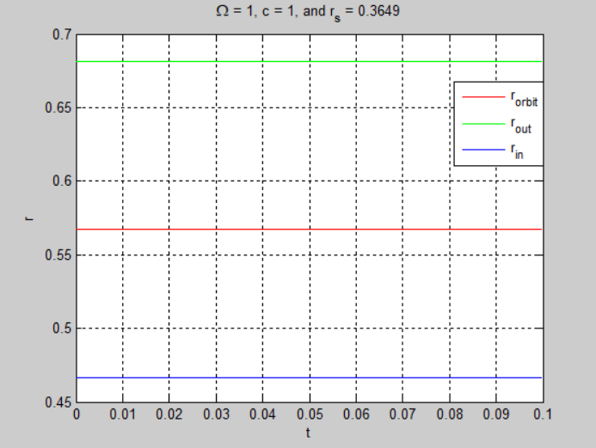
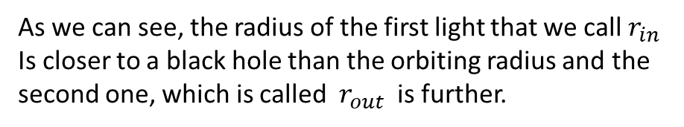
Visualization of these distances:
As we can see, the radius of the first light that we call $r_{in}$
Is closer to a black hole than the orbiting radius and the
second one, which is called ${ r}_{out}$ is further.

Slide 13
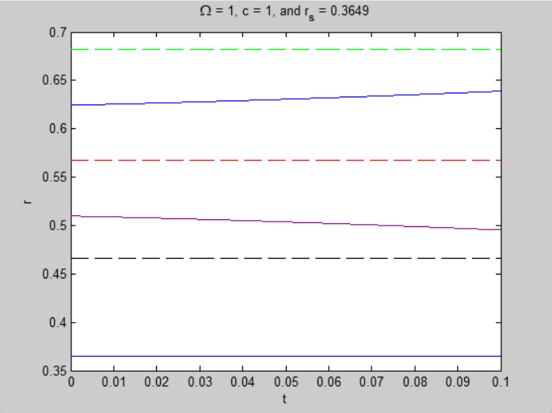
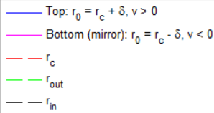
Numerical solutions to equation motion:
As we can see, particles that are between the first light
Cylinder and steady orbit are going to fall on the first light cylinder and
The ones above on the second.

Slide 14
Calculating the maximum Lorenz factor

Slide 15
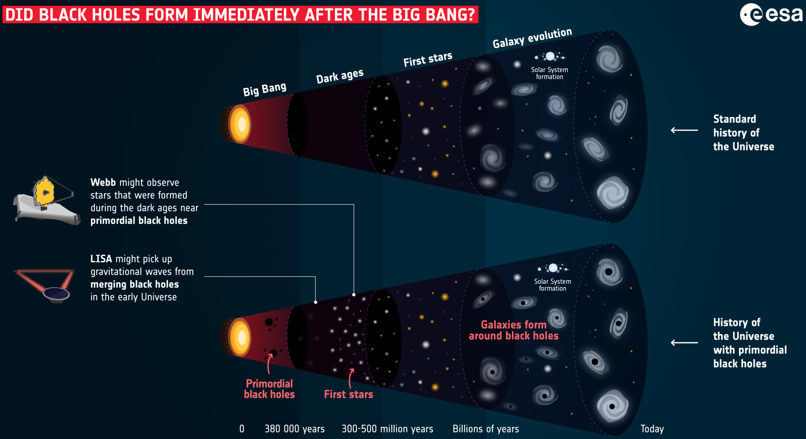
Primordial black holes:

Slide 16
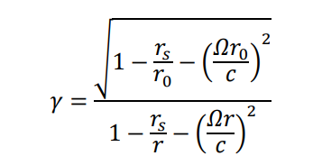



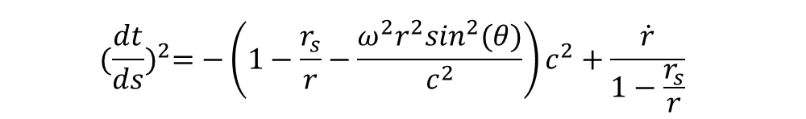
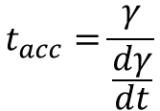

Lorenz factor and characteristic acceleration time:
$${(\frac{dt}{ds})}^{2}={−\left(1−\frac{r_{s}}{r}−\frac{ω^{2}r^{2}\sin^{2}(θ)}{c^{2}}\right)c^{2}+\frac{\dot{r}}{1−\frac{r_{s}}{r}}}^{}$$
$$α_{0}$$
$\frac{dγ}{dt}=$ $α_{0}γ^{2}(−\frac{r_{s}}{r^{2}}+{2(\frac{ωsin⁡(θ)}{c})}^{2}r)\dot{r}$
$$t_{acc}=\frac{1}{ α_{0}γ (−\frac{r_{s}}{r^{2}}+{2(\frac{ωsin⁡(θ)}{c})}^{2}r)\dot{r}}$$
$$t_{acc}=\frac{γ}{\frac{dγ}{dt}}$$

Slide 17

Limiting factors(Inverse Comtpton scattering):
Tompson regime:
Where
Inverse Comtpton scattering
Power emitted by a single electron
Klein-Nishina regime

Slide 18
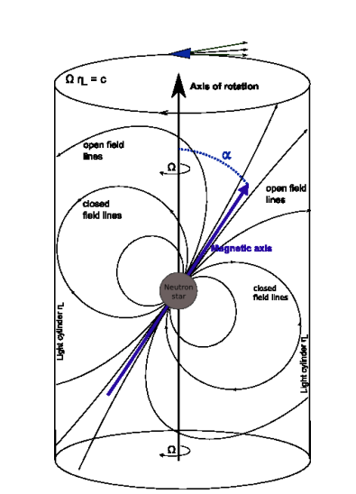

Curvature radiation
$$P=\frac{2}{3}\frac{e^{2}c}{r^{2}}γ^{4}$$

Slide 19
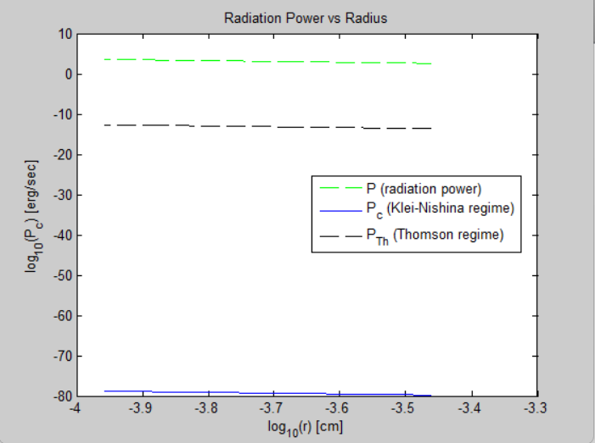
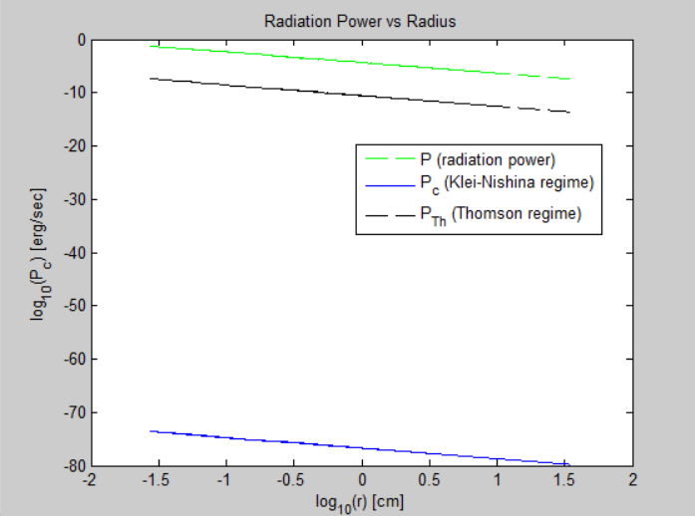
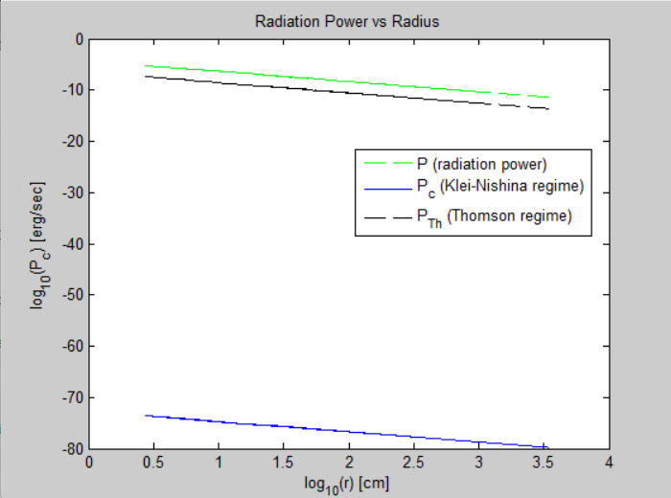



Power estimates(Inner region):
$$M={10}^{−10}M_{sun}$$
$$M={10}^{−5}M_{sun}$$
$$M={10}^{−3}M_{sun}$$

Slide 20
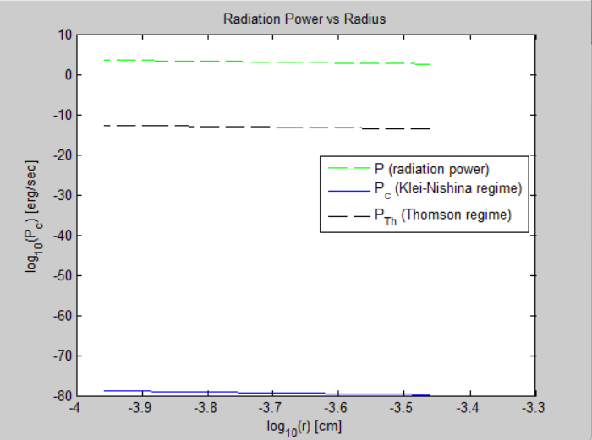
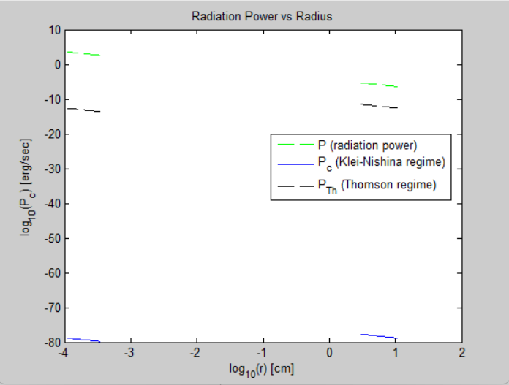
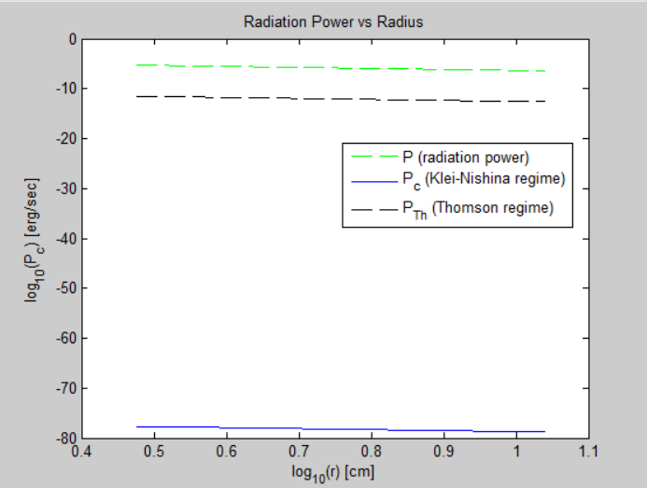



Power estimates(outter region):
$$M={10}^{−5}M_{sun}$$
$$M={10}^{−3}M_{sun}$$
$$M={10}^{−10}M_{sun}$$

Slide 21
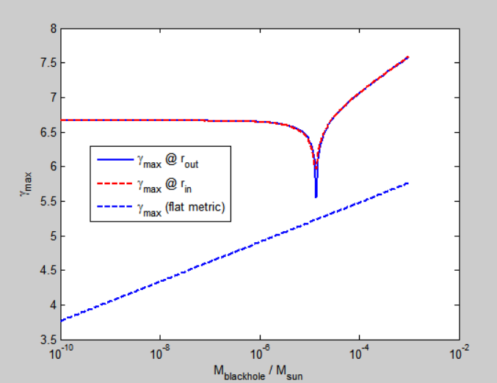


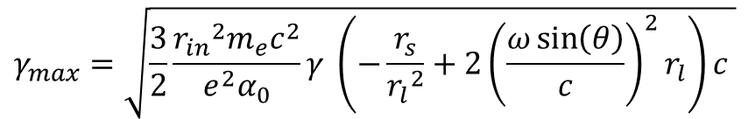


Maximal Lorenz factor:
$$t_{cool}=\frac{γm_{e}c^{2}}{p_{c}}$$
$$t_{acc}=\frac{1}{ α_{0}γ (−\frac{r_{s}}{r^{2}}+{2(\frac{ωsin⁡(θ)}{c})}^{2}r)\dot{r}}$$
$t_{cool}=$ $t_{acc}$
Near light cylinder
$$\dot{r}\sim c,r\sim r_{l}$$
$$γ_{max}=\sqrt{\frac{3}{2}\frac{{r_{in}}^{2}m_{e}c^{2}}{e^{2}α_{0}}γ \left(−\frac{r_{s}}{{r_{l}}^{2}}+{2\left(\frac{ω\sin\left(θ\right)}{c}\right)}^{2}r_{l}\right)c }$$

Slide 22
Thank you for your attention

Slide 23
Bibliography
On particle acceleration and very high energy γ-ray emission in Crab-like pulsars-Z. Osmanov and F. M. Rieger
On the efficiency of particle acceleration by rotating magnetospheres in AGN-Zaza Osmanov, Andria Rogava, and Gianluigi Bodo
Primordial Black Holes as Dark Matter-Bernard Carr, Florian Kuhnel, Marit Sandstad
THE CLASSICAL THEORY OF FIELDS-L. D. LANDAU AND E. M. LIFSHITZ
Relativistic effects of rotation in γ-ray pulsars Invited Review – Zaza Osmanov

Slide 24
Codes(lorenz)
% Mass range: log-spaced from 1e-10 to 1 M_sun
M = logspace(-10, -3, 200); % in solar masses
% Constants (CGS units unless stated otherwise)
c = 2.99e10; % cm/s
e = 4.8e-10; % esu
G = 6.67e-8; % cm^3/g/s^2
m = 9e-28; % g (electron mass)
w = (c^3 ./ ( G .* M * 1e30)).*0.25;
rl = c ./ w;
% Radii (corrected formula)
arg = 3*sqrt(3).*w./(2*c);
rout = 2*c*cos(acos(arg)/3) ./ (sqrt(3).*w);
rin = 2*c*cos(acos(arg)/3 - 2*pi/3) ./ (sqrt(3).*w);
% Schwarzschild radius
rs = 2*G.*M*(1e33)./c^2;
% Gamma_max values

Slide 25
Codes(lorenz)
g1 = sqrt(3.*m.*c^2.*(rout).^2 .* (2.*w.^2.*rout./c^2 - rs./(rout).^2) ./ e^2);
g2 = sqrt(3.*m.*c^2.*(rin).^2 .* (-2.*w.^2.*rin./c^2 + rs./(rin).^2) ./ e^2);
% Additional parameters
G1 = 1e-11;
m1 = 1e-31;
e1 = 1e-19;
c1 = 1e8;
mi = 1e-7;
w1 = (c1^3 ./ (40 * G1 .* M * 1e33));
g = ((12 * pi * c1 * m1) ./ (mi .* (e1.^2) .* w1)).^(2/7);
% Plot results
plot(M, log10(g1), 'LineWidth', 1.5)
hold on
plot(M, log10(g2), '--r', 'LineWidth', 1.5)
plot(M, log10(g), '--b', 'LineWidth', 1.5)
set(gca, 'XScale', 'log')
xlabel('M_{blackhole} / M_{sun}')
ylabel('\gamma_{max}')
legend('\gamma_{max} @ r_{out}', '\gamma_{max} @ r_{in}', '\gamma_{max} (flat metric)', 'Location', 'best')

Slide 26
Codes(powers)
% Constants
c = 2.99e10; % cm/s
e = 4.8e-10; % esu
G = 6.67e-8; % cm^3/g/s^2
me = 9e-28; % g
sigma_T = 6.6524587321e-25;
T = 1e7; % K
gamma = 1;
k = 1.38064852e-16; % erg/K (correct CGS value)
pi_val = pi;
% Mass (scalar for now, can be a loop or vector later)
M = 1e6; % in solar masses
M_cgs = M * 1e33; % Convert to grams
% Derived quantities
B = c^4 / sqrt(G^3 * M_cgs^2);

Slide 27
Codes(powers)
w = c^3 / (40 * G * M_cgs); % angular velocity
% Avoid invalid acos input
arg1 = 3*sqrt(3)*w/(2*c);
arg2 = arg1 - 2*pi/3;
% Clamp values between -1 and 1
arg1 = max(min(arg1, 1), -1);
arg2 = max(min(arg2, 1), -1);
% Radii
rout = 2*c*cos(acos(arg1)) / (sqrt(3)*w);
rin = 2*c*cos(acos(arg2)) / (sqrt(3)*w);
rs = 2*G*M_cgs / c^2;
% Orbit radius
rorbit = (rs * c^2 / w^2)^(1/3);

Slide 28
Codes(powers)
% Radius vector
r = linspace(rin, rorbit, 500); % More robust than colon operator
% Compute Pc
term1 = sigma_T * (me * c * k * T)^2 / (16 * pi_val^3);
log_term = log(4 * gamma * k * T / (me * c^2)) - 1.981;
Pc = term1 * log_term * (rs ./ r).^2;
P = (2/3) * (e^2 * c) ./ (r.^2) .* (gamma^4);
% Stefan-Boltzmann constant in CGS
sigma_SB = 5.670374419e-5; % erg cm^-2 s^-1 K^-4
% Approximate luminosity from Schwarzschild surface (just for scale)
L = 4 * pi_val * rs^2 * sigma_SB * T^4;
% Thomson pressure
Pth = L * sigma_T ./ (4 * pi_val * r.^2 * c);

Slide 29
Codes(powers)
% Plotting
plot(log10(r),log10(P),'--g');
xlabel('Radius R [cm]');
ylabel('P_c [erg/cm^3]');
title('Radiation Power vs Radius');
hold on
% Plotting
plot(log10(r), log10(Pc));
xlabel('log_{10}(r) [cm]');
ylabel('log_{10}(P_c) [erg/sec]');
plot(log10(r), log10(Pth), 'k--', 'DisplayName', 'Thomson Regime');
legend({'P (radiation power)', 'P_c (Klei-Nishina regime)', 'P_{Th} (Thomson regime)'});

Slide 30
Codes(Equation of particle’s motion
):
clc
clear
% Schwarzschild radius
rs = 0.3649;
% Compute rout, rin, rc
rout = 2 * cos(acos(-3 * sqrt(3) * rs / 2) / 3) / sqrt(3);
rin = 2 * cos(acos(-3 * sqrt(3) * rs / 2) / 3 - 2 * pi / 3) / sqrt(3);
rc = (rs / 2)^(1/3);
% Time step and total steps
dt = 0.00001;
N = 10000;

Slide 31
Codes(Equation of particle’s motion
):
% Initialize time array
t = zeros(1, N+1);
% Initial conditions
y = zeros(2, N+1); % y(1,:) = r, y(2,:) = dr/dt
y(1,1) = rc + 0.01;
y(2,1) = 0.1;
% Function defining the system
f = @(y) [...
y(2);
((y(1) - 1 / y(1)^2) / (1 - 2 / y(1)) - ((1 / (1 - 2 / y(1)))^3) * y(2) / y(1)^2) ...
];
% Runge-Kutta 4th order loop

Slide 32
Codes(Equation of particle’s motion
):
for i = 1:N
k1 = dt * f(y(:,i));
k2 = dt * f(y(:,i) + 0.5 * k1);
k3 = dt * f(y(:,i) + 0.5 * k2);
k4 = dt * f(y(:,i) + k3);
y(:,i+1) = y(:,i) + (k1 + 2*k2 + 2*k3 + k4) / 6;
t(i+1) = t(i) + dt;
end
% Constant lines for plotting
rc_line = rc * ones(size(t));
rout_line = rout * ones(size(t));
rin_line = rin * ones(size(t));

Slide 33
Codes(Equation of particle’s motion
):
% Plotting
plot(t, rc_line, 'r--', 'DisplayName', 'r_c')
hold on
plot(t, rout_line, 'g--', 'DisplayName', 'r_{out}')
plot(t, rin_line, 'b--', 'DisplayName', 'r_{in}')
plot(t, y(1,:), 'k', 'LineWidth', 1.2, 'DisplayName', 'r(t) using RK4')
hold off
xlabel('t')
ylabel('r')
title('\Omega = 1, c = 1, and r_s = 0.3649')
legend show
grid on

