Slide 1


Mikheil Kalantarovi
Completed Bachelor's Degree in Electrical Engineering
  at Agricultural University of Georgia.
Participating in projects at SMART|EDM_lab since 2024
  Under the guidance of David Mchedlishvili.
Seeking opportunities in the field of Engineering/Physics
  Internships or Masters Degree.

Slide 2
High precision managed thermostatic chamber
Work performed at SMART|EDM_lab

Slide 3
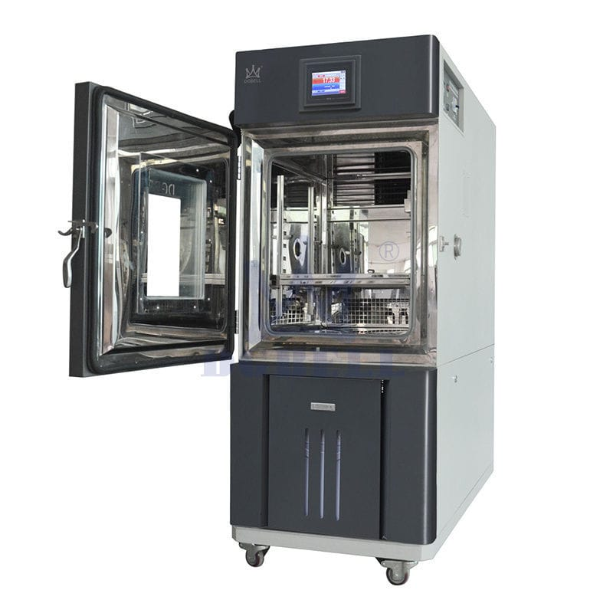
Thermostatic chamber
What is thermostatic chamber
  a device used to create and maintain a specific, stable temperature environment.
Applications
  used to examine temperature dependence in devices.
What we used it for
  quality assurance for SiPM power supplies.

Slide 4
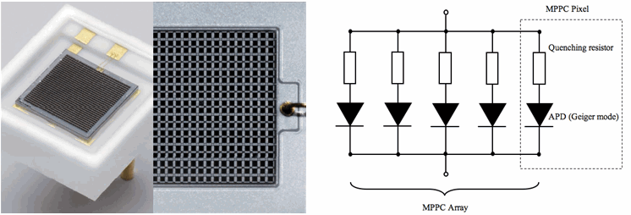
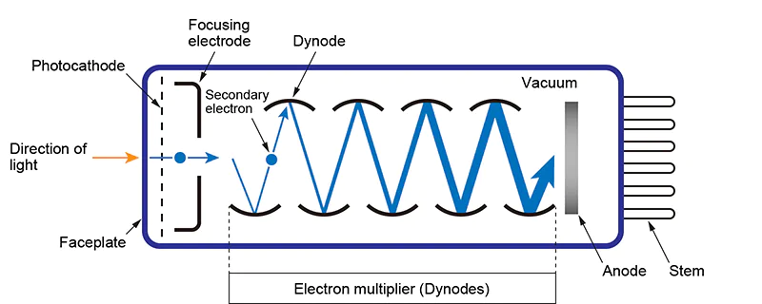
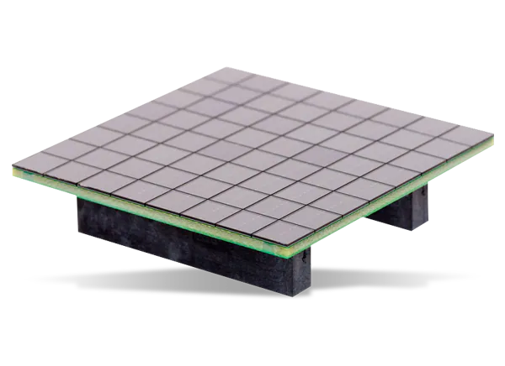
From PMTs To SiPMs
Silicon photomultiplier(SiPM)
Photomultiplier tube(PMT)

Slide 5
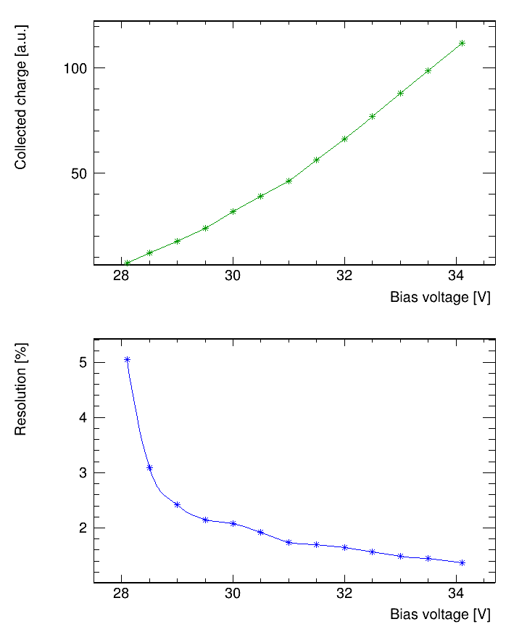
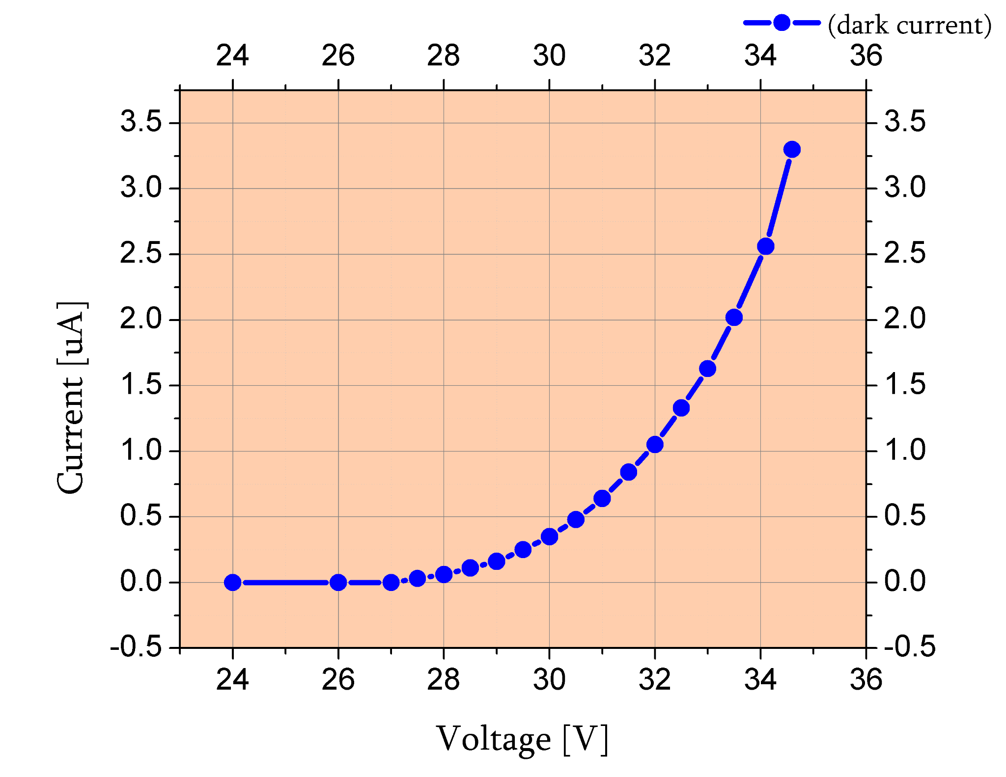
Typical SiPM characteristics
Measured SiPM sample: AFBR-S4N33C013
Gain
Dark current
Resolution
Main characteristics are highly dependent on voltage.

Slide 6
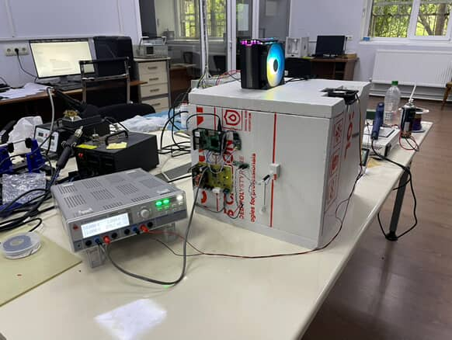
Project overview
System contains:
Thermally isolated box;
Heater(power resistor) and cooler(Peltier element);
Digital sensors for internal and ambient temperature measurements;
Adjustable power supply for heating and cooling;
Raspberry Pi: main component of the system;
Web interface for real-time control and monitoring.

Slide 7
Block diagram
Internal temperature sensor
External temperature sensor
Cooling element
Web control interface
Raspberry PI
DAC
DC-DC
Remote temperature monitoring
Heating element

Slide 8
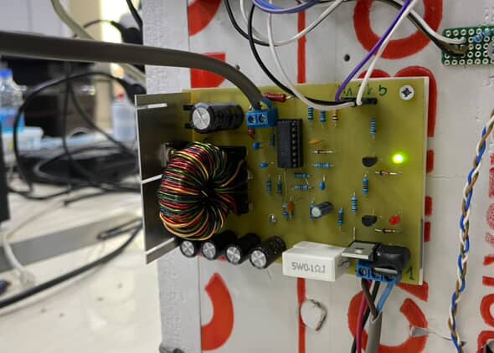
Power supply overview
Converts 24VDC input to a variable output
Custom made;
Based on DC-DC buck converter topology;
Operating frequency: ≈ 100 kHz;
Max. output current: 6 A(current limiting);
Output voltage: 0 – 23 V.

Slide 9
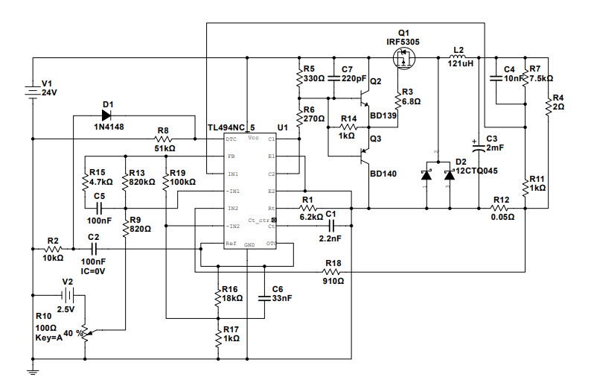
Power supply circuit
MOSFET driver
Buck converter
Designed and simulated in NI Multisim
Simulated DAC output
Shunt resistor for current limiting
PWM controller

Slide 10
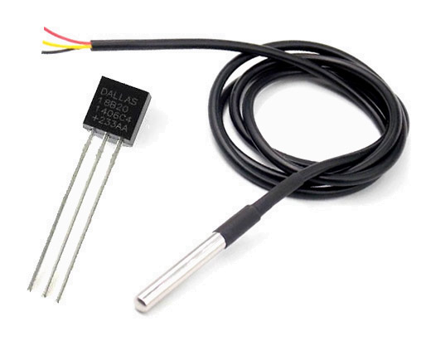

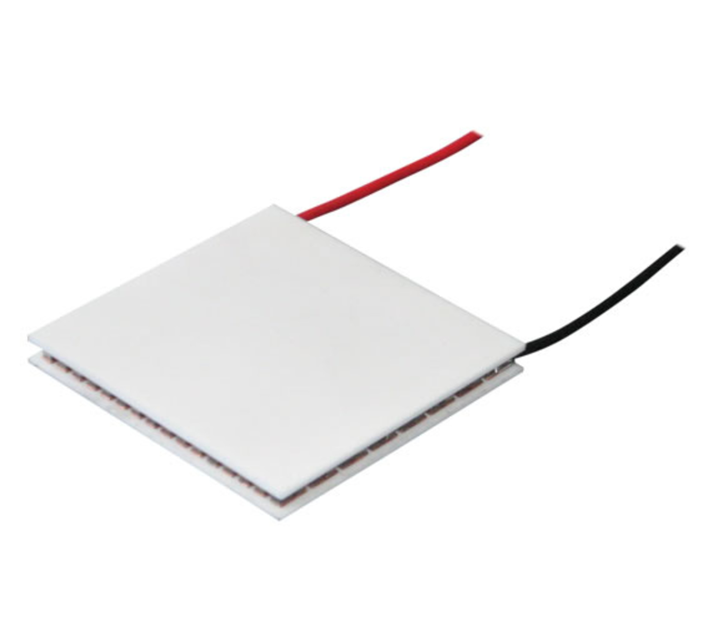
Components used
Temperature sensor(DS18B20)
Power resistor and Peltier element, both mounted on the heat sink
Accuracy: ± 0.5 °C (from -10°C to +85°C)
Resolution: 0.0625 °C (at 12 bit internal ADC resolution)

Slide 11
Software overview
Main program code is written on Python. It contains:
Temperature readout
Heating/Cooling control using PID algorithm
Web control interface, based on Flask framework
Remote temperature monitoring
  CERN ROOT framework(external)
  WebSockets

Slide 12
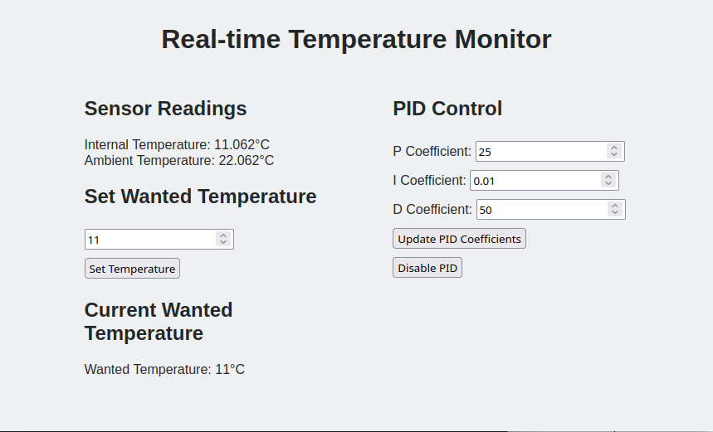
Graphical User Interface(GUI)

Slide 13
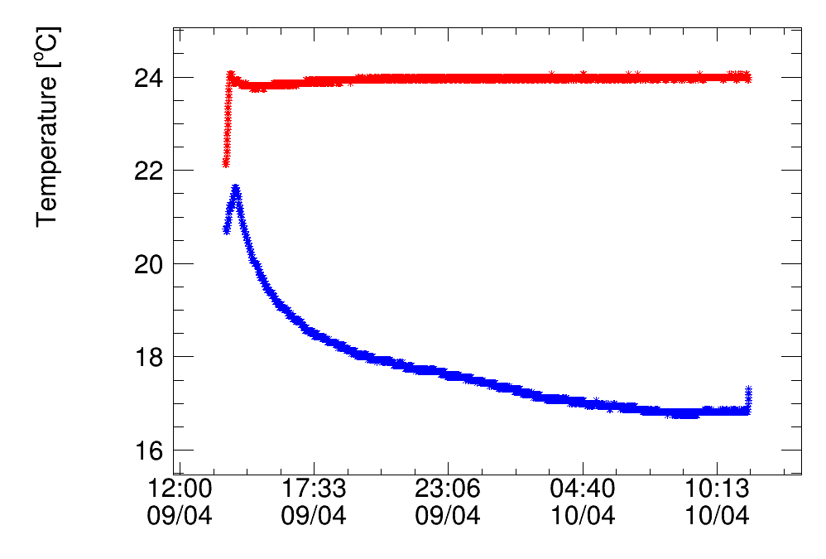
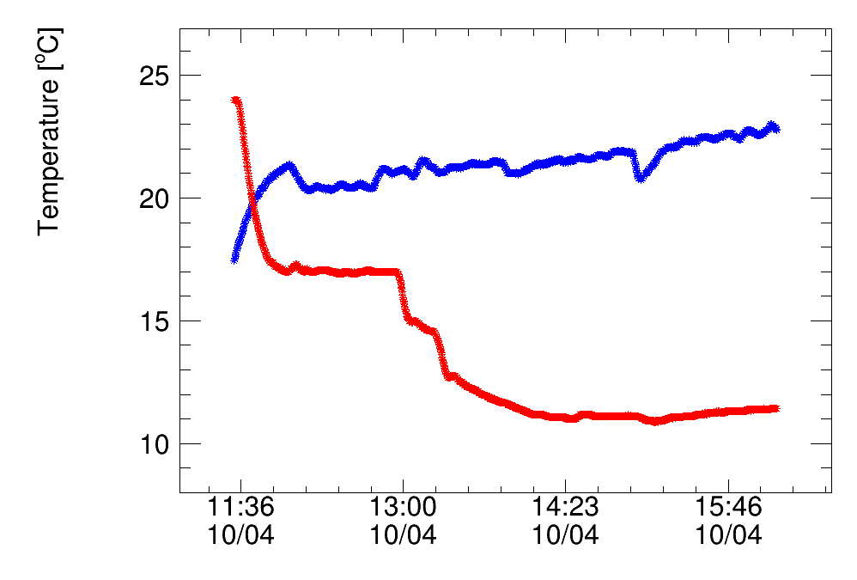
Tests
Ambient temperature
Internal temperature
Ambient temperature
Internal temperature
t_{max} > 45°C
t_{min} = t_{ambient} - 11°C

Slide 14

Future plans
SiPM power supply development
Input voltage: 80V;
Output voltage: 35 – 70 V;
Linear regulation;
Current limitation;
Ramp up/down;
Will be tested in the chamber.

Slide 15
Thank you
Questions?

Slide 16

Example of using SiPM
Signal Generator
Power Supply
25v ~ 32v
Dark box
SiPM
Oscilloscope
(Fixed Signal)
LED Flasher

