Slide 1

Investigation of isotope effect using supercritical fluid chromatography coupled with tandem mass spectrometry
${Vazha Tkemaladze}^{1}$, ${Saba Jorbenadze}^{1}$, ${Aluda Chelidze}^{1}$, ${Giorgia Sprega}^{2}$, ${Bezhan Chankvetadze}^{1}$
1) Institute of Physical and Analytical Chemistry, School of Exact and Natural Sciences, Iv. Javakhishvili Tbilisi State University, I. Chavchavadze Ave 1, 0179 Tbilisi, Georgia
2) Department of Excellence-Biomedical Sciences and Public Health, Università Politecnica delle Marche, 60121 Ancona, Italy
Scientific supervisor –Academician of the National Academy of Sciences of Georgia professor Bezhan Chankvetadze1

Slide 2
isotopologues

Slide 3
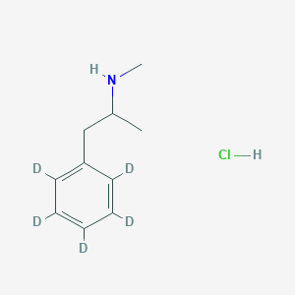
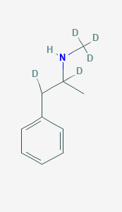
Isotopomers

Slide 4
normal isotope effect
inverse isotope effect

Slide 5
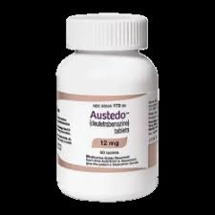
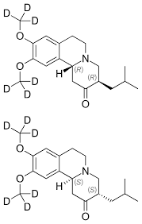
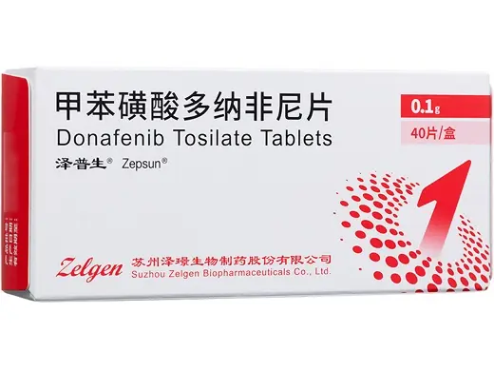
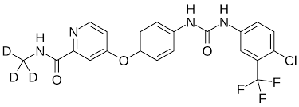
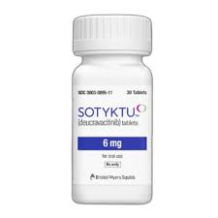
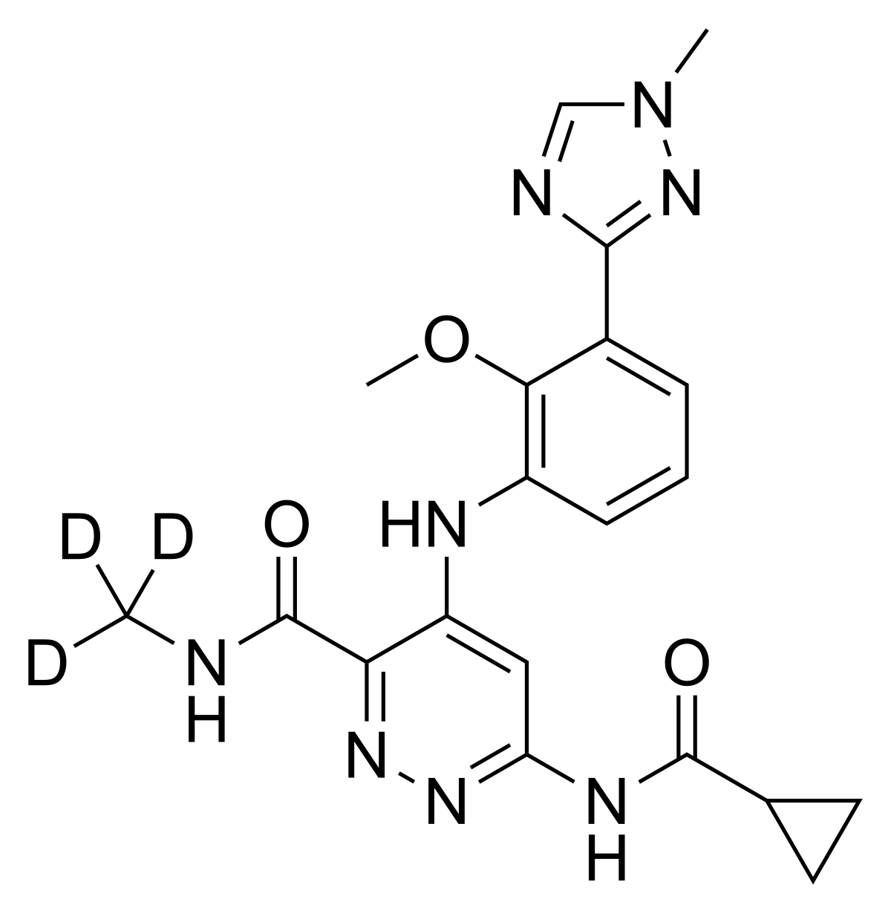
deutetrabenazine
donafenib
Deucravacitinib

Slide 6
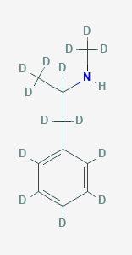
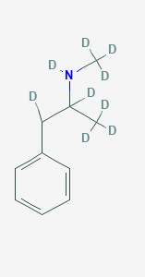
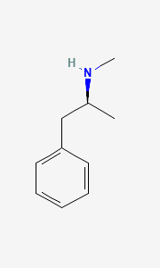
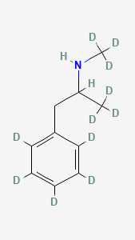

Amphetamine-d11
Amphetamine-d6
Methamphetamine-d14
Methamphetamine-d9
Methamphetamine-d5(side)
Methamphetamine
Methamphetamine-d11
Methamphetamine-d8
Methamphetamine-d5(ring)
Amphetamine-d5(side)
Amphetamine-d8
Amphetamine

Slide 7
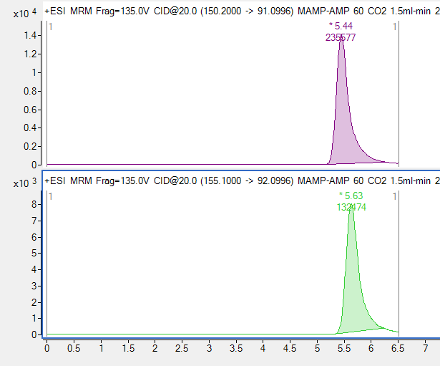


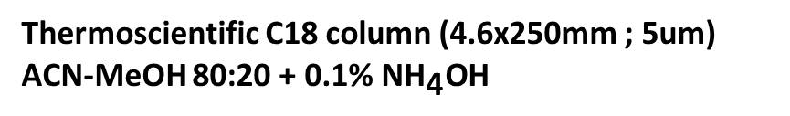
Thermoscientific C18 column (4.6x250mm ; 5um)
ACN-MeOH 80:20 + 0.1% ${\text{NH}}_{\text{4}}\text{OH}$
${CO}_{2}$(90%)
${CO}_{2}$(50%)
Methamphetamine
Methamphetamine
Methamphetamine
Methamphetamine
Methamphetamine d5
Methamphetamine d5
Methamphetamine-d5(ჯაჭვი)
Methamphetamine-d5(ჯაჭვი)

Slide 8
Methamphetamine
Content of CO2 %

Slide 9
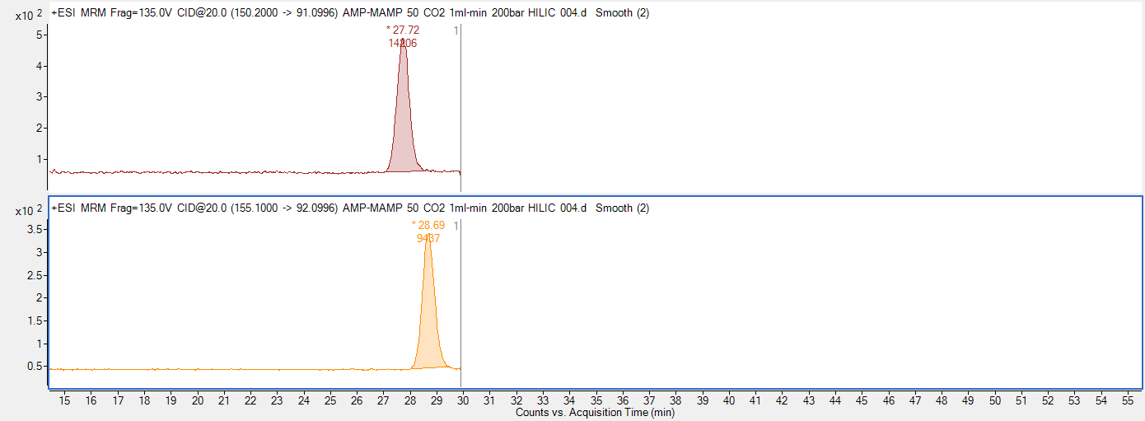
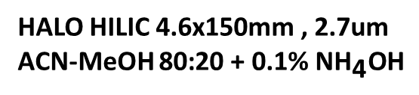


HALO HILIC 4.6x150mm , 2.7um
ACN-MeOH 80:20 + 0.1% ${\text{NH}}_{\text{4}}\text{OH}$
Methamphetamine
${CO}_{2}$(50%)
Methamphetamine d5
Methamphetamine
${CO}_{2}$(80%)
Methamphetamine d5

Slide 10
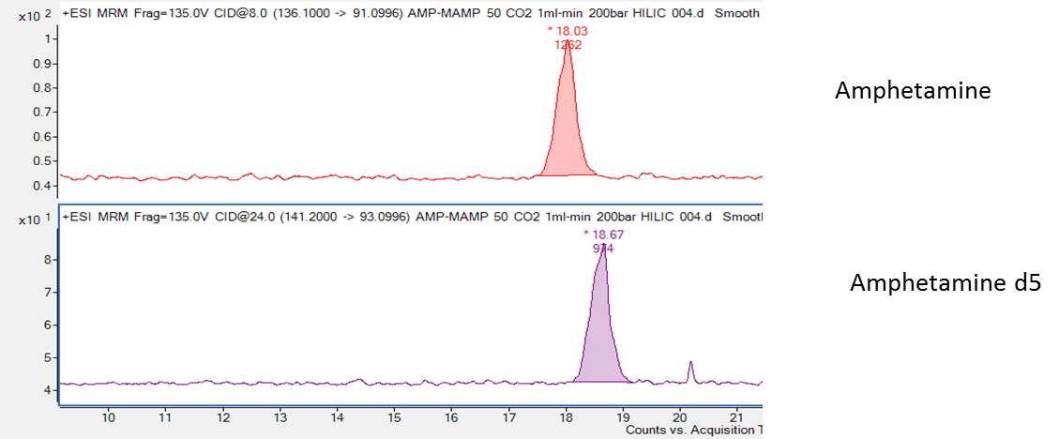


HALO HILIC 4.6x150mm , 2.7um
ACN-MeOH 80:20 + 0.1% ${\text{NH}}_{\text{4}}\text{OH}$
${CO}_{2}$(50%)
Amphetamine
${CO}_{2}$(80 %)
Amphetamine d5

Slide 11
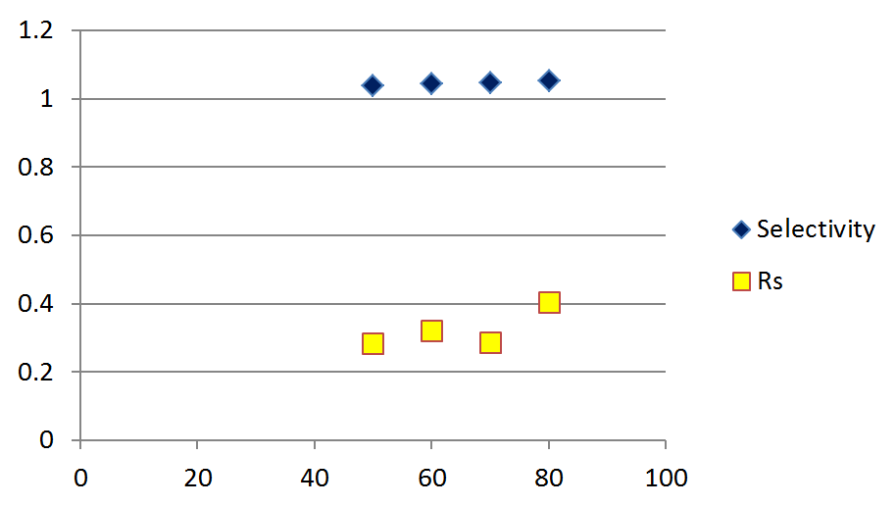
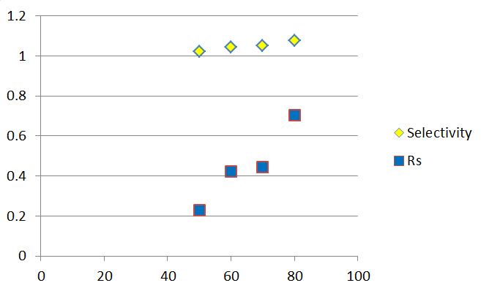
Amphetamine
Methamphetamine
Content of CO2 %
Content of CO2 %

Slide 12
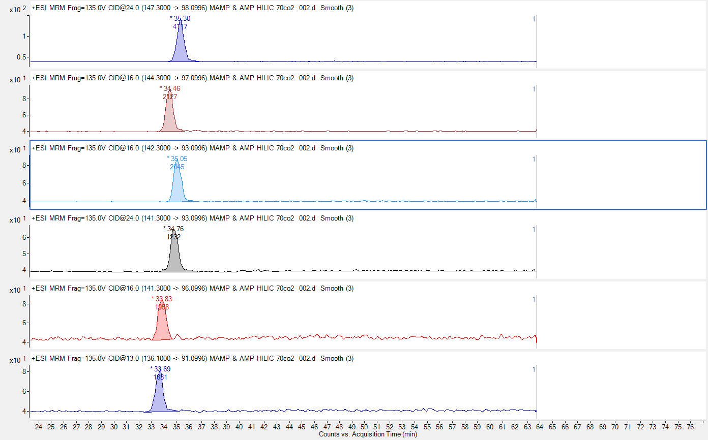
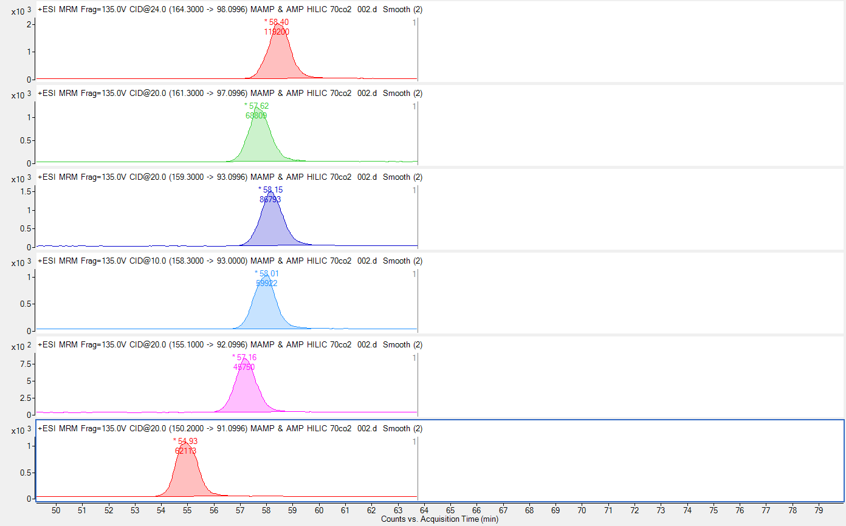

HALO HILIC 4.6x150mm , 2.7um
70:30 CO2:MP (MeOH:ACN 20/80 + 0.1%${ \text{NH}}_{\text{4}}\text{OH}\text{) }$
AMP
MAMP
AMP-D5(side)
MAMP-D5
AMP-D5(ring)
MAMP-D8
AMP-D6
MAMP-D9
AMP-D8
MAMP-D11
MAMP-D14
AMP-D11

Slide 13
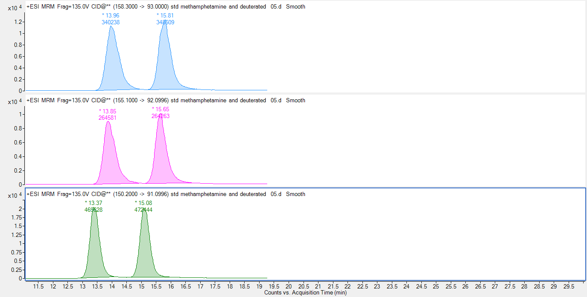
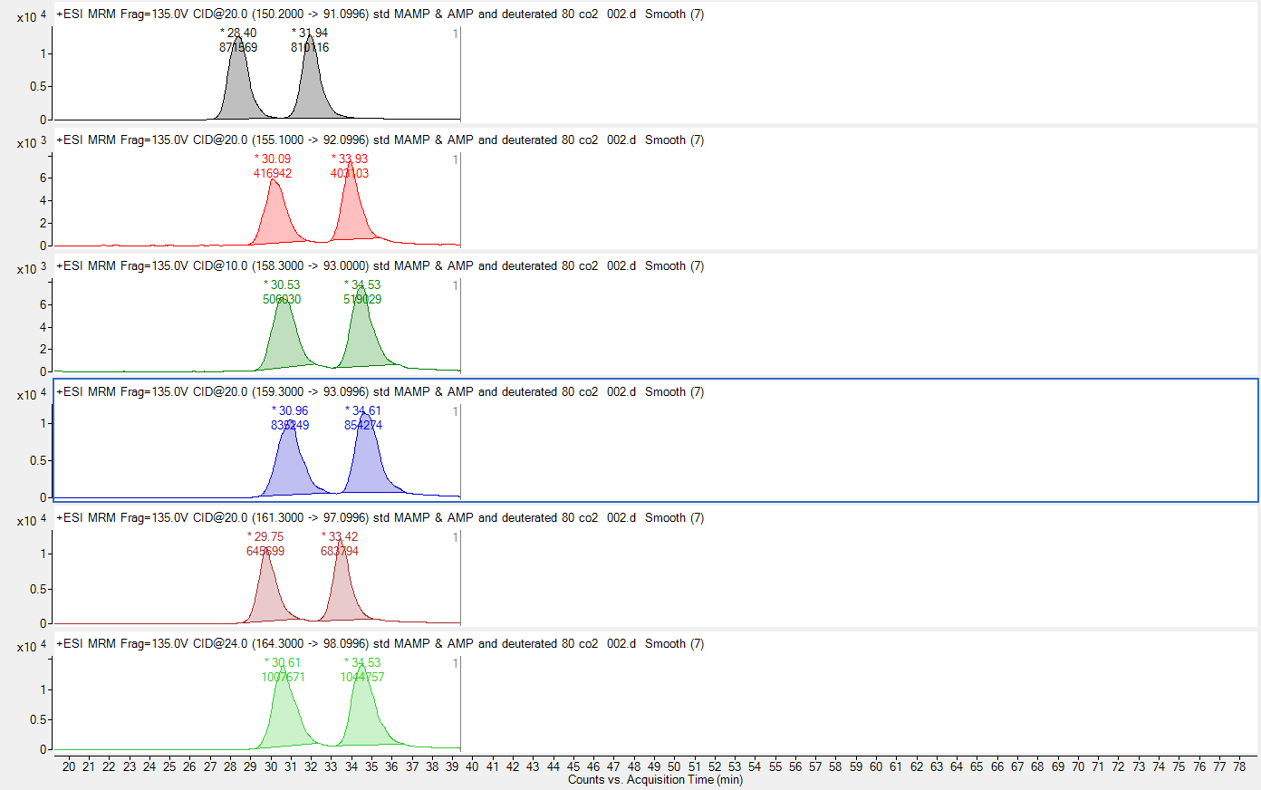
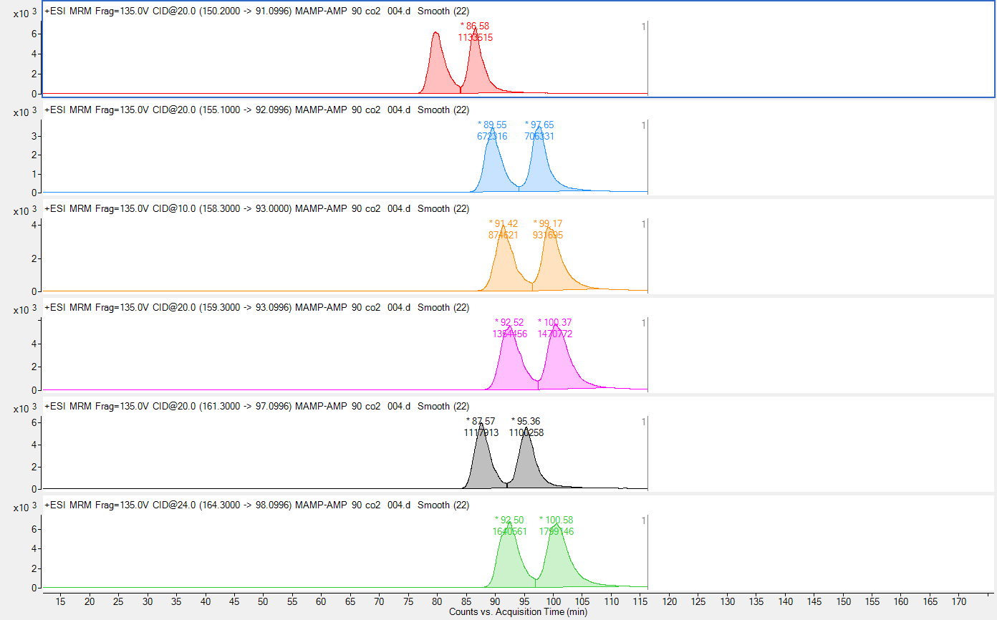
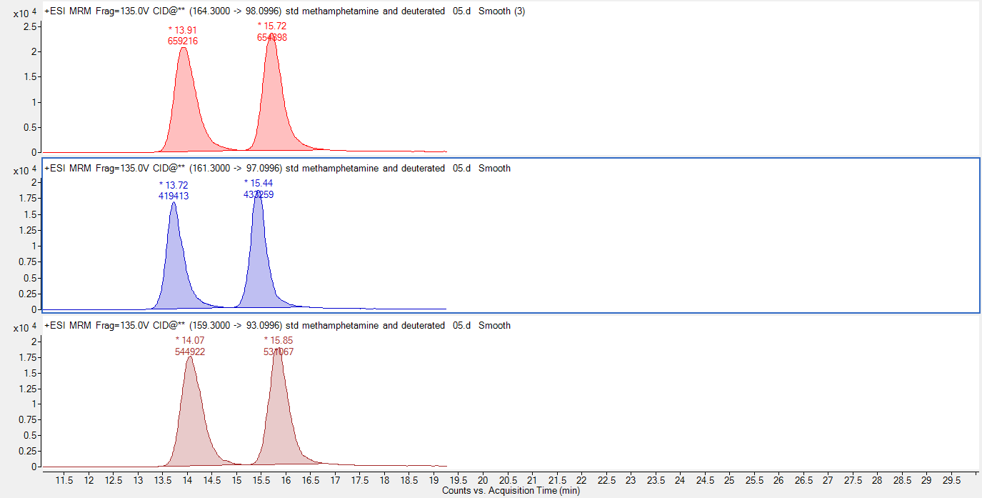



LUX AMP
MeOH:IPA:ACN 5/15/80 + ${\text{0.1 \%} \text{NH}}_{\text{4}}\text{OH}$
${CO}_{2}$(70%)
${CO}_{2}$(80%)
${CO}_{2}$(90%)
MAMP
MAMP
MAMP
MAMP
MAMP
MAMP-D5
MAMP-D5
MAMP-D5
MAMP-D5
MAMP-D5
MAMP-D8
MAMP-D8
MAMP-D8
MAMP-D8
MAMP-D8
MAMP-D9
MAMP-D9
MAMP-D9
MAMP-D9
MAMP-D9
MAMP-D11
MAMP-D11
MAMP-D11
MAMP-D11
MAMP-D11
MAMP-D14
MAMP-D14
MAMP-D14
MAMP-D14
MAMP-D14

Slide 14
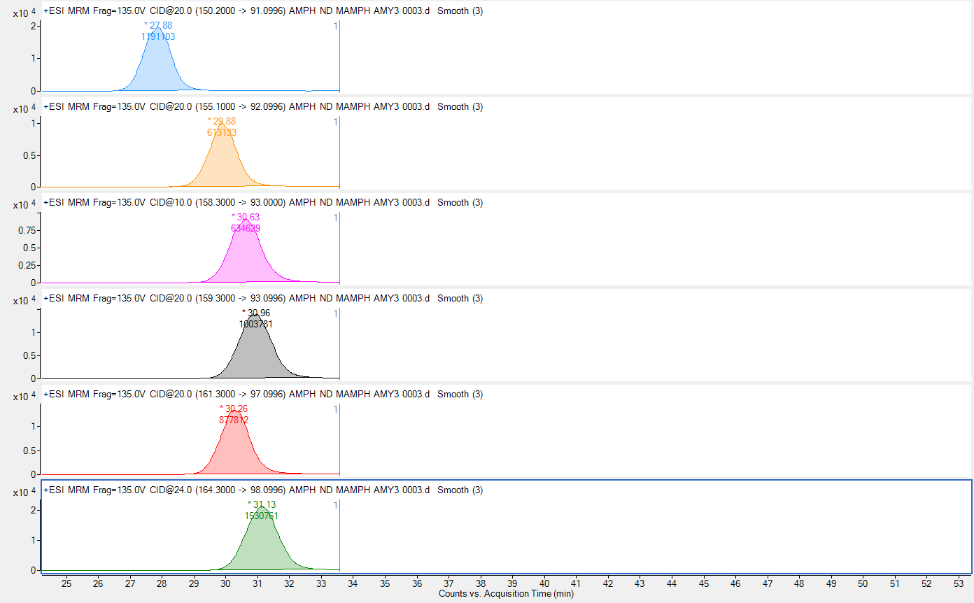
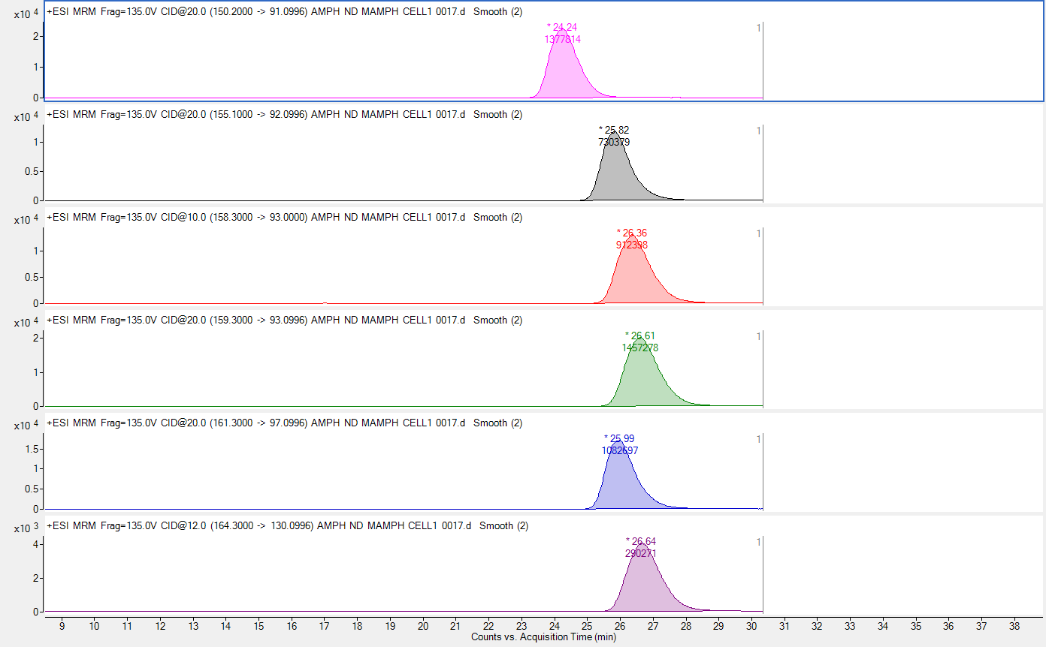
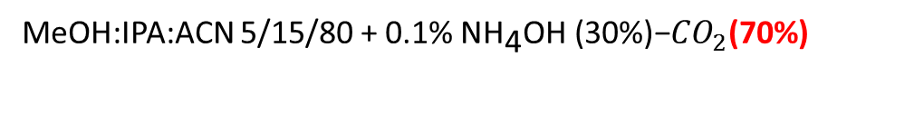
MeOH:IPA:ACN 5/15/80 + 0.1% ${\text{NH}}_{\text{4}}\text{OH}\text{ (30\%)−}{CO}_{2}\text{(70\%)}$
Amylose-3
Cellulose-1
MAMP
MAMP
MAMP
MAMP
MAMP-D5
MAMP-D5
MAMP
MAMP-D5
MAMP-D8
MAMP-D8
MAMP-D5
MAMP-D5
MAMP-D8
MAMP-D8
MAMP-D8
MAMP-D9
MAMP-D9
MAMP-D9
MAMP-D9
MAMP-D9
MAMP-D11
MAMP-D11
MAMP-D14
MAMP-D11
MAMP-D11
MAMP-D14
MAMP-D14
MAMP-D14
MAMP-D14

Slide 15
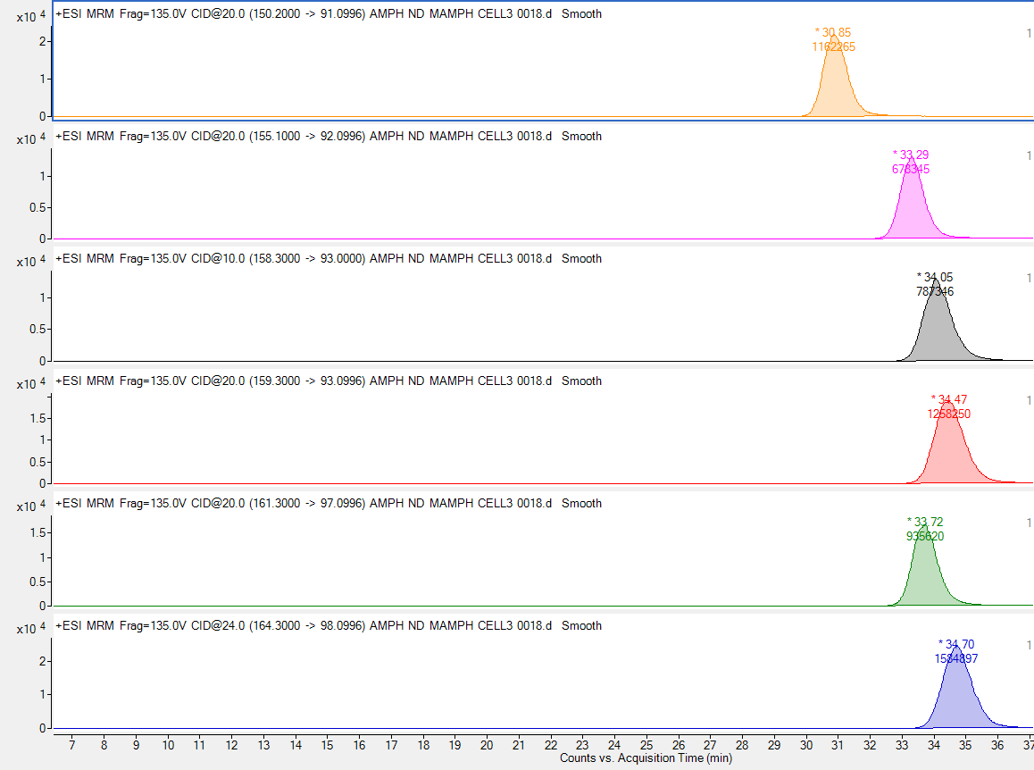
Cellulose-3
MAMP
MAMP-D5
MAMP-D8
MAMP-D9
MAMP-D11
MAMP-D14

Slide 16
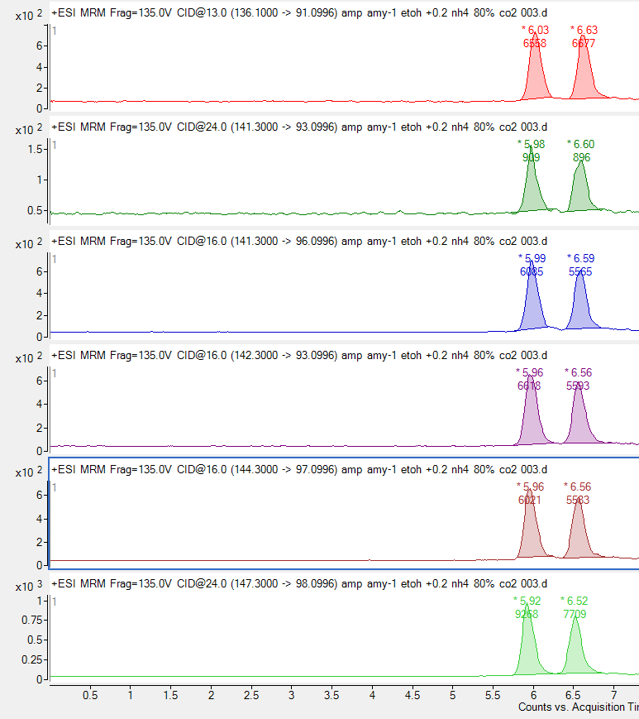
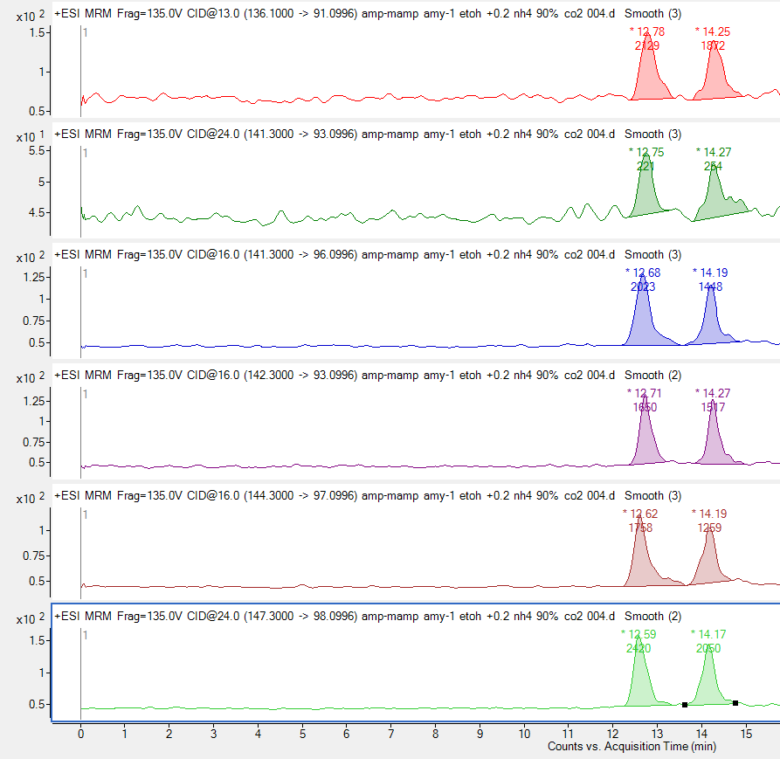

Lux Amylose-1
80:20 CO2:MP (EtOH + 0.2% ${\text{NH}}_{\text{4}}$0H)
90:0 CO2:MP (EtOH + 0.2% ${\text{NH}}_{\text{4}}$0H)
AMP
AMP
AMP
AMP-D5(side)
AMP-D5(side)
AMP-D5(side)
AMP-D5(ring)
AMP-D5(ring)
AMP-D5(ring)
AMP-D6
AMP-D6
AMP-D6
AMP-D8
AMP-D8
AMP-D8
AMP-D11
AMP-D11
AMP-D11

Slide 17
conclusion
The present study represents the first attempt to investigate the isotope effect using supercritical fluid chromatography.
The experiments showed that a strong isotope effect is observed during the analysis of methamphetamine and its deuterated derivatives, specifically achieving their baseline separation using various chiral and achiral columns through supercritical fluid chromatography.

