Slide 1

Ivane Javakhishvili Tbilisi State University
Faculty of Exact and Natural Sciences
Particulate matter in ambient atmosphere
MA Student: Giorgi Nizharadze
Supervisor: Dr. Giorgi Jibuti (Head of the SMART|AtmoSIM_LAB at TSU)
Tbilisi
15.08.2025

Slide 2





SMART|AtmoSim_LAB
29 September 2017-Opening ceremony of SMART|AtoSim_LAB
Notes:
Founding, GGSB, 2nd smartlab
Bezhan and Ramaz,
Andreas, Astrid, Franz

Slide 3
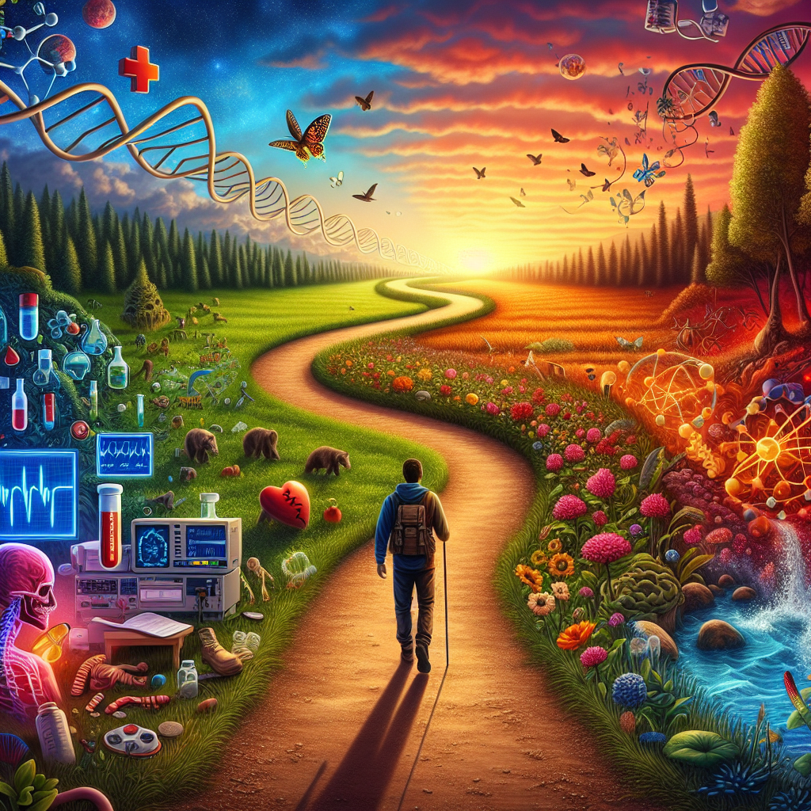
About me
Education
Points of interest
Bachelor’s degree: Ecology
Master’s degree: Chemical expertise(In process)
PhD: ……
Environmental sciences
Analytical chemistry

Slide 4


Slide 5
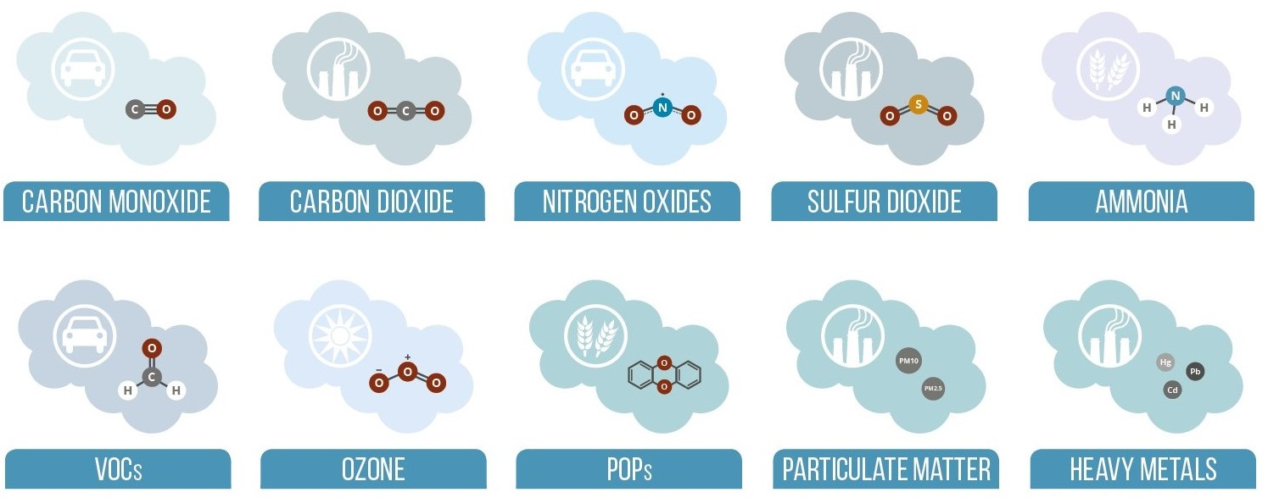
Qualitative depletion sources

Slide 6
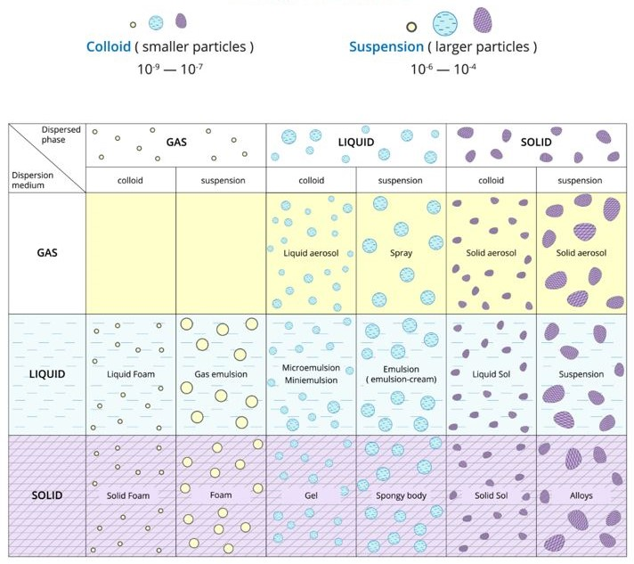
Disperse systems - Aerosol

Slide 7
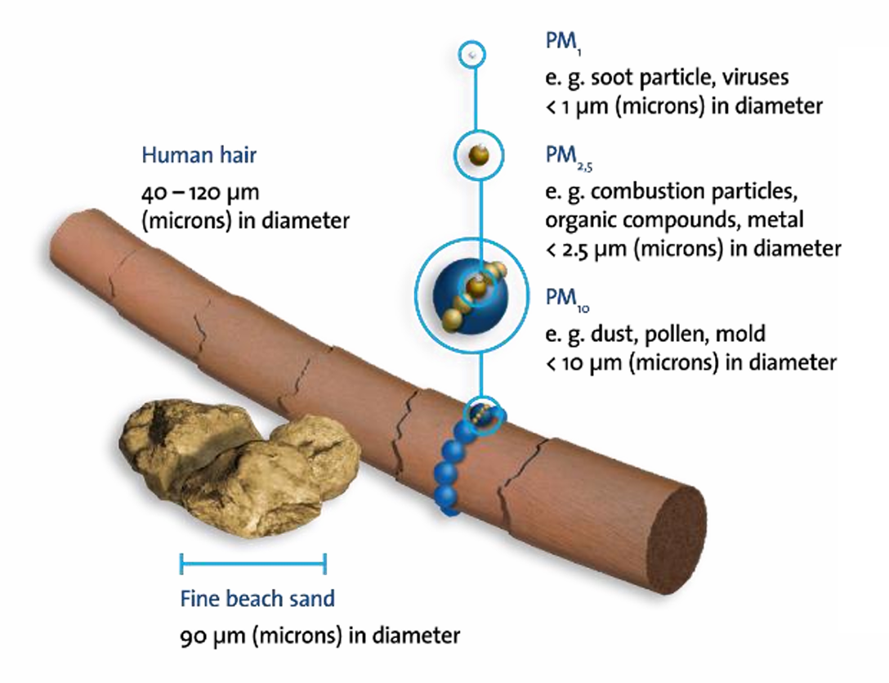
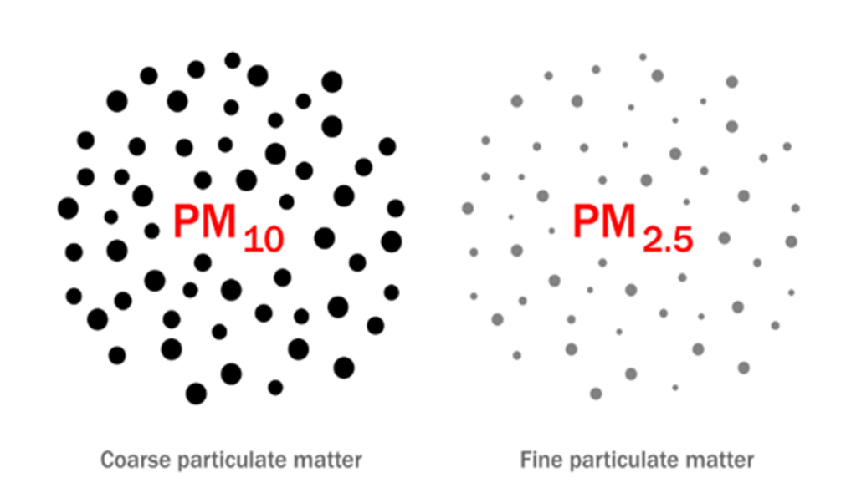
PM 2.5 and PM 10

Slide 8
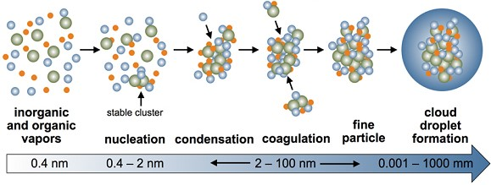
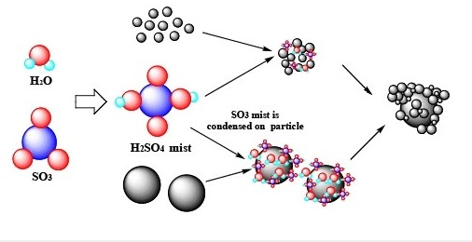
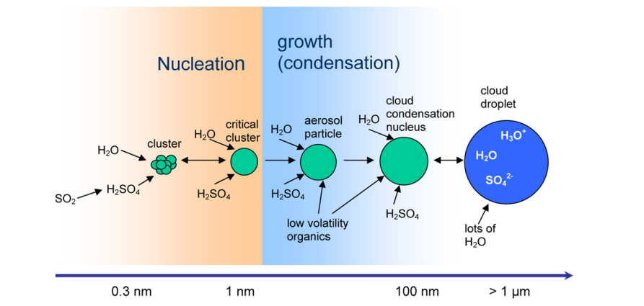
Particle Formation

Slide 9
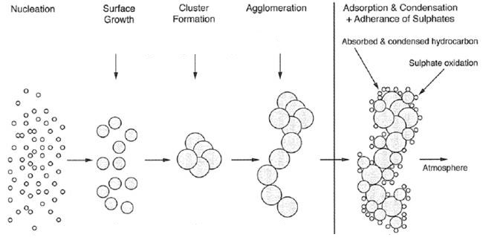
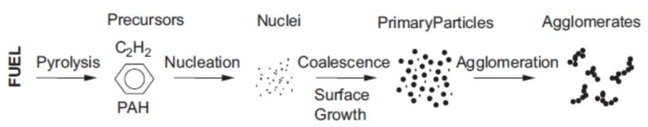

Slide 10
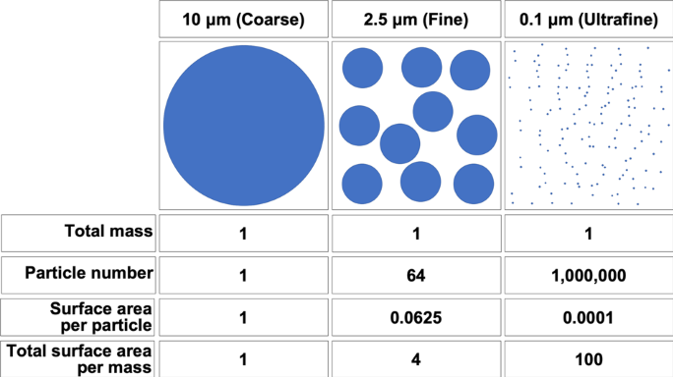
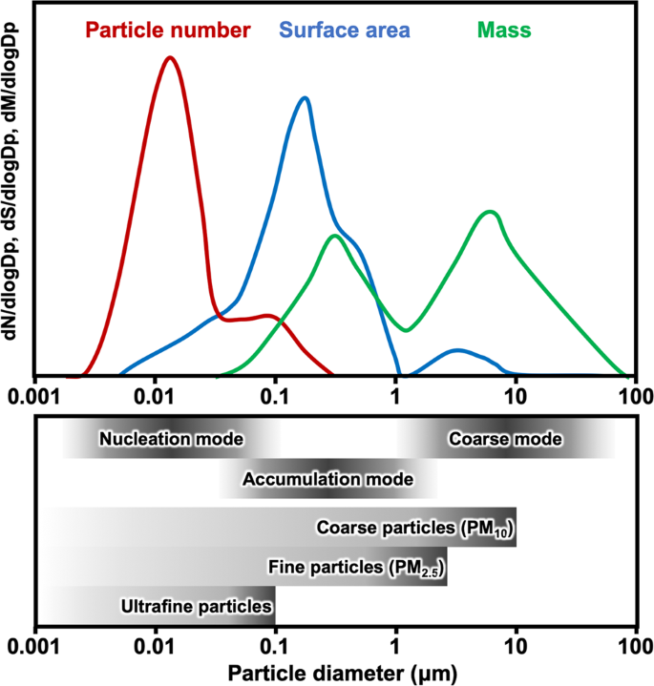
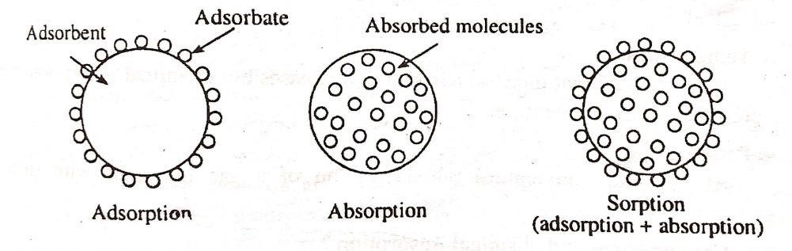
Relationship between particle size and total surface area

Slide 11
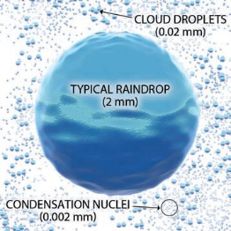
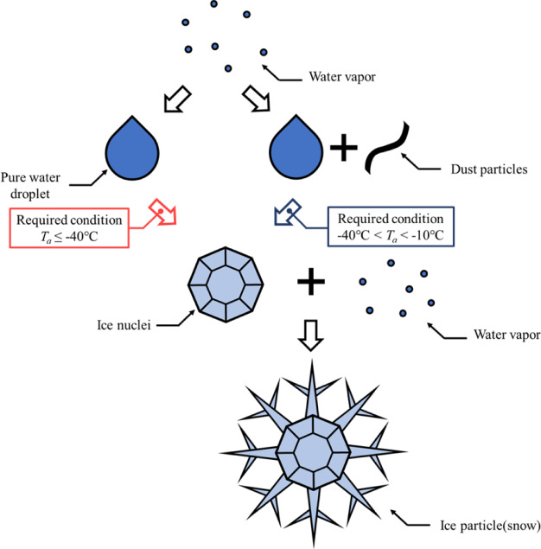
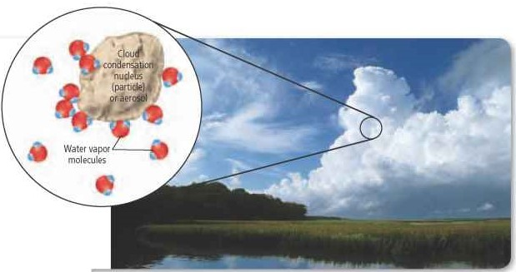
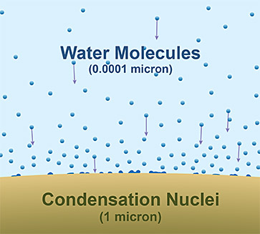
Condensation nuclei – raindrop formation

Slide 12
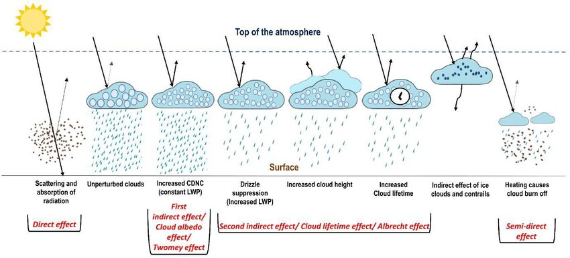
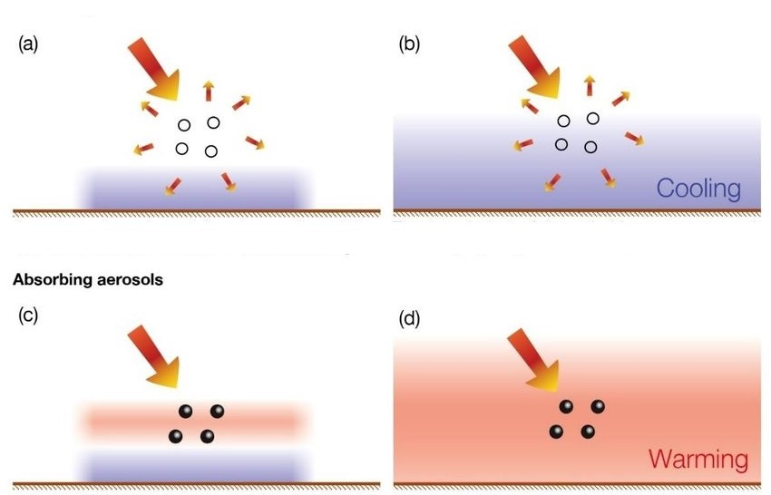
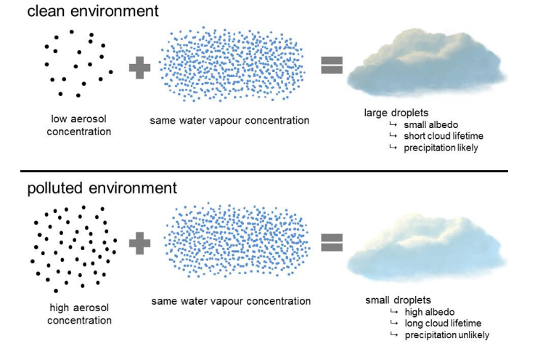
The scattering of solar radiation – Contribution to the average albedo of the Earth

Slide 13
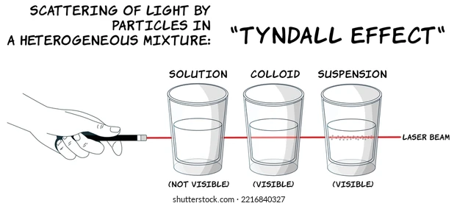
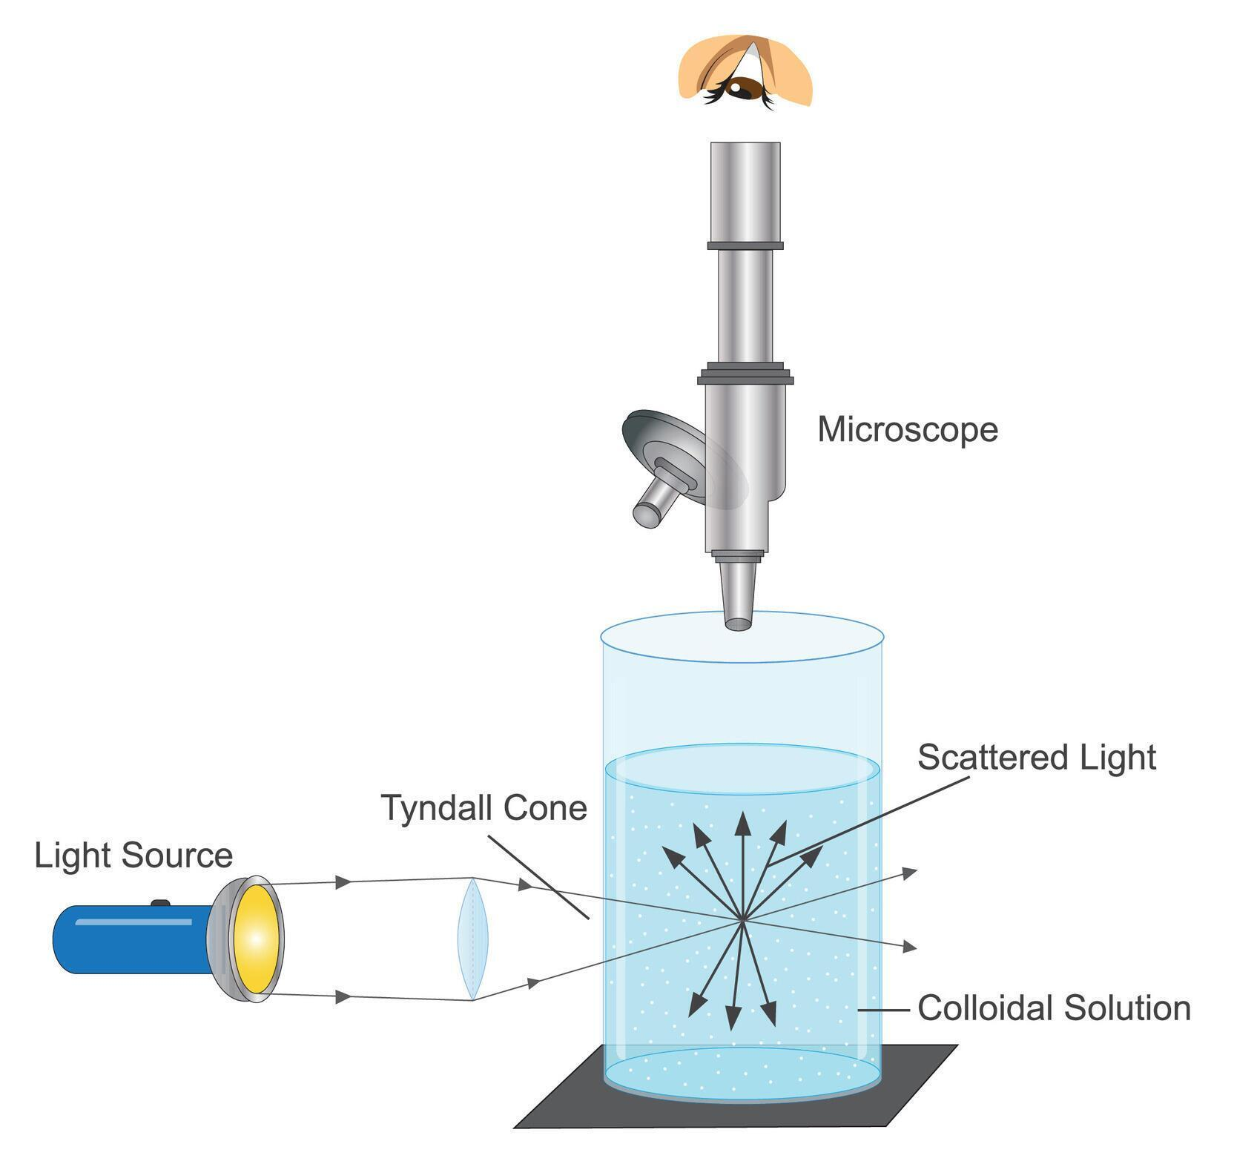
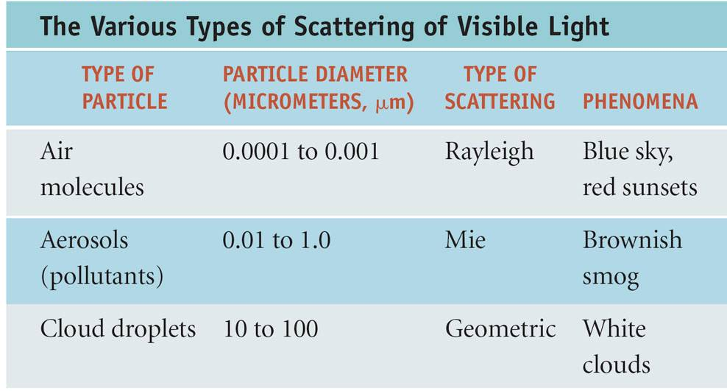
Tyndall effect

Slide 14
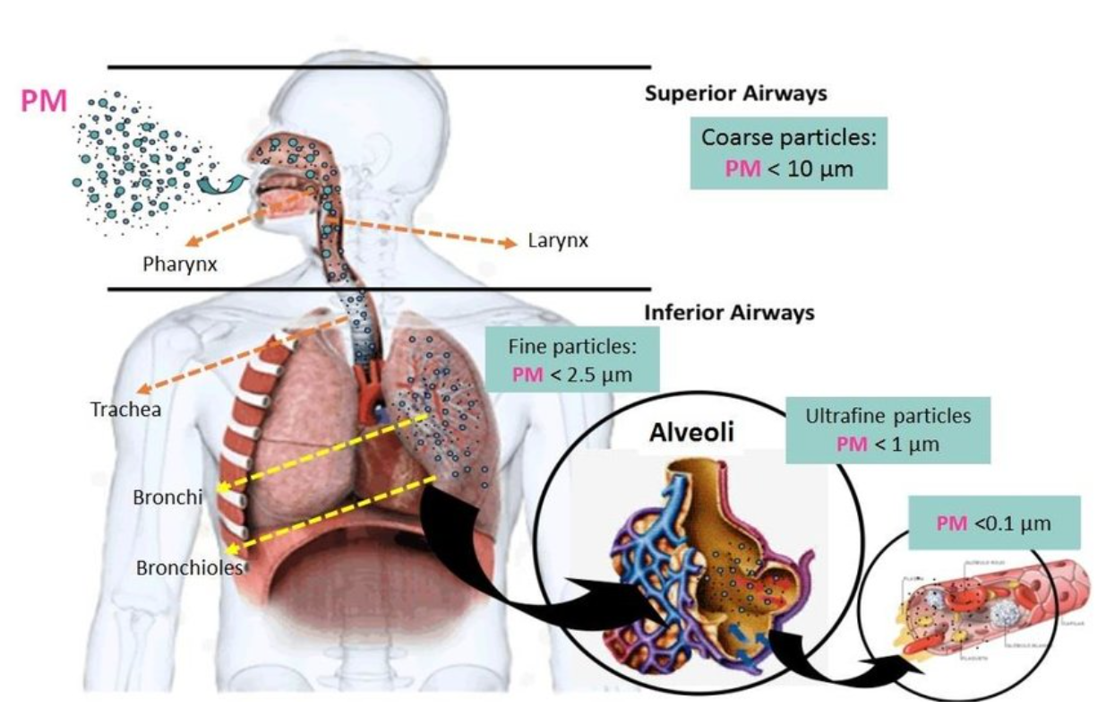
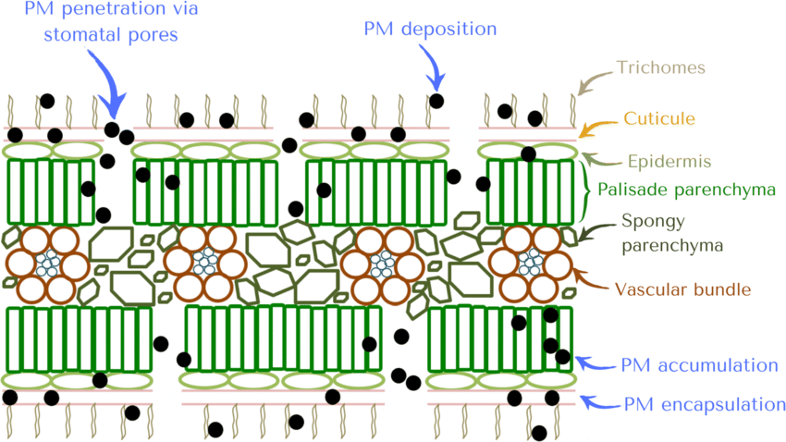
Particulate matter's interference in physiological processes

Slide 15
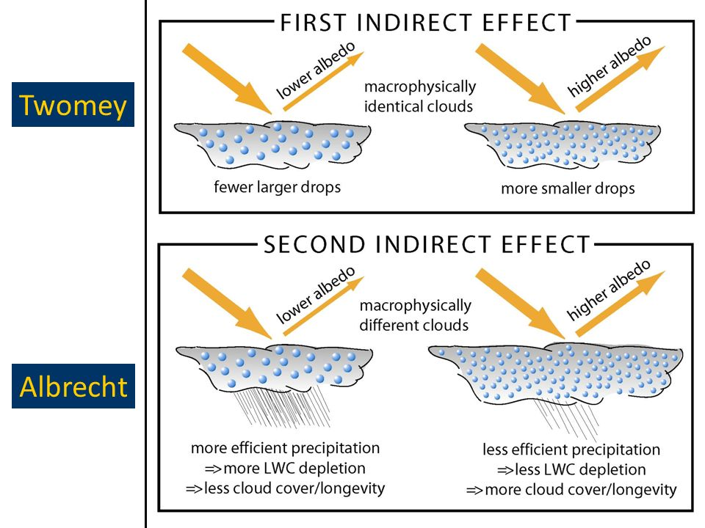

Slide 16
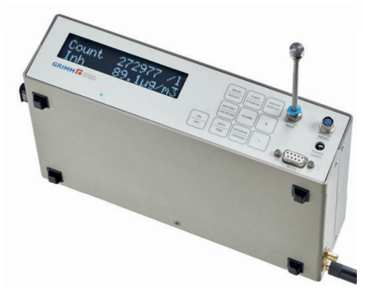
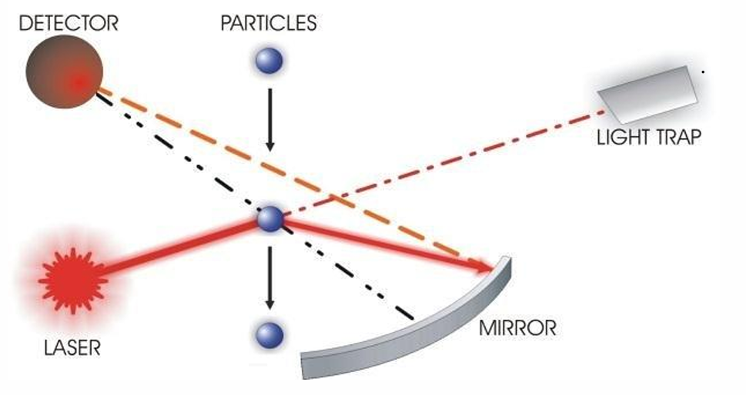
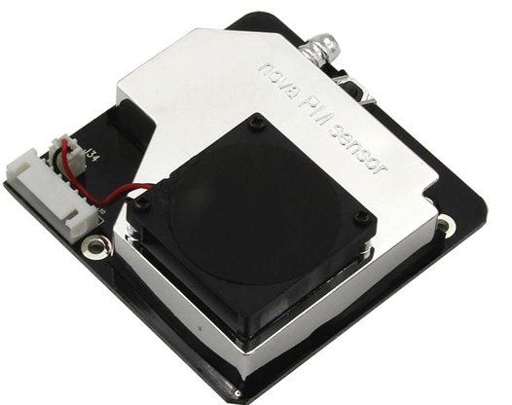
Experimental Part
General Principles of Operation
Grimm Aerosol Monitor
SDS011

Slide 17
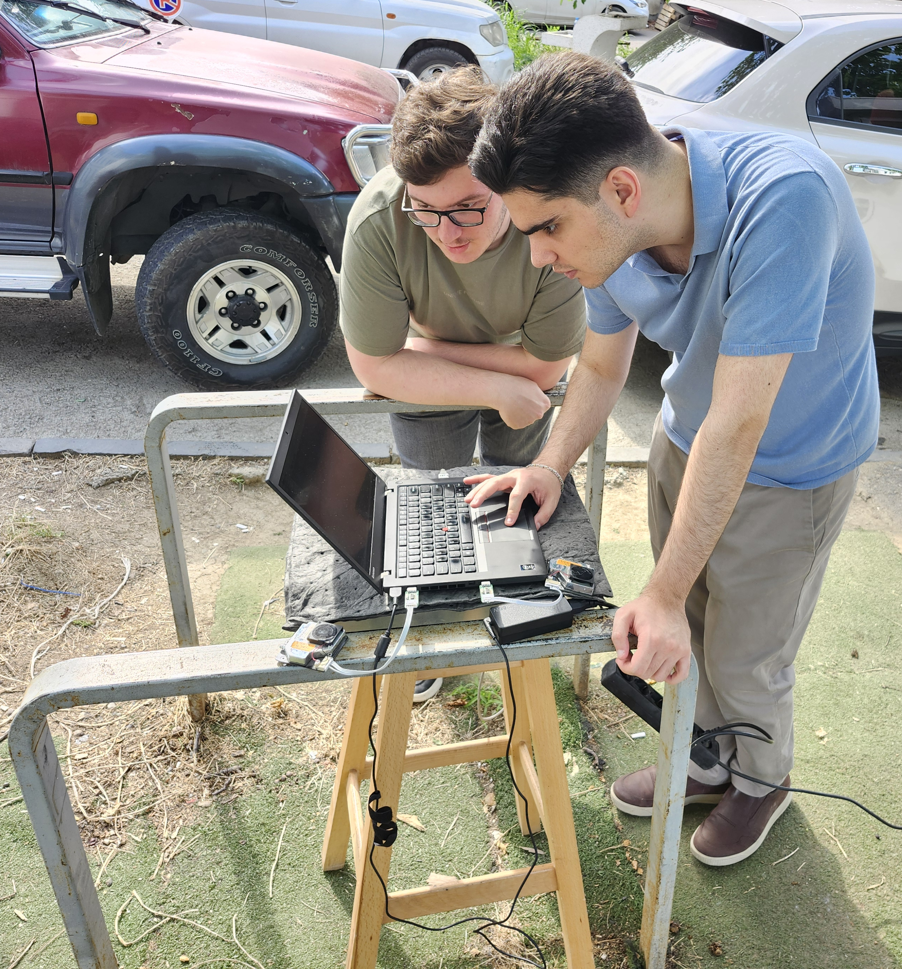
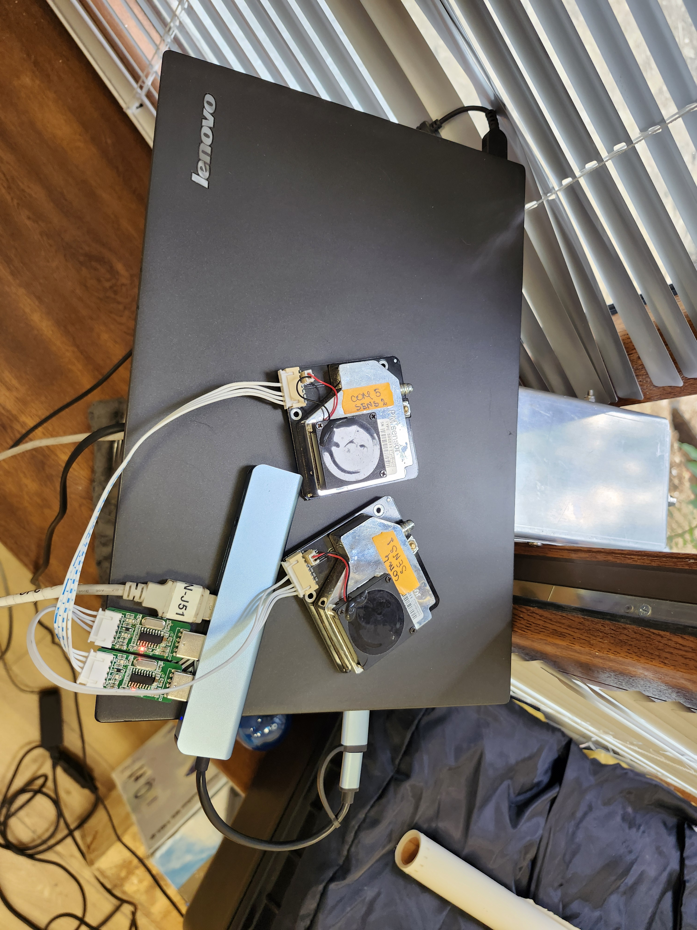

Slide 18
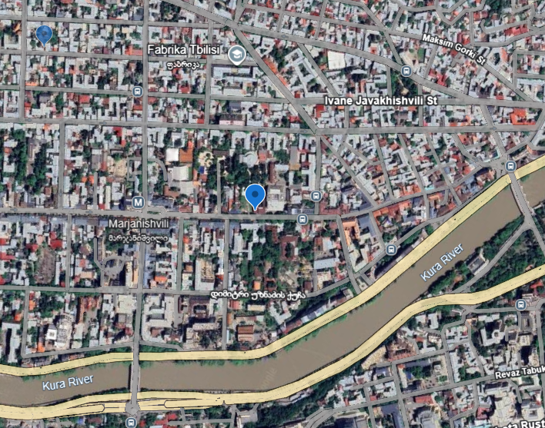
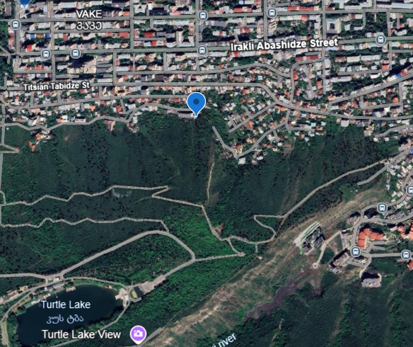
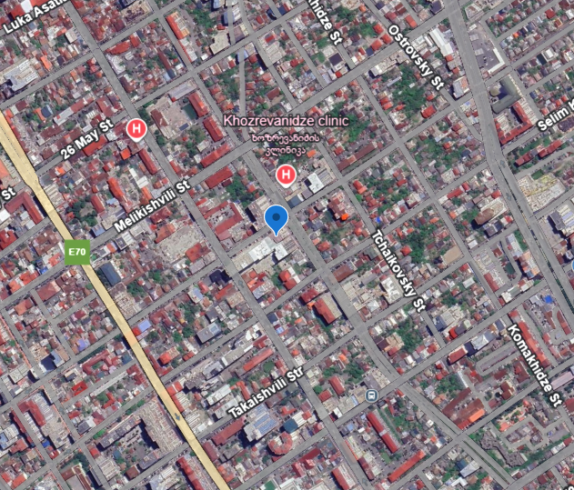
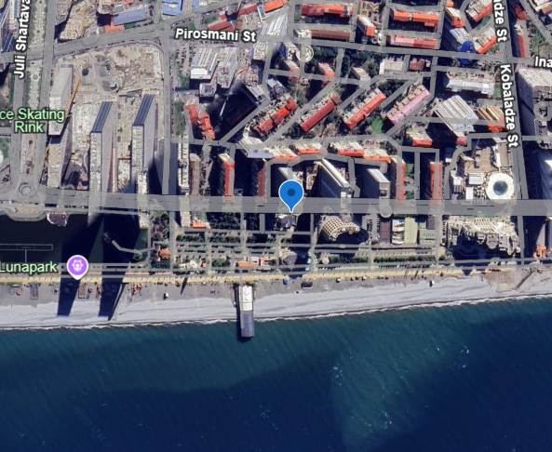
Measurement locations
Tbilisi
Batumi
To take measurements on pinned locations we were assisted by Luka Menabde BA student of the Faculty of Exact and Natural sciences, TSU

Slide 19
Measurement results
 | 2.5 PM (mcg/ m³) | 10 PM (mcg/ m³)
Urban area 1 (41°42'27"N 44°47'57"E) | 21.40 | 38.14 | SDS011
 | 18.28 | 36.32 | GRIMM
Recreational area 1 (41°42'21"N 44°45'40"E) | 15.41 | 32.46 | SDS011
 | 15.50 | 32.50 | GRIMM
Urban area 2 (41°49'15"N 41°46'29"E) | 11.62 | 18.17 | SDS011
 | 11.35 | 17.85 | GRIMM
Recreational area 2 (41°51'41"N 41°46'41"E) | 8.18 | 12.64 | SDS011
 | 8.25 | 12.67 | GRIMM

Slide 20
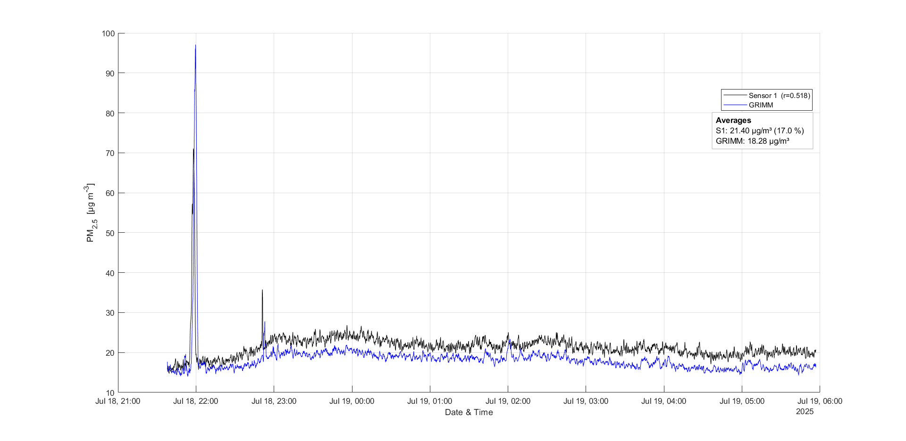
Urban area 1 (41°42'27"N 44°47'57"E)

Slide 21
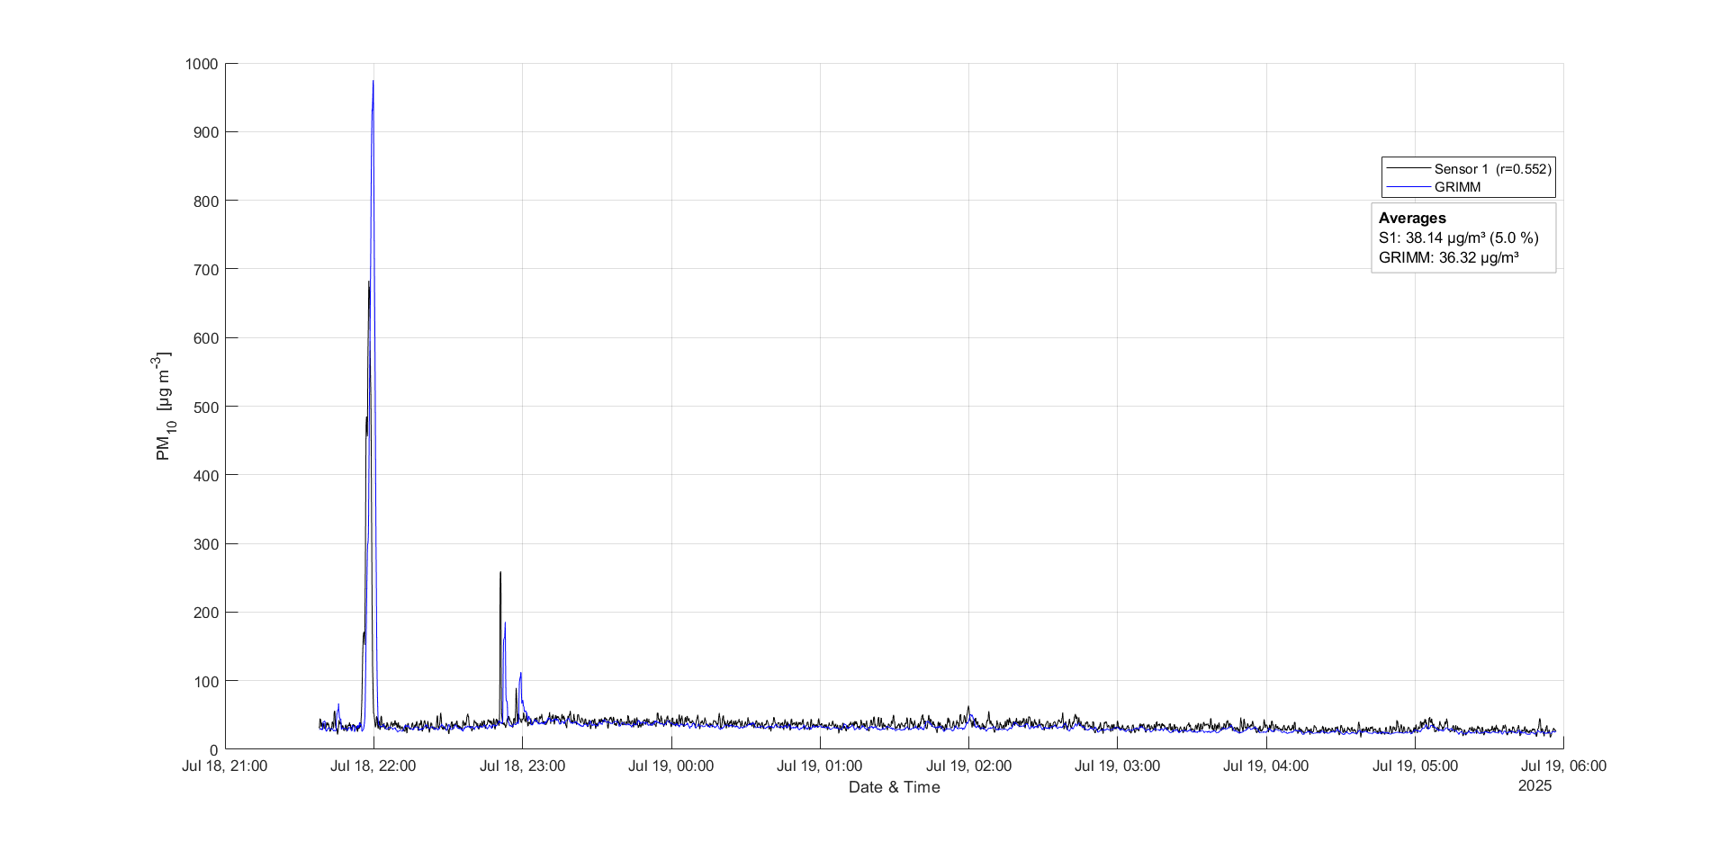

Slide 22
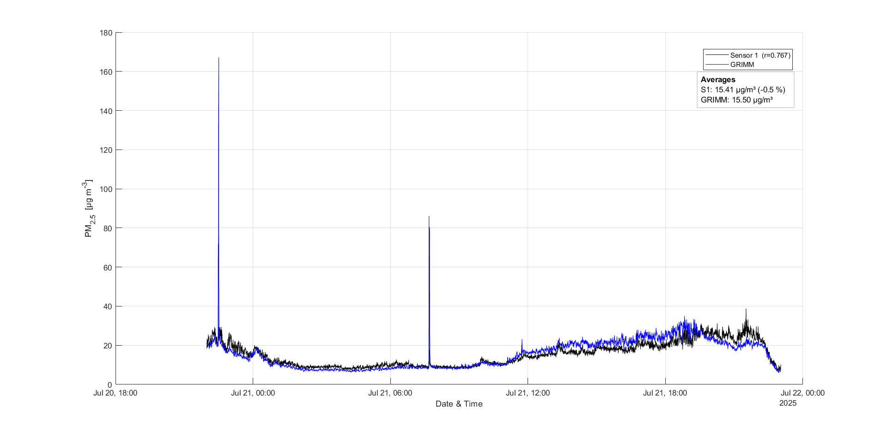
Recreational area 1 (41°42'21"N 44°45'40"E)

Slide 23
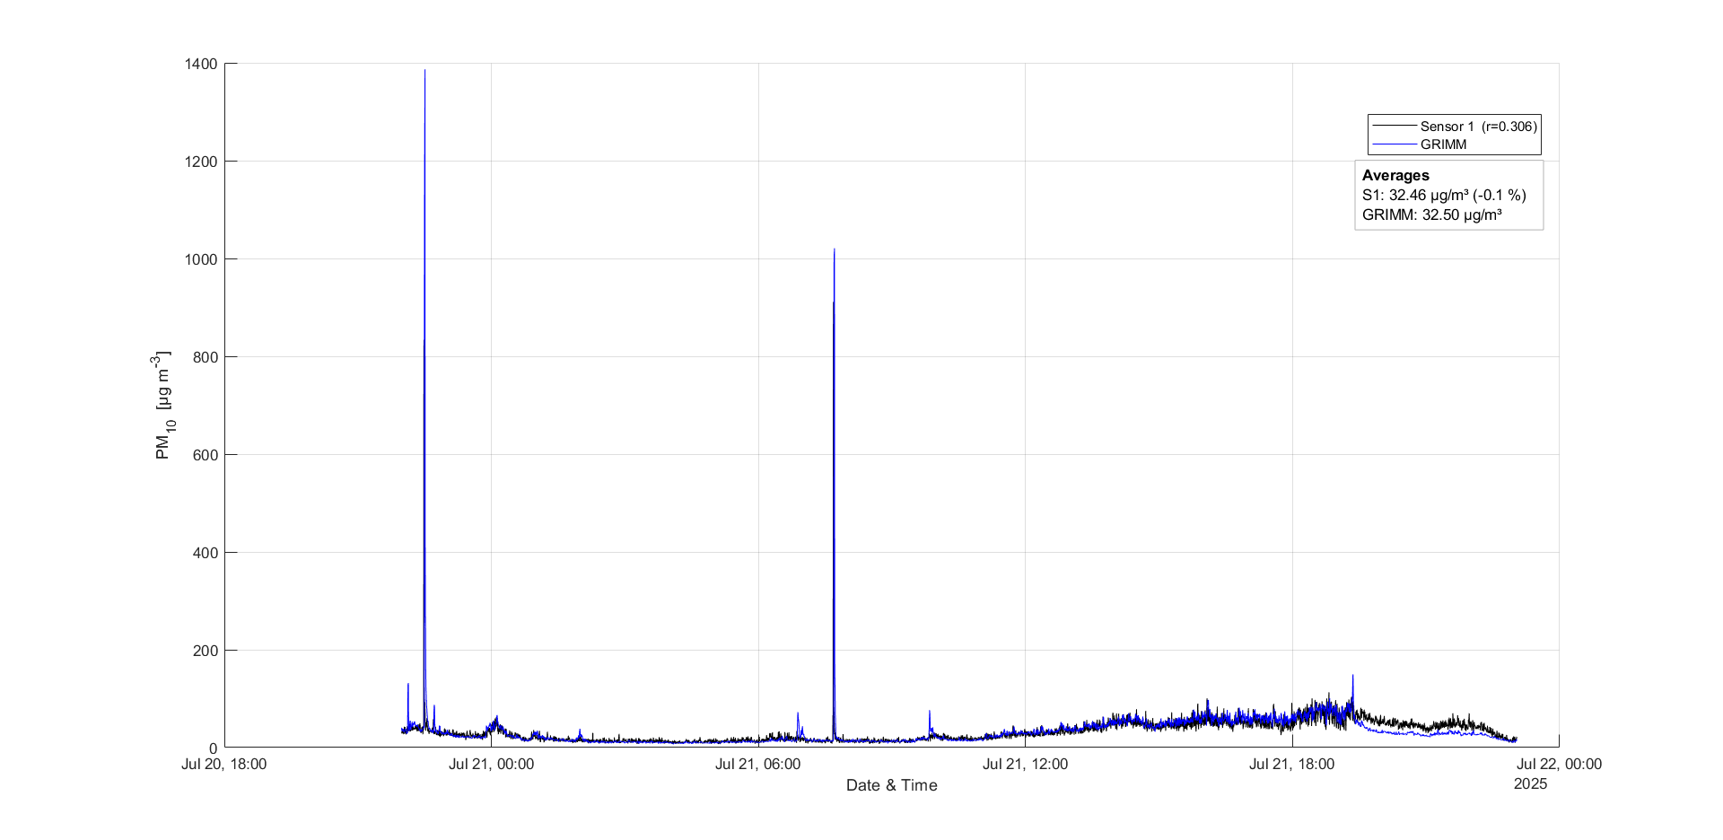

Slide 24
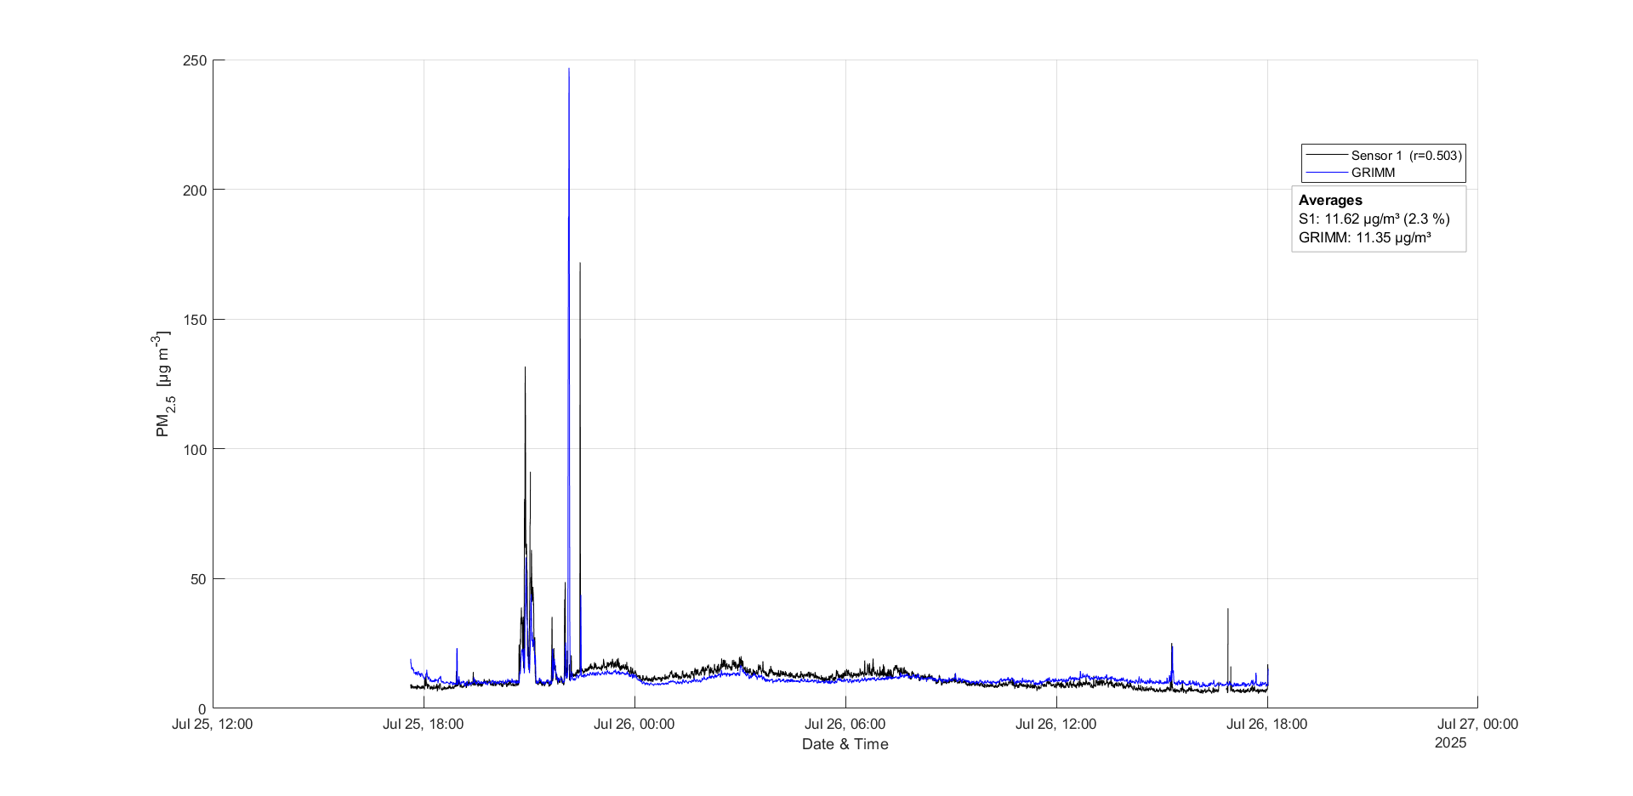
Urban area 2 (41°49'15"N 41°46'29"E)

Slide 25
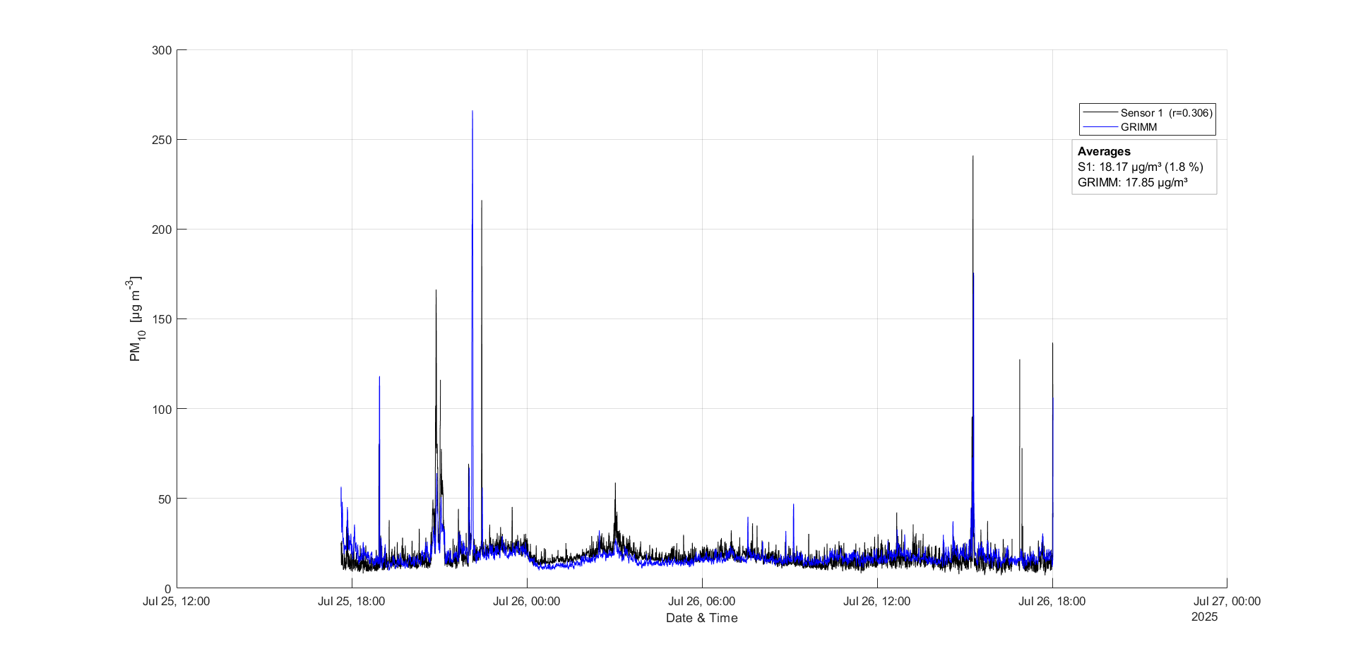

Slide 26
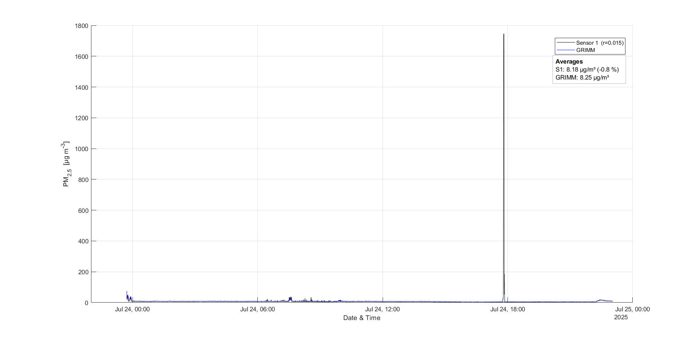
Recreational area 2 (41°51'41"N 41°46'41"E)

Slide 27
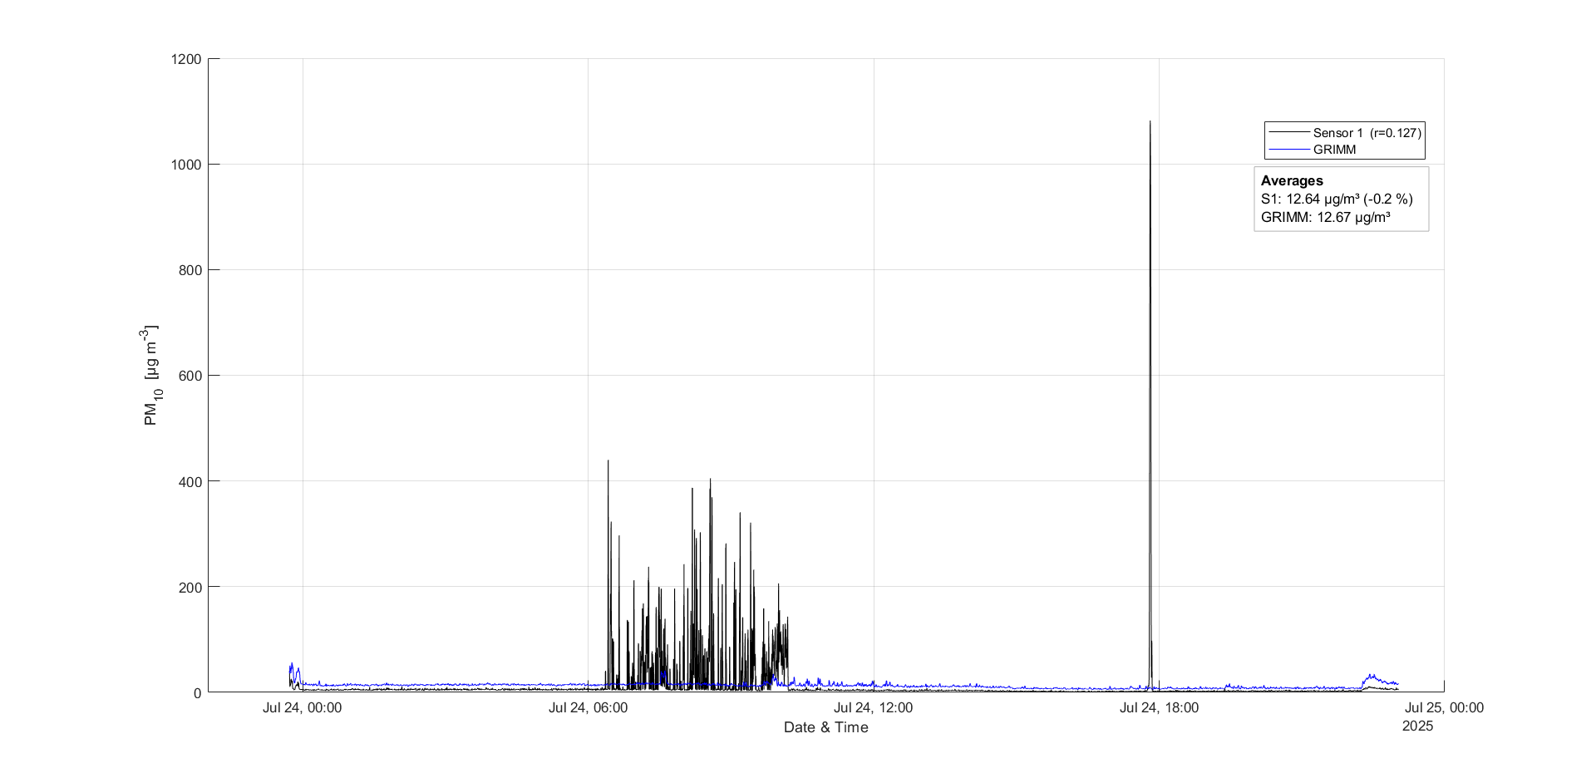

Slide 28
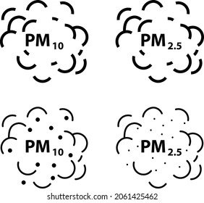
Thank You For Your Attention!
Questions?

