Slide 1

Synthesis and characterization of silicon dioxide nanoparticles and study of their co-incubation with UN phage
School of Natural Sciences and Biotechnology
Scientific supervisors:
Prof. Revaz Korashvili
Prof. Besarion Lasareishvili
Agricultural University of Georgia
Mariam Kenkadze
2025

Slide 2
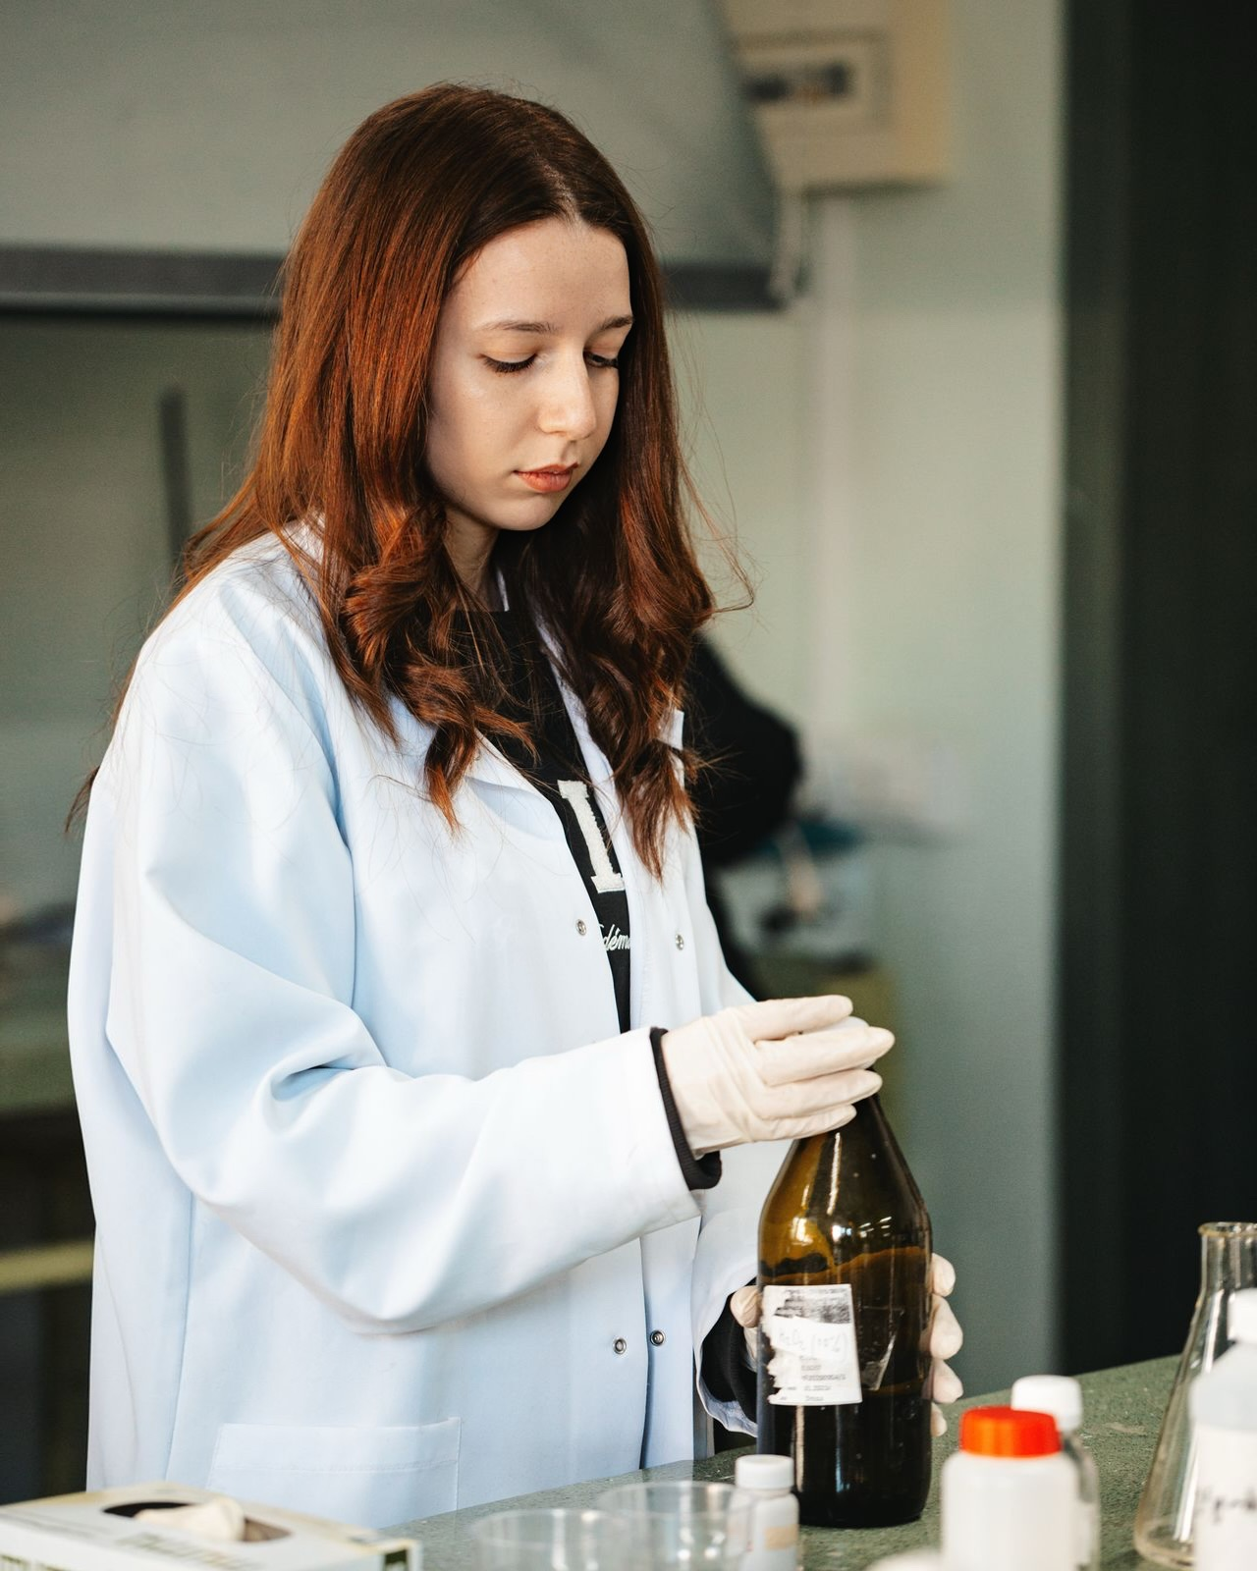
About myself
•Research experience
Laboratory of Antimicrobial Resistance and Phage Therapy
G. Eliava Institute of Bacteriophages, Microbiology and Virology
Laboratory of Chemical Technology
•Research interests
•Olympiad Problem Developer
•Jury committee member (“Zurgchanta”, “Golden Fleece”, “Lavoisier”…)
•Teacher

Slide 3
Relevance of the research
Antimicrobial resistance is a major global problem.
Phage therapy is a powerful tool to combat antimicrobial resistance
Phage therapy needs to be improved
The science of nanomaterials is attracting more and more attention these days.
The use of nanotechnology is one of the possible ways to increase the efficiency and stability of phages

Slide 4
Literature review
Nanotechnology is the ability to control and understand matter at the nanoscale.
Nanoparticles frequently exhibit distinctive size-dependent features, mostly due to their tiny size and colossal surface area
Using nanotechnology, targeting drug molecules to specific tissues becomes a real possibility.
discovery of biomarkers, molecular diagnostics, drug discovery and delivery
effect is achieved due to the small size of the particles, as they can penetrate various barriers.
With the global spread of antimicrobial resistance, the need to find safer alternatives to therapy has increased.
The pharmacokinetic profile of bacteriophages
Encapsulation and binding to other molecules is an effective strategy to protect phage and create a delivery platform.

Slide 5
Research objective
Co-incubation of nanoparticles with UN bacteriophage to study the effect of nanoparticles on the plaque forming ability of bacteriophages
Study of the synthesis of 3 different sized silica nanoparticles by the sol-gel method and their characterization by TEM and IR spectroscopy
Notes:
DLS

Slide 6

Method overview
Si$O_{2}nanoparticles$
The classical method for the synthesis of monodisperse silica nanoparticles is the Stober Process. It involves the controlled synthesis of particles when the polydispersity is 10% or less.
The reaction catalyst is ammonia, the amount of which determines the size of the nanoparticles.

Slide 7
Why silicon dioxide?
Stable, inexpensive
As a result of physisorption, the local concentration of active phages increases
Infection efficiency, change in the ability to form negative colonies
Inhibition of bacterial adhesion and biofilm formation
Inhibition of the mononuclear phagocytic system, damage to the immune cell wall.
Immobilization of phages for the preparation of antimicrobial surfaces

Slide 8
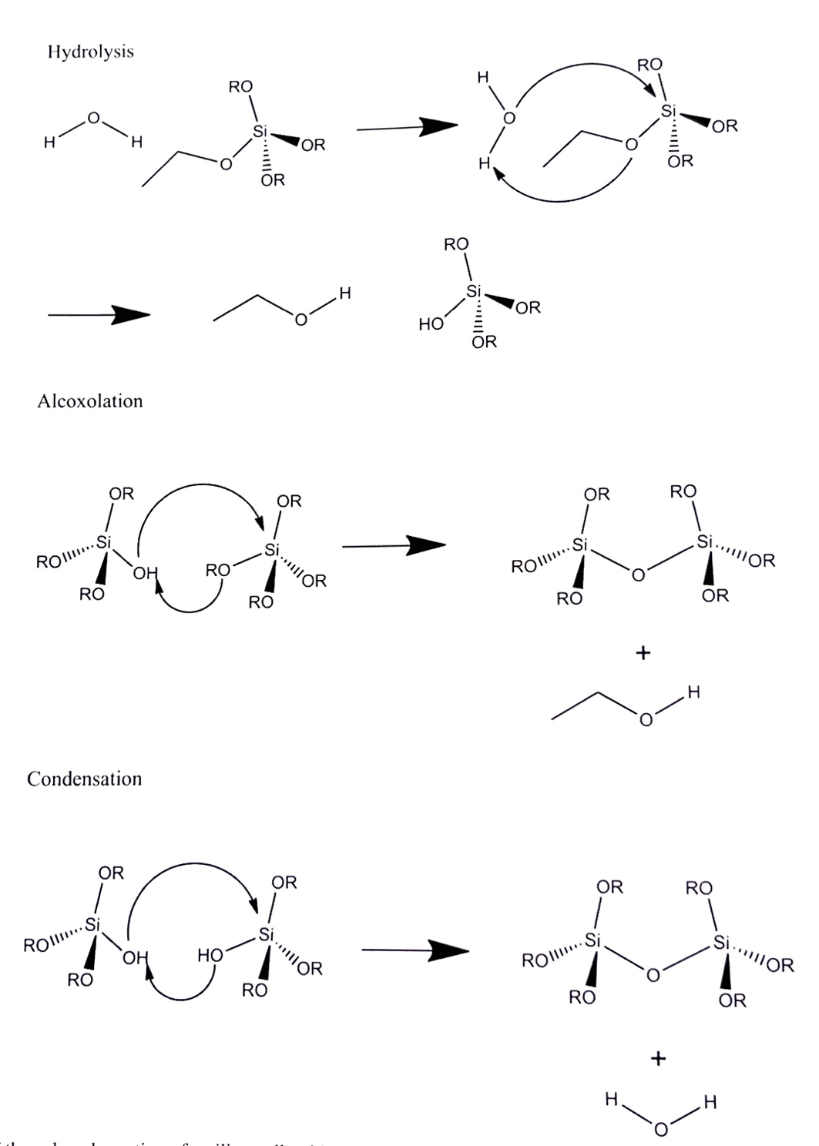
The hydrolysis of silicon alkoxide (TEOS) takes place
condensation/polymerization of the resulting compound forms the -Me-O-Me- structure. Basic and acid hydrolysis are known.

Slide 10
Experimental part
substance | Ammonia (25%) / ml | TEOS / ml | Ethanol / ml
volume | 3.0/3.5/4.0 | 4 | 50
37 degrees celsius, 2 hours –ultrasonic bath
Vacuum dryer 16-18 hours

Slide 11
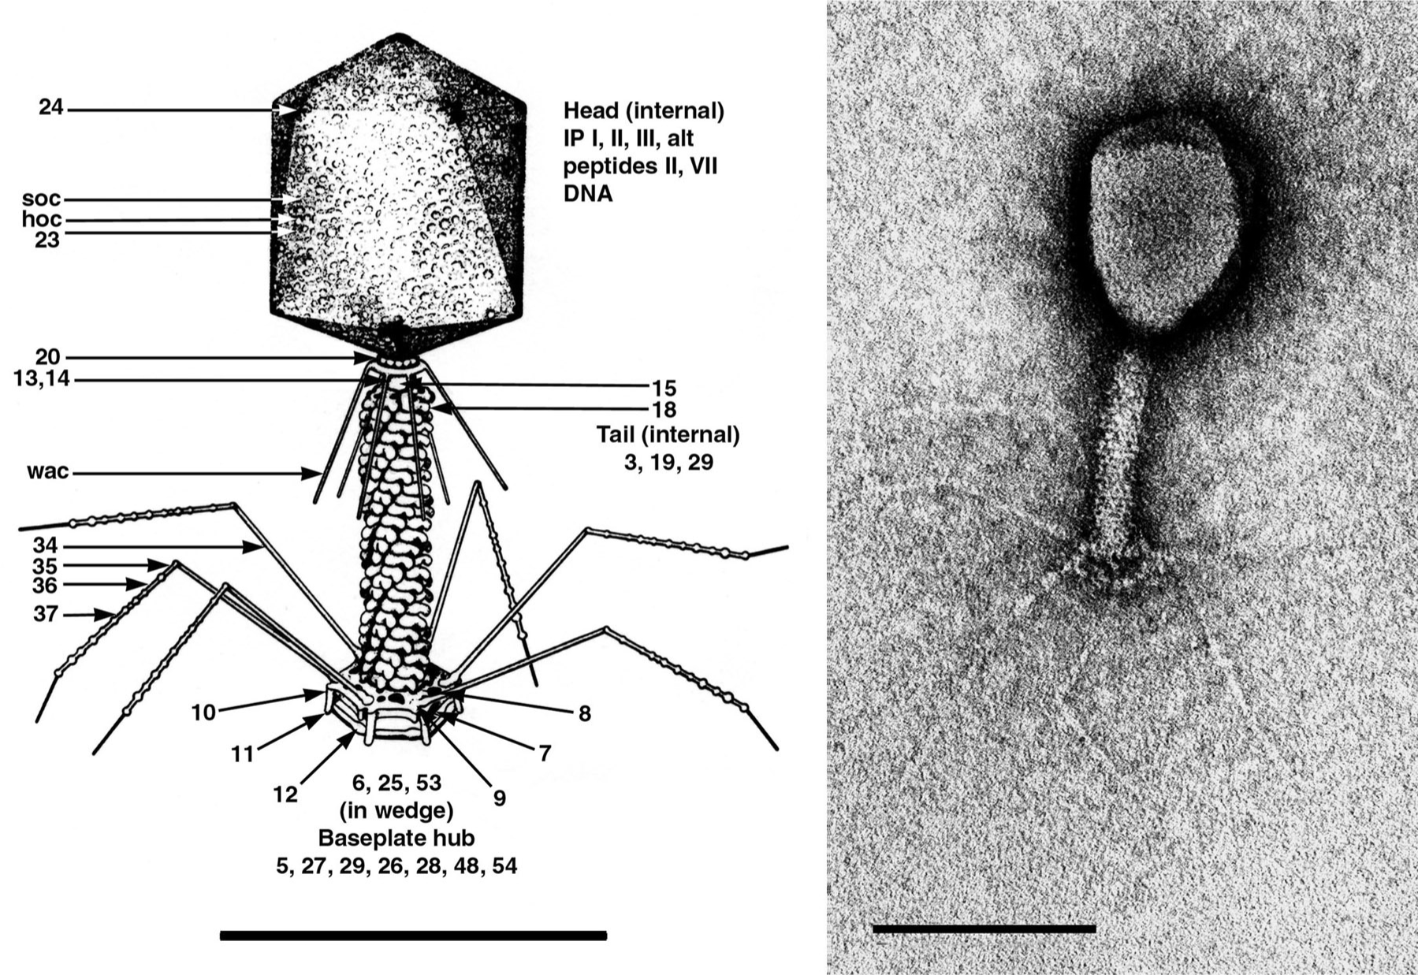
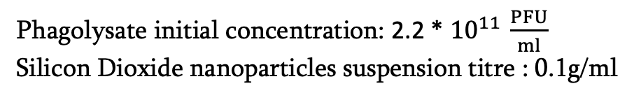
Interaction of silica nanoparticles with UN phage
Dried silica nanoparticle powder was dissolved in PBS buffer, added to a specific concentration of UN phagolysate, and plated on Petri dishes using the double-layer agar method after 0, 6, and 24 hours of co-incubation.
https://ictv.global/report_9th/dsDNA/Myoviridae
Head size 90x65 nm, tail size 95x15 nm.
Hydrophobic phage with a negative zeta potential
Phagolysate initial concentration: 2.2 * ${10}^{11 }\frac{PFU}{ml}$
Silicon Dioxide nanoparticles suspension titre : 0.1g/ml

Slide 12
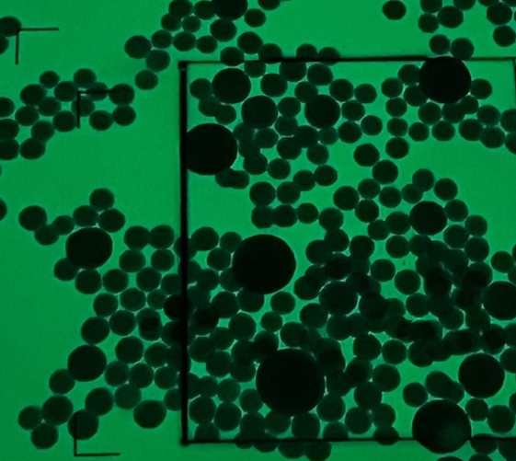
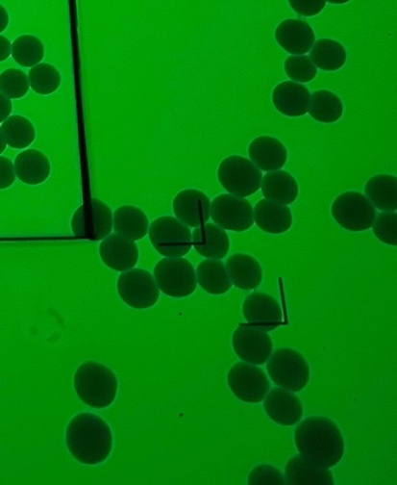
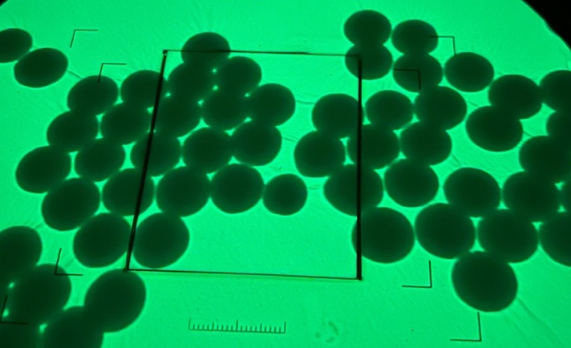
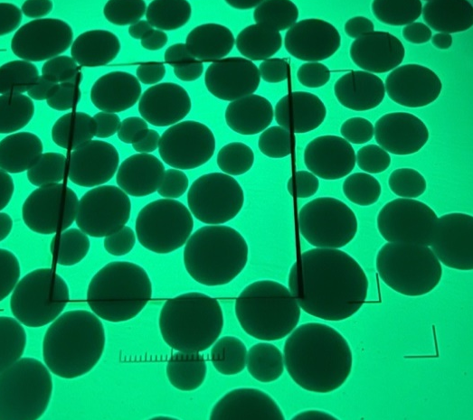
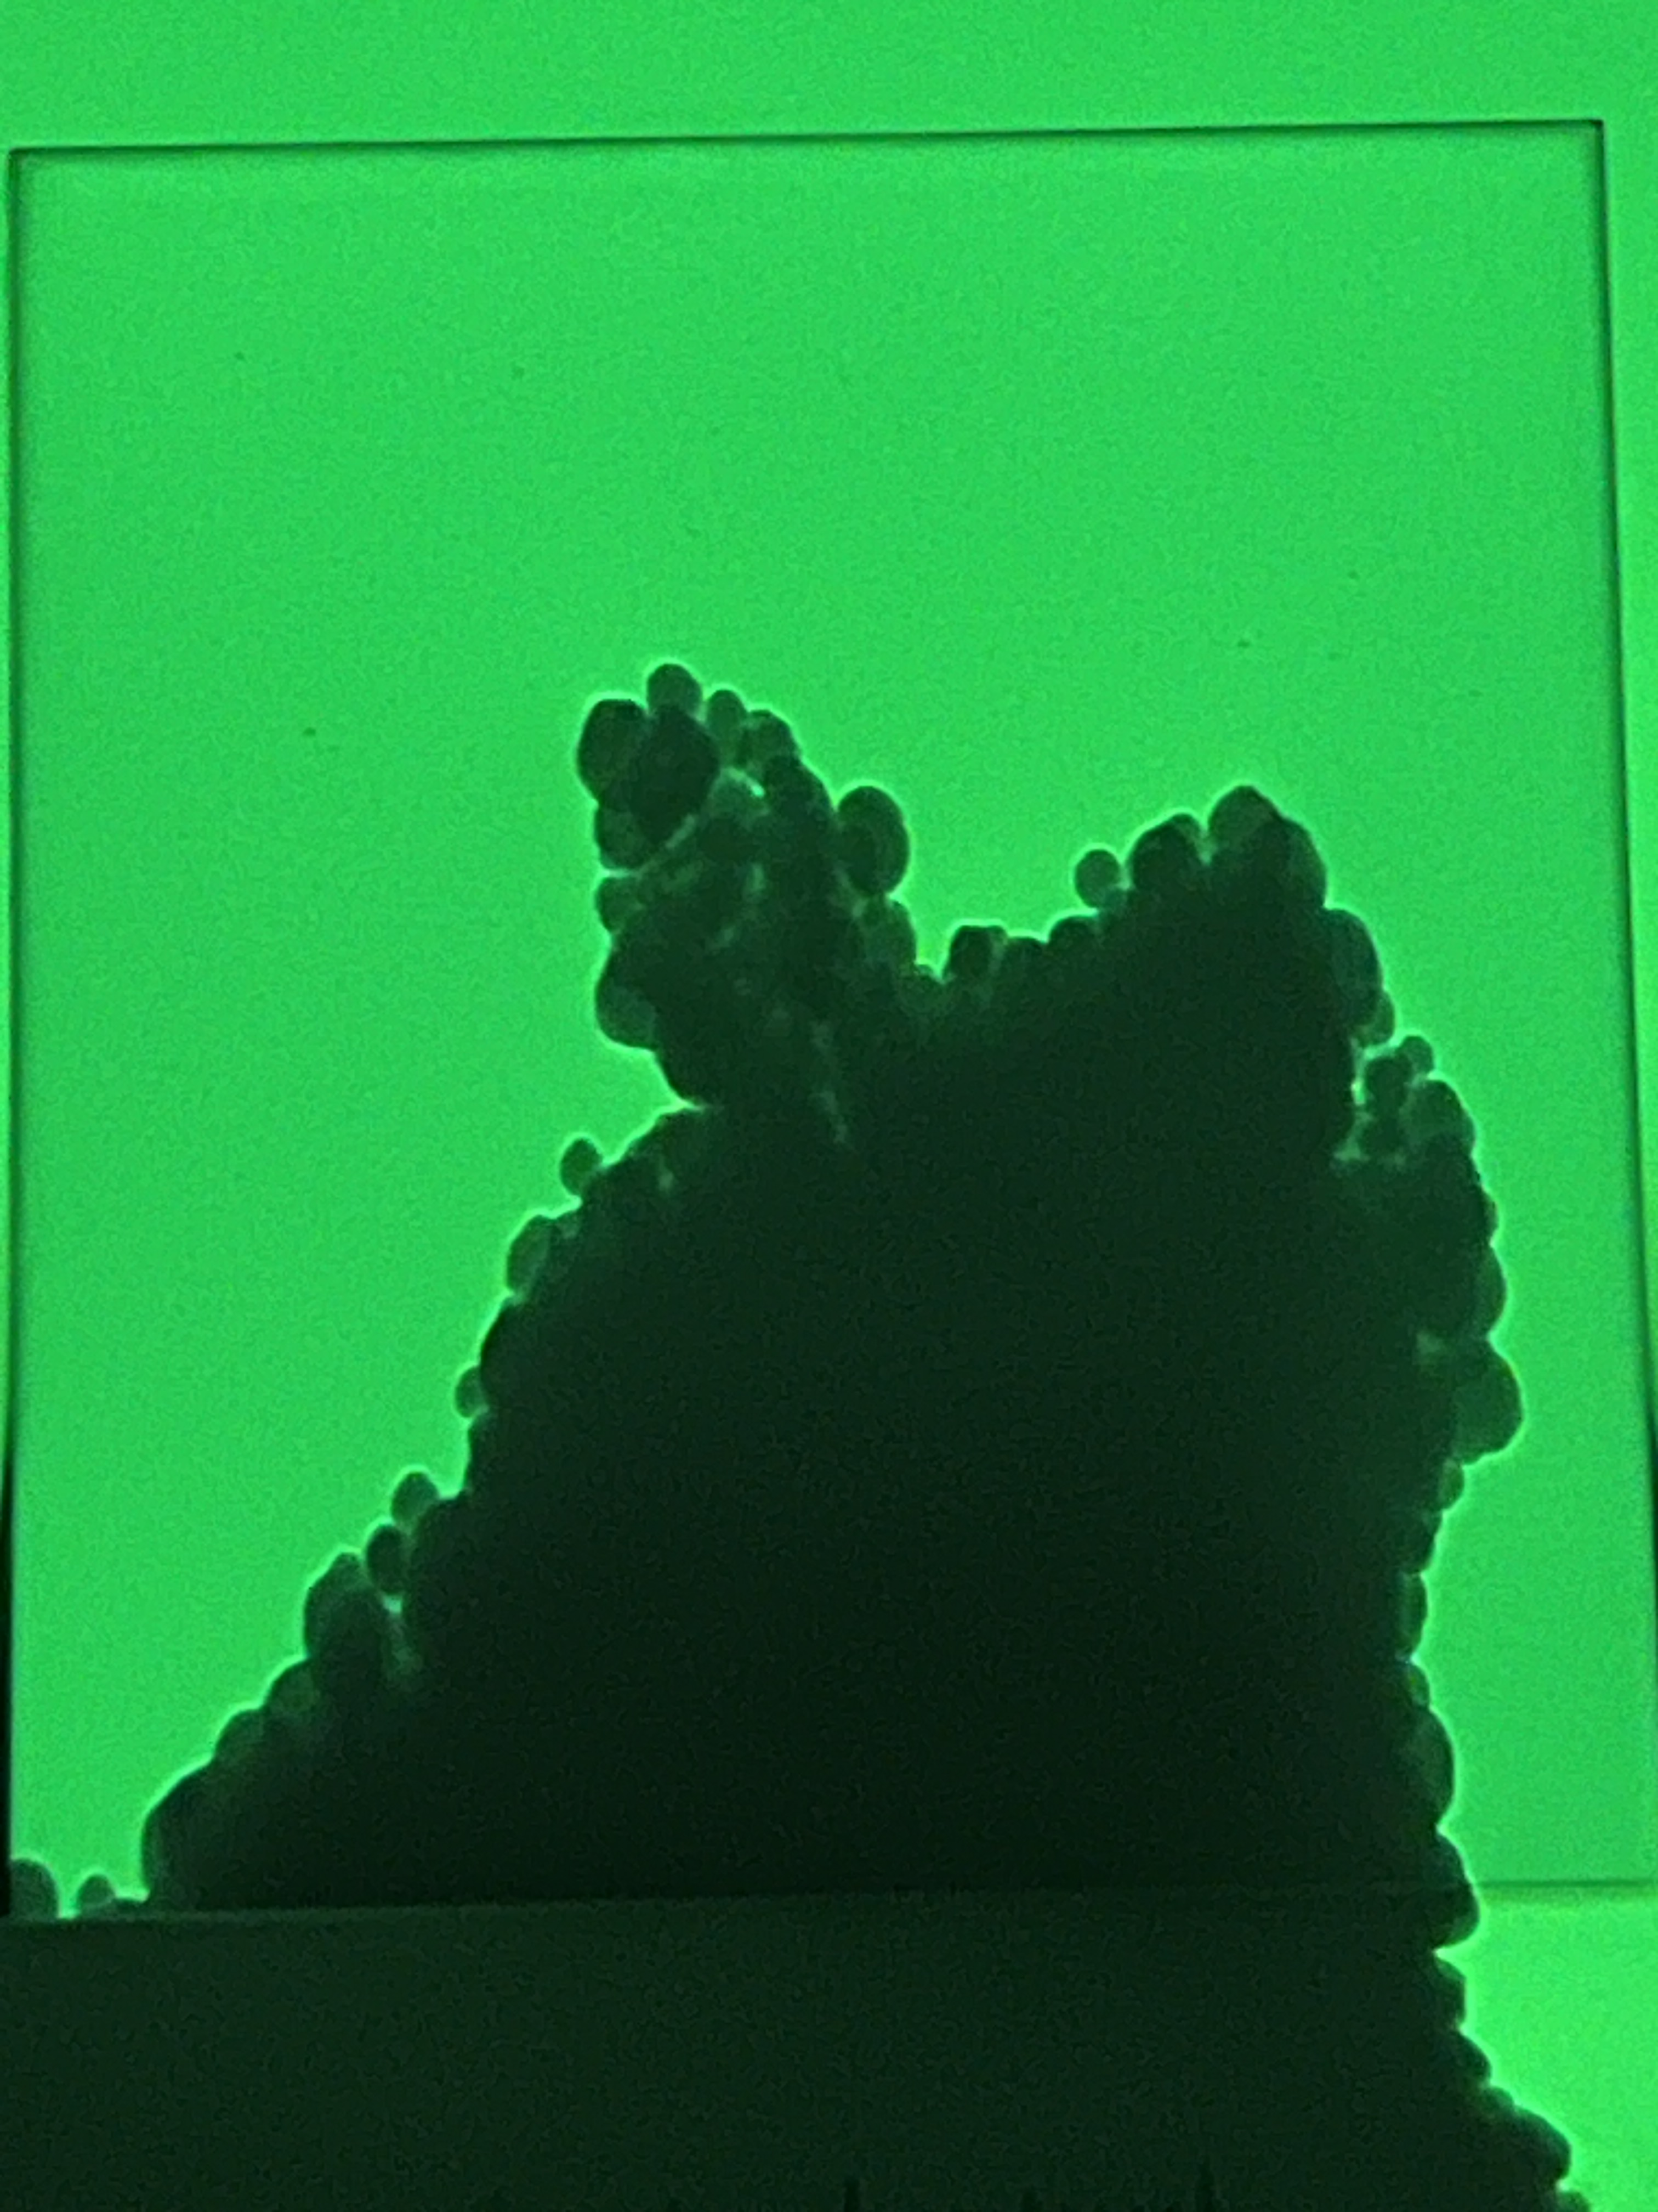
Research results and judgment
I used a transmission electron microscope to evaluate the resulting silica nanoparticles. I observed their morphology and size.
50000x
175-250 nm sized particles
50 nm sized particles
75-150 nm sized particles

Slide 13
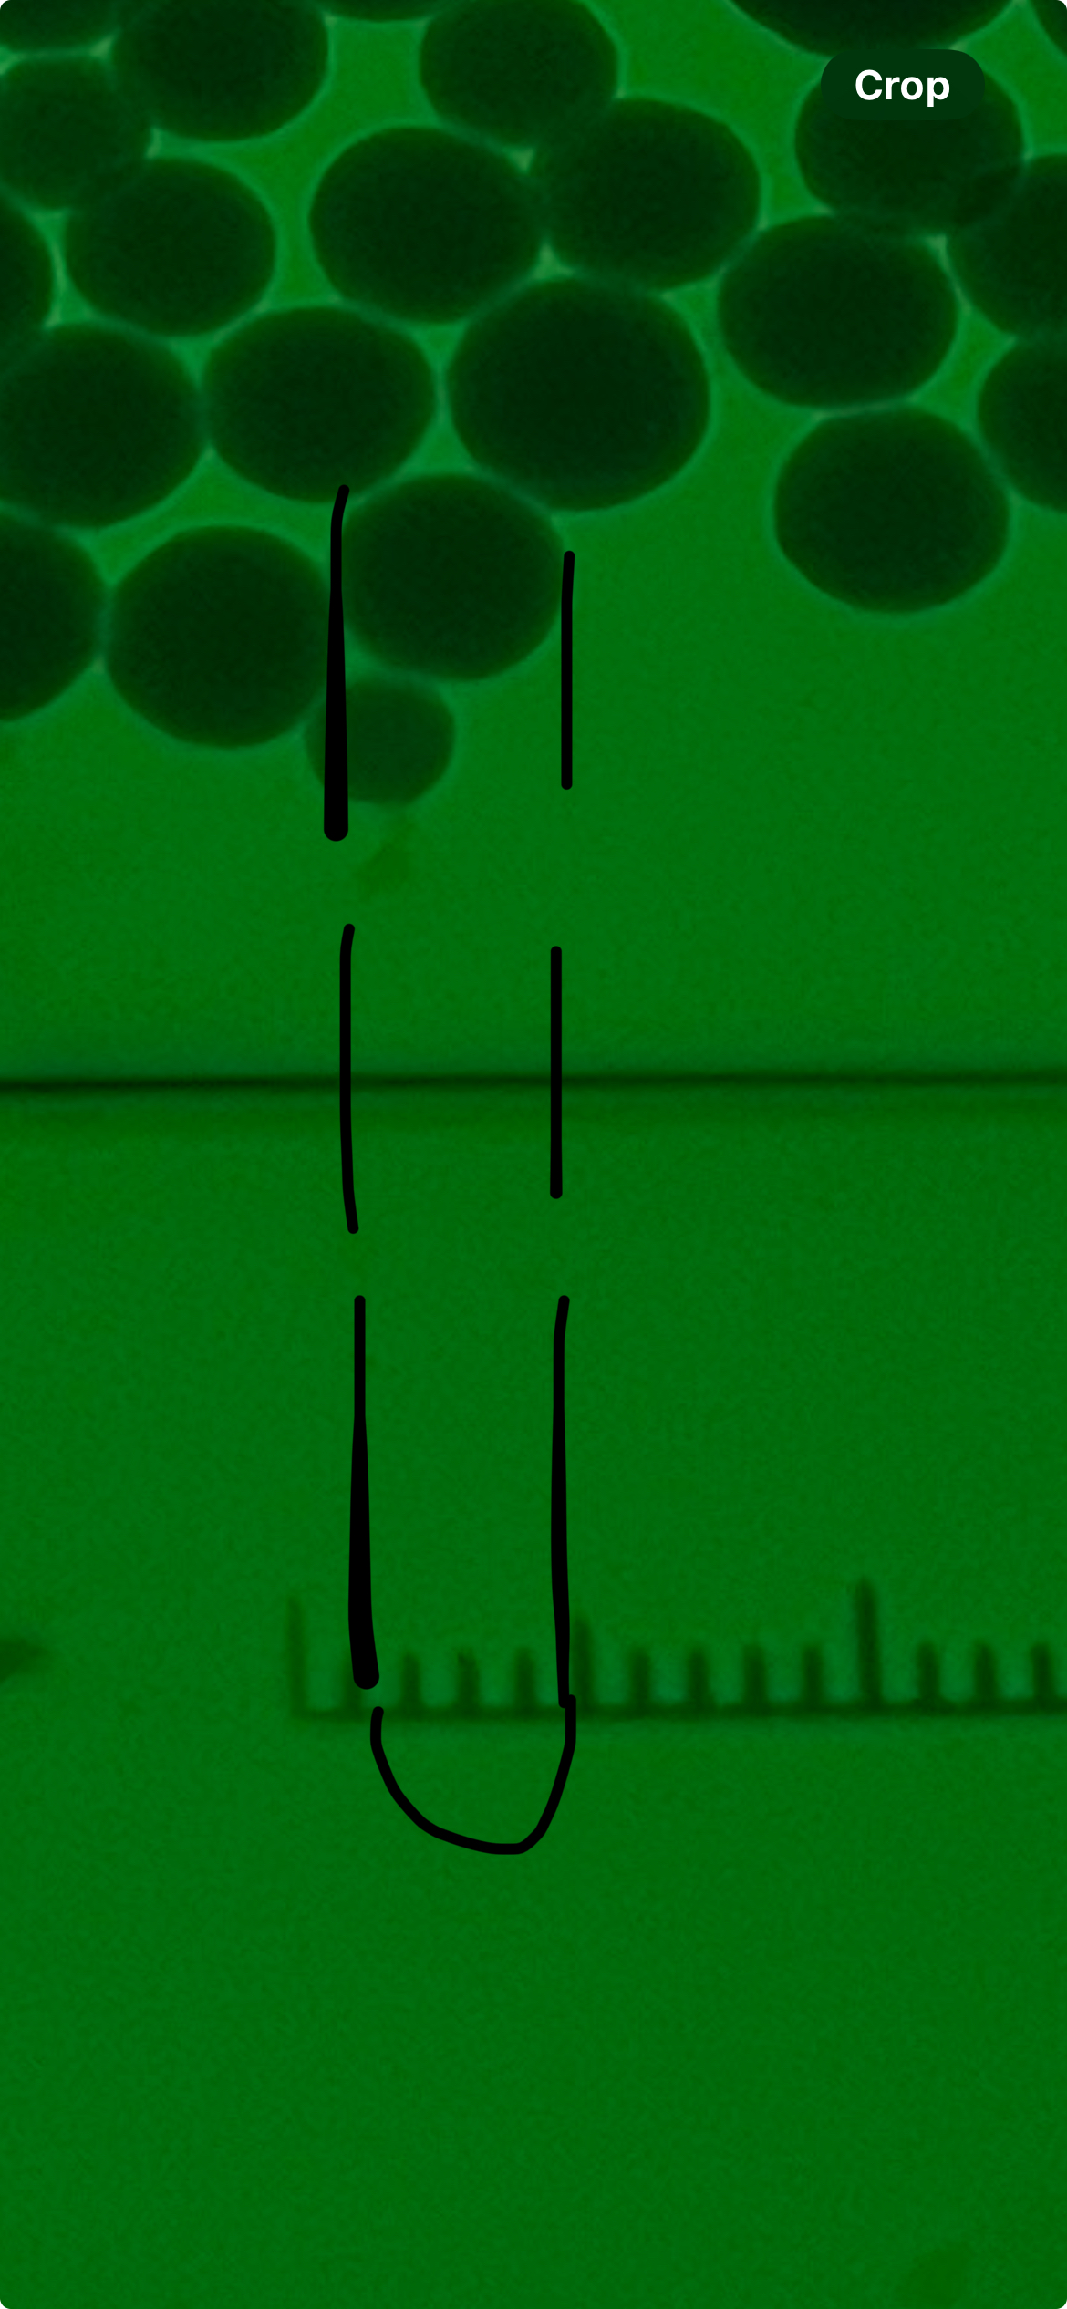
zoom: 50000x

Slide 14
TEM results
Ammonia Volume (ml) | Nanoparticle Size (nm)
2.0 | 15
2.5 | 33
3.0 | 47
3.5 | 76
4.0 | 115
Literature data
Ammonia Volume (ml) | Nanoparticle Size (nm)
3.0 | 50
3.5 | 75-150
4.0 | 175-250
My obtained data

Slide 15
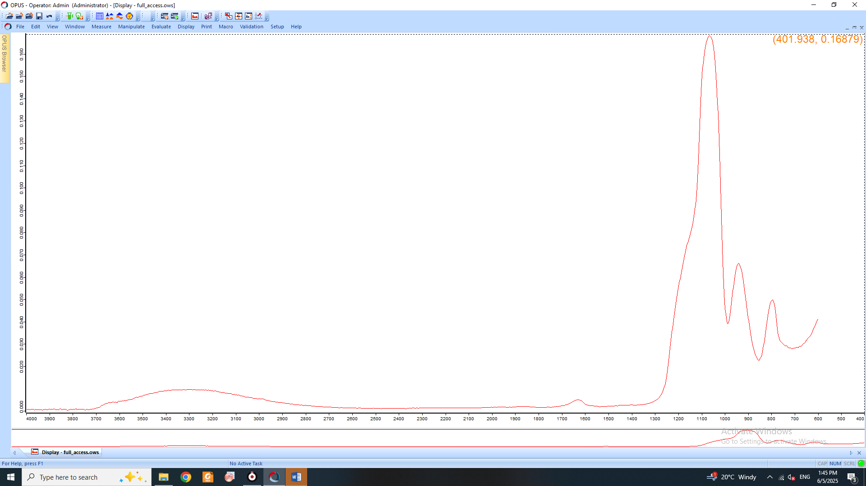
Infra Red spectra

Slide 16
Observation of the ability of bacteriophage to form negative colonies when coincubated with a nanoparticle
Time (hours) | Control | UN x NP
0 | 570 | 375
6 | 413 | 600
Counted plaques
Time (hours) | Control | UN x NP(3) | UN x NP(3.5) | UN x NP(4)
0 | 490 | 150 | 370 | 330
6 | 305 | 378 | 430 | 408
24 | 102 | 113 | 203 | 197
The result of co-incubation of three different sized nanoparticles with phage

Slide 17
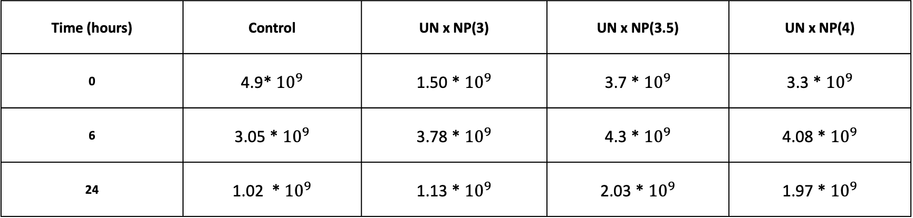
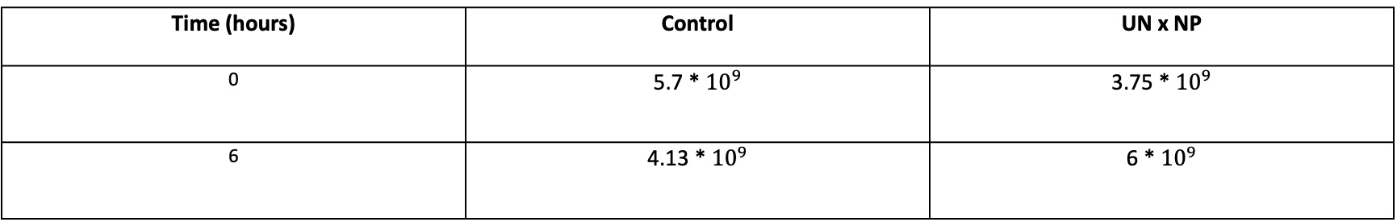
Observation of the ability of bacteriophage to form negative colonies when coincubated with a nanoparticle
Time (hours) | Control | UN x NP
0 | 5.7 * ${10}^{9}$ | 3.75 * ${10}^{9}$
6 | 4.13 * ${10}^{9}$ | 6 * ${10}^{9}$
Time (hours) | Control | UN x NP(3) | UN x NP(3.5) | UN x NP(4)
0 | 4.9* ${10}^{9}$ | 1.50 * ${10}^{9}$ | 3.7 * ${10}^{9}$ | 3.3 * ${10}^{9}$
6 | 3.05 * ${10}^{9}$ | 3.78 * ${10}^{9}$ | 4.3 * ${10}^{9}$ | 4.08 * ${10}^{9}$
24 | 1.02 * ${10}^{9}$ | 1.13 * ${10}^{9}$ | 2.03 * ${10}^{9}$ | 1.97 * ${10}^{9}$

Slide 18
Graphical representation of colony counts

Slide 19
Summary
Silicon dioxide nanoparticles of various sizes were successfully synthesized
They were studied using transmission electron microscopy and infrared spectroscopy
They were tested on UN phage, confirming the assumption that they would improve the ability of the phage to form negative colonies.
The best results were obtained when relatively large particles were incubated with phages for 24 hours.

Slide 20
Thank you for your attention.

Slide 21
Bibliography
Medina, C., M. J. Santos-Martinez, A. Radomski, O. I. Corrigan, and M. W. Radomski. “Nanoparticles: Pharmacological and Toxicological Significance.” British Journal of Pharmacology 150, no. 5 (2007): 552–558. https://doi.org/10.1038/sj.bjp.0707130.
Kaur, Sandeep, Anila Kumari, Anjana Kumari Negi, Vikas Galav, Shikha Thakur, Manish Agrawal, and Vandana Sharma. “Nanotechnology Based Approaches in Phage Therapy: Overcoming the Pharmacological Barriers.” Frontiers in Pharmacology 12 (2021). https://doi.org/10.3389/fphar.2021.685249.
Choińska-Pulit, Anna, Paweł Mituła, Paulina Śliwka, Wojciech Łaba, and Aneta Skaradzińska. “Bacteriophage Encapsulation: Trends and Potential Applications.” Trends in Food Science & Technology 45, no. 2 (2015): 212–221. https://doi.org/10.1016/j.tifs.2015.07.001.
Karimi, Mohammad, Hanieh Mirshekari, Seyed Mohammad Mahdi Basri, Seyed Bahrami, Mohammad Moghoofei, and Michael R. Hamblin. “Bacteriophages and Phage-Inspired Nanocarriers for Targeted Delivery of Therapeutic Cargos.” Advanced Drug Delivery Reviews 106 (2016):45-62. https://doi.org/10.1016/j.addr.2016.03.003.
Stöber, Werner, Arthur Fink, and Ernst Bohn. "Controlled Growth of Monodisperse Silica Spheres in the Micron Size Range." Journal of Colloid and Interface Science 26 (1968): 62–69.
Abdrew M. Collins, nanotechnology cookbook, school of chemistry, University of Bristol, Elsevier ltd. 2012, 35
Stachurska, Xymena, Krzysztof Cendrowski, Kamila Pachnowska, Agnieszka Piegat, Ewa Mijowska, and Paweł Nawrotek. "Nanoparticles Influence Lytic Phage T4-like Performance In Vitro." Edited by Alexandru Mihai Grumezescu.
Cademartiri, Rebecca, Hany Anany, Isabelle Gross, Rahul Bhayani, Mansel Griffiths, and Michael A. Brook. "Immobilization of Bacteriophages on Modified Silica Particles." Biomaterials 31, no. 7 (2010): 1904–1910. https://doi.org/10.1016/j.biomaterials.2009.11.029.

Slide 22
Toxicity assessment
There are different forms of silica. The crystalline form is dangerous.
Synthetic, "amorphous" silica - widely used in many fields, including medicine. Not considered toxic, although studies are now actively underway to assess cytotoxicity.
Ryu et al - conducted a toxicity study, found it not toxic.
Uboldi et al - did not cause cytotoxicity, cell mutations, genotoxicity in mouse fibroblast cells
In contrast to many efforts aimed at exploiting desirable properties of nanoparticles for medicine, there are limited attempts to evaluate potentially undesirable effects of these particles when administered intentionally for medical purposes.

Slide 23
Why does ammonia increase the size?
If we had not added ammonia and started the reaction with water alone, TEOS would still hydrolyze at some point, but it would have taken much longer. The formation of silicic acid (if there is even a little water) indicates that the nucleation process has started even before the catalyst is added.
In water, the process is very slow and oligomers are formed that do not agglomerate and do not precipitate. Ammonia speeds up the process and promotes agglomeration, so the more ammonia, the larger the particles.

