Slide 1

New results in ionospheric research at ISU on the formation and prediction of Es layer and possible collaboration with HZDR
Giorgi Dalakishvili,
Goderdzi G. Didebulidze, Maya Todua
Ilia State University, Space research center, Department of Atmosphere-ionosphere and Near Space,
giorgi.dalakishvili@iliauni.edu.ge
Work is supported by Grant of Shota Rustaveli National Science Foundation of Georgia FR-21-22825

Slide 2
Summary
International Double Degree Master Program In Atmosphere and Near Space Sciences
Areas of possible collaboration-HZDR
New theory of Es layer formation

Slide 3
Areas of Possible Collaboration-HZDR
Atmosphere and Climate
Fluid dynamics
Computing-numerical simulations, data analyses
AI (? ☺ )

Slide 4





International Double Degree Master Program In Atmosphere and Near Space Sciences
Recently Enrolled student

Slide 5
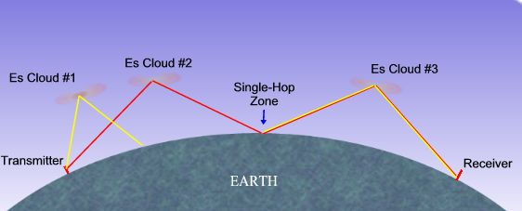

Sporadic E (Es)

Slide 6
Abstract
Theoretically and by corresponding numerical simulations it is shown that the formation and localization of sporadic E (Es) layer at its mainly observable mid-latitude lower thermosphere heights can be determined by homogeneous horizontal wind velocity direction and value. In the suggested theory, differently from 'windshear' theory, the wind direction and value, in addition to geomagnetic field and vertically changing ion-neutral collision frequency, determine the minimal negative value of the divergence of heavy metallic ions drift velocity, which in turn causes ion convergence into Es type horizontal thin layer. Here, in the upper heights of the lower thermosphere, the Es layer peak density and thickness are also controlled by ion ambipolar diffusion.
The important contributions of the directions and magnitudes of the meridional and zonal wind (using the HWM14 data), its shear and electric field (using four different polarizations) to the vertical drift velocity of ions and, accordingly, the maximal total ion vertical convergence rate- MTotIVCR (about 10⁻³–10⁻⁴ s⁻¹) are shown during the formation of Es layers in typical equatorial (with magnetic inclination I = 0 and 0.5° N; 195° E), between equatorial and mid-latitude (BEML) (I = 30°; 16° N; 195°E) and mid-latitudes (I = 60°; 45° N, 195° E) regions. For the considered zonal wind data and zonal and vertical components of electric field the important role of electric field in the increase of TotIVCR and correspondingly in formation and localization of the Es.
ISU and HZDR could efficiently collaborate in MHD numerical simulations and developing theoretical and numerical model of ion ionospheric global distribution under influence of arbitrary winds and electromagnetic fields.

Slide 7
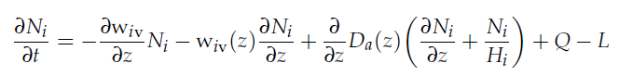
Governing equations

Slide 8
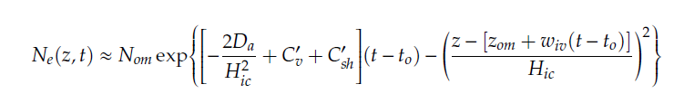
Analytical analyses
In case when C, C'=0

Slide 9
Constant Homogenious wind

Slide 10
Results for The case of Contant-Homogenious Wind

Slide 11
Results for The case of Contant-Homogenious Wind

Slide 12
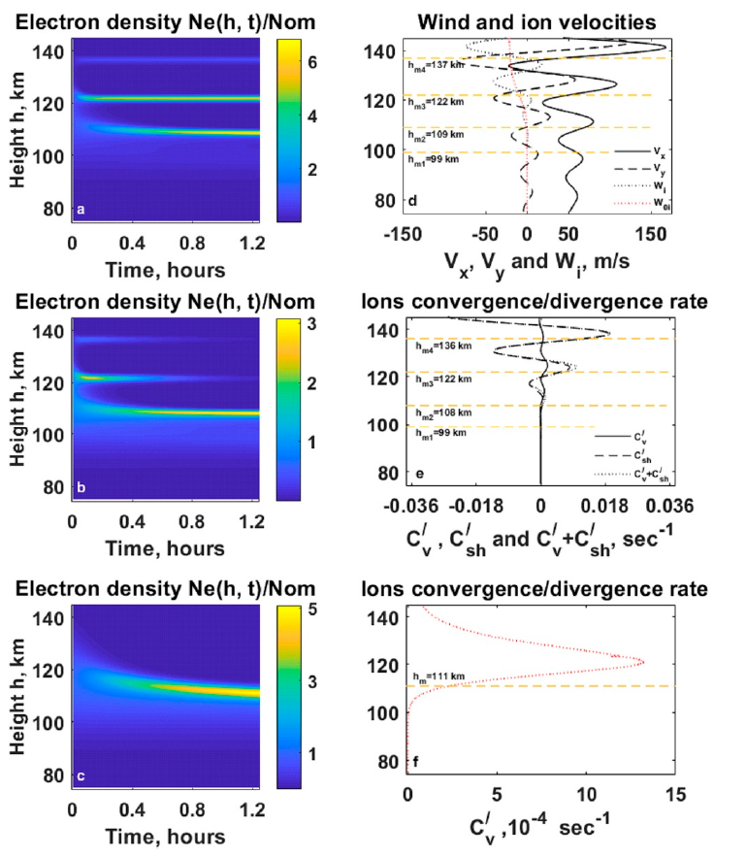
Results for the case of Atmospheric Gravity Waves

Slide 13
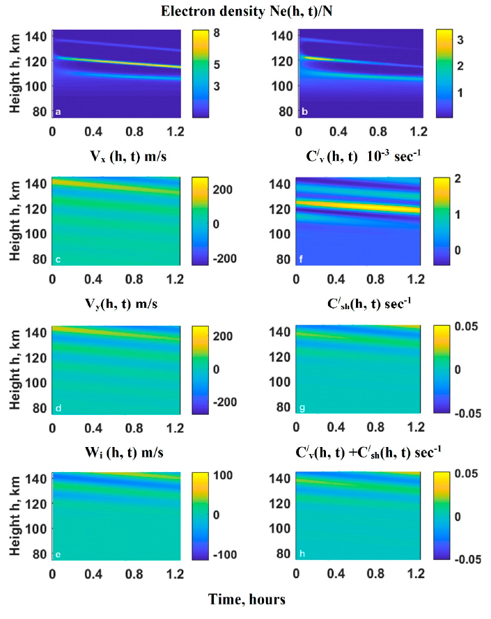
Results for the case of Atmospheric Gravity Waves

Slide 14
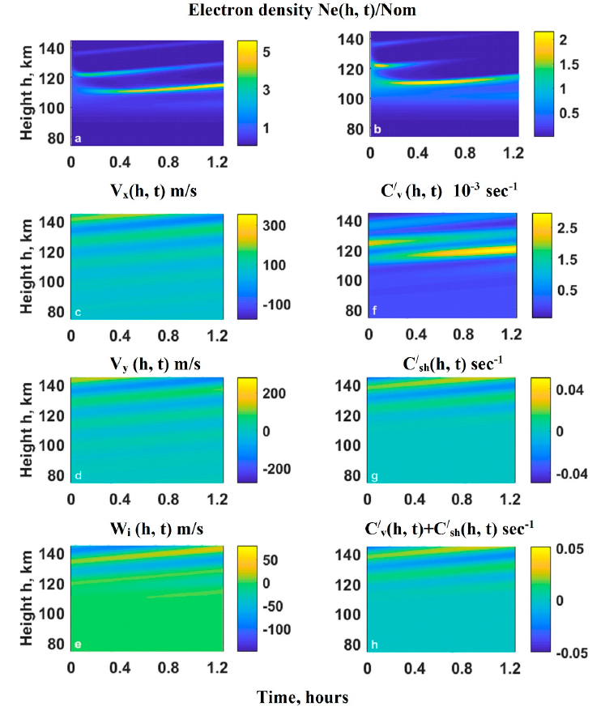
Results for the case of Atmospheric Gravity Waves

Slide 15
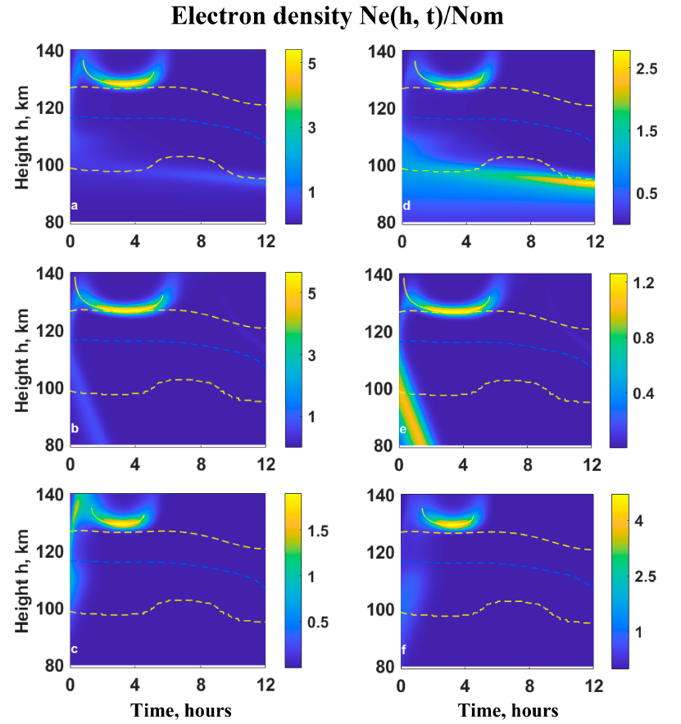
Results for the case of the Horizontal Wind Model

Slide 17
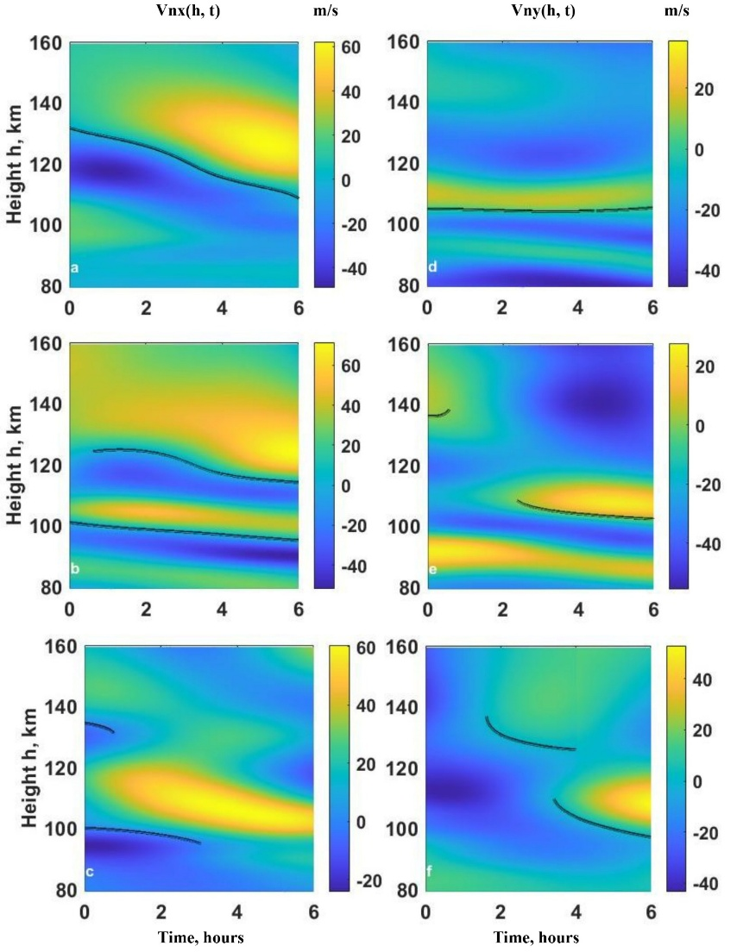
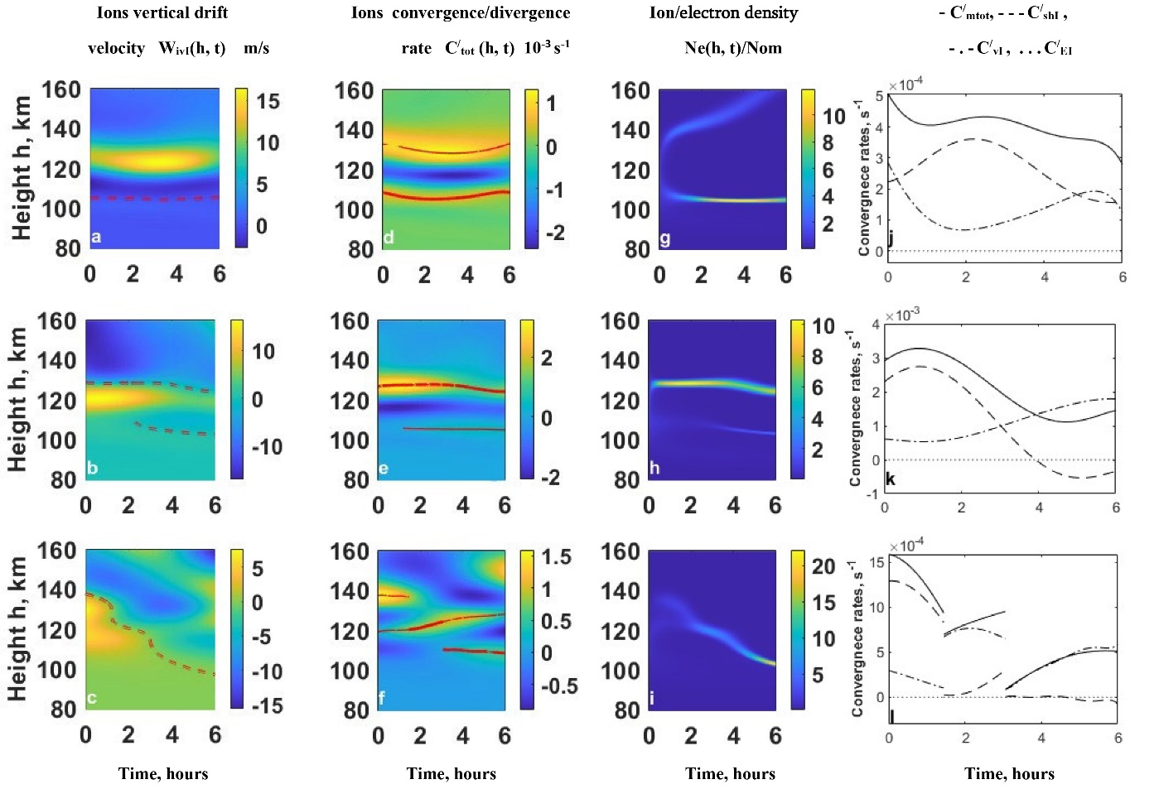
HWM Ion Drift, density and Convergence rates

Slide 18
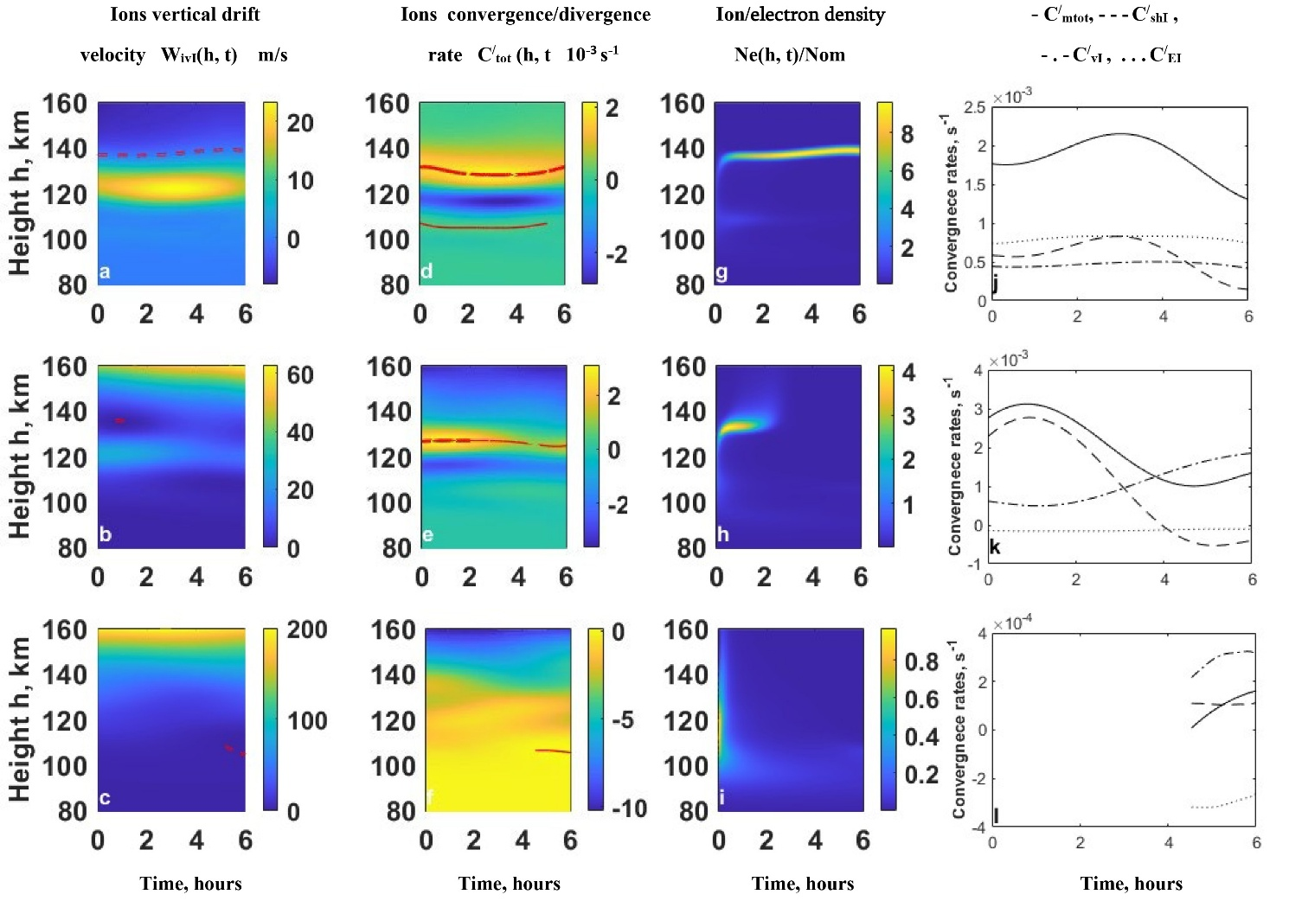
Ion Drift, Density and convergence Rates (Ey>0, Ez>0)

Slide 19
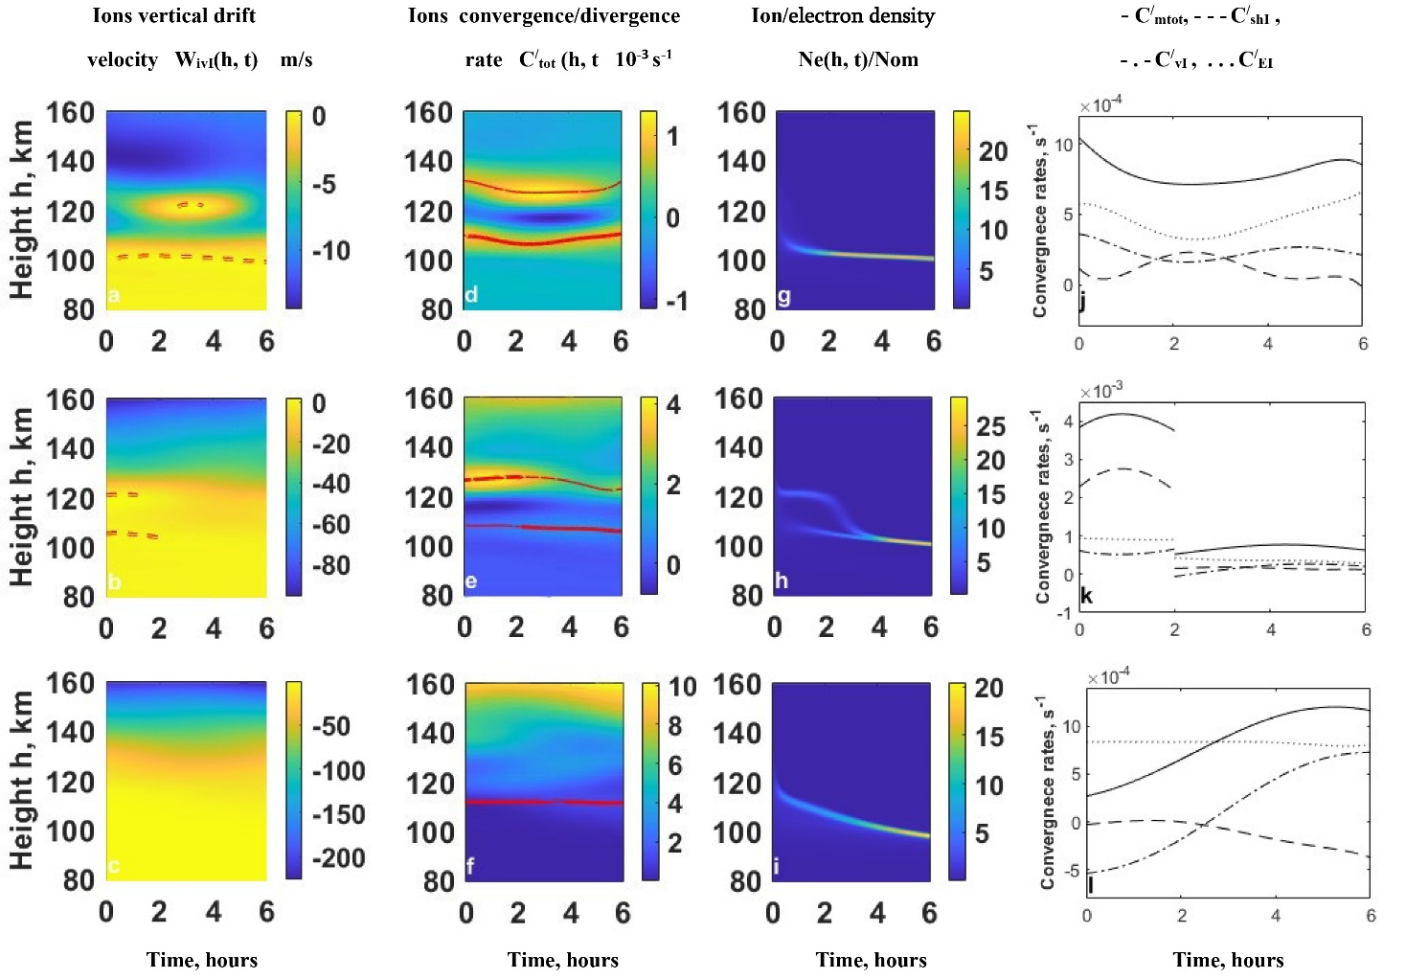
Ion Drift, Density and convergence Rates (Ey>0, Ez<0)

Slide 20
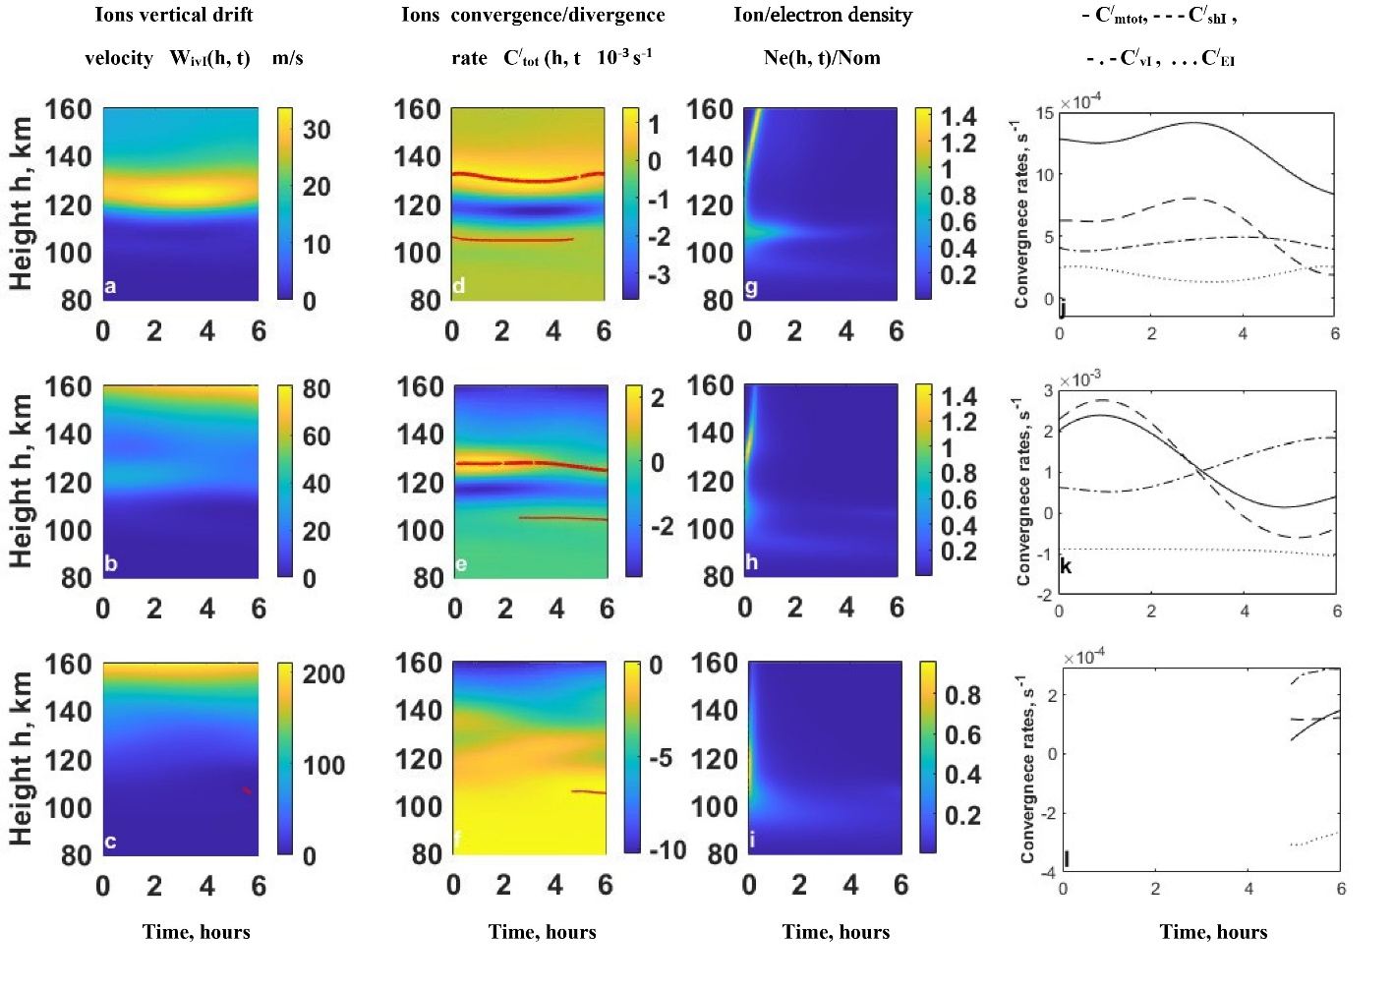
Ion Drift, Density and convergence Rates (Ey<0, Ez>0)

Slide 21
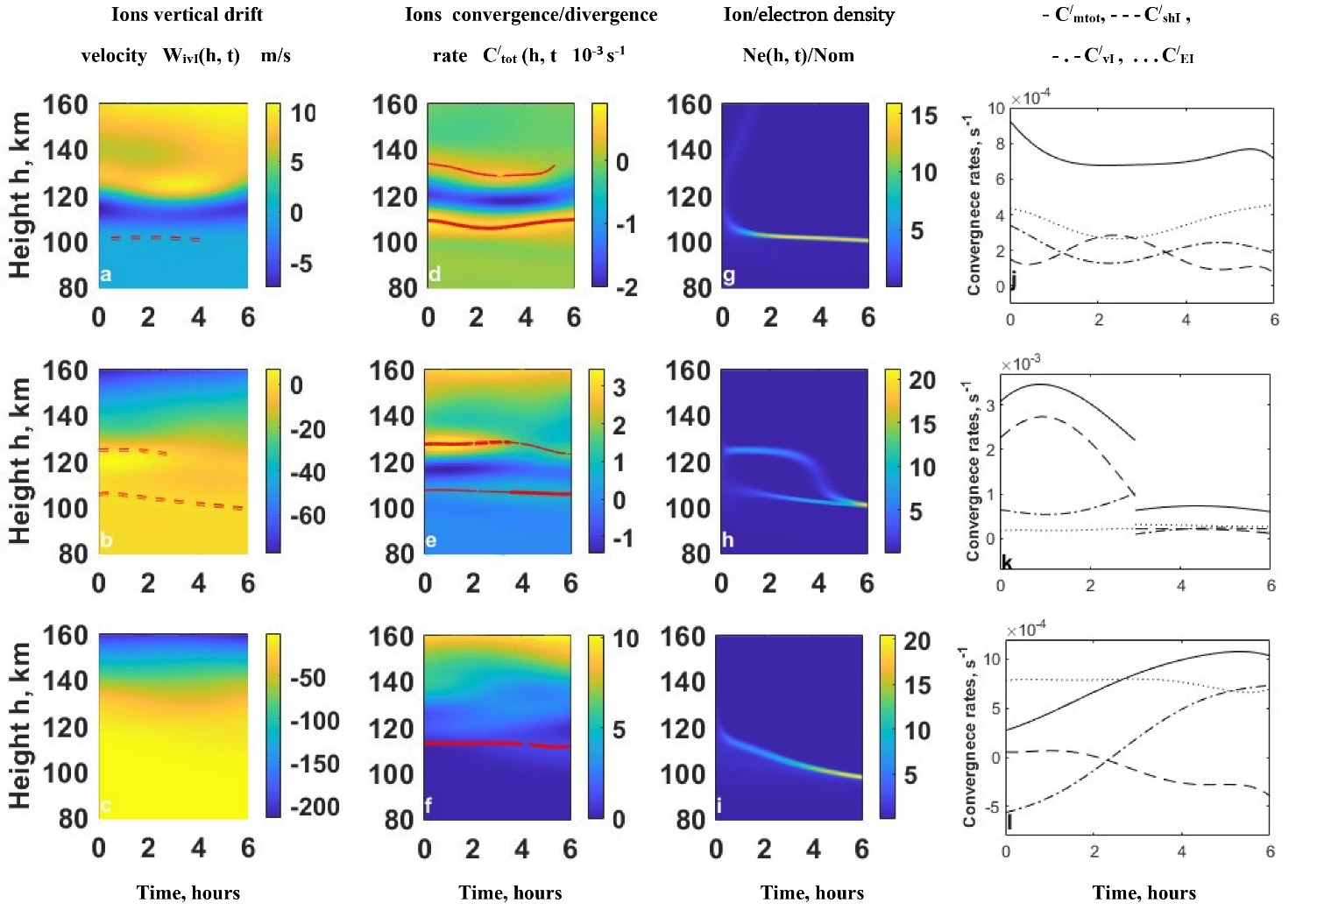
Ion Drift, Density and convergence Rates (Ey<0, Ez<0)

Slide 22
ISU and HZDR could efficiently collaborate in MHD numerical simulations and developing theoretical and numerical model of ion ionospheric global distribution under influence of arbitrary winds and electromagnetic fields
Vielen Dank
Thanks a Lot
დიდი მადლობა

