Slide 1
Semiconductor materials
processing by ion beams
for chip and quantum technologies
Shengqiang Zhou s.zhou@hzdr.de
Semiconductor Materials
Helmholtz-Zentrum Dresden-Rossendorf (HZDR)

Slide 2
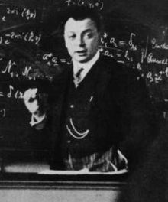
Wolfgang Pauli
One shouldn’t work on semiconductors, that is a filthy mess; who knows if they really exist!

Slide 3
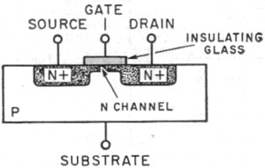
The basic element in chips

Slide 4
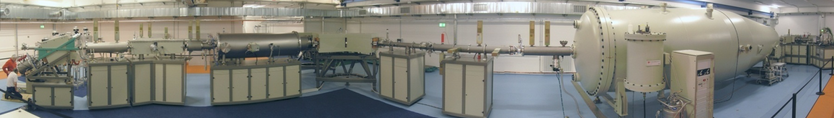
Ion Beam Center
Seite 4
Notes:
4

Slide 5
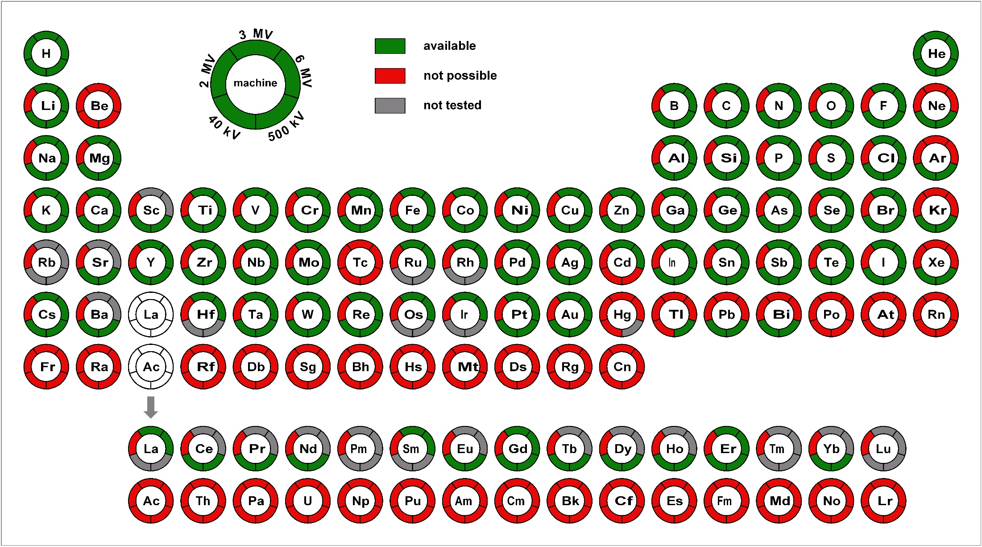
Ion Beam Center at HZDR
Seite 5
Notes:
5

Slide 6
Ion irradiation effect in matter
Ions flux: 10⁸⁻¹⁵ ions/second, Target: 10²² atoms/cm³
large number of interactions -> questions must be answered using approximation, statistics and probabilities

Slide 7
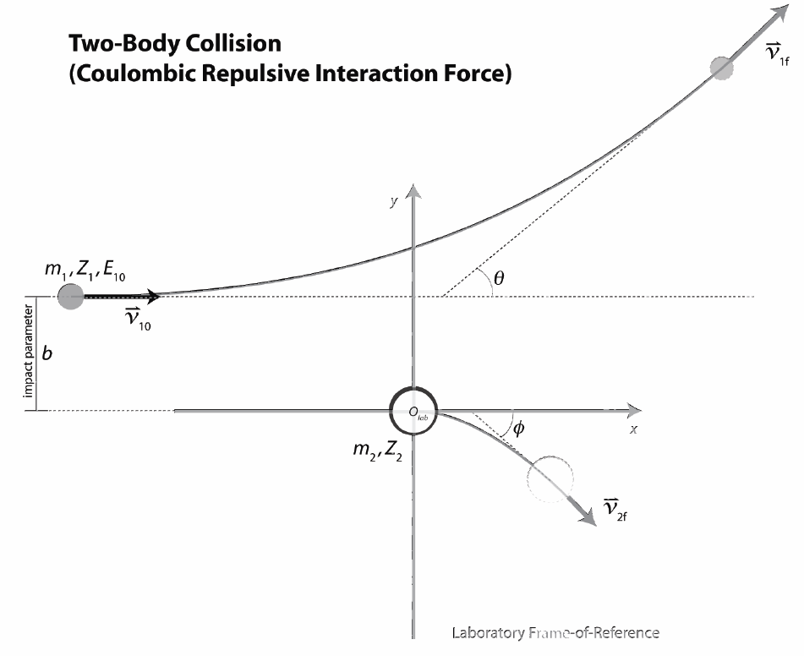

Slide 8
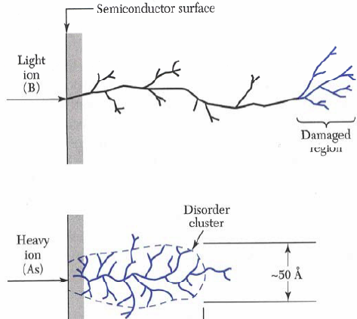
Ion implantation: effect

Slide 9
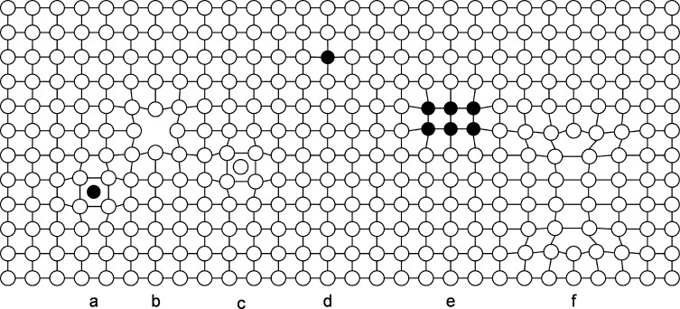
Ion implantation: effect
Common defects in materials
Wang et al., J. Appl. Phys. 115, 17C104, (2014)

Slide 10
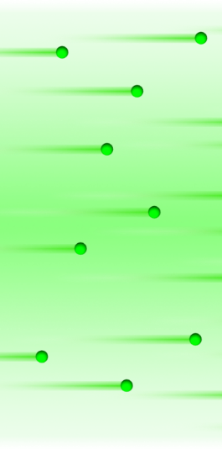
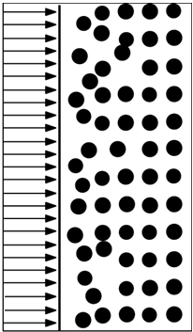

Pushing the doping limit by non-equilibrium processing
Ion species: n and p
Energy: depth
Fluence: concentration
Ion implantation:
E₁ < E₂ < E₃
Concentration
Implantation profile
Diffusion
Depth (nm)

Slide 11
Isotope-selectivity!
Poate and Saadatmand, Rev. Sci. Instrum., 73, 868 (2002)

Slide 12
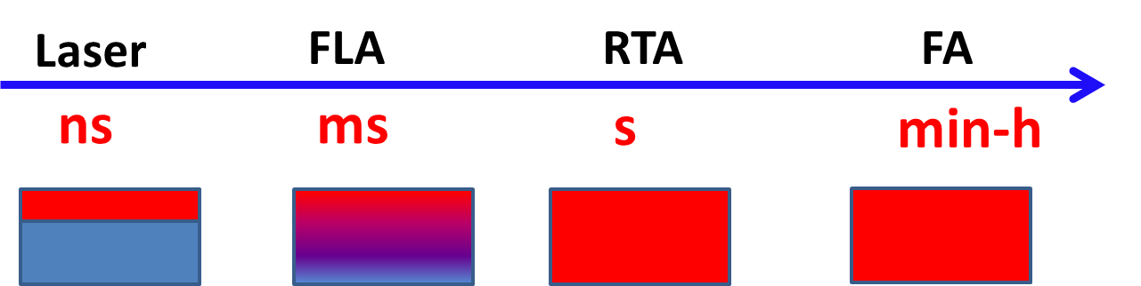
Semiconductor Materials
Different thermal processing at different time scale
Ion implantation works far away from thermal equilibrium, allowing us to dope semiconductors with exotic elements
up to large concentration of 1…10%. Flash lamp or pulsed laser processes materials down to milli- or nano- second time scale.
We create ultra-high doped Ge using Flash lamp annealing and ferromagnetic semiconductors using pulsed laser melting.

Slide 13

Helmholtz Innovation Lab:
sheet-to-sheet (S2S)
Compound Semiconductors
 | S2S | R2R
Energy density per pulse | medium large | low
Pulse length | ms range | < 1 ms
Flash frequency | low | medium / high
# of lamps | many | one or few
Illuminated area | whole area | stripe-type part
100
Silicon
Germanium
10
TCO
Energy density (Jcm⁻²)
Printed inks
Precursors
organics
1
roll-to-roll (R2R)
0.1
1
10
20
Pulse duration (ms)

Slide 14
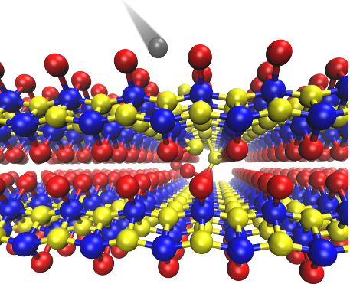
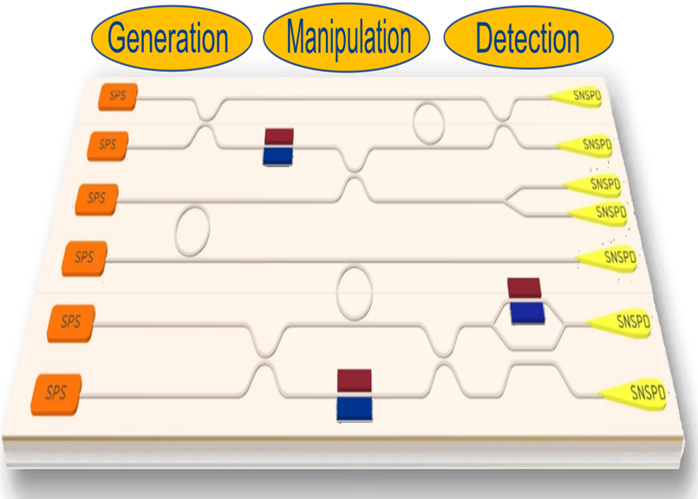
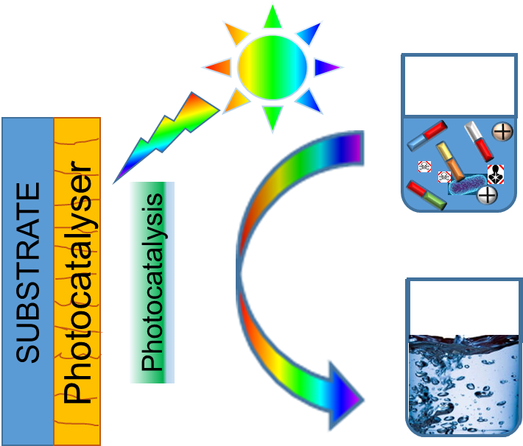
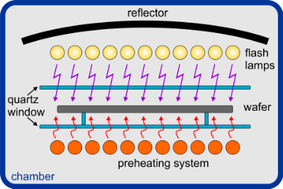
Semiconductor Materials
Doping and defect engineering by ions
Quantum Photonics & Optoelectronics
Semiconductors for energy and environment
Sub-second thermal processing

Slide 15
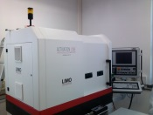
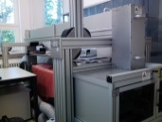
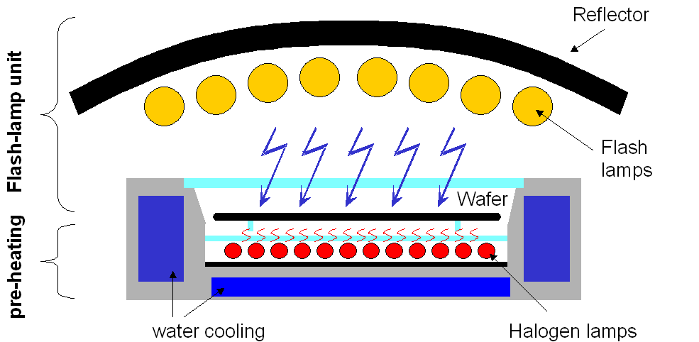
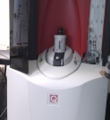
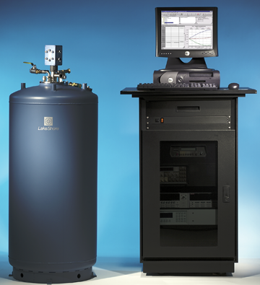
Material processing: laser and flash lamp annealing
Material characterization: magnetic and electrical
SQUID-VSM
SQUID-MPMS
Lakeshore Hall Measurement system
1.8-400 K
up to 7 T
Material characterization: optics
Raman, PL, ODMR
And the user facilities: ion beam center

Slide 16
Ion beam and sub-second annealing for materials processing
Break the doping limit
Color centers for quantum technologies

Slide 17
Further device minimization: node down to 1 nm
Contact resistance becomes a new problem!
Source contact
Drain contact
Gate
R_{contact}
R_{channel}
R_{contact}
R_{SD}
R_{SD}
G. Rengo, et al., IMEC, ECS Trans. 98, 27 (2020).

Slide 18
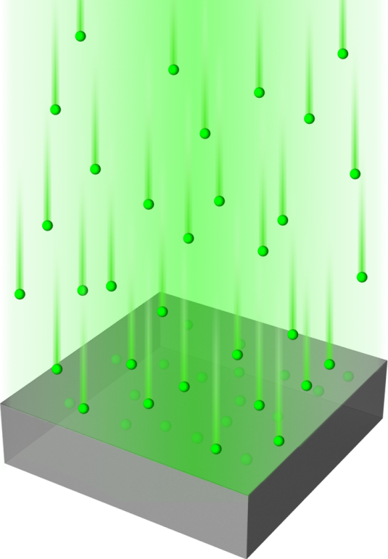
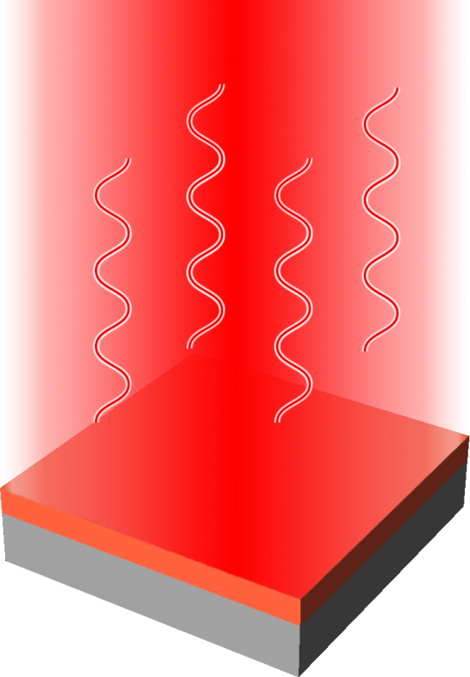
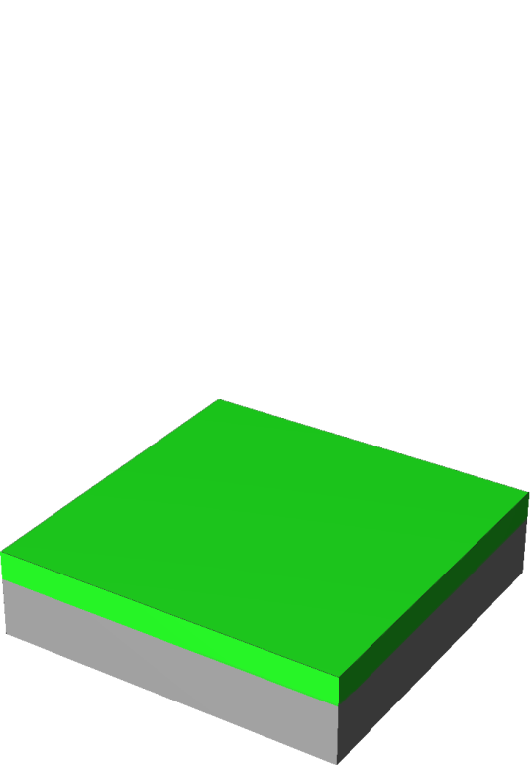
New phases from non-equilibrium processing
Ion implantation and sub-second annealing
Ion implantation
Flash lamp: milli-second
Pulsed laser: nano-second
Epitaxial layer
Maximum activation at minimum redistribution !!!

Slide 19
Pushing the doping limit: deep impurities in Si
Breaks the limit!
The electron concentration is approaching 10²¹ cm⁻³, breaking the doping limit.
No saturation even at the impurity concentration of 2.5%.
M. Wang et al, Phys. Rev. Appl. 11, 054039 (2019)

Slide 20
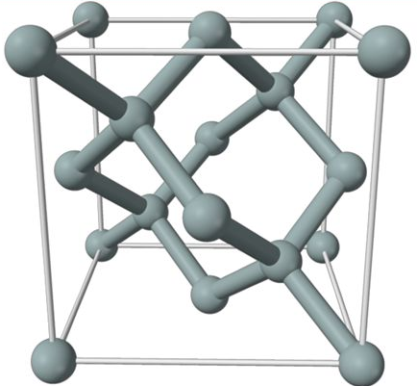
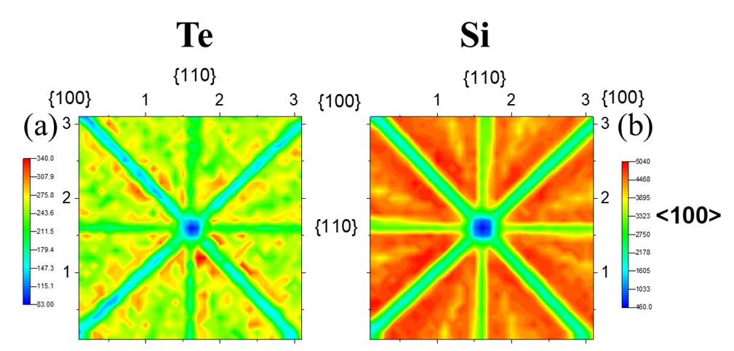
Determining the lattice location of impurities
Rutherford backscattering/channeling
Si
Te-Te dimer
M. Wang et al,
Phys. Rev. Appl. 11, 054039 (2019)
Nanoscale 14, 2826 (2022）

Slide 21
Ion beam and sub-second annealing for materials processing
Break the doping limit
Color centers for quantum technologies

Slide 22
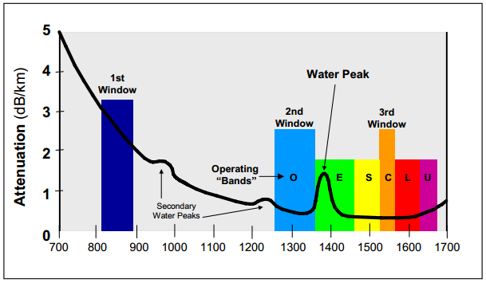
Why telecom-wavelength single-photon emitters in silicon?
Attenuation spectrum of silica optical fibers
http://fowiki.com/b/understand-fiber-attenuation
Wavelength (nm)
Integration with “near-zero change” of standard CMOS technology
No need for developing a new technology!

Slide 23

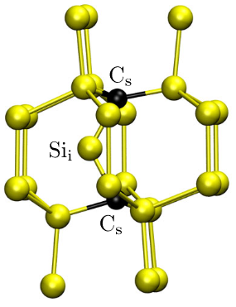
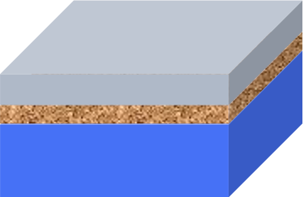
Point defect centers in silicon: The so-called G center
Single-point defect = single-photon source (SPS)
Defect’s atomic configuration
Defect creation by radiation damage
Ion implantation/irradiation
Silicon
SOI wafer
Phys. Rev. Lett. 127, 196402 (2021).
Opt. Express 28, 26111-26121 (2020).
A substitutional-substitutional carbon pair (Cs-Cs) bounded to a silicon interstitial (Sii).

Slide 24
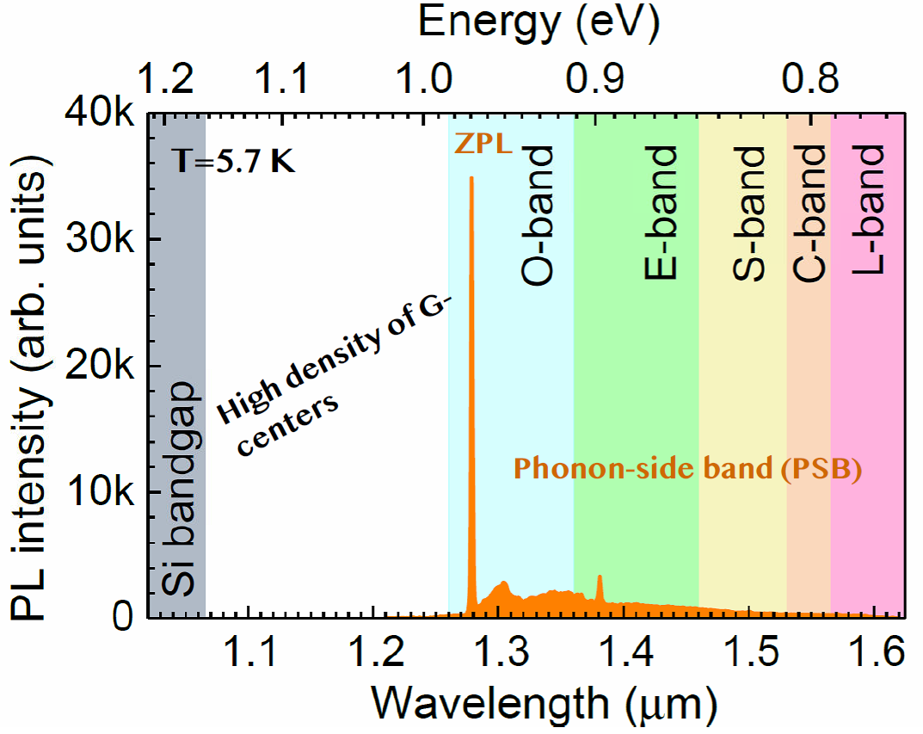
Point defect centers in silicon: The so-called G center
Spectroscopic fingerprint of the G center
Suitable for fiber-based optic communication (ZPL@1278 nm)
Indistinguishable single-photons on demand (Narrow linewidth)
Quantum photonic integrated circuits (QPICs)
Opt. Express 28, 26111-26121 (2020)

Slide 25
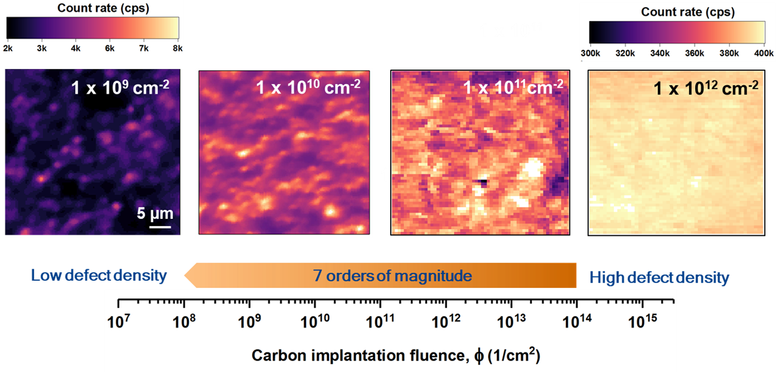
State-of-the-art: Engineering single G centers in silicon
Carbon fluence-dependent confocal 2D Photoluminescence scans
Diffraction-limited spots
Excitation: 637 nm
Detection: 1200-1600 nm
Scan area: 40 x 40 µm²
Opt. Express 28, 26111-26121 (2020)

Slide 26
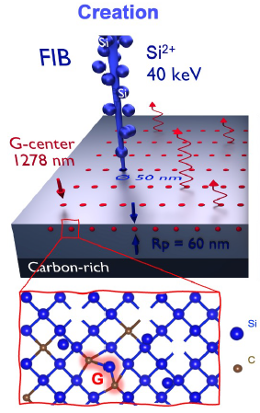
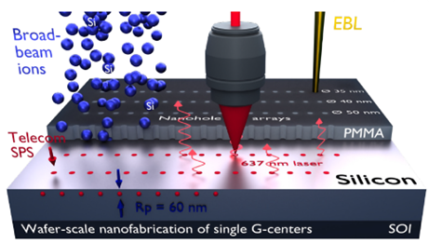
Very large-scale integration (VLSI) quantum silicon photonics
Single G center emitters at desired locations and wafer-level scalability
I - Focused ion beam (FIB) writing
II – Broad beam ion implantation
through a PMMA mask
Read out

Slide 27
Ultimate goal of ion beam
Deterministic ion implantation with precision at atomic level!
At the target position: there is one and only one impurity

Slide 28












Acknowledgements
n++ doping of Si, Ge: Mao Wang, Slawomir Prucnal
Color centers: Yonder Berencen, Zhen Shang, Shuyu Wen
2D materials: Slawomir Prucnal, Kaiman Lin…
Oxide films: Changan Wang, Lei Cao, Parul Pandey

Slide 29

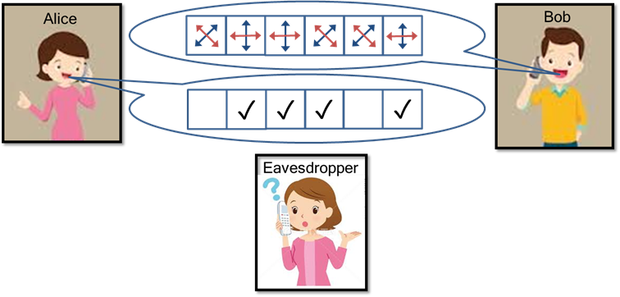
Quantum communication with single-photons
Quantum internet
Secure communication (Quantum Key Distribution)
No-cloning theorem
Fiber-based quantum communication
Chip- and/or fiber-based quantum communication
A single-photon source is the gold standard

Slide 30
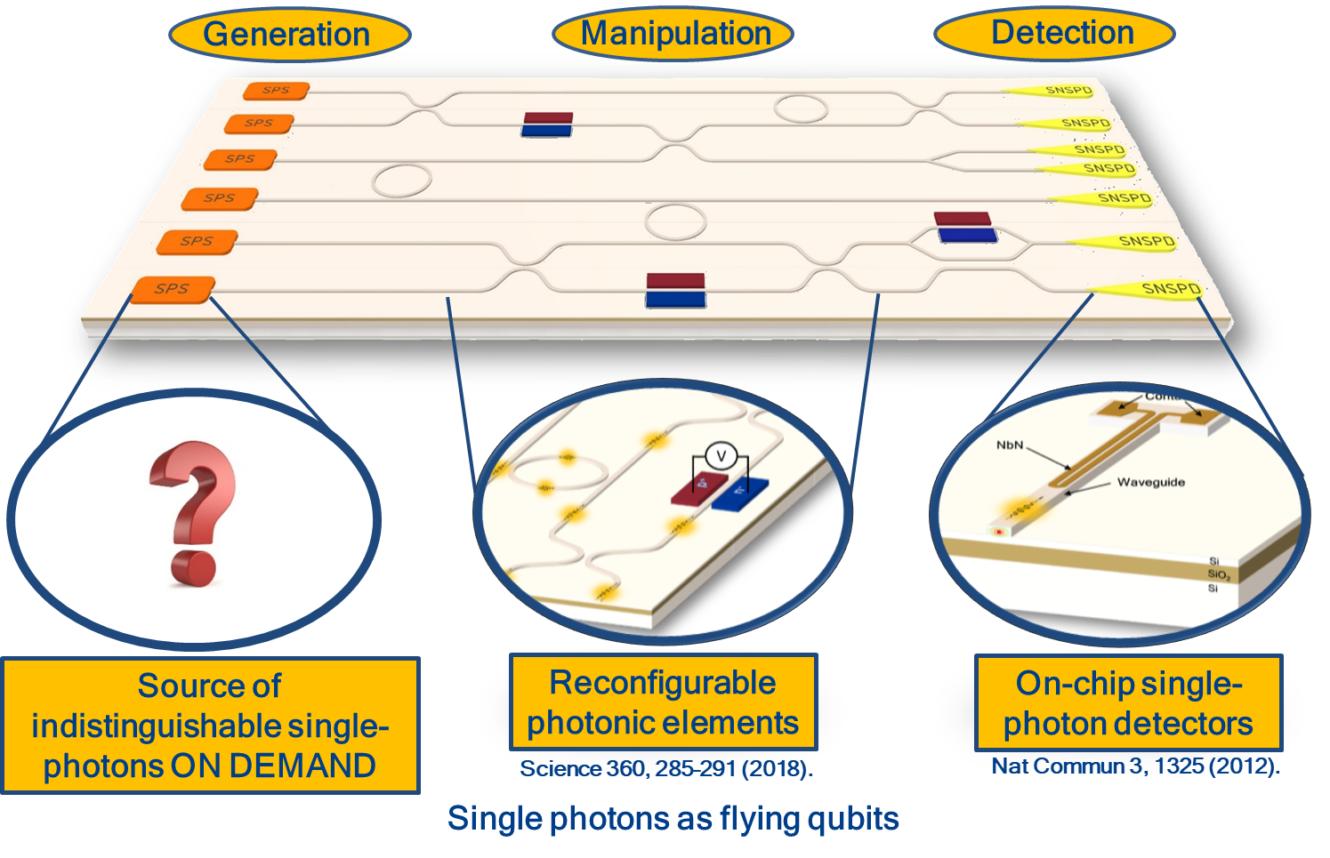
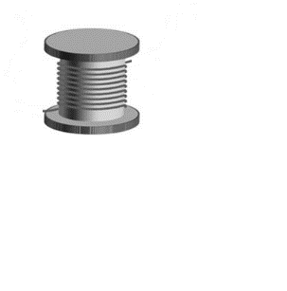
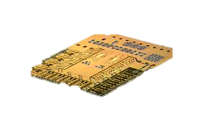

A silicon quantum photonic integrated circuit (QPIC)
Chip- and fiber-based quantum communication and computing
Optical link among chips via fibers
Chip A
Chip B
Link between quantum computing and quantum communication in the same framework
Notes:
These QPICs can be designed to work independently of each other, but it is even more interesting to integrate them in a modular way into large-scale quantum networks, thus enabling the link between quantum computing and quantum communication in the same framework.

Slide 31
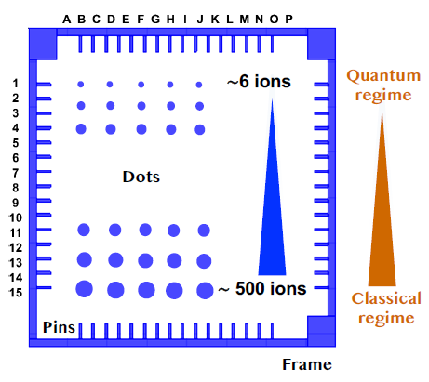
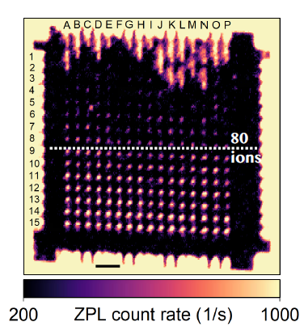
Focused ion-beam writing of G centers in SOI chips
Chip layout
2D confocal PL map
20 µm
Single dot writing
(15 x 16 spots)
Si⁺⁺, 40 keV, Rp= 60 nm
Nat Commun 13, 7683 (2022)

Slide 32
Resource for collaboration
All stable ions from eV to MeV
for ion implantation
Nanosecond Laser
Milli-second flash lamp
Contact: Shengqiang Zhou, s.zhou@hzdr.de

Slide 33
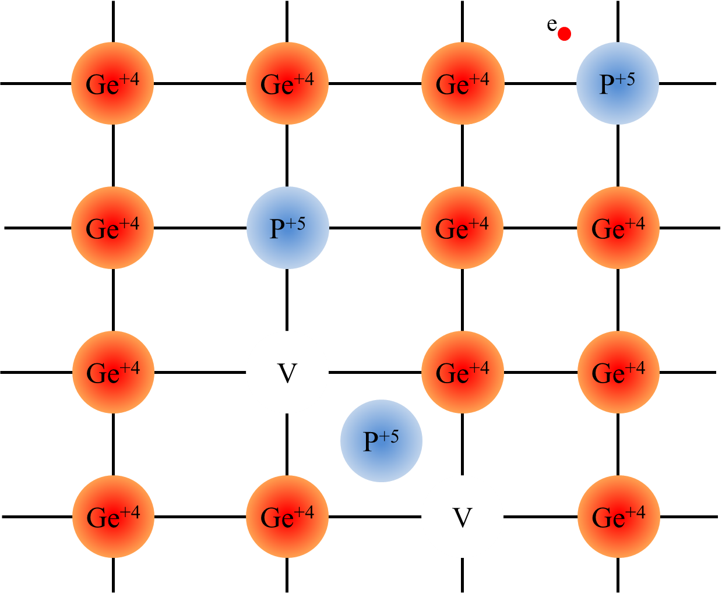
Pushing the doping limit: n++ Ge by flash lamp annealing
P doped Ge films grown on Si substrates
Vohra et al. J. Appl. Phys. 125, 025701 (2019)
Prucnal et. al. New J. Phys. 22, 123037 (2020)
ECV: electrochemical capacitance–voltage (carrier profiling)
SIMS: secondary ion mass spectroscopy (impurity profiling)

Slide 34
Dissolving P4V clusters in Ge by Flash lamp annealing
Released Vacancies from P4V
join V-clusters
Kujala et al., J. Phys.: Condens. Matter 28, 335801 (2016)
Vohra et al. J. Appl. Phys. 125, 025701 (2019)
Prucnal et. al. New J. Phys. 22, 123037 (2020)

Slide 35

2D Materials: FWIM + FWIH + FWIO + FWIN + ….
CrSBr
Nano Lett. revision

Slide 36
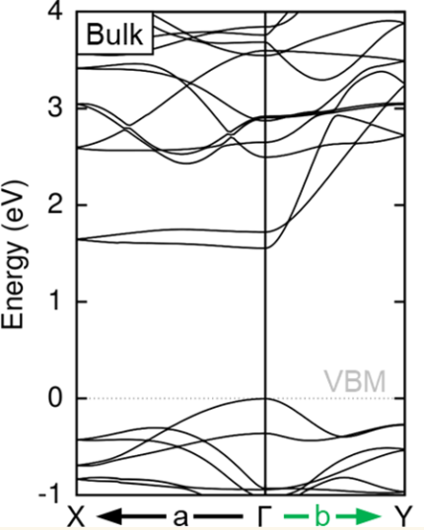
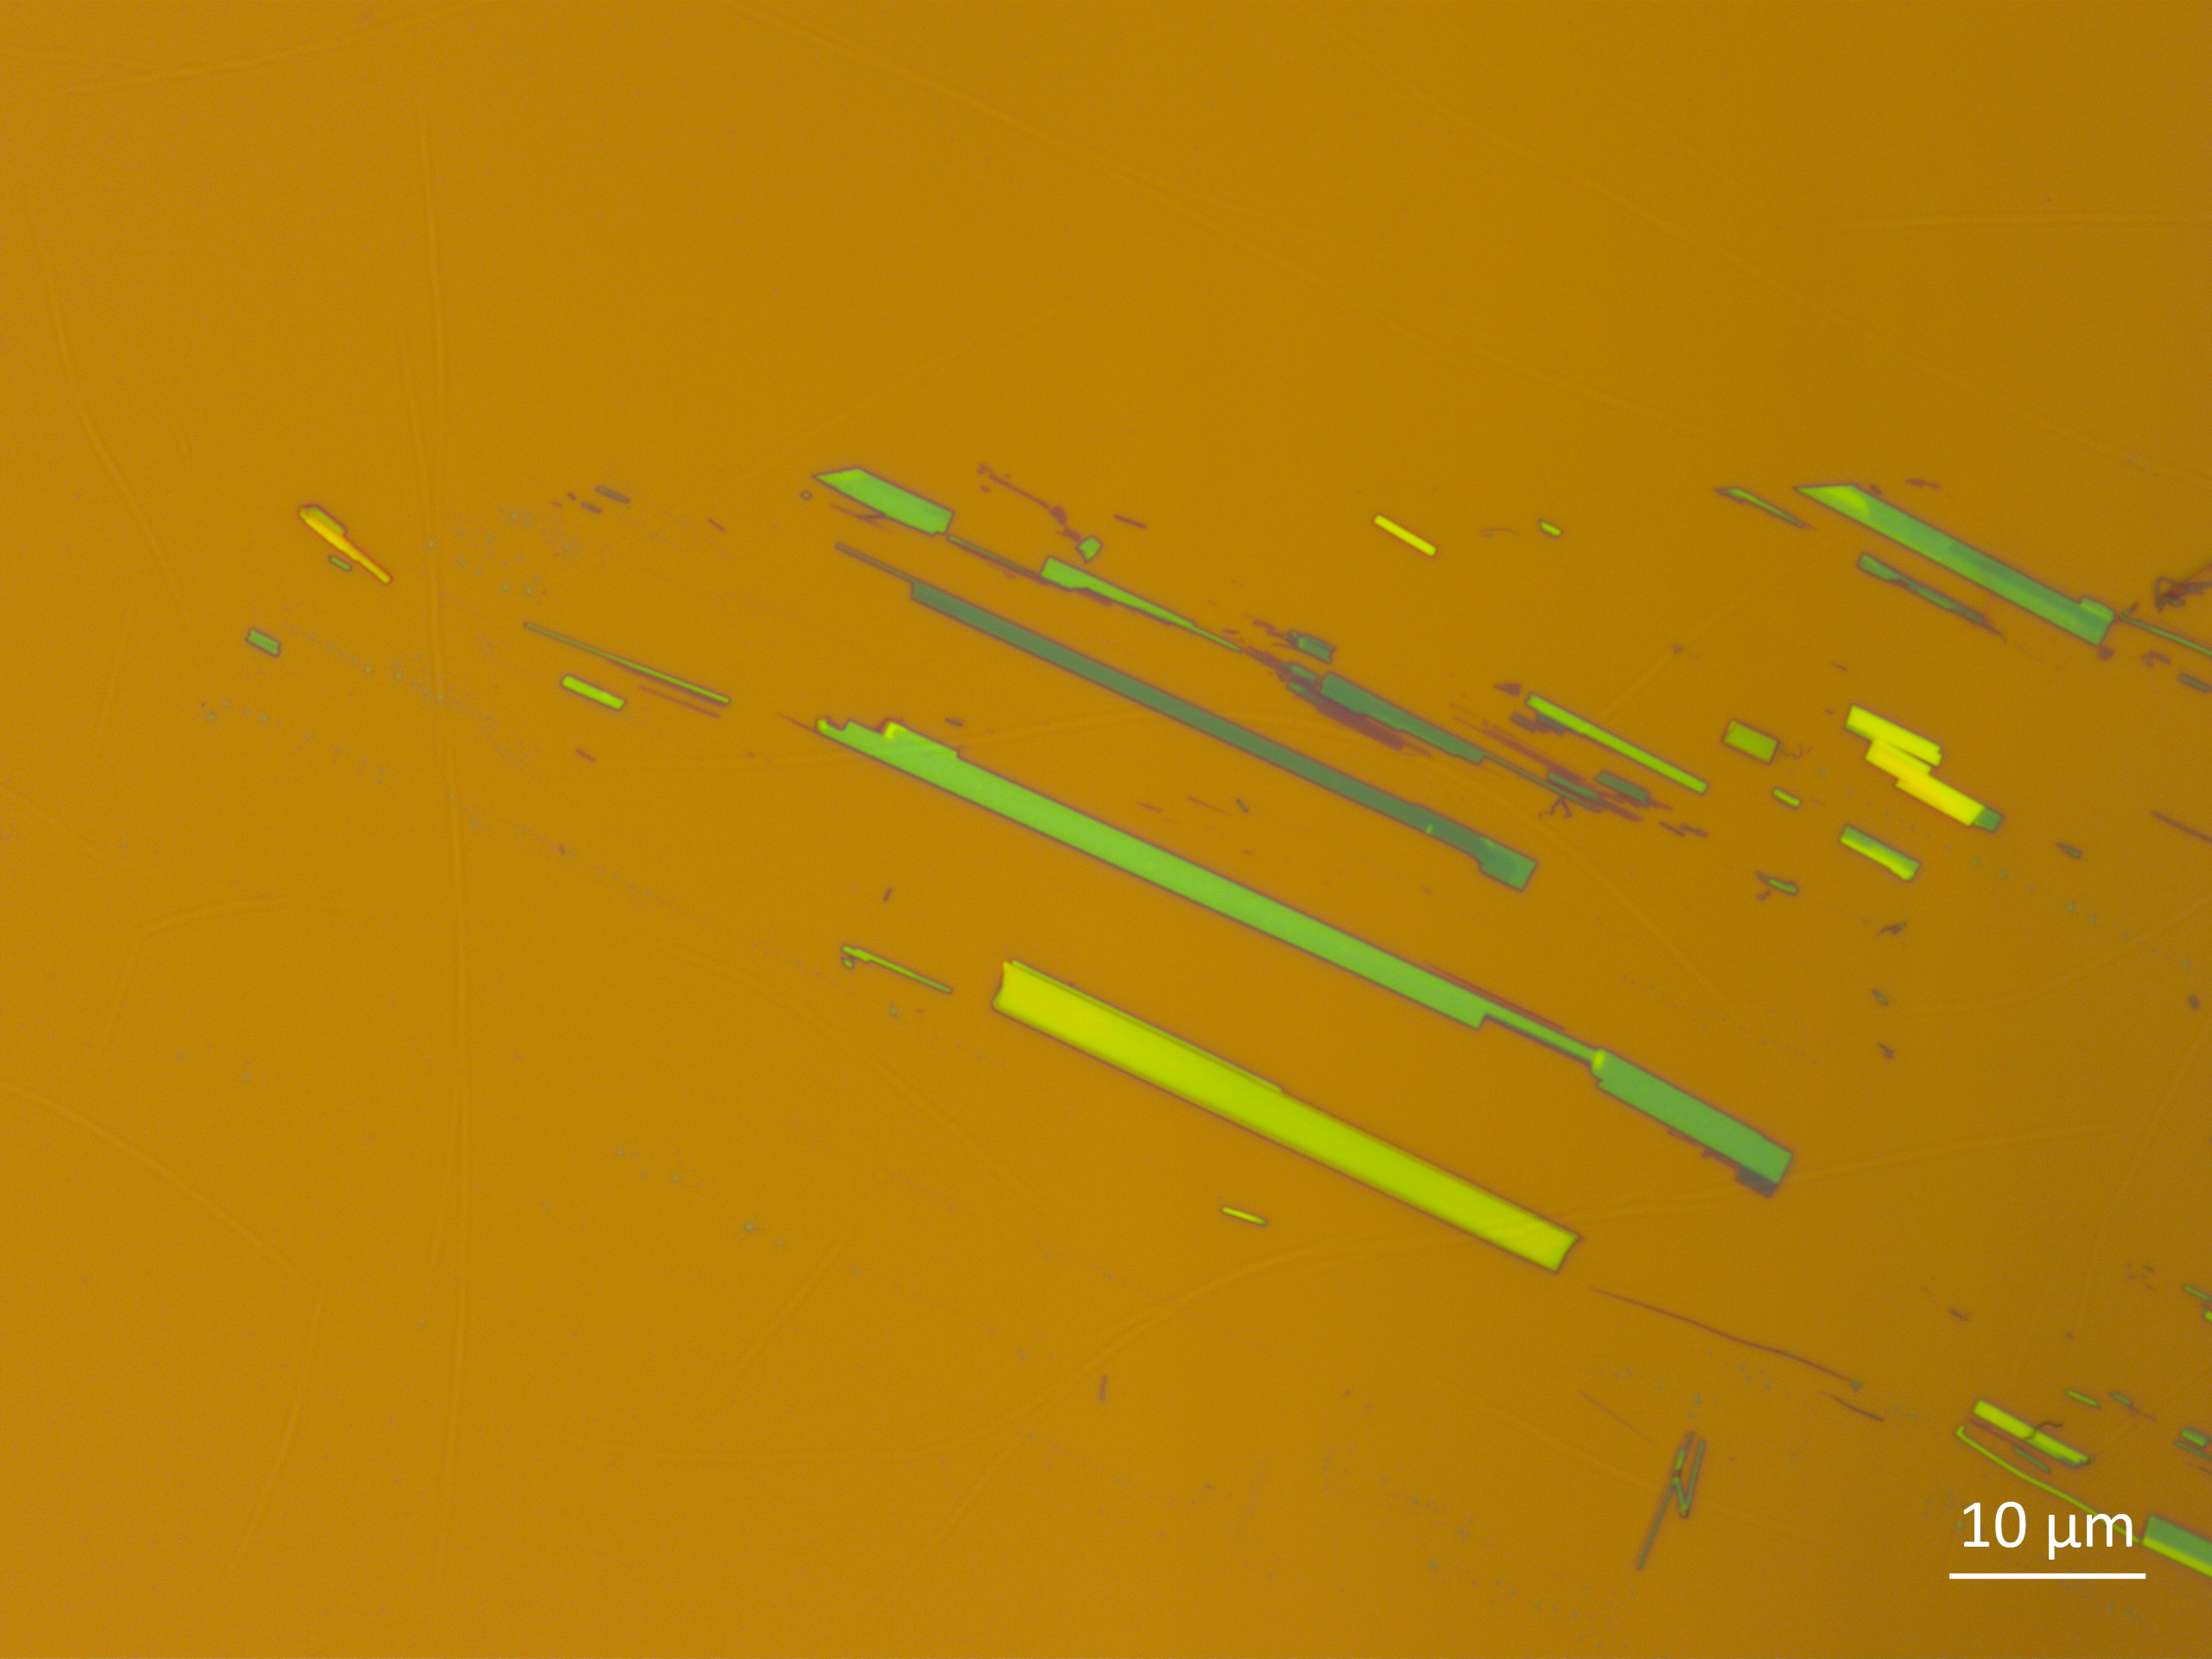
CrSBr
a
b
Klein J, et al. ACS nano, 2023, 17(6): 5316-5328.
Notes:
This is the optical image of CrSBr we exfoliated on SiO2.
a and b axis can be easily identified by its needlelike shape.
This is the band structure of bulk CrSBr pubilished recently.
showing a flat conduction band along the Γ−X direction, which corresponds to the a direction, and a highly dispersive band along the Γ−Y direction, which corresponds to the b direction.
The nearly flat conduction band along the Γ-X direction provides high possibility of phonon-assisted transitions.

