Slide 1




SDDL-AUG
The way to a Smart-Digital-Development-Lab AUG – an extremely stony road
2025-08-18 | Stefan van Waasen

Slide 2

Georgian-German Science BRIDGE (GGSB)
General structure
Three Pillars
Joint
Research
Educational
Training
Knowledge
Transfer
Atmospheric Res.
Biomedical Imaging
Machine Learning
Particle Physics
Internships
Lecture Weeks
MSc-, PhD-Theses
Workshops
SMART|Labs:
AtmoSim
Digital
EDM
Biomedical Imaging

Slide 3
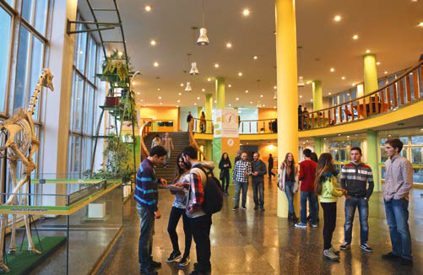
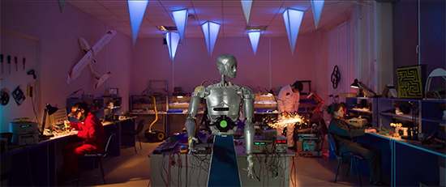
Educational consortium of 2 private universities
Agricultural University of Georgia (AUG) & Free University of Tbilisi (FUT)
Agricultural University of Georgia (AUG)
  Founded in 1929
  Consortium since 2011
Engineering, Chemistry, Biology, Agrosciences, Business, Liberal Arts
18 programs at 3 schools
17 research institutes/centers
40 laboratories
1950 under graduate students
200 graduate students
35 PhD students

Slide 4
Educational consortium of 2 private universities
Agricultural University of Georgia (AUG) & Free University of Tbilisi (FUT)
Free University of Tbilisi
  Founded in 2007
  Consortium since 2011
Math, Physics, Computer Science, Electrical & Computer Eng., Law, Business, International Relations, Social Science, Visual arts & Design, Architecture
16 programs at 8 schools
6 research institutes/centers
2315 under graduate students
328 graduate students
12 PhD students

Slide 5


ZEA-2 Portfolio
Two main groups: IC design and measurement system
QUANTUM COMPUTING
QC
INFORMATION:
Integrated Computing Architectures (ICA)
NEUROMORPHIC
COMPUTING
NC
EARTH AND ENVIRONMENT:
Measurement System

Slide 6


ICA Portfolio
ICs design for Future Computing
QUANTUM COMPUTING
QC
INFORMATION:
Integrated Computing Architectures (ICA)
NEUROMORPHIC
COMPUTING
NC
EARTH AND ENVIRONMENT:
Measurement System

Slide 7

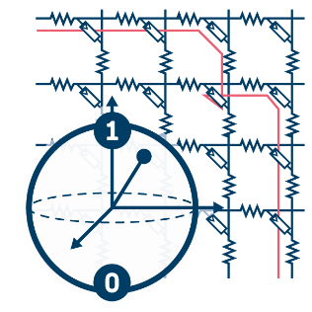

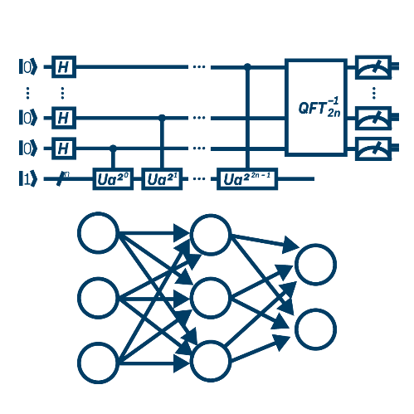
Integrated Computing Architectures
Semiconductors enable Future Computing architectures
  → High integration, VLSI scalability
System integration of memristors, qubits, etc.
  Algorithms, hardware and physics co-design
System modeling of hardware implementations
  → Application requirements and error mitigation / correction
Novel Devices
Qubit Memristor
…
Integrated Computing Architectures
Applications
Algorithms
Methods
…

Slide 8
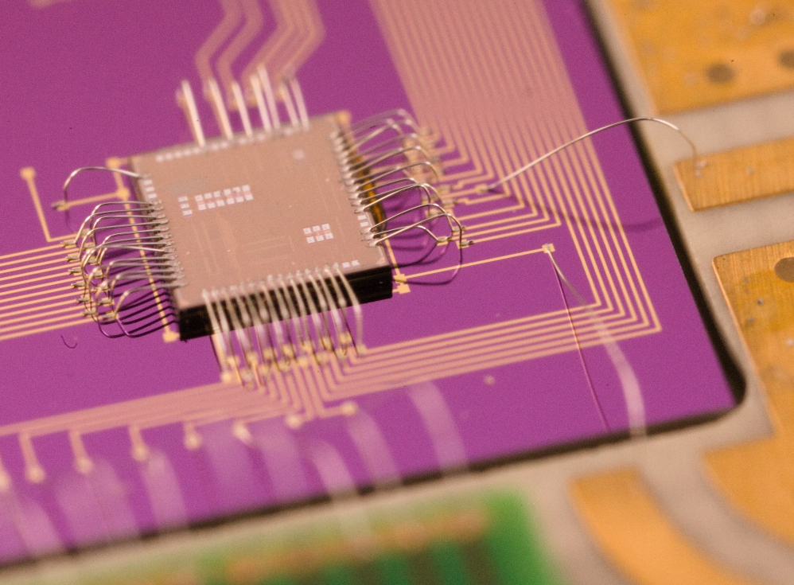
Scientific research focus
CMOS Chip Design
Integrated Circuits are a KEY Enabling Technology
CMOS development group is built around experience
in communication industry
≈ 20 out of the 65 employees directly work on chip design
Activities Span the Entire Stack:
System Modelling and Algorithm
Integrated Circuit Implementation
System Integration of Novel Devices
CMOS Chip
Integrated Circuit (IC)
Application Specific IC (ASIC)
synonymously
used today

Slide 9
cooperation History
Motivation and tools
What are the motivations and the targets for the cooperation between AUG – ZEA-2/ICA?
  AUG
    Improve education and future perspective for students
    Motivate with further opportunities for personal development of students
    Get further opportunities to work on “exciting” science projects
  FZJ – ZEA-2/ICA
    Find talented people for cooperation and help to lift their potential
    Support on the development of student skills – consultant and active involvement
What are the “tools” up to now?
  Block lectures at AUG based on university course at Uni DuE
  Exchange of students (internship program, Master thesis)

Slide 10
This cannot be the End of the road!?
Improve sustainability and self-consistency of cooperation
Highest motivation to learn rises from exciting own experiences
→ participation in real projects (tasks) in an early stage
  But single students as trainees have a very limited reach and sustainability
  Extend this experience to more students directly at AUG/FUT
    Best case in early stages of studies (latest during Master studies)
    What is a suitable and feasible first field to enable this?
Digital Design based on FPGAs is an ideal candidate
  Required infrastructure and tooling is quite limited
  Tasks on different levels enable early engagement and increasing difficulty
  Excellent combination for self-consistent and remote cooperation

Slide 11

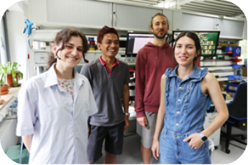
Project Outline
Supported by Volkswagen Foundation funding
SMART|Digital_Lab – SDDL-AUG
Electronic Systems
Project: Smart Digital Development Lab
Funding application at Volkswagen Foundation in 12/2021
Technology: Cluster of Field Programmable Gate Arrays
Application: Hard- and software development
PI: Prof. Zaza Metreveli at Agricultural University of Georgia
Partner: ZEA-2 – Prof. Stefan van Waasen
Status: in implementation phase
Educational componenst:
  Block lectures started in 2017
  FPGA course in Bachelor ciriculum
Granted 01/2023 by Volkswagen Foundation
  147 kEUR over 2 years

Slide 12
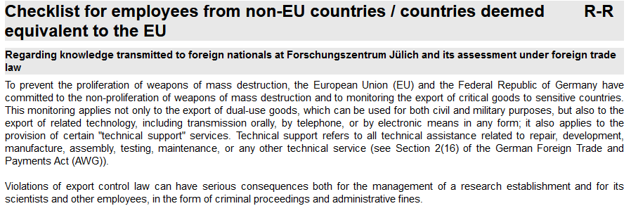
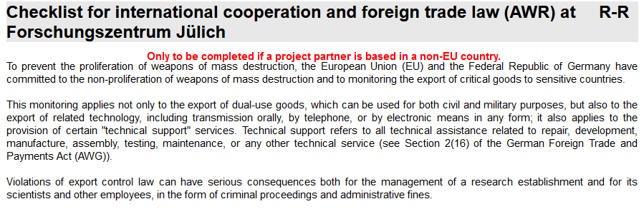
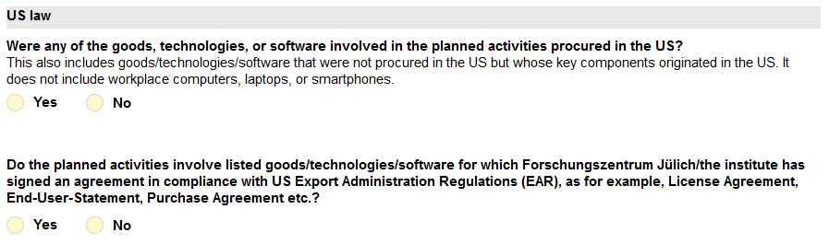
„Great idea“ – BUT …
Some legal boundary conditions are blocking
Start of Ukraine war made situation much worse
  EU export control – FPGAs are excluded for export into “critical countries”
    Many things we do are TRL 4 or higher and clearly dual-use relevant
  US trade law – FPGA software is not even downloadable in “critical countries”
  Georgia is “critical” and not allowed to purchase any high-tech products due to dual-use assessment
    Even IPAP (NATO) and EU candidate status does not change anything
    ➔ Possible solution: Apply for exceptional authorization
What about internships?
  Are we still allowed to bring Georgian students into ZEA-2?
  In principle same rules apply, but is this really “export”?
    ➔ Possible solution: Apply for exceptional authorization

Slide 13
What is the „Solution“?
Some legal boundary conditions are blocking
Exceptional authorization for FPGA cluster HW & SW purchase
  Application sent to U.S. embassy in Georgia by AUG
    No reaction or answer at all
Exceptional authorization for internships
  First “direct” assessment – exceptional authorization required!
  Intensive discussions and final legal assessment
    Internships are no “export” in the sense of the EU and U.S. law → re-start initiated
    What does this mean overall for the project? – Workaround possible?
  What about a “remote lab”? – HW & SW in ZEA-2 and enable limited remote access
  (combine w/ internships)!
    Legal assessment: no “export” in the sense of the EU and U.S. law!
    Implementation done : Ilja will give you the details

