Slide 1
GGSB Meeting @HZDR -
QUALI-Start-Up Lectures
Sunday, August 17, 2025 - Saturday, August 23, 2025
Helmholtz-Zentrum Dresden-Rossendorf (HZDR)
SMART|Biomarker-Lab: Contributions, possibilities at TSU / Georgia
Bezhan Chankvetadze
Institute of Physical and Analytical Chemistry
School of Exact and Natural Sciences
Iv. Javakhishvili Tbilisi State University
Tbilisi, Georgia

Slide 2
Know-How
Infrastructure
Personnel

Slide 3
Expertise
Infrastructure
Personnel

Slide 4
Expertise
Infrastructure
Personnel

Slide 5
What are enantiomers?
Why is enantioselective analysis important?
What are current challenges in enantioselective analysis?
How do we deal with the challenges?

Slide 6
Types of isomers
Constitutional isomers
Cis-trans/geometric isomers
Stereoisomers
Diastereoisomers
Meso isomers
Enantiomers

Slide 7
Definition of chiral molecules
A chiral molecule is a type of molecule that lacks an internal plane of symmetry and has a non-superimposable mirror image.
The feature that is most often the cause of chirality in
molecules is the presence of an asymmetric center.

Slide 8
Enantiomers and Diastereomers
Stereoisomers contain the same atoms with the same connectivity but with different orientation in space.
Stereoisomers which relate to each other as the mirror images are enantiomers.
Stereisomers which do not relate to each other as the mirror images are diastereomers.
Diastereomers can be resolved by using achiral stationary phases while for separation of enantiomers a chiral stationary phase (CSP) must be used.
The sign of optical rotation depends on the solvent used, sample concentration, wavelength, etc. and does not directly relate to the absolute stereochemical configuration of a chiral compound.

Slide 9
Why is enantioselective anaylsis important?
Different pharmacology, pharmacokinetics, metabolism and toxicity of enantiomers
of chiral drugs
Different effect and environmental fate of enantiomers of chiral agrochemicals
Different biological activity of enantiomers of chiral food additives
Biomarkers

Slide 10
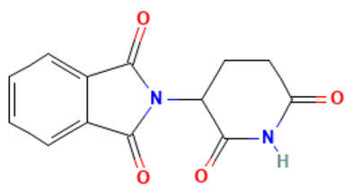
Different biological activity of enantiomers
Taste
Smell
Toxicity
Pharmacology (Thalidomide)
The Thalidomide Tragedy: Lessons for Drug Safety and Regulation
By: Bara Fintel, Athena T. Samaras, Edson Carias, Jul 28, 2009

Slide 11
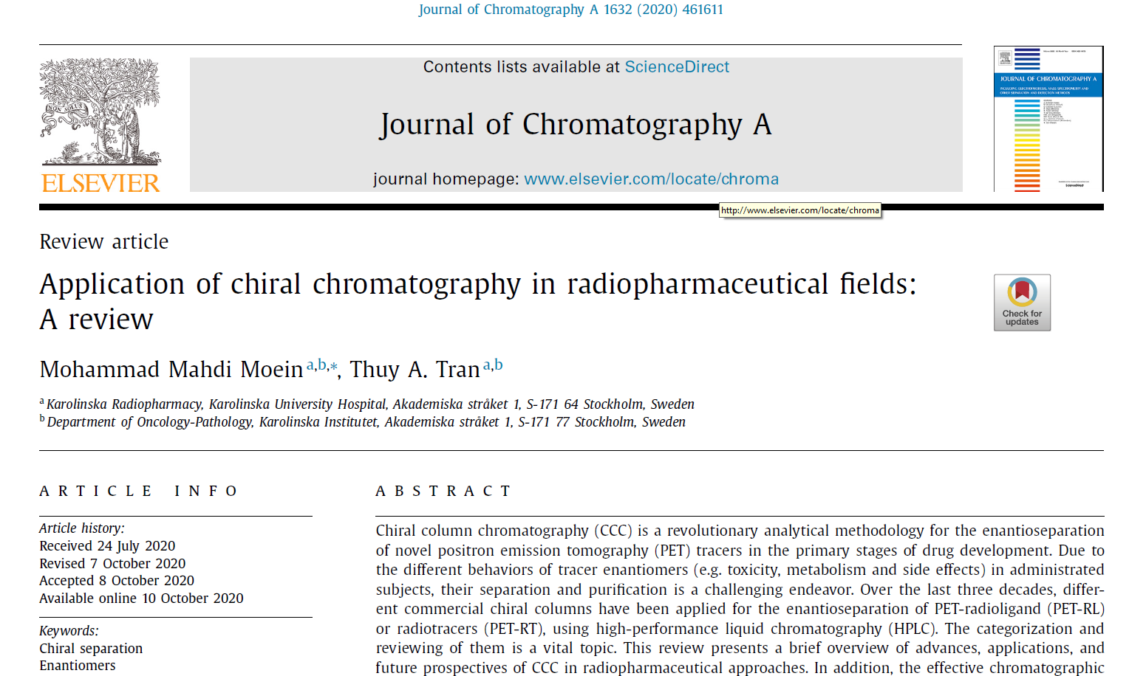
Chiral column chromatography (CCC) is a revolutionary analytical methododlogy for the enantioseparation
of novel positron emission tomography (PET) tracers in the primary stages of drug development.

Slide 12
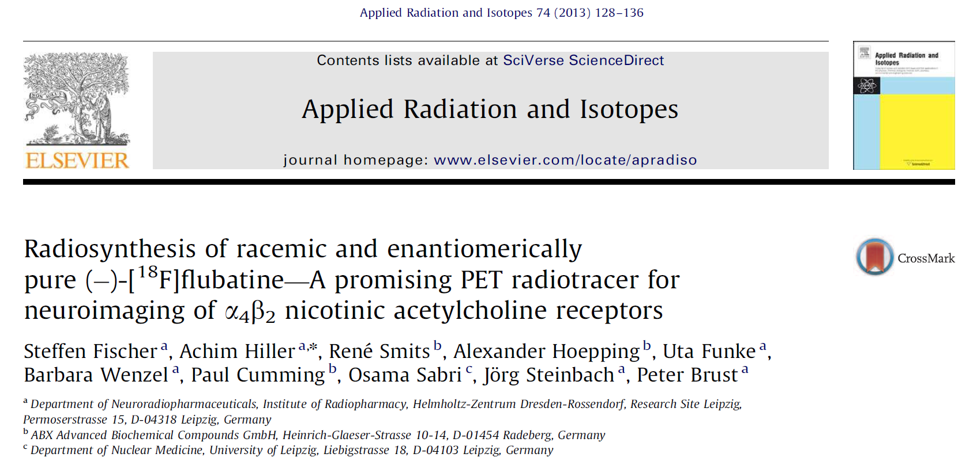

Slide 13
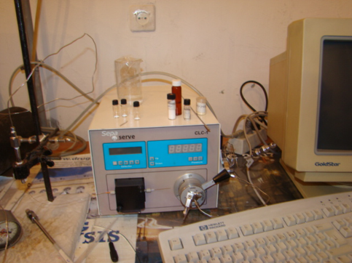
Separation techniques applied in our research:
High-Performance Liquid Chromatography
Nano-Liquid Chromatography
Capillary Electrophoresis
Capillary Electrochromatography
Supercritical fluid chromatography
B. Chankvetadze, D. Bergenthal, H. Wennemer, Vorrichtung zur Trennung von Substanzgemischen mittels Flüssigchromatographie, Application number: 102 60 700.1. Application date: 24.12.2002. Anmeldenummer: 10260700. Veröffentlichungsdatum: 08.07.2004

Slide 14


Torrance, CA, USA
Phenomenex Announces New Line of Chiral HPLC/SFC Columns
27/06/2008
Torrance, CA (June 27, 2008) – Phenomenex Inc., a global leader in the manufacture of separation science consumables, introduces Lux™ – a new line of polysaccharide-based columns for the identification and resolution of enantiomers. Lux columns are offered with two chiral stationary phases (CSPs), both of which use coated derivatized cellulose as the chiral selector. The two phases combine to create a dependable screening set with a wide range of selectivity. The Lux line is based on chiral technology that was developed by noted expert Professor Bezhan Chankvetadze. “Phenomenex is a dynamic organization with a strong global distribution and support network and their entry into chiral separations will be beneficial for the science,” commented Professor Chankvetadze.
Lux Cellulose-1
Lux Cellulose-2
Lux Cellulose-3
Lux Cellulose-4
Lux i-Cellulose-5
Lux Amylose-1
Lux i-Amylose-1
Lux Amylose-2
Lux i-Amylose-3

Slide 15
Expertise
Infrastructure
Personnel

Slide 16
Organic synthesis laboratory space in accordance to international standards
is available.
All major instrumentation to follow organic synthesys, for purification and identification
of synthesiszed materials, as well as for structure identification of chemical compounds
are available.
(Nothing is available for working with radioactive compounds).
The dean of the Faculty of Exact and Natural Sciences, Prof. Petre Babilua and rector of
Iv, Javakhishvili Tbilisi State University Prof. Jaba Samushia support the idea of starting
new Biomarker Smartlab

Slide 17
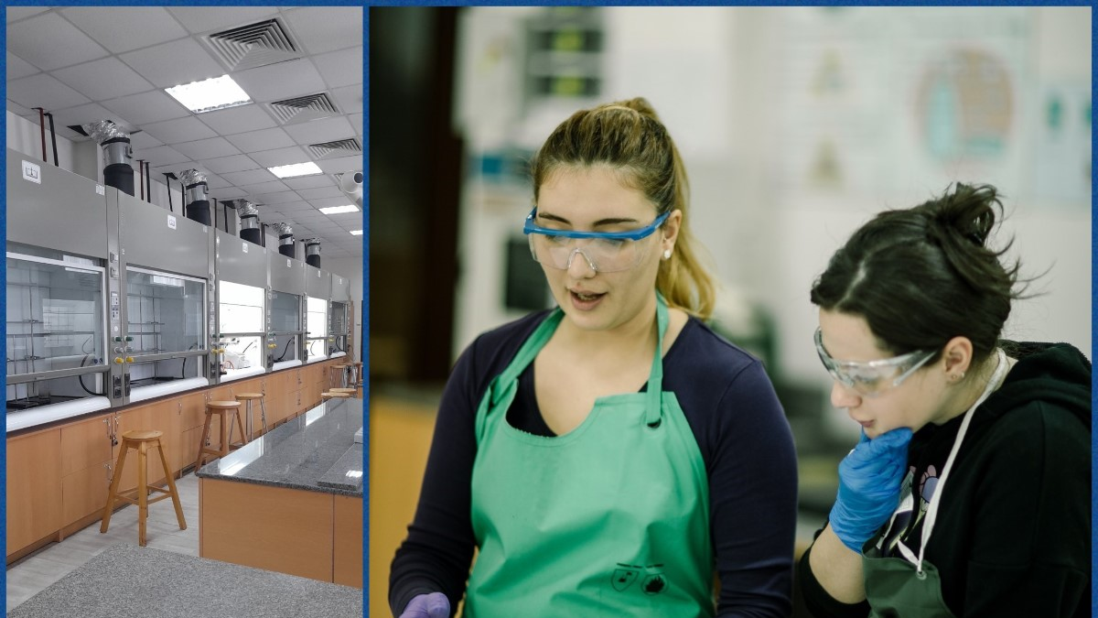

Slide 18
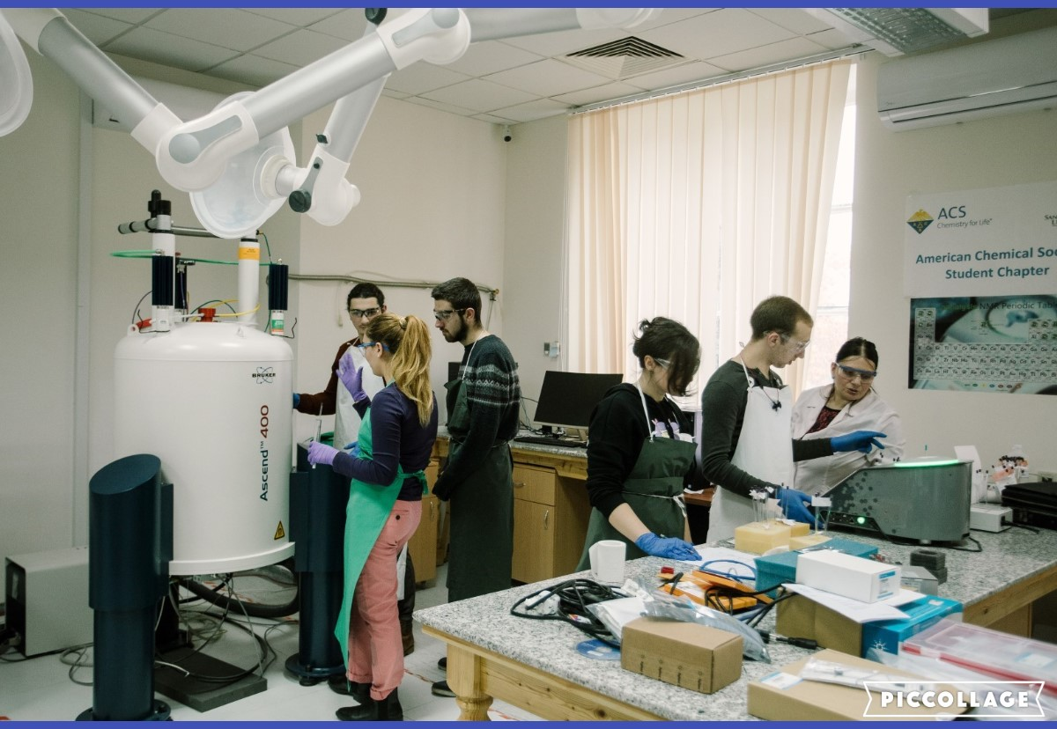

Slide 19
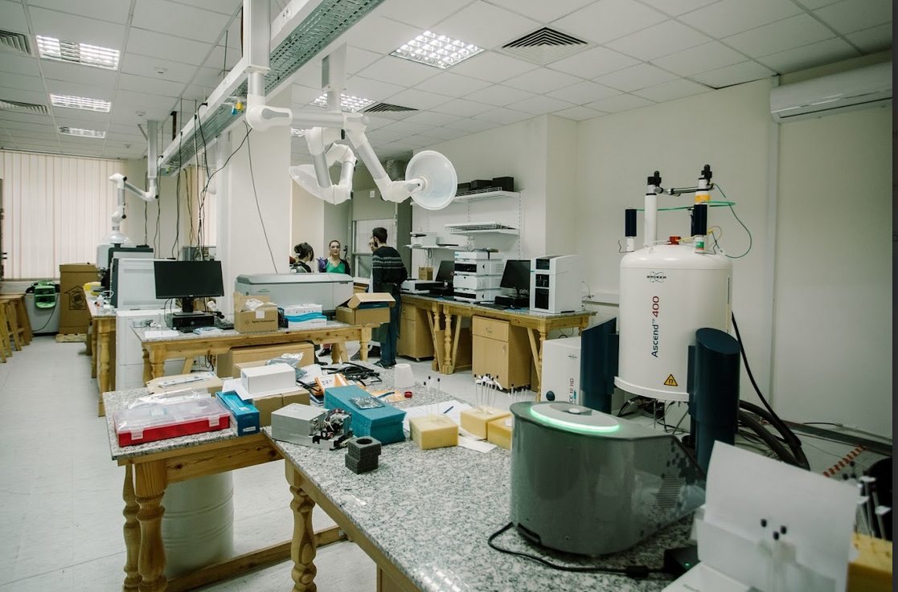

Slide 20
Expertise
Infrastructure
Personnel

Slide 21
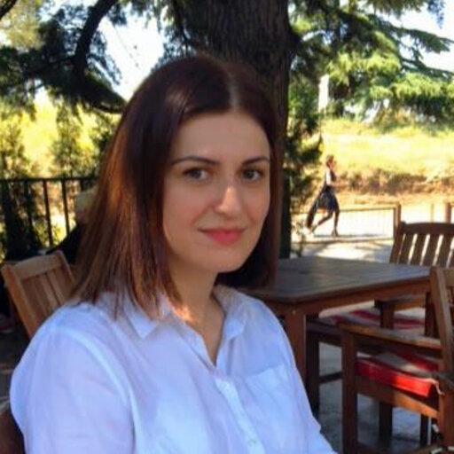

July 26, 2025
Laboratory trip-2025 in Rkoni
Dr. Rusudan Kakava, expert in organic synthesis
and separation science.
Research experience in INM-5 at Forschungs
zentrum Jülich.
Mr. David Gabadadze, expert in organic synthesis
and separation science.
Prepared his Master‘s thesis in INM-5 under the supervision
of Dr. Sven Humpert and Prof. Bernd Neumeyer at Forschungs
zentrum Jülich.
Many well-trained and motivated students.

