Slide 1
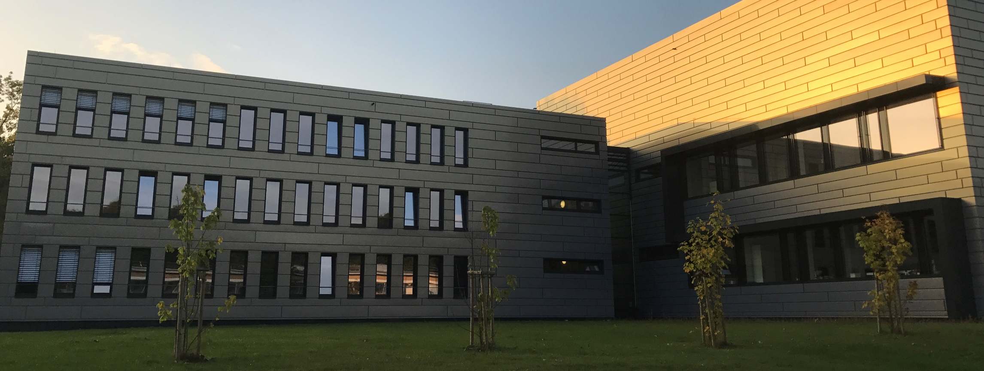
Medical diagnostics
Nuclear Chemistry
18.09.2025 | Institute of Neuroscience and Medicine – INM-5| Swen Humpert

Slide 2
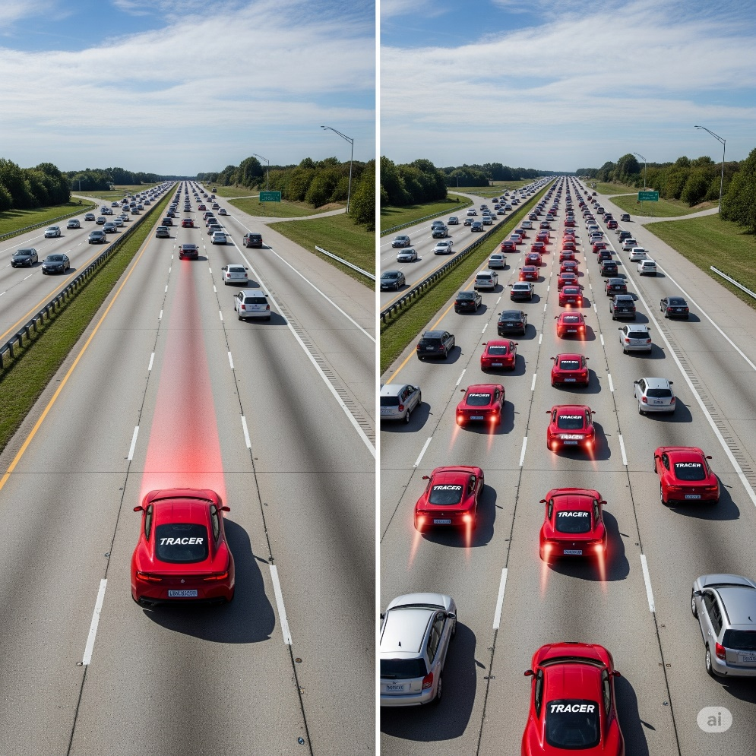
Tracer principle
Adding a traceable agent to follow a process
Potential biological processes (targets)
  Active transport, e.g. glucose, amino acids
  Receptor binding
  Enzyme activity
  Protein expression
Process must not be altered by the tracer!

Slide 3

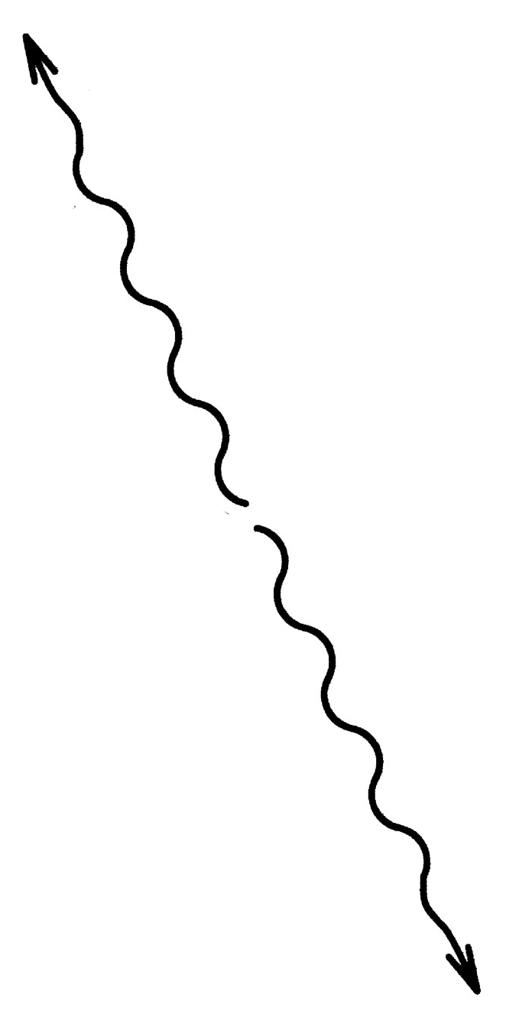
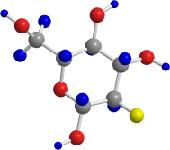
PET:Physical background Hintergrund

Slide 4
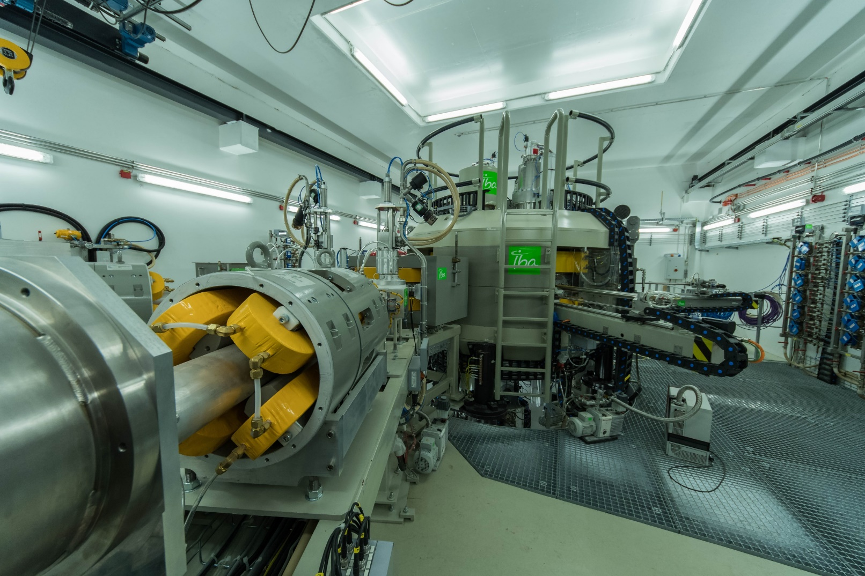
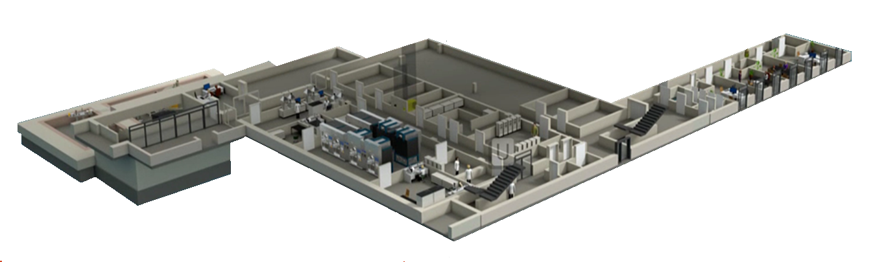
Radionuclide production
n
¹⁸O
≠
p
¹⁸F
Compound nucleus [¹⁹F]*
¹⁸O(p,n)¹⁸F
¹⁸F Half life: 110 min

Slide 5
F-18 Chemistry
Modern radiochemical methods to overcome the limitations of F-18 chemistry.

Slide 6
F-18 Chemistry
[¹⁸F]SuFEx- Chemistry
ultrafast ¹⁸F/¹⁹F isotopic exchange
Modern radiochemical methods to overcome the limitations of F-18 chemistry.
[¹⁸F]AlF-
Chemistry
aluminium-[¹⁸F]fluoride ([¹⁸F]AlF) complex is a “pseudo-radiometal”
Next Gen CMRF
Improving copper-mediated radiofluorination with novel mediators
S-Arylation
radiolabeling of thiol-containing substrates

Slide 7
F-18 Chemistry
[¹⁸F]SuFEx- Chemistry
ultrafast ¹⁸F/¹⁹F isotopic exchange
1) Elution of [¹⁸F]F⁻ with BnEt₃NCl in MeOH
2) Removal of MeOH
3) MeCN, 0–105 °C, ≤5 min
[¹⁸F]AlF-
Chemistry
aluminium-[¹⁸F]fluoride ([¹⁸F]AlF) complex is a “pseudo-radiometal”
(AY>30% in <30 min)
29 examples
Next Gen CMRF
Improving copper-mediated radiofluorination with novel mediators
S-Arylation
radiolabeling of thiol-containing substrates

Slide 8
F-18 Chemistry
[¹⁸F]SuFEx- Chemistry
ultrafast ¹⁸F/¹⁹F isotopic exchange
[¹⁸F]AlF-
Chemistry
aluminium-[¹⁸F]fluoride ([¹⁸F]AlF) complex is a “pseudo-radiometal”
Next Gen CMRF
Improving copper-mediated radiofluorination with novel mediators
S-Arylation
radiolabeling of thiol-containing substrates

Slide 9
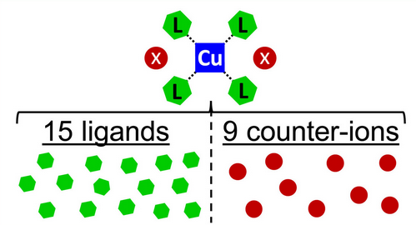
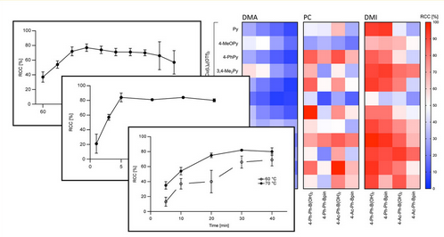
F-18 Chemistry
[¹⁸F]SuFEx- Chemistry
ultrafast ¹⁸F/¹⁹F isotopic exchange
[¹⁸F]AlF-
Chemistry
aluminium-[¹⁸F]fluoride ([¹⁸F]AlF) complex is a “pseudo-radiometal”
Next Gen CMRF
Improving copper-mediated radiofluorination with novel mediators
S-Arylation
radiolabeling of thiol-containing substrates

Slide 10
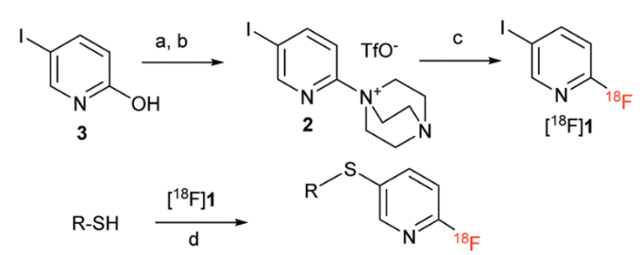
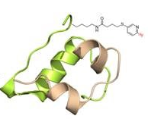
F-18 Chemistry
[¹⁸F]SuFEx- Chemistry
ultrafast ¹⁸F/¹⁹F isotopic exchange
[¹⁸F]AlF-
Chemistry
aluminium-[¹⁸F]fluoride ([¹⁸F]AlF) complex is a “pseudo-radiometal”
Next Gen CMRF
Improving copper-mediated radiofluorination with novel mediators
S-Arylation
radiolabeling of thiol-containing substrates

Slide 11

Tryptophan
Target selection
Tryptophan metabolism…
Trp is the least abundant amino acid in proteins
Precursor of bioactive metabolites like serotonine, melatonin and kynurenine
Involved in key physiological processes (immunity, neuronal function and gut homeostasis)
Deregulation results in a wide range of diseases, from neurological diseases to cancer.
Serotonin pathway
Kynurenine pathway
Notes:
tryptophan is metabolized via three distinct pathways:
The kynurenine pathway plays a major role in inflammatory signaling. Metabolite ratios from this pathway enable insights into enzyme activities and immune activation.
The serotonin pathway and its metabolites are crucial in gut-brain axis communication. The metabolite serotonin itself is, among others, involved in learning, mood regulation, and sleep.
Indols are direct signaling molecules used by the microbiome in communication with the host. Indols are involved in inflammatory pathways.

Slide 12
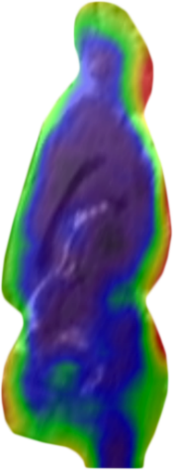
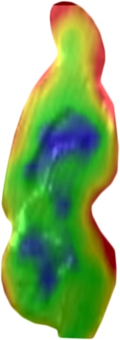
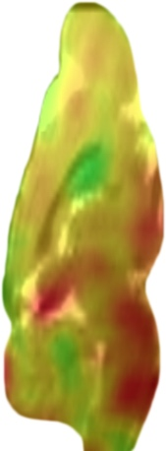
Tryptophan
4-[¹⁸F]FTrp
Preclinical evaluation
5-[¹⁸F]FTrp
7-[¹⁸F]FTrp
INM-5; Uinversity Clinic Cologne; Institute of Radiochemistry and Experimental Molecular Imaging (IREMB)

Slide 13
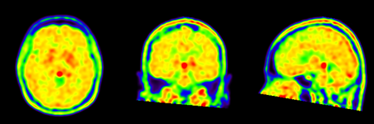
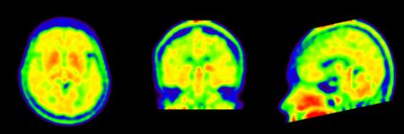
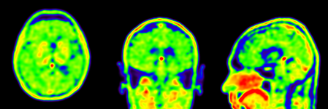
Tryptophan
A
a
First-in-human
B
b
C
c
INM-5; University Clinic Cologne; Russian Scientific Center of Radiology and Chirurgic Technologies, Department of Drug Design and Pharmacology, Denmark, Center for Nuclear Medicine & PET/CT Positronmed, Santiago, Chile
d
D
A: Healthy control; B: Depressive patient with insomnia; C: MCI patient; D: , Auditory hallucinations

Slide 14
FAPI
Fibroblast activation protein inhibitor
Target selection

Slide 15
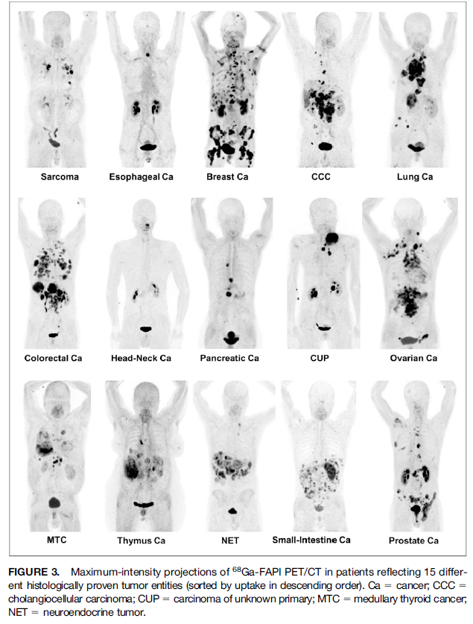
FAPI
Fibroblast activation protein inhibitor
FAPI PET imaging
[⁶⁸Ga]-FAPI-4

Slide 16
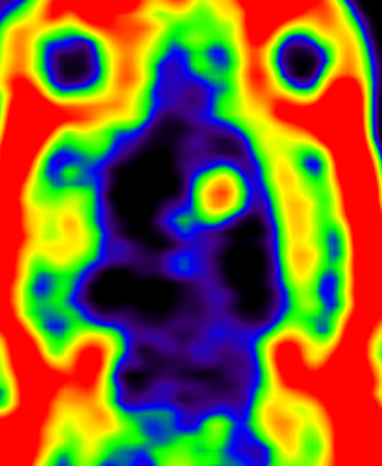
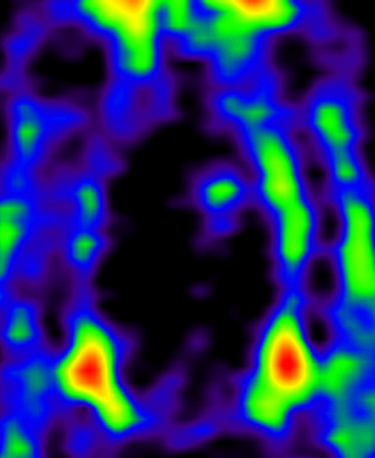
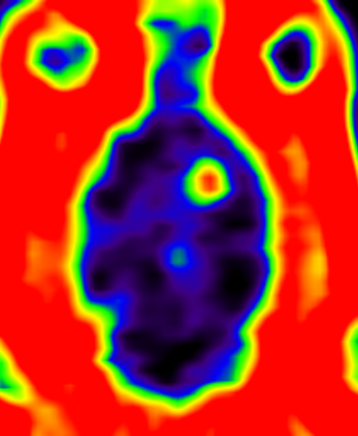
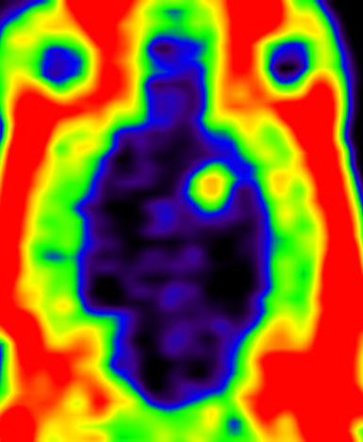
FAPI
Fibroblast activation protein inhibitor
[¹⁸F]AlF-FAPI-42
6-[¹⁸F]F-FAPI
0-30 min
90-120 min
Preclinical evaluation
T
Al[¹⁸F]F-FAPI-42
INM-5; University Clinic of Cologne; Institute of Radiochemistry and Experimental Molecular Imaging (IREMB)
6-[¹⁸F]F-FAPI

Slide 17
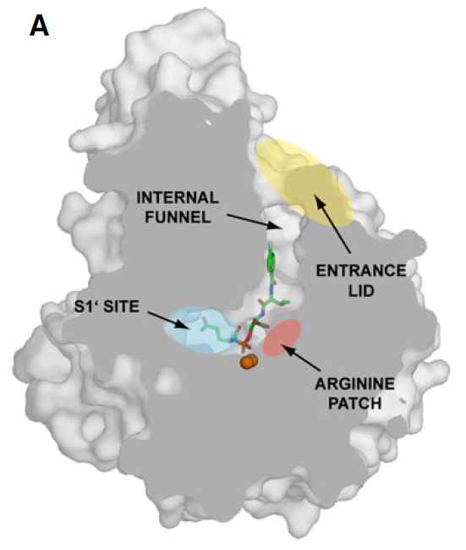
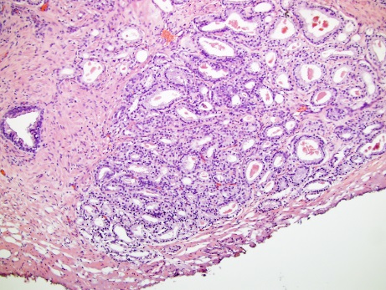
PSMA
Prostate-specific membrane antigen
Target selection

Slide 18
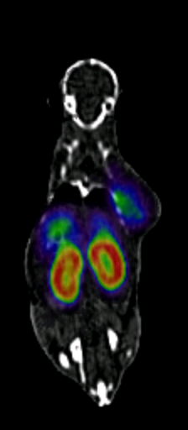
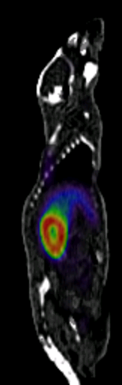
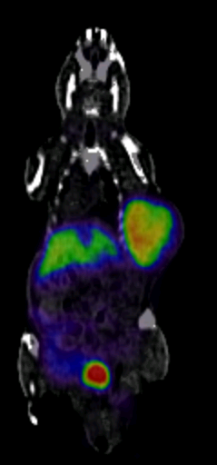
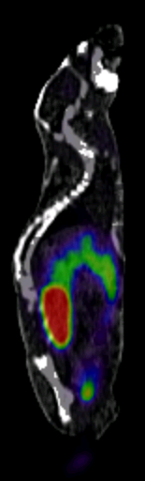
PSMA
Prostate-specific membrane antigen
Preclinical evaluation
PC-3 (PSMA-) LNCap C4-2 (PSMA+)
INM-5; University of Cologne; Institute of Radiochemistry and Experimental Molecular Imaging (IREMB)

Slide 19
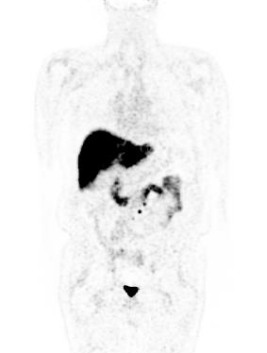
PSMA
Prostate-specific membrane antigen
PSMA PET imaging
INM-5; UoC
¹⁸F-JK-PSMA-7

Slide 20
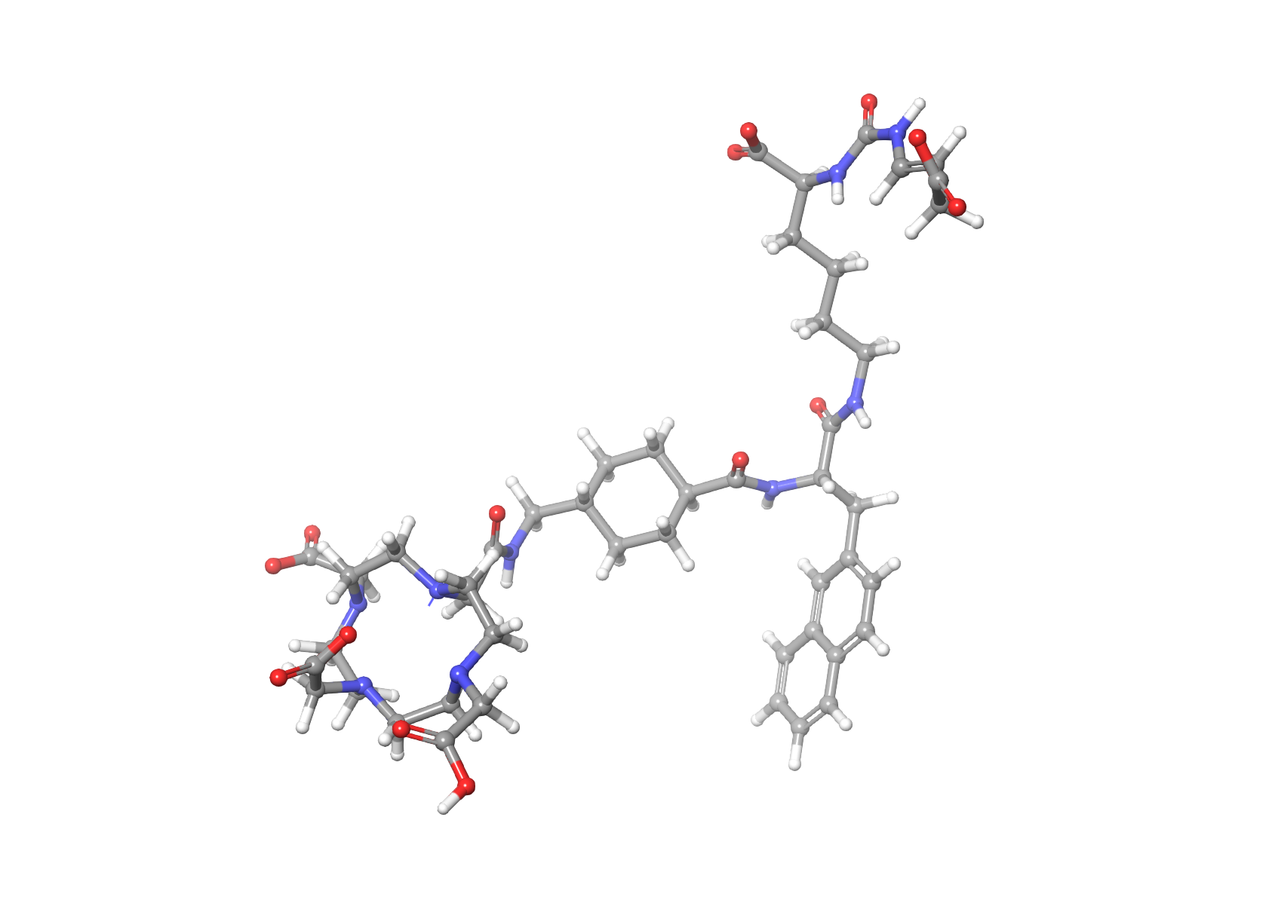

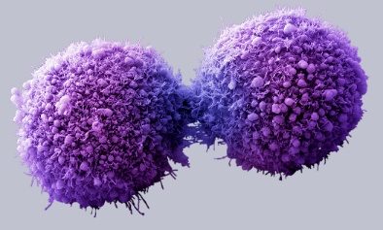
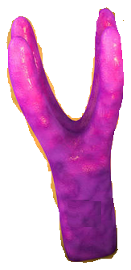

Theranostics
Therapy and diagnostics in one
Paradigm shift: combination of therapy and diagnostics
Change of therapy management –
high precison medicine
Molecular targets: PSMA (Pca), FAP
(pancreas, breast and ovarian cancer), kynurenine-pathway (colon cancer)
Target vectors: PSMA-inhibitors, FAP-inhibitors, tryptophan-analogues
Target vector
small molecule or biopolymer
Radionuclide
diagnostic or therapeutic radionuclide
Molecular target
Cancer cell
THERAPY
DIAGNOSTICS
Individualized therapy and improved patient care

Slide 21
Theranostics
Therapy and diagnostics in one
Paradigm shift: combination of therapy and diagnostics
Change of therapy management –
high precison medicine
Molecular targets: PSMA (Pca), FAP
(pancreas, breast and ovarian cancer), kynurenine-pathway (colon cancer)
Target vectors: PSMA-inhibitors, FAP-inhibitors, tryptophan-analogues
Target vector
small molecule or biopolymer
Radionuclide
diagnostic or therapeutic radionuclide
Molecular target
Cancer cell
THERANOSTICS
Individualized therapy and improved patient care

Slide 22
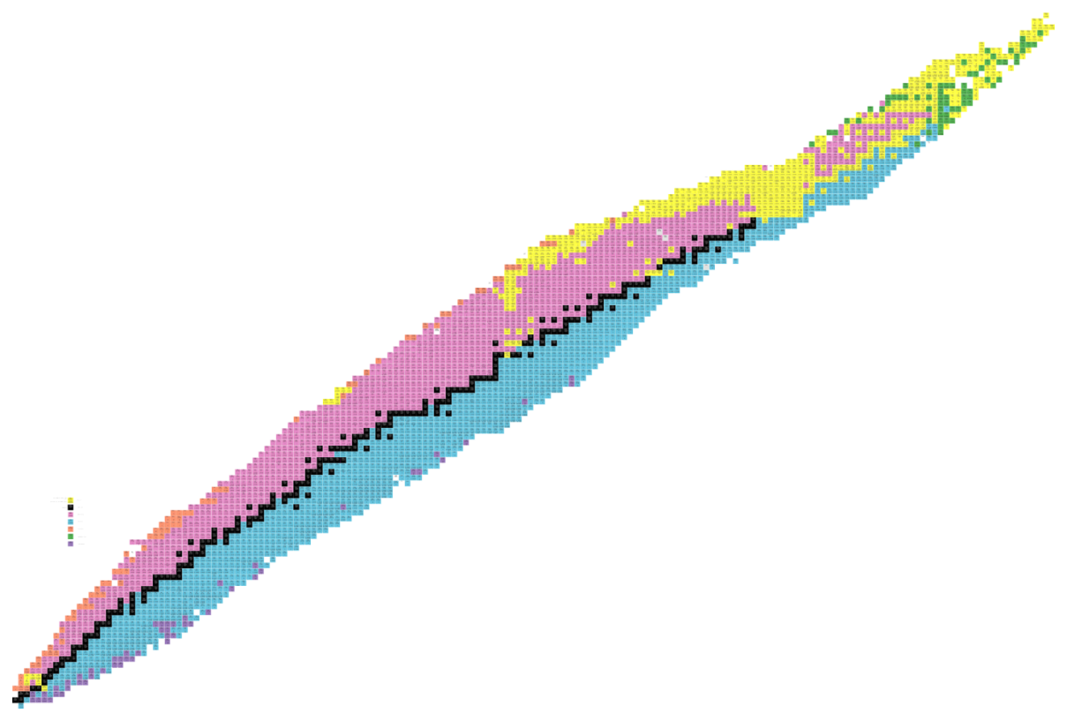
Theranostic radionuclides
RADIONUCLIDE
Diagnostic | Particle | Therapy | Particle
Sc-44 | β⁺ (511 KeV) | Sc-47 | β⁻ (162 KeV)
Cu-61/64 | β⁺ (511 KeV) | Cu-67 | β⁻ (141 KeV)
Ga-68 | β⁺ (511 KeV) | Ga-67 | Auger (0.04-9.5 KeV)
(I-124) | β⁺ (511 KeV) | At-211 | α (5867 KeV)
Y-86 | β⁺ (511 KeV) | Y-90 | β⁻ (935 KeV)
([AlF-18]) | β⁺ (511 KeV) | Lu-177 | β⁻ (498 KeV)

Slide 23
α-Therapy hub
²¹¹At-production and chemistry

Slide 24
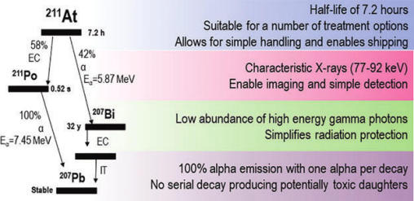


α-Therapy hub
²¹¹At-production and chemistry
Copenhagen
Nantes

Slide 25
FUTURE
OF
RADIOCHEMISTRY
Go to Future

Slide 26
RC
SHAPING THE FUTURE OF RADIOCHEMISTRY
1
Lab on a Chip
2
High-Throughput
is a device that integrates one or several laboratory functions on a single integrated circuit (chip) of only millimeters to a few square centimeters to achieve automation
a technique that allows the execution of large numbers of experiments to be conducted in parallel while requiring less effort per experiment when compared to traditional means of experimentation
3
DoE
4
CA Tracer design
is the design of any task that aims to describe and explain the variation of information under conditions that are hypothesized to reflect the variation
includes finding, developing and analyzing medicines and related biological active compounds by computer methodologies. The use of CADD methodologies speeds up the early stages of chemical development while guiding and speeding up drug discovery
Notes:
“Design of Experiments” (DoE) is a statistical toolset that aims to provide a detailed model of processes’ performance with respect to multiple experimental variables (factors) while minimizing the number of optimization experiments.

Slide 27
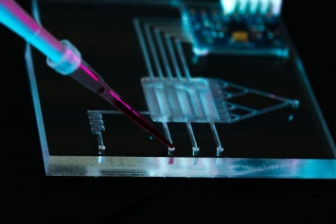
RC
SHAPING THE FUTURE OF RADIOCHEMISTRY
1
Lab on a Chip
2
High-Throughput
is a device that integrates one or several laboratory functions on a single integrated circuit (chip) of only millimeters to a few square centimeters to achieve automation
a technique that allows the execution of large numbers of experiments to be conducted in parallel while requiring less effort per experiment when compared to traditional means of experimentation
3
DoE
4
CA Tracer design
is the design of any task that aims to describe and explain the variation of information under conditions that are hypothesized to reflect the variation
includes finding, developing and analyzing medicines and related biological active compounds by computer methodologies. The use of CADD methodologies speeds up the early stages of chemical development while guiding and speeding up drug discovery
Notes:
“Design of Experiments” (DoE) is a statistical toolset that aims to provide a detailed model of processes’ performance with respect to multiple experimental variables (factors) while minimizing the number of optimization experiments.

Slide 28
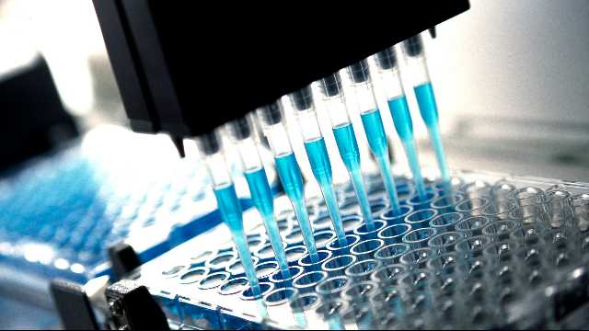
RC
SHAPING THE FUTURE OF RADIOCHEMISTRY
1
Lab on a Chip
2
High-Throughput
is a device that integrates one or several laboratory functions on a single integrated circuit (chip) of only millimeters to a few square centimeters to achieve automation
a technique that allows the execution of large numbers of experiments to be conducted in parallel while requiring less effort per experiment when compared to traditional means of experimentation
3
DoE
4
CA Tracer design
is the design of any task that aims to describe and explain the variation of information under conditions that are hypothesized to reflect the variation
includes finding, developing and analyzing medicines and related biological active compounds by computer methodologies. The use of CADD methodologies speeds up the early stages of chemical development while guiding and speeding up drug discovery
Notes:
“Design of Experiments” (DoE) is a statistical toolset that aims to provide a detailed model of processes’ performance with respect to multiple experimental variables (factors) while minimizing the number of optimization experiments.

Slide 29
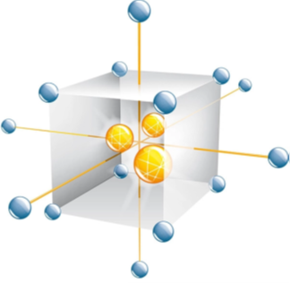
RC
SHAPING THE FUTURE OF RADIOCHEMISTRY
1
Lab on a Chip
2
High-Throughput
is a device that integrates one or several laboratory functions on a single integrated circuit (chip) of only millimeters to a few square centimeters to achieve automation
a technique that allows the execution of large numbers of experiments to be conducted in parallel while requiring less effort per experiment when compared to traditional means of experimentation
3
DoE
4
CA Tracer design
is the design of any task that aims to describe and explain the variation of information under conditions that are hypothesized to reflect the variation
includes finding, developing and analyzing medicines and related biological active compounds by computer methodologies. The use of CADD methodologies speeds up the early stages of chemical development while guiding and speeding up drug discovery
Notes:
“Design of Experiments” (DoE) is a statistical toolset that aims to provide a detailed model of processes’ performance with respect to multiple experimental variables (factors) while minimizing the number of optimization experiments.

Slide 30
RC
SHAPING THE FUTURE OF RADIOCHEMISTRY
1
Lab on a Chip
2
High-Throughput
is a device that integrates one or several laboratory functions on a single integrated circuit (chip) of only millimeters to a few square centimeters to achieve automation
a technique that allows the execution of large numbers of experiments to be conducted in parallel while requiring less effort per experiment when compared to traditional means of experimentation
3
DoE
4
CA Tracer design
is the design of any task that aims to describe and explain the variation of information under conditions that are hypothesized to reflect the variation
includes finding, developing and analyzing medicines and related biological active compounds by computer methodologies. The use of CADD methodologies speeds up the early stages of chemical development while guiding and speeding up drug discovery
Notes:
“Design of Experiments” (DoE) is a statistical toolset that aims to provide a detailed model of processes’ performance with respect to multiple experimental variables (factors) while minimizing the number of optimization experiments.

Slide 31
დიდი მადლობა
Nuclear Chemistry
18.08.2025 | Institute of Neuroscience and Medicine – INM-5| Swen Humpert

