Slide 1


Slide 2


QUALI-Start-Up Lectures
2024:
2025:
SMART|Labs: Introduction & Overview
Hans Ströher

Slide 3
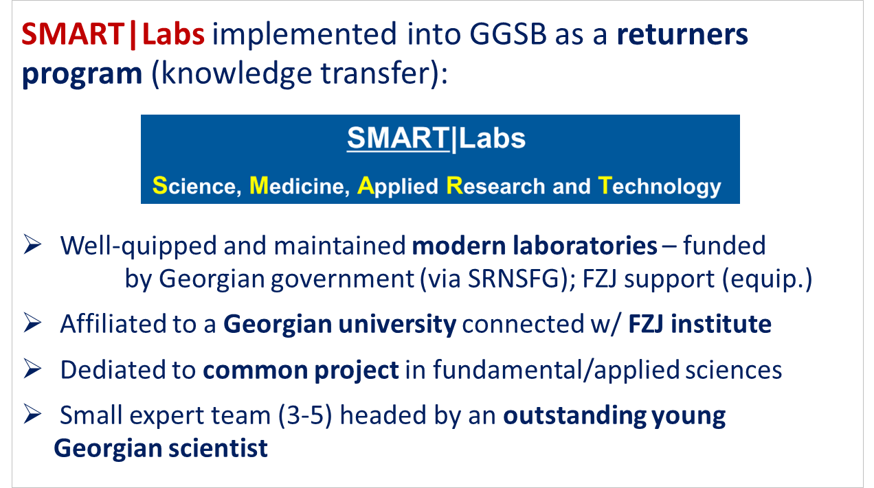
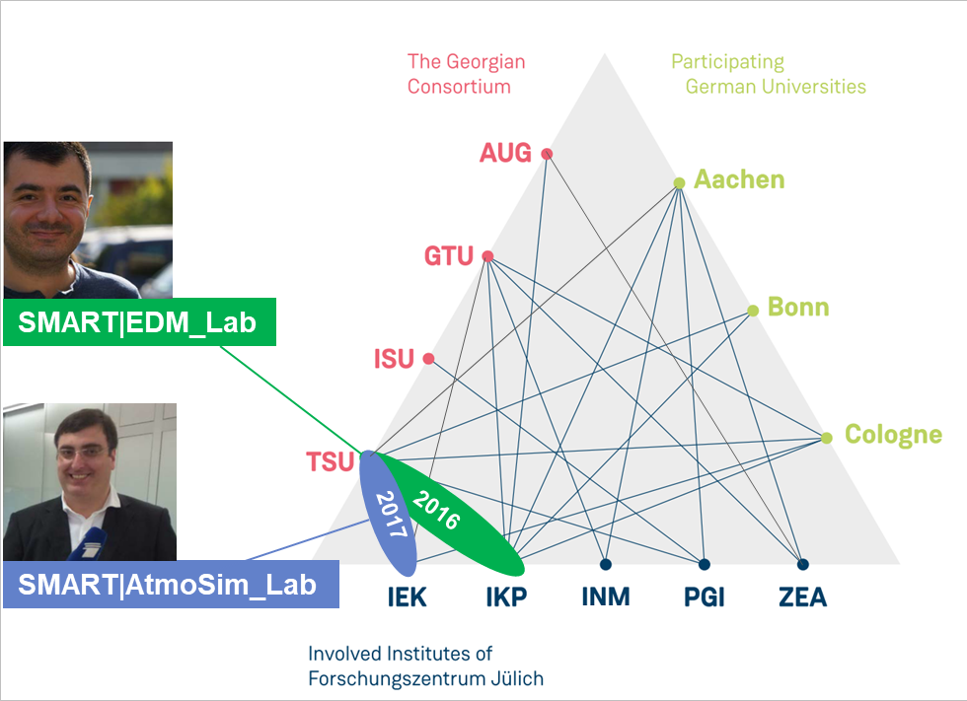
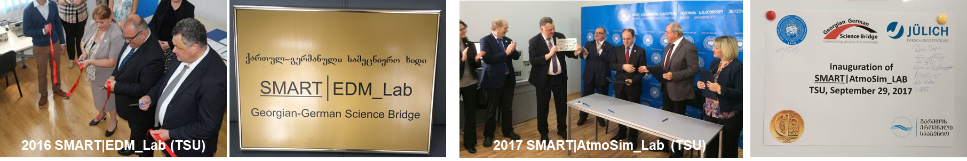
GGSB: SMART|Labs – Overview

Slide 4

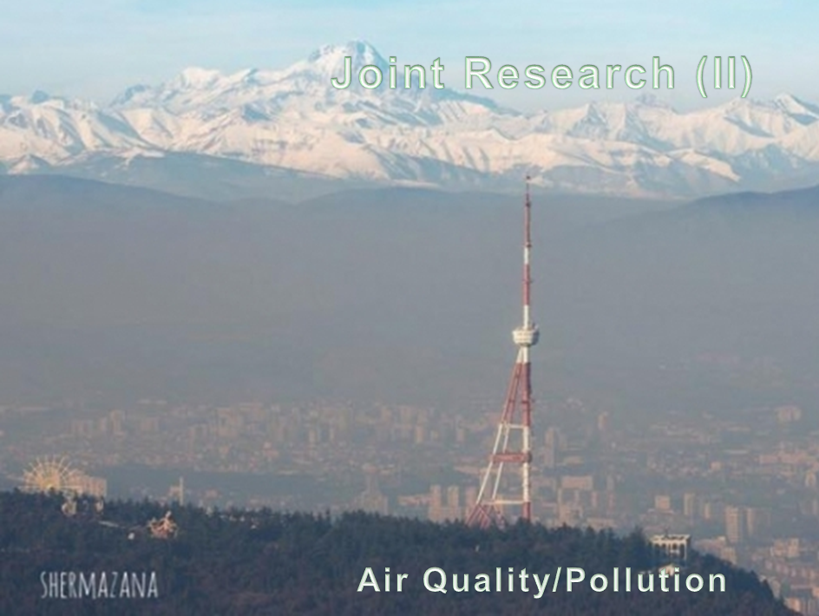
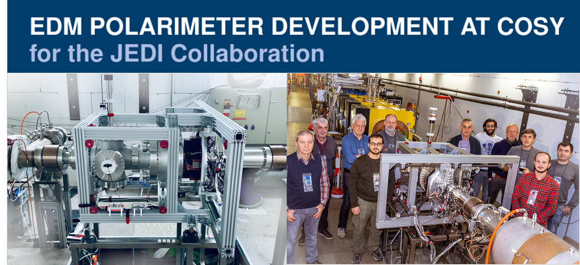
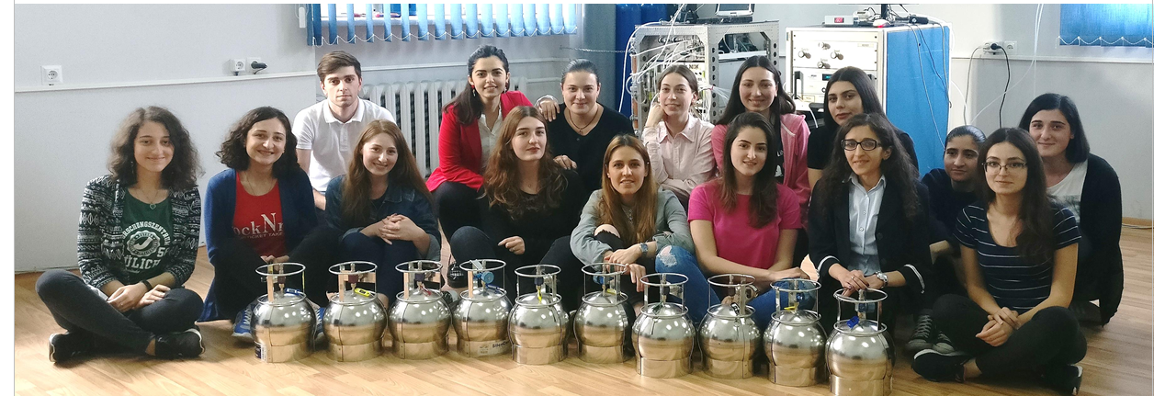
GGSB: SMART|Labs – Science Cases

Slide 5


GGSB: SMART|Labs – Status and Plans
SMART|EDM_Lab TSU David Mchedlishvili (Returner) Science Min
SMART|AtmoSim_Lab TSU Giorgi Jibuti (TSU staff) Tbilisi City
SMART|DigitalDevelopment_Lab AUG Zaza Metreveli (AUG staff) Volkswagen
SMART|MedicalImaging_TrainingLab GTU Tamo Xechiashvili ?

Slide 6
GGSB: SMART|Labs – Overview
New definition/working scheme:
Scientific and technological cooperations
  between Georgian and German partners
  (scientists, engineers, institutions) on a
  specific item
But:
Dedicated laboratory in Georgia not required
Affiliation w/ Georgian university not necessary
Young Georgian scientific leader preferable
but not mandatory
→ Virtual laboratories for science projects

Slide 7
GGSB: SMART|Labs – Future
SMART|EDM_Lab TSU David Mchedlishvili (Returner) Science Min
SMART|AtmoSim_Lab TSU Giorgi Jibuti (TSU staff) Tbilisi City
SMART|DigitalDevelopment_Lab AUG Zaza Metreveli (AUG staff) Volkswagen
SMART|MedicalImaging_TrainingLab GTU Tamo Xechiashvili ?
SMART|Biomarker_Lab [Bernd Neumaier (FZJ), Bezhan Chankvetadze (TSU), … (HZDR)]
SMART|BiomedicalImaging_Lab [Jon Shah, Hanno Scharr (FZJ), Ramaz Botchorishvili (KIU), …]
SMART|Tech_Lab [Ghaleb Natour, Harald Glückler (FZJ), Zaza Metreveli (AUG), …]

Slide 9
GGSB Organigram
(Draft, 2025)
GGSB Speaker
Prof. Dr. Sebastian M. Schmidt (HZDR)
Coordinator FZJ
Prof. Dr. Bernd Neumaier
Coordinator GSI
Dr. Irakli Keshelashvili
Coordinator HZDR
Dr. Sandra Hamann
Liason (Georgia, Germany): Dr. Andro Kacharava
Partners in Georgia

