Slide 1
Research for the World of Tomorrow
The Helmholtz-Zentrum Dresden-Rossendorf

Slide 2


GGSB Meeting @HZDR
მოგესალმებით @HZDR
Today
Introduction into excisting SMART Labs
Tuesday
presentation of HZDR topics & liquid metal technologies
lab visits material science
Wednesday
visit of OncoRay
ENERGY
MATTER
HEALTH

Slide 3
GGSB Meeting @HZDR
მოგესალმებით @HZDR
Thursday
presentation of HZDR topics & radiopharmacy,
lab visits DRESDYN,
astrophysics
Friday
visit of large scale facilities ELBE and HLD
MATTER
HEALTH
MATTER

Slide 4
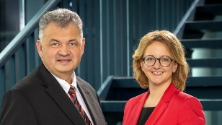
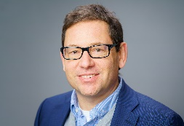
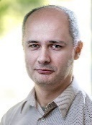
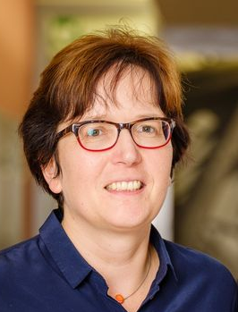
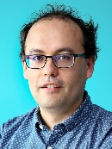
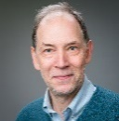
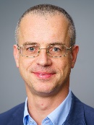
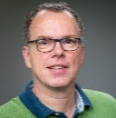
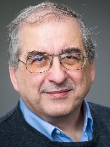
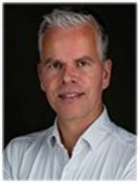
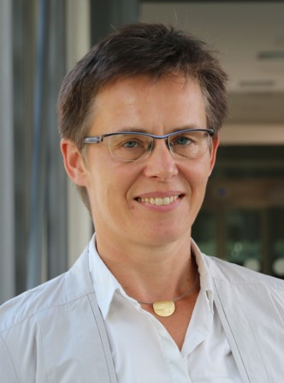
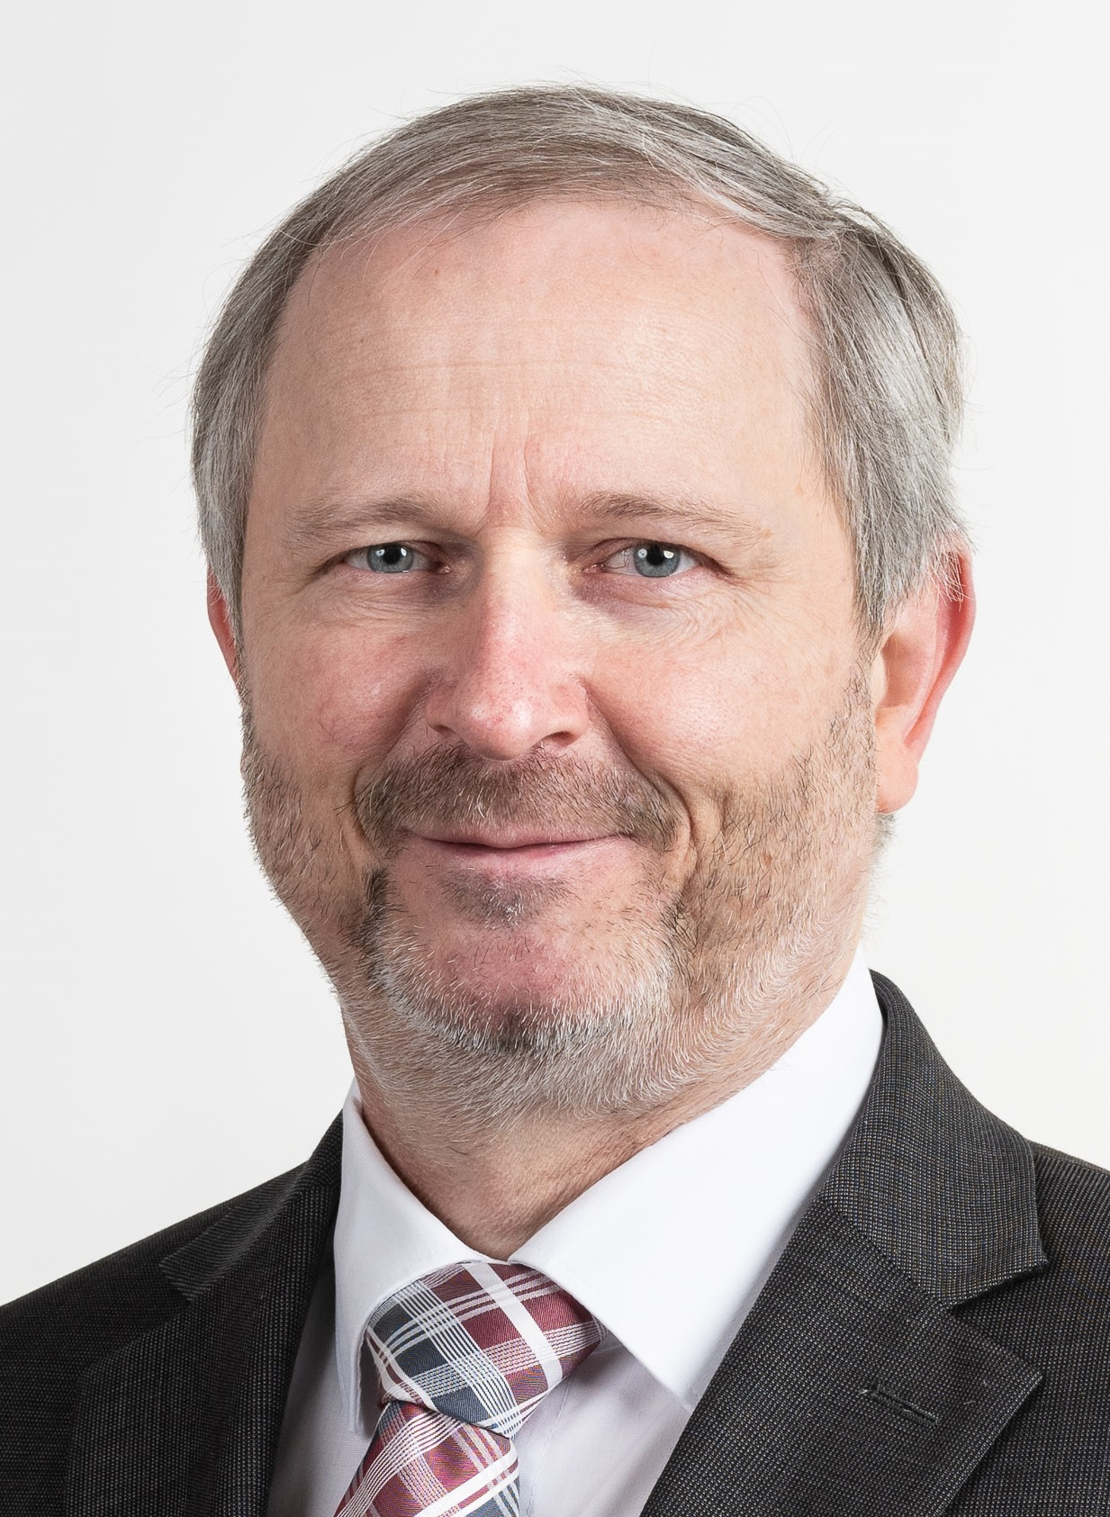
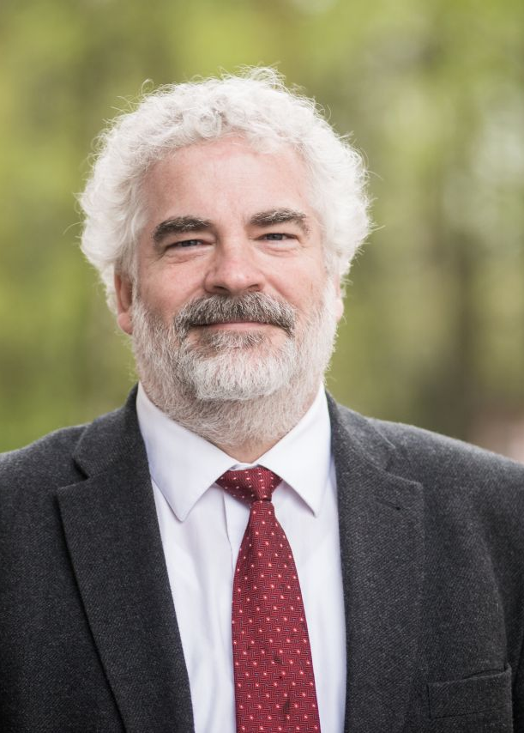
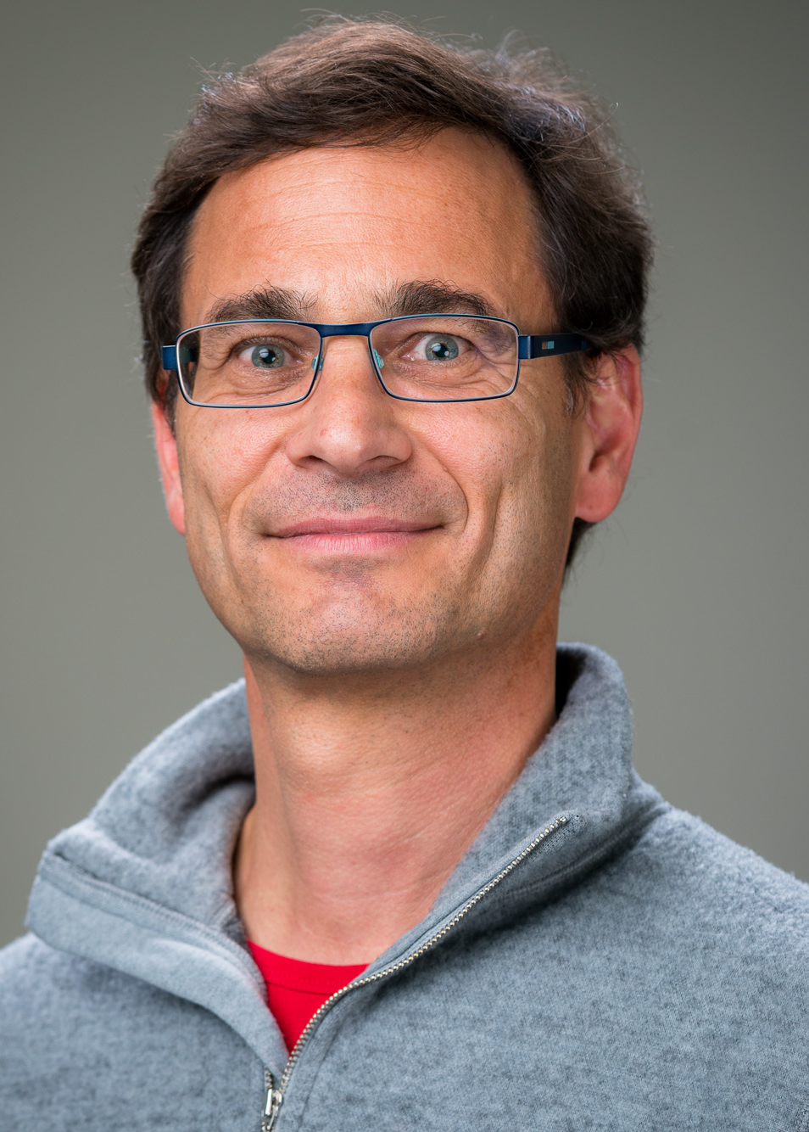
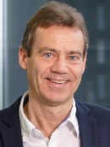
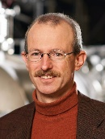
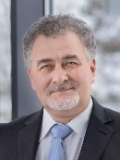
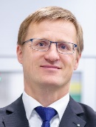
HZDR
Board of Directors
Prof. S. M. Schmidt
Dr. D. Stiller
Institutes & Central Departments
ENERGY
MATTER
HEALTH
Resource Ecology
Prof. T. Stumpf
Ion Beam Physics and Material­s Research
Prof. M. Helm
Prof. J. Fassbender
Theoretical Physics
Prof. R. Schützhold
Radiooncology - OncoRay
Prof. M. Krause
Prof. T. Kühne
CASUS
Center for Advanced Systems Understanding
HI Freiberg for Resource Technology
Prof. J. Gutzmer
Dresden High Magnetic Field Laboratory
Prof. J. Wosnitza
Radiopharmaceutical Cancer research
Prof. K. Kopka
Institutes
Fluid Dynamics
Prof. K. Eckert
Prof. U. Hampel
Radiation Physics
Prof. T. E. Cowan
Prof. U. Schramm
Information Services and Computing
Dr. U. Konrad
Research Technology
Prof. P. Kaever
Technical Services
D. Reichelt
Chief Innovation & Transfer Officer
Dr. B. Wolf
Departments
CITO

Slide 5
Summer Student Program
Project and Lectures
summer students will work on individual projects submitted by HZDR research groups.
once applications are received and participants are selected, a matching process is conducted.
series of lectures designed to provide an insight into the research in the various areas of the HZDR.
accomondation is covered, additional grant of 36€ per day
minimum length of stay is six weeks and the maximum is nine weeks

Slide 6
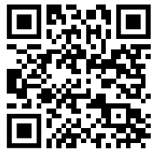
Summer Student Program
Who can apply?
All advanced undergraduate or master students of natural sciences
(physical and life sciences) or related areas.
Deadline for applications
Students should apply before February 28th 2026
Notification of acceptance: Middle of April 2026
Contact and more information
Yvonne Matthes - International Office
summer@hzdr.de

