Slide 1
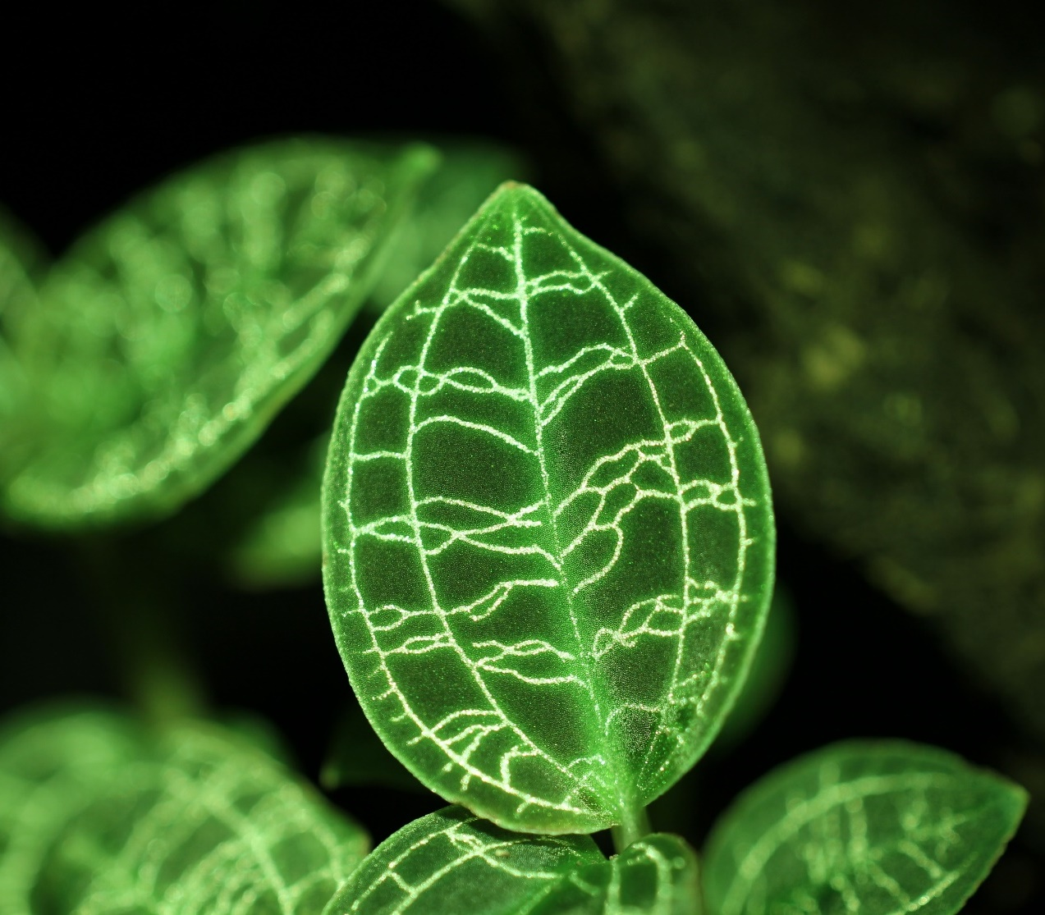
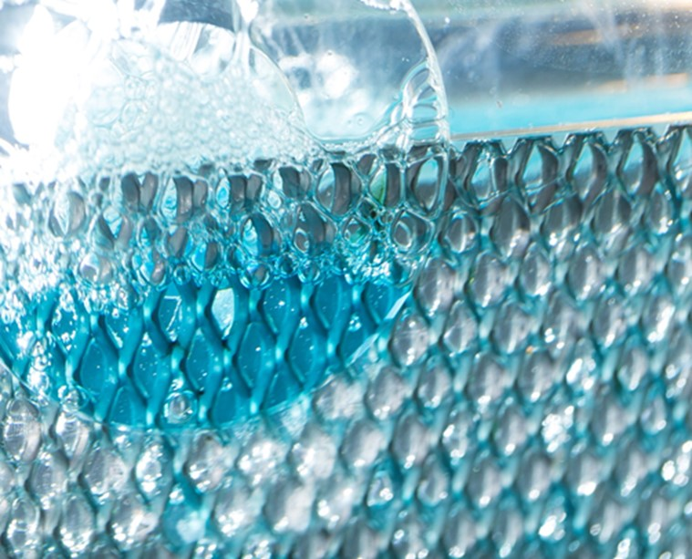
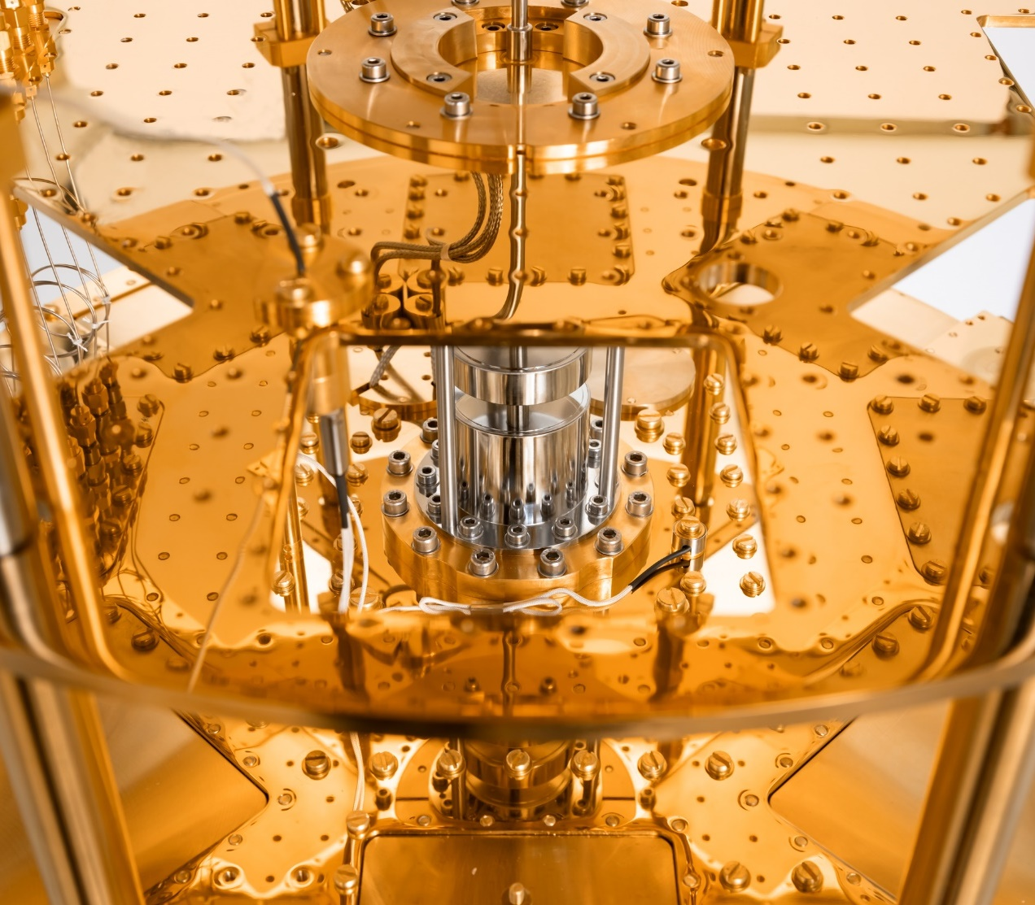
GGSB Meeting 2025 | QUALI-Start-up lectures
Possibilites At Forschungszentrum Jülich
18.08.2025| Dr. Harald Glückler

Slide 2

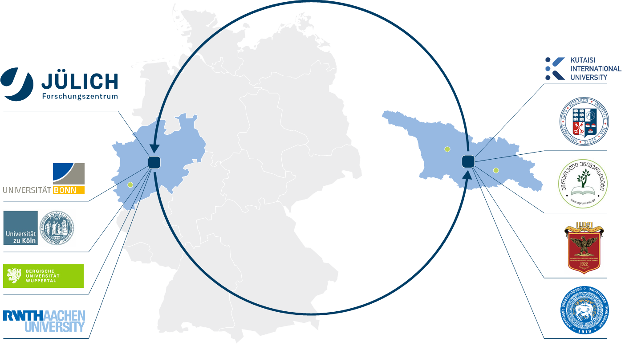

Georgian-German Science Bridge
Steadily growing

Slide 3
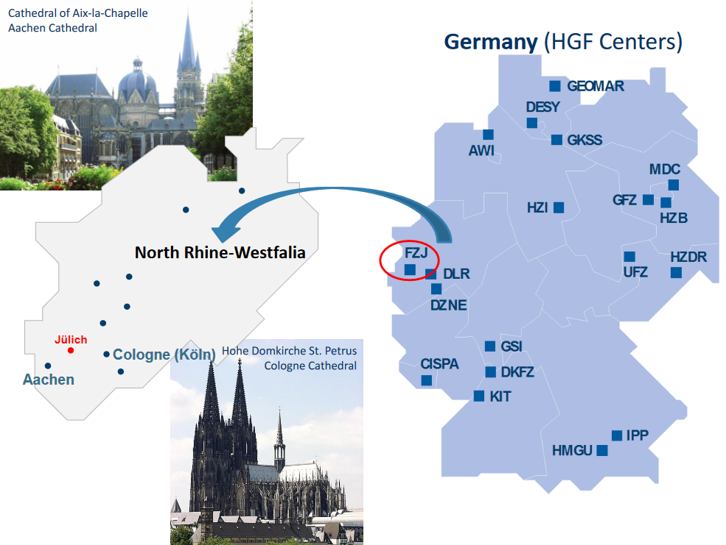
Forschungszentrum JÜlich | Location
18.08.2025

Slide 4




German research organisations
Missions
Focus on fundamental research
Focus on “application-inspired” basic research
Focus on applied research
18.08.2025

Slide 5
Helmholtz Association
18 Helmholtz Centers in Germany –
Forschungszentrum Jülich is one of them
Employees
45,000 (in 18 centers)
Budget
€ 5.9 billion Euros (of which more than 30 % external funding)
18.08.2025

Slide 6
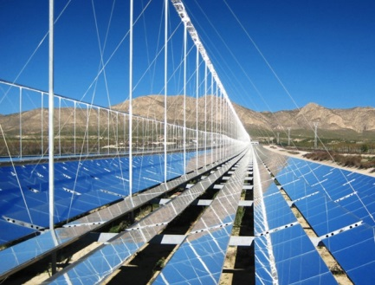
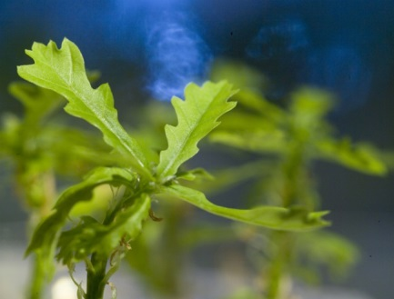
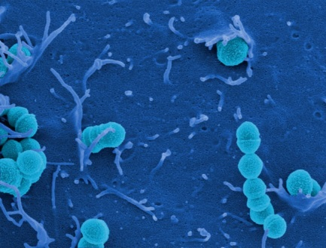
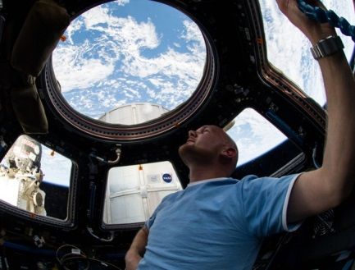


Helmholtz Association
Forschungszentrum Jülich: a Member of the Helmholtz Association
Energy
Earth & Environment
Health
©DLR
©UFZ
©HZI
©DLR
©GSI
©fotolia.de#100741115_S_Datenpaket
Aeronautics, Space &
Transport
Matter
Information
18.08.2025

Slide 7
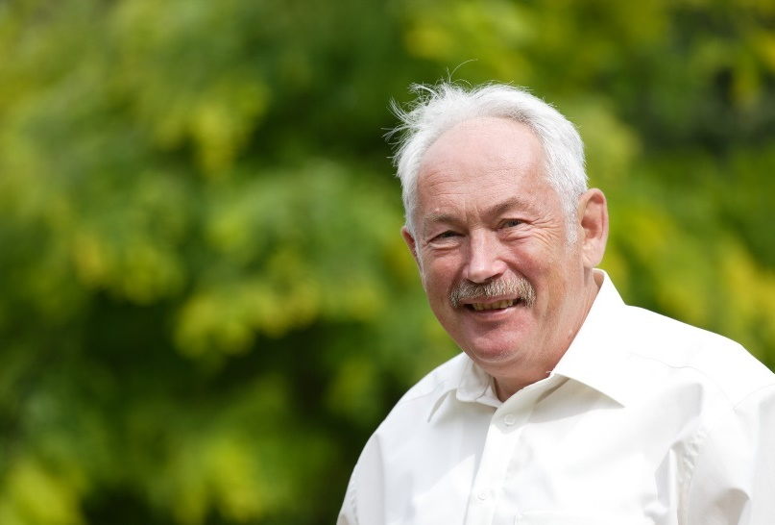
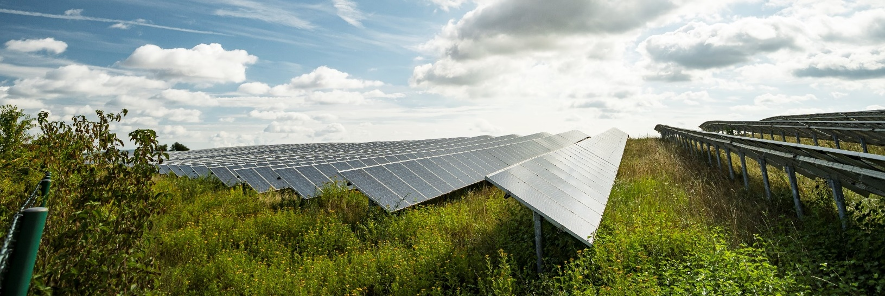
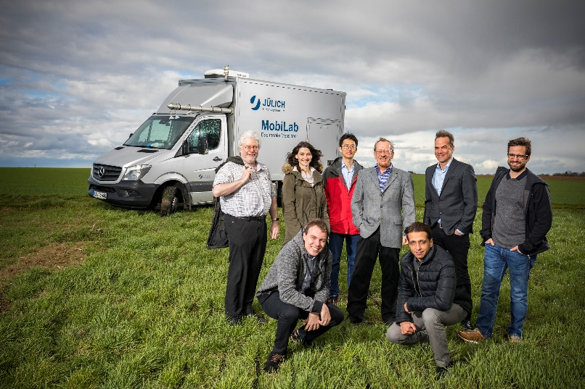
ForscHungszentrum Jülich At first glance
Year of foundation 1956
Nobel Prize in Physics in 2007: Peter Grünberg
Around 7200 employees
Over 2900 scientists
Over 1600 people in technical and laboratory professions
More then 800 PhD students
1540 colleagues in the project management agencies
Over 1100 guest scientists from 66 countries
Research campus
15 institutes
over 2,2 qkm
16 large-scale research facilities
Budget:
€ 964 Millionen in 2024
Shareholders: Federal Government (90%) and state of NRW (10%)
18.08.2025

Slide 8
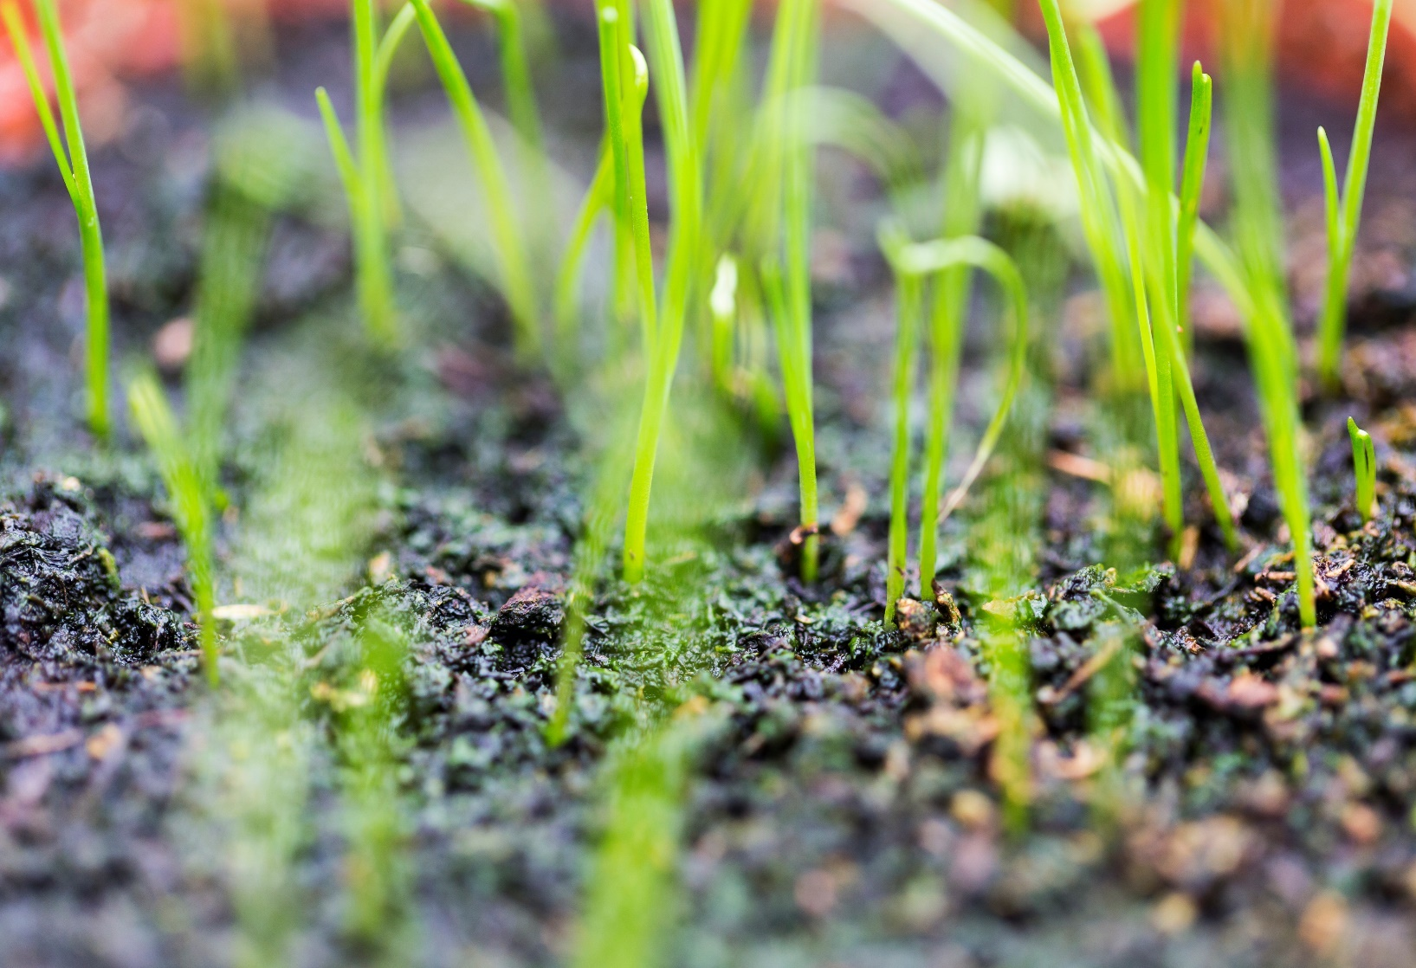
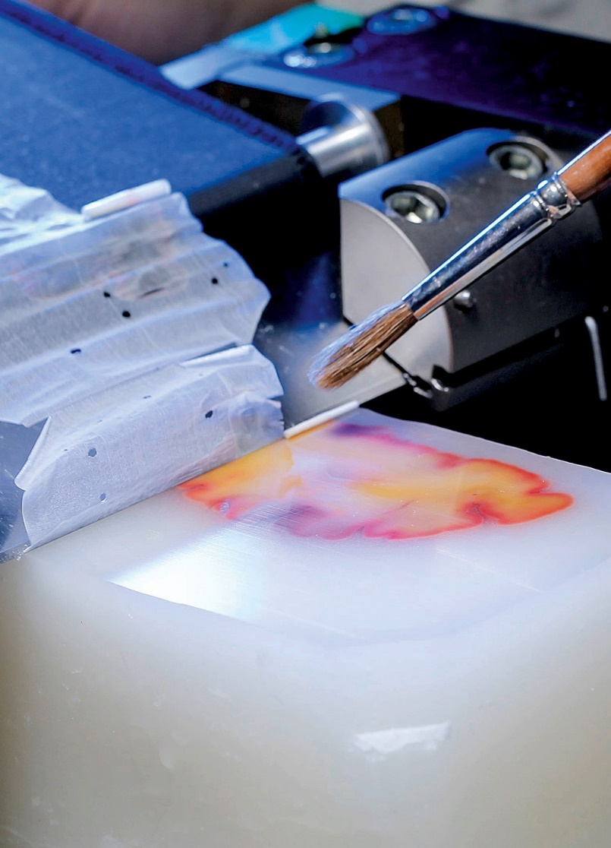
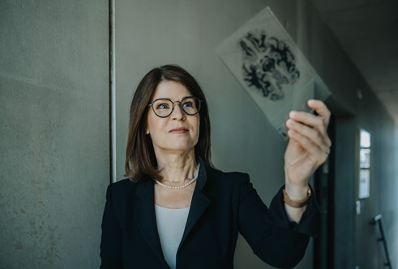
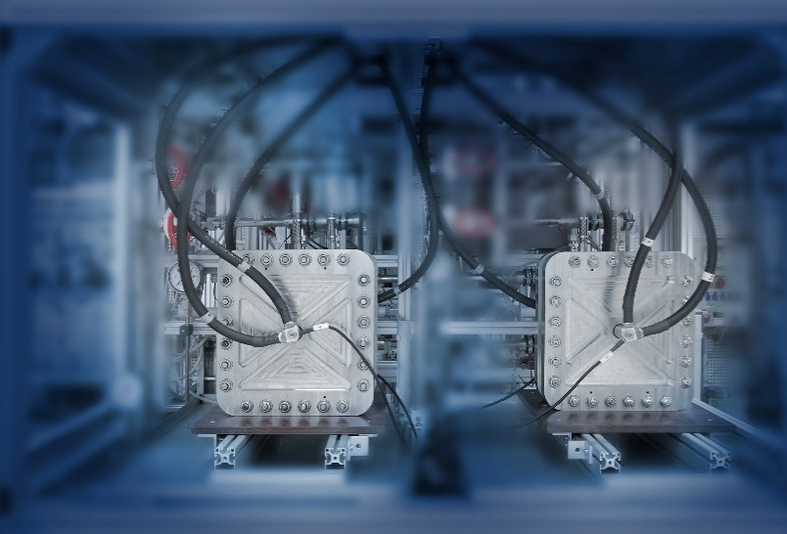
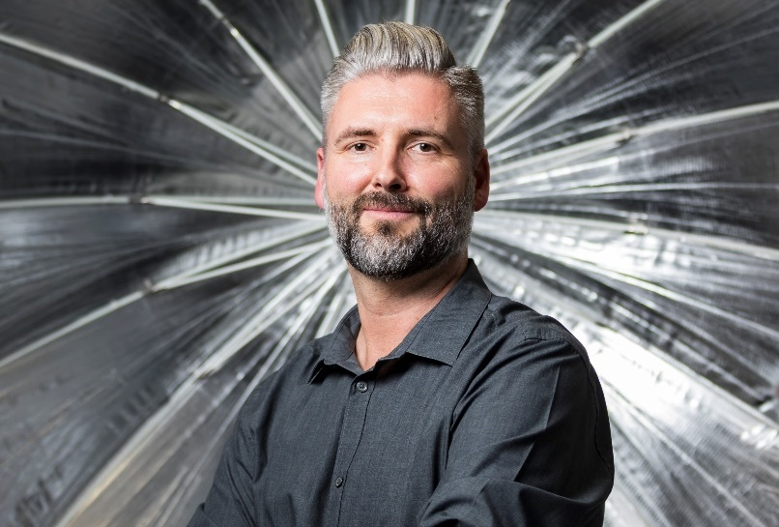
ForscHungszentrum Jülich At first glance
Information
Energy
Bioeconomy
Research priorities

Slide 9
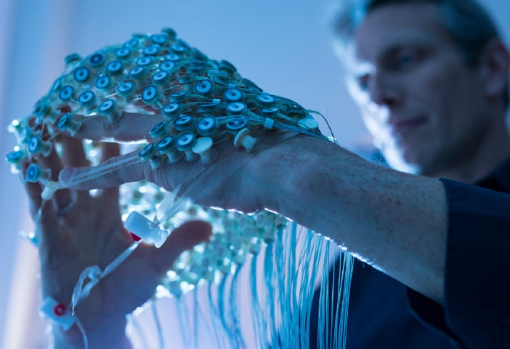
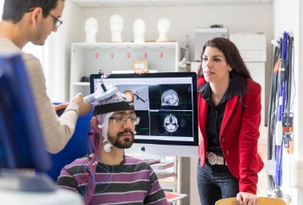
Information
Our fields of research
Beyond digital:
We develop information technologies of the future, such as quantum computing and neuromorphic computing.
We study the structure, organization, functions, and cognitive processes in healthy and diseased brains.
We develop, build, and operate supercomputers,
which we use to analyse large amounts of data in order to model and simulate complex systems.
We research the processing of information in natural and artificial systems.

Slide 10
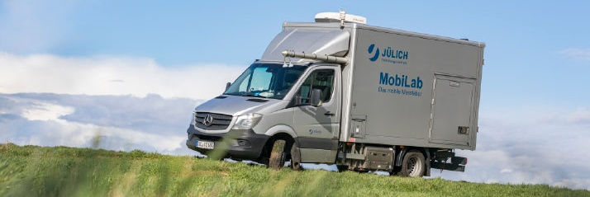
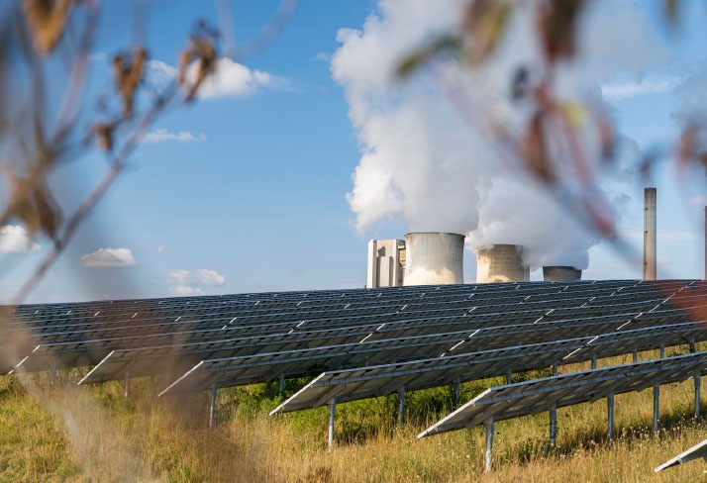
Energy
Our fields of research
… by integrating new components into innovative process chains,
We conduct research for a climate-friendly energy system
by developing new materials,
… and by achieving a holistic view of the system,
… and also take into account air quality and climate.

Slide 11
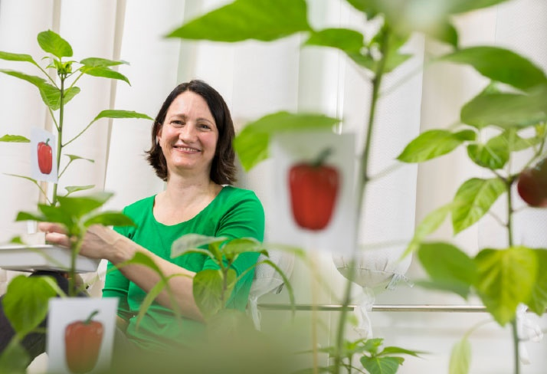
Bioeconomy
Our fields of research
Sustainable production based on plant and microbial processes.
Sustainable use of the natural resources of soil and water.
We conduct research for a resource-efficient economic system
We analyse and optimize material cycles and energy use.
… to meet the growing demand for food, raw materials, and energy in a sustainable way.

Slide 12
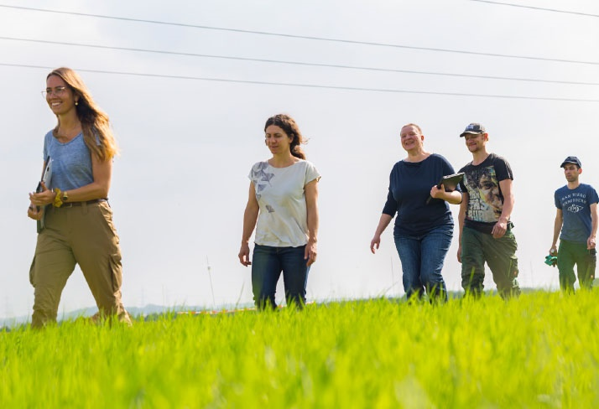
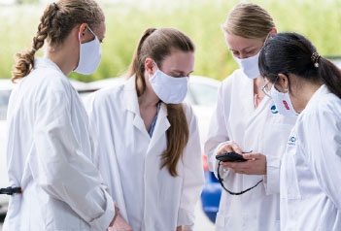
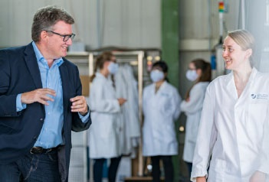
We work Hand in Hand
Integrated in a network:
157 joint appointments with 18 universities in Germany and Europe
Interdisciplinary:
physics,
computer science,
biology,
medicine,
chemistry,
engineering,
neuroscience,
mathematics,
informatics,
geology,
social sciences (…)
Diversity is a requirement for success in our work.

Slide 13
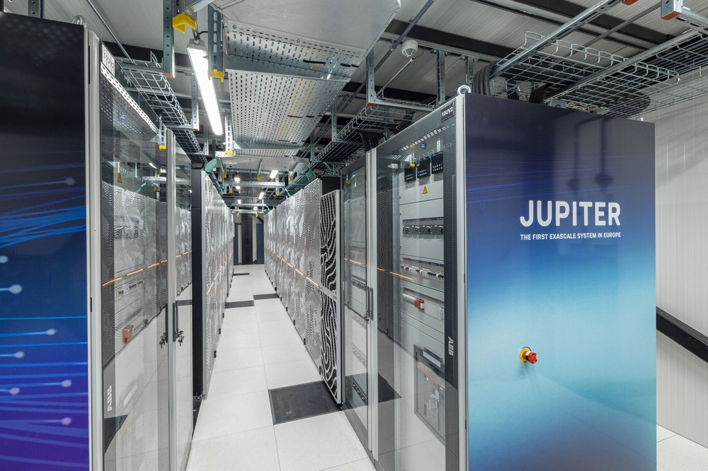
Infrastructure
Unique scientific infrastructure for the benefit of an international user community, i.e.
• Ernst Ruska-Centre for Microscopy and Spectroscopy with Electrons (ERC)
• Jülich Supercomputing Centre (JSC)
• Jülich Centre for Neutron Science (JCNS)
• Helmholtz Nano Facility (HNF)
• SAPHIR atmospheric simulation chamber

Slide 14
Georgian-german science bridge
THREE PILLARS
Joint Research
Collaboration with joint research projects in Hadron Physics, Climate Research, Engineering, AI, Medical Imaging, …
Expand collaborations (HZDR, GSI, …)
Educational Training
Joint Master- &
PhD program (18 & 19)
Knowledge Transfer
Cotutelle de thèse program (1)
Scientific Workshops (9)
Lecture courses
Internships (65) as of 2023
SMARTLabs to return Alumni in Georgian Universities
Training Courses

Slide 15
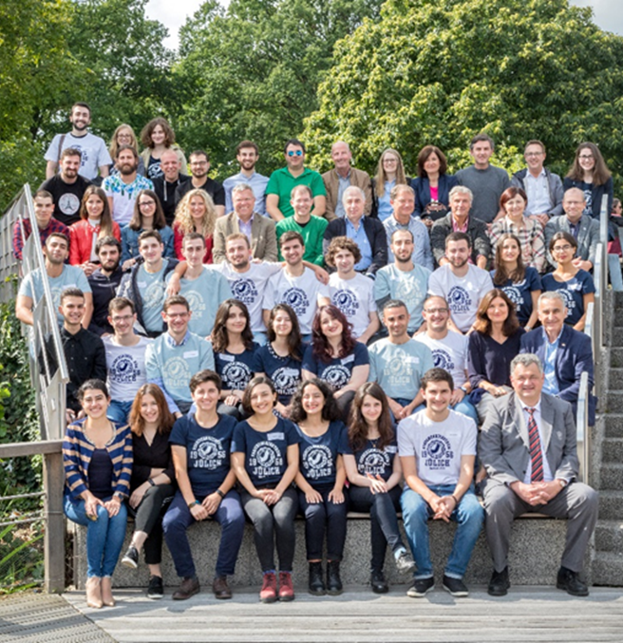
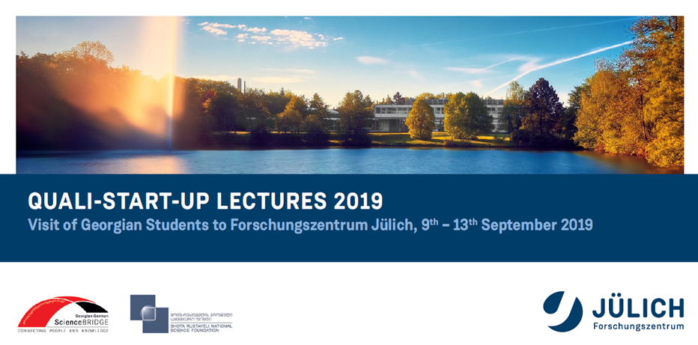

We promote young talent : Joint Funding
We wish to inspire young talents and give them the best possible support
30 Georgian students visited the campus in 2019, 21 in 2017
Hands-on training & lectures in several institutes

Slide 16
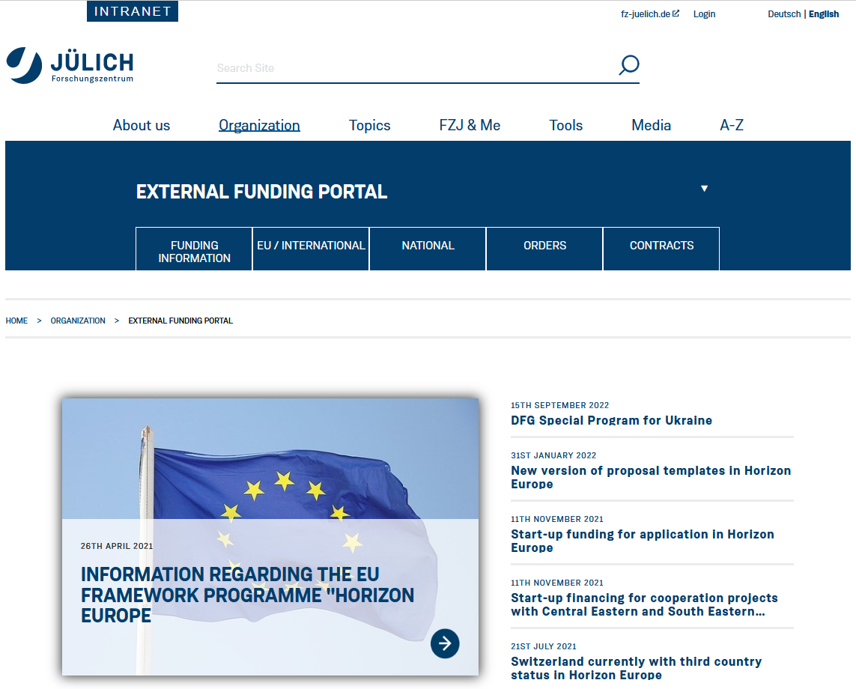
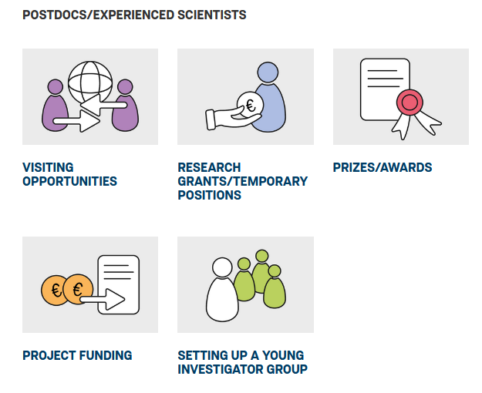
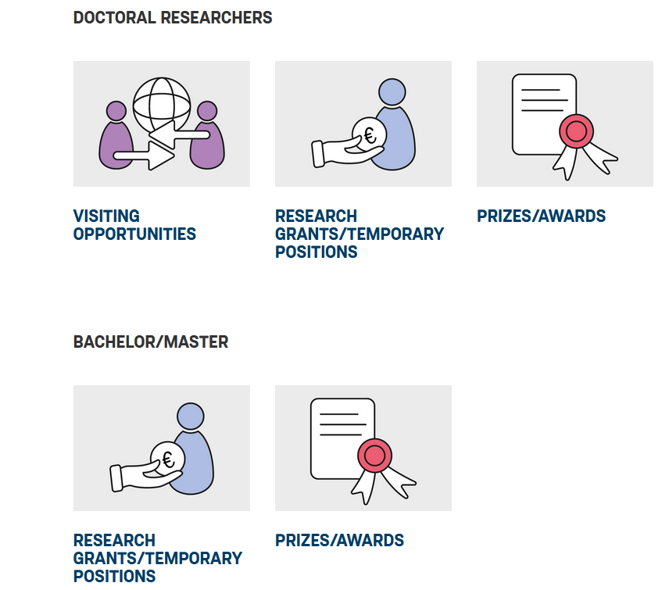
Support for young researchers
POSTDOCS/EXPERIENCED SCIENTISTS
DOCTORAL RESEARCHERS
BACHELOR/MASTER
https://intranet.fz-juelich.de/en/organization/drittmittelportal/03funding-information
https://www.fz-juelich.de/en/research/young-scientists/funding_calendar

Slide 17
Funding Avenues for Students
Scholarships and Forschungszentrum Jülich support
DAAD Regional Office Georgia https://www.daad-georgia.org/ka/; Foundations: KAS, FES
Erasmus+ and within EU-projects, VolkswagenStiftung Projects
LEPL Shota Rustaveli National Science Foundation of Georgia
GGSB STATISTICS (as of 2023)
PIs currently involved in GGSB from Georgia and Germany: 35, overall in the past ~50 PIs
Senior Scientists from Georgia and Germany: 135
Graduate Researchers from Georgia: 19 PhD | 18 Master-Studies
Schools: 5 | Workshops: 8 | Lecture Courses 5
Internships from Georgia: so far 60+ students | Funding by the participating FZ Juelich institutes

Slide 18
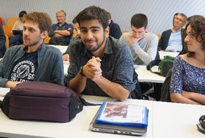
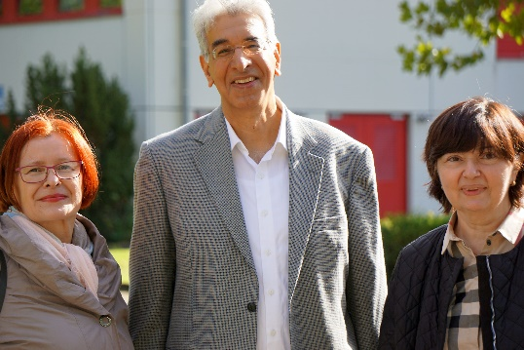
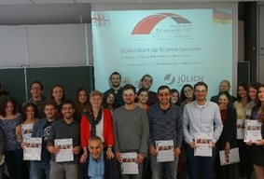
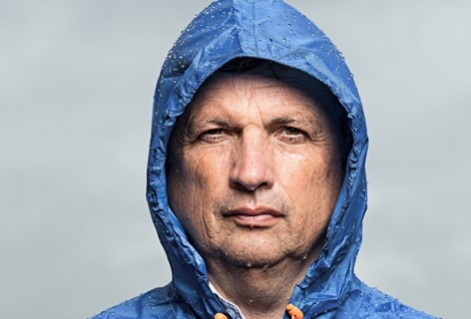
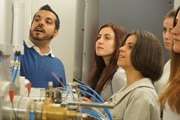

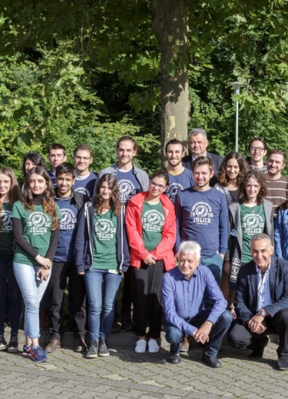
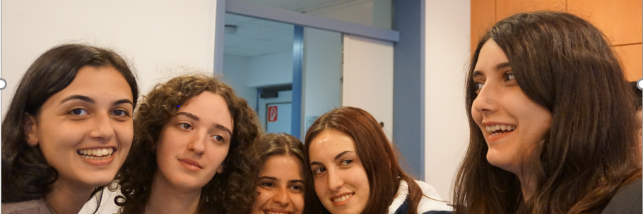
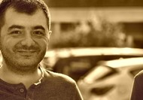
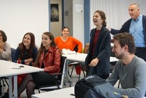
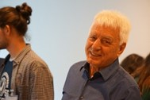
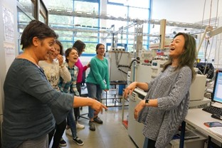
Impressions of Past Student Lectures

Slide 19



Enjoy the lectures and Discussions!

Slide 20
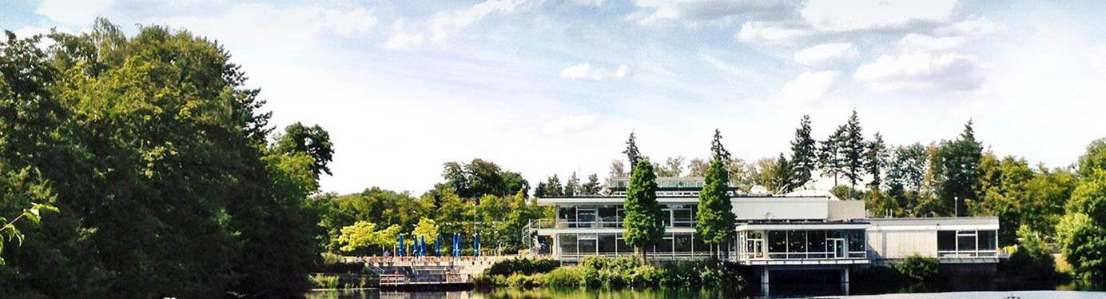
Eva Portius
Manager International Relations –
Eastern Europe, Central Asia, Middle East, Israel, India
Forschungszentrum Jülich GmbH
Corporate Development
E-Mail: e.portius@fz-juelich.de
Phone: +49 2461 61 6232
Thank you very much for your attention!

