Slide 1
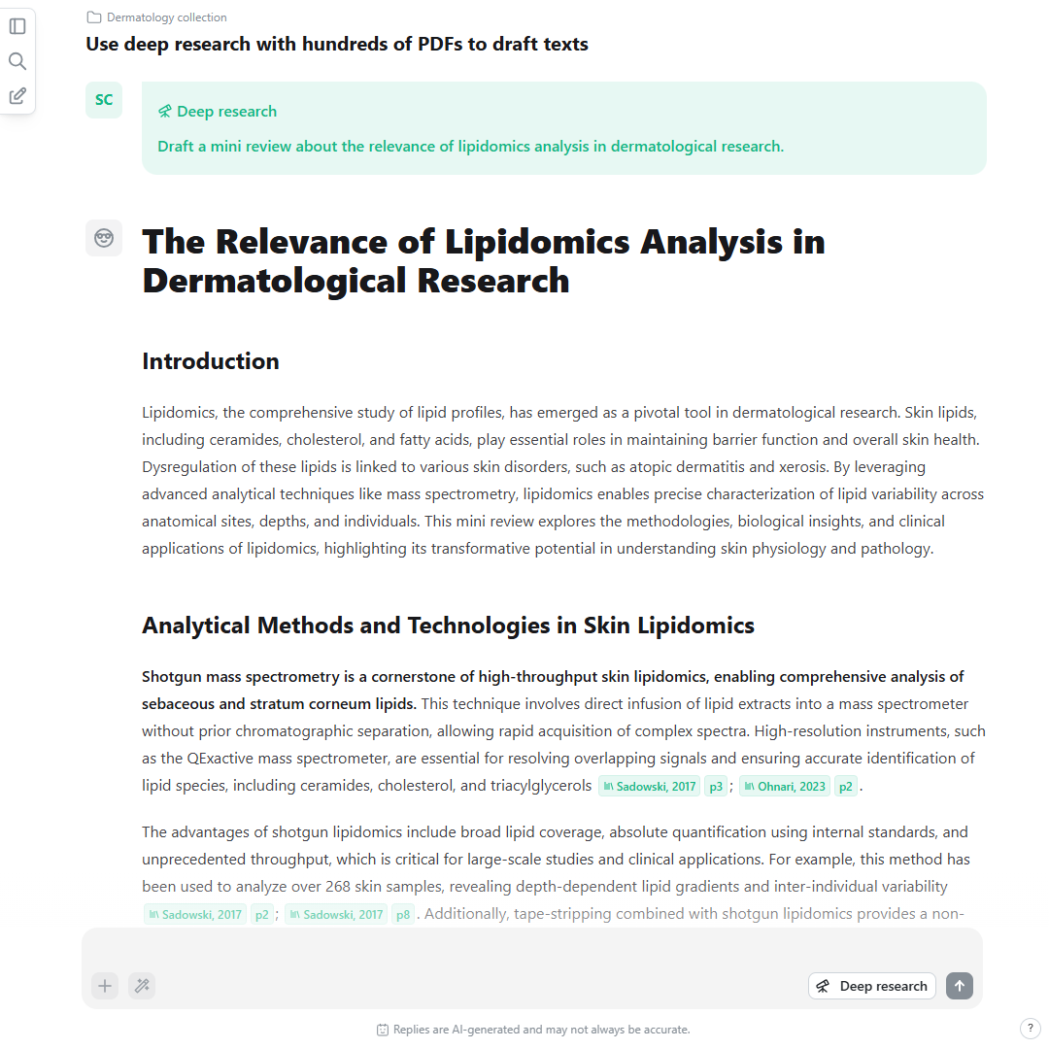
An AI research agent
for scientists with
high standards
Notes:
Hi, I am Henri.
Today, I will show you what you can do with scienceOS – the AI research agent for scientists with high standards and little time.

Slide 2



Mark Reinke
André Kischkel
Henri M Deda
AI & ML Data Science
TU Dresden & Harvard
Software Architecture
TU Dresden & HTWD
Science & Business
TU Dresden & WHU
The team developing scienceOS
Notes:
But first, who is scienceOS?
Mark + André + Henri -> 50+ Beta Testers
(no VC + no banks + no companies -> our success is only driven by creating happy users + sprinkle of marketing)

Slide 3
Collaboration
Simplicity
Where scientists can swiftly tackle global challenges.
Agility
Vision
The guiding principles of scienceOS
Notes:
The three of us, share four core values which drive us in our decision making.
Collaboration.
Simplicity.
Agility.
Vision.
We want to create a world where scientists…

Slide 4





USE CASE
PROBLEM
Scientific answers
slide 5
„I am starting a new R&D project and need to quickly gain an overview about the field.“
Ask research questions and follow-ups to dive into detail.
Explore citations
slide 14
„There are too many publications. I need to find the best and most relevant papers.“
Create citation networks and analyze how papers are cited.
Compare papers
slide 20
„I need to compare the results from several papers and assess their validity.“
Upload research papers to quickly chat with them.
Drafting texts
slide 26
„A grant application deadline is approaching. I still need to write the introduction!“
Generate answers based on your literature collection.
How scienceOS supports your research
Notes:
So, how can scienceOS actually help you with your research?
Together, we will take a journey from initiating a research project to drafting texts - from hypothesis to publication.
1 + 2 +3 + 4
[BRIDGE: Let‘s start with example 1.]

Slide 5
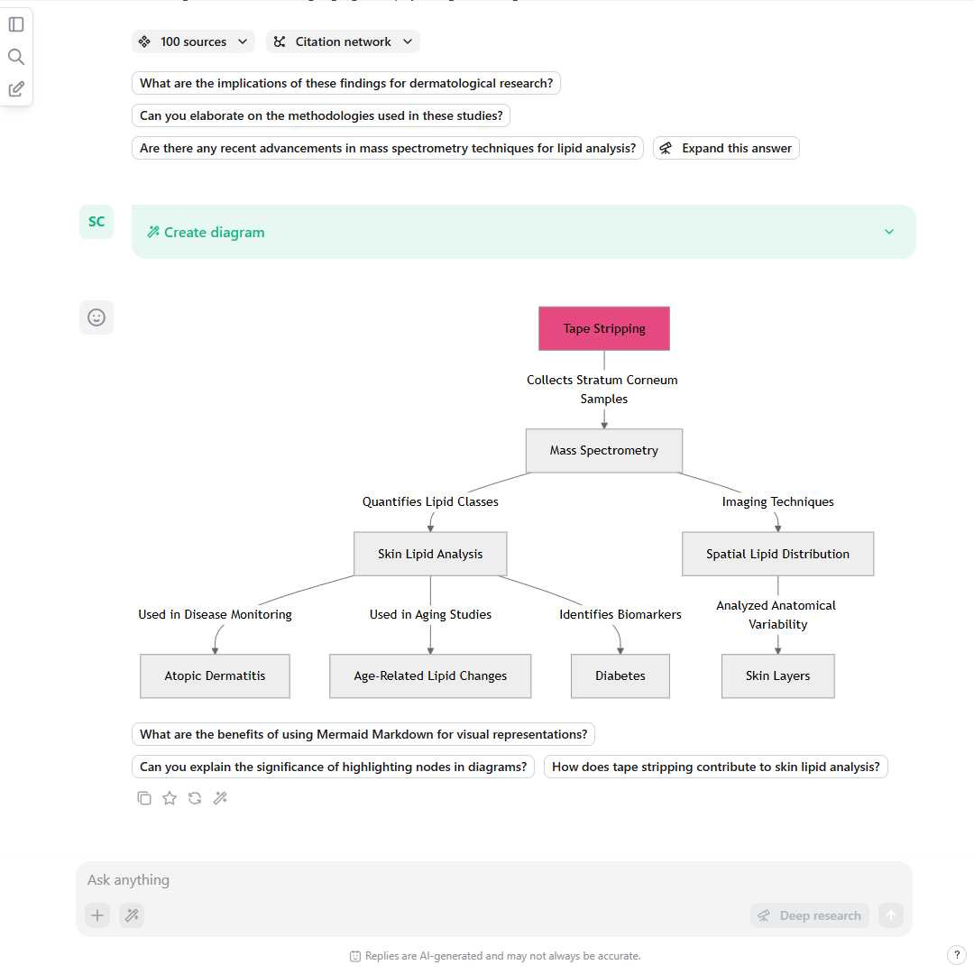
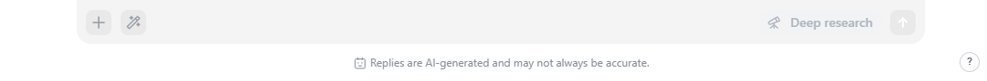
Access to the
knowledge
of mankind
Notes:
The first use case is the core feature of scienceOS:
Fast and easy access to scientific answers grounded in published research.

Slide 6
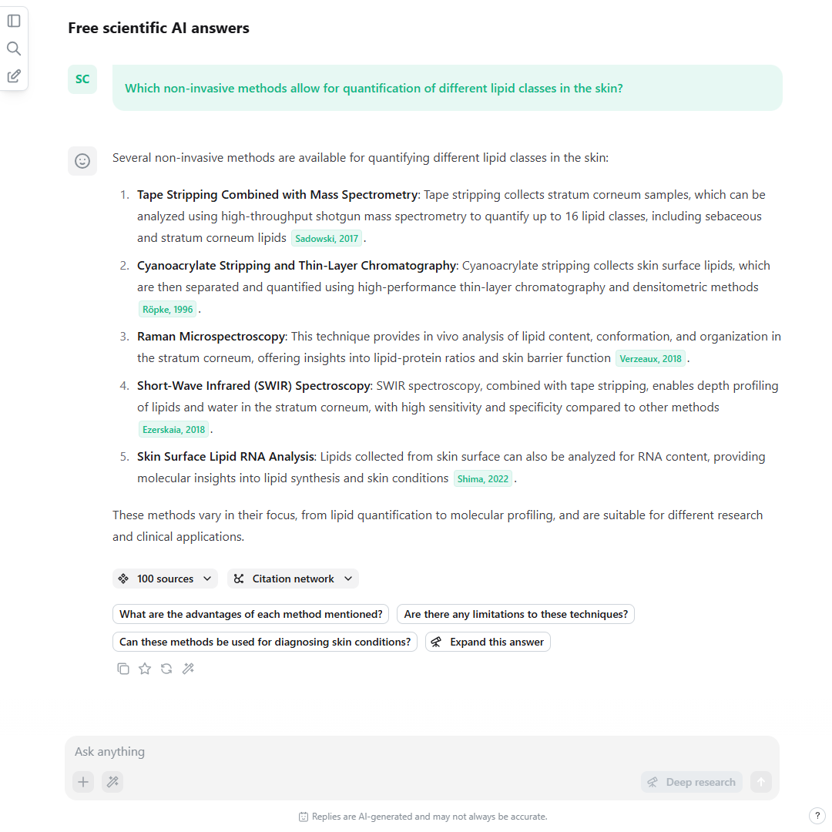
Ask a question.
www.scienceOS.ai
Notes:
Our story starts with diving into a new research area – the complex role of lipids (fat molecules) in dermatological research.
I am new to this field and need to get an overview.
So, I simply ask scienceOS a question.
[EXPLAIN SCREENSHOT]
What happened is: the AI went through our database of more than 225M documents, factoring in citation counts, publication dates, reference relationships, and more.
Then, the AI agent read relevant documents and generated an answer grounded in published research, including in-text citation markers.
[BRIDGE: If you click on one of the citation markers, a popup appears.]

Slide 7
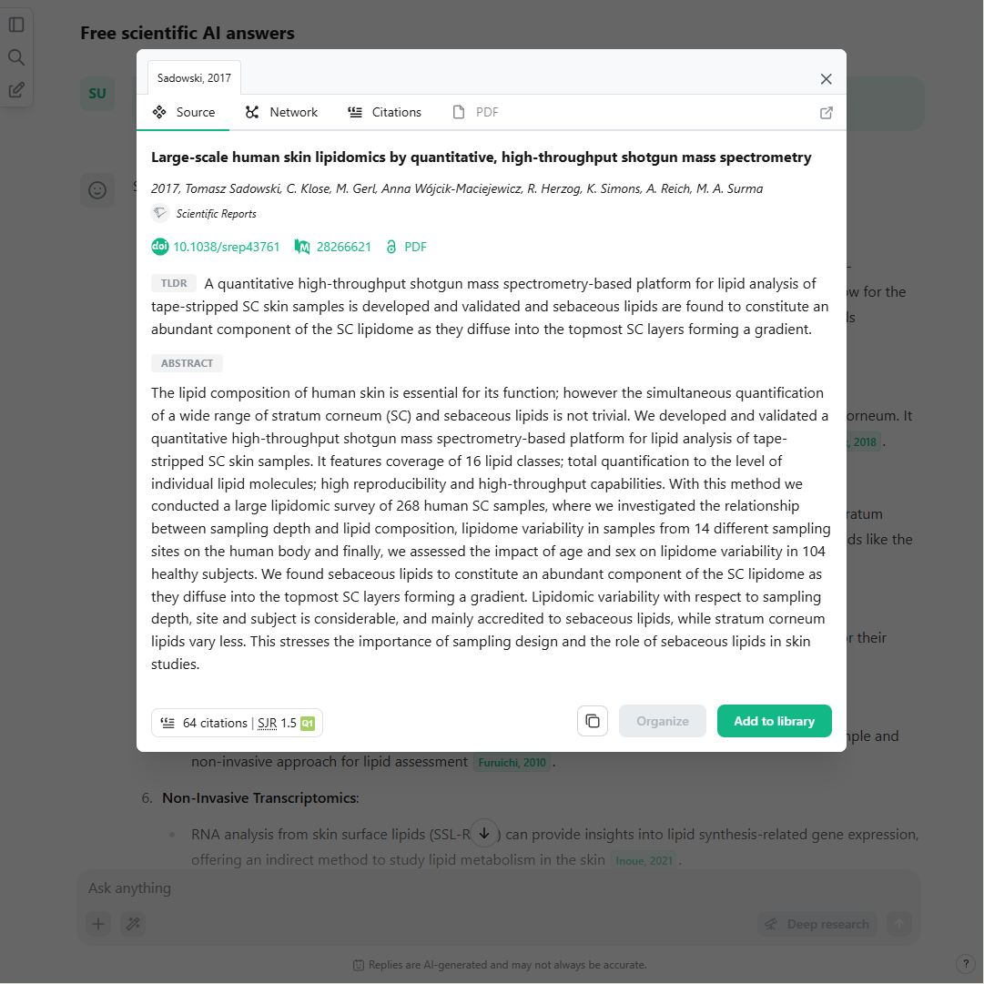
Click on citation markers for source details.
www.scienceOS.ai
Notes:
It features: the abstract, publication date, authors, […].
Because this is a highly relevant source – it‘s mass spectrometry-based, a method for molecular quantification - I click on „Add to library“ to save it to my scienceOS library.
[BRIDGE: Now, scienceOS offers more than just plain text answers.]

Slide 8
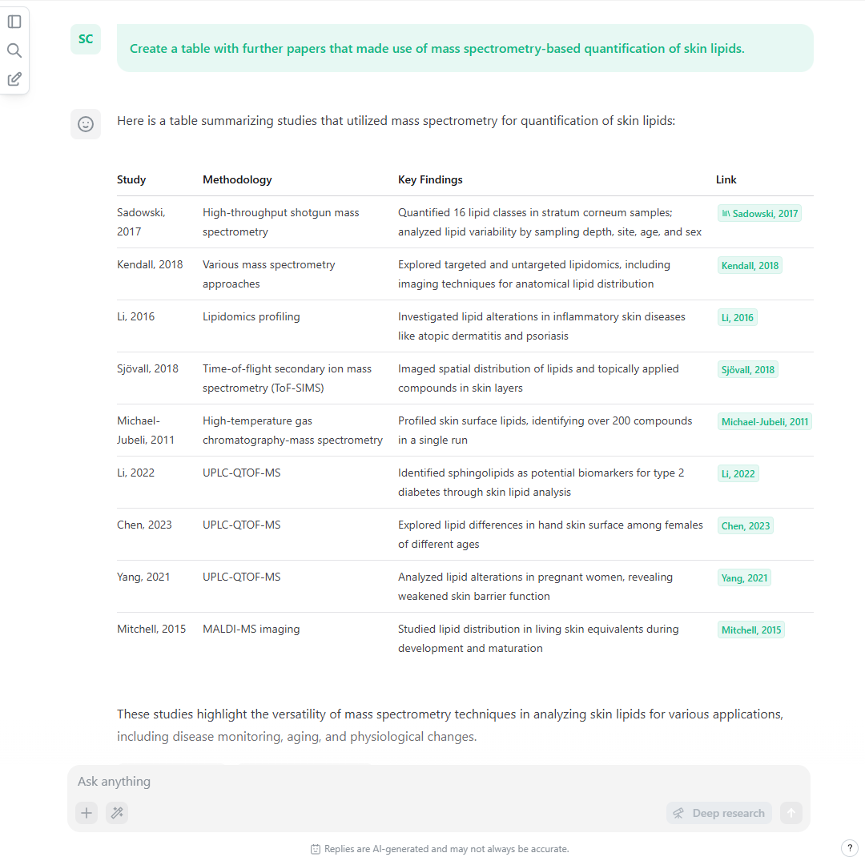
Create a table
to compile information.
www.scienceOS.ai
Notes:
For example, if I wanted to find further papers that also made use of mass spectrometry to quantify lipids in skin samples, I can also ask scienceOS for a table.
This makes it easier to quickly grasp the essence of multiple papers.
[EXPLAIN SCREENSHOT]
[BRIDGE: Or, you may even ask for a diagram!]

Slide 9
Show relations in a diagram.
www.scienceOS.ai
Notes:
This is particularly helpful, if you want to understand relationships between different pieces of information.
[EXPLAIN SCREENSHOT]

Slide 10
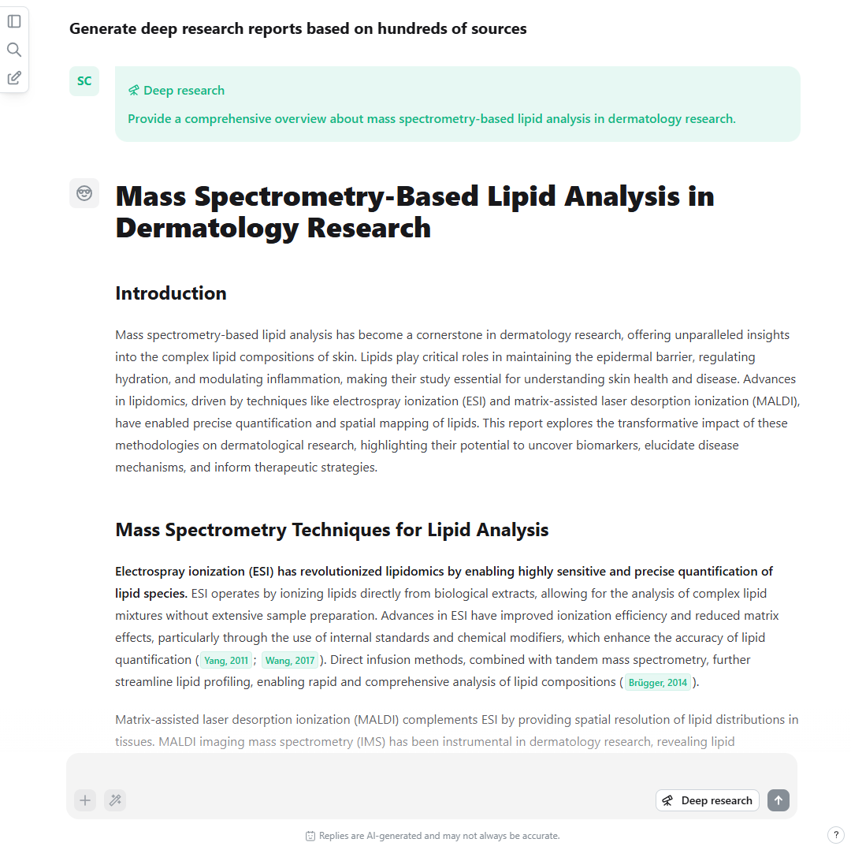

Selecting the ‘Deep research’ mode will provide a detailed report.
Notes:
Finally, instead of providing you with a brief answer, scienceOS can also generate long reports.
Selecting the ‘Deep research’ mode will generate a detailed report based on hundreds of sources.
This help you get a comprehensive overview about a new field to identify key trends and findings across the field.
[EXPLAIN SCREENSHOT]
In the deep research report, I discovered many more relevant sources and added them to my library.
[BRIDGE (if tech): But how does all of this work?]
[BRIDGE (if networks): But how do you assess whether your literature search is truly complete and comprehensive?]

Slide 11
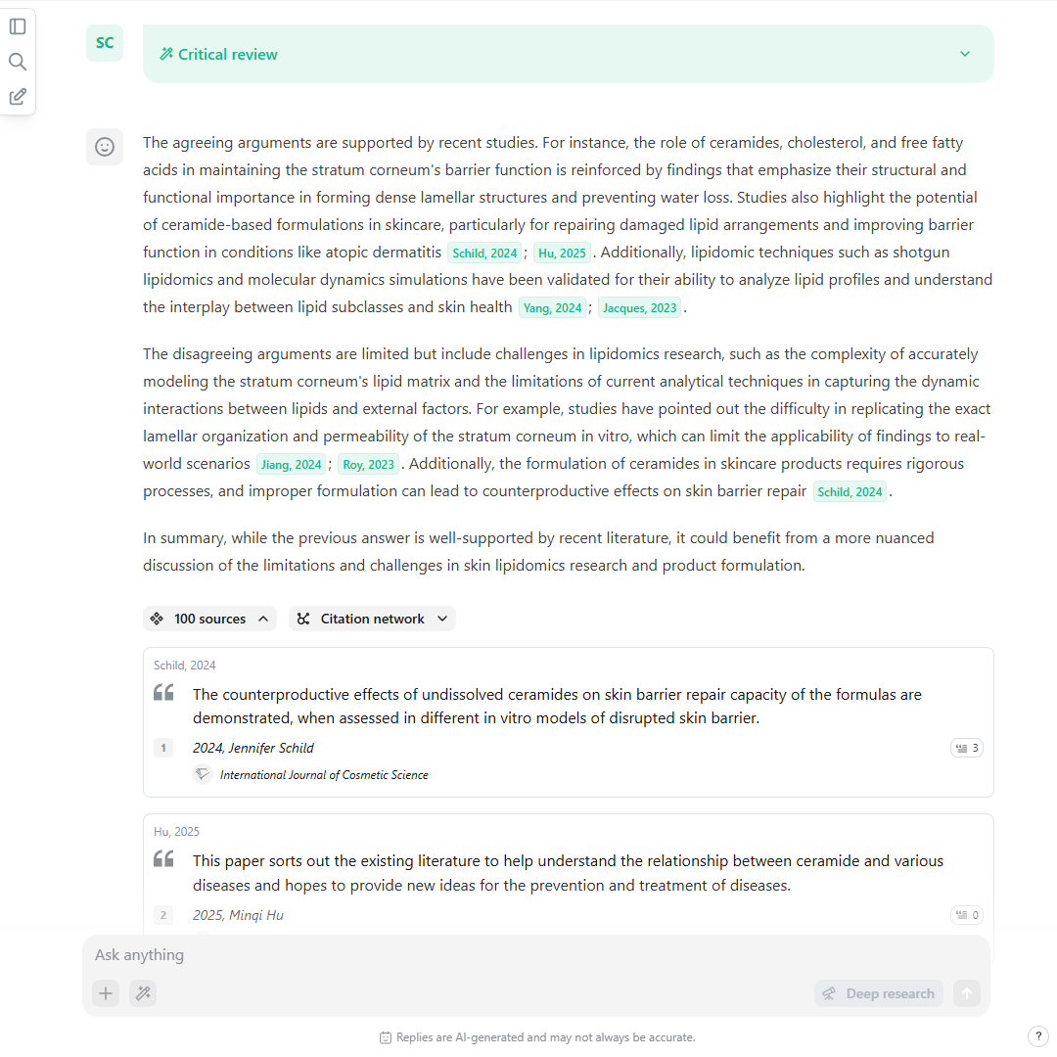
User Input
Chat History
AI Agent
based on an LLM
Search
Library
PDF
The scienceOS AI research agent
Notes:
In the beginning I said: scienceOS is an agent.
[AGENT PRINCIPLE]
[BRIDGE: The most important tool of the scienceOS agent is the Search tool.]

Slide 12

Paper Search Index
>225M publications from
all fields of science
Query Builder
100 Publications
by keyword frequency
Reranking
by proximity to question, publication date, citations, SJR, references, …
15 Publications
AI Agent
The Paper Search Tool
Notes:
[SEARCH TOOL]
[BRIDGE (if scienceOS for business): Before I forget, for businesses, we also offer to integrate their data into scienceOS.]
[BRIDGE (if networks): But how do you assess whether your literature search is truly complete and comprehensive?]

Slide 13
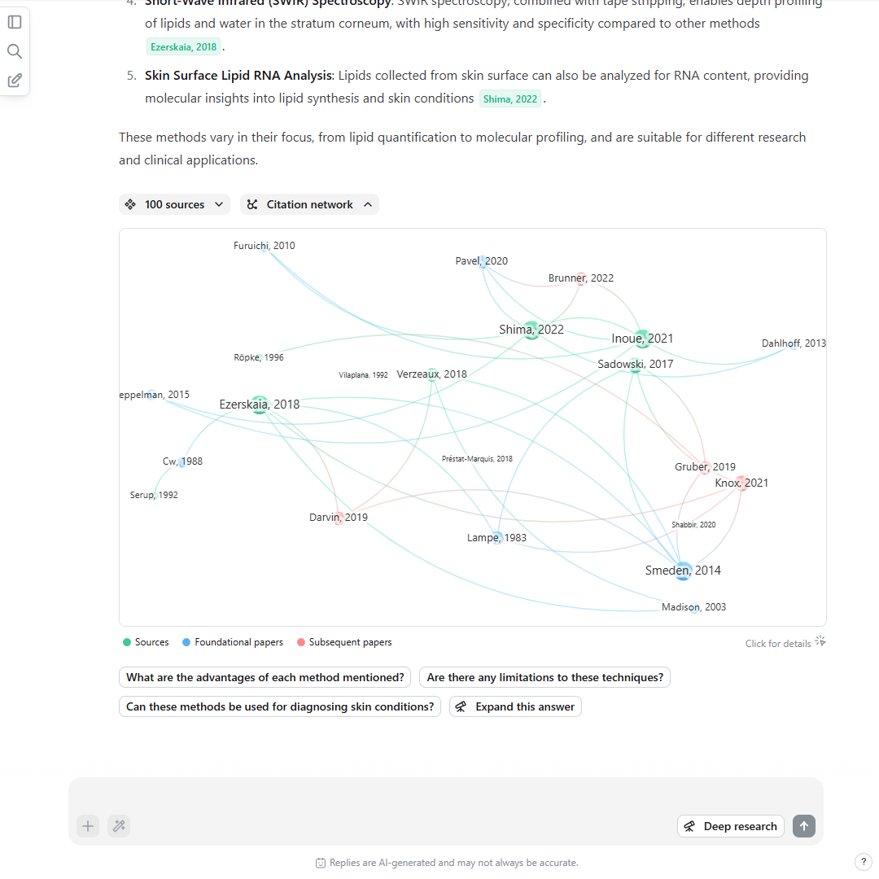
Explore
networks of
related papers
Notes:
In the next example, we will review how to tackle the problem: „There are too many publications. I need to find the best and most relevant papers.“

Slide 14
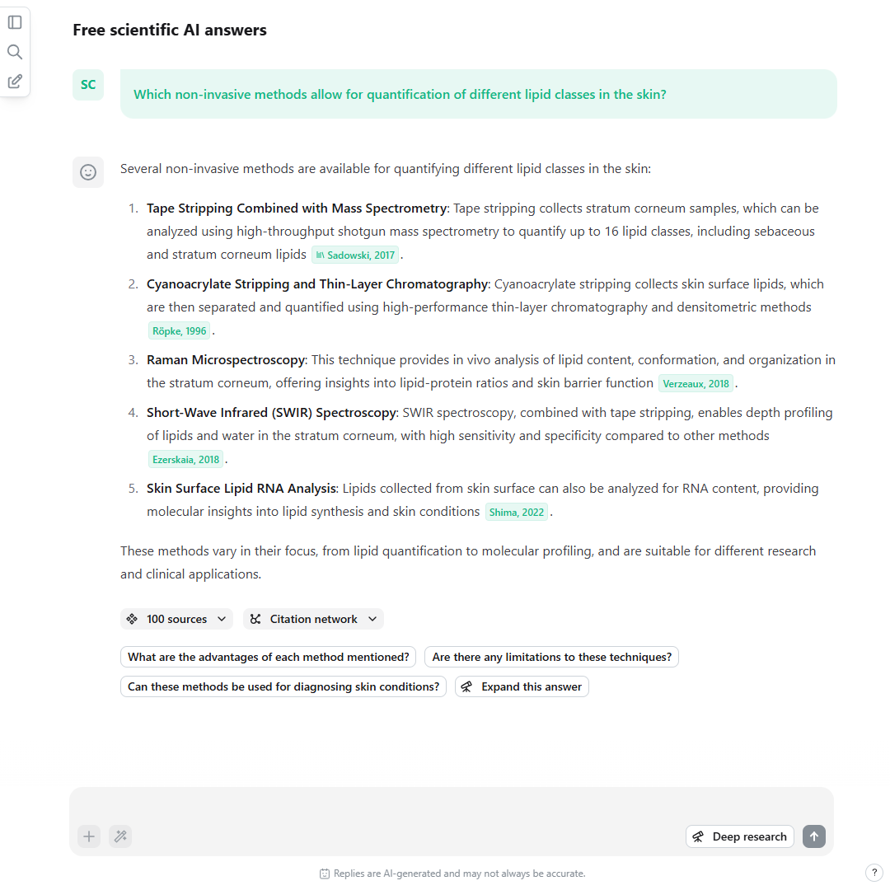
Ask a question. Then, click on the button Citation network.
www.scienceOS.ai
Notes:
The scienceOS database does not only contain 225M research documents, but also 2.4B reference data pairs.
We use these reference data pairs for two features.
The first one is citation networks, knowledge graphs that show how papers are referecing each other.
After each generated answer, there is a button called ‚Citation network‘.

Slide 15
Find subsequent or foundational papers in the citation network.
www.scienceOS.ai
Notes:
Click on it to create a citation network based on the sources in the answer.
GREEN + BLUE + RED
This helps me make sure that I do not miss important foundational papers or where current research is heading.
For example, the paper „Smeden, 2014“ in the bottom right corner has hundreds of citations – which is a lot in biomedical research!
I do not want to miss this paper in my scienceOS library!

Slide 16
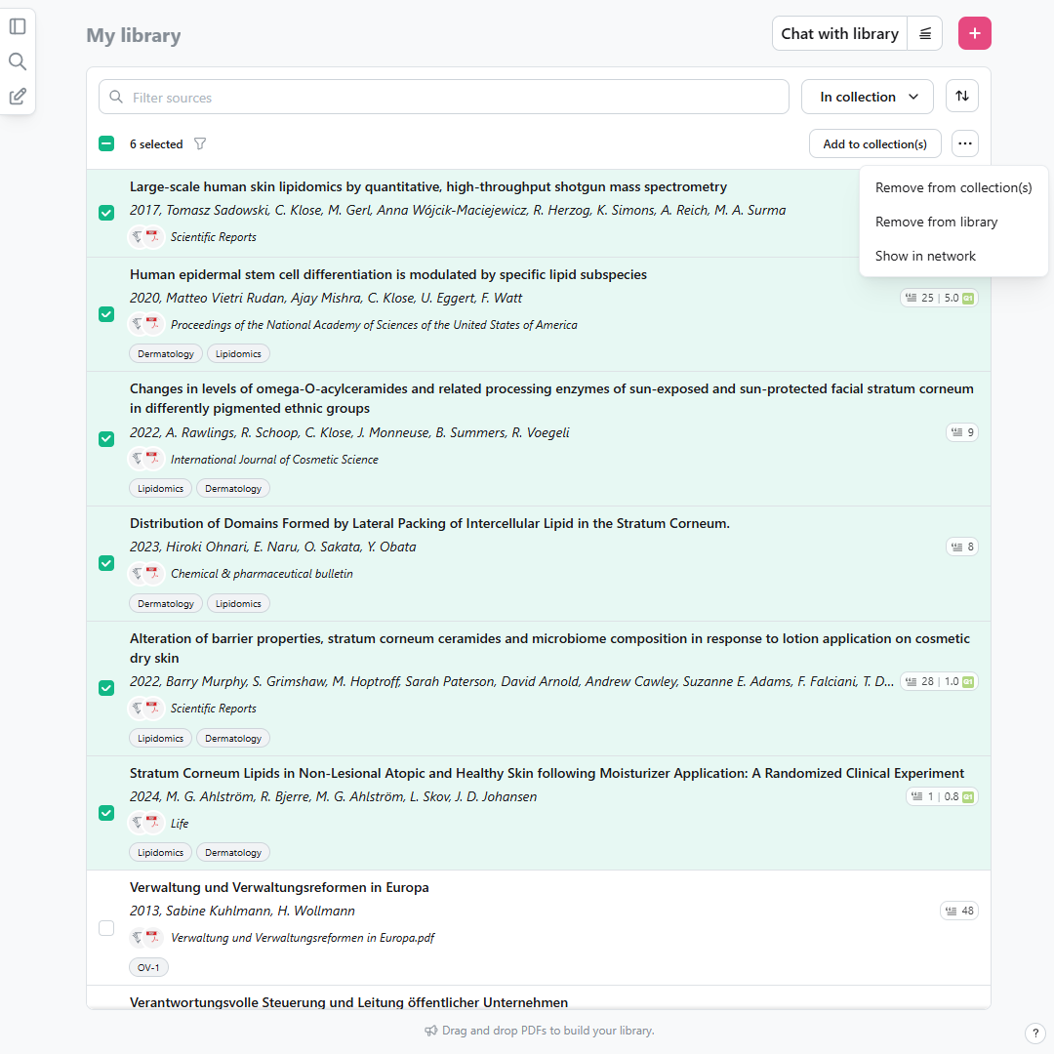
Create citation networks in your library to expand your collection.
www.scienceOS.ai
Notes:
Going one step further - if you upload your reference manager to scienceOS - you can even handpick up to 10 sources in your library and create a citation network based on these.
This is probably the most efficient way to find papers you may want to add to your library.

Slide 17
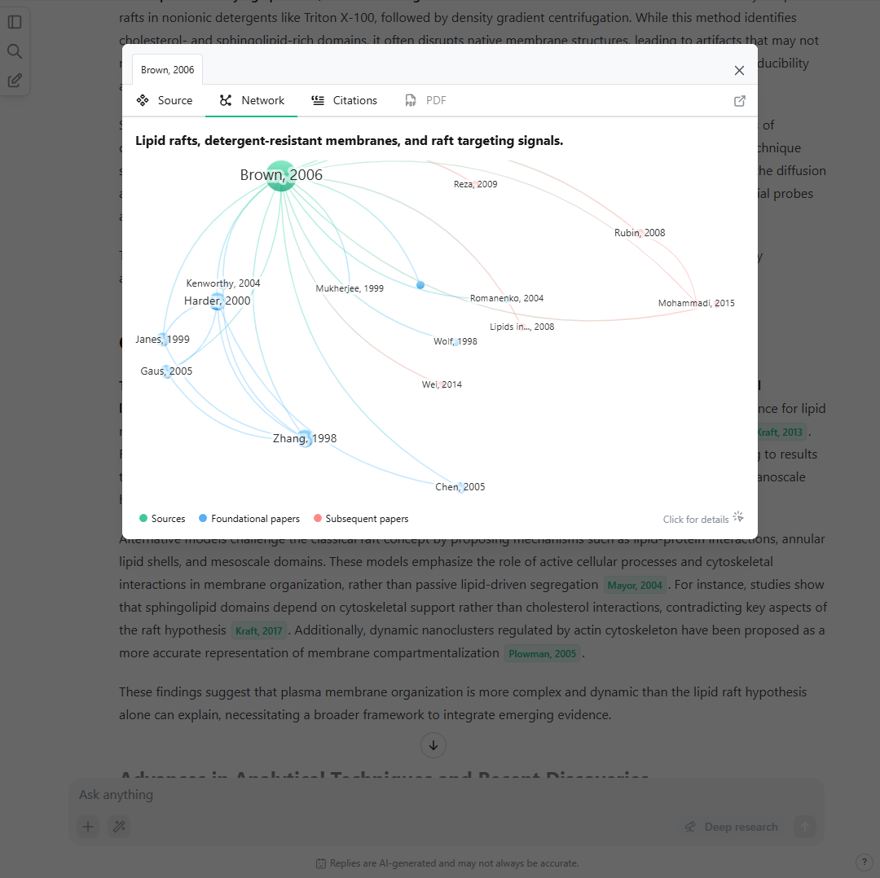
Or click on a source and select the Network tab.
www.scienceOS.ai
Notes:
Finally, you can also click on an individual source and select the Network tab to explore the citation network of an individual paper.

Slide 18
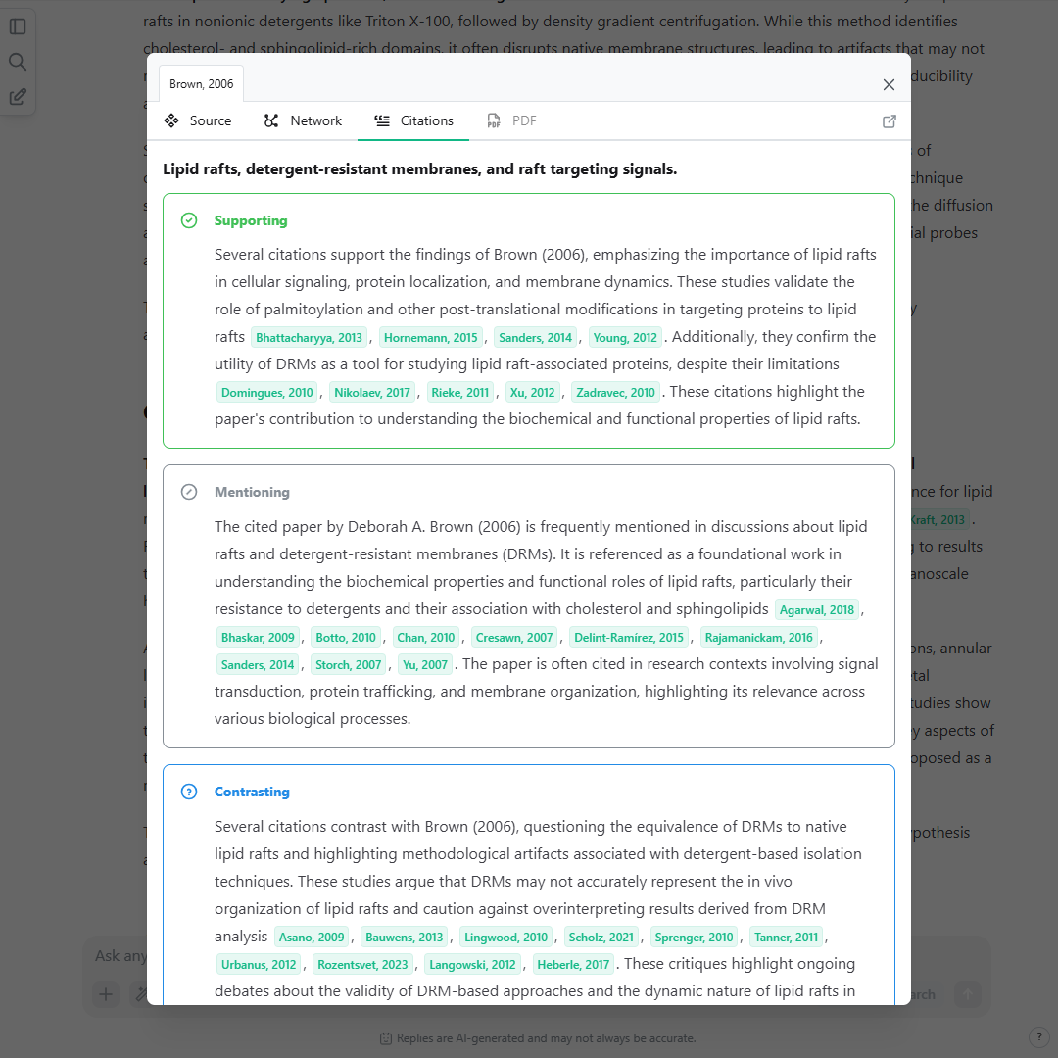
Select the Citations tab to read how papers cite a source.
Notes:
The second references-based feature is a citations analysis.
Go to the citations tab, and you can take a look at how other papers are citing this work - whether they support, mention, or challenge it.
It helps understand the real influence of a source, how the conversation in the field is changing, and also supports evaluating the quality of a paper.
Both, the citation networks and the citations analyses help you identify the most relevant papers for your literature collection.
[BRIDGE: But what if you do not want answers and networks based on everything that has been published?]

Slide 19
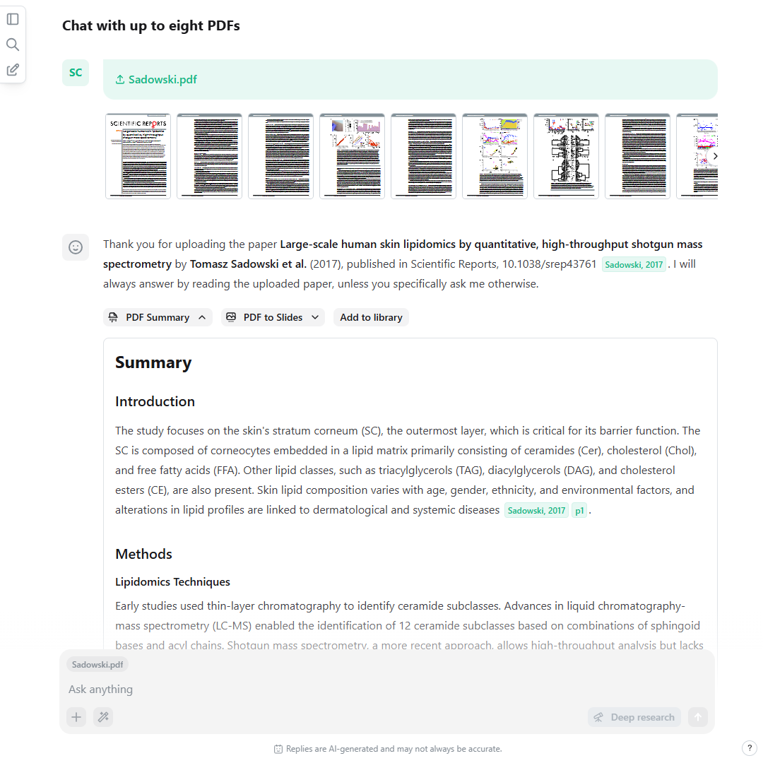
Upload and
chat with
PDF files
Notes:
Now, the third example revolves around chatting with individual research papers.
A prime use case for the PDF chat in scienceOS is to quickly get an overview about a new paper.

Slide 20
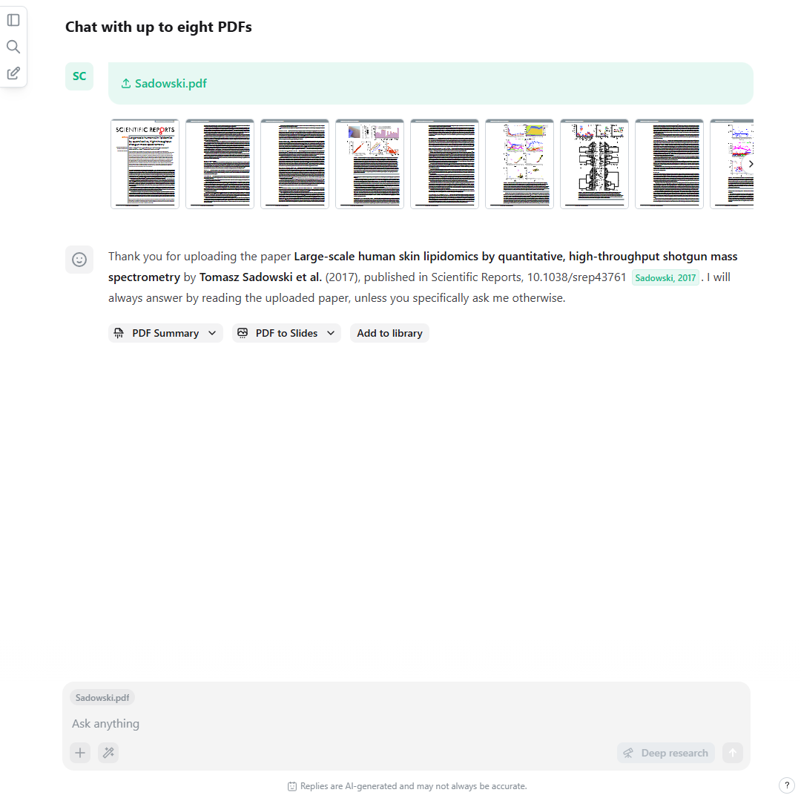
Upload a PDF file to a chat.
www.scienceOS.ai
Notes:
To skim a new paper with the help of the AI research agent, first, add the PDF to a chat session.
[Drag&Drop + Plus-Button]
By the way, this paper, Sadowski 2017, is the same paper I discovered at the start of the journey when I was aiming for an overview about the field.
After the upload, it will instantly generate a preview of the PDF
[BRIDGE: It will also offer a summary of the uploaded document in text and slide format.]

Slide 21
Each upload
will automatically write a structured summary for you.
www.scienceOS.ai
Notes:
Click on the button ‚PDF Summary‘ to access the structured summary of your research paper.
The structured summary support you in quickly gaining an overview about a new paper.
Similarly to the previous chat messages generated by the AI agent, the summary will also contain citation markers.
[BRIDGE: If you click on them, a PDF viewer appears.]

Slide 22
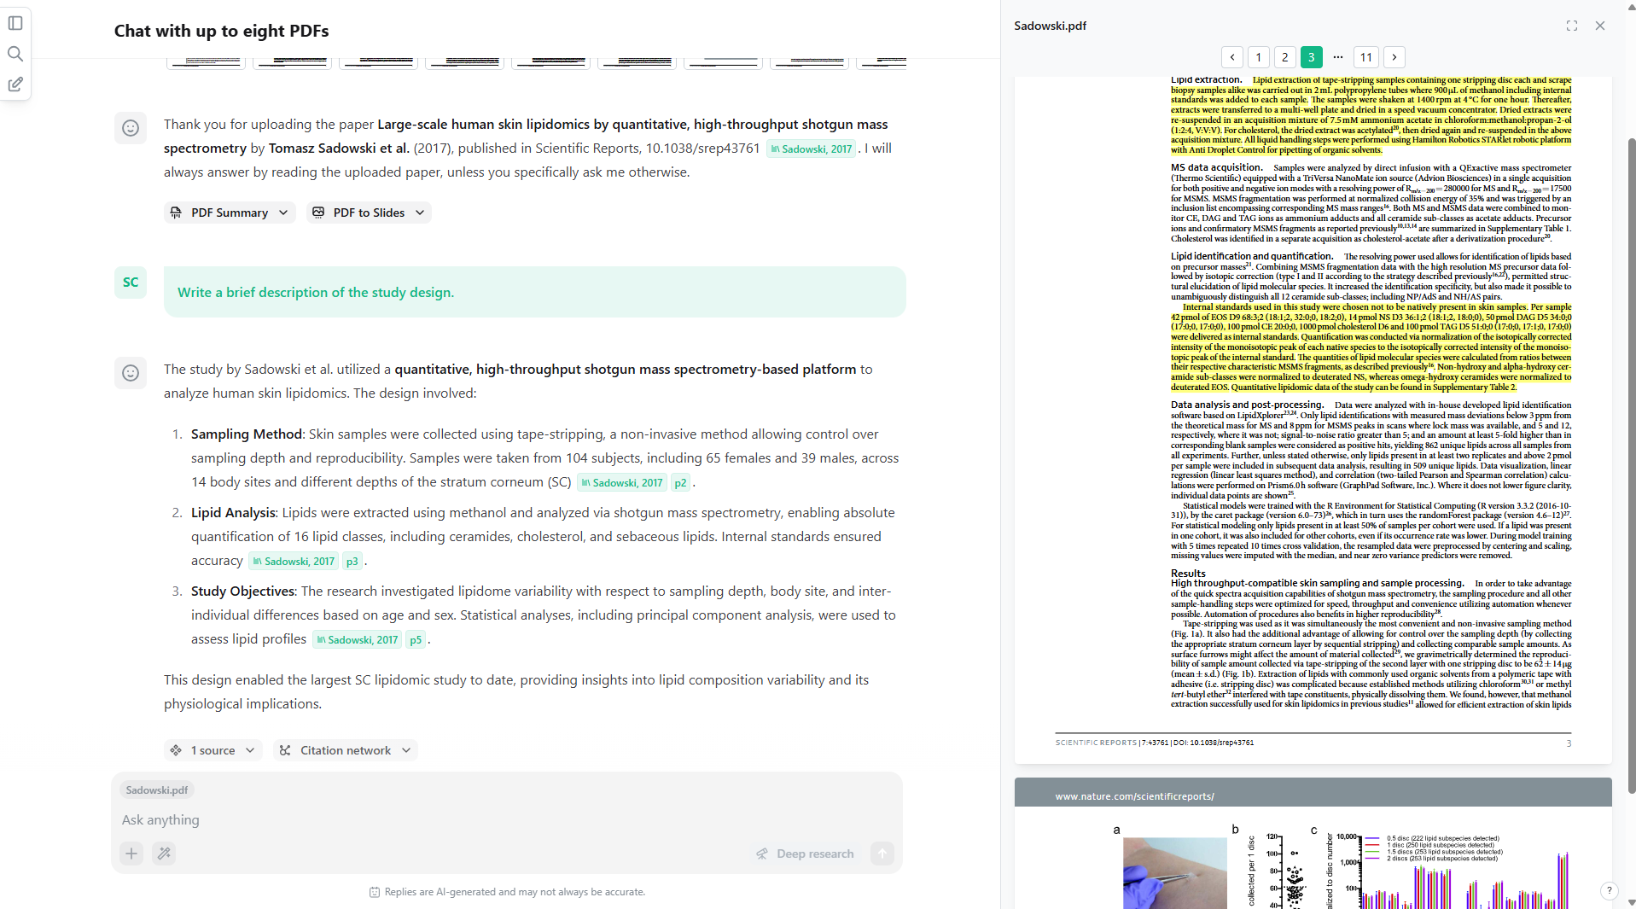
Notes:
When chatting with a PDF, all generated answers will be based on the content of the PDF.
Therefore, the page citation markers will reference specific text segments and pages in the PDF file.
When I start working with the full text of a paper, I like to start by understanding the study design.
[EXPLAIN SCREENSHOT]

Slide 23
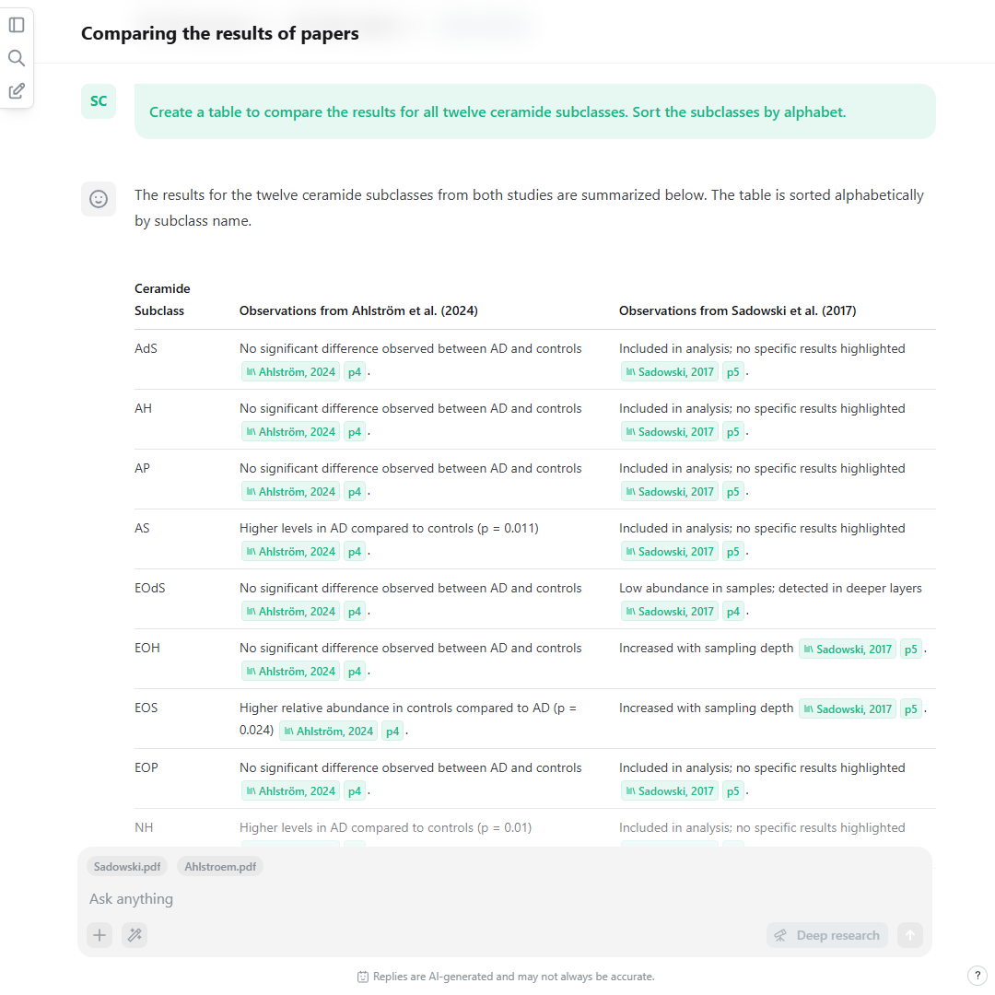
Upload several PDFs to compare them and synthesize data.
www.scienceOS.ai
Notes:
However, you are not limited to chatting with just 1 PDF; you can upload up to eight PDFs per chat session.
You may use this to synthesize information from multiple papers or to compare the results from several publications.
[EXPLAIN SCREENSHOT]
But the most powerful aspect of scienceOS is: everything I am showing you happens within the same chat.
[BRIDGE: What does that mean?]

Slide 24
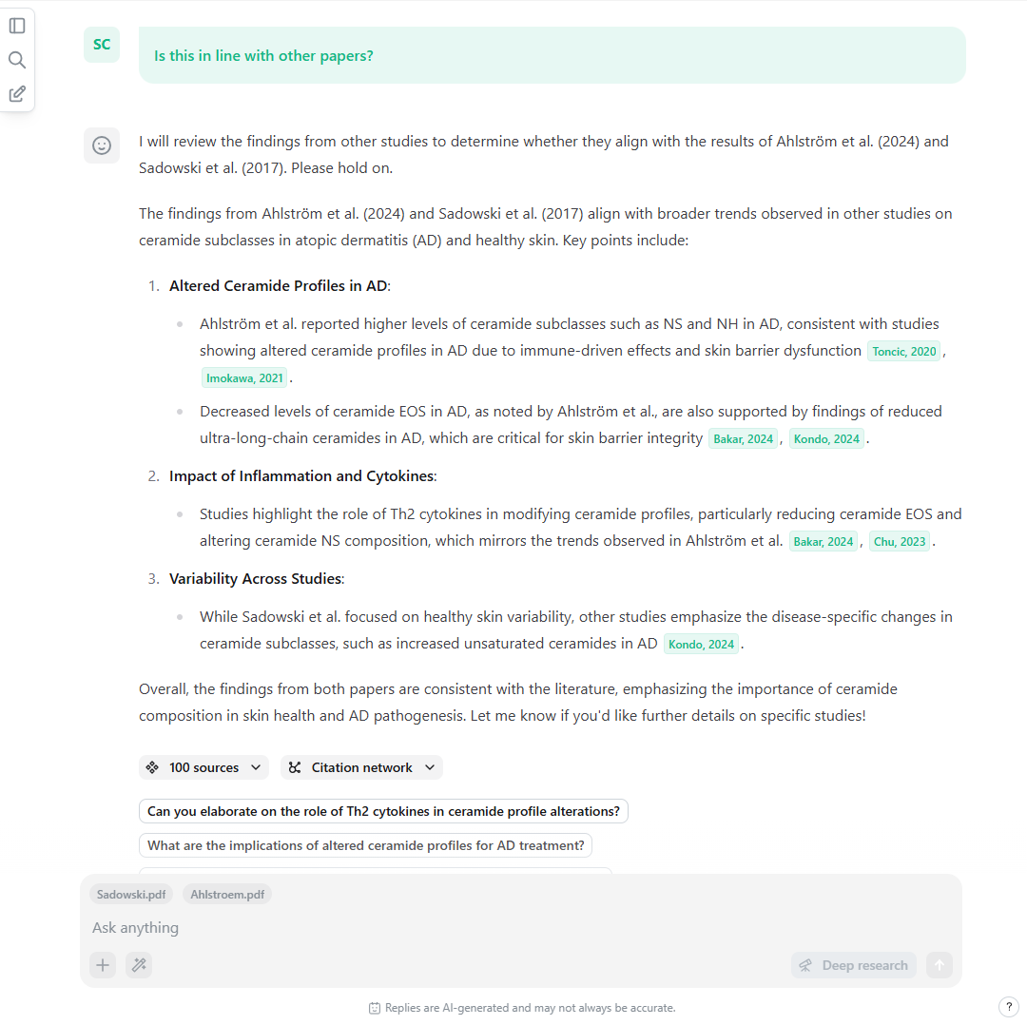
During a PDF chat, you can still ask the global paper database.
Notes:
While you are chatting with a PDF, all the answers will be based on the content of the PDF.
However, often you will come to a situation where you:
- want to check if a result of this particular paper is in line with other sources
- need to assess the validity of a method in the context of this research field
- require a definition for certain terminology used in the paper
Usually, you would simply browse some databases in parallel while reading a paper - until you get lost in hundreds of open tabs.
To overcome this tab chaos, simply ask scienceOS to check for other sources.
[EXPLAIN SCREENSHOT]
As everything happens in the same chat, you can combine the content of the PDF with the 225M sources from our index.
[BRIDGE: Instructing the AI Agent to combine its tools, is a powerful way to use scienceOS. Let’s review another example for that.]

Slide 25
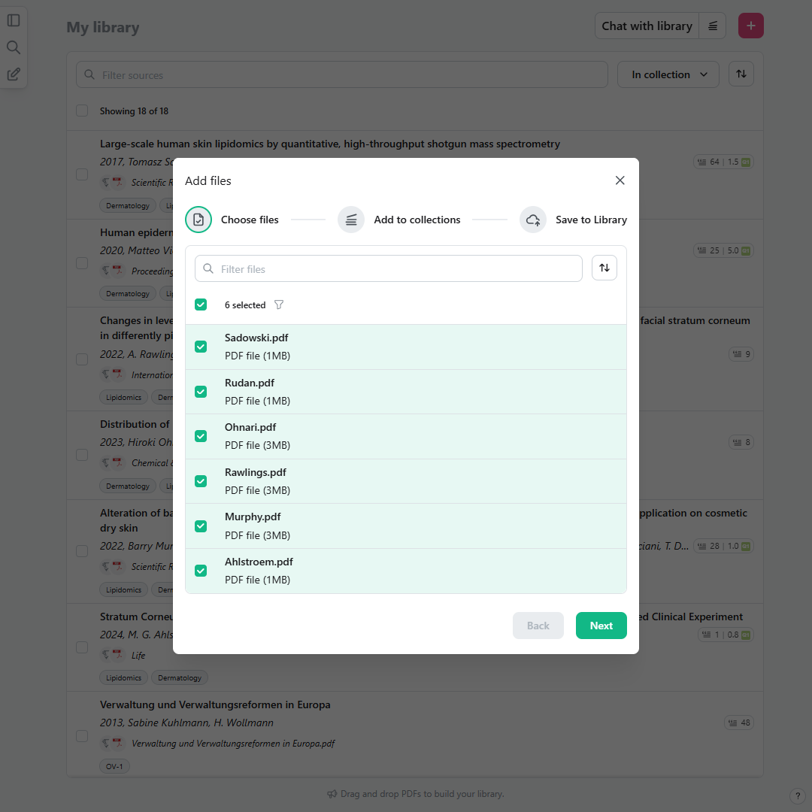
Drafting texts
based on your
own literature
Notes:
In the last example, we will review how to tackle the problem: „I need to draft a text based on papers I can fully trust!“

Slide 26
Add 4,000 PDFs to your library.
www.scienceOS.ai
Notes:
Over the course of the previews examples – gain an overview, find related papers, dive into specific PDFs – I added a handful of relevant research papers to my library.
Of course, you can bypass this whole process if you already have relevant literature for drafting a text.
You can upload up to 4,000 PDFs directly to your scienceOS library – which is essentially an AI reference manager.
Simply go to My library in the side panel.
Then, drag&drop PDFs into your library or click the pink ‚plus‘ button in the top right corner.
As an Angel user, you can upload up to 50 PDFs simultaneously; for free users, the cap is 8 PDFs simultaneously.
[ALTERNATIVE: RIS/BibTex]

Slide 27
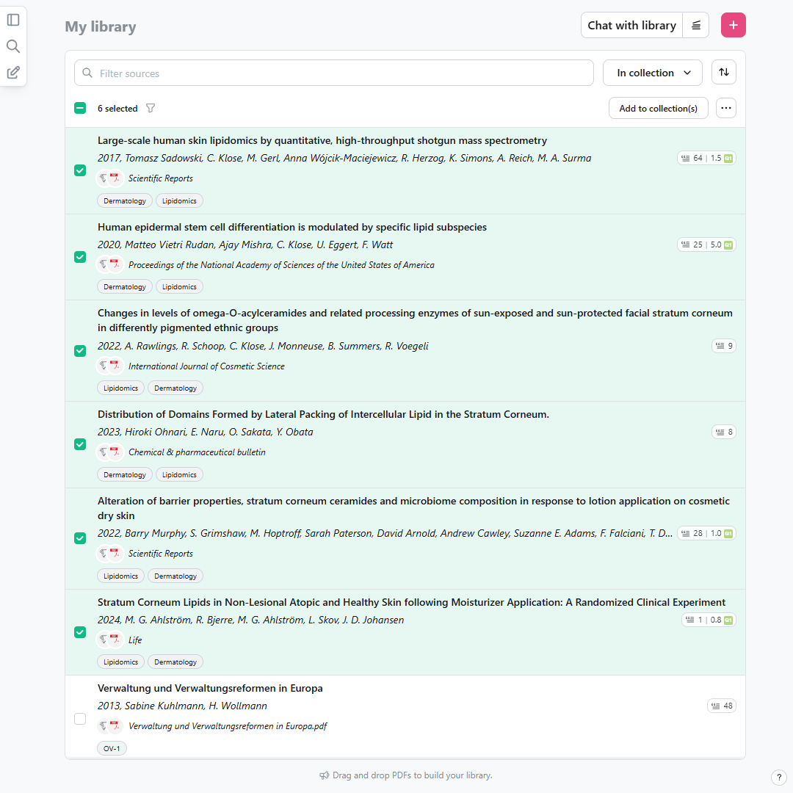
Create collections to organize sources in your library.
www.scienceOS.ai
Notes:
I also highly recommend organizing your sources by creating collections within your library.
Within a few slides, you will see why.
[BRIDGE: Finally, click „Chat with library“ to switch to the project ‚Library chat‘.]

Slide 28
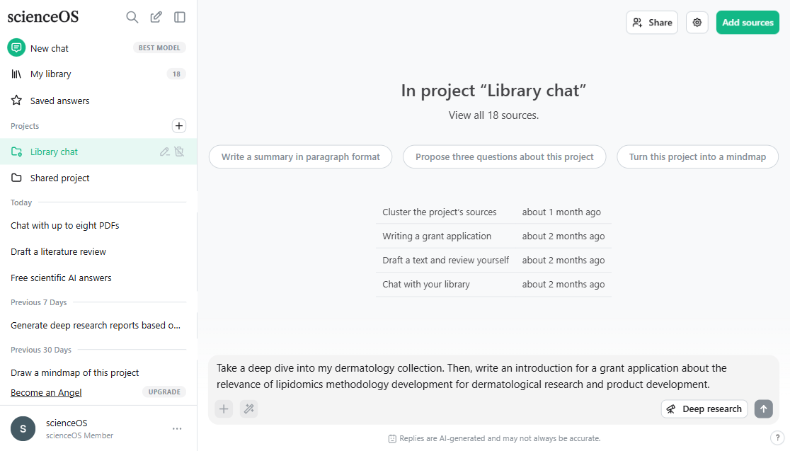
Notes:
As the name suggests: the project ‚Library chat‘ contains all the sources from your library.
It is a default project created by us for you – you cannot delete or substantially modify it.
When you chat with the project ‚Library chat‘, the AI agent will browse all the content in your library and base its answers on your uploaded documents.
[BRIDGE: In this example, I begin drafting a text based on my library by stating [CHAT MESSAGE].]

Slide 29
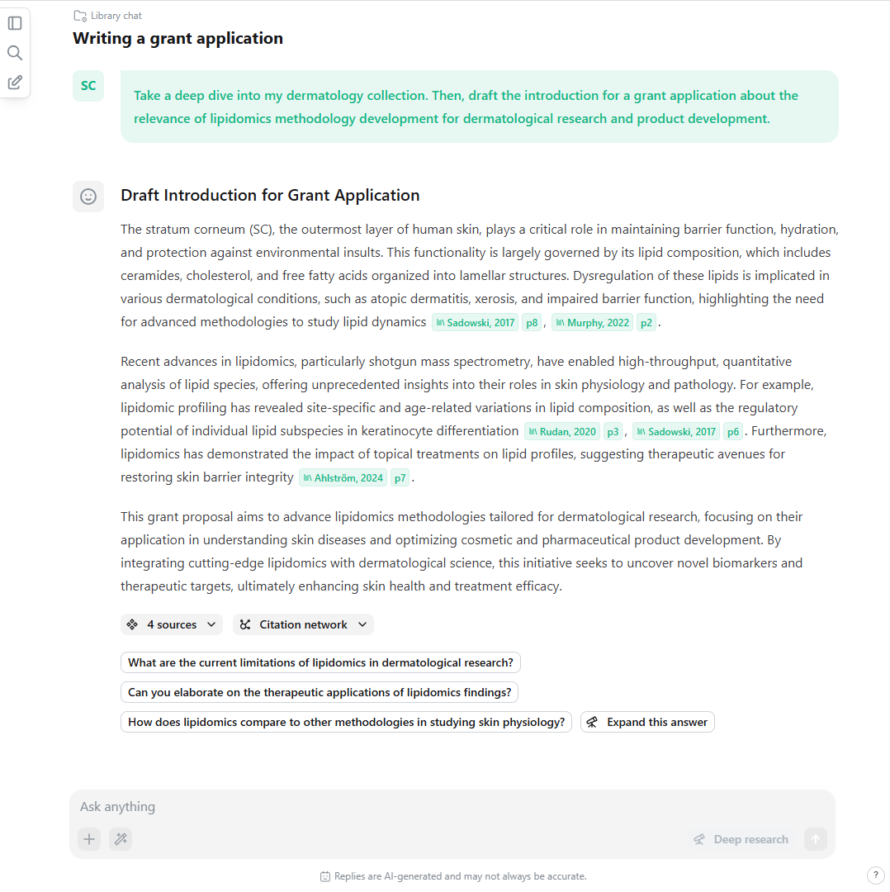
Use the ‚Library chat‘ to interact with your library.
www.scienceOS.ai
Notes:
If you uploaded PDFs to your library, every answer will again cite relevant paragraphs from your documents - whether they are papers, protocols, reports, or any other source.
Yet, writing a grant application by retrieving insights only from the PDFs in your library is obviously biased.
All the text will be based on papers you know and like.
To overcome this, you may want to ask scienceOS to critically review the text by consulting the 225M papers database.
[BRIDGE: But for this, you need to allow the project to access sources outside the project library.]

Slide 30
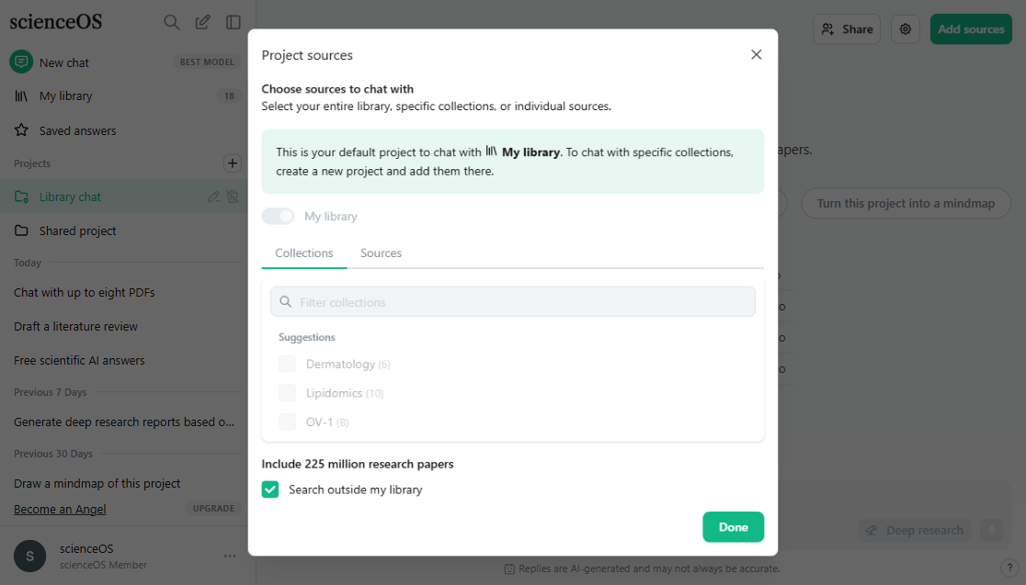
Notes:
Go back to the project homepage of ‚Library chat‘ and open the Project sources.
Here you can see: the ‚Library chat‘ does always search in all of your library.
Further, you can allow the AI agent to search outside your library and include external sources in the project.
So I check the option ‚Search outside my library‘ and go back to the chat where I started to draft the grant application.

Slide 31
Review yourself: combine library answers with data from 225M papers.
www.scienceOS.ai
Notes:
If you provide the AI agent with the option to search in the 225M papers database - as everything happens in the same chat - you can combine your own data with the public information.
This allows you to effectively review yourself.
In this example, I use the AI Action ‘Critical review’ to provide further pro and contra arguments for my library-based grant application draft.
[BRIDGE: Now, instead of using the normal project chat, you can also use the ‘Deep research’ mode!]

Slide 32
‘Deep research’ in projects helps you draft reviews, protocols, and co.
Notes:
When you use ‘Deep research’ in projects it will generate a comprehensive report based on the PDFs and sources in the project.
Running ‘Deep research’ with your own or your colleague’s selected full-text papers helps you:
get a useful first draft for a literature review or
develop a study design based on methodological papers
much more
It generates four to five pages based on the PDFs in the project.
[EXPLAIN SCREENSHOT]
All in less then two minutes.
Uploading your carefully curated literature collection to your library is the most powerful way to use scienceOS!
[BRIDGE: Or is it?]

Slide 33

Get scientific answers.
Evaluate research papers.
Use the AI science chat and ‚Deep research‘ to quickly gain an overview about a new research area.
Upload up to eight research papers per chat. Ask questions to them and compare results.
Find related papers.
Work with your papers.
Create citation networks and analyze how a paper has been cited.
Import up to 4000 PDFs to your library. Draft texts and critically review yourself.
The last 25 min in 4 bullet points
Notes:
Let‘s quickly recap what we discussed so far.
1 + 2 + 3 + 4
But when we take a step back, we can see: basically none of this takes place in a lonely study room.
There are virtually ALWAYS further people involved in these processes.
Research is collaborative by design.
[BRIDGE: And so is scienceOS.]

Slide 34
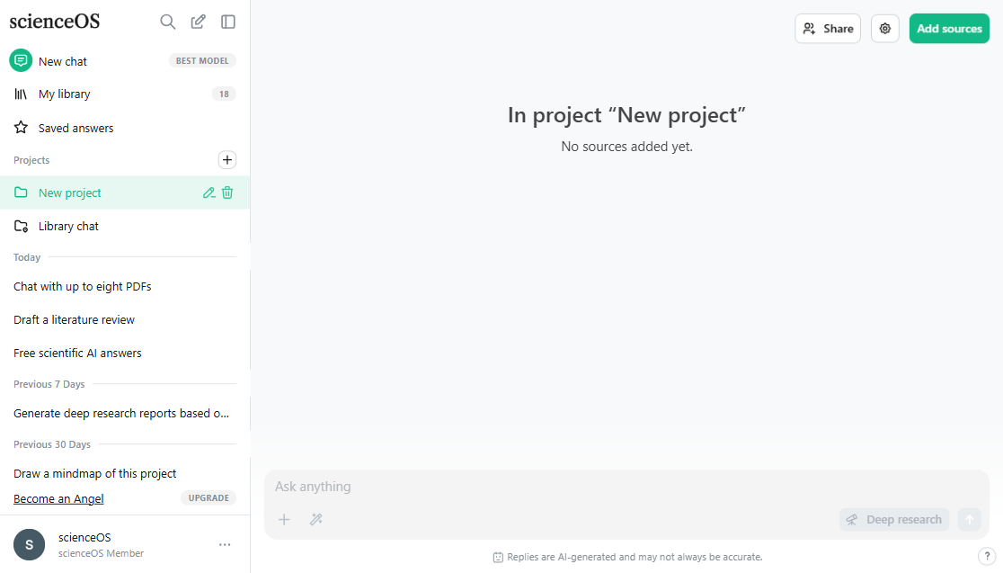
Notes:
Projects are not just a feature to chat with your library.
A project is a collaborative workspace within scienceOS.
Projects are made up of three components:
sources from your library (and/or access to the 225M papers of our database)
your past chats with the respective project
and the project members
Essentially, with projects, you can group your sources and chats in one place and share chat access to your literature collection with your collaborators.
[BRIDGE: Whether shared or not, the first step when setting up a new project is to add sources to the project.]

Slide 35
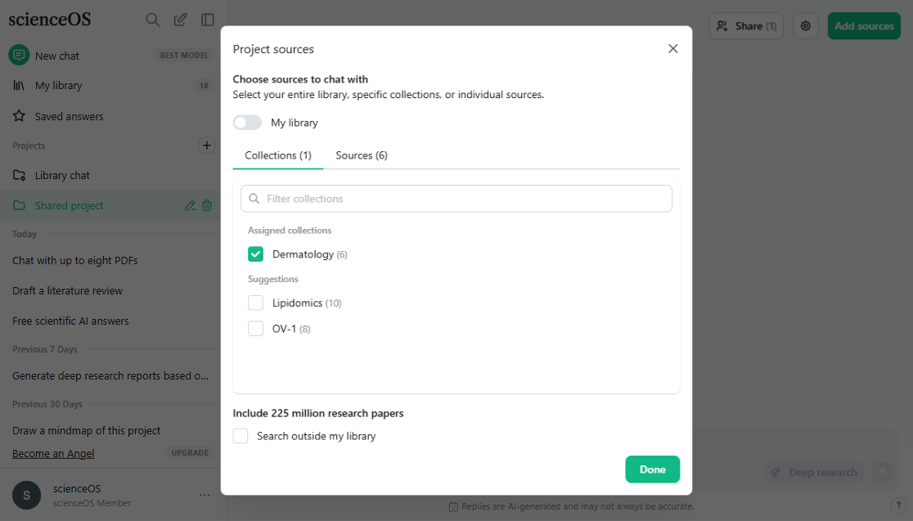
Notes:
For this exemplary project, I add only 1 collection and do not allow the AI agent to browse the 225M papers outside the project sources.
[BRIDGE: Now, I want to share access to my project with my great colleague „contact@scienceOS.ai“ – they are part of the grant and want to read what I have discovered so far.]

Slide 36
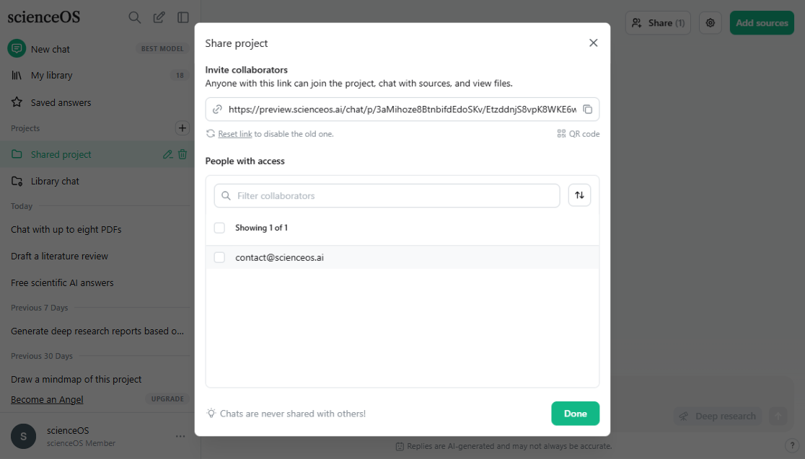
Notes:
Simply click on “Share” to open the project members management area.
Generate an invitation link and send it to your colleagues; or create an invitation QR code that you print out and place strategically in the lab.
Once someone joins your shared project, they will appear in the list of collaborators.
What’s important to know: All project chats remain private and will not be shared with others.
If you want to, you can also share the default project “Library chat” with your colleagues.
Creating a new project for sharing just provides you with more granular control over what you are sharing.
[BRIDGE: Now let‘s change perspective – for the next few slides, I will become contact@scienceOS.ai.]

Slide 37
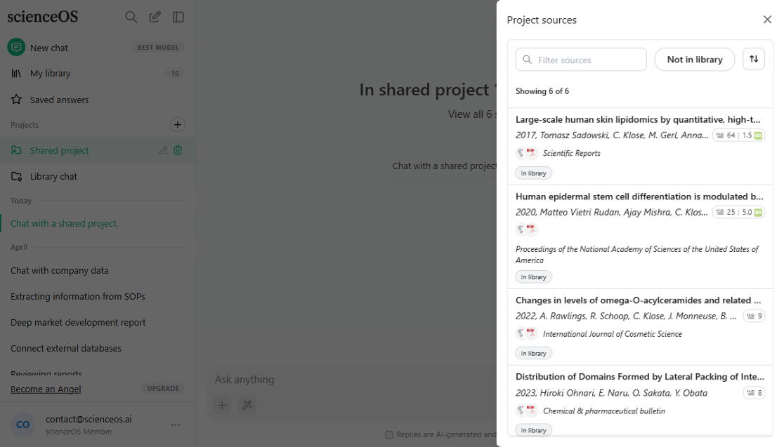
Notes:
Now, I am no longer the project owner; and I cannot change the project sources, members, or settings.
But I can review the source list.
And I can chat with the shared project.
[BRIDGE: So what’s the use case here?]

Slide 38
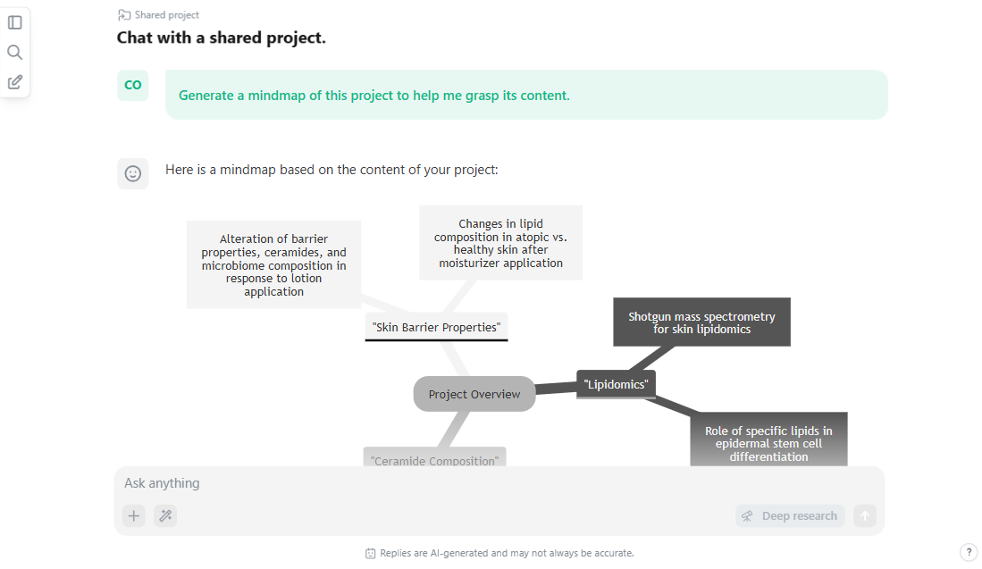
Notes:
If I am a new lab member, I can onboard myself by diving into the baseline literature of the lab and discover it in my own words.
If I am a researcher from another lab, and we are working together on a joint project, I can understand how your papers relate to my part of the work.
If the project contains all the established protocols in my lab, I can quickly find the correct protocol by using natural language.
If I am a student, I can chat with a manually curated collection of materials provided by my professor – a safe space for independent exploration.
As said, research is collaborative by design.
There are probably a thousand more examples for when chatting with the literature of someone else solves an annoying teamwork problem for you.
[BRIDGE (if pricing slide): Now to the most important question. What does all of this cost?]

Slide 39
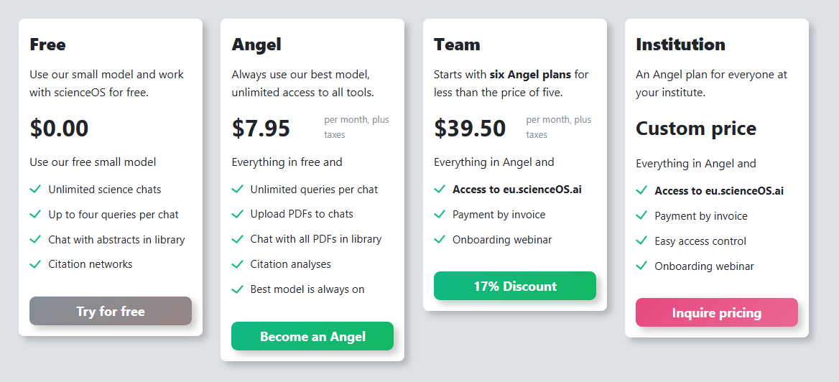
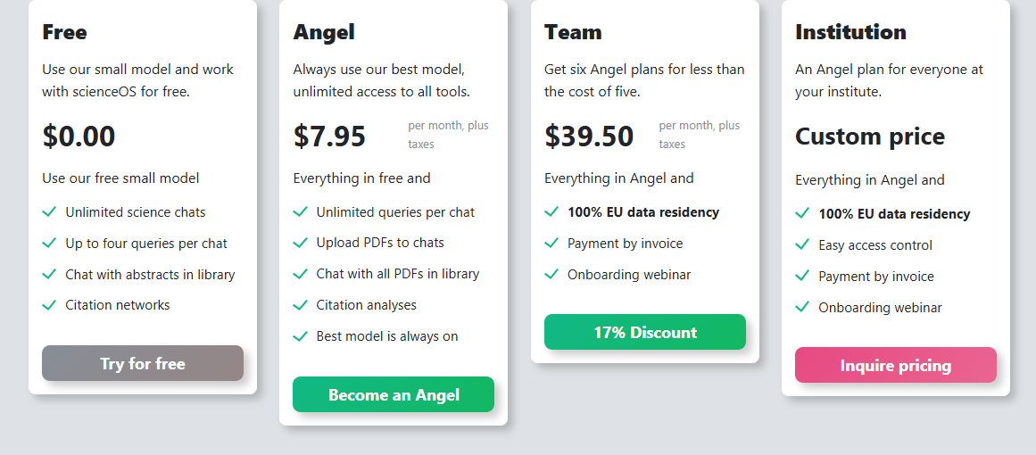
A fair price for a powerful academic tool
Notes:
Most of it is for free.
If you want to have access to all the high computation features: it‘s $8/month – a price that was defined by asking 300 scientists what‘s fair to charge.
The good news is: We believe a tool that makes you more productive should be paid for by your employer.
This means, there is also a team and an institution plan with one invoice per year to make the purchasing department happy.
A team license starts at 6 users for less than the cost of five; and the institution plan comes with usage-based pricing.
On top of that: with the team and institution plans, you get access to eu.scienceOS.ai to meet additional requirements of your IT admin.

Slide 40
Where scientists can swiftly tackle global challenges.
Q&A
www.scienceOS.ai
Notes:
Now, it’s up to you, to decide what’s the most powerful aspect of scienceOS:
Is it that everything happens in the same chat?
Is it that you can upload 4,000 PDFs and chat with all of them at once?
Or is it that you can share chat access to your literature?
Maybe it’s that all of this takes place in just one single app with an intuitive user interface.
Irrespective of that, we are proud to support your research!

