Slide 1
Introduction to the first workshop on modernizing OPA
Bettina Kuske
HZB, Berlin, April 3rd-4th, 2025

Slide 2
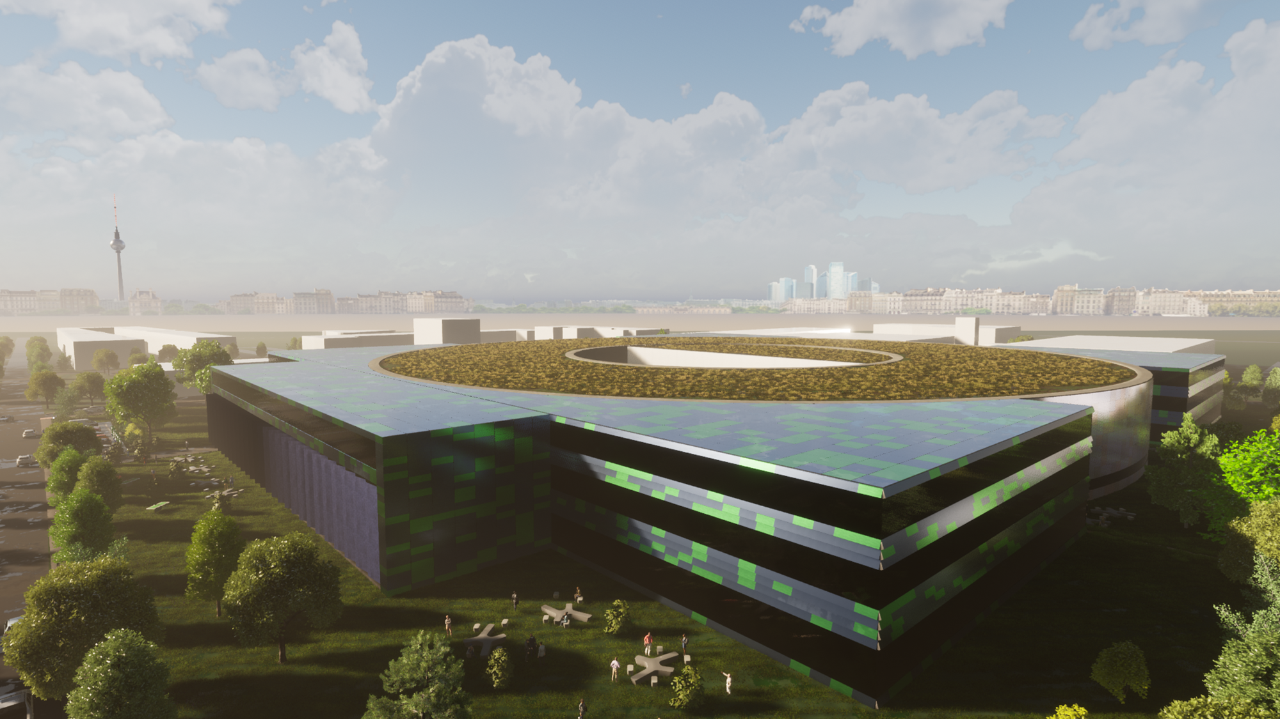
Welcome
Welcome to HZB and thank you for your interest in our endeavor!
Who are we?
PSI:
Andreas Streun
Author of OPA
HIFIS:
Stephen Schaumann
Fredo Erxleben
Helmholtz Federated
IT Services
HZB IA-ARD:
Teresia Olsson
Paul Goslawski
Bettina Kuske
Ronja Grünke
Users of OPA and
organizers of workshop
HZB IA-ARD:
Michael Abo-Bakr
Beñat Alberdi
Anny Gora
Sébastien Joly
Arnold Kruschinski
Natthawut Chaisueb
Lukas Molks
Paul Volz
Working for BESSY II/III
Students, postdocs, staff members
HZB IT-ED:
Olaf-Peter Sauer
Gabriel Preuß
Gerrit Günther
IT experts, contacts to
Bachelor students

Slide 3
Workshop goal
Why did we invite you?
  Why are we interested in OPA?
  OPA is a code to design accelerators, and the basis for the design of BESSY III
  OPA is used worldwide, although in a specialized user community (option for education)
  OPA has a couple of stand-alone characteristics
  OPAs further development and maintenance to date
    solely depends on Andreas
  OPA is a tool developed along with the SLS/SLS2 design needs =>
    not really maintainable for ‘outsiders’
  What do we/you expect from the workshop?
  An assessment of what it takes to transform OPA into a modern, maintainable
  open-source code? (manpower, skills, structure)
  Guidance on how to set up such a project / how to structure such a program
  What could be your interest in the project?
Final goal for this workshop:
“ To have a plan! ”
B. Kuske, HZB ,OPA workshop, 3.-4. April 2025

Slide 4
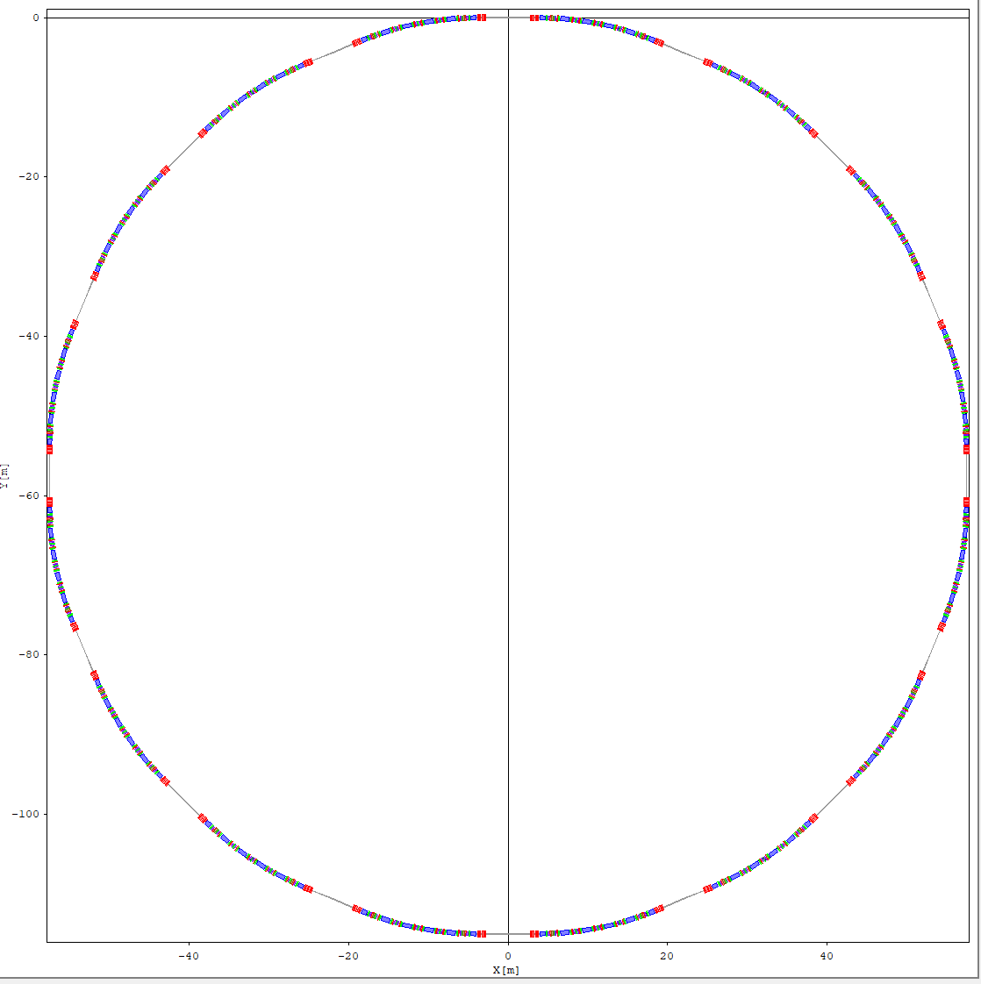
Some basics in accelerator design
Bessy III:
360m circumference
16-fold symmetry
Per super period (1/16th ):
  6 dipoles
  18 quadrupoles
  10 reverse bends
  34 sextupoles
  86 drifts
  ------------------
  160 devices with 1-3 parameters
  each to be optimized
Lots of symmetry conditions help!
Objectives: beam parameters
Constraints: size and technological
boundary conditions
Accelerator design
is a multi-objective
optimization task
in a large parameter
space.
MOGA approaches are
common (brut force)
There is a lot of physics
involved that can be used to
reduce the parameter space
In our case, to an almost
unique solution
One super period

Slide 5
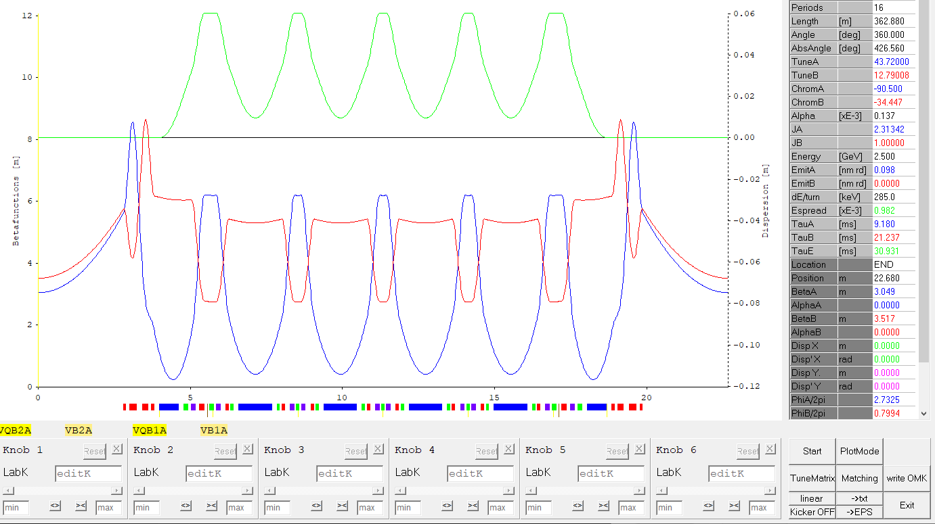
“Dispersion
suppression
cell”
OPA main panel – 1 super period
“Unit
Cell”
1/16 of ring
“straight”
Parameters calculated from input
and beta-functions
Beta-functions define the envelop
of the particle beam, their analysis
provides further
information on beam characteristics
Knobs / sliders to vary magnetic properties
Further options,
Like matching, set
reference points …

Slide 6
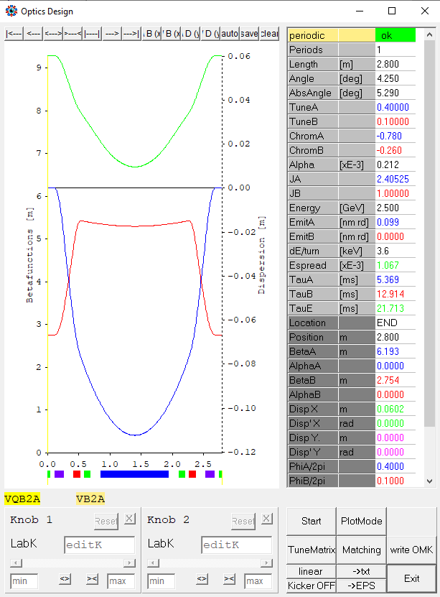
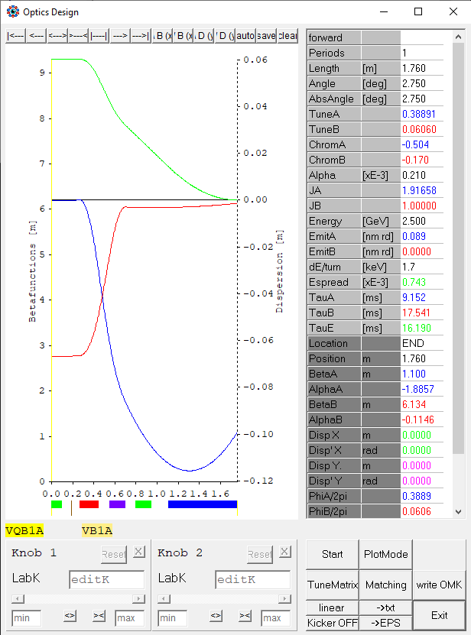
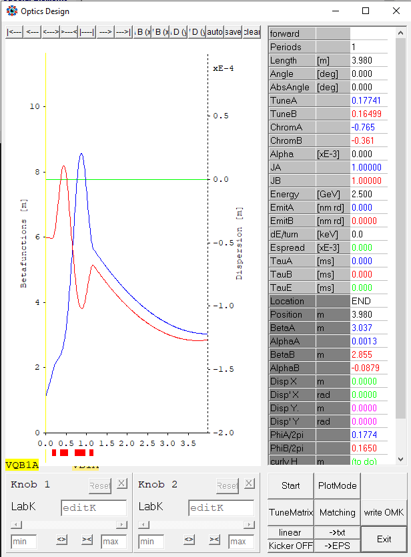
OPA strong points
OPA’s strong points:
Display of all necessary information at once
Intuitive display, magnets & lattice functions & derived parameters
Easy lattice segmentation ring, super period, subparts
Interactive: knobs and sliders to show impact of magnet changes
Direct link to matching, tune changes, data storage, …
“Unit Cell”
“Dispersion suppression cell”
We used these features extensively in the BESSY III design:
Analyze/understand/optimize substructures with few parameters
Combine lattice from optimized substructures
“Straight”

Slide 7
Further strong points
Further OPA strong points:
OPA is fast!
Easy installation: download the executable and start working
Completely stand-alone: no internet, additional libraries, etc. needed
Sub-menus cover all aspects of basic accelerator design in a ‘representative’ manner
  Not too sophisticated, but reliable (4D-tracking, restricted type of errors…)
No intent to be more detailed – need to switch to other codes for detailed studies anyway

Slide 8
Opa ⬄ other codes
OPA is sequential:
Other accelerator codes are ‘flat’:
Read the lattice
Read the lattice
(often full ring)
Get single parameters
Linear optics
Plot lattice functions
Non-linear optics
(sextupoles)
Off momentum optics
Layers can help
to structure
the project!
Match/optimize
RF parameters
Tracking
Non-linear optics
Octupoles
Touschek tracking
Non-linear optics
Tracking
….
Every ‘layer’ displays complete information
No information provided without being asked for

Slide 9
Summary
We want to keep most of OPA, but add few features:
Parameter scans
Option to compare two lattices
Display the initial situation against changes
Store RF parameters on the lattice file
Local RDTs
Im/e xport to pyat, spectra
Tracking with errors
…
Comments:
There are many accelerator programs on the market
All the physics has been programmed many times: reuse ⬄ program yourself
Emphasis on interactive graphics and speed
Thursday: Concentrate on OPA, exchange of information
Friday: Concentrate on project, workflow, interfaces, basic design choices

Slide 10
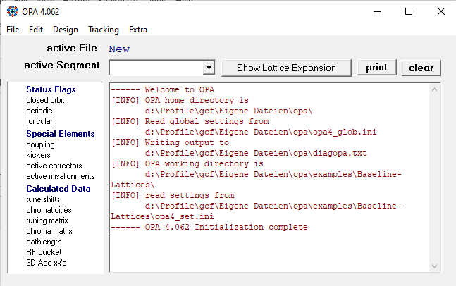
Main menu
Different topics:
Linear/nonlinear optics
Off-momentum optics
Longitudinal optics
Closed orbit correction
Injection
Magnet optimization
Different topics:
Phase space
Dynamic aperture
Touschek tracking
Different topics:
Magnet parameters
Output (none, rich)
Open close,
save, export
File editor
What has been done

Slide 11
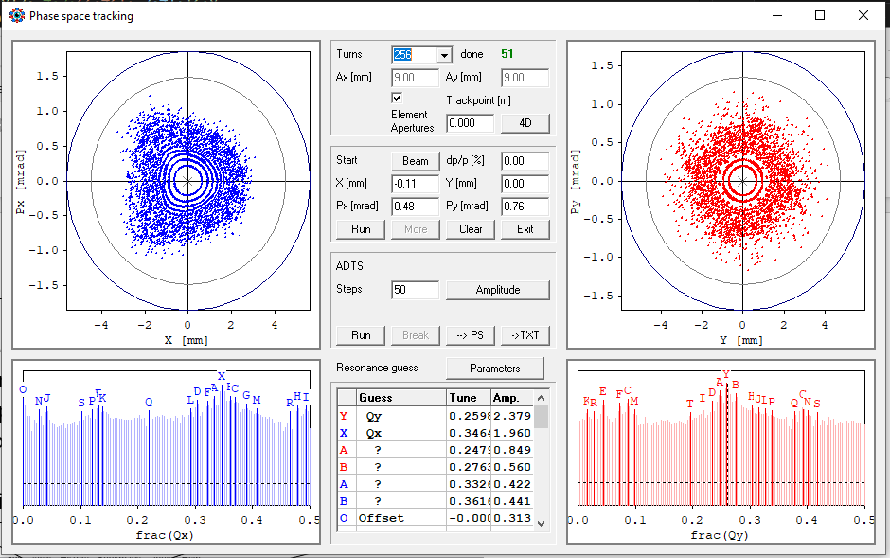
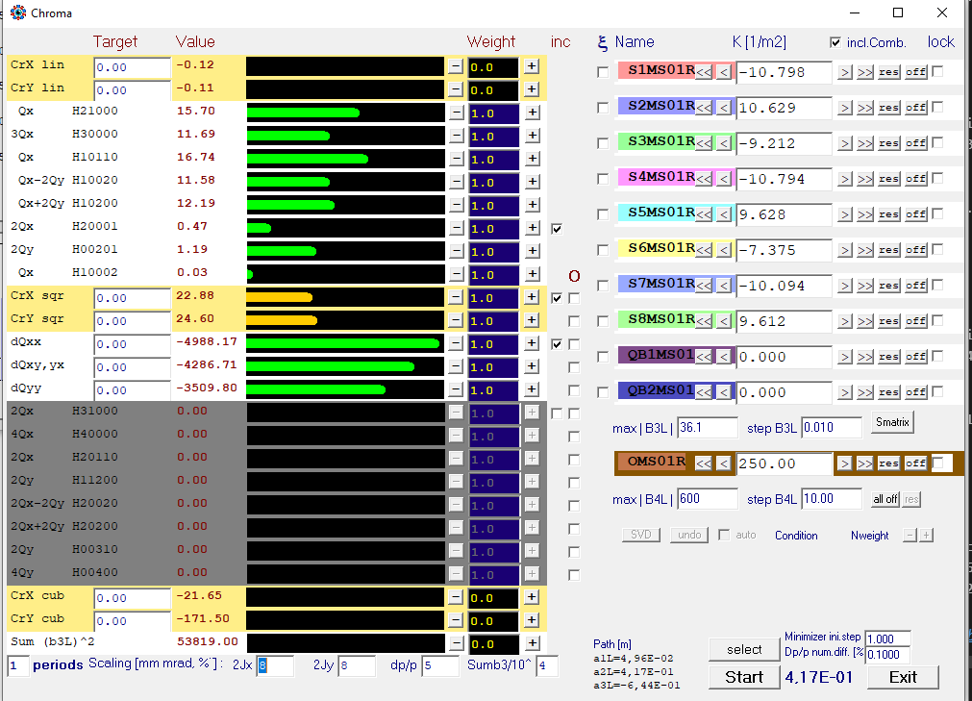
Sub-menus
Tracking -> phase space
Design -> nonlinear dynamics

