Slide 1
WP9 - Mass Spectrometry Network
Report Summary
ChETEC-INFRA 5th General Assembly

Slide 2
The goal of WP9 is to connect
High precision isotope analyses of physical samples and
Nucleosynthetic models of different stars
For both stable and radioactive isotopes

Slide 3
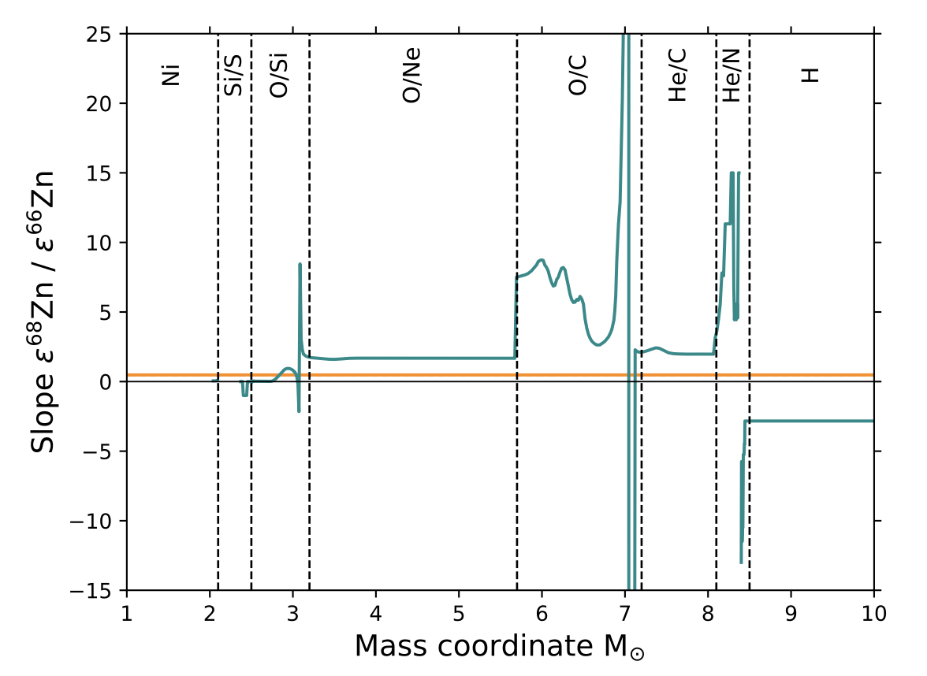
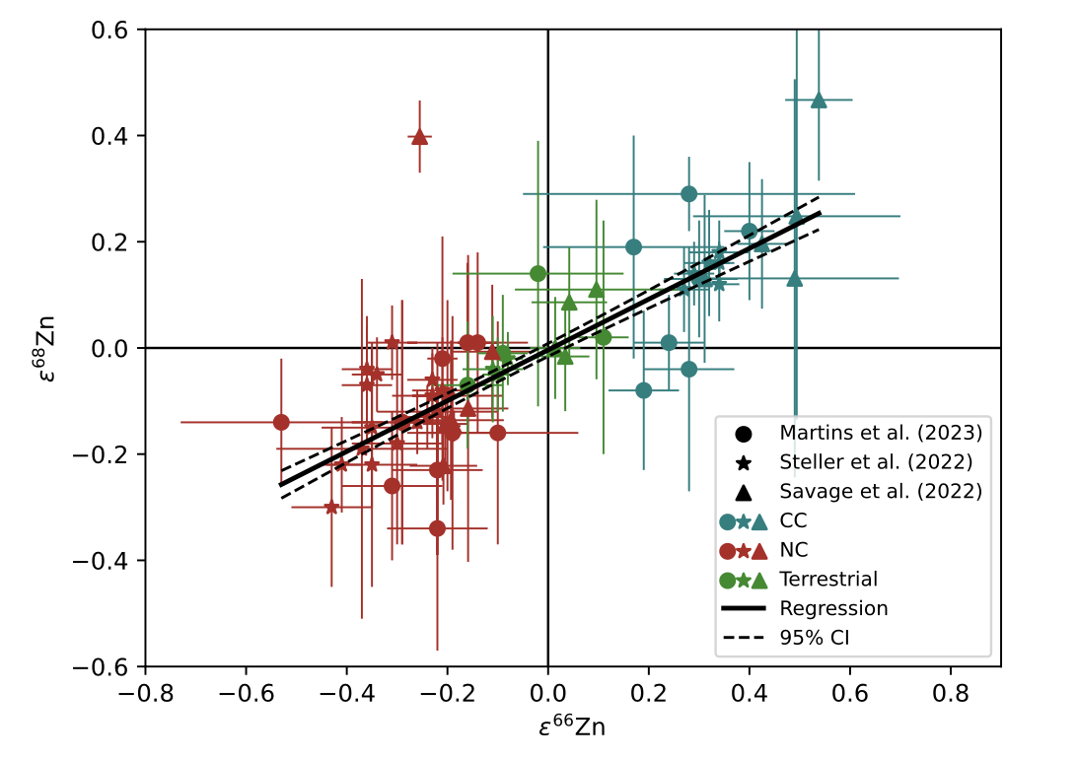
The goal of WP9 is to connect
High precision isotope analyses of physical samples and
Nucleosynthetic models of different stars
For both stable and radioactive isotopes
Zn isotope variation in meteorites
⬌

Slide 4
Summary of deliverables
D9.1 mathematical transformation from stellar yields to meteoritic bulk rock data (s-process example): delivered + paper published 2023
D9.2 compare core-collapse supernova yields to meteoritic bulk rock: delivered + paper to be submitted
D9.3 database of papers of meteoritic data: delivered
D9.4 code for implantation of noble gases into dust grains: delivered
NEW D9.5 database of results from D9.2: delivered at month 42 (to be updated together with submission of the D9.2 paper)
NEW D9.6 distribution of radioactive nuclei in the interstellar medium via diffusion: delivered at month 42

Slide 5
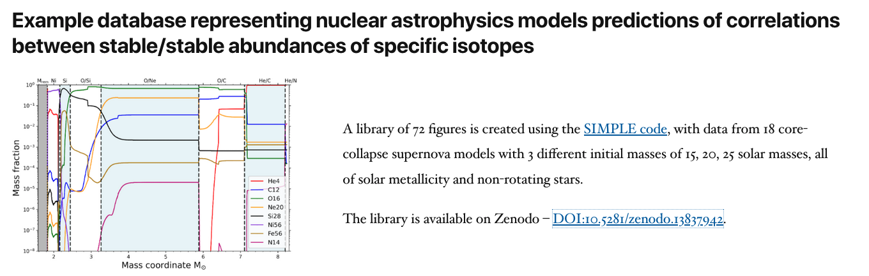
D9.5 – month 36 42
Created by Gábor Balázs

Slide 6
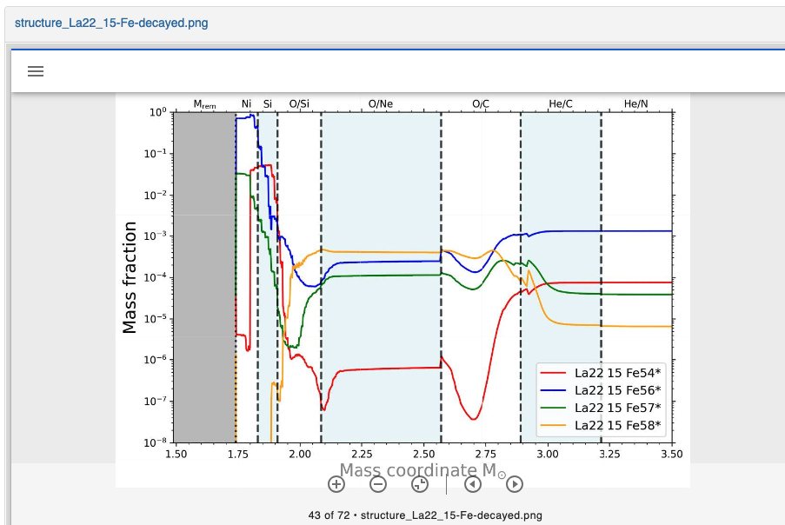
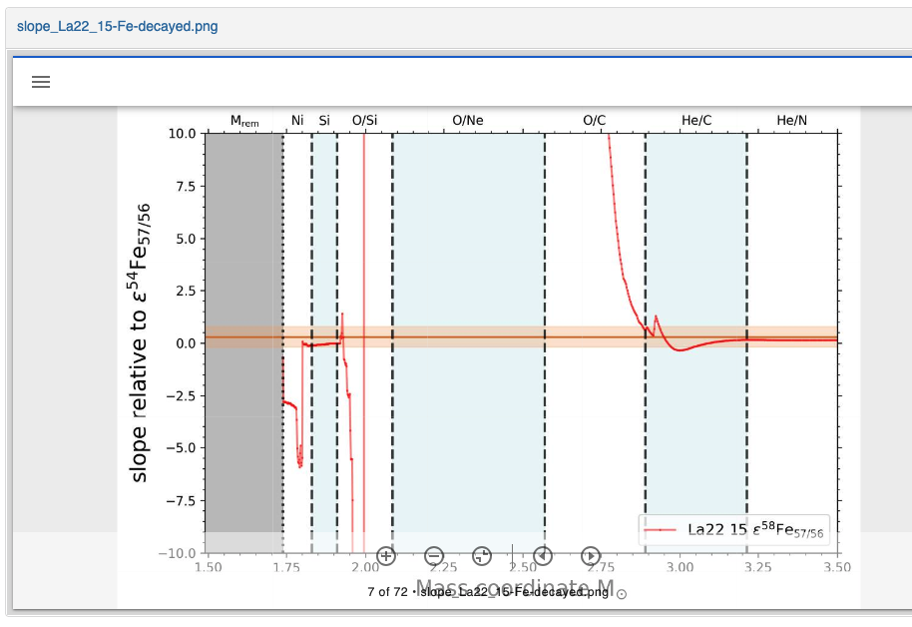
D9.5 – month 36 42
The example data base focuses on Fe and Ni
For each of 18 core-collapse supernova models (3 masses x 6 papers) there are two types of figures for both Ni and Fe for a total of 72 figures
1) “structure” = the isotopic mass fractions in the supernova ejecta
2) “slope” = the corresponding gradient of the correlation of isotopic ratios measured in meteorites

Slide 7
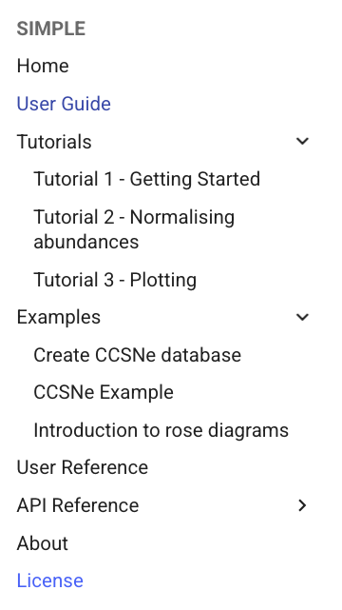
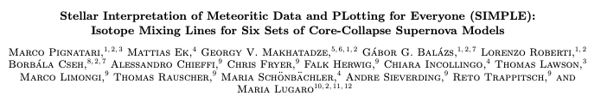
D9.5 – month 36 42
The database was generated using the SIMPLE code (delivered as D9.2). This code is still been improved, especially to make it as user-friendly as possible.
The working set-up is at
https://mattias-ek.github.io/SIMPLE/
including several tutorials
The work is currently being finalized for the submission (to Astrophysical Journal Supplements) of the related paper (full draft is ready)

Slide 8
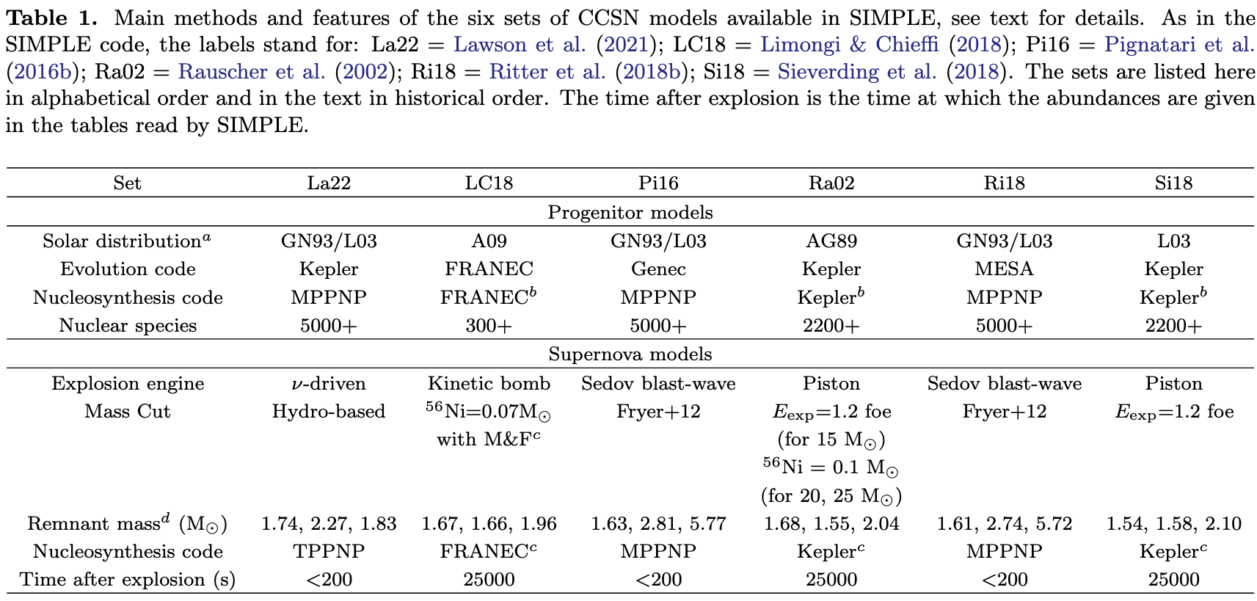
Solar metallicity
Initial masses: 15, 20, and 25 solar mass
Different codes, methods, and physics for both the progenitor and the explosive modelling; and different combinations of them
Table from the paper,
the variety of 18 core-collapse supernova models:

Slide 9
Solar metallicity
Initial masses: 15, 20, and 25 solar mass
Different codes, methods, and physics for both the progenitor and the explosive modelling; and different combinations of them
Table from the paper,
the variety of 18 core-collapse supernova models:
The point is to be able to evaluate at least qualitatively systematic uncertainties from stellar model nucleosynthesis predictions during the comparison between data and models

Slide 10
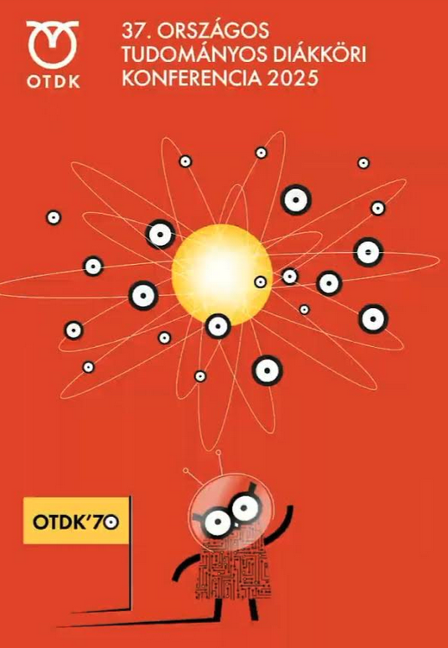

D9.5 – month 36 42
BSc student Gábor Balázs presented his work related to D9.2 and D9.5 at the Hungarian National Student Competition (OTDK) and won the second prize in the Solar System and Exoplanetary Systems Section

Slide 11
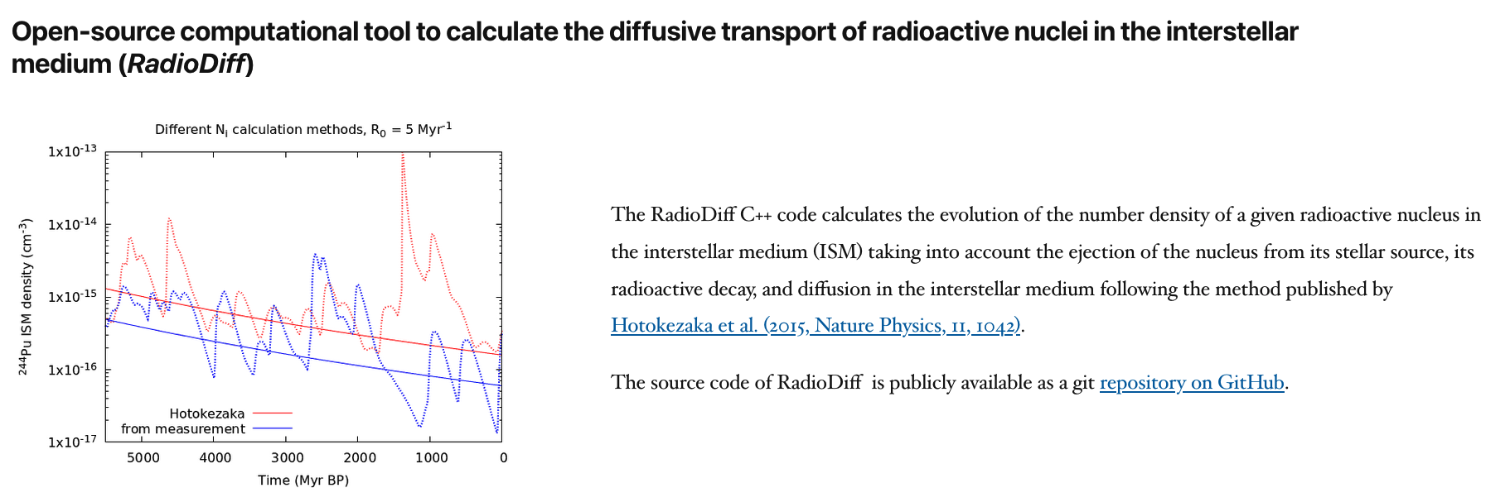
D9.6 – month 42
Created by Zsófia Stermeczky and Andrés Yagüe Lopéz
One parcel of the interstellar medium
median
Evolution of the ²⁴⁴Pu interstellar medium density using D9.6 RadioDiff C++ code:
Monte Carlo (random events in time and space) plus
diffusion in the interstellar medium
Based on the method of Hotokezaka et al. (2015)

Slide 12
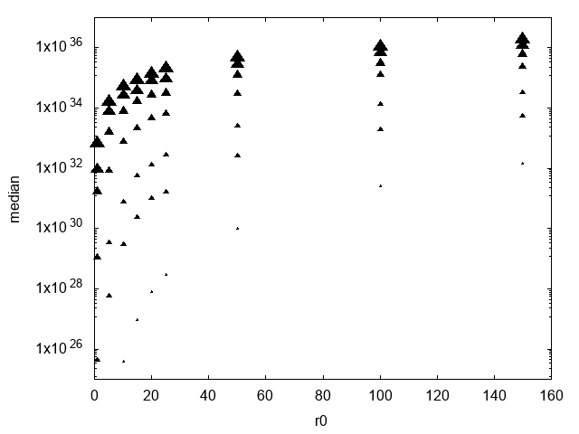
D9.6 – month 42
Created by Zsófia Stermeczky and Andrés Yagüe Lopéz
Beyond ²⁴⁴Pu: variable τ and event rate R₀
Example of work in progress
The median of n_{i} increases with the mean life τ of the isotope and with the event rate R₀, as it should.
We can test its behavior in detail
We will also test the σ around the median
τ
Longer-lived isotope
median of n_{i}
More frequent events
R₀

Slide 13
In Summary, all the deliverables have been produced, with a 6-month delay in D9.5.
On top of the ChETEC-INFRA website, dissemination of 4 out of 6 deliverables is also supported by other means
✅
Recorded as publication
✅
Recorded as publication
Publication? This will depend on resources at CSFK
✅
✅
Maintained at CSFK
Outlook: we are looking into the future of this network activity via supporting its development through grant applications
✅
Connected to publication D9.2
✅
Publication? This will depend on resources at CSFK

Slide 14
In Summary, all the deliverables have been produced, with a 6-month delay in D9.5.
On top of the ChETEC-INFRA website, dissemination of 4 out of 6 deliverables is also supported by other means
✅
Recorded as publication
✅
Recorded as publication
Publication? This will depend on resources at CSFK
✅
✅
Maintained at CSFK
Outlook: we are looking into the future of this network activity via supporting its development through grant applications
✅
Connected to publication D9.2
Thanks goes to everyone involved including BSc and PhD students!
✅
Publication? This will depend on resources at CSFK

