Slide 1
11–13 June, Prague, Czechia
What defines an academic event, and why are PIDs essential for it?
Stephanie Hagemann-Wilholt
PID Network DE Workshop “PIDs for academic events”, https://doi.org/10.25798/8jzc-sm02
Hannover, May 7, 2025

Slide 2
What is an academic event?
Opportunities …
for informal social exchange and networking
to gather knowledge and feedback – independently from sometimes lengthy publication cycles
to get a broad overview of new research topics and areas
Types
Conferences and series → incl. subconferences, umbrella & joint conferences, sessions
Workshops
Symposia
Colloquia
Seminars
…
Ziedorn, F. (2025). Icons for 10 PID Use Cases (1.0). Zenodo. https://doi.org/10.5281/zenodo.15173234

Slide 3
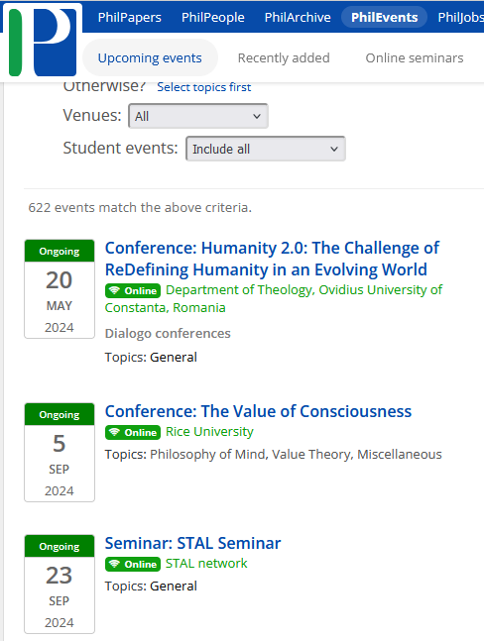
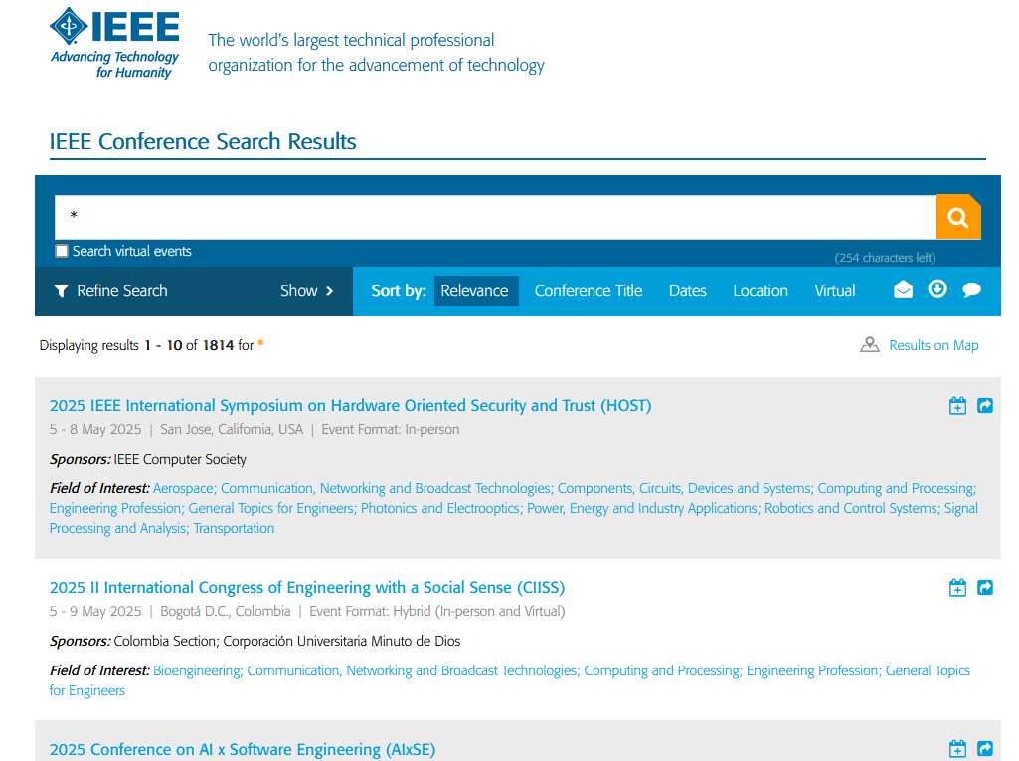
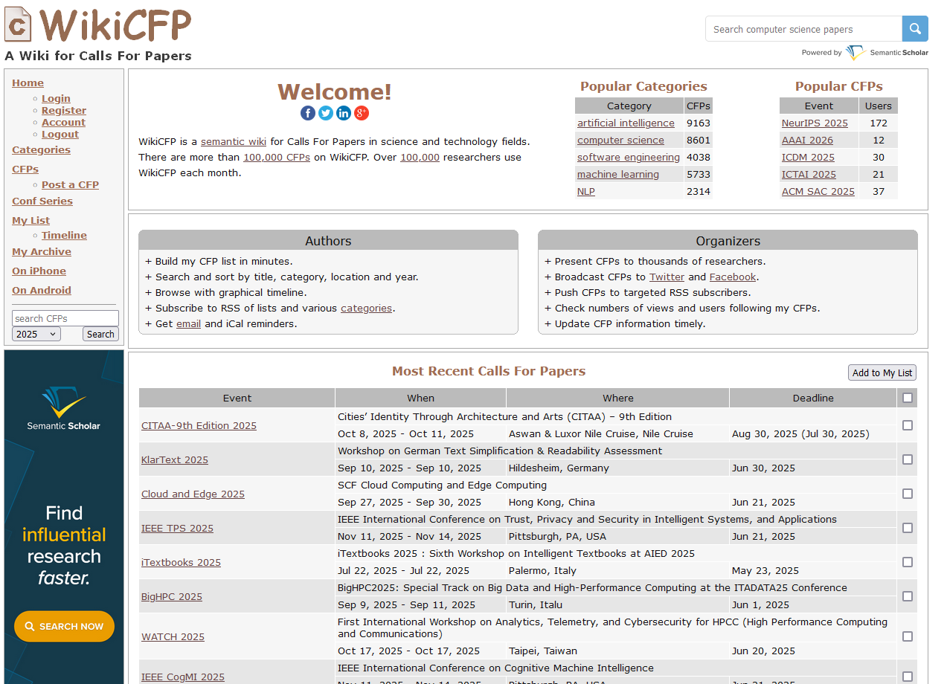
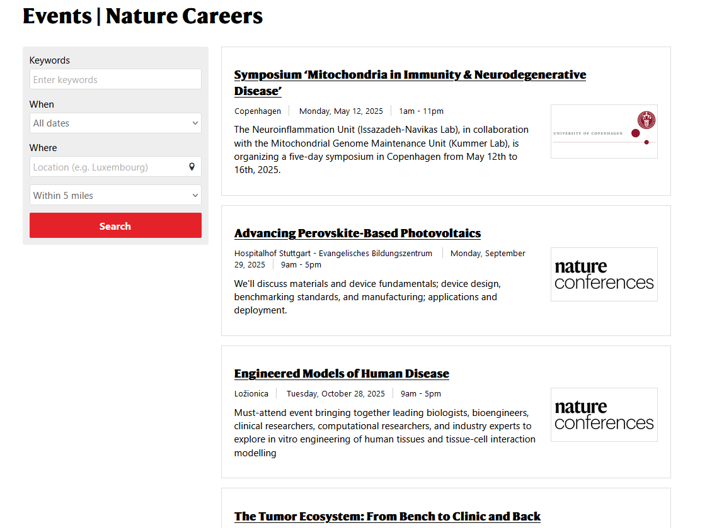
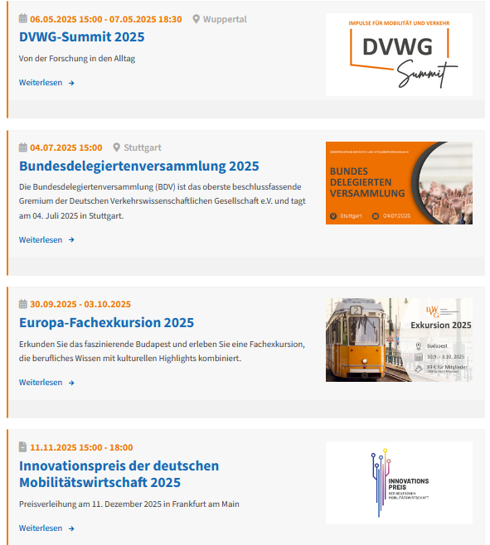
How to find academic events?
Methods of discovery
Listening to peer reccommendations
Browsing discipline-specific platforms and tools, newsletter
Analyzing conference proceedings
Using rankings
Selection criteria
Topic
Reputation
Manageable deadlines
Location
Publication opportunity
https://philevents.org/; https://www.dvwg.de/events/veranstaltungskalender.html; https://www.ieee.org/conferences/index.html; http://www.wikicfp.com/cfp/; https://www.nature.com/naturecareers/events/

Slide 4
How to find academic events?
Challenges from metadata perspective
information on events is spread across many sources
long-term preservation of data
great variation of metadata across services and disciplines → missing interoperability
dependencies on commercial providers
quality assessment of events
Consequences
reduced discoverability
loss of academic record
reduced comparability of information
overreliance on commercial platforms

Slide 5
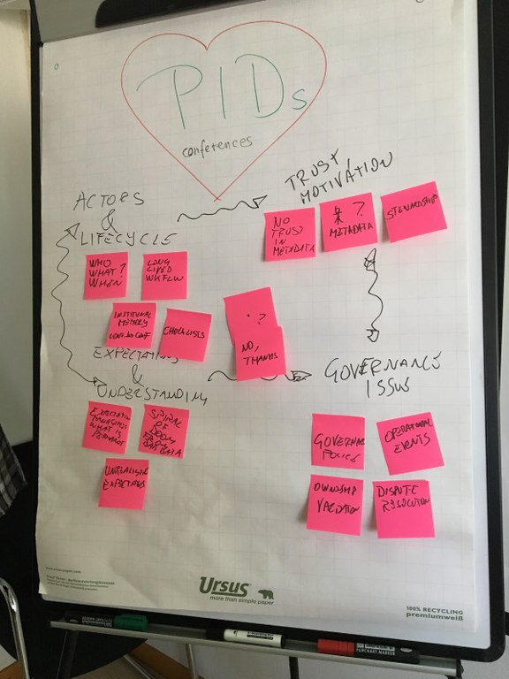
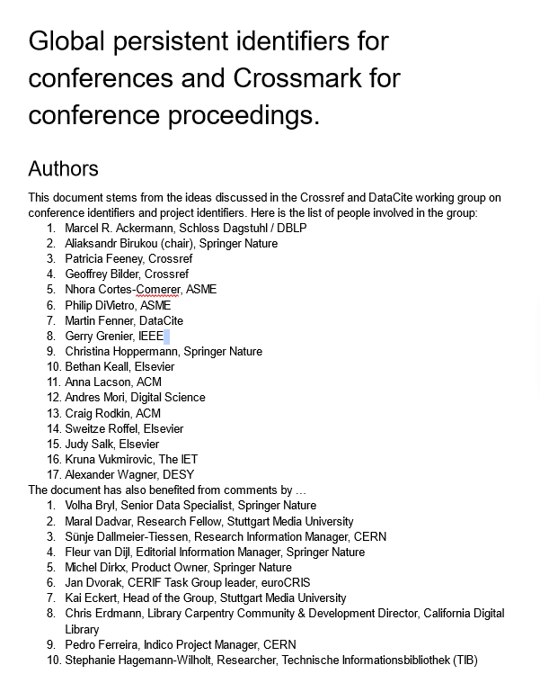
Facing the challenges with PIDs
Why do we need them?
→ Disambiguation of (meta)data
→ Machine-readable metadata
→ Provenance information to increase research integrity
Who needs them?
→ All stakeholders of academic events
What has been done so far?
→ Library standards
→ Conference Platforms with internal IDs
→ Working group on PIDs for Conferences
Ackermann et al. (2018): Global persistent identification for conferences and Crossmark for conference proceedings.
Birukou et al. (2019): Towards Persistent Identification of Conferences. URL: https://www.project-freya.eu/en/blogs/blogs/towards-persistent-identification-of-conferences

Slide 6
What is ?

Slide 7
Event Lifecycle
Data Consumer
Organizer
Organizer:
Organization Committee
Programme Committee
Reviewer
Researcher
Research Organizations
Mode
Topic
Announce- ment
Data Provider & Consumer:
Researcher
Libraries
Research Organizations (CRIS)
Publisher
PID Provider
Conference Management Systems
Conference Aggregation Platforms
Projects and Initiatives
Citation
Initialisation
CFP
Data Provider
Review
Indexing
Referencing
Programme
Release
Proceedings
Regri- stration
Data
Output
Event
Videos
Location
Poster
Duration
Presen- tations
Research Community:
Individual Researcher
Research Organizations
Learned Societies
Community Initiatives
Funding Agencies
Phase
Slides
Infrastructure Services
Abstracts
Documen- tation
Discus- sions
Step
Research Community
Stakeholder

Slide 8
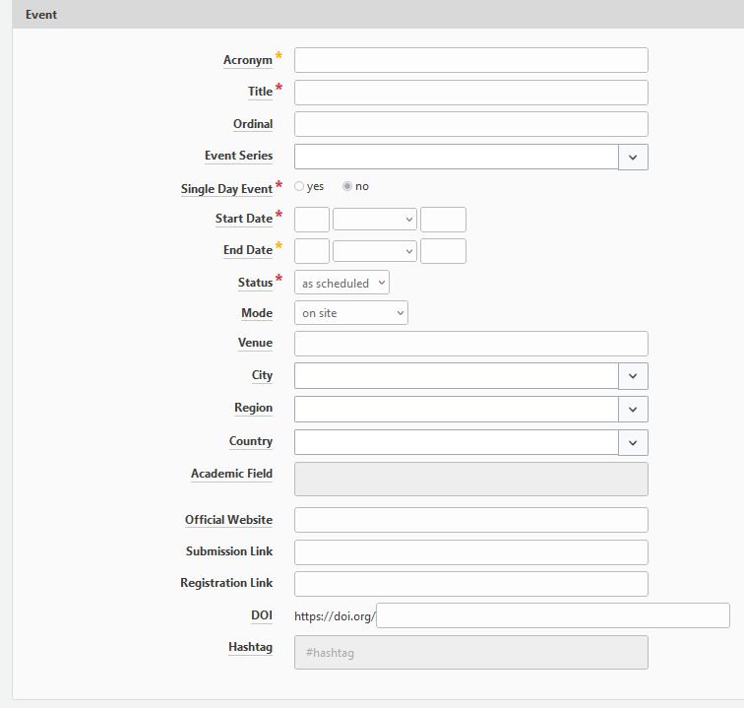
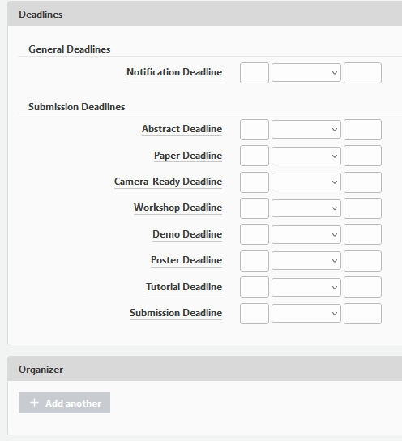
Selected Features of

Slide 9
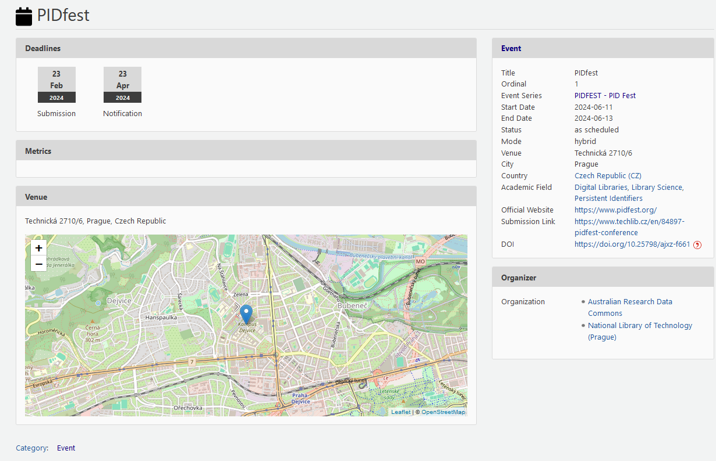
Metadata
Mapping on DataCite Metadata Schema
→ Guidelines on interpretation of schema
Development of Academic Event Ontology (AEON)
Re-usability: CCO Licence
ConfIDent Prototype:
Structured metadata
Focus on core metadata for unique identification
ConfIDent DOI: https://doi.org/10.25798/ajxz-f661

Slide 10
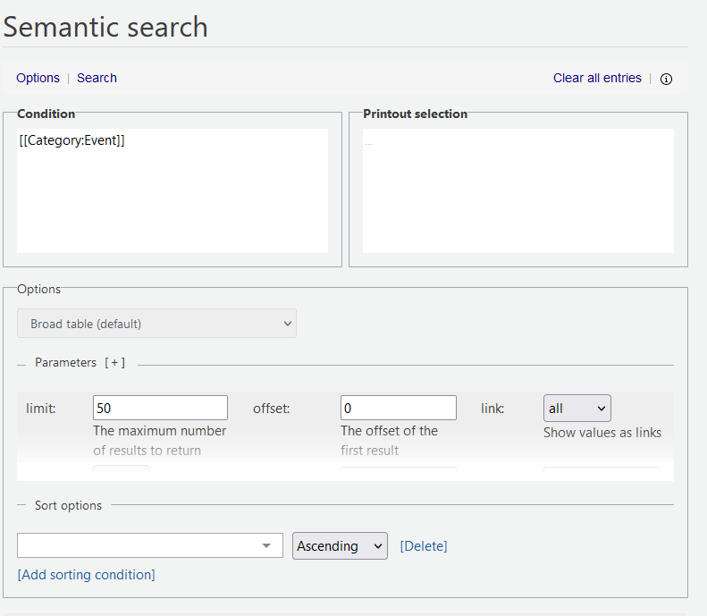
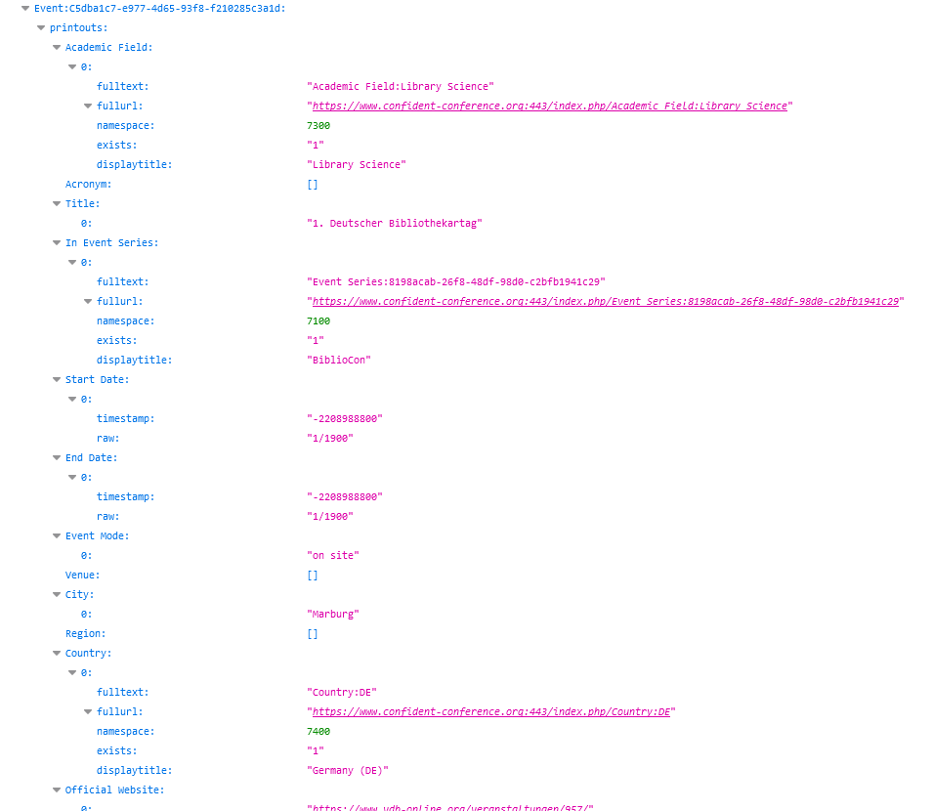
API
More information: https://www.confident-conference.org/index.php/Help:FAQ#How_to_use_the_API

Slide 11
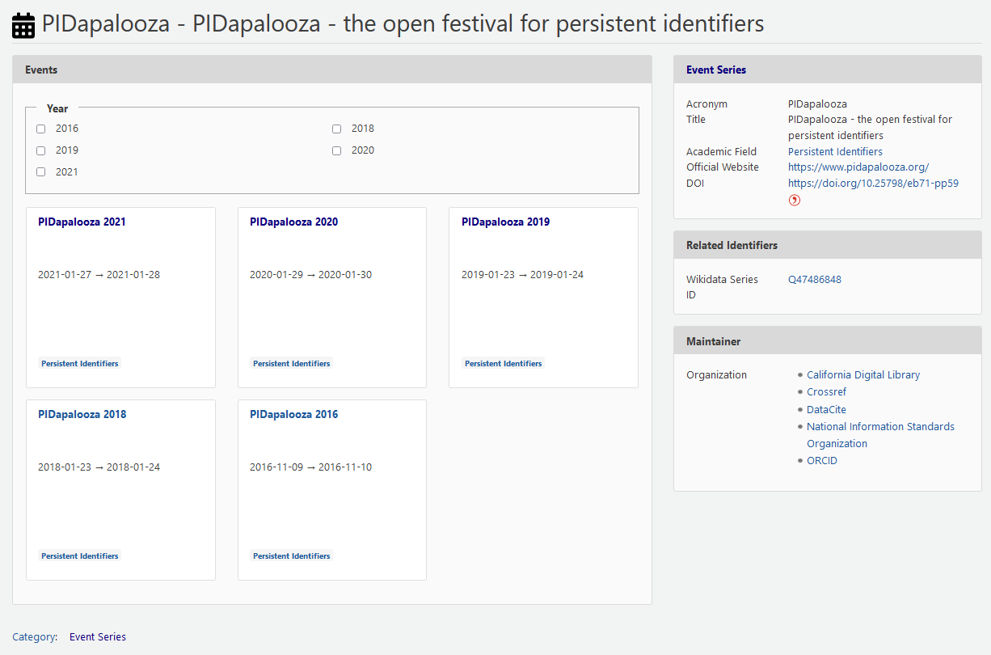
Linking of…
… events to event series,
… series DOI to other (P)IDs
ConfIDent DOI: https://doi.org/10.25798/eb71-pp59

Slide 12
Linking of…
… events to organizer
<identifier identifierType="DOI">10.25798/AJXZ-F661 </identifier>
<creators>
<creator>
<creatorName nameType="Organizational">Australian Research Data Commons</creatorName>
<nameIdentifier nameIdentifierScheme="ROR" schemeURI="https://ror.org">https://ror.org/038sjwq14</nameIdentifier>
</creator>
<creator>
<creatorName nameType="Organizational">National Library Of Technology</creatorName>
<nameIdentifier nameIdentifierScheme="ROR" schemeURI="https://ror.org">https://ror.org/028txef36</nameIdentifier>
</creator>
</creators>
<titles>
<title xml:lang="en">PIDfest</title>
</titles>

Slide 13
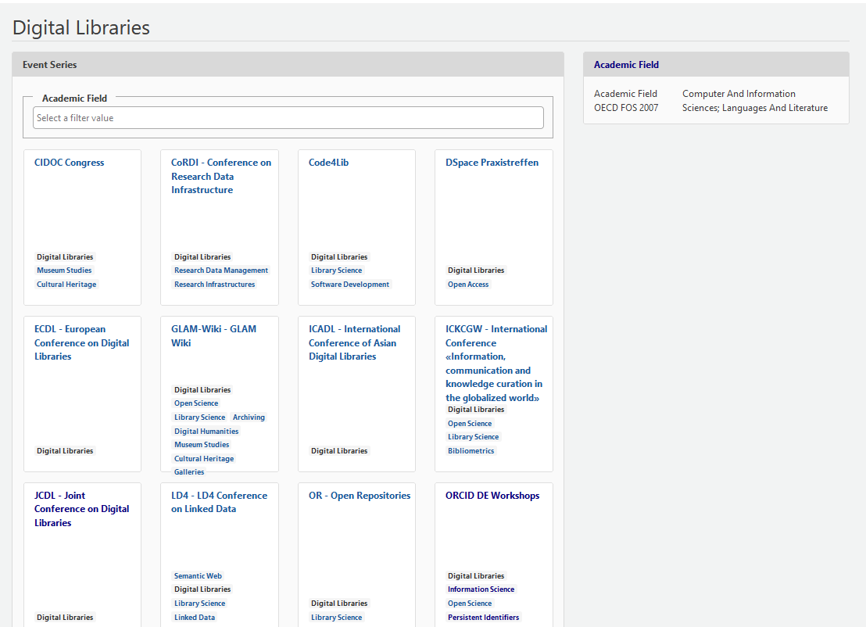
Linking of…
… events and event series to subject classification
<subjects>
<subject subjectScheme="Fields of Science and Technology (FOS)" schemeURI="http://www.oecd.org/science/inno/38235147.pdf" classificationCode="1.2" >FOS: Computer and information sciences</subject>
</subjects>

Slide 14
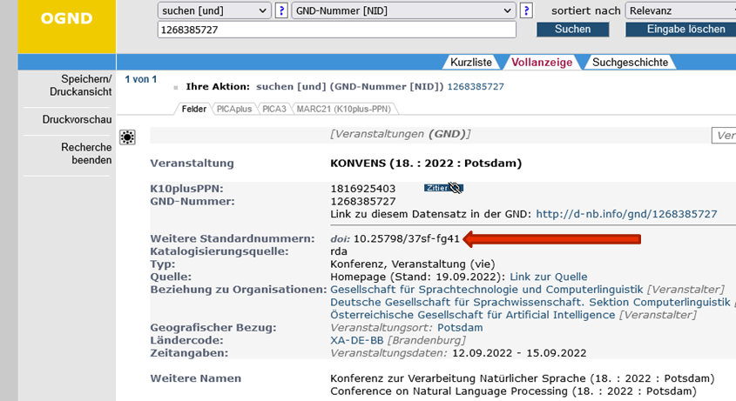
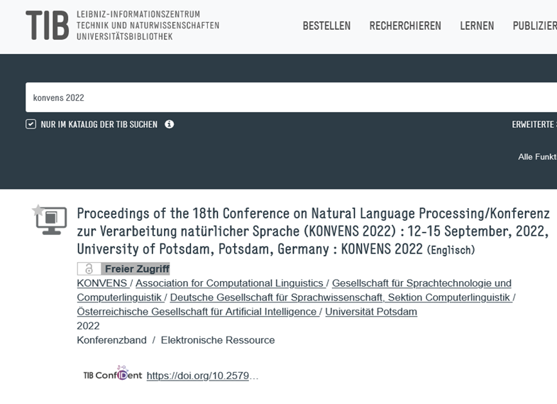
Linking to …
… other event identifiers: … proceedings

Slide 15
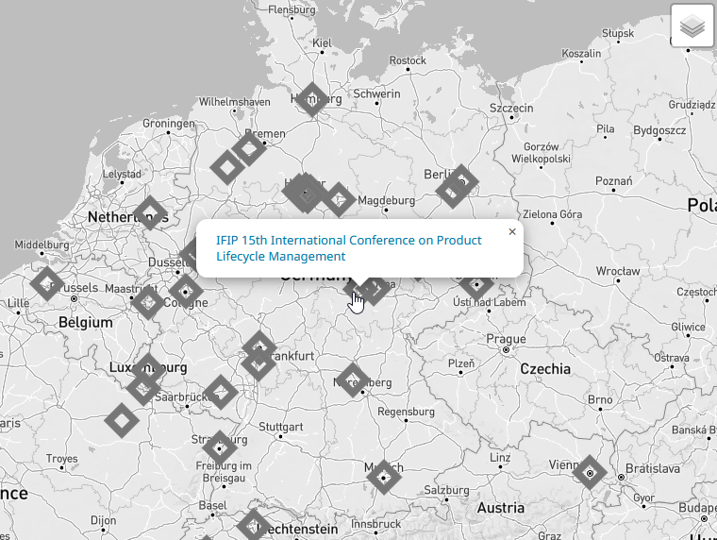
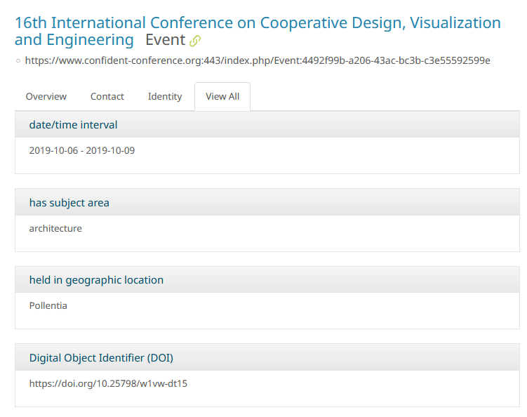
Re-use
https://forschungsatlas.fid-bau.de/events
https://forschungsatlas.fid-bau.de/individual/4492f99b-a206-43ac-bc3b-c3e55592599e

Slide 16
Outlook
Metadata
Automatization of workflows
Further integration of data model to include output, people, programs, incl. (P)IDs → linking entities
Collection at early stage of event life cycle (via CMS) → subsequent use in RIS, discovery services and open metadata services
…
Technical Base
Automatization of workflows
Enable writing API access
Optimized search
Improve usability
…
Community
Building communities around disciplinary and subject-specific areas
support research on scientific events
support alternative research assessment
…

Slide 17
How to use ?
https://www.confident-conference.org
Request an account

Slide 18
Contact:
confident@tib.eu
www.confident-conference.org

