Slide 1
Metadata for Academic Event PIDs
Robin Kraus
Leibniz Information Centre for Science and Technology (TIB)

Slide 2
What is …
… an (academic) event?
→ Depending on definition (and interpretation)
… the thing an event(ish) DOI is attached to?
→ Depending on metadata schema (and interpretation)
metadata set of the event (e.g. GND, ConfIDent)
metadata set of conference (proceedings) and the conference (CrossRef)
metadata set of event-related resource (information material, contribution, output) or the event (DataCite)
ConfIDent Basic Definitions (Draft):
“An academic event is […] a format for conveying the latest scientific outputs. It is defined by the meeting of researchers at a specific time and place (virtual or physical) and with a specific thematic focus to present, hear and discuss these outputs. In contrast to other forms of events, academic events should primarily serve the exchange of results and methods of scientific research and their didactic mediation. Furthermore, a significant participation of scientific organizations in the realization of an academic event is constitutive for this type of event […].”
DataCite Metadata Schema Documentation:
Event
Description: A non-persistent, time-based occurrence.
Examples and Usage Notes: Descriptive information and/or content that is the basis for discovery of the purpose, location, duration, and responsible agents associated with an event such as a webcast or convention.
https://datacite-metadata-schema.readthedocs.io/en/4.5/appendices/appendix-1/resourceTypeGeneral/#event
CrossRef Conference Proceedings Markup Guide:
Conference deposits require metadata about the event (captured in <event_metadata>) such as conference name (required) and theme, acronym, sponsor, location, and date (all optional), and proceedings-specific metadata such as a proceedings title, publisher, and date (all required) and subject (optional).
https://www.crossref.org/documentation/schema-library/markup-guide-record-types/conference-proceedings/

Slide 3
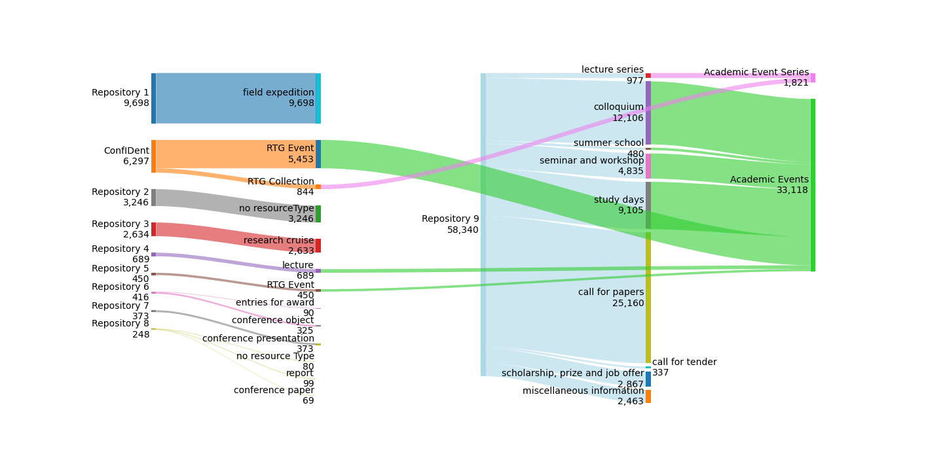
DataCite Event-DOIs: Resource Types
ConfIDent: Repository of ConfIDent service
Repository 4: Institutional repository of technical university
Repository 5: Institutional repository of independent research institution
Repository 9: Repository of academic event calendar service
Numbers as of 30 April 2025

Slide 4
DataCite Event-DOIs Metadata: Organizers & Organizing Institutions
Which metadata field for …
The organizing of academic events
is necessary for academia
takes time and resources
is still undervalued in research evaluation
→ Inclusion in metadata can help to make this fairer
The role of organizer (particular to use case „academic event“) is not specified in (generic) DataCite metadata schema
→ Interpretation of metadata fields
is necessary, but reduces comparability
Persons as organizers | Persons providing content
Confident: [Creators - not yet implemented] | Confident: [Contributors - not yet implemented] → via relatedIdentifiers
Repo 4: no systematic mention | Repo 4: Creators
Repo 5: Creators (if event = parent event) | Repo 5: Contributors (if event = parent event), Creators (if event = presentation, part of parent event)
Repo 9: [partly Contributors] | Repo 9: no systematic mention [partly Creators and/or Contributors]
Institutional organizers
ConfIDent: Creators
Repo 4: ~ Publisher
Repo 5: ~ Publisher
Repo 9: no systematic mention

Slide 5
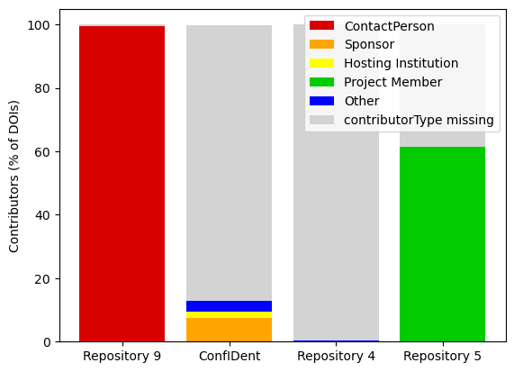
DataCite Event-DOIs Metadata: Contributor Types

Slide 6
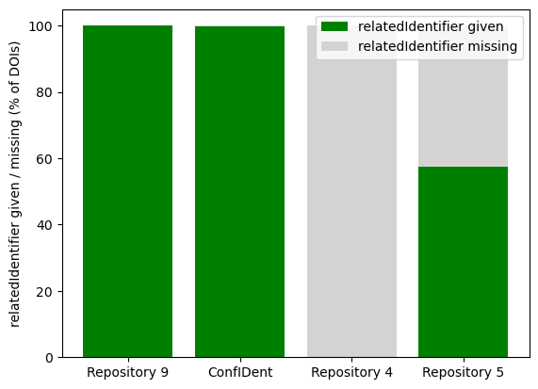
DataCite Event-DOIs Metadata: Related Identifiers
Relation Types of Related Identifiers:
Repository 9:
IsPartOf: given for 100 % of DOIs; 100 % of relatedIdentifiers → 100 % ID of repository-related service
ConfIDent:
IsPartOf : given for 98 % of DOIs; 47 % of relatedIdentifiers
→ event series (RTG: collection)
IsDocumentedBy : given for 21 % of DOIs; 10 % of relatedIdentifiers
→ conference proceedings, recordings, presentations/slides, pdf of program, …
IsDescribedBy : given for 74 % of DOIs; 35 % of relatedIdentifiers
→ original event website (by hosting institution)
IsReviewedBy : 2 occurances
→ link to review process information
IsSupplementedBy : given for 15,6 % of DOIs; 7,4 % of relatedIdentifiers
→ conference proceedings, presentations …
Total connections by relatedIdentifier : ~ 2 per DOI on average
Repository 5:
HasPart : given for 51 % of DOIs; 95 % of relatedIdentifiers
→ recordings or metadata sets of contributions IsPartOf : given for 12 % of DOIs; 4,7 % of relatedIdentifiers
→ parent event
Total connections by relatedIdentifier : > 2 per DOI on average

Slide 7
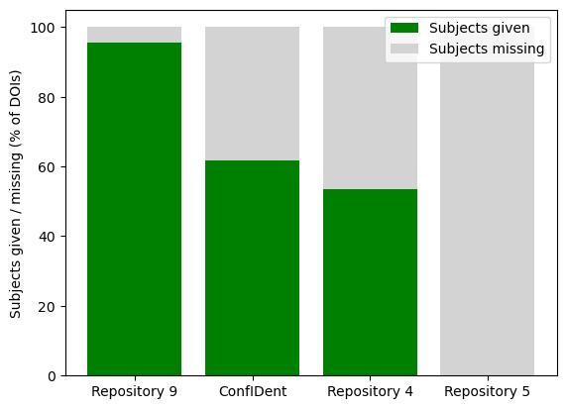
DataCite Event-DOIs Metadata: Subjects
Repository 9:
Subject scheme: internal
Strong bias towards humanities
ConfIDent:
Subject scheme: Fields of Science
Strong bias towards pilot communities (engineering, computer and information sciences, transport and mobility)
Repository 4:
Partly subject, partly subject scheme, partly document/resource type information
→ Different standards and interpretations of metadata fields reduce comparability

Slide 8
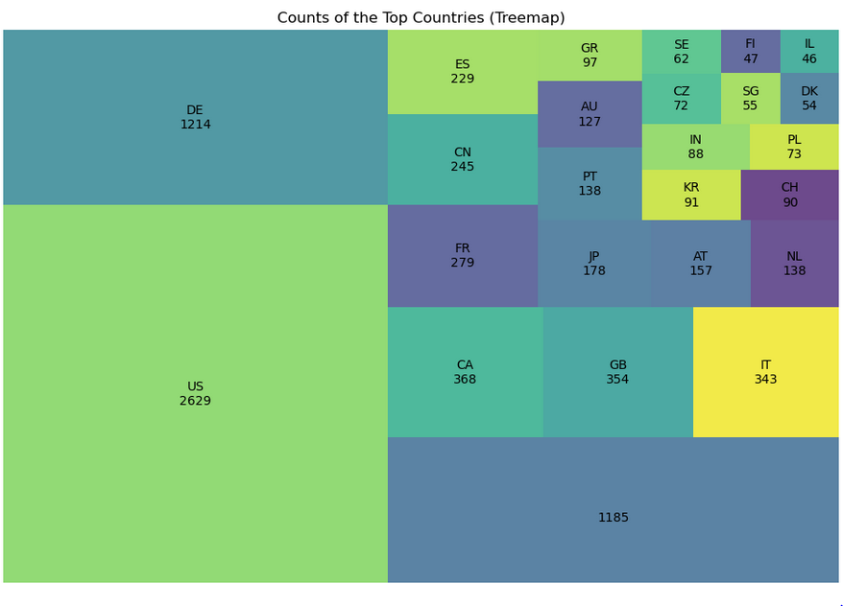
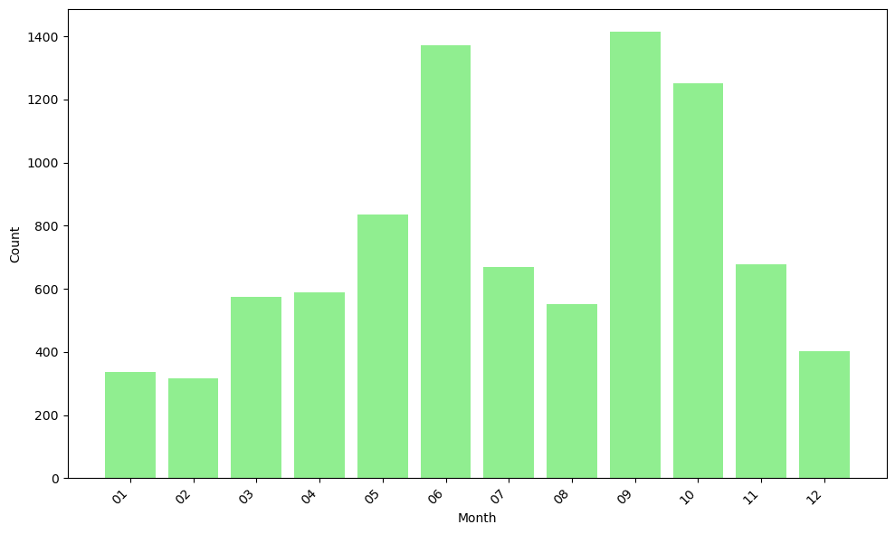
Metadata: Geolocations & Conference Seasons
Academic event counts, top 25 countries
Academic events per month (accumulated)
Analysis based on event metadata sets registered in ConfIDent, 28 May 2024 and 30 May 2024

Slide 9
Thank you for your attention!
Contact: pid@tib.eu

