Slide 1
Modeling the Galactic Chemical Evolution of Dwarf Galaxies IC 10 and IC 1613
Uniquer-Process Laboratories?
By
GURUPRASAD YAGADEVAN
University of Wroclaw

Slide 2
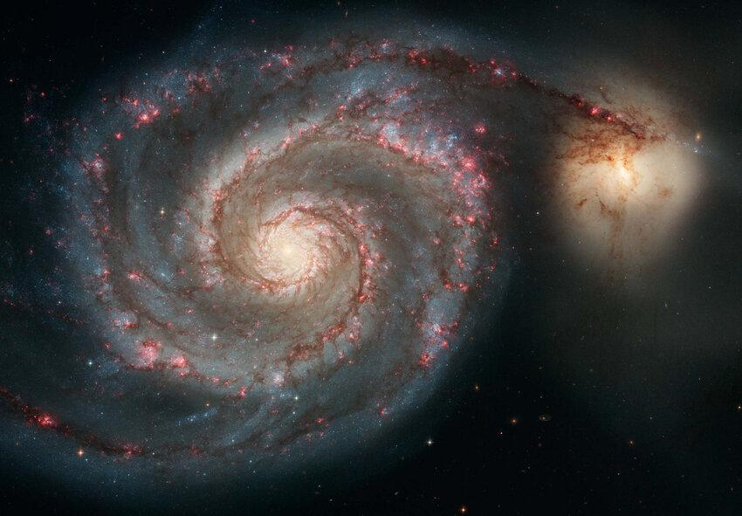



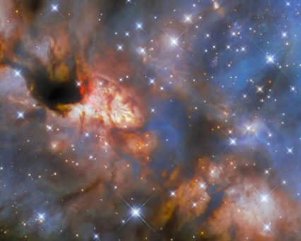
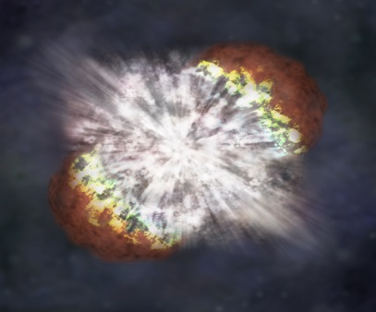
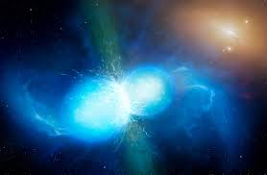

GALACTIC CHEMICAL EVOLUTION
Exploring the origins of elements in the universe
Formation of Elements
Source: NGC 5194 (Credits: nasa.gov), ESA/Hubble & NASA, R. Fedriani, Illustration: NASA/CXC/M.Weiss, University of Warwick/Mark Garlick

Slide 3
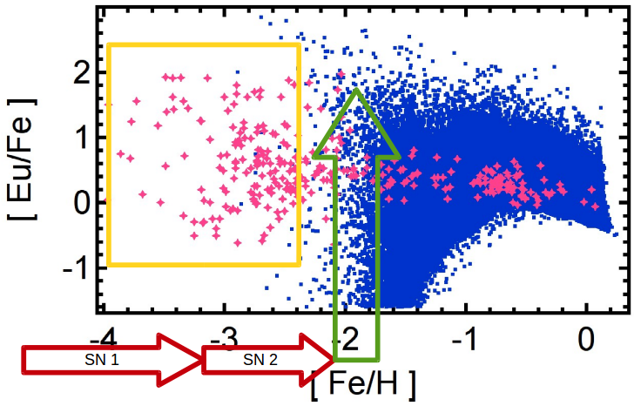
Research Question
But in low-metallicity region, highly r-process enhanced stars have been detected! (yellow box)
Can not be explained by NSMs! Need for further modeling.
Classical r-process site, (Neutron star mergers, NSM) requires 2 neutron stars, hence 2 supernovae! (2 red arrows)
2 Supernovae eject Fe twice, so NSM happens in a metal-rich environment
Figure: alpha element metallicity.
Source: Wehmeyer et al., 2019, 2019a.

Slide 4
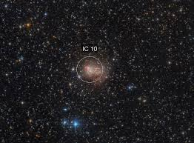
Earlier Approaches And Problem
NSMs in low star formation efficiency environments (e.g., dwarf galaxy systems) can contribute r-process elements at lower metallicities.
Problems with Dwarf galaxy systems:
Gravitational retention potential, gravitational friction, mixing/dissolution of other sub-systems,……
We suggest a new object: IC10
Irregular dwarf galaxy at 750 ± 150 kpc distance from Milky Way
Shows no sign of any previous interactions with its neighbors
Is massive enough to retain r-process ejecta
Alpha elements have already been modeled
Good chances to be the REAL unique laboratory for the r-process!

Slide 5
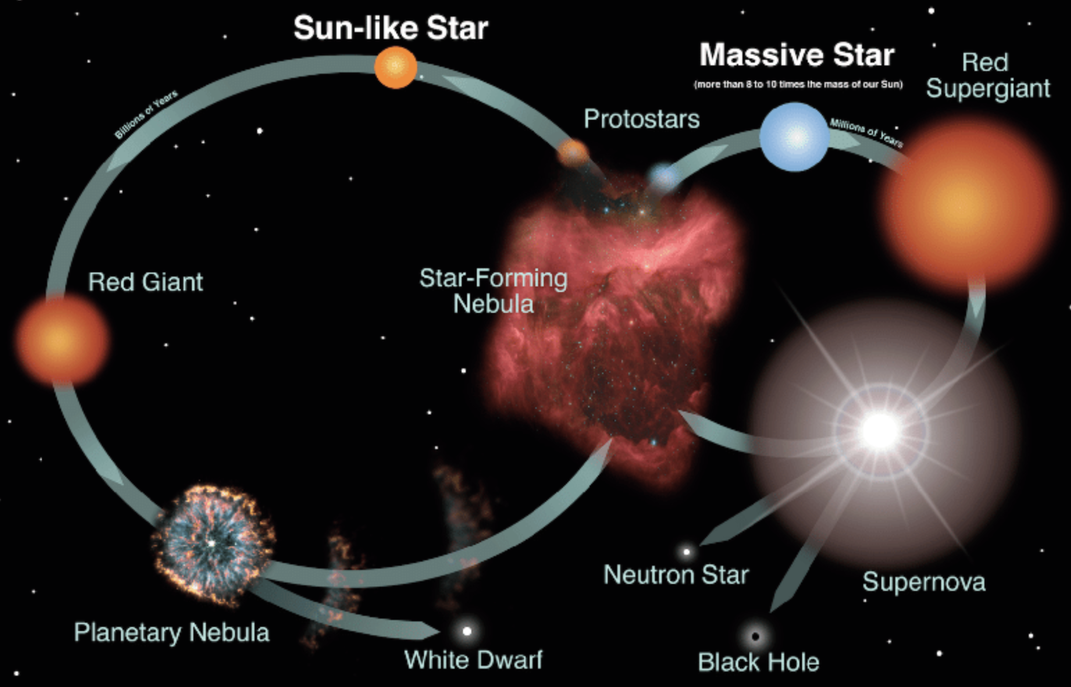
GALACTIC CHEMICAL EVOLUTION MODELING
. . . .
Supernovae
Star formation history
Stellar Feedback
Yields
Supernova/merger rates
. . . .
. . . .
Gas inflow
Gas outflow
Star mass
Mass distribution
Primordial Gas
. . . .
Figure credits: NASA/JPL, Astronomical Society of the Pacific
Star formation history, Star formation efficiency, Neutron star mergers. . . .

Slide 6
Omega code
NuPyCEE suite
GCE in single-zone framework
Star Formation Efficiency (SFE)
Inflow/Outflow efficiencies
Stellar yields, Delay-Time Distributions (DTD)
Star Formation Histories (SFH)
Tracks gas mass, SFR, stellar mass, and elemental abundances
Includes inflow and outflow processes
Uses stellar yields from AGB stars, SNII, SNIa
Chemical evolution modeling of galaxies
Teaching & prototyping
Interpreting observed abundance patterns
Source: Côté+17

Slide 7
Changes made in Omega code
Original Omega code | Changes we made
Handles only constant SFE | Made it to handle variable SFE(star bursts)
Works with only well developed Galaxies and selected Dwarf Galaxies | Made changes to work with Isolated Dwarf Galaxies
Needs SFH as file input to run GCE | SFH is implicitly calculated with in the code using SFE and other parameters
Needs Mass-loading to calculate outflow which is dependent on SFR | Outflow is calculated independently and SFR is calculated from Outflow, Inflow, SFE
Takes defeat NuGrid yield tables | Made availability of flexible yield tables

Slide 8
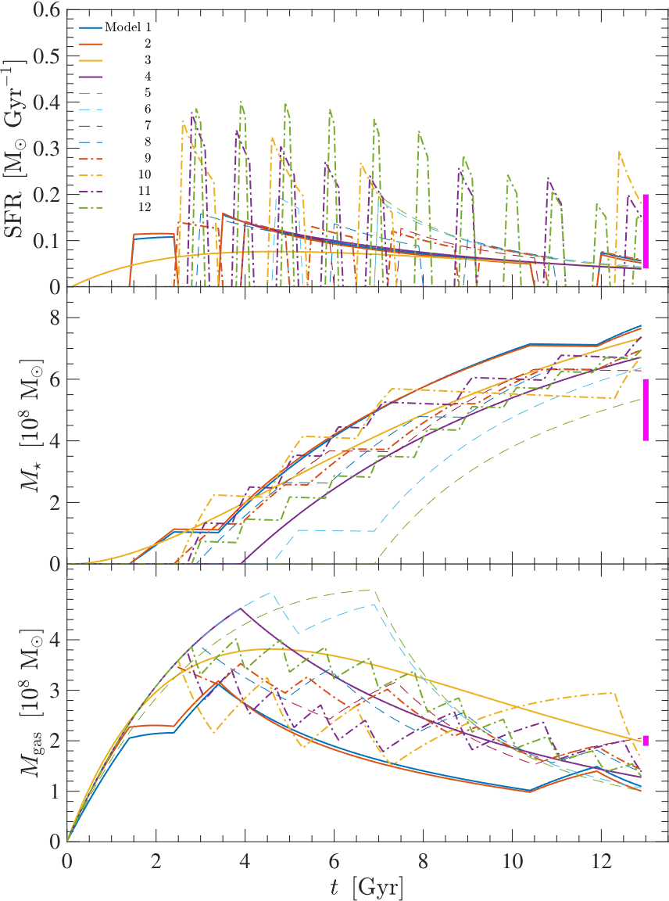
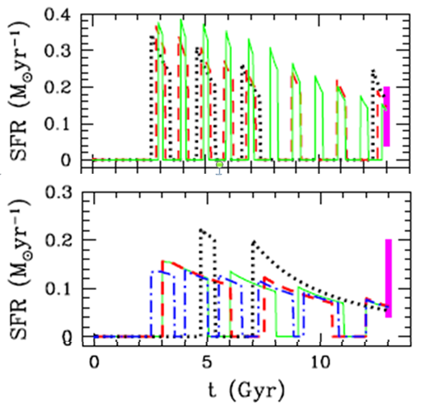
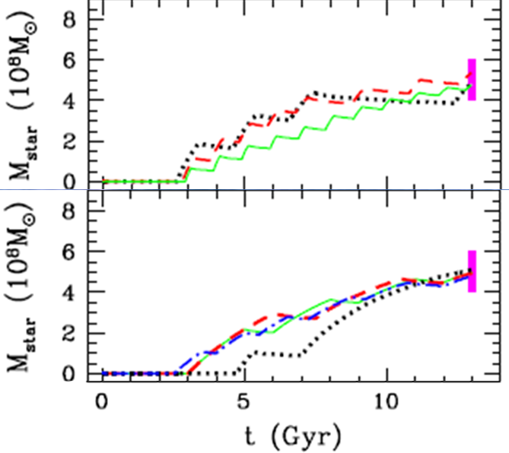
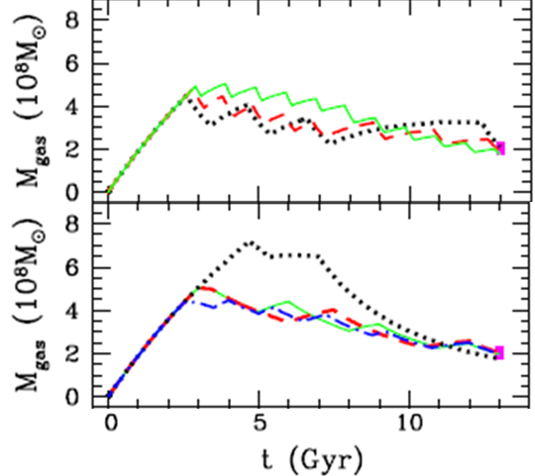
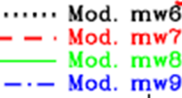

Calibrating the Model
Mode recreation

Slide 9
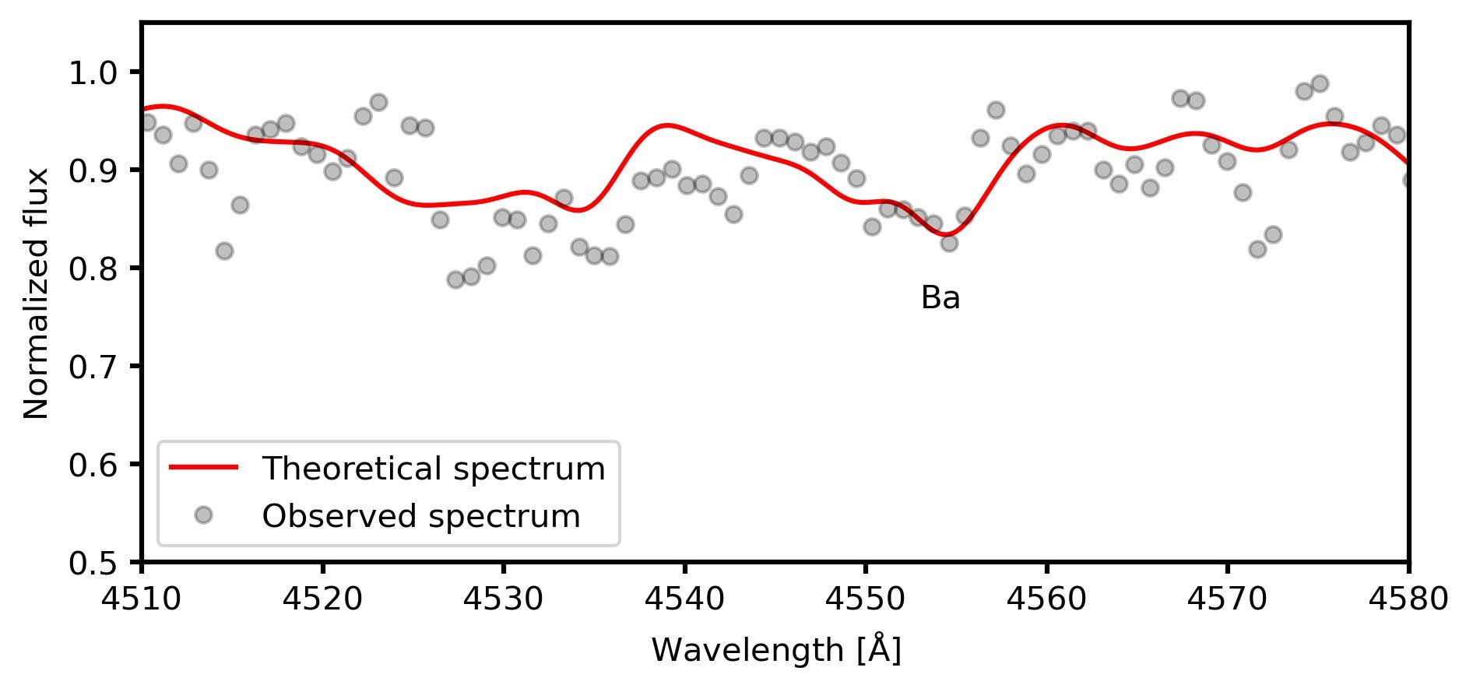
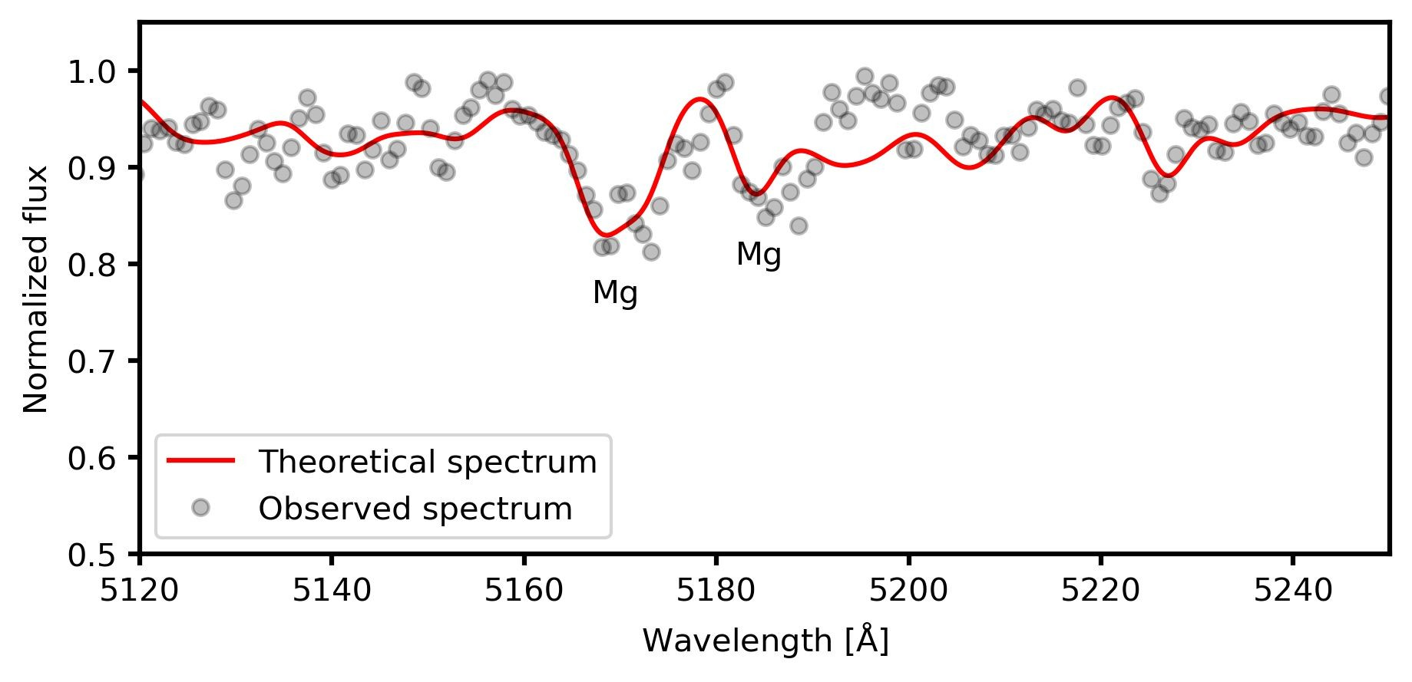
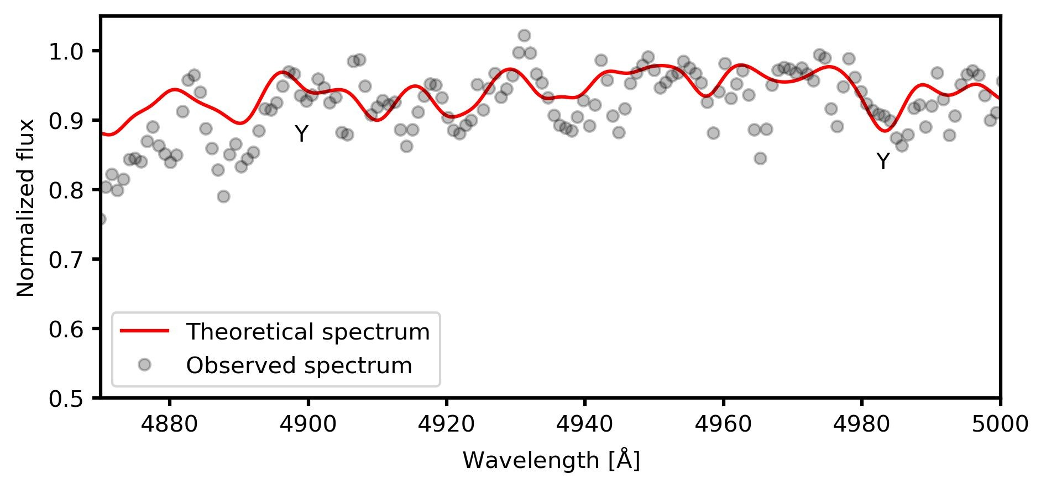
Spectral Analysis
- Mahtab Golami and Ewa Niemczura
GC22
GC22 and GC37 analyzed using ATLAS9 + SYNTHE.
Parameters derived via χ² minimization:
  GC22: Teff=5700K, logg=2.0, [Fe/H]=–0.8
  GC37: Teff=5900K, logg=2.5, [Fe/H]=–0.6
Elemental abundances: Mg, Y, Ba (using VidmaPy tools).

Slide 10
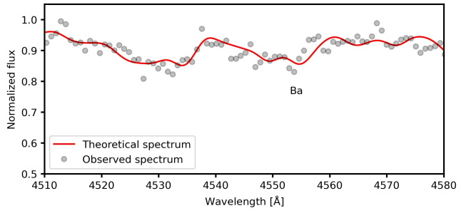
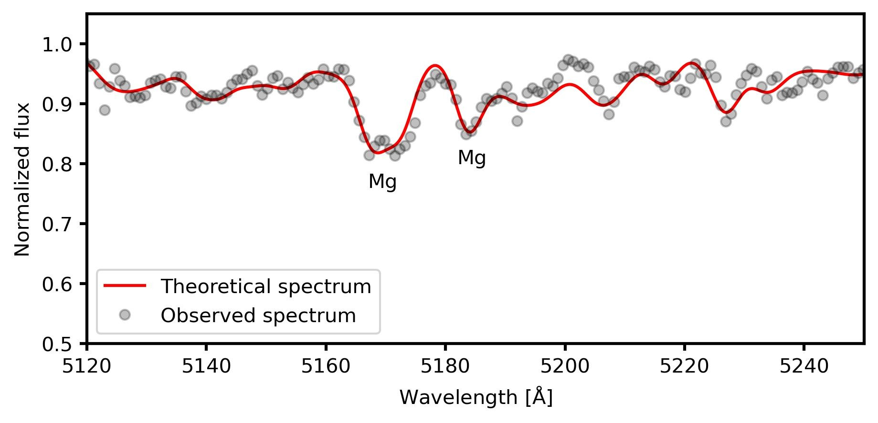
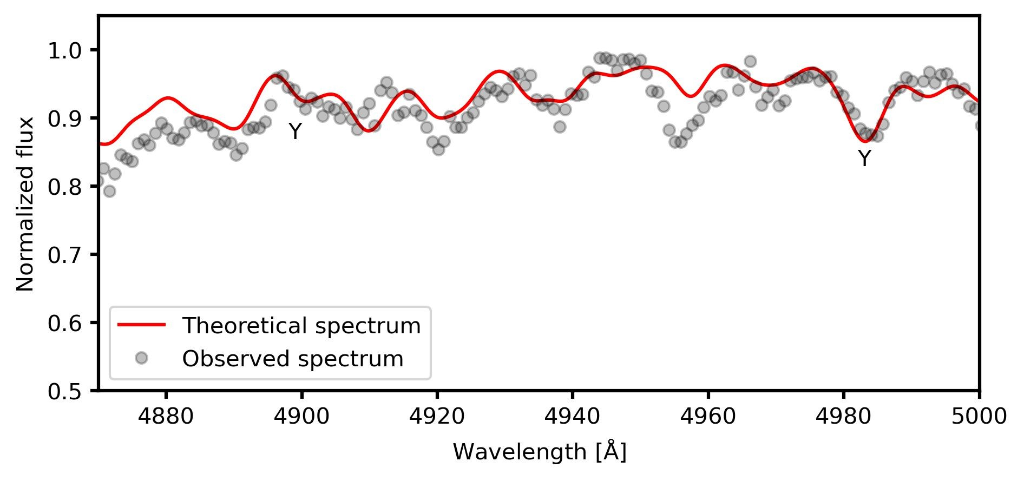
GC37

Slide 11
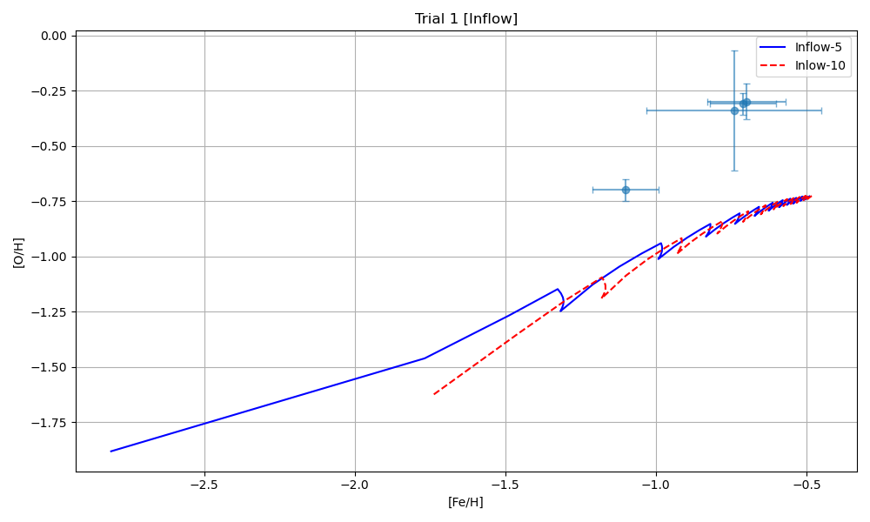
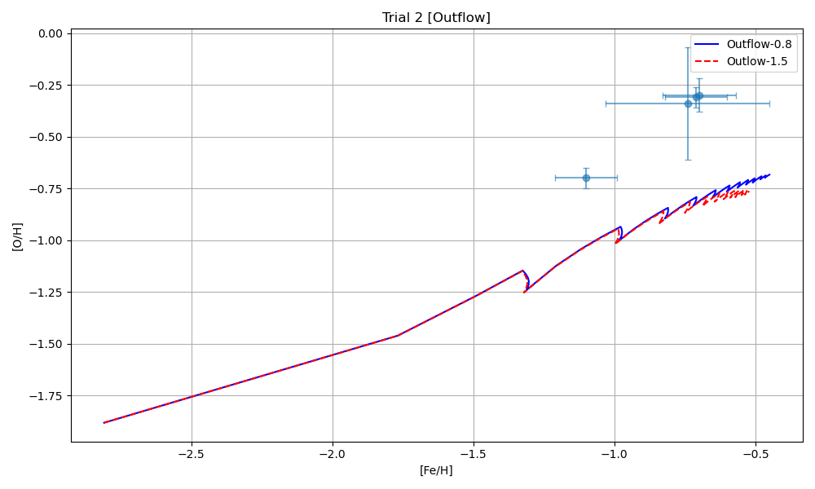
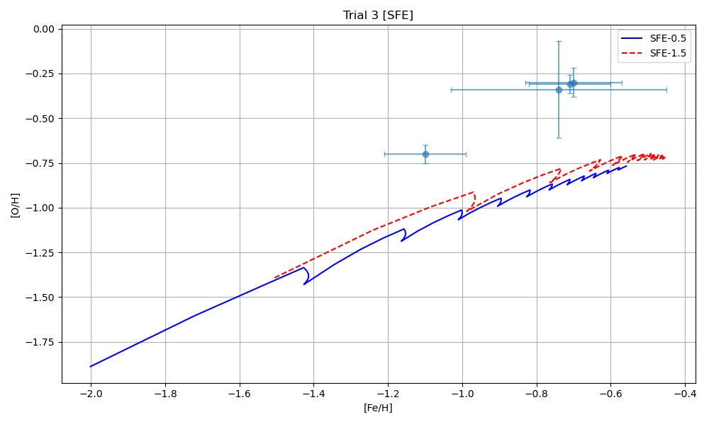
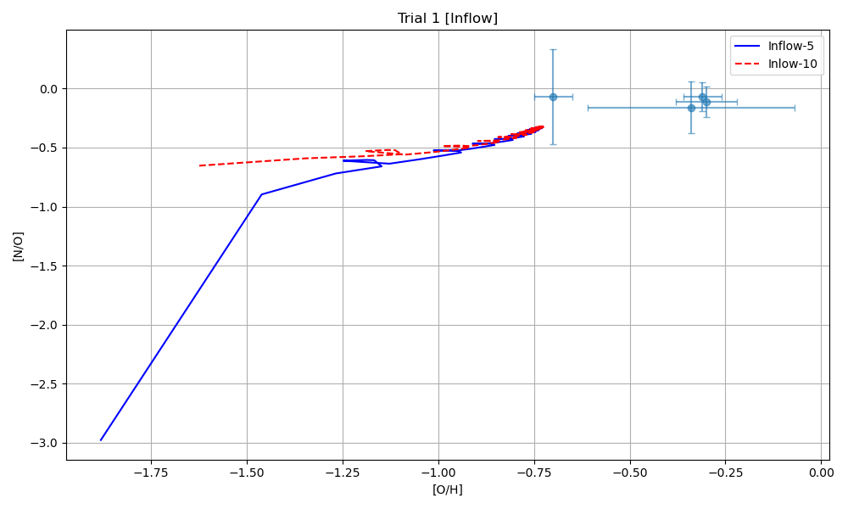
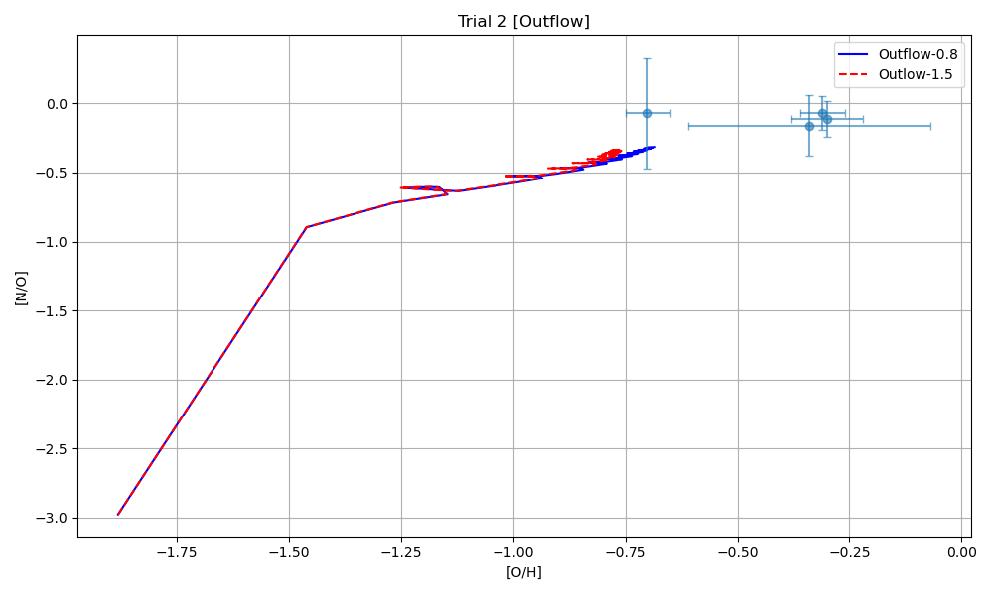
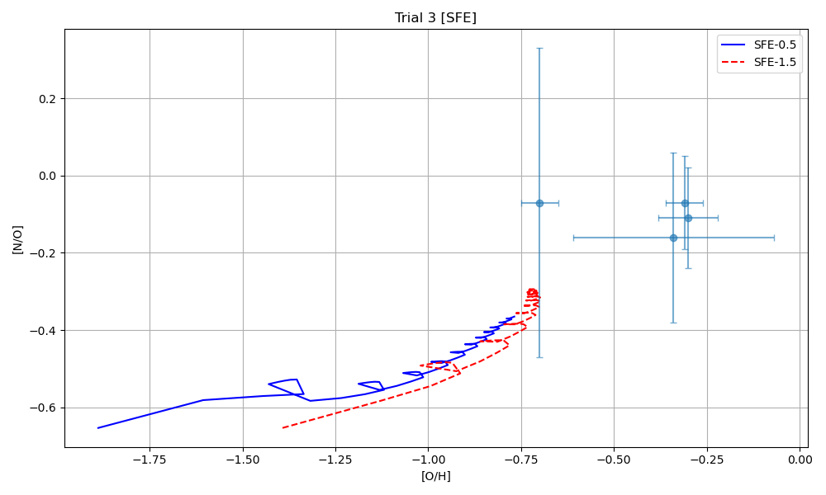
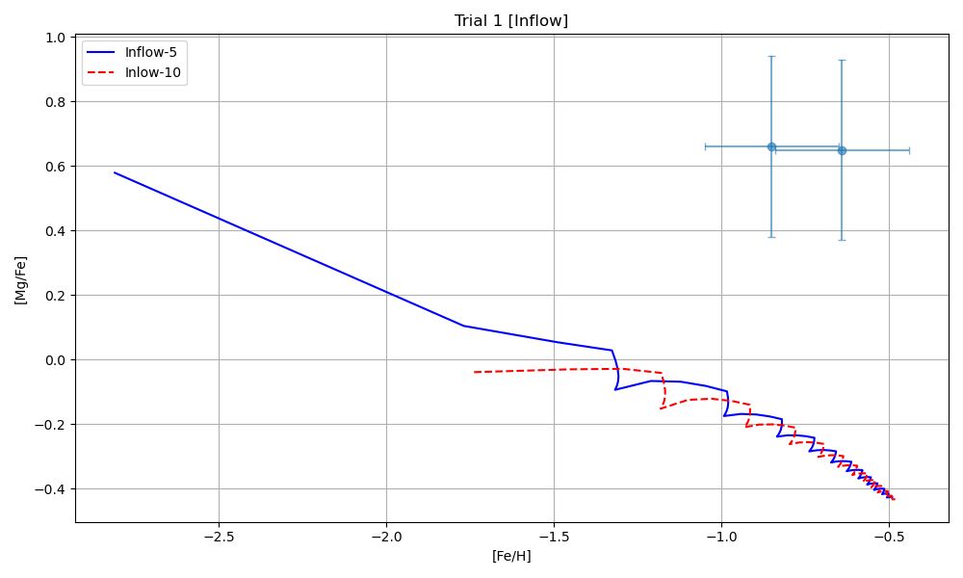
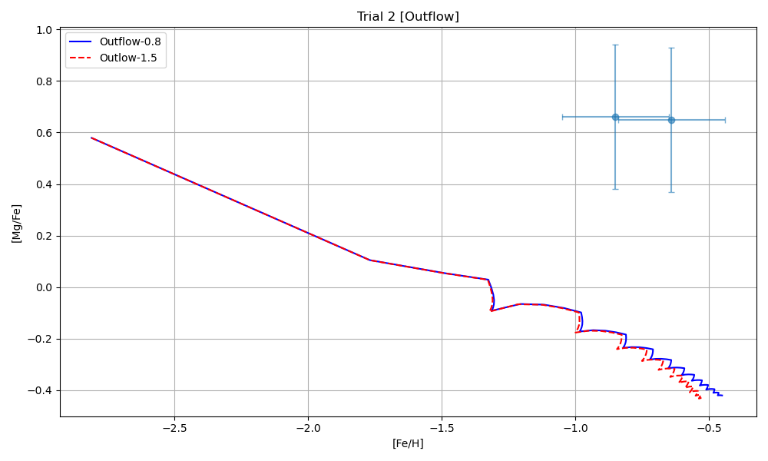
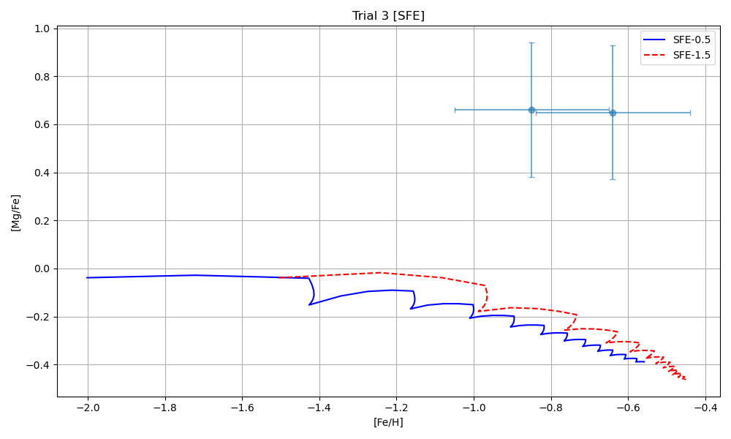
COMPARISION STUDY
Inflow
Inflow
SFE

Slide 12
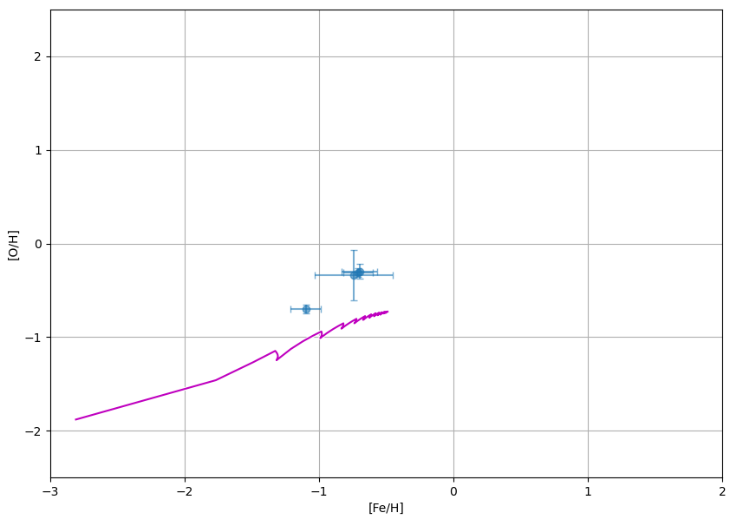
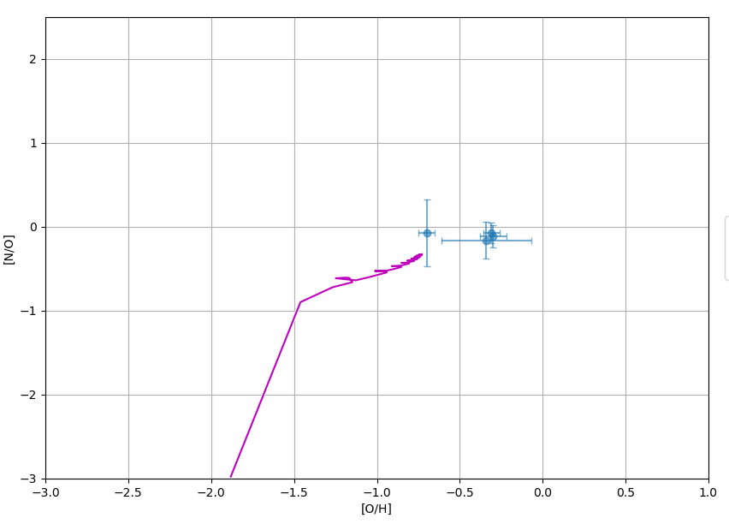
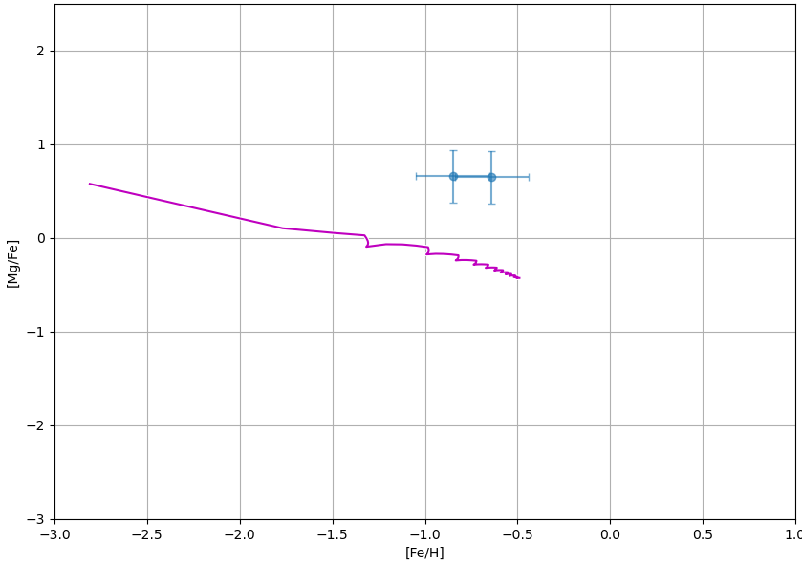
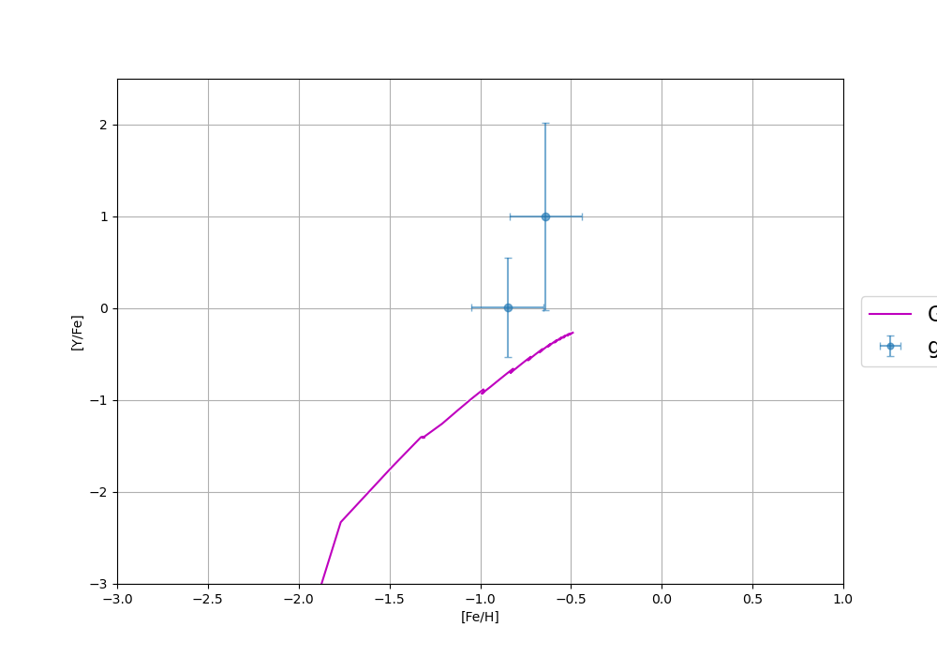
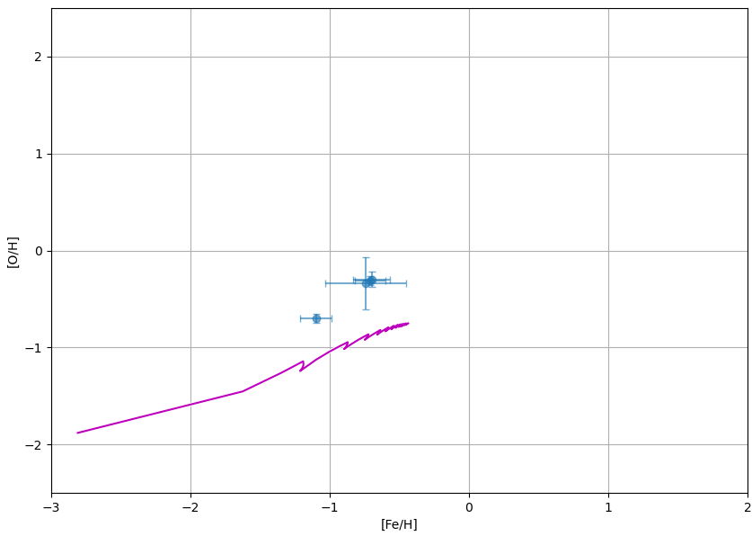
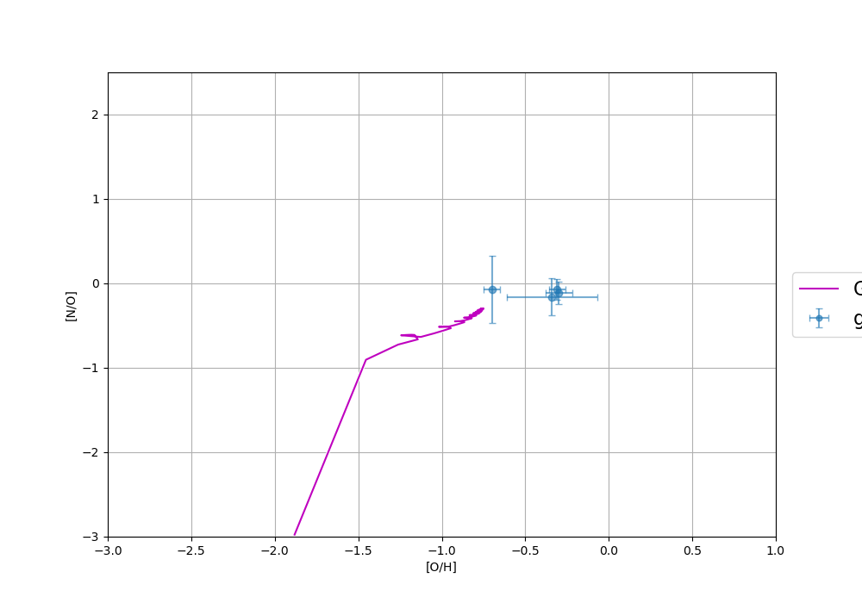
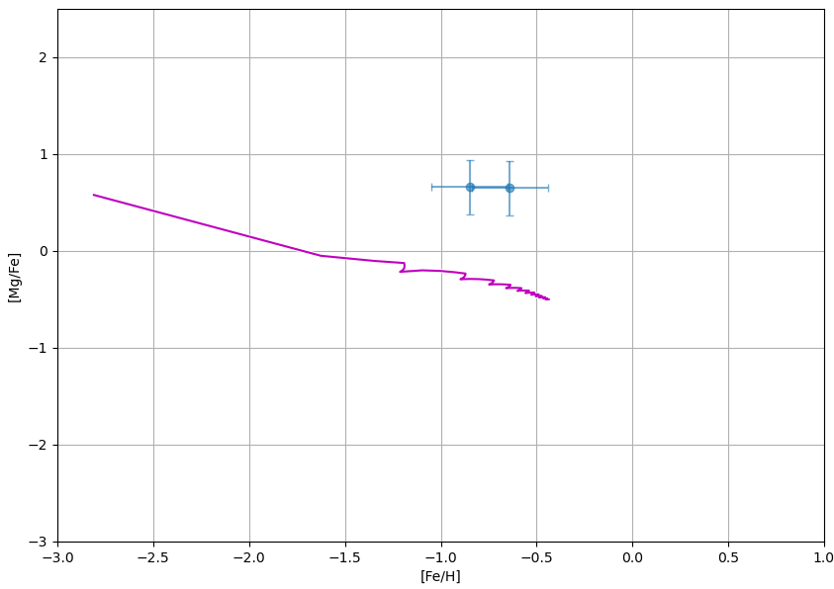
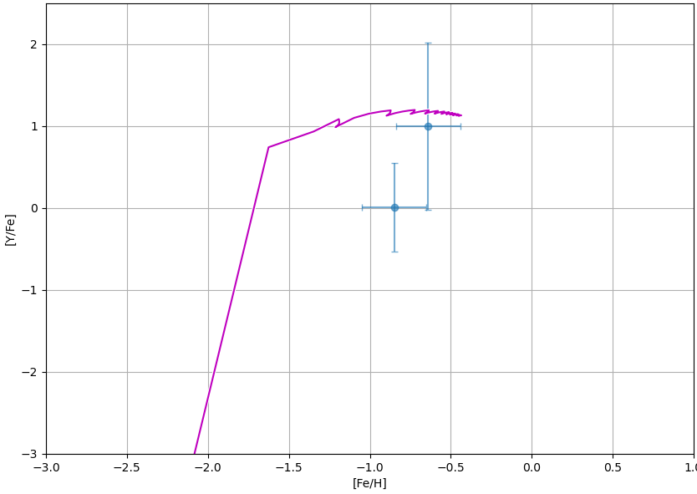
COMPARISION STUDY
agb_and_massive_stars_nugrid_MESAonly_fryer12delay
agb_and_massive_stars_nugrid_MESAonly_fryer12mix

Slide 13
Conclusion
The model stimulated Gas mass, Star mass, SFR were in well alignment with the paper used for calibrating the model.
The GCE simulated with the custom parameters reach the observed abundance within the range of error for different yield sets.
Future work
Make the GCE more accurate and reduce the error
Find the correct yield sets that fits Dwarf Galaxies
The lack of observational, high Resolution points makes the error factor high and less reliable
Suggest more observational data points in high resolution

Slide 14
Reference
“the eleven open questions about the Universe” from the American Academy of Sciences, the “long range plan” for nuclear physics in the USA, and the white paper of Schatz et al. (2022): “Horizons: Nuclear Astrophysics in the 2020s and Beyond”.
Ishimaru, Y., Wanajo, S., and Prantzos, N., “Neutron Star Mergers as the Origin of r-process Elements in the Galactic Halo Based on the Sub-halo Clustering Scenario”, <i>The Astrophysical Journal</i>, vol. 804, no. 2, Art. no. L35, IOP, 2015. doi:10.1088/2041-8205/804/2/L35.
Wanajo, S., Hirai, Y., and Prantzos, N., “Neutron star mergers as the astrophysical site of the r-process in the Milky Way and its satellite galaxies”, <i>Monthly Notices of the Royal Astronomical Society</i>, vol. 505, no. 4, OUP, pp. 5862–5883, 2021. doi:10.1093/mnras/stab1655.
Ji, A. P., Simon, J. D., Frebel, A., Venn, K. A., and Hansen, T. T., “Chemical Abundances in the Ultra-faint Dwarf Galaxies Grus I and Triangulum II: Neutron-capture Elements as a Defining Feature of the Faintest Dwarfs”, <i>The Astrophysical Journal</i>, vol. 870, no. 2, Art. no. 83, IOP, 2019. doi:10.3847/1538-4357/aaf3bb.
J. Yin, L. Magrini, F. Matteucci, G. A. Lanfranchi, D. R. Gonçalves and R. D. D. Costa,A&A, 520 (2010) A55. DOI: https://doi.org/10.1051/0004-6361/201014377
Fischer, T., Wu, M.-R., Wehmeyer, B., Bastian, N.-U. F., Martínez-Pinedo, G., and Thielemann, F.-K., “Core-collapse Supernova Explosions Driven by the Hadron-quark Phase Transition as a Rare r-process Site”, <i>The Astrophysical Journal</i>, vol. 894, no. 1, Art. no. 9, IOP, 2020. doi:10.3847/1538-4357/ab86b0.

Slide 15
Acknowledgement
I would like to sincerely thank the following individuals and organizations for their invaluable support and contributions to this project:
Prof. Tobias Fischer (Polytechnical University of Wroclaw) – Head of our research group and a key mentor throughout this work.
Prof. Benjamin Wehmeyer (University of Wroclaw) – Project head and my supervisor, for his continuous guidance and encouragement.
Prof. Ewa Niemczura (University of Wroclaw) – For her expertise and contributions in performing spectral analysis.
Dr. Mahtab Gholami (INAF) – Postdoctoral researcher who contributed significantly to the astronomical modeling aspects.
Noshad Khosravi Largani(University of Wroclaw) – PhD student under Prof. Fischer, who greatly assisted in the preparation of this presentation.

Slide 16
THANK YOU
For you’re Attention!
Questions Please??

Slide 17
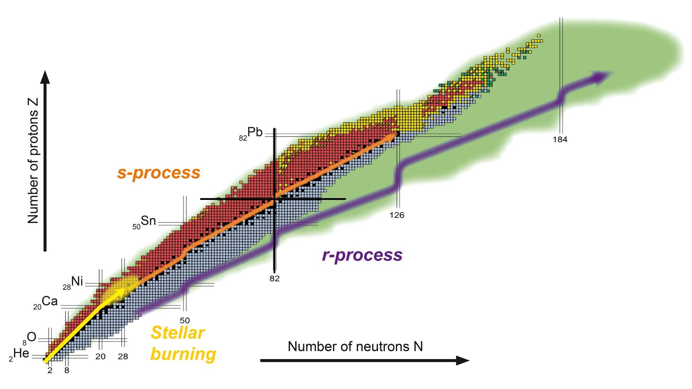
The Slow Neutron Capture Process
(s-process)
The Rapid Neutron Capture Process
(r-process)
Figure : Chart of nuclei and the paths followed by different nucleosynthetic processes.
Source: EMMI, GSI/Different Arts

Slide 18
The Rapid Neutron Capture Process, ”r-process”:
Proceeds on neutron rich side of the valley of stability.
Time scales : | Within one second neutron capture ~ 0.2 μs
Temperature T : | T > 10⁹ K
Neutron density: | n > 10²² cm⁻³
Site: (observationally confirmed) | Neutron star mergers (GW170817 followed by macro-nova SSS-17a)
Site: (under theoretical discussion) | Supernovae and Collapsars
Responsible for approx. 50% of nuclei heavier than iron
Temperature: ~1-2 GK
Density: 300 g/cm3 (~60% neutrons !)
Rapid neutron capture
β-decay
Seed
Equilibrium favors
“waiting point”
(γ,n) photodisintegration
No of p⁺
Figure : r-process.
No of n
Courtesy of T.Rauscher
Source: Nucleosynthesis of the heavy elements- Sean Burcher.
Notes:
‹#›

Slide 19
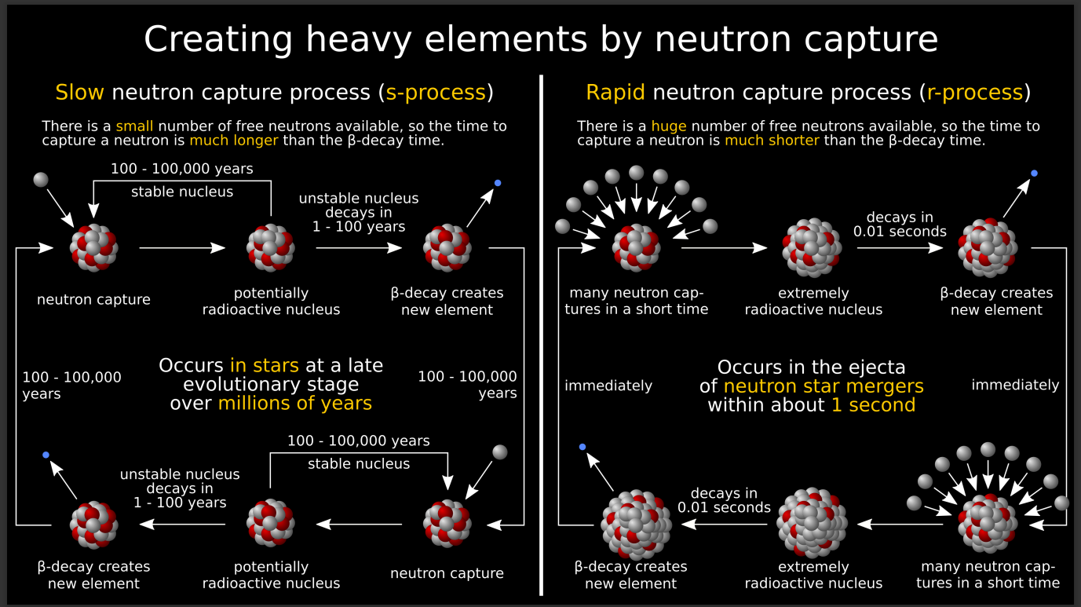
The neutrons needed for the neutron capture come mainly from the
22-Ne(α,n)25-Mg
And
13-C(α,n)16-O
reactions.
Thermalization in 10⁻¹¹ Sec
https://permalink.lanl.gov/object/tr?what=info:lanl-repo/lareport/LA-UR-17-30147

Slide 20
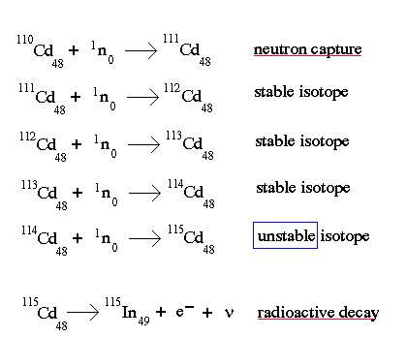
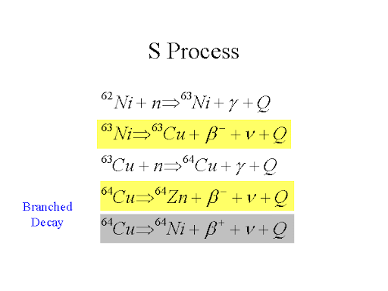
Example for r- and s-process
R Process

