Slide 1
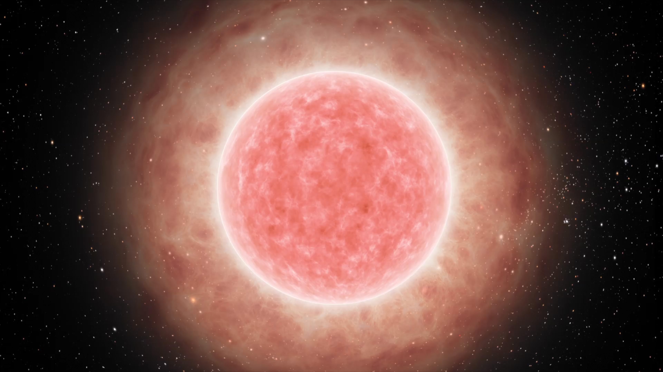

Effects of Mass Loss and Overshooting on the
Pre-Supernova Neutrino Signal in Red Supergiants
McKenzie Myers
North Carolina State University
HELIUM25 – July 25, 2025 (HZDR)

Slide 2
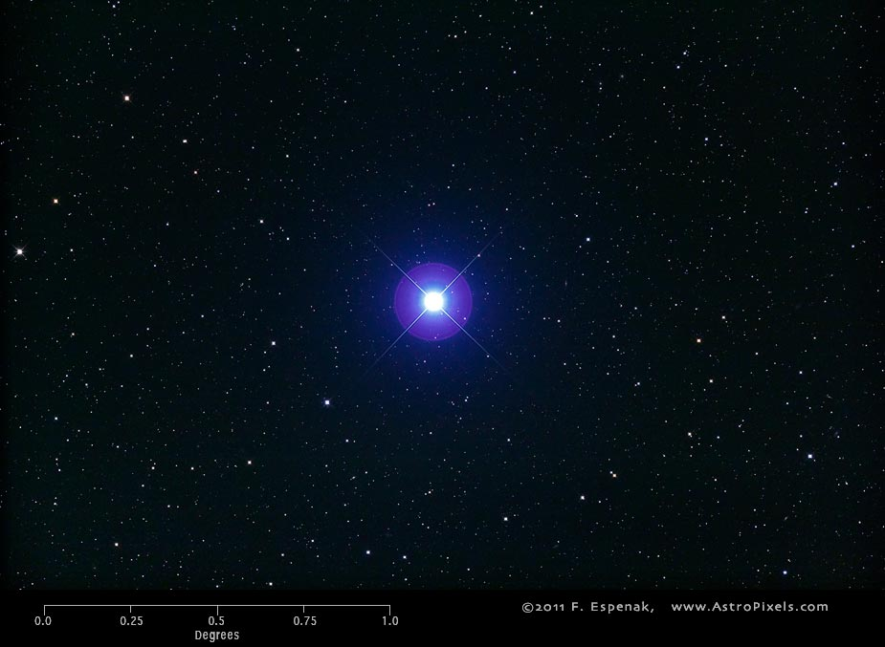
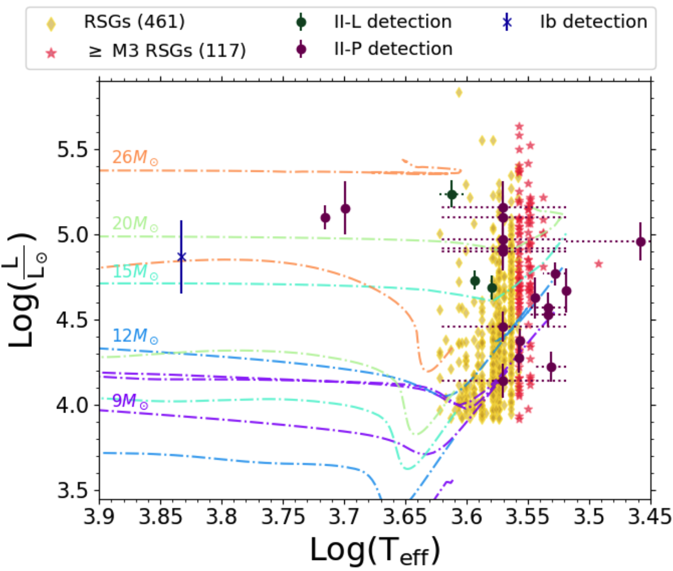
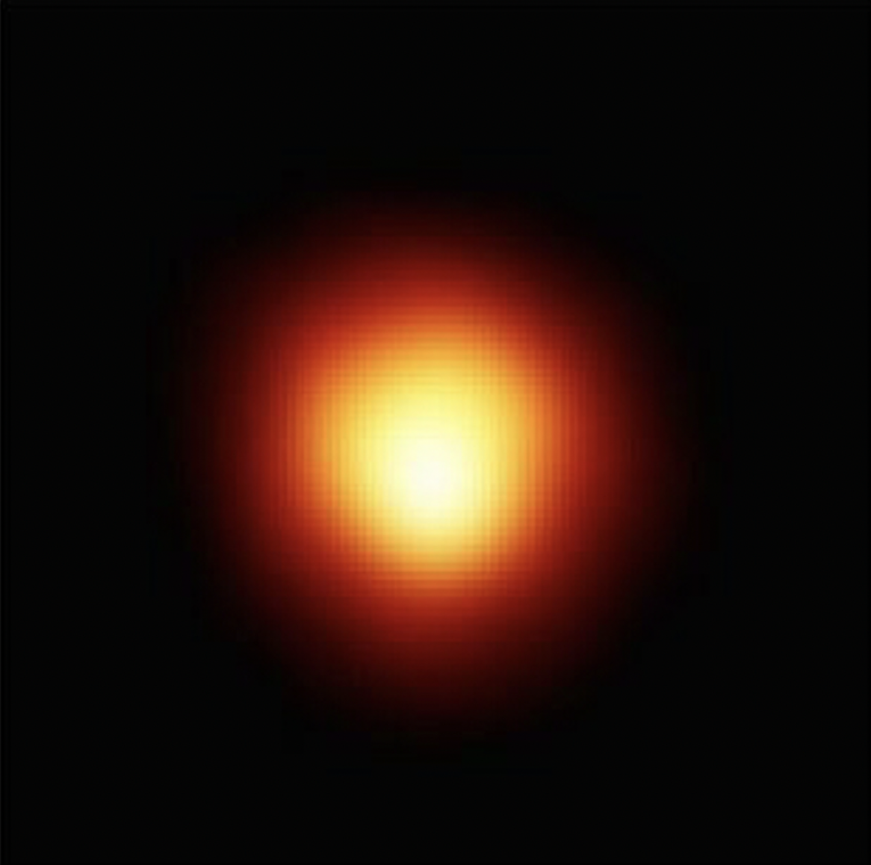
The life of a red supergiant
Spica via Fred Espenak
20 million years
Healy et al., MNRAS (2024)
Betelgeuse via Hubble
Notes:
Talk about lifetime, evolutionary phases, burning phases. Image of Betelgeuse from Hubble. Figure from https://arxiv.org/pdf/2412.04386. HR tracks shown are from MIST. Talk about Betelgeuse and Spica.
Fred Espenak is a Goddard Scientist Emeritus who took this image on his personal telescope with a UV/IR filter.

Slide 3
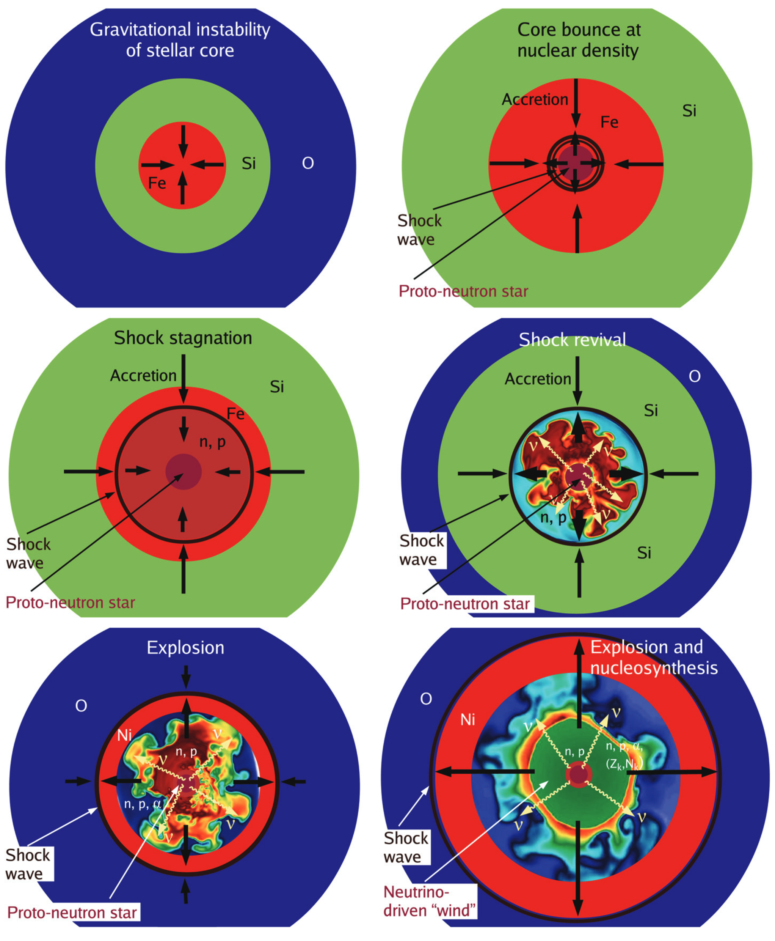
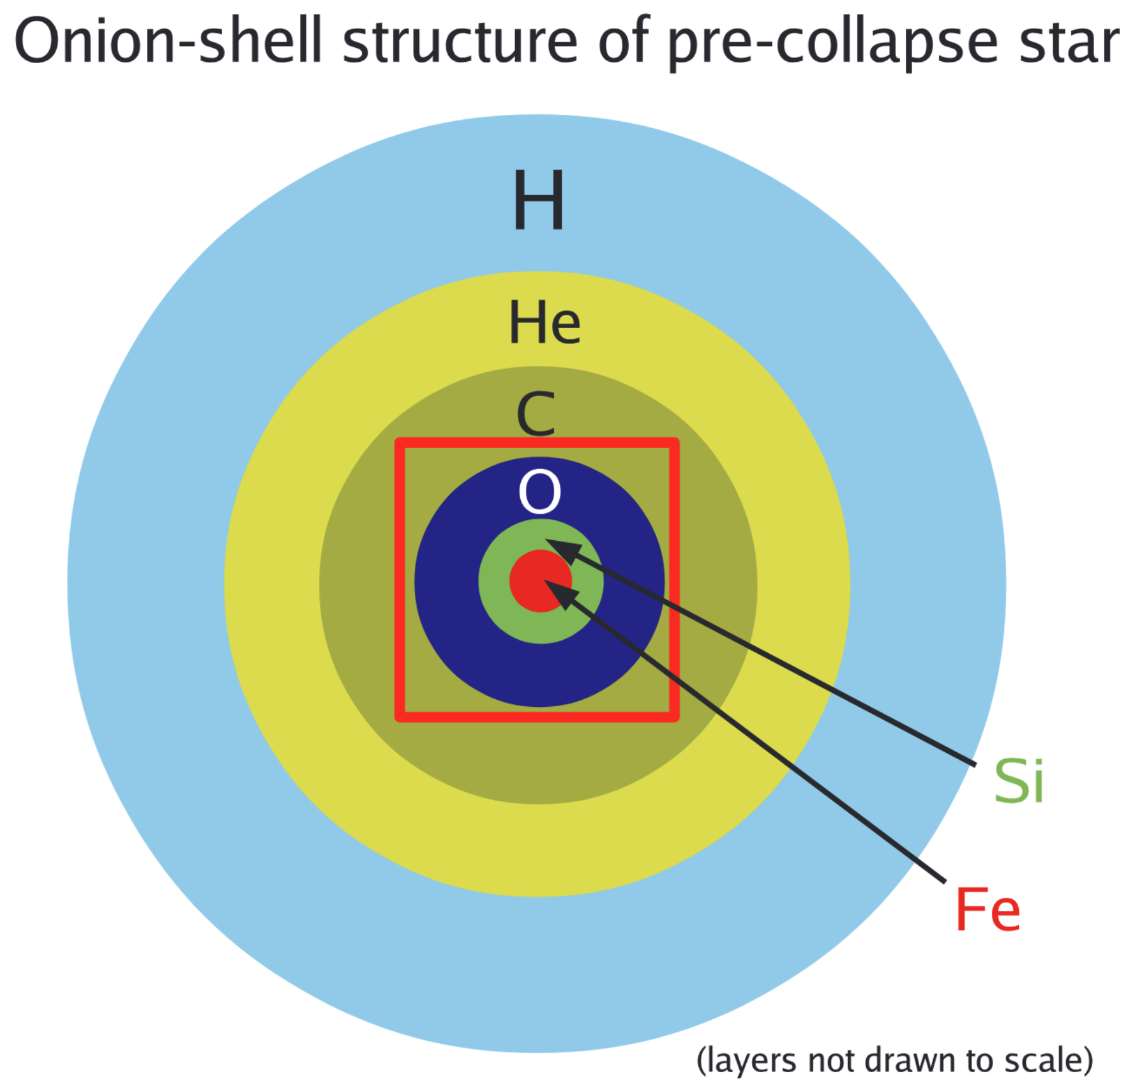
The death of a red supergiant
Janka et al., PTEP (2012)
Notes:
Talk about how explosion vs failure depends on shock wave revival, which is done by neutrino heating

Slide 4
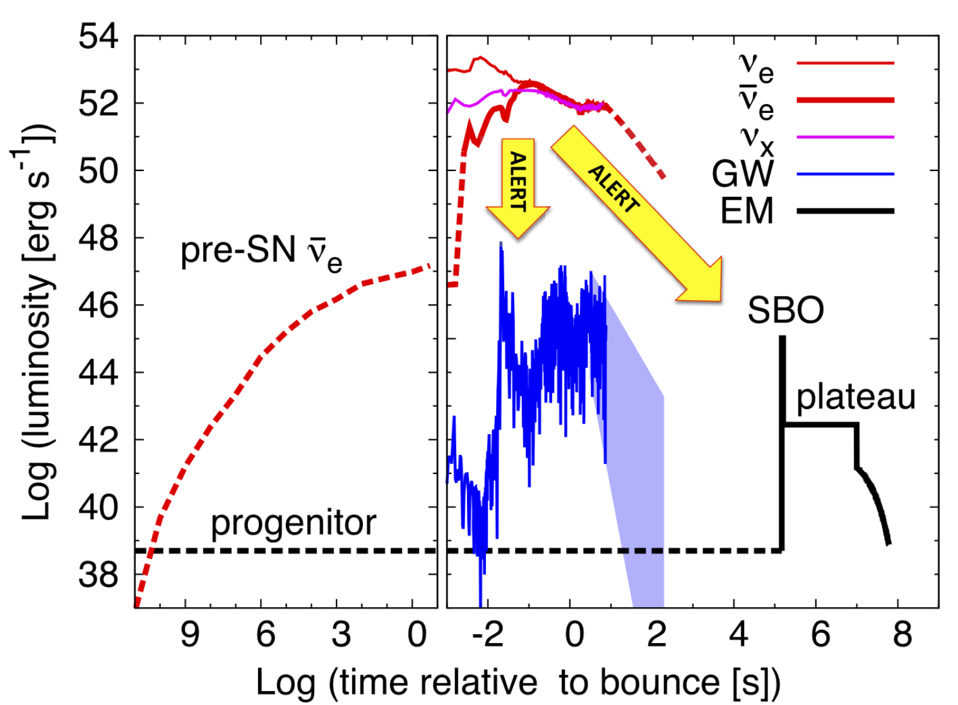
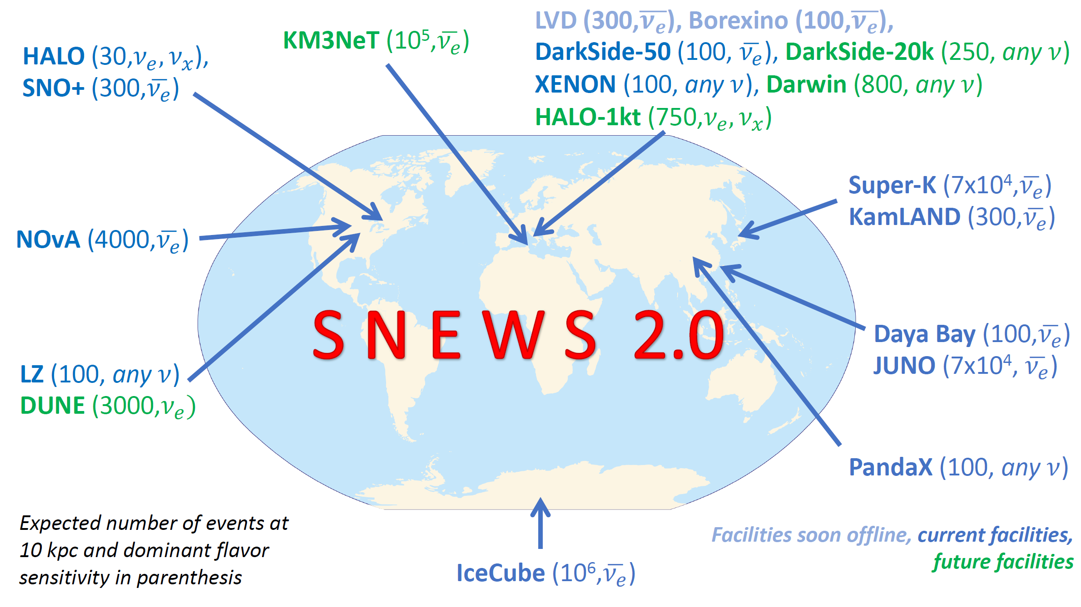
SuperNova Early Warning System (SNEWS) 2.0
Galactic CCSN rate: ~1-2 per century (we are overdue!)
Neutrinos can predict a galactic CCSN before it is visible in telescopes
SNEWS 2.0 automates alerts through a software stack connecting neutrino detectors
Betelgeuse via Hubble

Slide 5
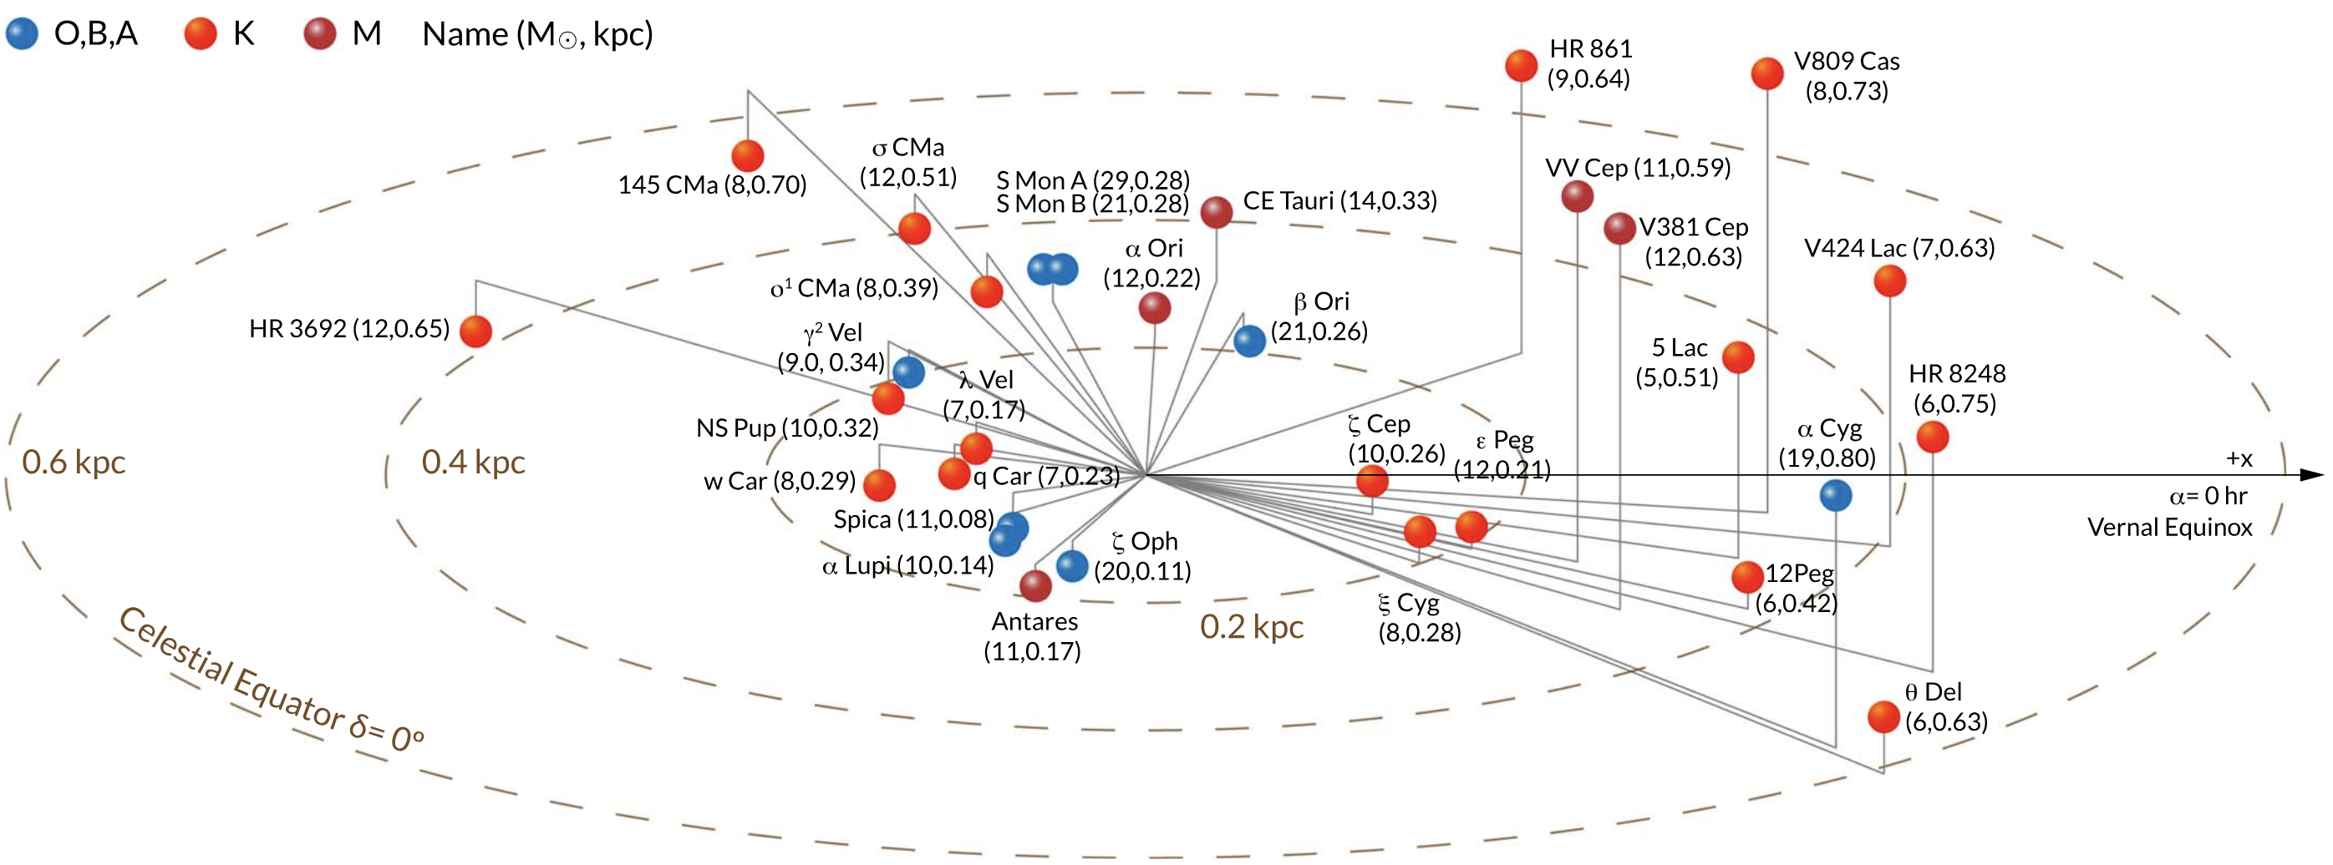
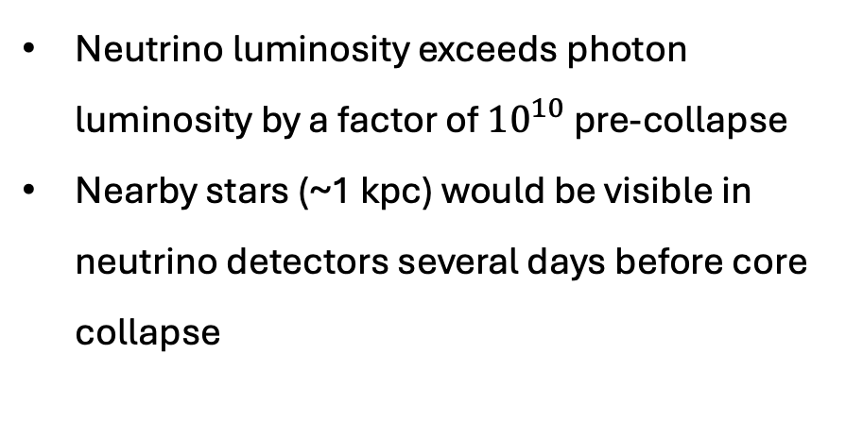
Pre-supernova neutrinos
Why care about pre-SN neutrinos?
Neutrino luminosity exceeds photon luminosity by a factor of ${10}^{10}$ pre-collapse
Nearby stars (~1 kpc) would be visible in neutrino detectors several days before core collapse
Neutrinos are the only direct probe of the core due to small cross-sections
Spectra are highly sensitive to density, temperature, chemical composition
Pre-SN neutrinos describe the core properties during late burning, which can constrain uncertainties in stellar evolution
Betelgeuse via Hubble

Slide 6
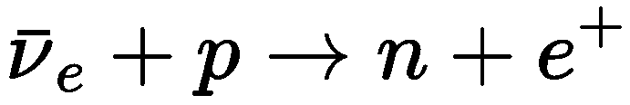
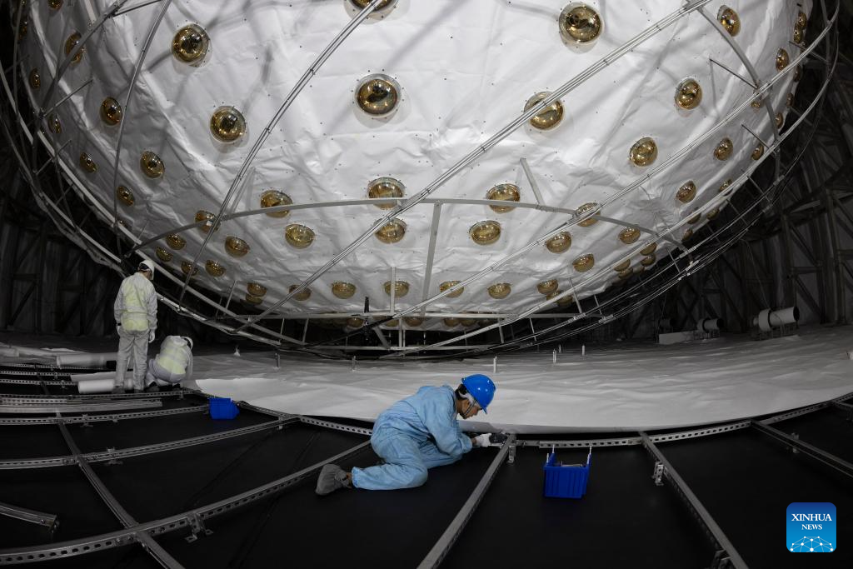
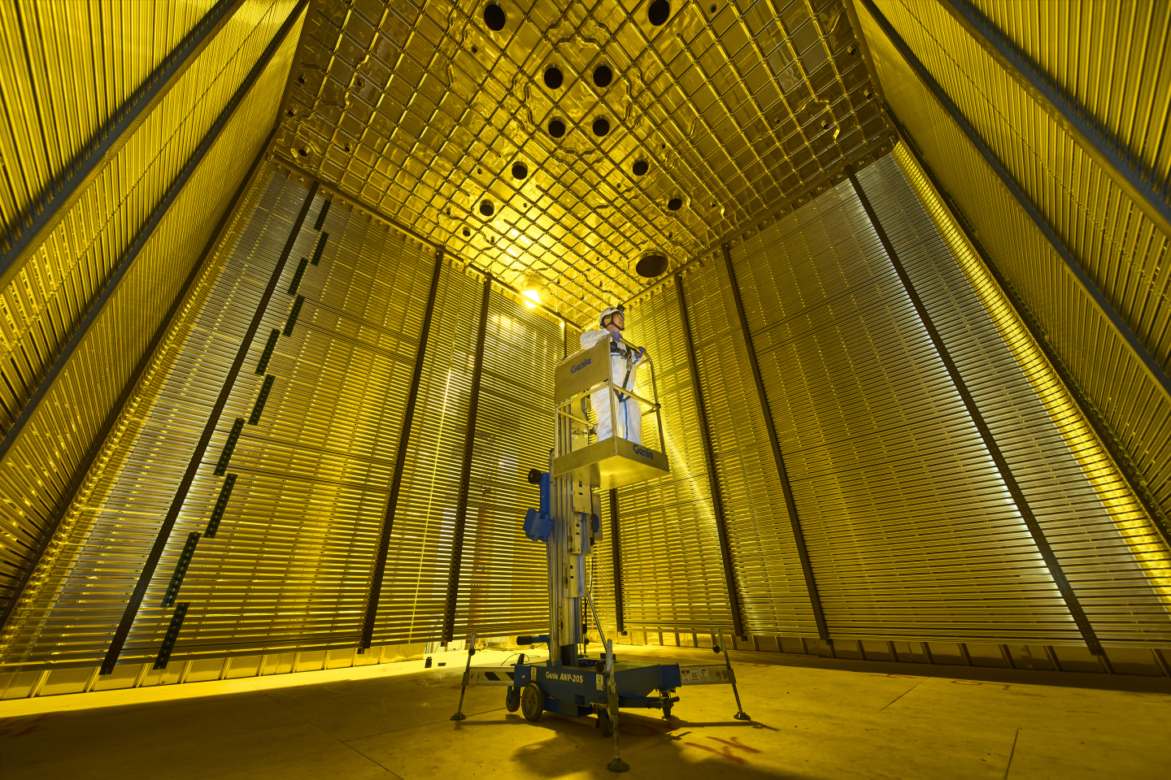
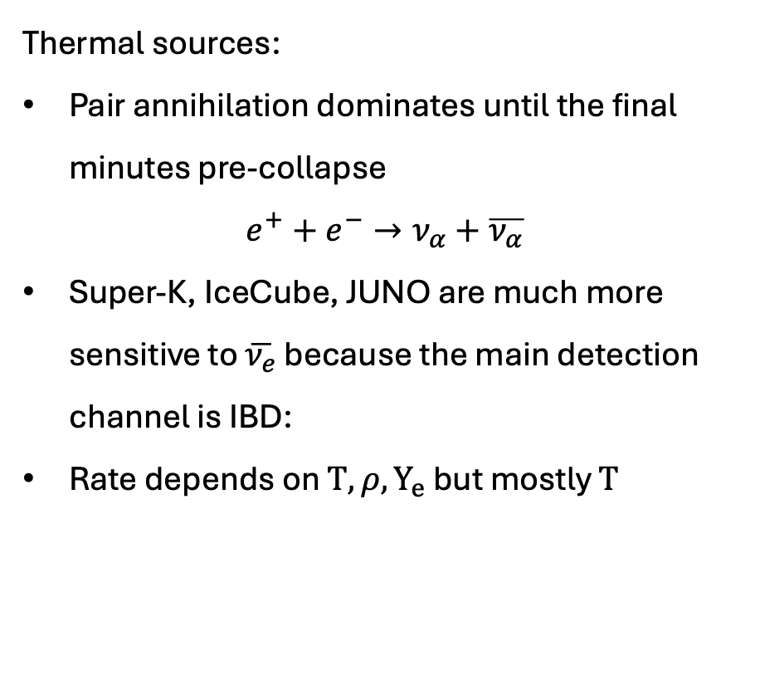
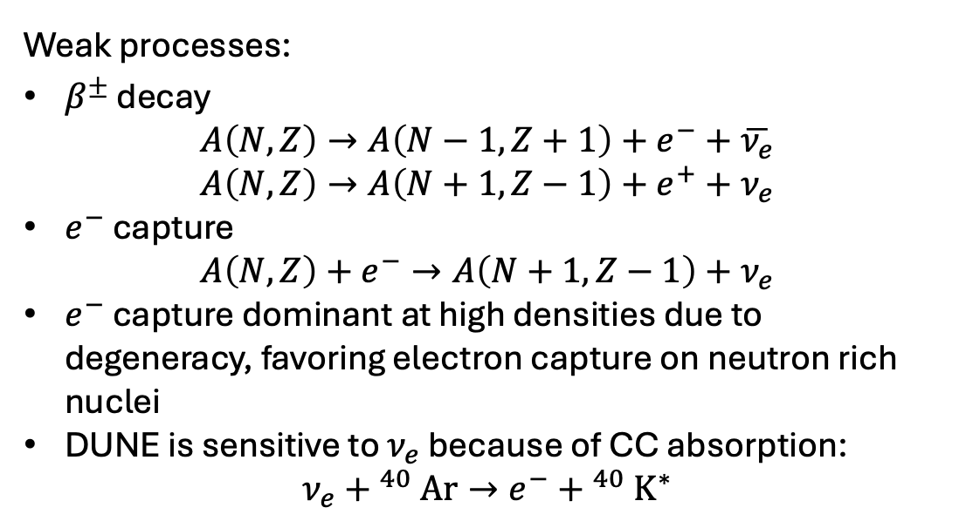
Pre-supernova neutrinos
Thermal sources:
Pair annihilation dominates until the final minutes pre-collapse
$$e^{+}+e^{−}→ν_{α}+\overline{ν_{α}}$$
Super-K, IceCube, JUNO are much more sensitive to $\overline{ν_{e}}$ because the main detection channel is IBD:
Rate depends on $T, {ρ,Y}_{e}$ but mostly $T$
Weak processes:
$β^{±}$ decay
$$A\left(N,Z\right)→A\left(N−1,Z+1\right)+e^{−}+\overline{ν_{e}}$$
$$A\left(N,Z\right)→A\left(N+1,Z−1\right)+e^{+}+ν_{e}$$
$e^{−}$ capture
$$A\left(N,Z\right)+e^{−}→A\left(N+1,Z−1\right)+ν_{e}$$
$e^{−}$ capture dominant at high densities due to degeneracy, favoring electron capture on neutron rich nuclei
DUNE is sensitive to $ν_{e}$ because of CC absorption:
$$ν_{e}{+ }^{40}Ar→e^{−}{+ }^{40}K^{∗}$$
JUNO under const. Energy threshold ~1.8 MeV
Photo: Chinese Academy of Sciences
ProtoDUNE test for DUNE
Photo: CERN
Betelgeuse via Hubble
Notes:
Pair annihilation highly sensitive to T because more pairs; less dependent on rho*Ye which decreases emissivity due to Fermi degeneracy

Slide 7
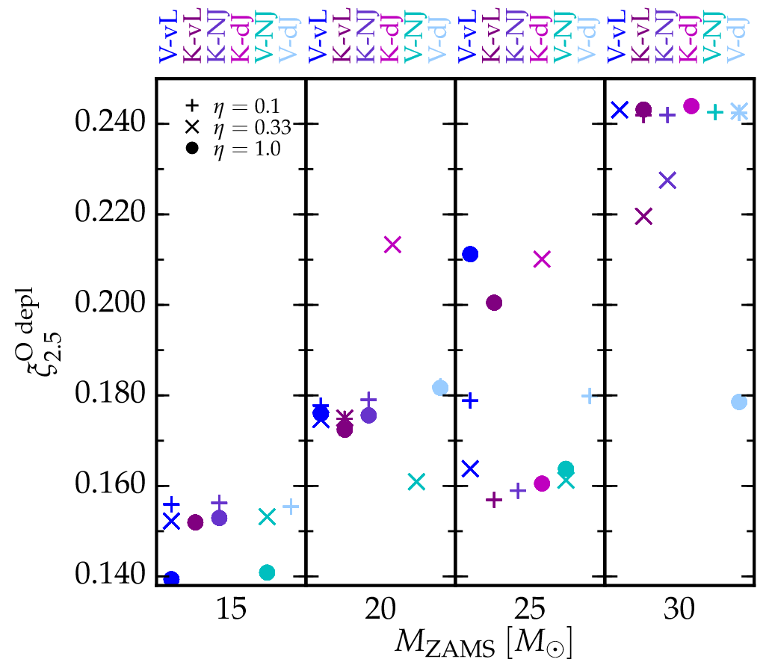
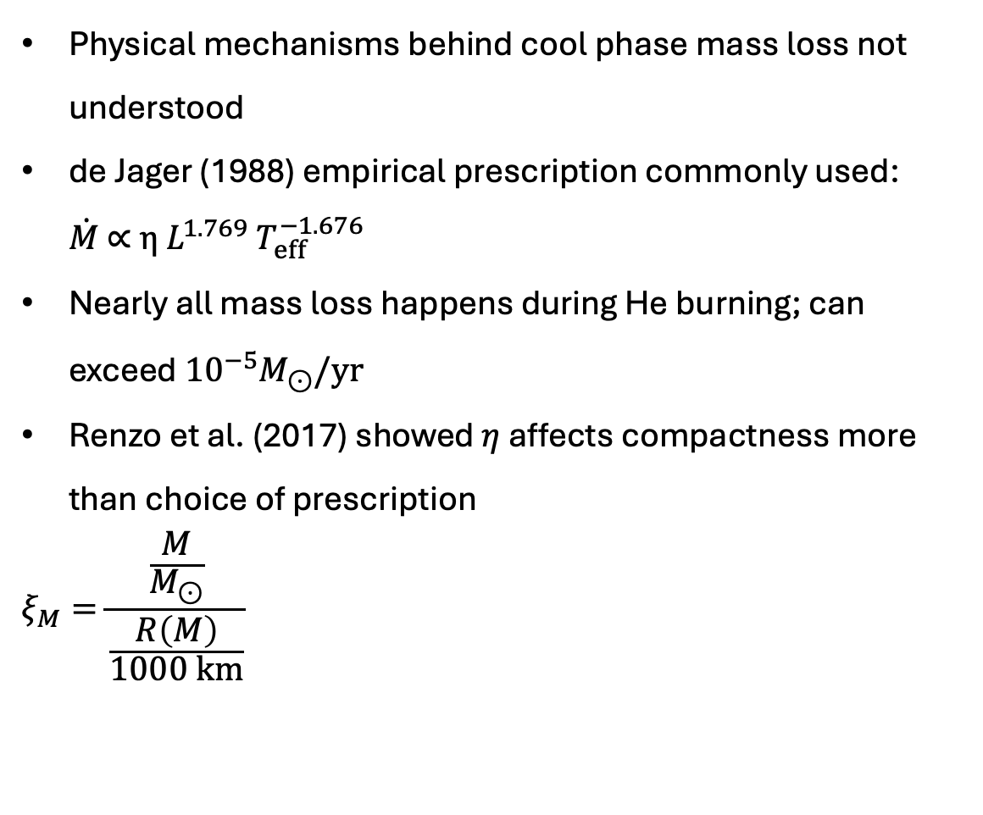
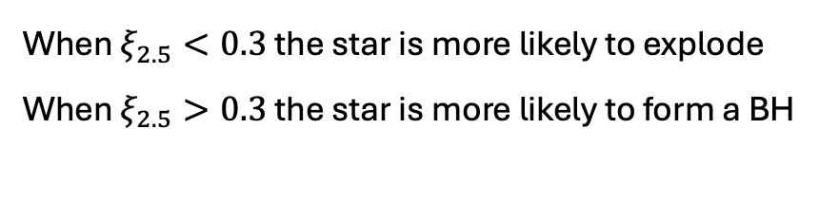
Uncertainties: mass loss
Physical mechanisms behind cool phase mass loss not understood
de Jager (1988) empirical prescription commonly used: $\dot{M} \text{∝} η L^{1.769} T_{eff}^{−1.676}$
Nearly all mass loss happens during He burning; can exceed ${10}^{−5}M_{⊙}/yr$
Renzo et al. (2017) showed $η$ affects compactness more than choice of prescription
$$ξ_{M}=\frac{\frac{M}{M_{⊙}}}{\frac{R\left(M\right)}{1000 km}}$$
When $ξ_{2.5}<0.3$ the star is more likely to explode
When $ξ_{2.5}>0.3$ the star is more likely to form a BH
Renzo et al., A&A (2017)
Betelgeuse via Hubble

Slide 8
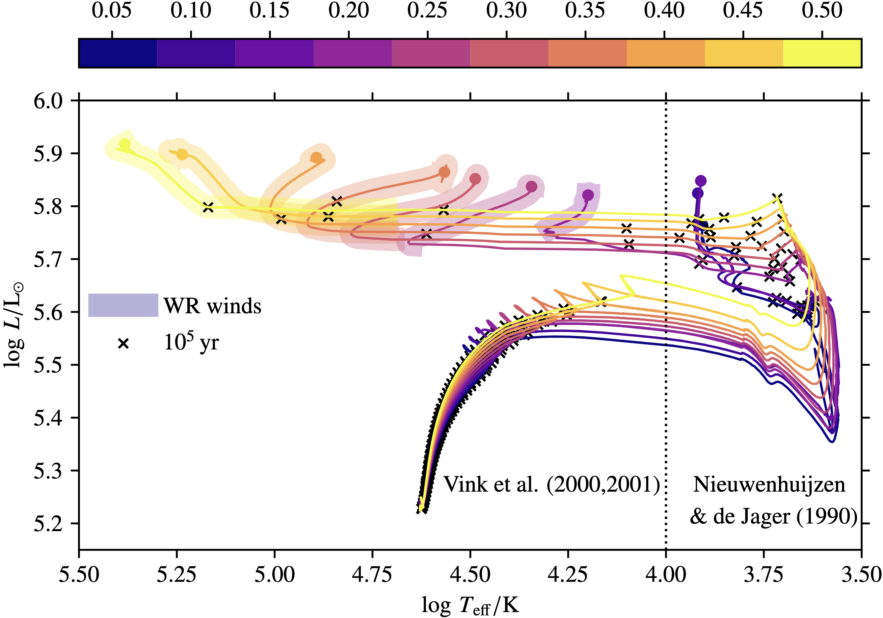


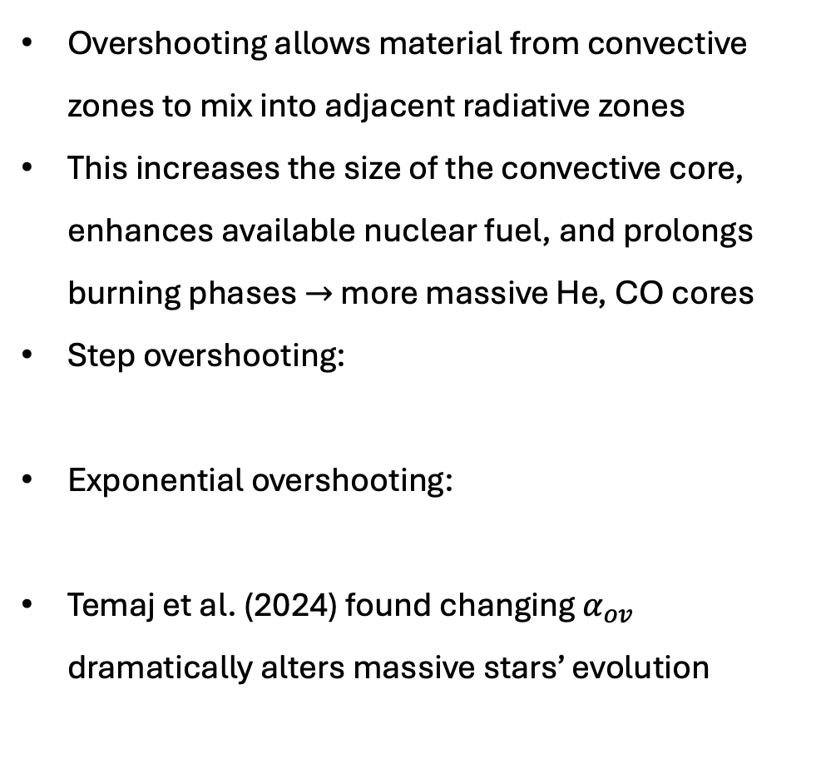
Uncertainties: convective overshooting
$α_{ov}$ (overshoot parameter)
Overshooting allows material from convective zones to mix into adjacent radiative zones
This increases the size of the convective core, enhances available nuclear fuel, and prolongs burning phases $→$ more massive He, CO cores
Step overshooting:
Exponential overshooting:
Temaj et al. (2024) found changing $α_{ov}$ dramatically alters massive stars’ evolution
Temaj et al., A&A (2024)

Slide 9
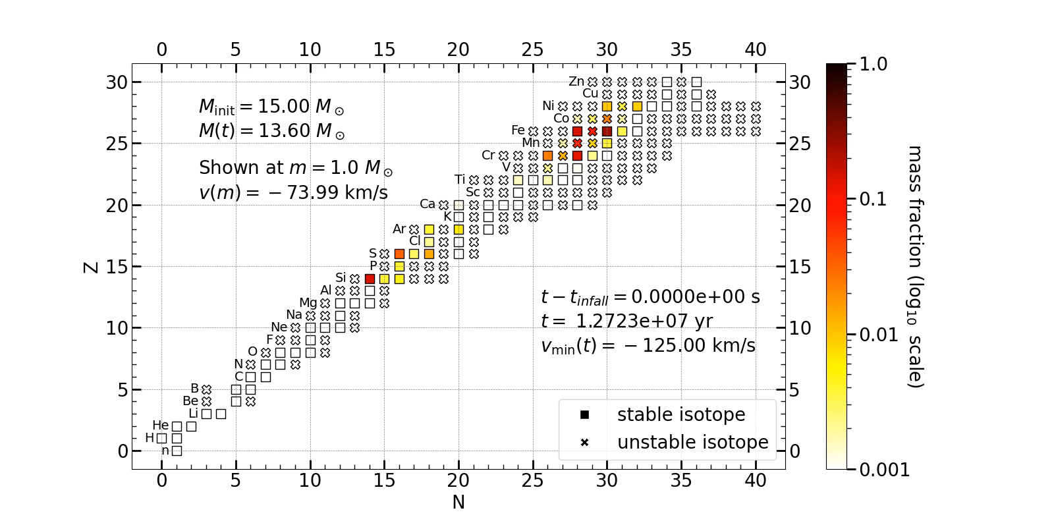
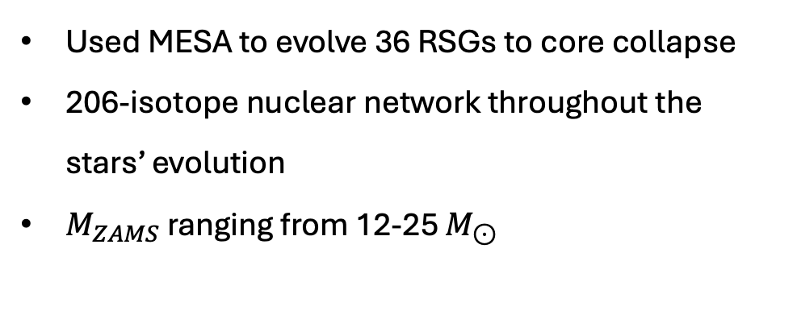
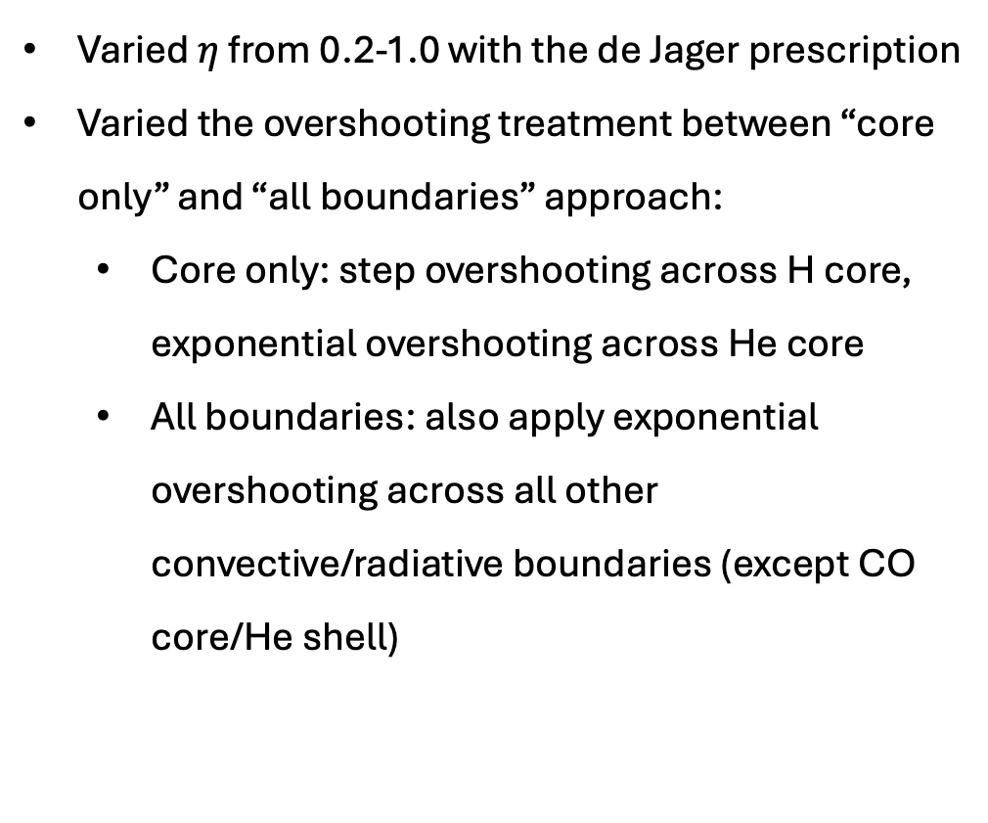
Constructing a RSG model grid
Used MESA to evolve 36 RSGs to core collapse
206-isotope nuclear network throughout the stars’ evolution
$M_{ZAMS}$ ranging from 12-25 $M_{⊙}$
Varied $η$ from 0.2-1.0 with the de Jager prescription
Varied the overshooting treatment between “core only” and “all boundaries” approach:
  Core only: step overshooting across H core, exponential overshooting across He core
  All boundaries: also apply exponential overshooting across all other convective/radiative boundaries (except CO core/He shell)

Slide 10
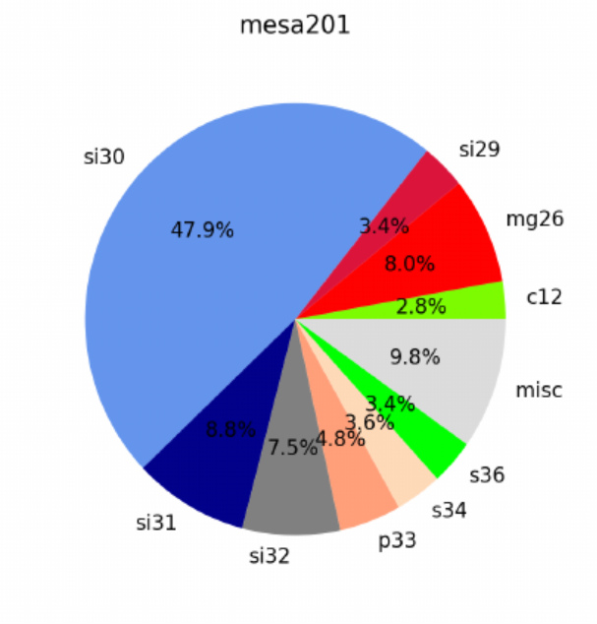
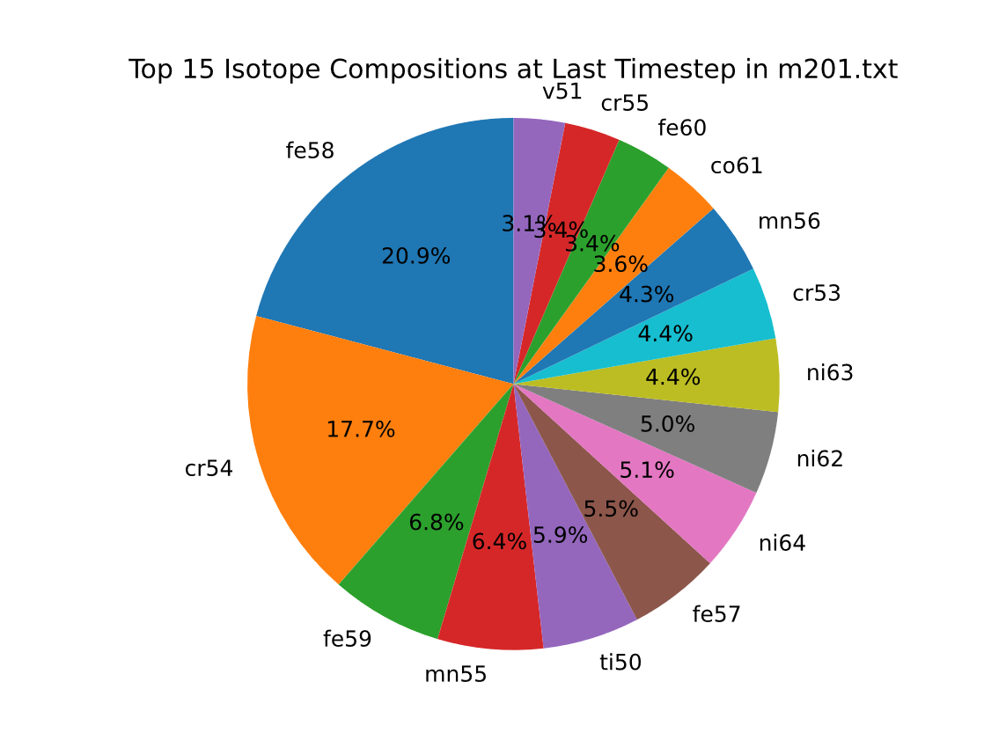
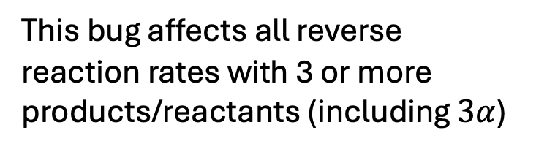
Reaction rate bug (yikes)
This bug affects all reverse reaction rates with 3 or more products/reactants (including $3α$)
Equilibrium composition pre bug fix
Post bug fix
https://github.com/MESAHub/mesa/issues/575

Slide 11
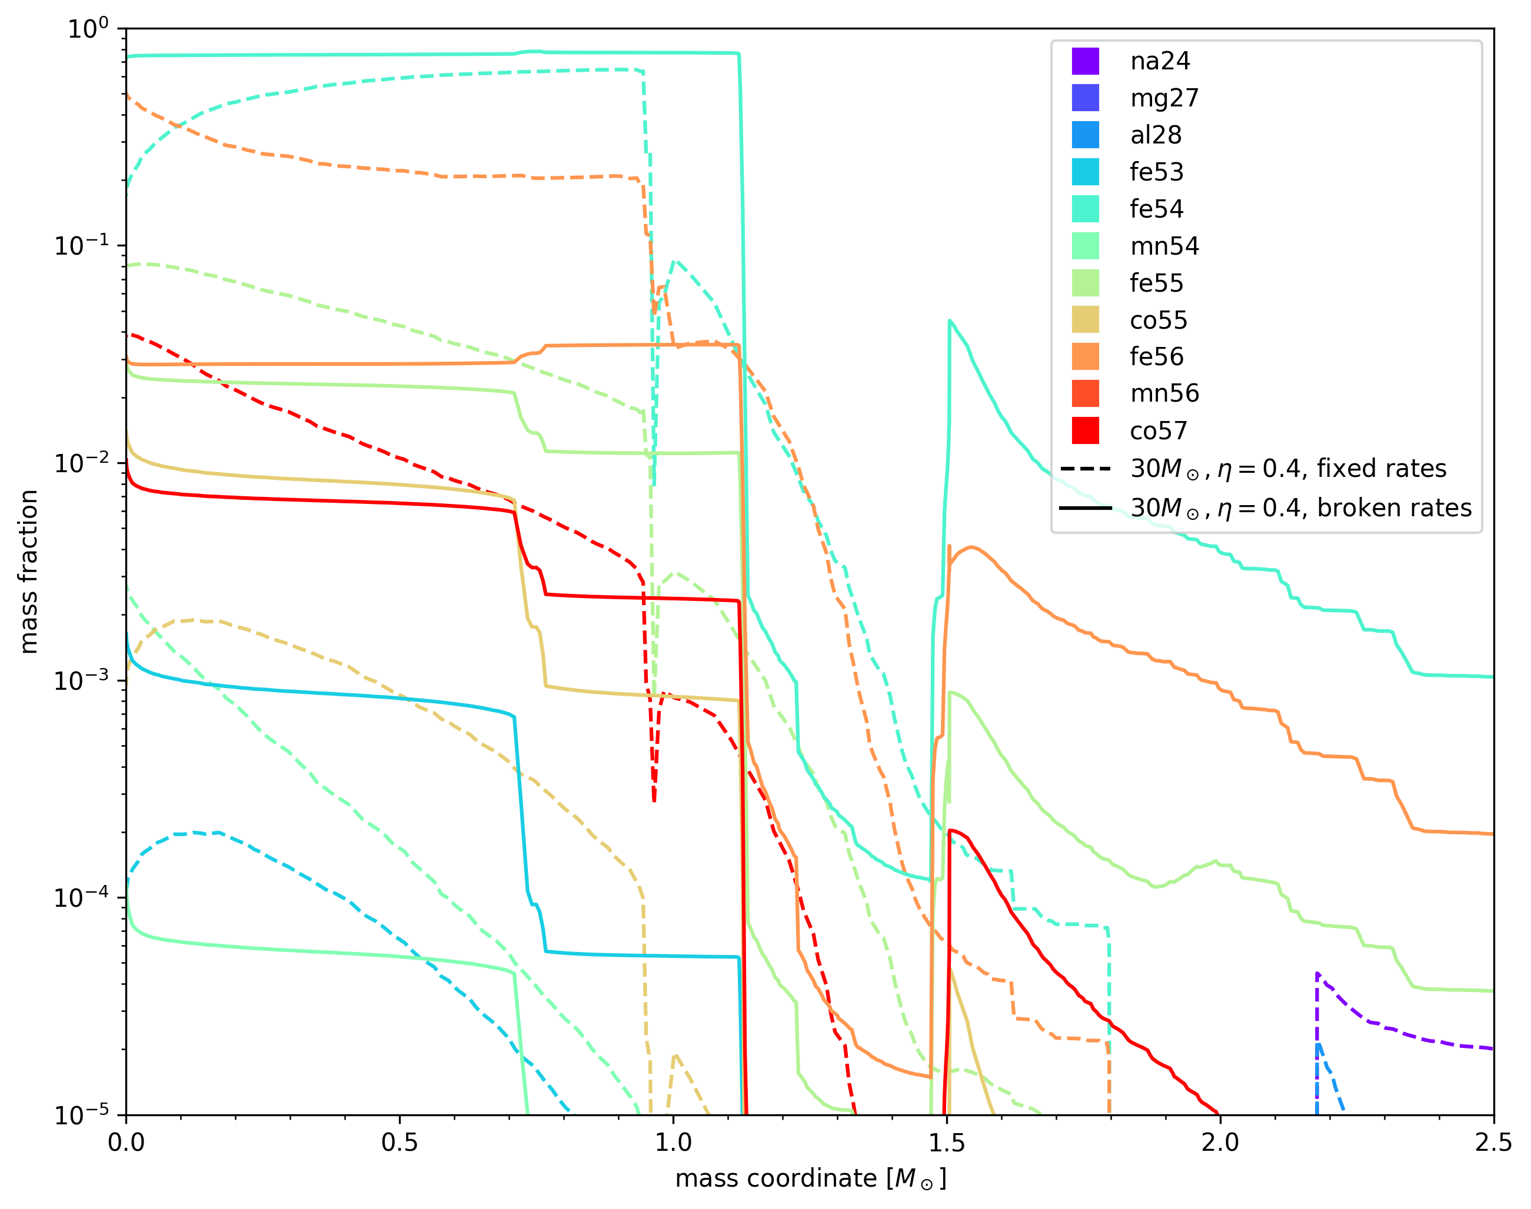
Order of magnitude difference in fe56, co55, fe53, mn54

Slide 12
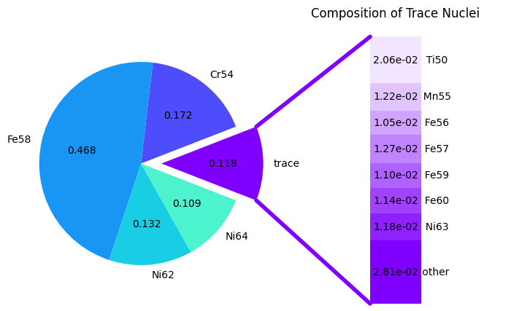
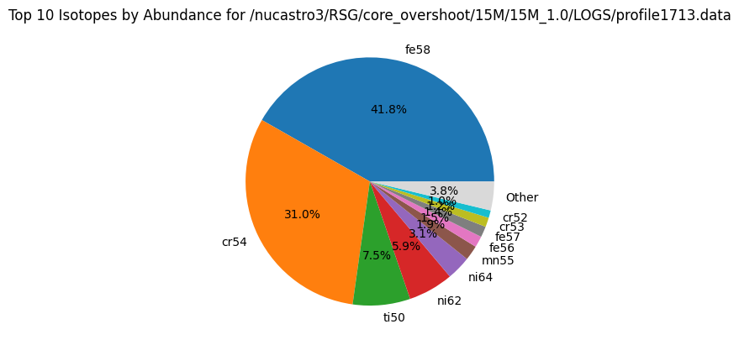
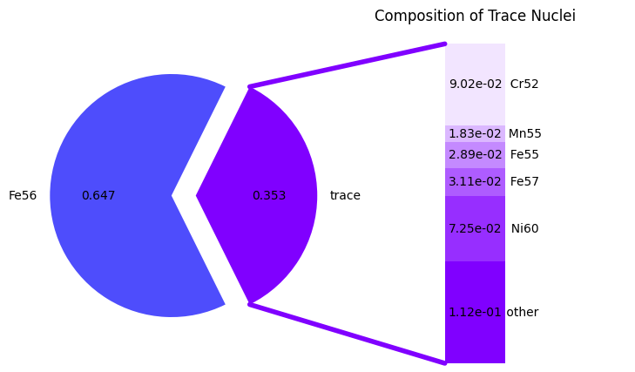
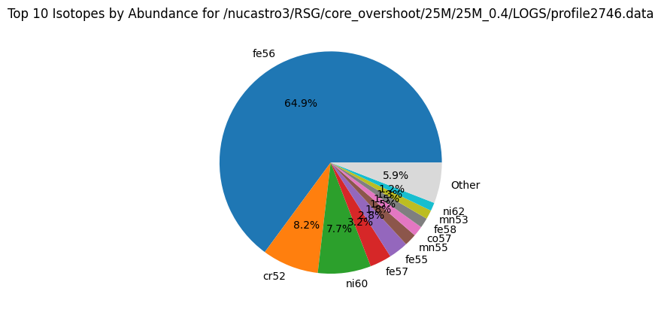


NSE calculation with pynucastro
Center composition of stellar model
${15 M}_{⊙}$, core only, $η=1.0$
${25 M}_{⊙}$, core only, $η=0.4$

Slide 13
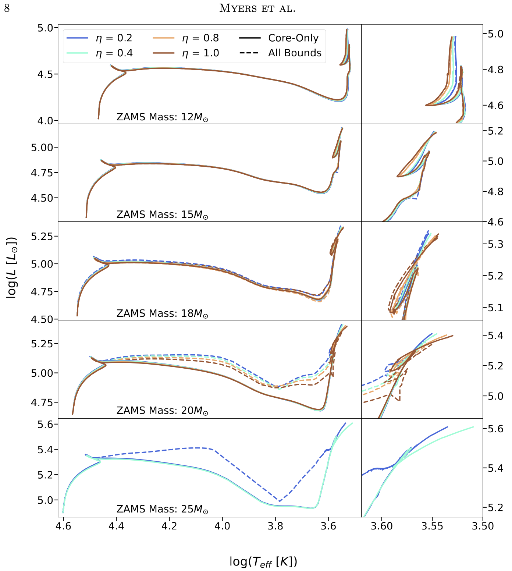
Results shown are preliminary
HR tracks not affected except for higher masses, with overshooting having a greater effect than mass loss
  Effect of higher mass loss is to decrease the core mass due to lower pressure; lower L
  Effect of more overshooting is to increase the core mass by mixing in more fuel; higher L
Pre-SN position on HR diagram almost completely unaffected

Slide 14
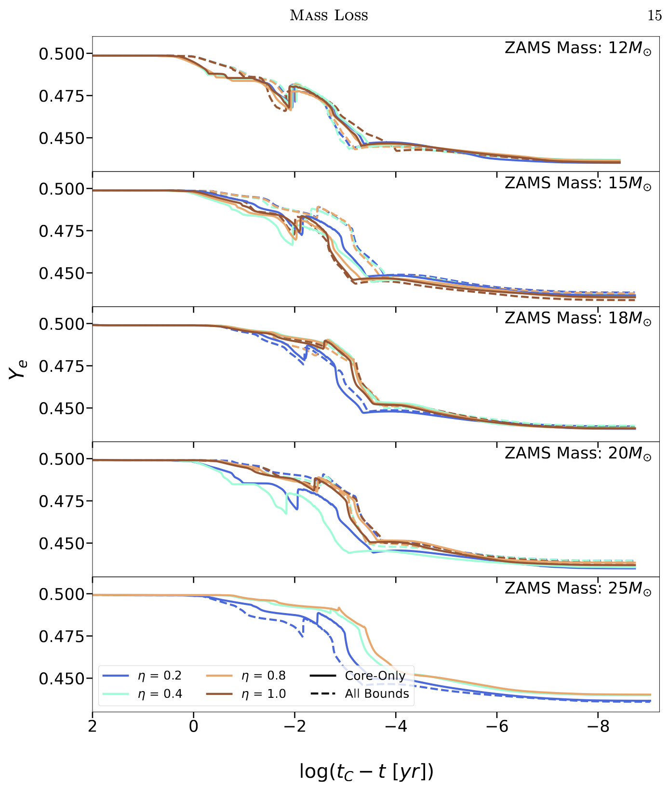
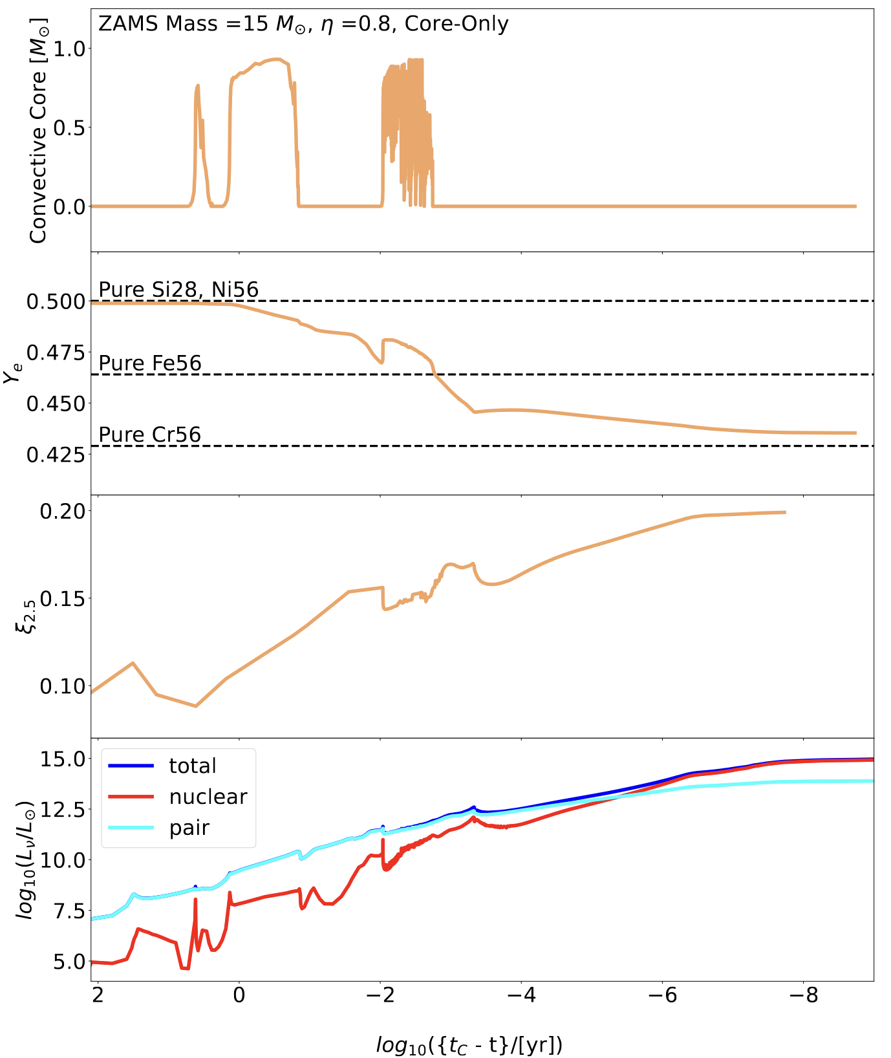

Slide 15
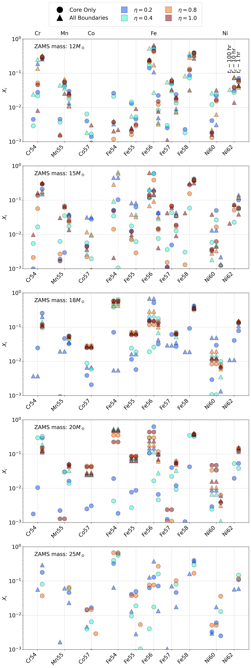

Slide 16
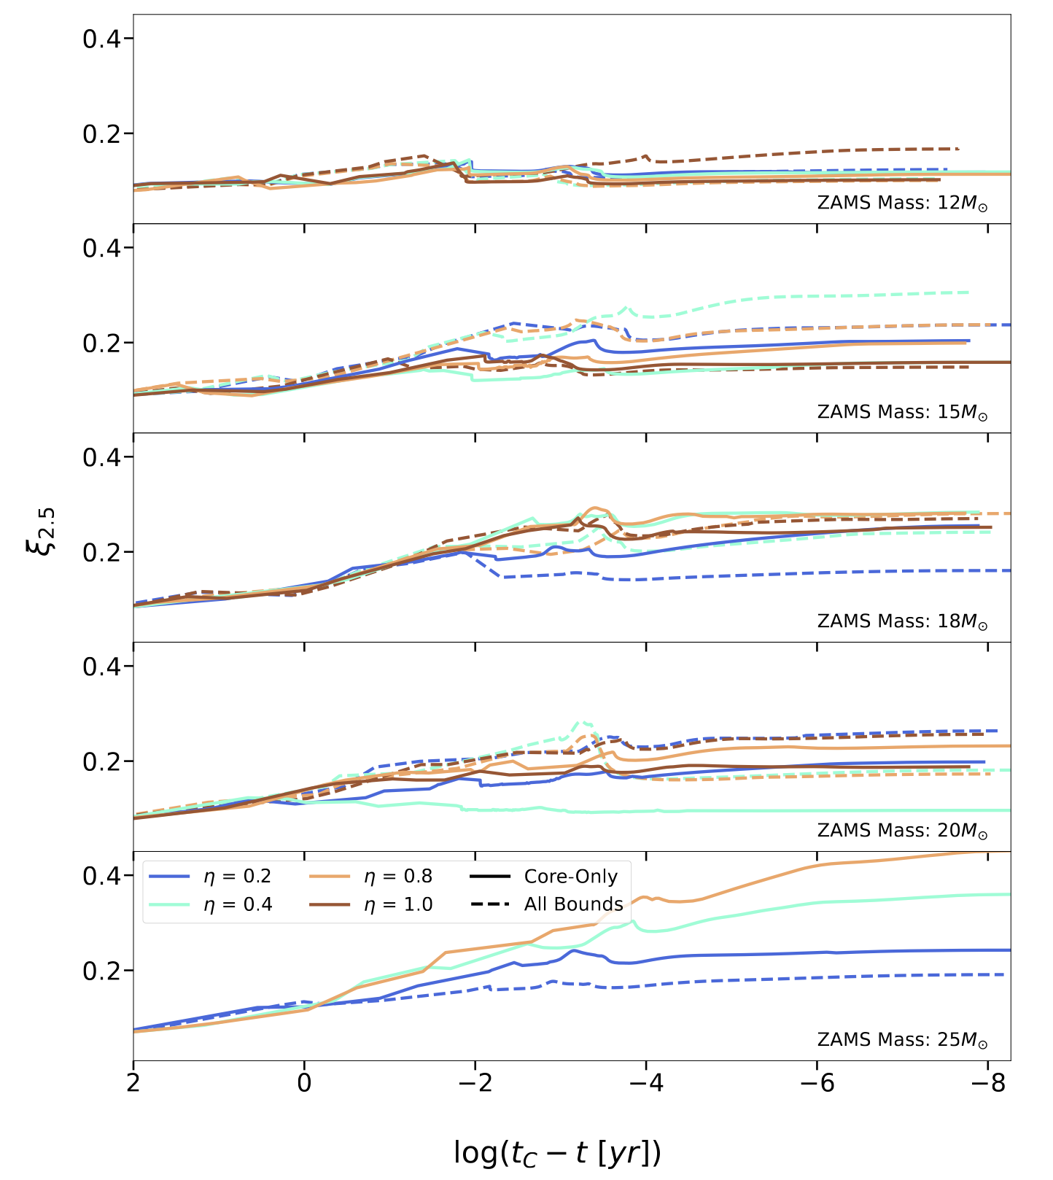
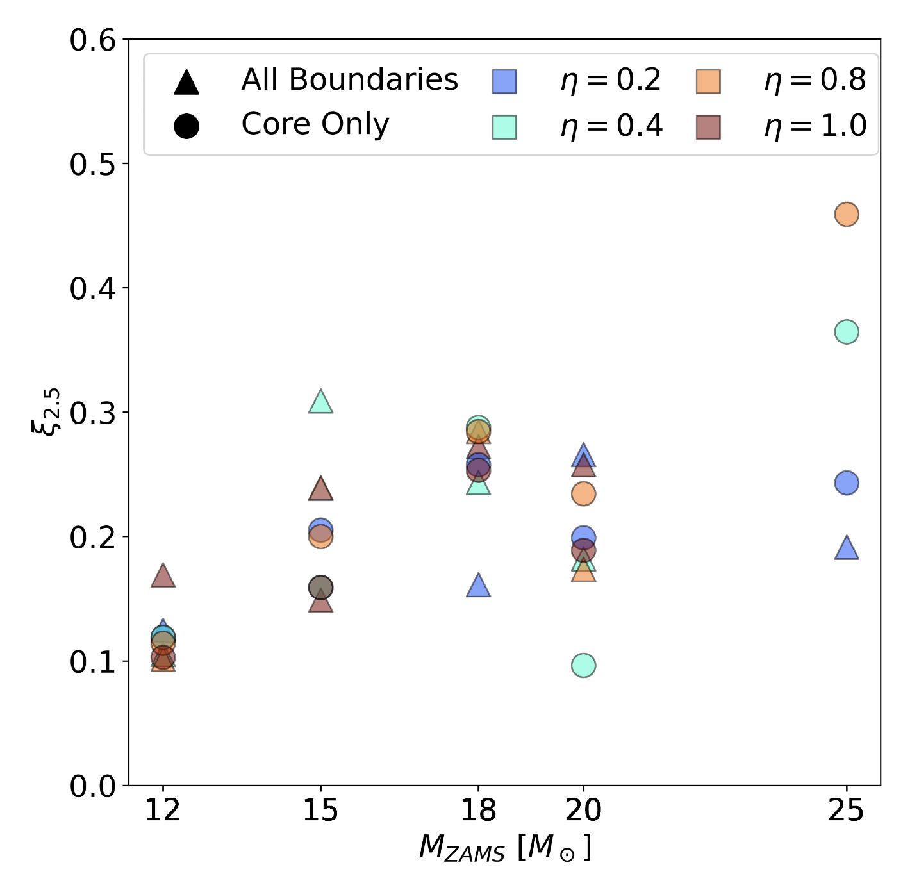

Slide 17
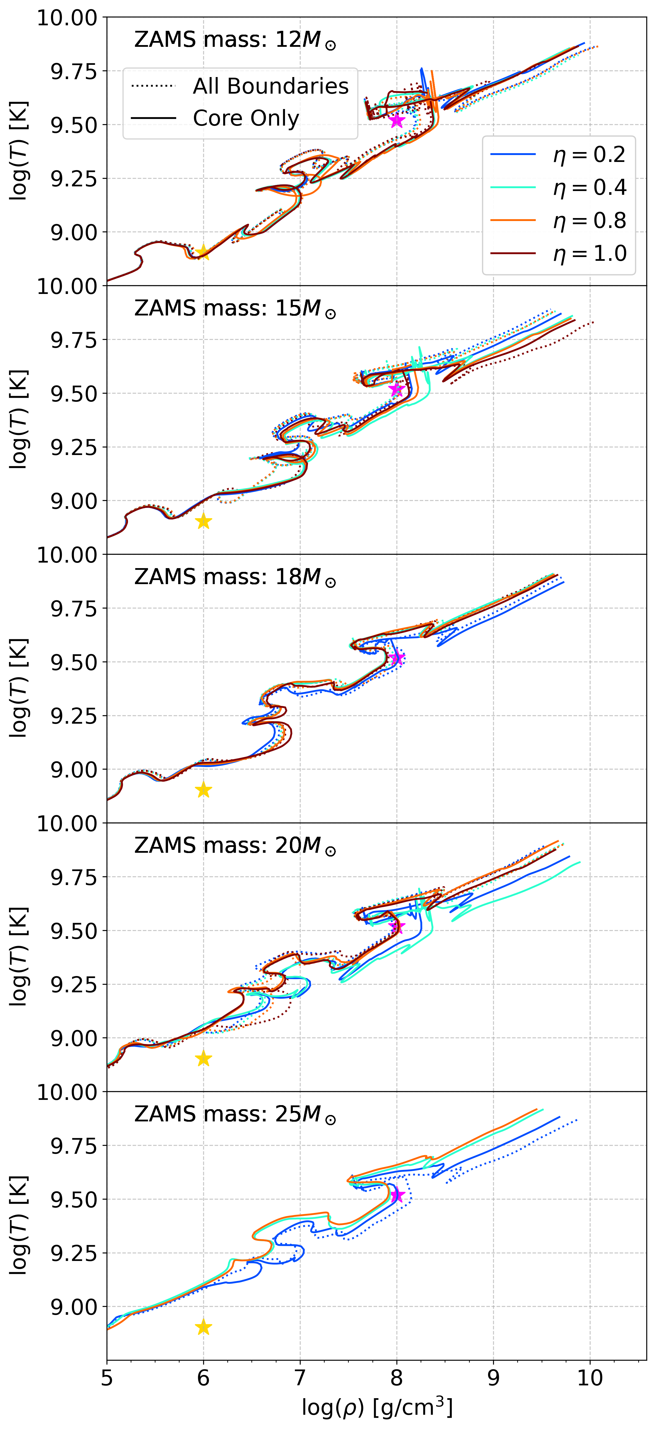

Slide 18
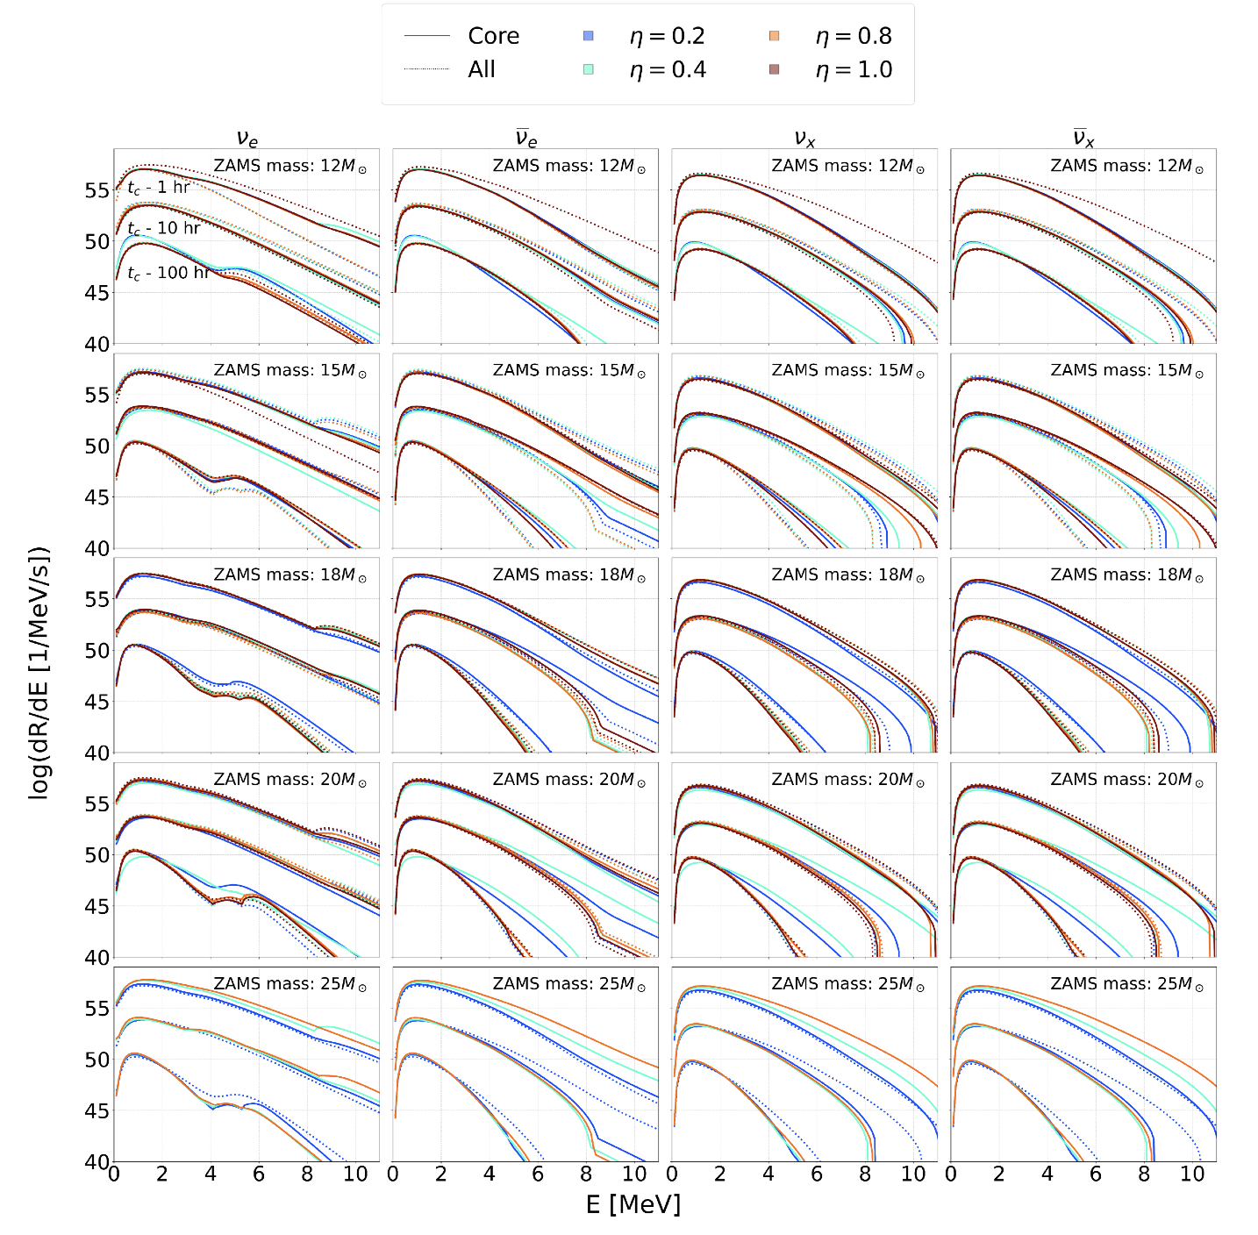

Slide 19
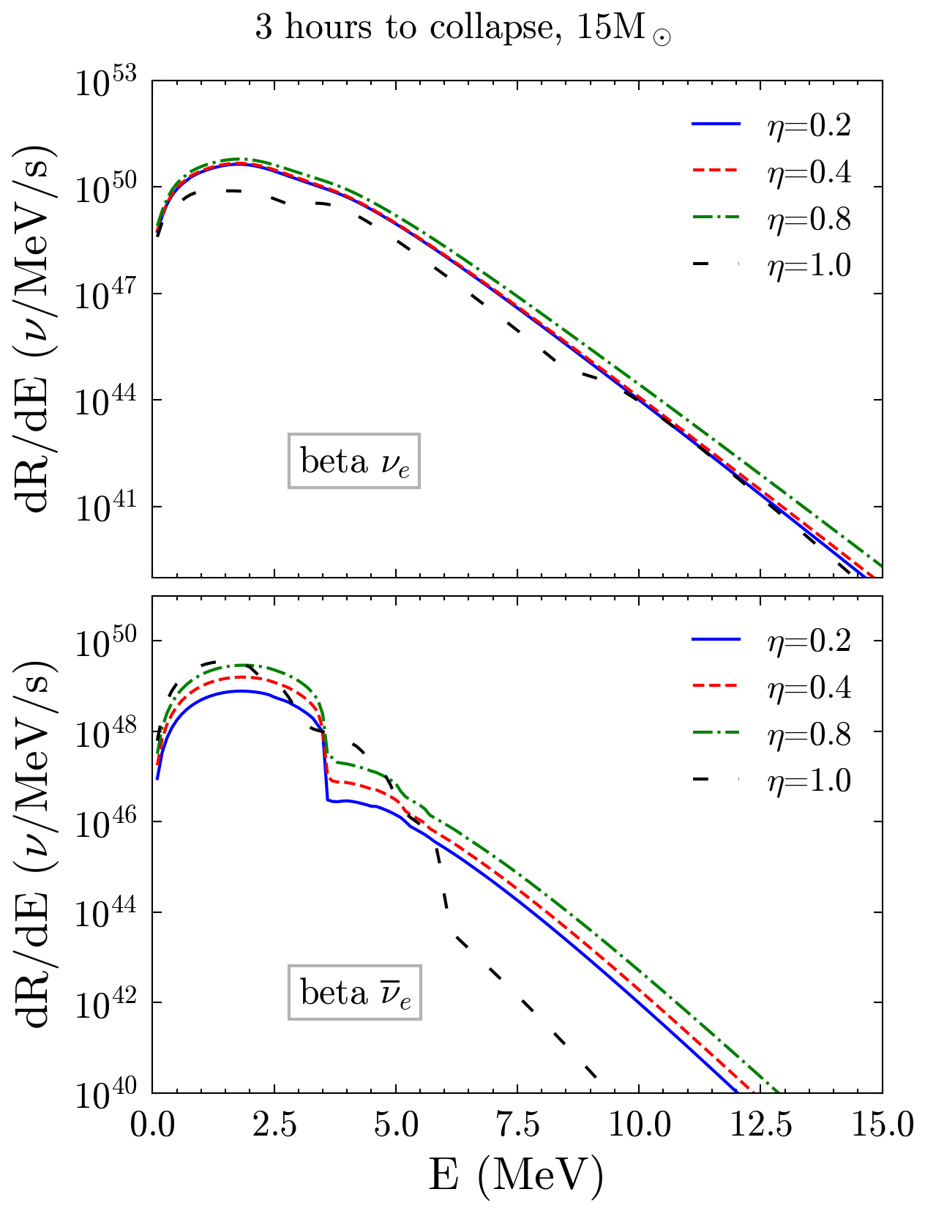
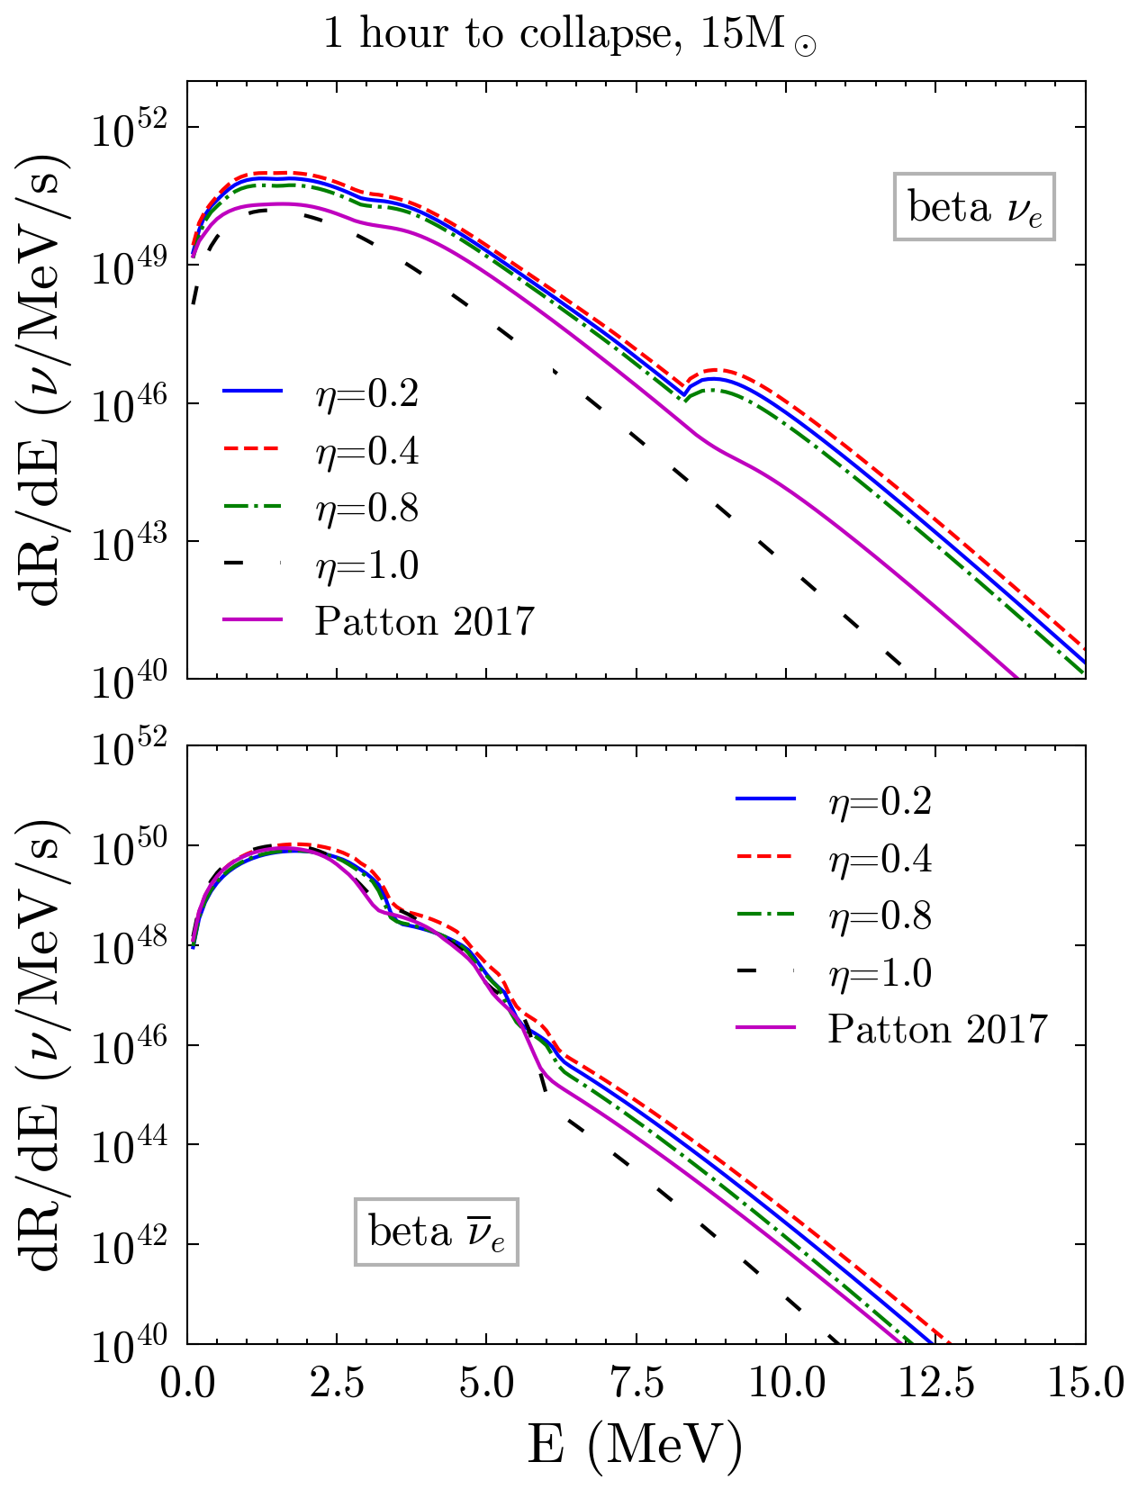
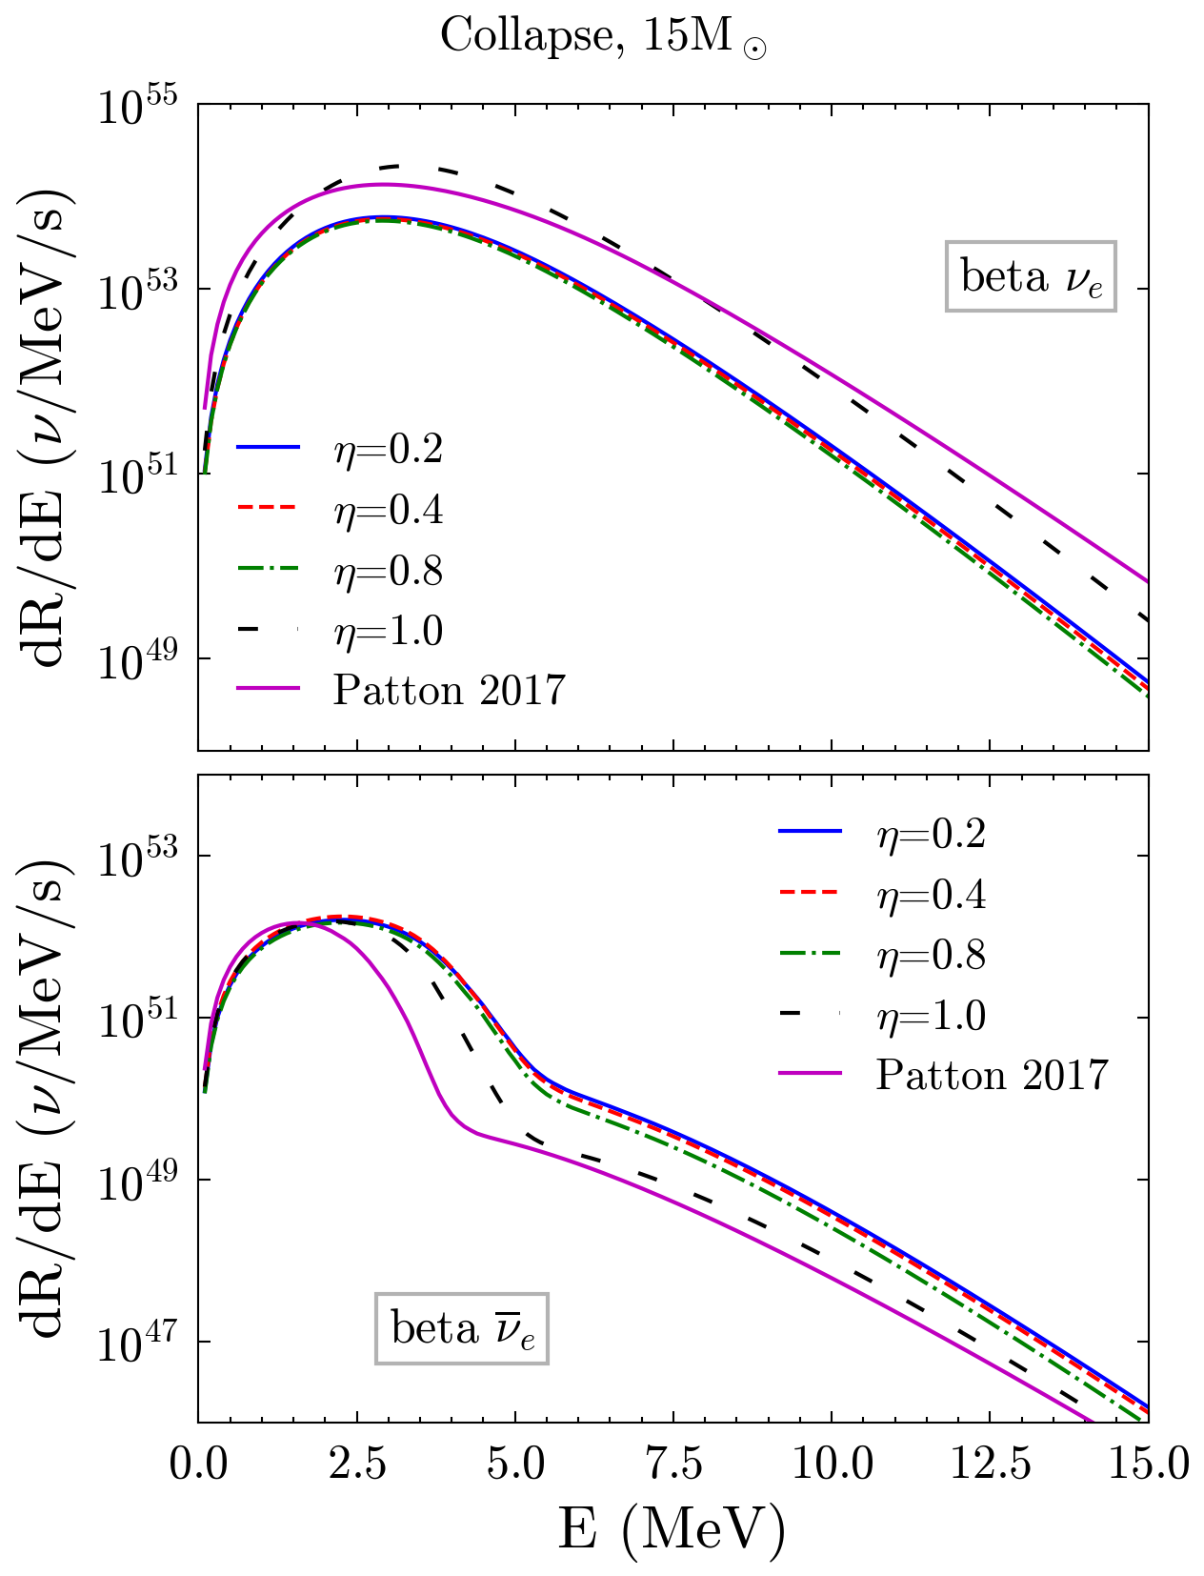

Slide 20
Summary
Effects of changing the mass loss/overshooting treatment are more exaggerated at higher ZAMS masses
Compositions varied by orders of magnitude
Compactness also varied significantly, with compactness at time of collapse depending on Si shell flashes
Stars with similar pre-SN observables may have very different composition and compactness

Slide 21
