Slide 1





HELIUM25 - Helium burning and pers. for und. labs
Structure of the ¹²C nucleus
and the triple alpha process in stars
Ivano Lombardo
for the NUCL-EX collaboration
Dip. di Fisica e Astronomia - Università di Catania
INFN - Sezione di Catania
Istituto Nazionale di Fisica Nucleare – Sezione di Catania
ivano.lombardo@ct.infn.it
Dresden, 23/07/2025
1

Slide 2
Exotic structures in light nuclei
Complexity of nuclear force → deviation from the sphericity: axial deformation (collective behaviours), spatial re-organization of nucleons in bounded sub-units (cluster model).
¹²O
¹³O
¹⁴O
¹⁵O
¹⁶O
¹⁷O
¹⁸O
¹⁹O
²⁰O
²¹O
²²O
¹¹N
¹²N
¹³N
¹⁴N
¹⁵N
¹⁶N
¹⁷N
¹⁸N
¹⁹N
²⁰N
²¹N
C
⁸C
⁹C
¹⁰C
¹¹C
¹²C
¹³C
¹⁴C
¹⁵C
¹⁶C
¹⁷C
¹⁸C
¹⁹C
²⁰C
α
B
⁸B
⁹B
¹⁰B
¹¹B
¹²B
¹³B
¹⁴B
¹⁵B
¹⁷B
¹⁹B
α
Istituto Nazionale di Fisica Nucleare – Sezione di Catania
Be
⁷Be
⁸Be
⁹Be
¹⁰Be
¹¹Be
¹²Be
¹⁴Be
α
Li
⁶Li
⁷Li
⁸Li
⁹Li
¹¹Li
linear chain
¹⁰Be,¹³⁻¹⁴C,¹⁶C(?),…
He
³He
⁴He
⁶He
⁸He
¹H
²H
³H
α
α
n
core
α
α
α
core
neutron skin
⁸He,C
α-cluster
⁸Be
neutron halo
⁶He,¹¹Li,¹¹Be
dilute gas
¹²C 0⁺,¹⁶O,²⁰Ne(?)
Long range correlations

Slide 3
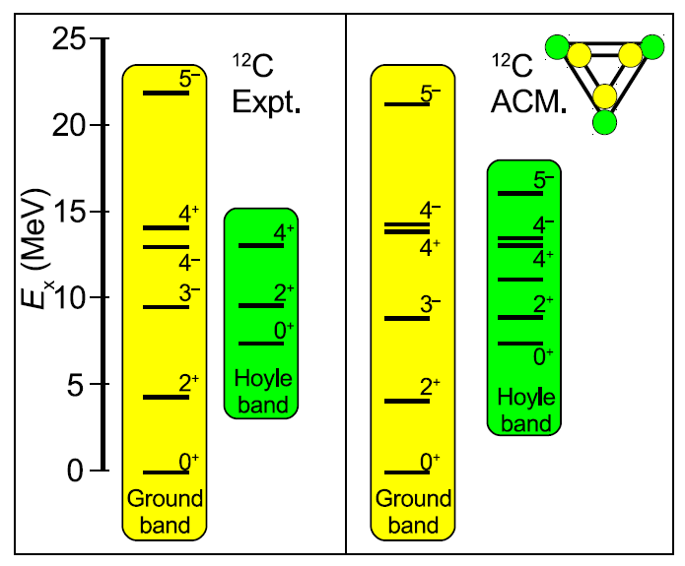
Clustering and Symmetry in light nuclei
Recently → applications of point group symmetries to clusterized nuclei, as ¹²C
D_{3h}
P. Atkins, Physical Chemistry (3rd ed.), OUP (1988) p. 409
Istituto Nazionale di Fisica Nucleare – Sezione di Catania
3-fold principal symmetry axis (C₃)
3 two-fold axes perpendicular to C₃
Horizontal mirror plane
R. Bijker & F. Iachello, Phys. Rev. C 61, 067305 (2000).
D. M. Lambarri et al, Phys. Rev. Lett. 113 (2014) 012502
Symmetry considerations → important benchmarck for microscopic calculations
Probe of the geometry of ¹²C → nuclear fluorescence experiments with linearly polarized γ beams, see e.g. L. Fortunato, PRC 99 (2019) 031302(R)
Symmetry considerations apply for other self-conjugate nuclei!
e.g. ⁸Be with Z₂ symmetry, ²⁰Ne with D_{3h} symmetry, ¹⁶O with T_{d} etc → Bijker and Iachello’s work!
Similar considerations for odd nuclei

Slide 4
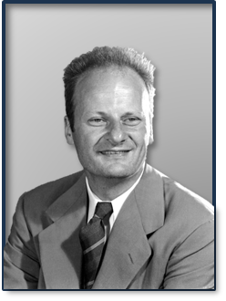



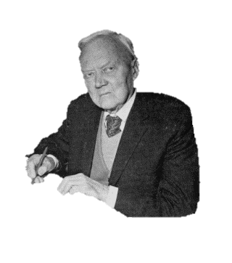





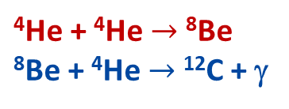
The triple alpha process in Nuclear Astrophysics
H. Bethe
1939
1951
1952
The formation of the ¹²C nucleus is extremely unlikely to happen from the simple collision of 3 α particles → T = 50x T_{Sun} would be required!
E. J. Öpik
C nucleosynthesis happens in the red giant phase
Istituto Nazionale di Fisica Nucleare – Sezione di Catania
It must be a sequential process
⁴He + ⁴He $→$ ⁸Be
⁸Be + ⁴He $→$ ¹²C + γ
D. Clayton, E. Salpeter
But, at temperatures of T = 0.1 GK and ρ = 10⁵, there are only 0.5 ⁸Be nuclei for one billion ⁴He!
How can we justify the ¹²C abundance and the C/O ratio?

Slide 5
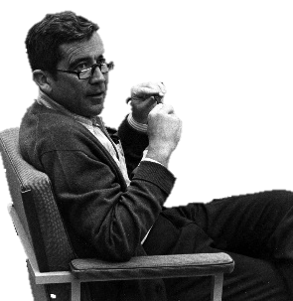
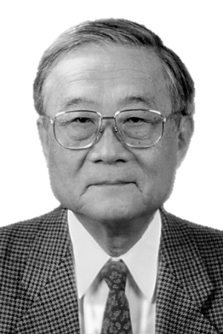
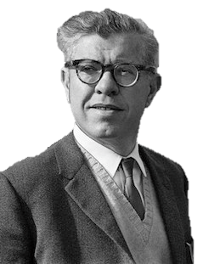
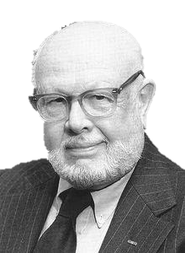
The Hoyle state in Nuclear Astrophysics
Hoyle state
In 1953, Fred Hoyle predicted the existence of a s-wave resonance to justify the observed C/O ratio and a viable mechanism for the 3α process.
(0⁺) 7.65 MeV
The existence of such a state was experimentally confirmed by W. Whaling (Caltech) during the same year.
(2⁺) 4.44 MeV
Ward Whaling (1923-2020)
In 1956, H. Morinaga described the Hoyle state as a linear chain configuration of α particles
Istituto Nazionale di Fisica Nucleare – Sezione di Catania
¹²C (0⁺) - 0 MeV
Haruiko Morinaga (1922-2018)
First steps towards the understanding of the importance of clustering phenomena in nuclear astrophysics!
Fred Hoyle (1915-2001)
J^{π} = 0⁺ verified by W. A. Fowler in 1957

Slide 6
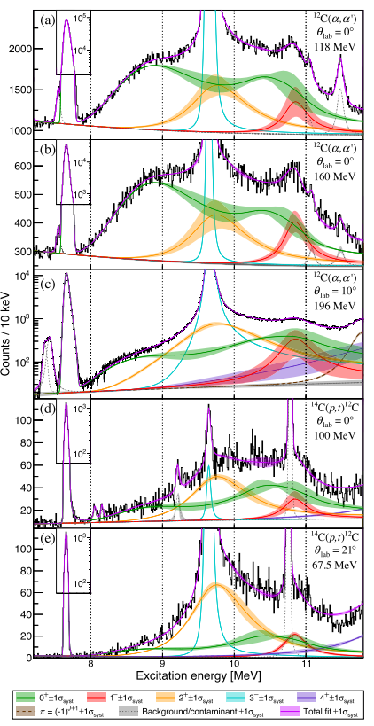
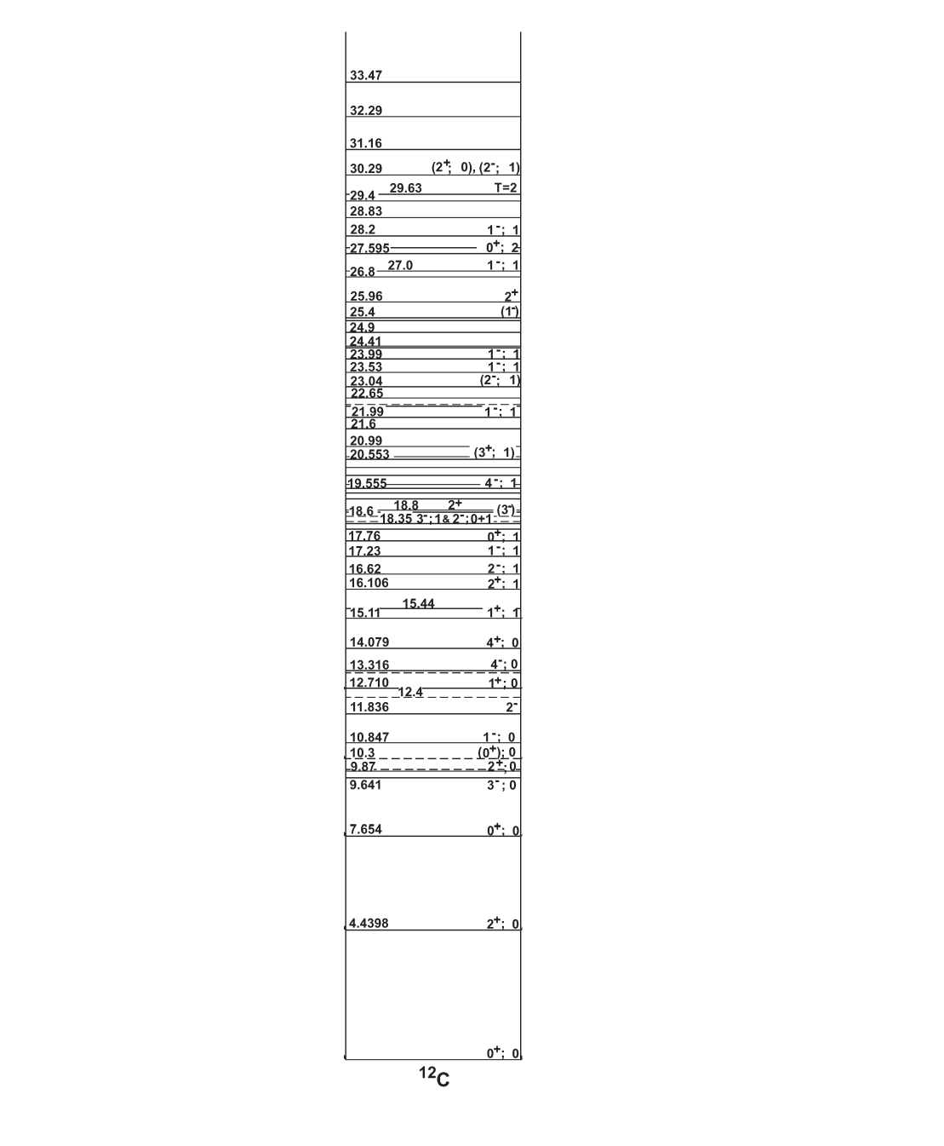
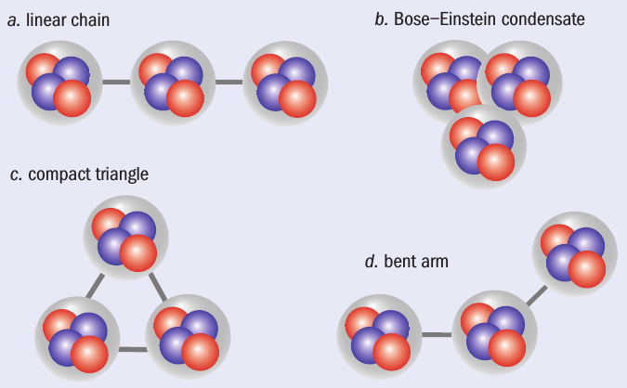
The hunt to the excited states of ¹²C
The structure of ¹²C
Cluster state of ¹²C located at 7.654 MeV (0⁺) → a pronounced cluster nature
→ not well understood properties → challenging open question in nuclear physics
E_{x} = 7.654 MeV, «Hoyle state»
J^{π} = 0⁺
from Ajzenberg-Selove
Istituto Nazionale di Fisica Nucleare – Sezione di Catania
18.722
¹¹C + n
15.957
¹¹B + p
D. Jenkins and O. Kirsebom, The Secret of Life,
Physics World Feb. 2013
4⁺ $≈$14 MeV
M. Freer et al., Phys. Rev. C 83, 034314 (2011)
4⁺
Hoyle band
(a) linear chain: α-cluster model
(b) Bose-Einstein condensate: microscopic models (GCM, RGM)
(c) compact triangle: ACM
(d) bent-arm: microscopic models (Faddev three-body formalism)
2⁺ 9.75 MeV
2⁺
7.367
⁸Be + α
0⁺
$$E_{x}=\frac{ℏ^{2}}{2I}J(J+1)$$
M. Itoh et al., Phys. Rev. C 84, 054308 (2011).
M. Freer et al., Phys. Rev. C 80, 041303 (2009).
W. R. Zimmerman, N. E. Destefano, M. Freer,
M. Gai, and F. D. Smith, Phys. Rev. C 84, 027304 (2011).
Breathing mode of the H.S. → K. Li et al, PLB (2022)

Slide 7
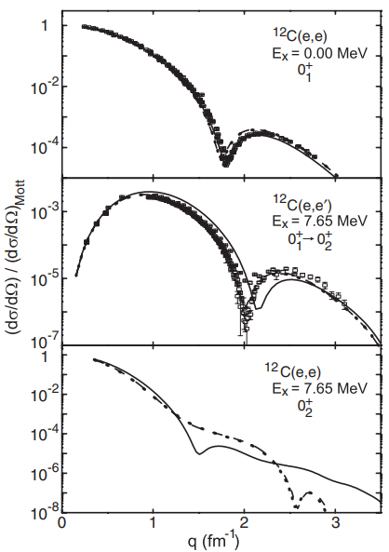
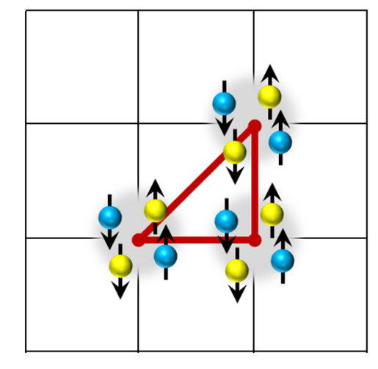
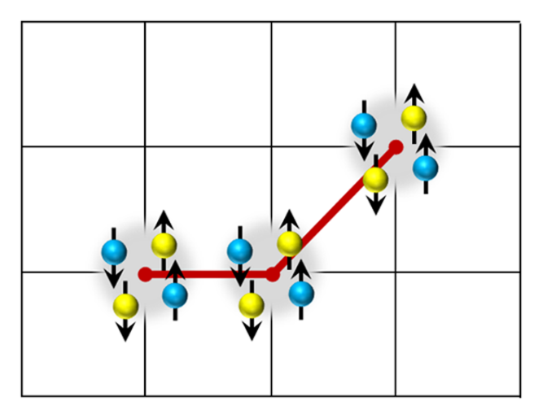
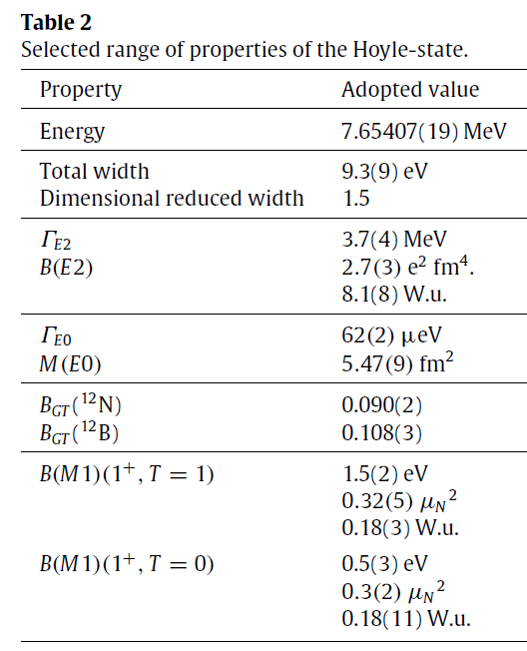
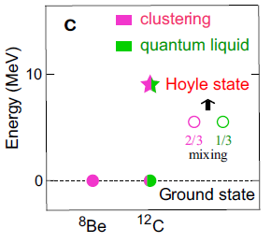
Some peculiarities of the Hoyle state
Was its introduction based on the use of the anthropic principle? H. Kragh, Arch. Hist. Exact Sci 64 (2010) 721; S. Thorvaldsen, Dialogo (2014) 43-46
Mass of light quarks from the Hoyle state and fine-tuning → Epelbaum et al, PRL 110 (2013)
Can the Hoyle state wave function show some BEC character? Tohsaki et al, PRL 87 (2001)
Abnormally large charge radius → (e,e’) or (h,h’) probes → model dependencies!
Direct decay, by-passing ⁸Be? Triple alpha reaction rate?
GS
HOYLE
Istituto Nazionale di Fisica Nucleare – Sezione di Catania
E. Epelbaum et al, PRL 109 (2012)
Ab initio lattice calculations
T. Otsuka et al, Nat. Comm. 13 (2022)
M. Chernykh et al, PRL 98 (2007)
see also Freer & Fynbo, PPNP 78 (2014)

Slide 8
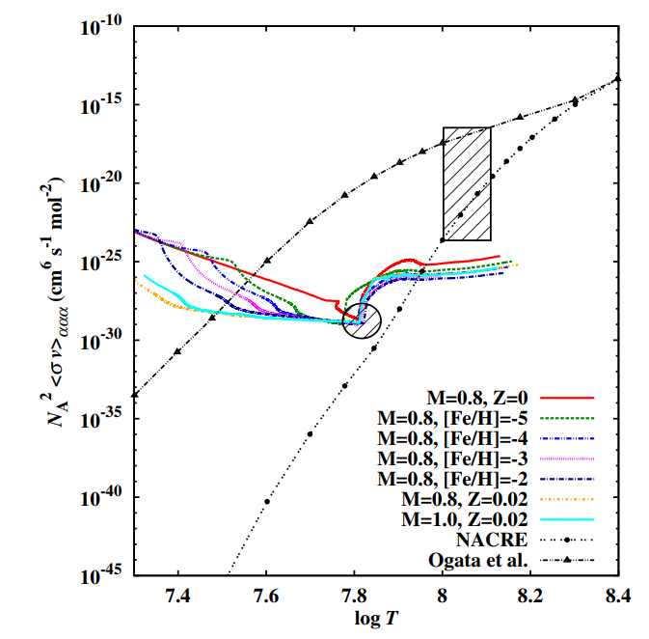
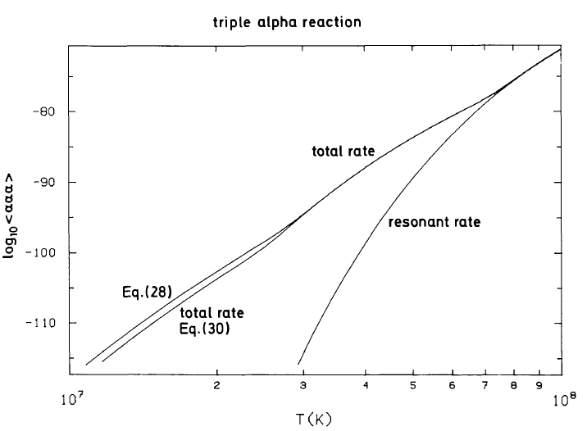
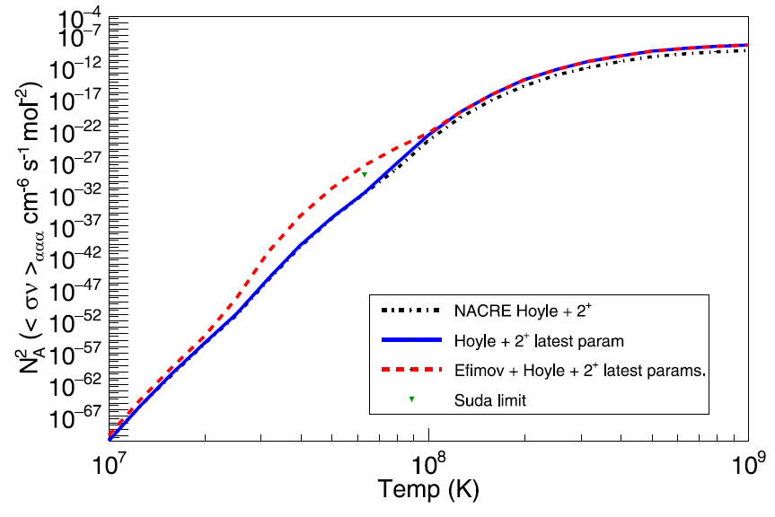
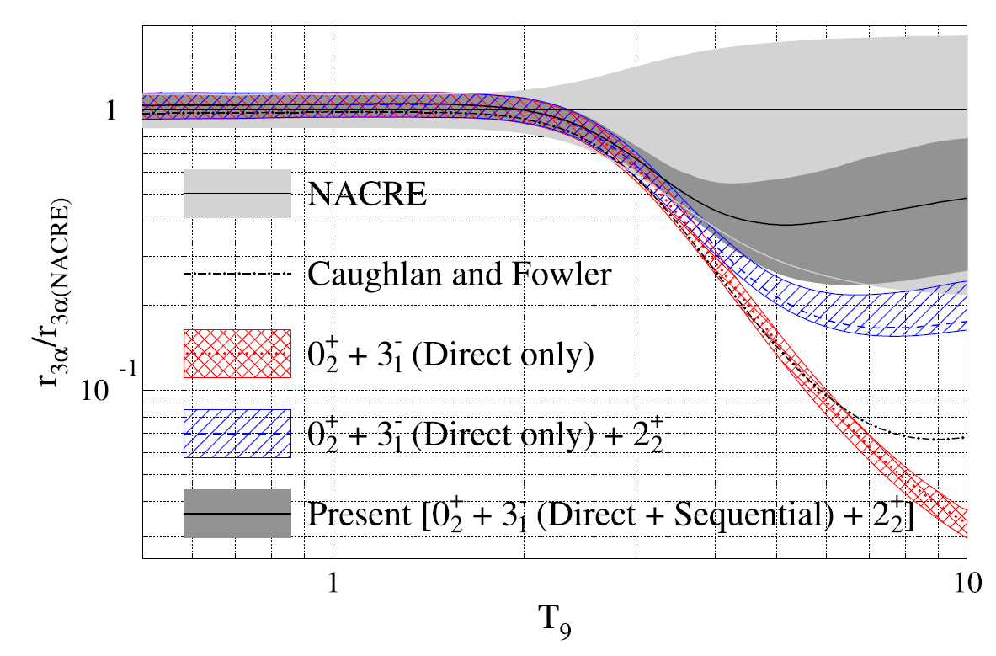
¹²C structure and triple α reaction rate
T. Suda et al, APJ 741 (2011)
K. Nomoto et al, A&A 149 (1985)
Ogata et al, PTP 122 (2009)
NACRE
Istituto Nazionale di Fisica Nucleare – Sezione di Catania
J. Bishop et al, PRC 103 (2021)
M. Tsumura et al, PLB 817 (2021)
… some news on this side → Conclusions

Slide 9
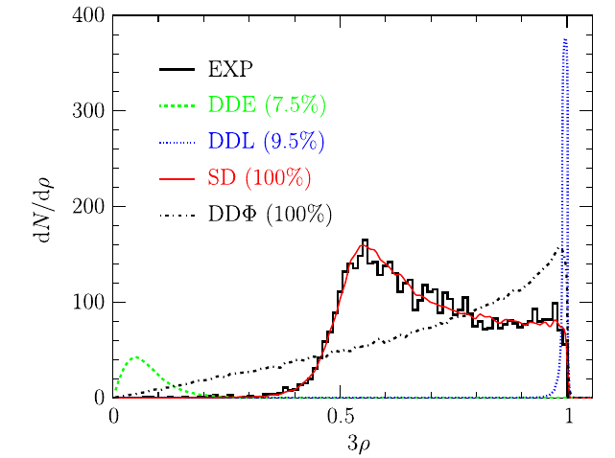
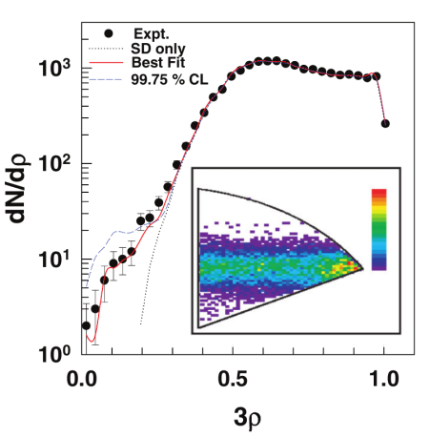
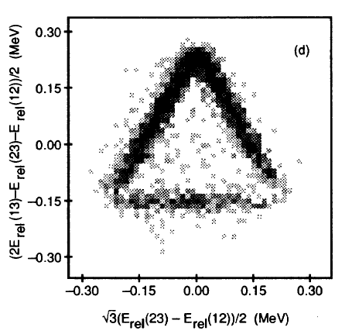
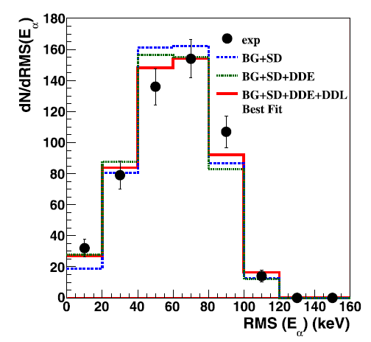
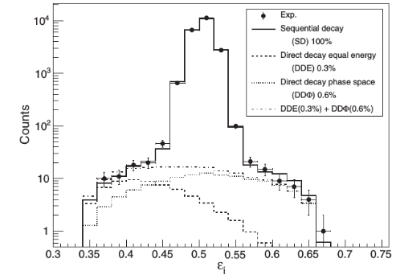
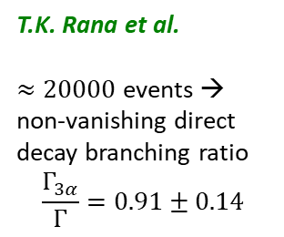
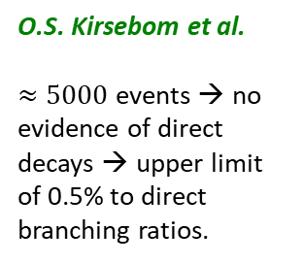
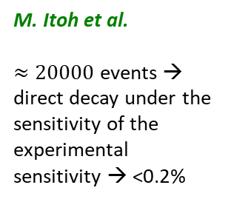
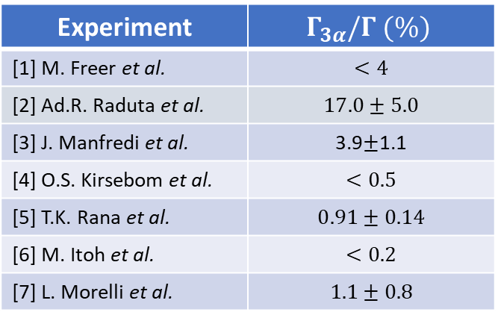
The Hoyle state in ¹²C: direct decay?
⁸Be
α
Experiment | $$Γ_{3α}/Γ (\%)$$
[1] M. Freer et al. | $$<4$$
[2] Ad.R. Raduta et al. | $$17.0±5.0$$
[3] J. Manfredi et al. | 3.9$±$1.1
[4] O.S. Kirsebom et al. | $$<0.5$$
[5] T.K. Rana et al. | $$0.91±0.14$$
[6] M. Itoh et al. | $$<0.2$$
[7] L. Morelli et al. | $$1.1±0.8$$
α
¹²C*
sequential
α
O.S. Kirsebom et al.
$≈5000$ events → no evidence of direct decays → upper limit of 0.5% to direct branching ratios.
α
α
α
direct
α
α
α
T.K. Rana et al.
$≈20000$ events → non-vanishing direct decay branching ratio
$$\frac{Γ_{3α}}{Γ}=0.91±0.14$$
Istituto Nazionale di Fisica Nucleare – Sezione di Catania
A. Raduta et al.
M. Freer et al.
M. Itoh et al.
$≈20000$ events → direct decay under the sensitivity of the experimental sensitivity → <0.2%
[1] M. Freer et al., Phys. Rev. C 49, R1751 (1994). [2] Ad. R. Raduta et al., Phys. Lett. B 705, 65 (2011). [3] J. Manfredi et al., Phys. Rev. C 85, 037603 (2012). [4] O. S. Kirsebom et al., Phys. Rev. Lett. 108, 202501 (2012). [5] T. K. Rana et al., Phys. Rev. C 88, 021601(R) (2013). [6] M. Itoh et al., Phys. Rev. Lett 113, 102501 (2014). [7] L. Morelli et al., J. Phys. G: Nucl. Part. Phys. 43, 045110 (2016).
…effects of the medium?

Slide 10
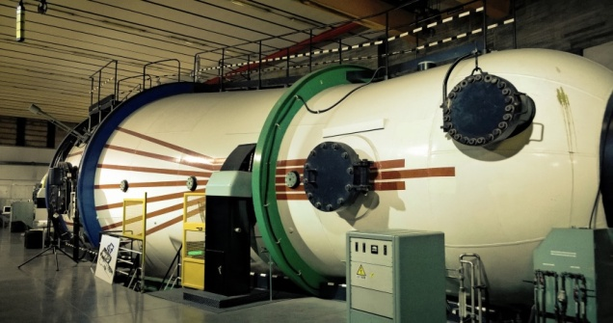
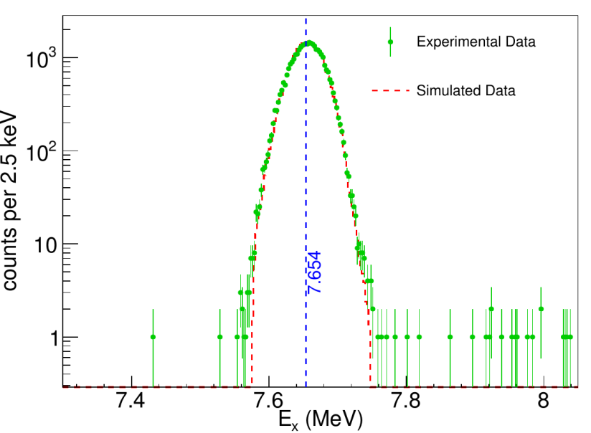
The HOYLE experiment at LNS
Tandem 15MV
¹⁴N(d,α₂)¹²C(7.654) at LNS, Catania
d beam at E_{d} = 10.5 MeV;
C₃N₆H₆ target (40 μg/cm²) + 5/10 μg/cm² backing C;
$I_{d}≈4enA$;
$≈30 days$ of beam time;
anti-coincidence telescope + hodoscope in KC
Hodoscope
anticoincidence
telescope
3α
C₃N₆H₆
α
Istituto Nazionale di Fisica Nucleare – Sezione di Catania
d
E_{d}=10.5 MeV
LNS
≈ 30kevts of four-fold coincidences

Slide 11
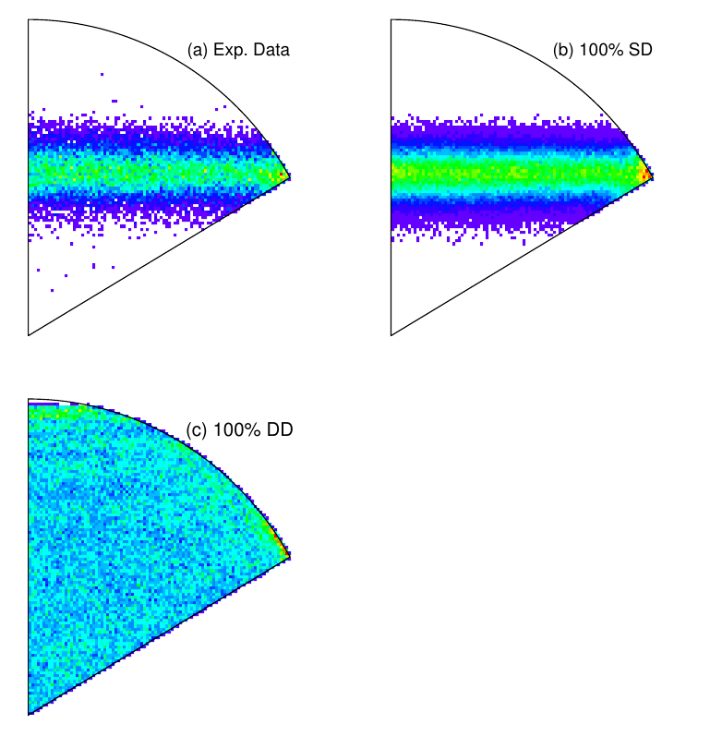
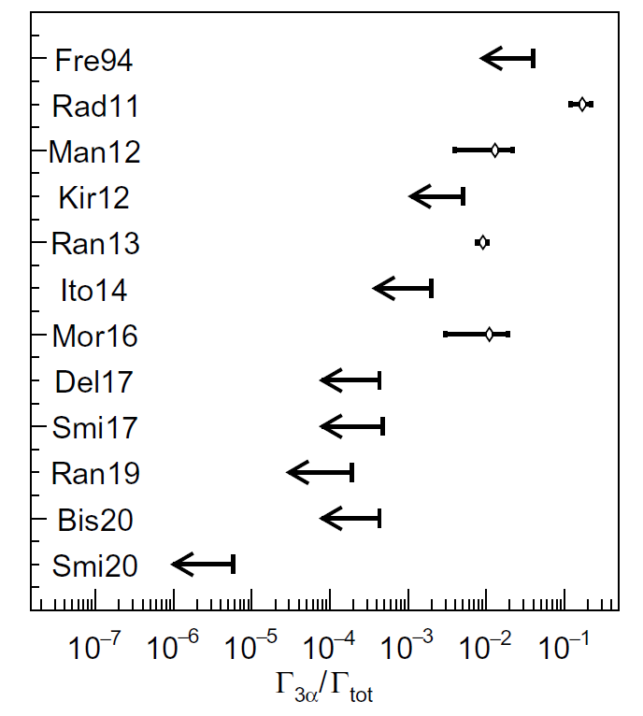
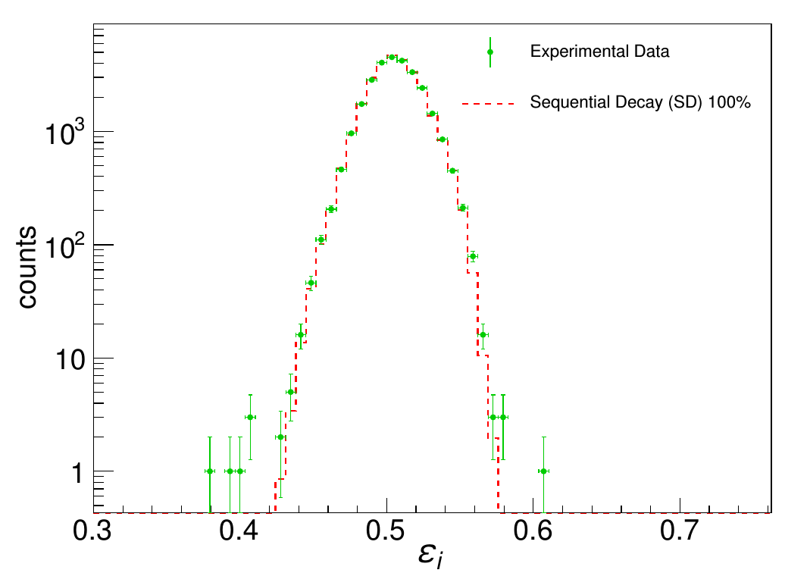
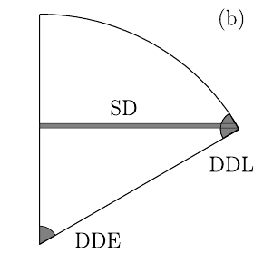
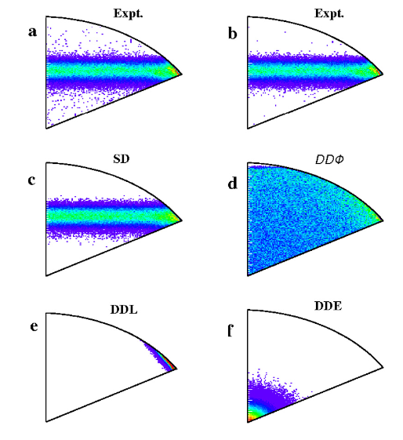
The Hoyle state direct decay width
<0.019% 95% CL
Istituto Nazionale di Fisica Nucleare – Sezione di Catania
DD < 0.043% at 95% CL
T.K. Rana et al, Phys. Lett. B 793 (2019)
Nearly identical to the findings of
R. Smith et al, PRL 119 (2017) 132502
and also, by using ¹²N decay:
J. Bishop, PRC 102 (2020) 041303 (R)
see also IL & DDA, Riv. Nuovo Cim. 46 (2023)

Slide 12
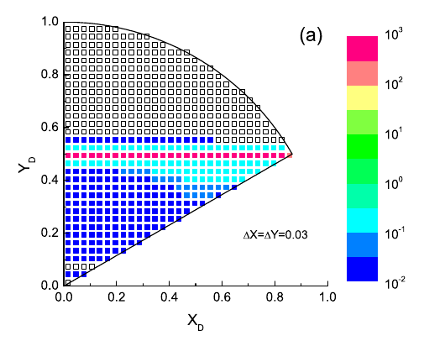
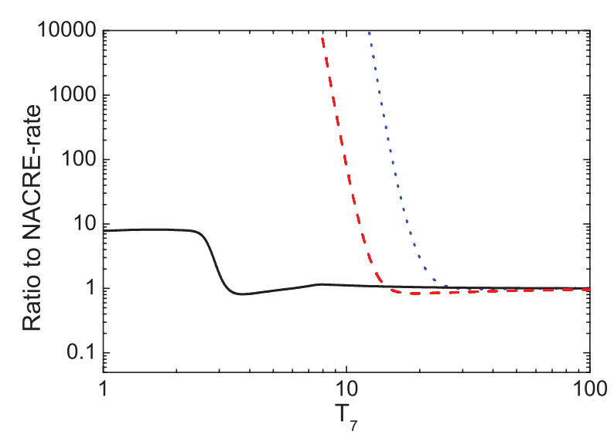
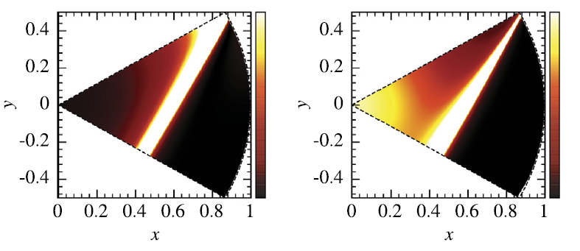
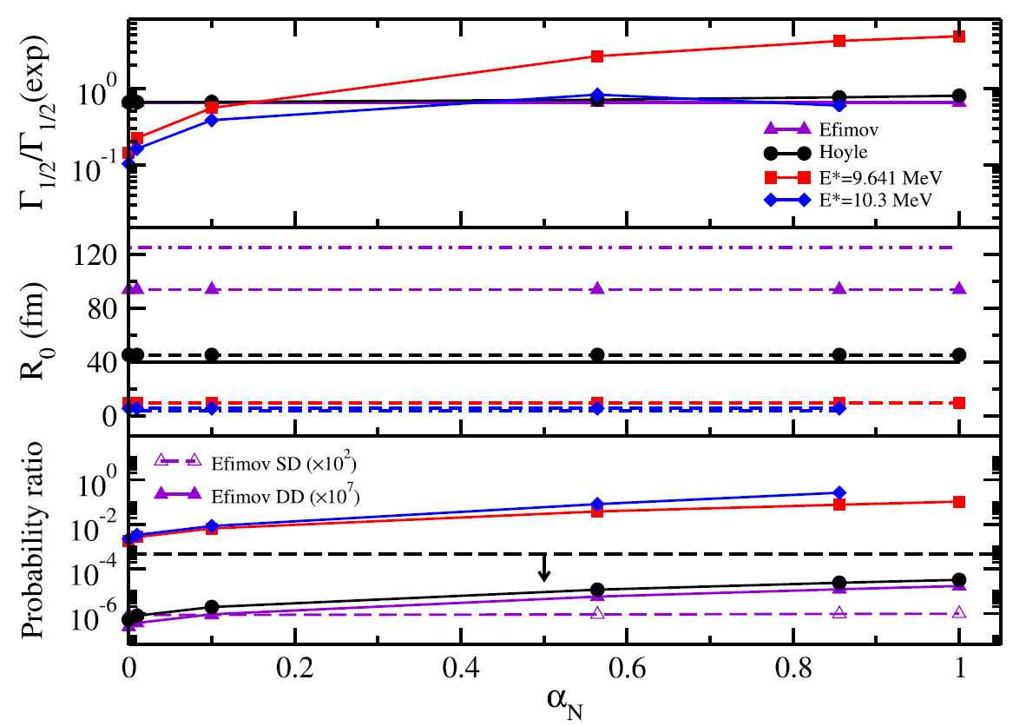
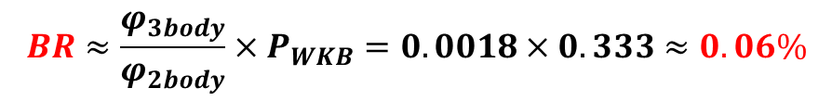
Some theoretical estimates on the DD
Faddeev 3-body calculations by Ishikawa (2014): DD < 1%
Simple phase-space calculations+WKB penetrability
R. Smith et al (PRL, 2017):
$$BR≈\frac{φ_{3body}}{φ_{2body}}×P_{WKB}=0.0018×0.333≈0.06\%$$
Semi-classical calculations by Zheng et al (Phys. Lett. B, 2018): ≈ 10⁻⁵
R-matrix calculations by Refsgaard et al (Phys. Lett. B, 2018)
Istituto Nazionale di Fisica Nucleare – Sezione di Catania
CDCC
OKK
Ghost anomaly
3-body
R. Smith et al, PRC 102 (2020): BR < 5.7·10⁻⁶

Slide 13

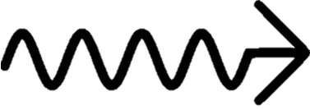

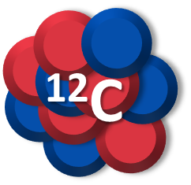



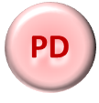
The Hoyle state radiative width
A ground state ¹²C nucleus can be formed only through a radiative decay of the Hoyle state.
¹²C
γ
¹²C
⁸Be
E_{x} = 7.65 MeV
E_{x} = 7.65 MeV
Istituto Nazionale di Fisica Nucleare – Sezione di Catania
Ground state
RD
Radiative decay
~ 0.05 %
PD
Particle decay
~ 99.95%
Emission of two γ-rays (or e+ e- couple) and production of a ground state ¹²C nucleus
Very rare, happens only
around 1 in 10⁴ times!
Emission (depicted as a two-step process) of an α particle. The final products are 3α particles.
It accounts for almost all the decays!
The C abundance in the whole universe completely depends from the Branching ratio of the Radiative to the Particle decay!
What is the real B.R. value?

Slide 14


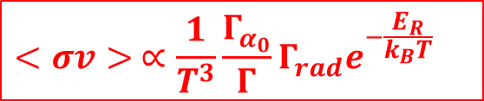


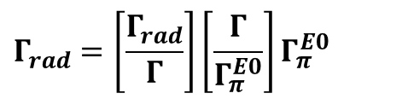


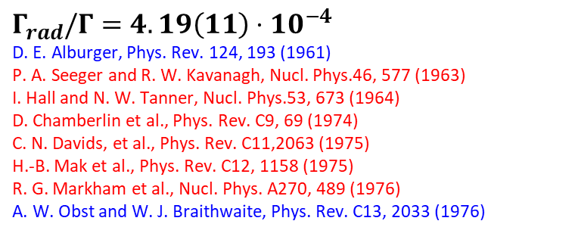

The Hoyle state radiative width
The triple alpha process reaction rate → resonant process:
$$<σv> ∝\frac{1}{T^{3}}\frac{Γ_{α_{0}}}{Γ}Γ_{rad}e^{−\frac{E_{R}}{k_{B}T}}$$
Key ingredients: $E_{R}$, $Γ_{rad},Γ_{α_{0}}/Γ$
$Γ_{rad}$: radiative decay width of the Hoyle state
Hoyle state
$$Γ_{rad}=Γ_{π}^{E0}+Γ_{π}^{E2}+Γ_{γ}^{E2}$$
$$0^{+}$$
$$7.65$$
$$Γ_{rad}=\left[\frac{Γ_{rad}}{Γ}\right]\left[\frac{Γ}{Γ_{π}^{E0}}\right]Γ_{π}^{E0}$$
$$Γ_{γ}^{E2}$$
$$Γ_{π}^{E2}$$
$$Γ_{π}^{E0}$$
Istituto Nazionale di Fisica Nucleare – Sezione di Catania
$$2^{+}$$
$$4.44$$
$$Γ_{π}^{E0}=63.3\left(20\right) μeV$$
M. Freer and H. O. U. Fynbo, Prog. Part. Nucl. Phys.78, 1(2014)
$$Γ_{π}^{E0}/Γ=7.6\left(4\right)⋅{10}^{−6}$$
T. K. Eriksen et al., Phys. Rev. C102, 024320 (2020)
$$0^{+}$$
$$0.0$$
$$Γ_{rad}/Γ=4.19\left(11\right)⋅{10}^{−4}$$
D. E. Alburger, Phys. Rev. 124, 193 (1961)
P. A. Seeger and R. W. Kavanagh, Nucl. Phys.46, 577 (1963)
I. Hall and N. W. Tanner, Nucl. Phys.53, 673 (1964)
D. Chamberlin et al., Phys. Rev. C9, 69 (1974)
C. N. Davids, et al., Phys. Rev. C11,2063 (1975)
H.-B. Mak et al., Phys. Rev. C12, 1158 (1975)
R. G. Markham et al., Nucl. Phys. A270, 489 (1976)
A. W. Obst and W. J. Braithwaite, Phys. Rev. C13, 2033 (1976)
¹²C
Associated-particle technique
Particle-γ-γ technique
… 4-fold coincidence …
…see also Rolfs-Rodney p. 393 sgg.

Slide 15
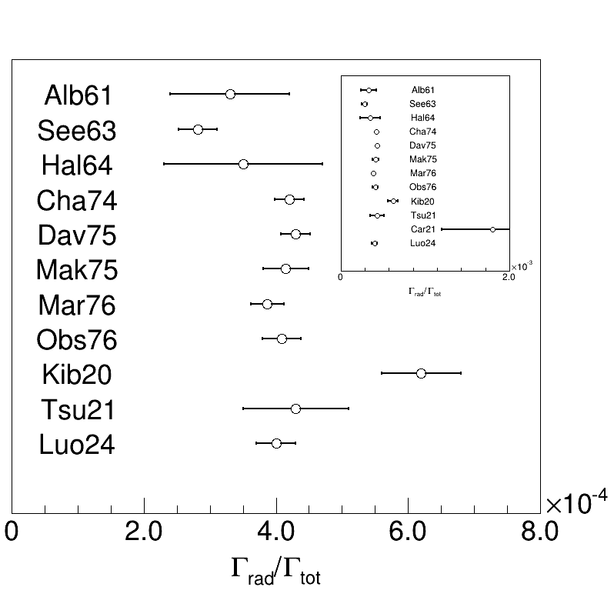
A new rush to the Hoyle state
2020 - T. Kibédi et al., Phys. Rev. Lett. 125 (2020): using gamma-particle coincidence techniques as in Obst PRC 1976, but identifying and correcting flaws in previous experiments
2021 – M. Tsumura et al. Phys. Lett. B 817 (2021): the experiment is tuned to probe the radiative branching ratio of the 9.63 MeV state
Istituto Nazionale di Fisica Nucleare – Sezione di Catania
2021 – G. Cardella et al. Phys. Rev. C 104 (2021): as in Tsu21, the experiment is tuned to probe the 9.63 MeV state. This is the only experiment so far capable to fully detect all the reaction products (4-fold coincidence technique)
2024 – Z. Luo et al. Phys. Rev. C 109 (2024): advanced particle-coincidence techniques using a magnetic spectrometer
Kibedi et al → BR_{rad} = 6.2(6)∙10⁻⁴

Slide 16
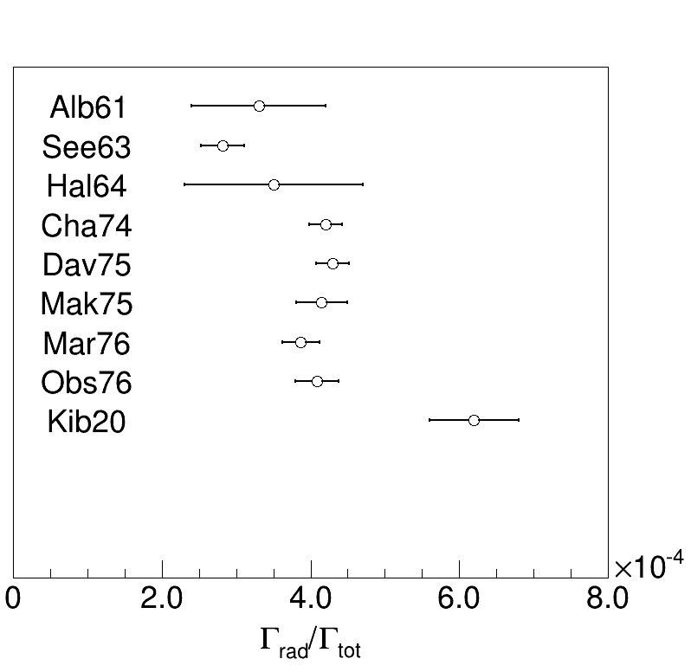
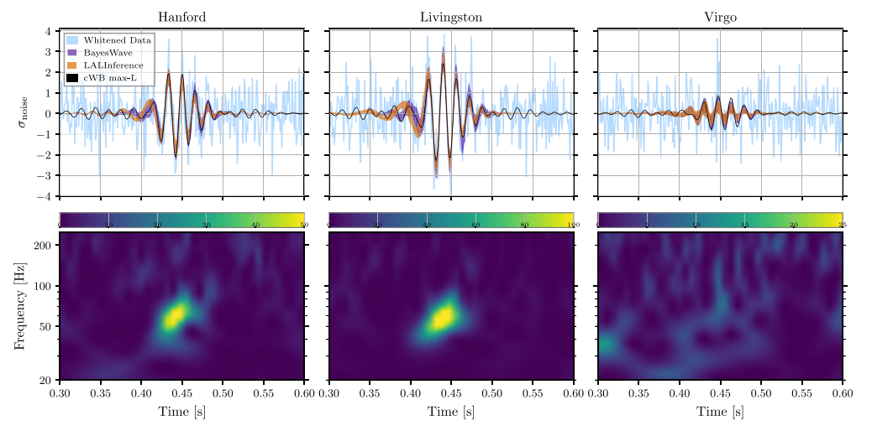


The Hoyle state radiative width
Sizable impact on the triple-alpha process in stars → about 34%
Impact on the pair instability mass gap for the formation of black holes (Woosley, S. & Heger, A. Astr. Jour. Lett. 912, L31 (2021)) $M_{low}≃50 M_{⨀}$
→ challenged by LIGO-Virgo data (Abbott 2020, Phys. Rev. Lett., 125, 101102): $65−70 M_{⨀}$
Istituto Nazionale di Fisica Nucleare – Sezione di Catania
S.E. Woosley and A. Heger, APJL 912 (2021)
new Γ_{rad} → $M_{low}≈64M_{⨀}$

Slide 17


The experimental set-up
The experiment was performed at the INFN-Laboratori Nazionali di Legnaro (LNL) over two runs in 2021 and 2023, with over 20 days of beam time.
Beam: d @ 2.7 MeV (CN accelerator), with intensities of a few tens of nA, to make negligible spurious coincidences between the two telescopes
Target: C₃H₆N₆ + C backing
Detectors: Anti-coincidence telescope (90°) + Anti-coincidence telescope (64.8°).
Istituto Nazionale di Fisica Nucleare – Sezione di Catania
CN accelerator at LNL
Dell’Aquila et al, Sci. Rep. 14 (2024)

Slide 18


Exp. results: the ejectile spectrum
¹²C detector
(anti-coincidence telescope)
¹²C kinematic cone
¹²C*
C₃H₆N₆ target (tilted by 65°)
α
alpha-detector
(anti-coincidence telescope)
Istituto Nazionale di Fisica Nucleare – Sezione di Catania
accelerated deuteron beam
Hoyle
4.44 MeV
Γ_{rad} → associated-particle method

Slide 19


Exp. results: the efficiency map
Hoyle
4.44 (2+)
coincidence data
Istituto Nazionale di Fisica Nucleare – Sezione di Catania
H.B. Mak et al, Phys. Rev. C 12 (1975)
The first time → 100 % + 2D mapping
2

Slide 20

Exp. results: the coincidence bkwd spectrum
coincidence data
Istituto Nazionale di Fisica Nucleare – Sezione di Catania
Hoyle

Slide 21


Exp. results: the coincidence frwd spectrum
Weighted average excluding outliers: $Γ_{rad}/Γ_{tot}=\text{4}\text{.}\text{11(10)}⋅{10}^{−4}$
Istituto Nazionale di Fisica Nucleare – Sezione di Catania
$$Γ_{rad}/Γ_{tot}=\text{4}\text{.2}\text{(}\text{6}\text{)}⋅{10}^{−4}$$
Confirmed by a subsequent work: T.K. Rana et al, Phys. Lett. B 859 (2024)
Recent re-analysis: W. Paulsen et al, https://arxiv.org/pdf/2406.00397
Dell’Aquila et al, Sci. Rep. 14 (2024)

Slide 22




nucl-ex>arXiv:2507.03514v1
Conclusions → Very recent news on the Efimov state
4th July → a new pre-print by the Mumbai group on the Efimov state in ¹²C
→ a new signal ???
Istituto Nazionale di Fisica Nucleare – Sezione di Catania
A. Baishya et al, arxiv 2507.03514v1

Slide 23
Summary and perspectives
Despite its outstanding importance, the structure and decay of the Hoyle state have been debated for over half a century
The direct 3α decay width has been the subject of an intense campaign of experiments, possibly linked with the occurrence of BEC in nuclei
Upper limit in our experiment (2017): 0.043% at 95% CL, now: R. Smith et al, Phys. Rev. C (2020): 5.7∙10⁻⁶ from 2⁺ analysis and the use of o-TPC
Recent experiments (Kibedi et al, PRL 2020) challenged the radiative decay branching ratio known from elder experiments (60s and 70s) with major implication in astrophysics
New, high-precision data can help to clarify the tension
This talk presented new results from a novel particle coincidence experiments, whose results are statistically compatible with the former state-of-the-art
Some still open questions: the estimate of Γ_{rad} for the 3⁻ state → non-vanishing branching ratio?
Structure of ¹²C and ACM predictions: some members of the GS and Hoyle band are still missing!
Very high energy states in ¹²C → still unassigned J^{π} and I → can have an impact in understanding clustering in light nuclei
Istituto Nazionale di Fisica Nucleare – Sezione di Catania
Thank you for the attention!
2

