Slide 1
Experience in academia by an Early Career Researcher
by Denise Piatti
Based on a true story

Slide 2

Warnings
be aware I will be honest
what I will report it is my own experience and my own experience only…
however, one can also draw some general and shared topics, trends, ideas, feelings etc..
you can use my experience as you prefer but at least consider to find out other points of view

Slide 3

Chapter 1: All at one glance
2015-2018 PhD at University of Padua (Italy)
2018-2019 Post-Doc position at INFN, Division of Padua (Italy)
2020 DAAD fellowship at Felsenkeller Lab. (Germany)
2020-2023 Post-Doc position(s?) at University of Padua (Italy)
2023 - 2026 RTDa at University of Padua (Italy)
Ed. Note: DO NOT TRY TO CALCULATE MY AGE… I INCREDIBLY MANAGED TO DO EVERYTHING BY THE AGE OF 25!!!!!!!!!!

Slide 4
Chapter 2: PhD
2015-2018 at University of Padua
My research activity was in LUNA Collaboration, specifically I worked on two measurements performed at the LUNA-400kV [Piatti, D. et al., PRC RC (2020) and Piatti, D. et al., EPJA (2022)]
It was(is) a great time:
  I learned a lot, from each single shift and shifter and from each discussion in the office
  I travelled a lot and I met a lot of people who ultimately become my friends, colleagues and basically a second family to me

Slide 5
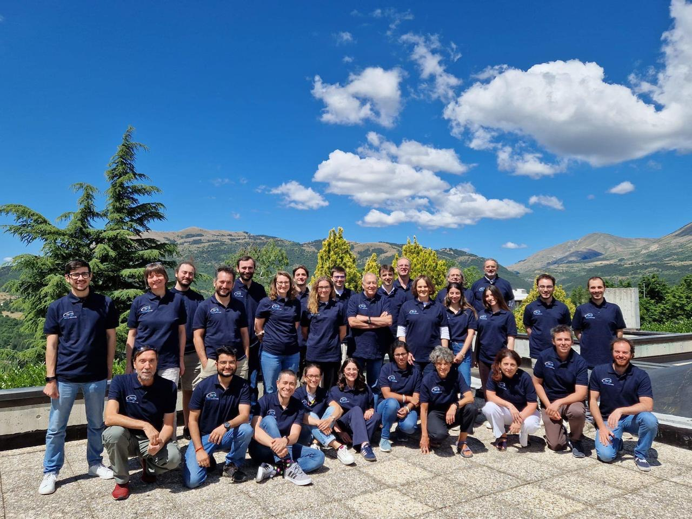
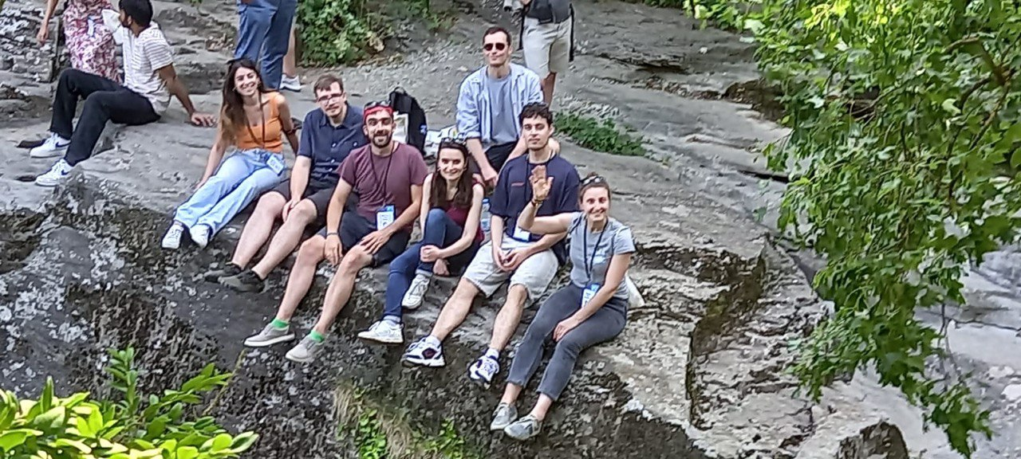
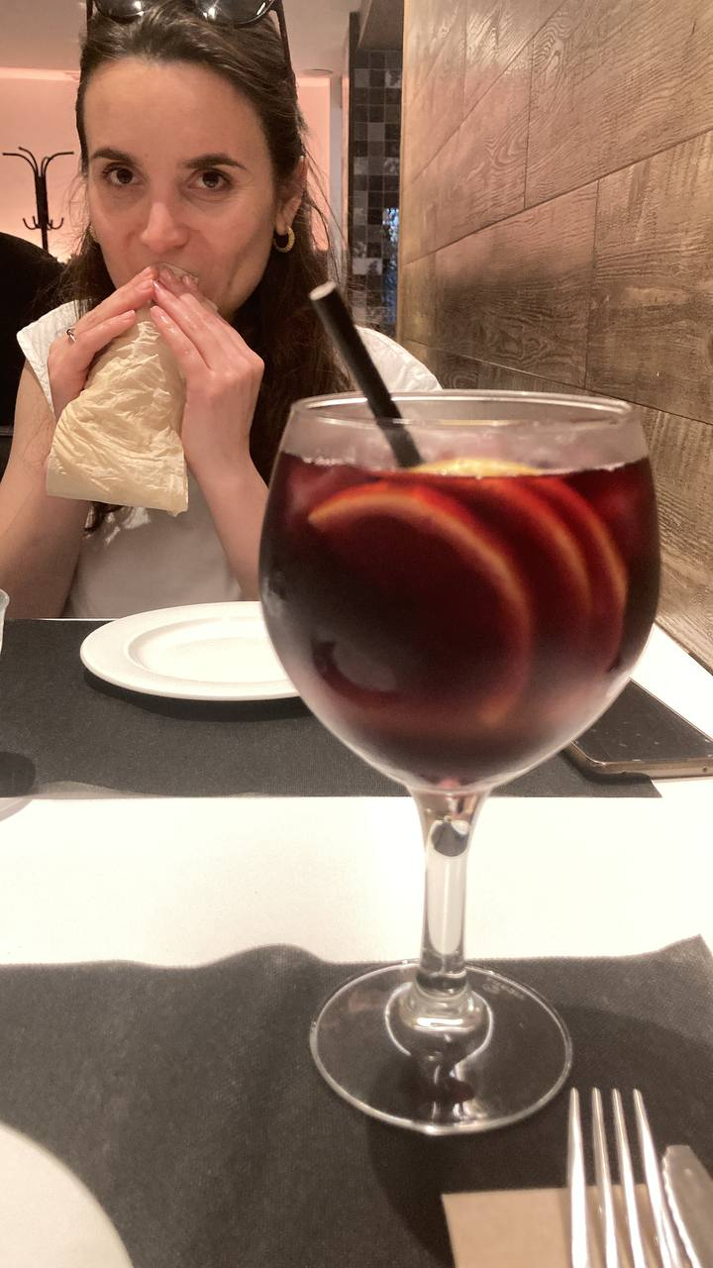
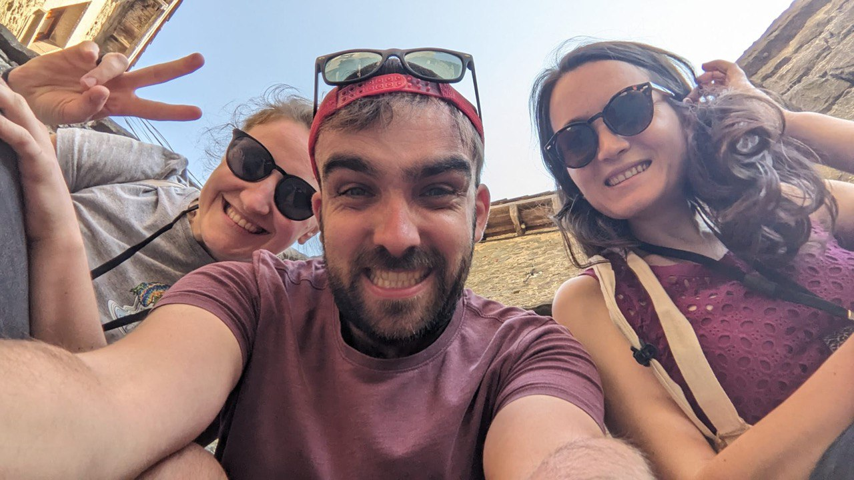
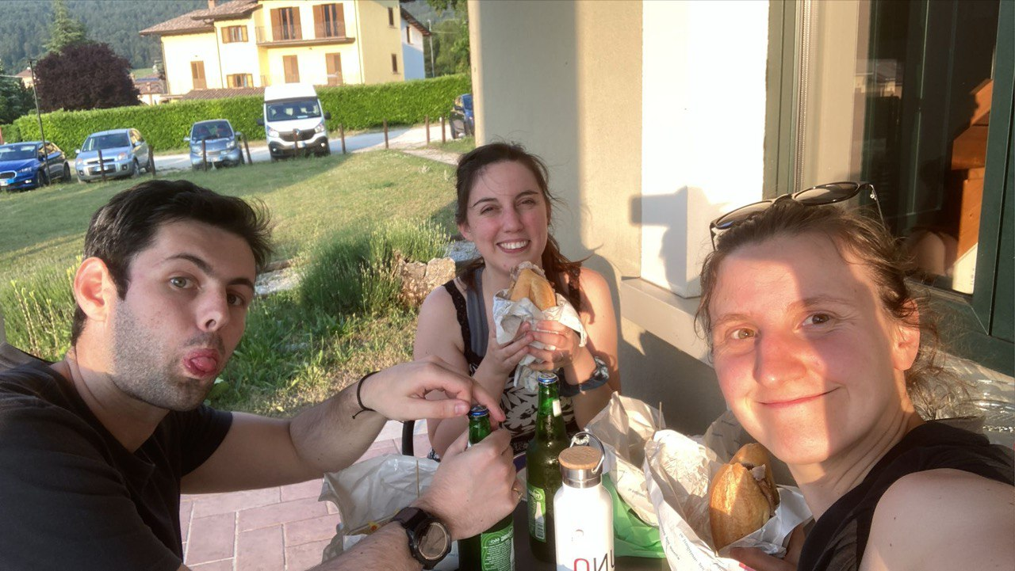
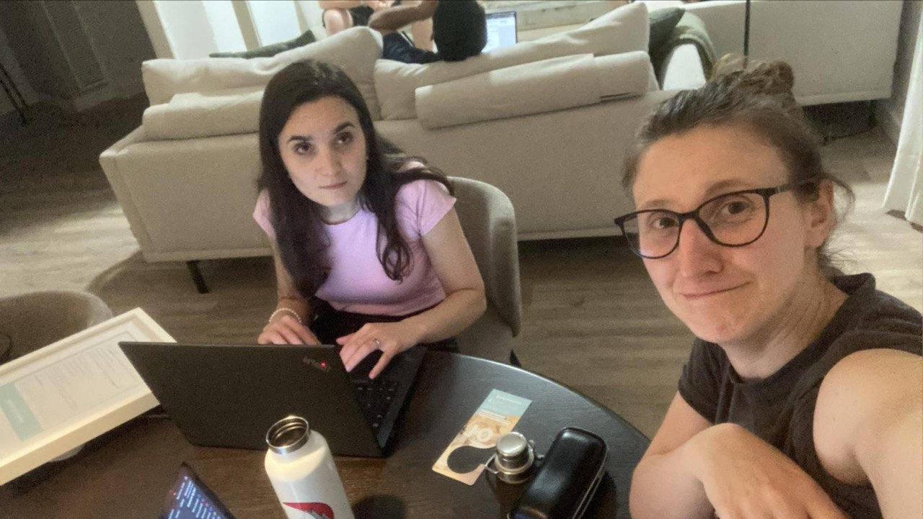
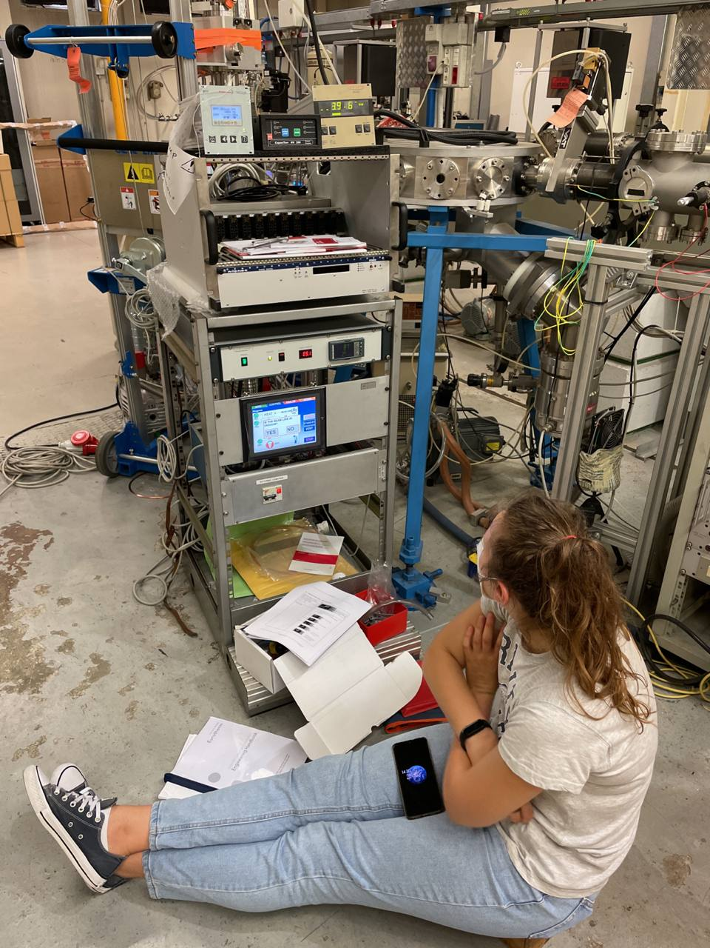
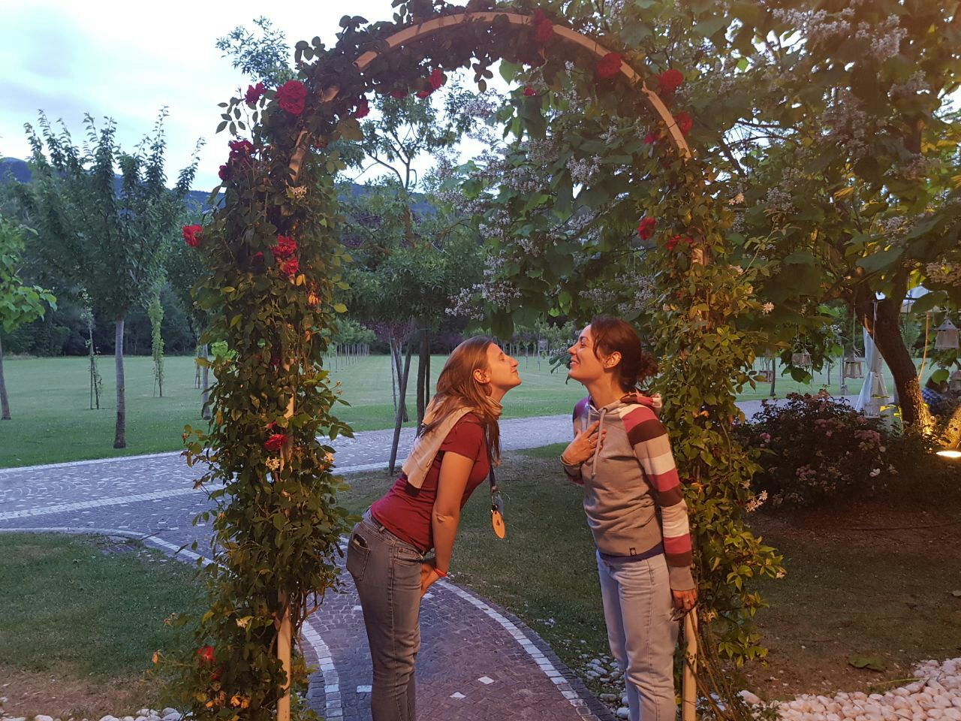
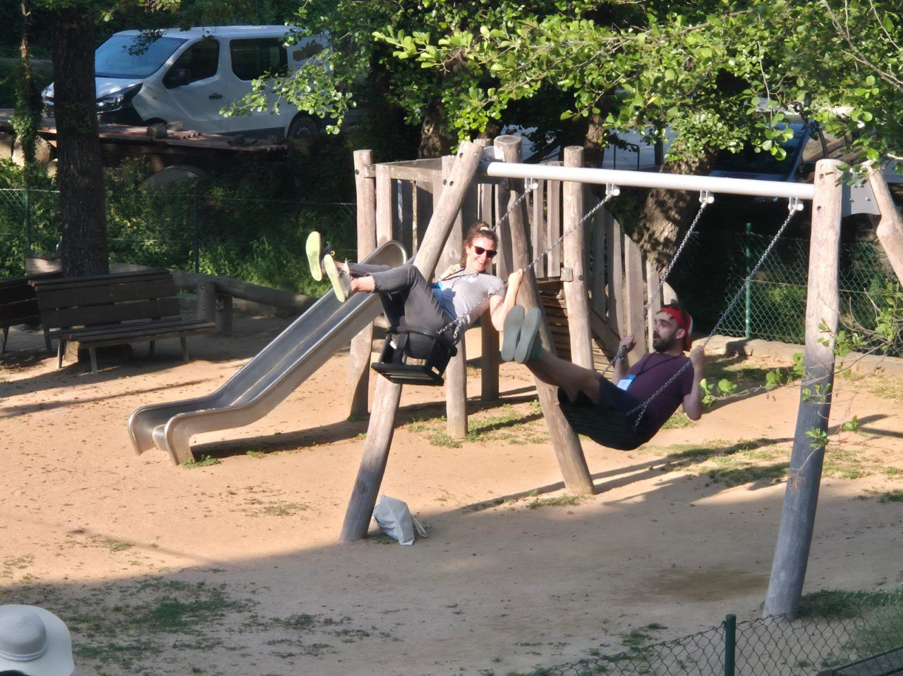
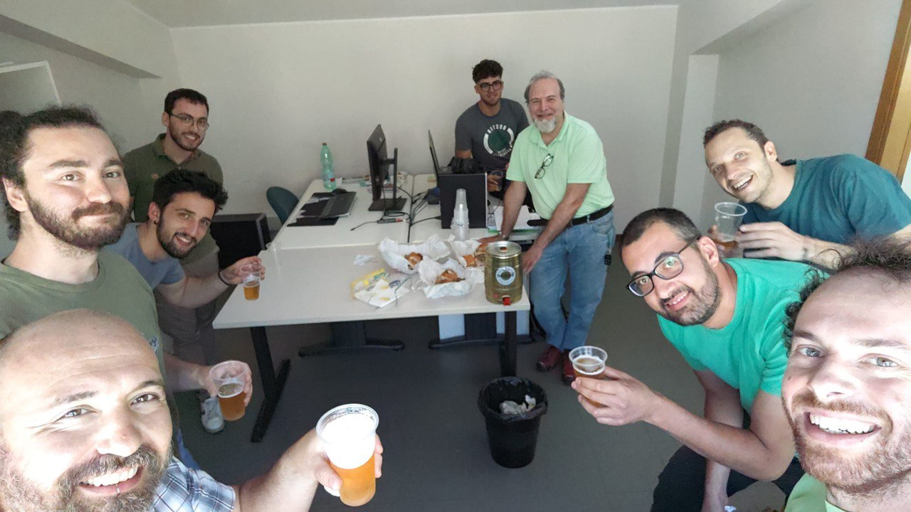
Chapter 2: PhD
2015-2018 at University of Padua
My research activity was in LUNA Collaboration, specifically I worked on two measurements performed at the LUNA-400kV [Piatti, D. et al., PRC RC (2020) and Piatti, D. et al., EPJA (2022)]
It was a great time:
  I learned a lot, from each single shift and shifter and from each discussion in the office
  I travelled a lot and I met a lot of people who ultimately become my friends, colleagues and basically a second family to me

Slide 6
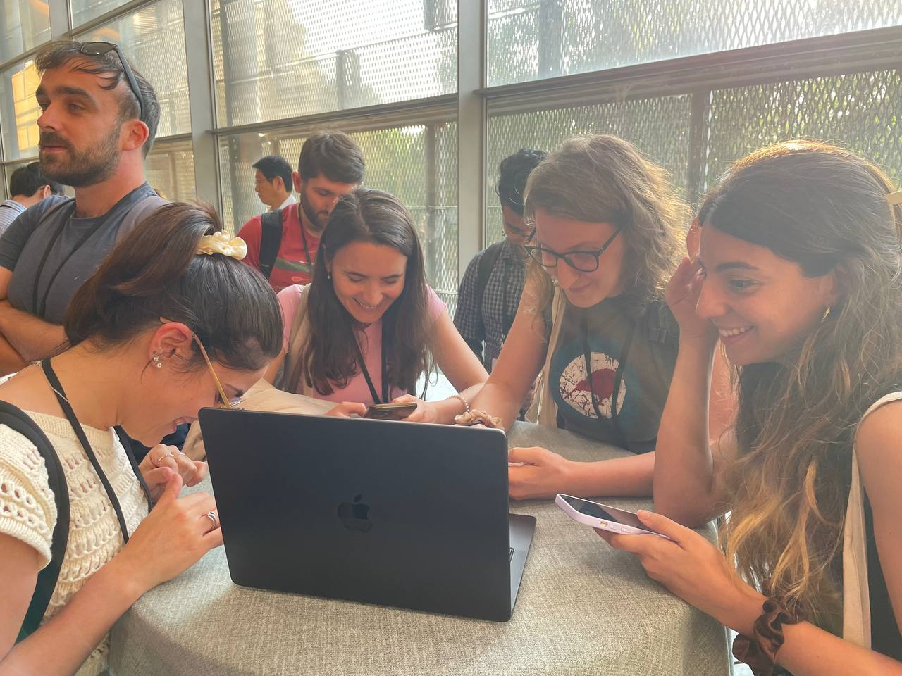
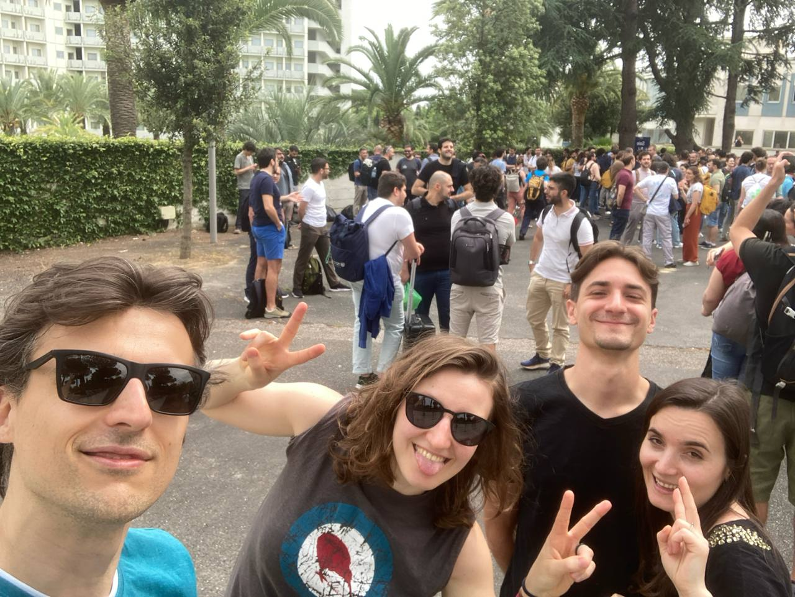
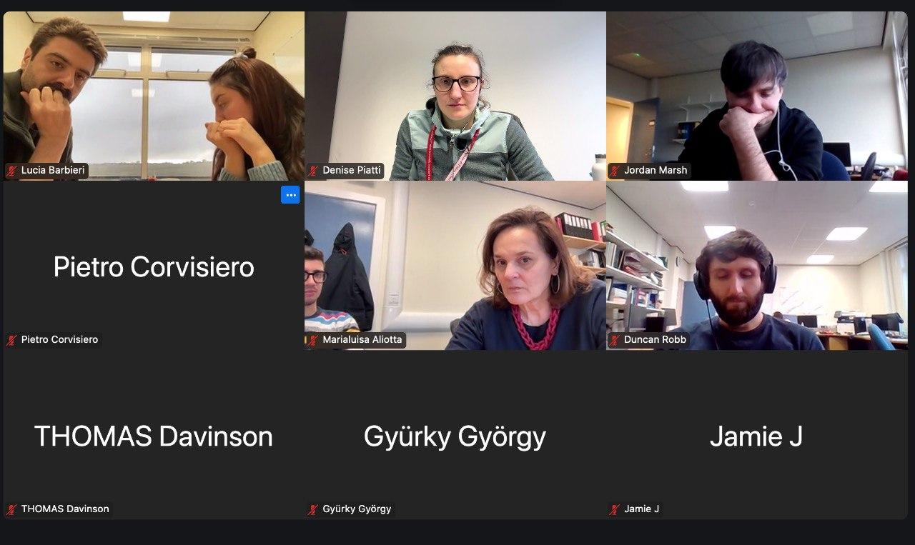
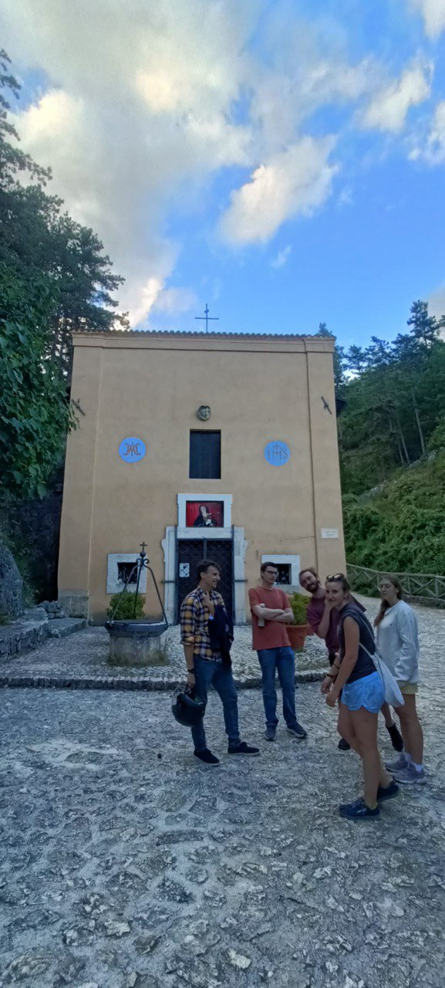
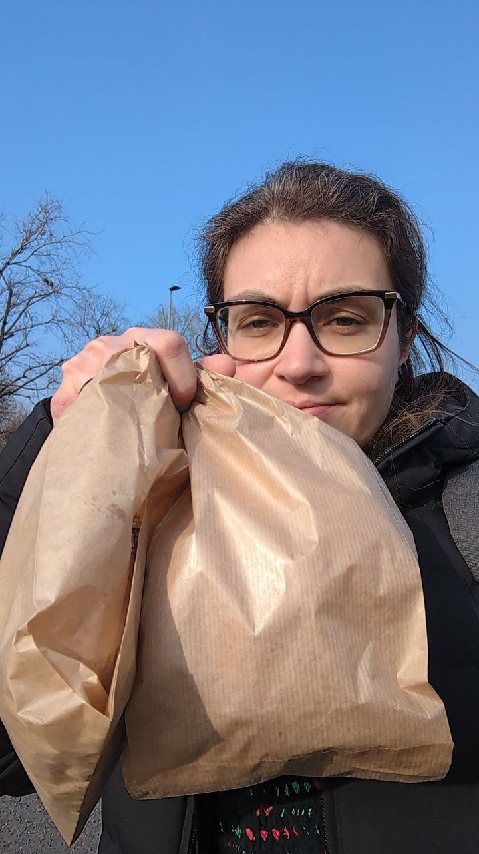
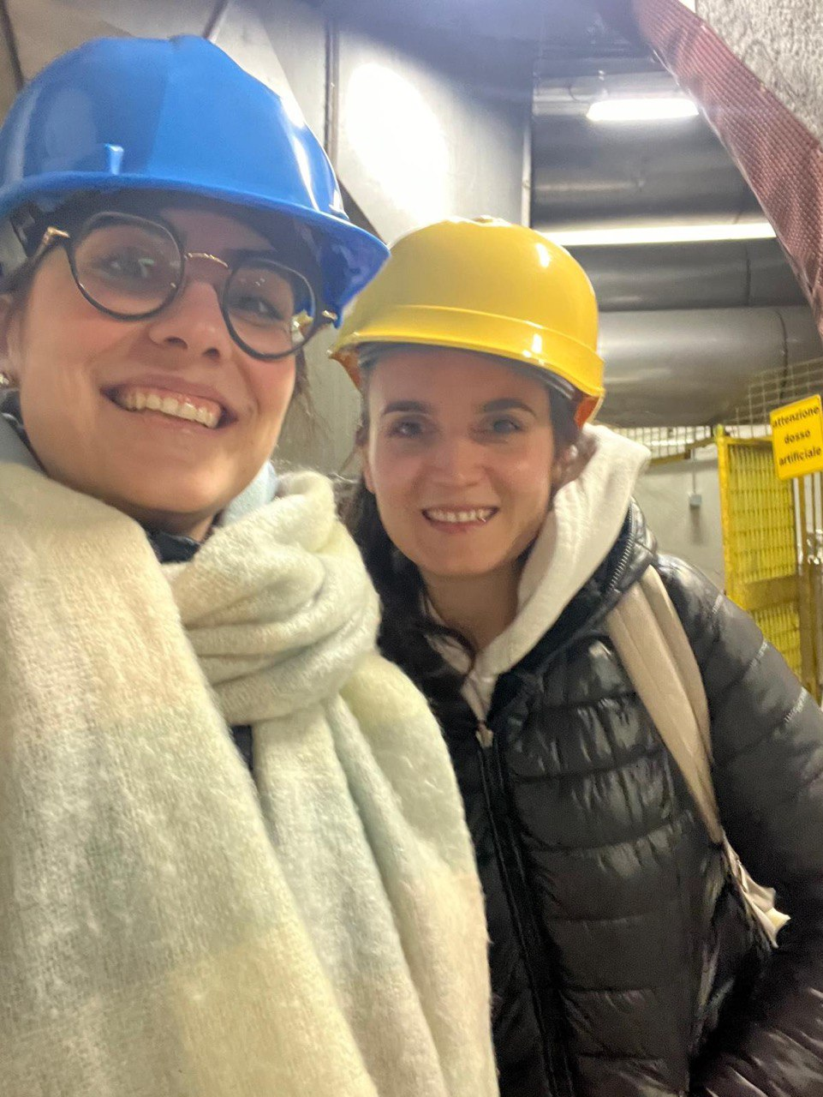
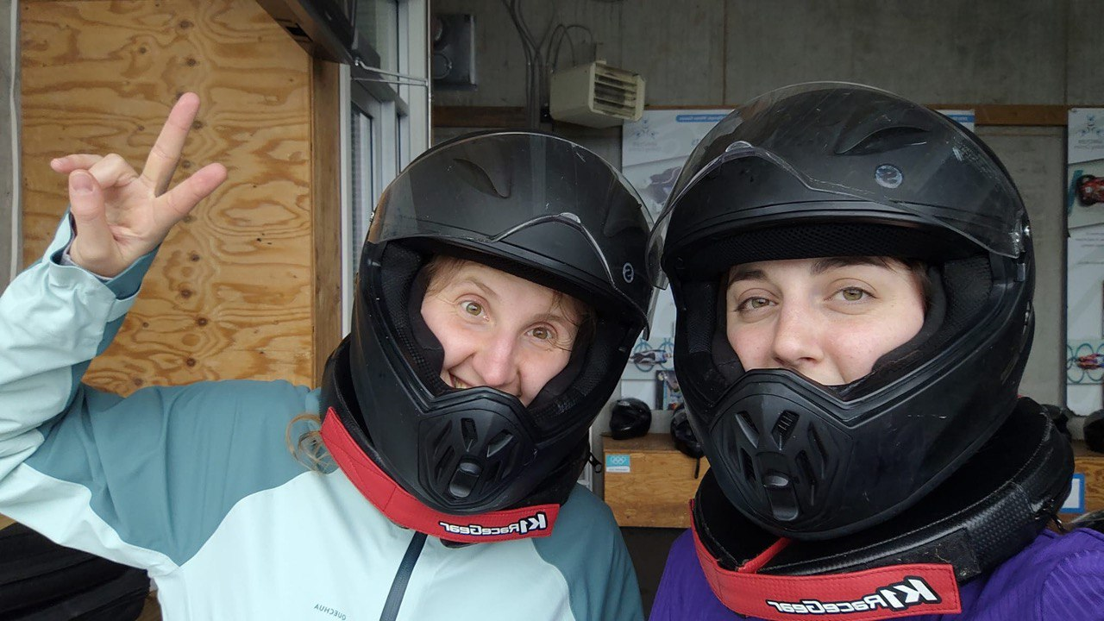
Chapter 2: PhD
2015-2018 at University of Padua
My research activity was in LUNA Collaboration, specifically I worked on two measurements performed at the LUNA-400kV [Piatti, D. et al., PRC RC (2020) and Piatti, D. et al., EPJA (2022)]
It was a great time:
  I learned a lot, from each single shift and shifter and from each discussion in the office
  I travelled a lot and I met a lot of people who ultimately become my friends, colleagues and basically a second family to me

Slide 7

Chapter 2: PhD
2015-2018 at University of Padua
My research activity was in LUNA Collaboration, specifically I worked on two measurements performed at the LUNA-400kV [Piatti, D. et al., PRC RC (2020) and Piatti, D. et al., EPJA (2022)]
It was a great time:
  I learned a lot, from each single shift and shifter and from each discussion in the office
  I travelled a lot and I met a lot of people who ultimately become my friends, colleagues and basically a second family to me
but there were also some dark times as well:
  sometimes I felt like I was not learning from someone but I was working for someone
  results, recognitions or simply goals take their time
  who to speak about your feelings and your supervisor?

Slide 8
Chapter 3: Outside Italy
2020 DAAD fellowship at Felsenkeller Lab. (Germany) [https://www.daad.de/en/study-research-teach-abroad/ ]
Going abroad is always a topic of discussion for ECR:
  is it good?is it bad?
  where to go? changing topic to learn more?
  how long should I stay?
In my case it was 6 months only and it was 2020… I stayed in LUNA and I anyway worked in NA
  again I learned a lot, the lab was starting its scientific activity and the working group was/is great, I have been planning new measurements there
  I wanted to come back to Italy, because LUNA-400kV is in Italy my personal life was almost all settled in Italy, I could travel to different lab. to measure cross sections at higher energy or with different methods
  my personal suggestion is respect yourself, go abroad only if you want and in case you do not have alternatives … make it clear if you want to come back and ask help

Slide 9
Chapter 4: The never ending story of post-docs in Italy
2020 - 2023 PostDoc positions in Italy, mainly I worked inside LUNA
Amazing/Scaring time since you start to be responsible for and you start to be involved in discussions and decisions, which affect the whole collaboration.
It might be pretty busy time and stressful

Slide 10
Chapter 5: RTDa
2023-2026 RTDa at University of Padova
You keep doing research but
…there is a new entry!!!

Slide 11
Chapter 5: teaching duties
2023-2026 RTDa at University of Padova
A very unstable time:
  You keep doing research but
  …there is a new entry: Teaching duties (48+6 hours, 16 hours, 48+6 hours)

Slide 12
Outlooks
2023-2026 RTDa at University of Padova
What’s next? ( a question you should be prepared to ask yourself many times…)
Well, honestly I do not know
  should I keep going from post-doc to post doc, which are not guaranteed anyway?
  and what about teaching duties, which my be on my way?
  perhaps should I think to quit research?Even if I really love research?

Slide 13
Outlooks
2023-2026 RTDa at University of Padova
What’s next? ( a question you should be prepared to ask yourself many times…)
Well, honestly I do not know
  should I keep going from post-doc to post doc, which are not guaranteed anyway?
  and what about teaching duties, which my be on my way?
  perhaps should I think to quit research?Even if I really love research?
  Well I think summer it is not the right time to decide..it is too hot…we are all too tired…so I will figure it out from September!

