Slide 1

HELIUM 25 - Helium Burning and Perspectives for Underground Labs
https://www.eubuero.de/de/nks-erc-2410.html
© Buena Vista Images via Getty Images
Career Development Day – Grant Opportunities
Dr. Barbara Schramm | International Collaboration and Research Funding | HZDR

Slide 2
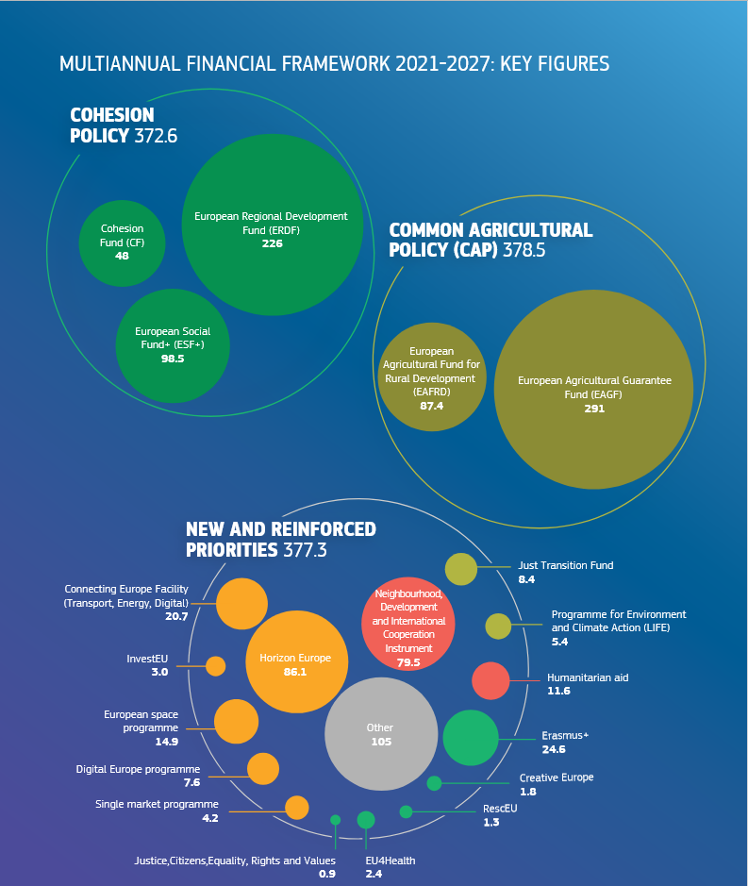
Multiannual Financial Framework (MFF) 2021-2027: Key Figures
European Commission: Directorate-General for Budget, The EU’s 2021-2027 long-term budget and NextGenerationEU – Facts and figures, Publications Office of the European Union, 2021, https://data.europa.eu/doi/10.2761/808559

Slide 3
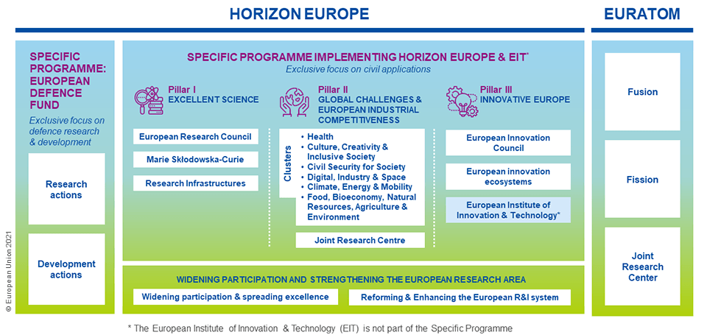
HORIZON EUROPE

Slide 4
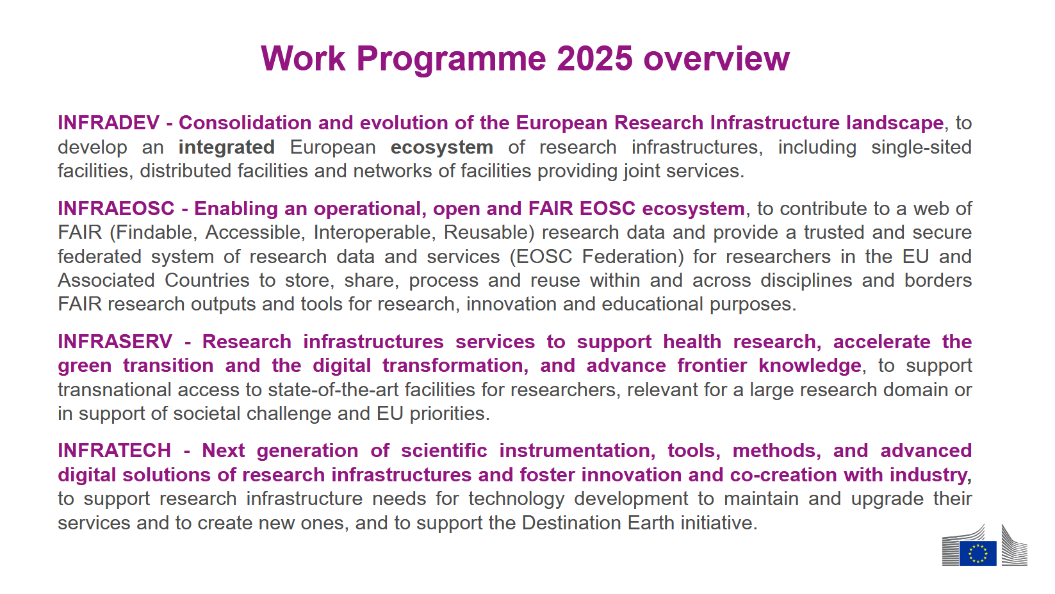

Research Infrastructures
European Strategy Forum on Research Infrastructures (ESFRI)
European Open Science Cloud (EOSC)
Trans-National Access (TNA)
Technological developments
Link

Slide 5
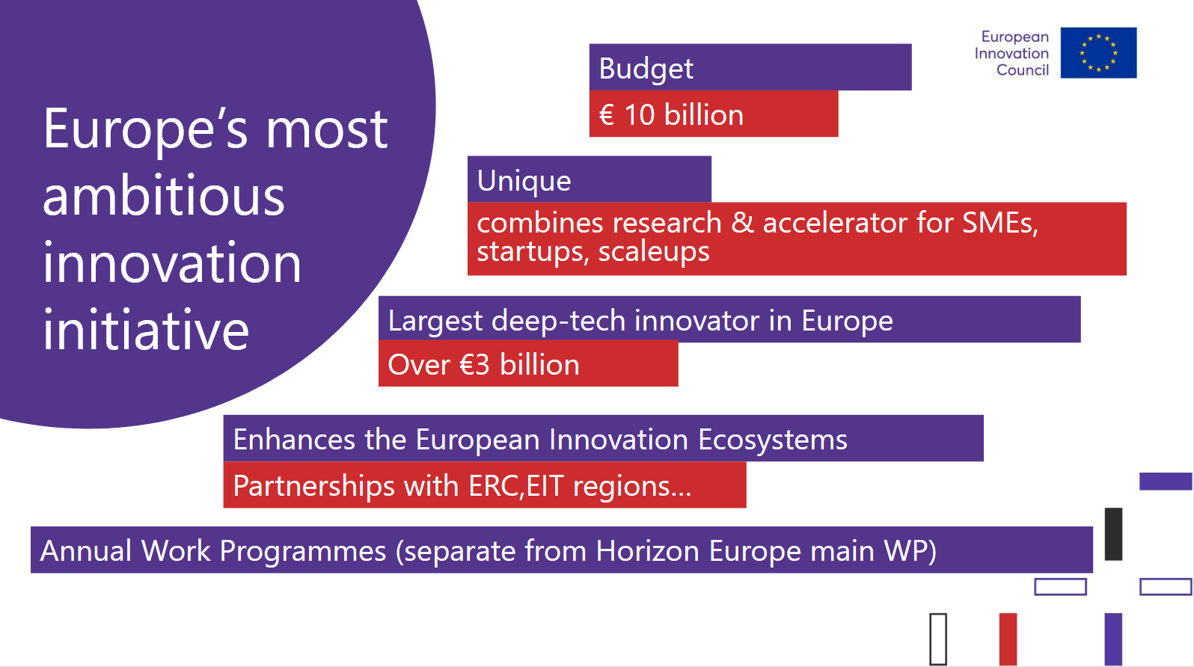
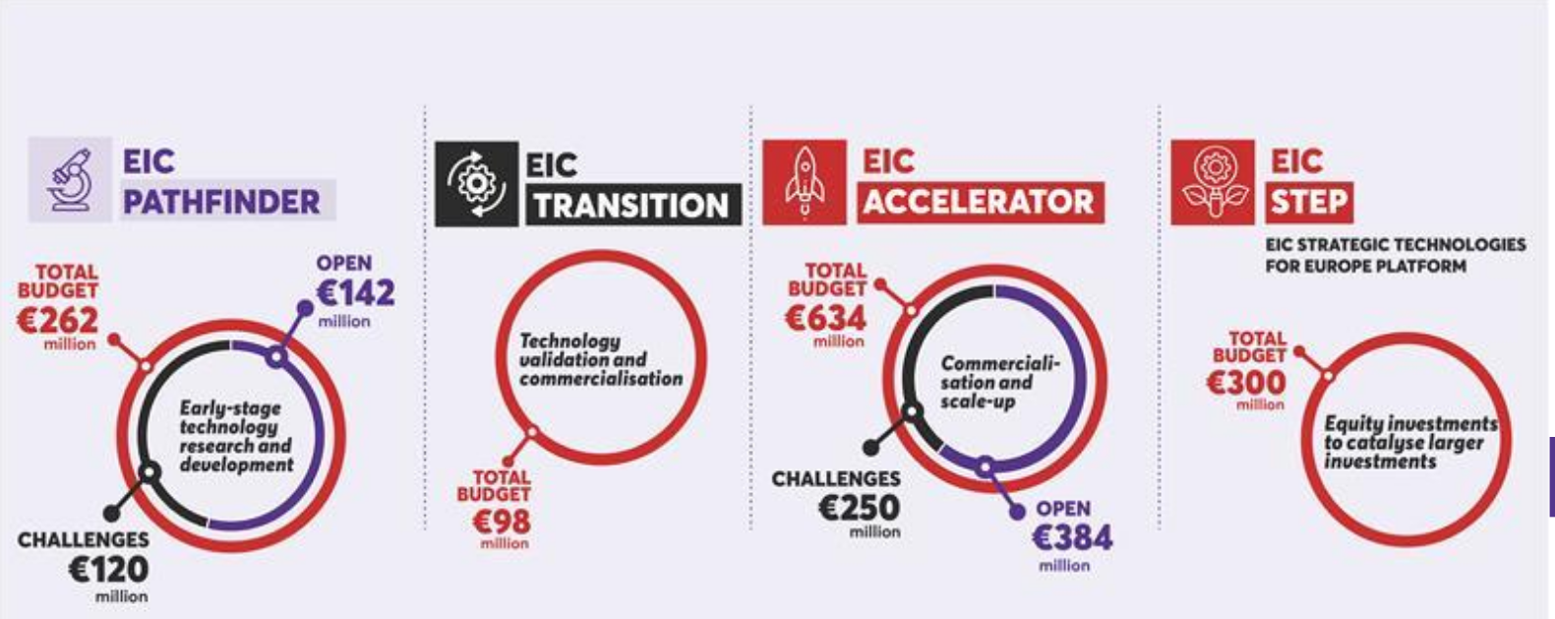
European Innovation Council (EIC)
Link
Proof-of-principle
Early TRL--> TRL3 or 4
Open Call: small consortia (3 MEUR)
Challenge call: single applicants to small consortia (4 MEUR)
Challenges 2025 (deadline 25 Oct.2025)
Validation
TRL 3 or 4 --> TRL5 or 6
Developing business/ market readiness
Single applicants or small consortia (2.5 MEUR)
Biotech for Climate Resilient Crops and Plant-Based Biomanufacturing
Generative-AI based Agents to Revolutionize Medical Diagnosis and Treatment of Cancer
Towards autonomous robot collectives delivering collaborative tasks in dynamic unstructured construction environments
Waste-to-value devices - circular production of renewable fuels, chemicals and materials

Slide 6
European Research Council (ERC)
Ambitious
Independant thinking
Frontier reserach
Bottom-up
Embarking on new avenues
Disruptive ideas
Bold
High-risk high-gain projects
Single (few) investigator(s) grants
Ground-breaking

Slide 7
ERC – Grants 2026
Proof-of-Concept Grants - ERC Grant holders - 150 kEUR - 1.5 years
Starting Grant
Single investigators
2 – 7 years after PhD defence
1.5 MEUR for 5 years
Deadline 14 Oct 2025
Consolidator Grant
Single investigators
>7 – 12 years after PhD defence
2.0 MEUR for 5 years
Deadline 13 January 2026
Advanced Grant
Single investigators
Recognized senior scientists
2.5 MEUR for 5 years
Deadline 27 August 2026
Synergy Grant
2 - 4 investigators
Any career stage
10 MEUR for 6 years
Deadline 5 Nov 2025
…
PhD defence
5 years
10 years
15 years

Slide 8
ERC – Grants 2027
Proof-of-Concept Grants - ERC Grant holders - 150 kEUR - 1.5 years
Consolidator Grant
Single investigators
5 – 15 years after PhD defence
2.0 MEUR for 5 years
Deadline ? January 2027
Starting Grant
Single investigators
<10 years after PhD defence
1.5 MEUR for 5 years
Deadline ? Oct 2026
Advanced Grant
Single investigators
Recognized senior scientists
2.5 MEUR for 5 years
Deadline ? August 2027
Synergy Grant
2 - 4 investigators
Any career stage
10 MEUR for 6 years
Deadline? Nov 2026
…
PhD defence
5 years
10 years
15 years

Slide 9
ERC: Scope and Target group
The ERC is dedicated to funding frontier research that explores uncharted territories, fosters interdisciplinary collaboration, and pushes the boundaries of knowledge.*
Evaluation criteria
Project:
Ground-breaking
Addressing important challenges
Ambitious and beyond the state of the art (e.g. novel concepts and approaches, development between or across disciplines)
PI:
Ability to conduct ground-breaking research
Evidence of creative and original thinking
Scientific expertise and capacity to successfully realise the project
*https://erc.europa.eu/projects-statistics/mapping-erc-frontier-research-overview

Slide 10
ERC: What fits and what doesn‘t
Positive impact on the probability for success
Mobility, i.e. postdoctoral position (at least 2 years) in a different place than where the PhD thesis was done, ideally in another country
Leading a group
Important publication(s) without the PhD supervisor in recognized journal
Expertise in different research fields (master/ PhD thesis, postdoc in different reserach areas)
Negative impact on the probability for success
Studies, PhD thesis and postdoctoral position in the same place
No invited talks
No leadership experiences e.g. from leading a (small) team or supervising students
Research topic, though scientifically exciting, being a logical continuation of the previous/ ongoing research
Research goal including a substantial part of technological, potantially very ambitious and challenging, development at a research infrastructure
Conclusion
ERC grants are a tool to support research of a particular nature, led by outstanding scientists with a comparably small team („single investigators“)
There are myriads of exciting research goals which do not suit the format of the ERC
In no way, an ERC grant is a benchmark for scientific excellence!
Very critically evaluate your research goal and your profile regarding the fit-for-purposeness before potentially wasting your time on an ERC grant applications, if the ERC simply does not provide the right tool for your situation!

Slide 11
MFF 2028-2034
Administration
118 billion €
Economic, social and territorial cohesion
Agriculture, rural and maritime prosperity
Security
1,060 billion €
Competitiveness, prosperity and security
590 billion €
Horizon Europe 180 billion €
Global Europe
215 billion €

Slide 12
HORIZON Europe 2028-2034
Excellent Science
44 billion €
European Reserach Council
Marie Sklodowska-Curie Actions
Science for EU Policies
Competitiveness and Society
76 billion €
Competitiveness
Clean Transition and Decarbonisation
Health, Biotech, Agriculture and Bioeconomy
Digital leadership
Resilience and Security, Defense Industry and Space
Society
Global societal challenges
EU Missions
New European Bauhaus Facility
Moonshots
Innovation
39 billion €
European Innovation Council
Innovation Ecosystems and the Knowledge Triangle
European Research Area
16 billion €
ERA Policies
Research and Technlogy Infrastructures
Widening Participation and Spreading Excellence
Moonshots
the future circular collider
clean aviation
quantum computing next-generation AI
data sovereignty automated transport and mobility
regenerative therapies fusion energy
Space economy
zero water pollution
ocean observation

Slide 13
Thank you very much for your attention!

Slide 14
Applying for ERC Grants 2026/2027 – the new proposal format
Part I = Science Part (up to 5 pages)
Aim: Convince the evaluation Panel that the proposal presents an original and creative idea addressing an important question in the research field
Elements:
State of knowledge
Scientific question that shall be tackled and objective of the project (= the disruptive idea)
Research strategy to reach the goal
No Overlapp!
Part II = Implementation Part (up to 7 pages; 10 pages for SyGs)
Aim: Explain how the project shall actually be implemented
Elements:
Research Methodology
Work plan
Staff requirements
Risk assessment and mitigation measure
Justification for the requested budget and resources

Slide 15
Technology Readiness Levels (TRLs)
TRL1 - Basic principles observed
TRL2 - Technology concept formulated
TRL3 - Experimental proof of concept
TRL4 - Technology validated in lab
TRL5 - Technology validated in relevant environment
TRL6 - Technology demonstrated in relevant environment
TRL7 - System prototype demonstration in operational environment
TRL8 - System complete and qualified
TRL9 - Actual system proven in operational environment

