Slide 2
Modern peer review of research outputs and its role in research assessment
A publisher’s perspective
Dr Johannes Wagner, Open Science Day, 3 March 2025, GFZ Potsdam

Slide 3
Copernicus Publications: our publishing philosophy
Copernicus Publications: Academic publisher, 100% owned by non-profit Copernicus e.V.
Partnership approach: as a society publisher, journals are owned by associations, not by Copernicus
Clear separation of business & science: no financial ties to editors and reviewers, no influence accept/reject decisions.
48 open-access journals, 4k preprints, 6k journal articles,
Dedicated data and code publishing journals ESSD and GMD
Open access as a fundamental principle:
1.0: free access to the publication (since 2001)
2.0: free access to the review process (see IOAP, since 2001)
3.0: free access to data, code, assets (since 2015)

Slide 4
Reviewer recognition
From DORA (Declaration on Research Assessment)
the need to eliminate the use of journal-based metrics, such as Journal Impact Factors, in funding, appointment, and promotion considerations;
the need to assess research on its own merits rather than based on the journal […]
Current reality
Peer review record mostly obscured
Recognition ranges from anonymous acknowledgement, over simple attribution, to publishing reports
Myriads of metrics exist to assess the journal article, virtually none to assess and value reviews
Demand and responsibility are high, reward is limited
Expanded by CoARA
Changes in assessment practices should enable recognition of the broad diversity of:
valuable contributions that researchers make to science and for the benefit of society, including diverse outputs beyond journal publications […];
practices that contribute to robustness, openness, transparency, and the inclusiveness of research and the research process including: peer review, teamwork and collaboration;
However
How can publishers respond?

Slide 5
Peer review in academia
“Early days”: mostly internal assessment by journal editors
20th century: external review becomes commonplace (e.g. Nature established ext. review in 1967), also to cope with increasing number of submissions
Today: most journals overwhelmed by submissions. Quality reports are the number-one limiting resource
More journals
More articles
More researchers
Limited quality assessment?
Time
Source: Scopus

Slide 6
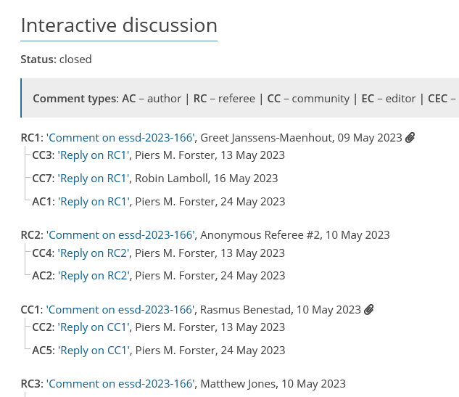
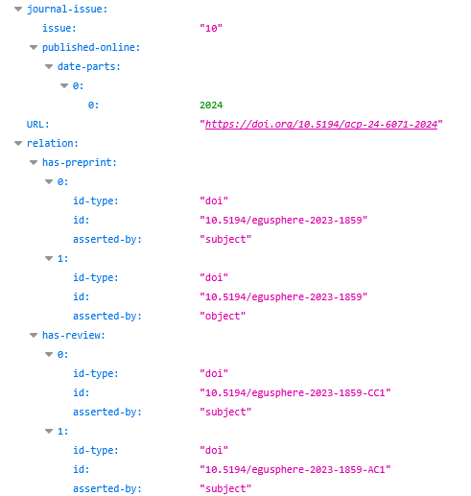
Interactive Public Peer Review
https://essd.copernicus.org/articles/15/2295/2023/essd-15-2295-2023-discussion.html
Copernicus’ approach to peer review:
Review reports as equal part of a research output (alongside journal article, research data, code, …)
Reports are published before publication decision alongside respective manuscript version (preprint)
Reports receive a DOI, machine-readable metadata, and permanent archiving
Optionally attributed (reviewers' choice)
Preserved in context even if manuscript is rejected
Next to invited reviewers, uninvited community reviews also possible and preserved
https://api.crossref.org/works/10.5194/acp-24-6071-2024

Slide 7
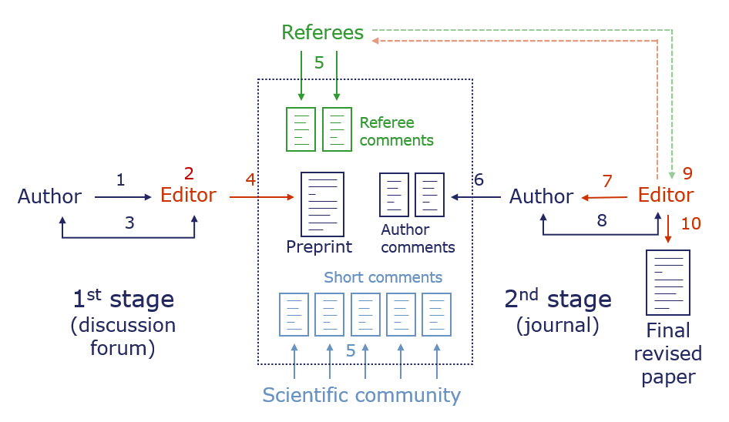
Interactive Public Peer Review
Theory...
..and practice
Over two decades of experience
Designed to combine rapid dissemination & thorough peer review
Designed to foster transparency in scientific quality assurance
All major legacy journals, all new journals
Machine-readable review report data ready to be explored by anyone

Slide 8
Wait, there is more: review of data and code
Preparing and preserving high quality research data takes time and effort
Use established tools to encourage change: Community gets well curated, peer-reviewed, open data, authors get a traditional publication
Dedicated team putting data/code at the centre (not treated as a supplement)
Data live longer, more use cases generated, adjacent works get more citations
Good idea back in the day, is it time for change?
Transparent review
Not for profit
Liberal data licence
Community led
Enforcing data citations
Barrier free access
Long term preservation
Open-source code and data

