Slide 1
GFZ Open Science Day
Potsdam, 3 March 2025

Slide 2
Open Science under stress
Wolfgang zu Castell
Director Department Geoinformation
Chair Helmholtz Open Science Working Group

Slide 3
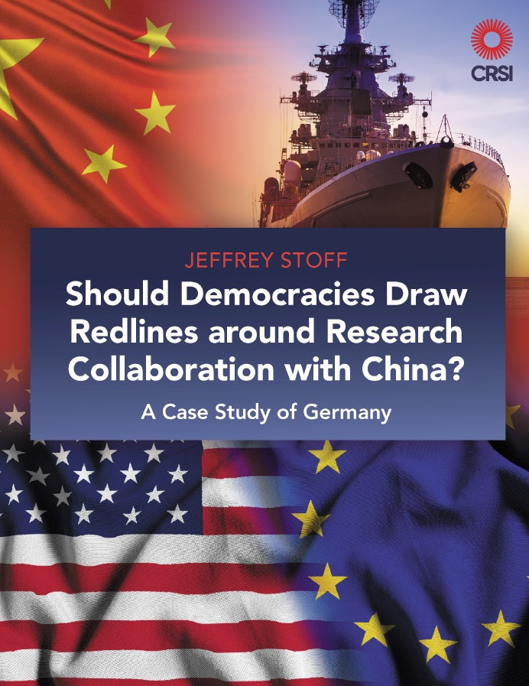
Limits to openness?
global research collaboration in
science has been critical in advancing
the frontiers of knowledge
regarding authoritarian nations, new
risks and challenges threaten this
open collaboration
nations, states, intensions of partners
and end users matter
democracies must protect their values
when dealing with authoritarian states

Slide 4
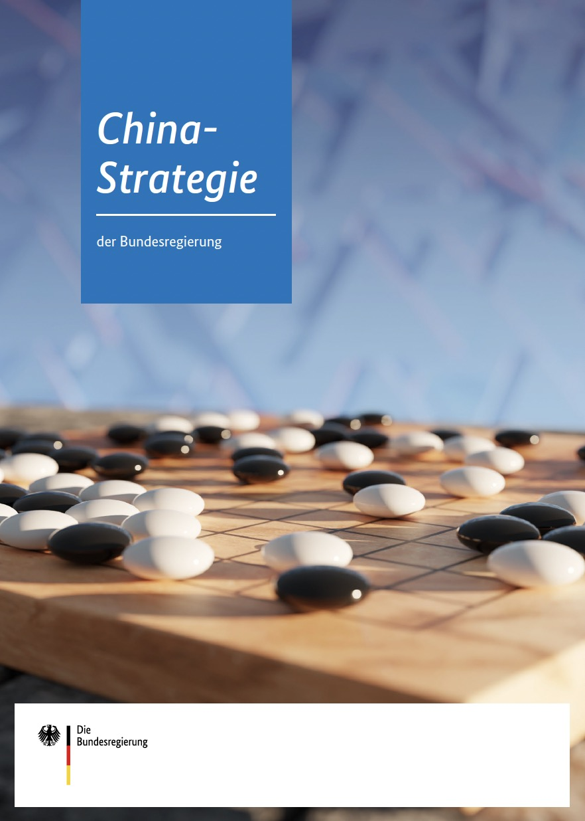
China Strategy of the German Government
civil societal exchange:
„important elements include …
open science and education systems to
maintain interest in each other and in an
independent dialogue beyond governments“
„China's policy of civil-military fusion sets
limits to our cooperation“

Slide 5
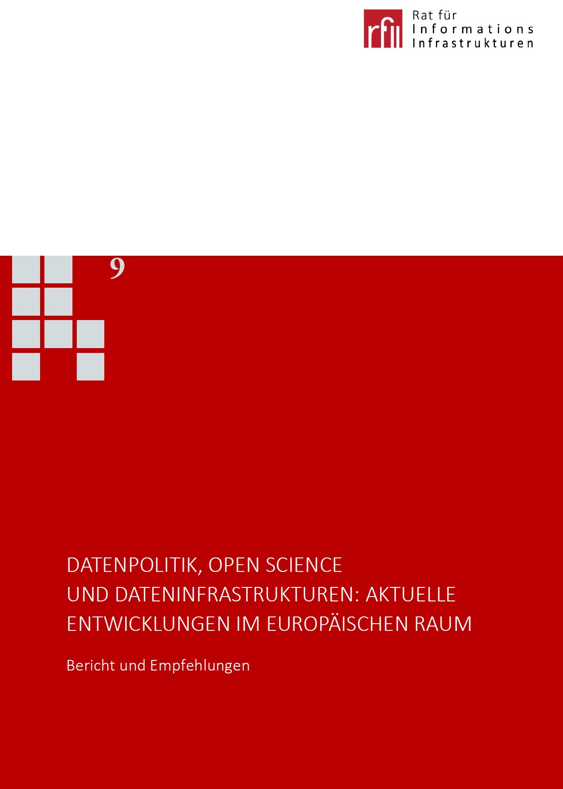
Council for Information Infrastructures
growing confrontation with authoritarian states
is leading to renewed consideration of whether
accessibility and openness of data
– in particular of research and economic
data that can be used commercially and for
security policy purposes –
needs to be aligned with security interests
research as „club asset“

Slide 6
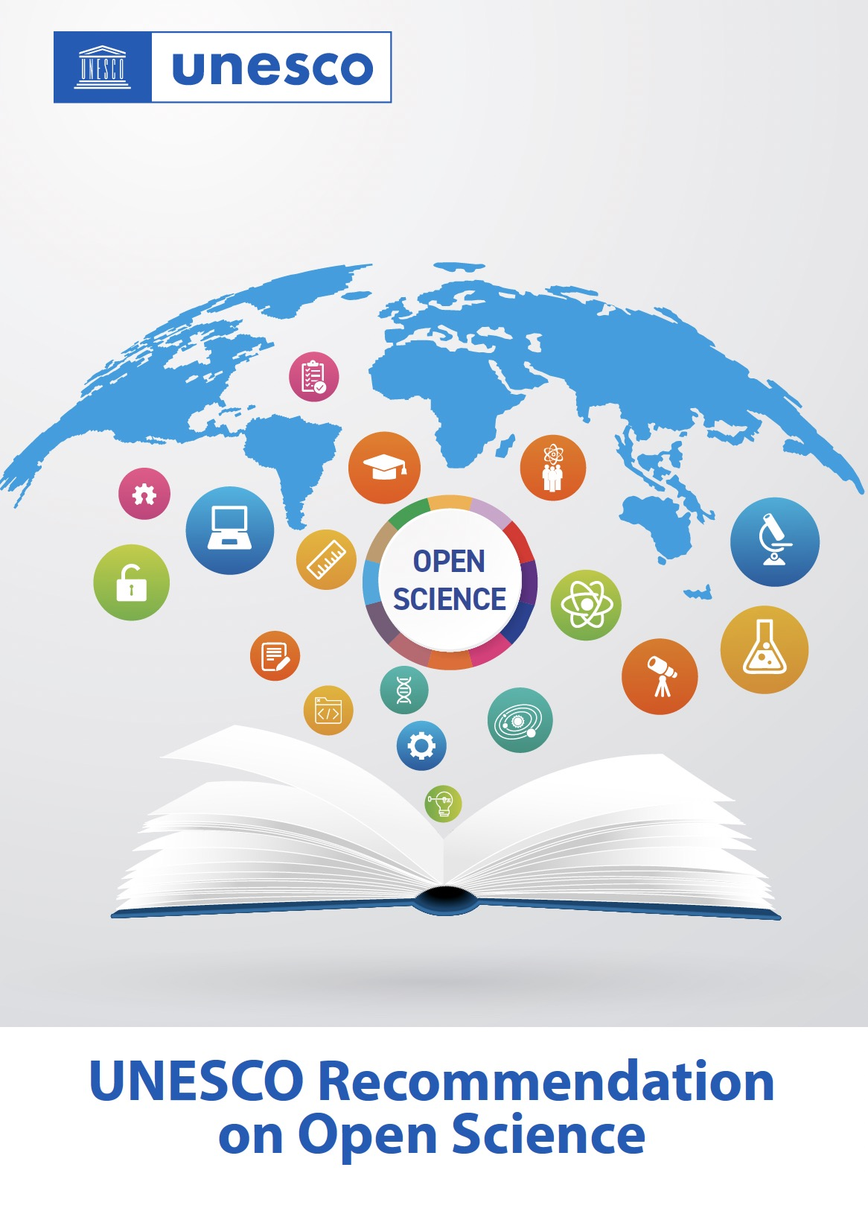
Open Science Core Values
quality and integrity
respect academic freedom and human rights
collective benefit
open science should belong to humanity
equity and fairness
should play significant role in ensuring equity
diversity and inclusiveness
embrace diversity

Slide 7
Open Science Guiding Principles
transparency, scrutiny, critique
and reproducibility
equality of opportunities
responsibility, respect and
accountability
collaboration, participation and
inclusion
flexibility
sustainability

Slide 8
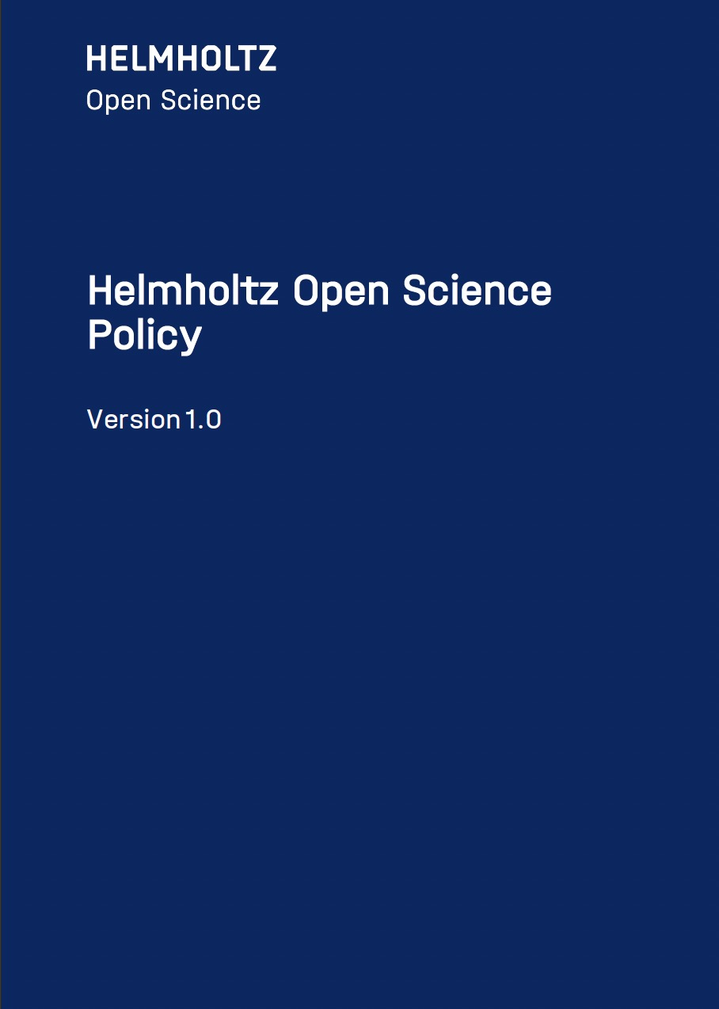
Helmholtz Policy builds on UNESCO
develop and expand central open
science infrastructures
in the context of research assessment,
recognize and value application of
open science practices
support networking to promote open
science at national and international
level

Slide 9
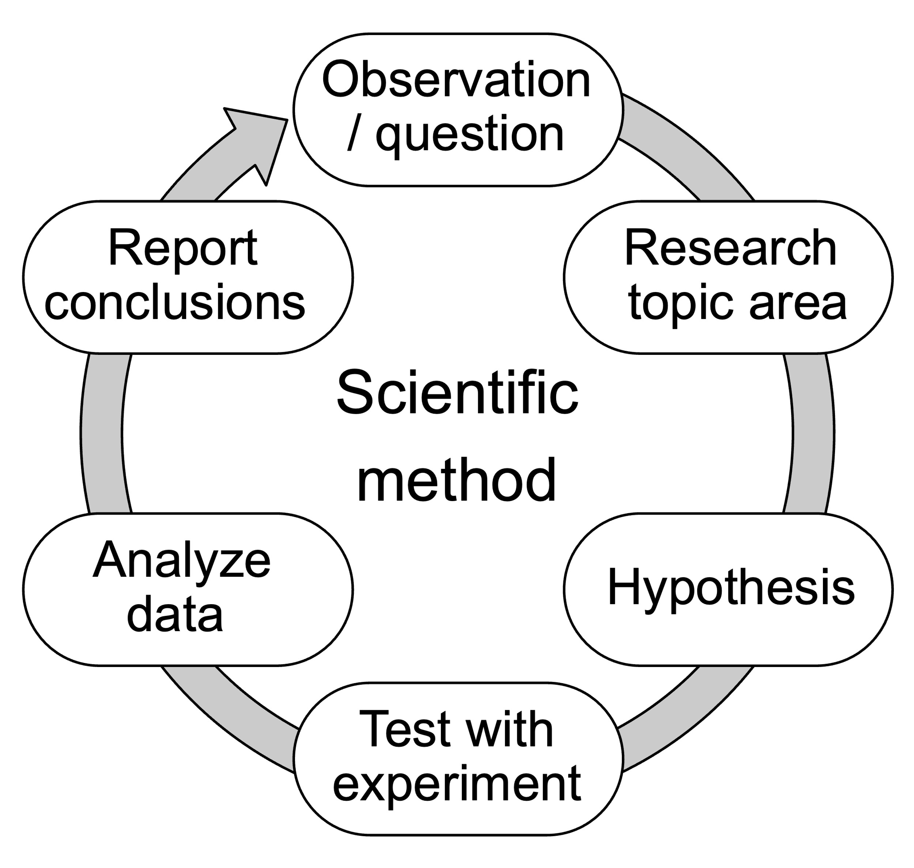
The Scientific Method
empirical method for acquiring knowlegde
critically relies on
  objectivity
  verifiability
  reproducibility
opening data, procedures, tools etc.
are essential elements for reproducibility
by Efbrazil - Own work, CC BY-SA 4.0

Slide 10
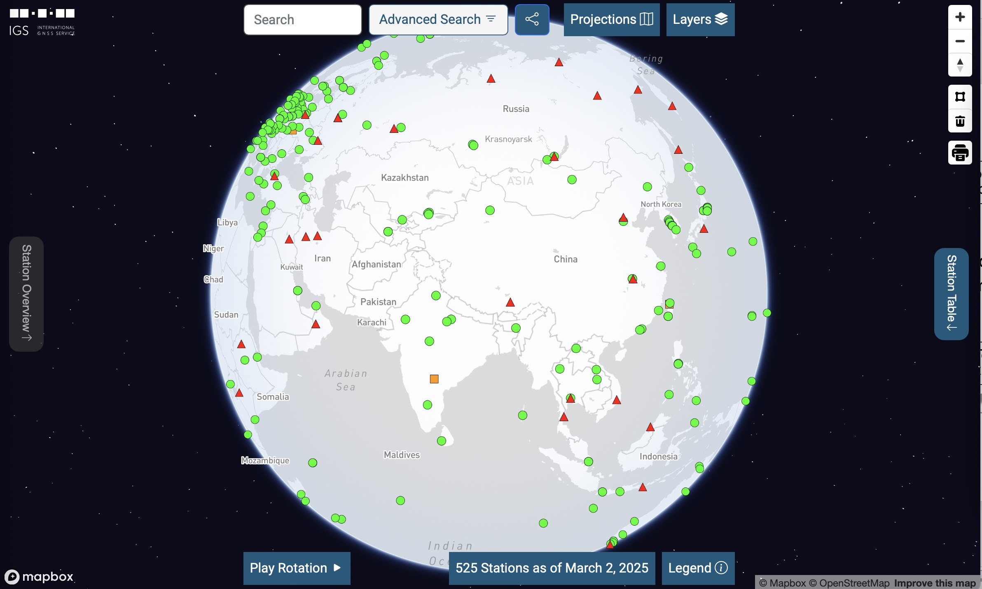
Geoscience is an International Business
our science relies on
international networking
partners can often be found
in countries which have
differing ethical principles
geoscientific research often
touches aspects of national
importance
The International GNSS Service (IGS)

Slide 11
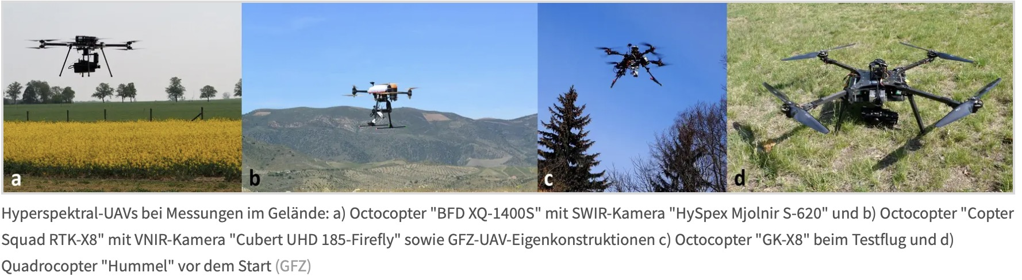
What is dual-use in Science?
Just to give an example …
remote sensing is per se a technology being used by the military
often, remote sensing data is open data … but „dual use“ also considers
acces to technology … thus, are the methods being developed „dual use“?
often, methods are being
published as open source
software … but is there
any harm which can be done
using this software?

Slide 12
Helmholtz started a Dialogue with CAS
scientific dialogue always persisted, even during the cold war
scientists can often
communicate much
easier than other
governmental agents
science can‘t ignore
the international
reality
The CAS – Helmholtz Working Group on Open Science

Slide 13
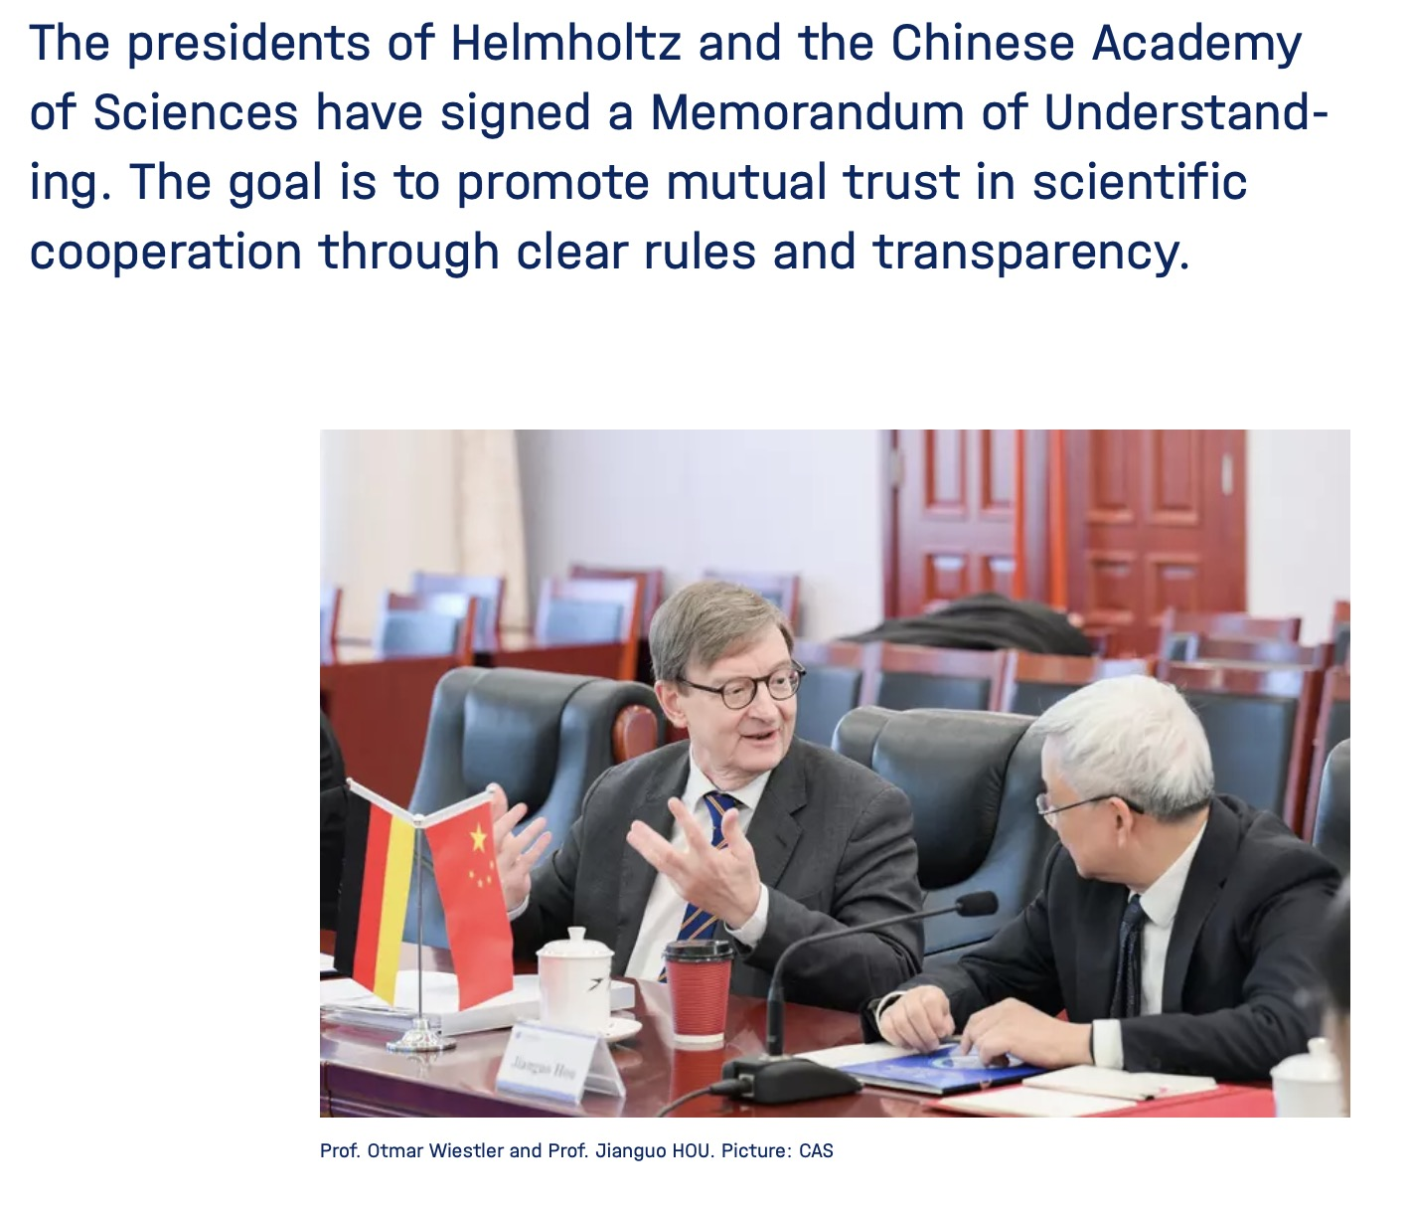
CAS – Helmholtz Working Group on Open Data
Challenges and Recommendations
Access & Usage Rights
Data Retrieval
Data Provenance
Persistent Identifiers (PIDs)
Technical Accessibility
Privacy and Data Protection
Regulations
Intellectual Property

Slide 14
Some Statements for Discussion …
There is no alternative to Open Science.
Science never existed in an idealized free world (e.g. ethics statements).
Scientists carry responsibility for what they are doing …
… and what it might imply (see Heisenberg and the Manhattan Project).
Openness cannot be used as a license to evade one's responsibility.

Slide 15
Contact
wolfgang.castell@gfz.de

