Slide 1
Rethinking Research Assessment: Moving Beyond Traditional Metrics to Foster Quality and Impact
Mathijs Vleugel – Helmholtz Open Science Office
03.03.2025, GFZ Open Science Day
Notes:
1

Slide 2
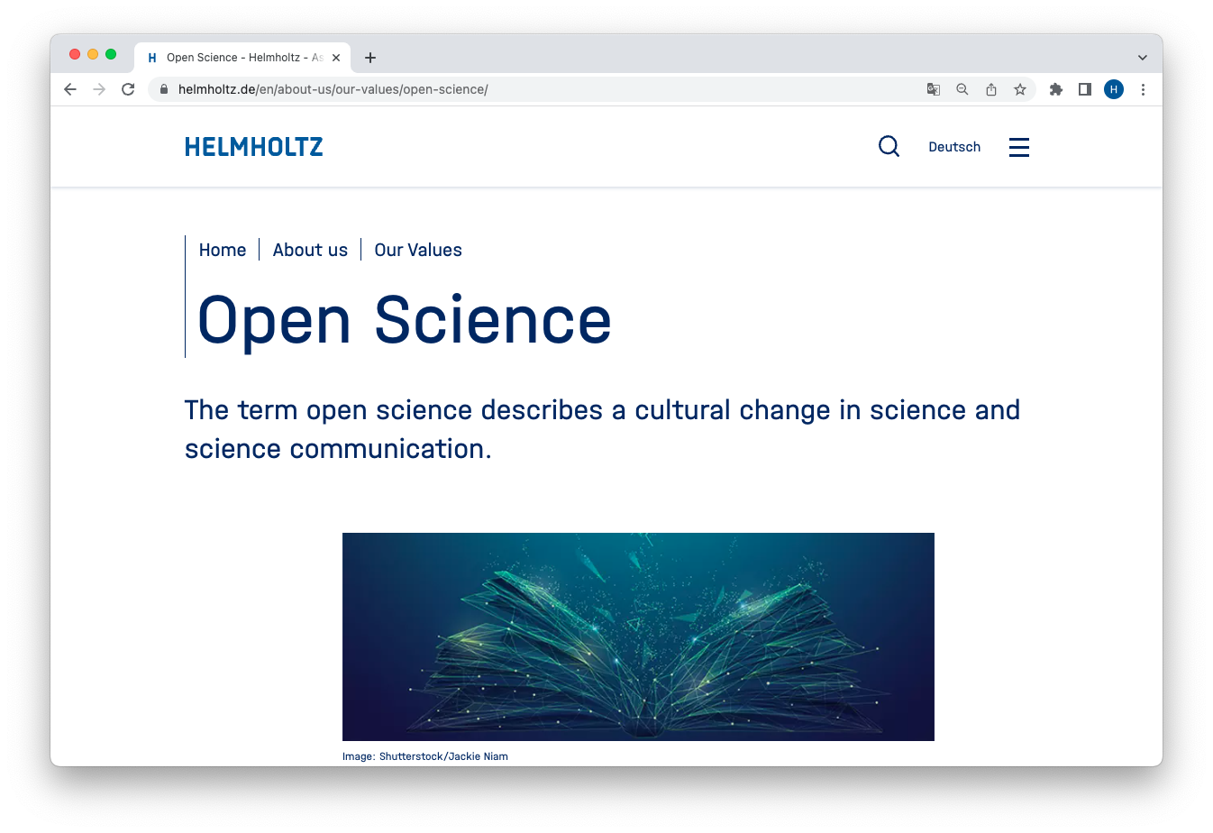
Open Science in Helmholtz
Open Science is an important cross-cutting topic with numerous points of contact
At the Helmholtz Centers:
digitization, research infrastructures, libraries, data centers, transfer, etc.
In the entire Helmholtz Association:
Digital transformation, KPIs, incubator platforms, Initiative and Networking Fund, transfer, etc.
Notes:
2

Slide 3
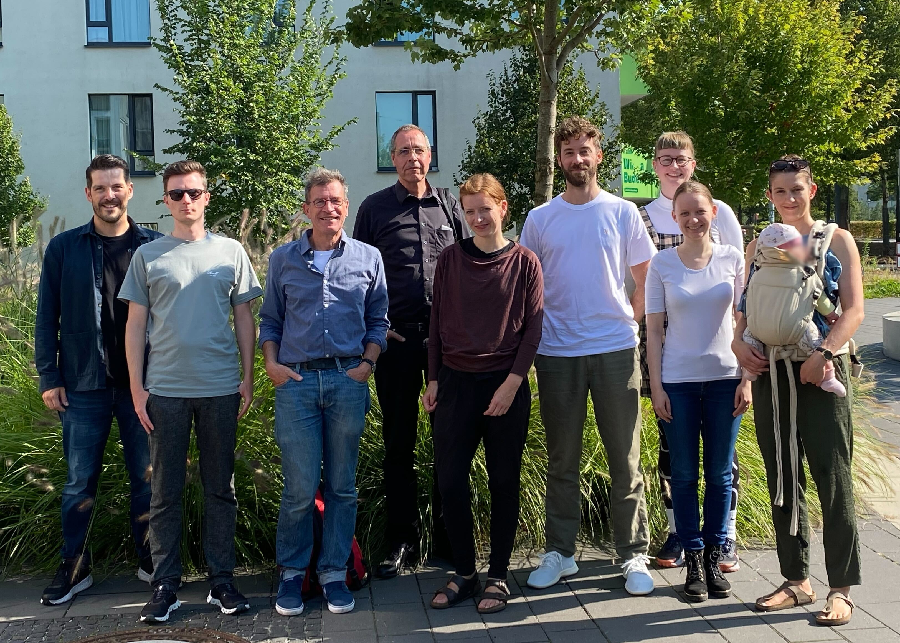
Helmholtz Open Science Office
Advancing Open Science at Helmholtz and beyond
The Helmholtz Open Science Office
supports the Helmholtz Association in shaping the cultural change “from closed to open”.
promotes dialogue and provides impulses within the Association.
collaborates with the centers in the Open Science working group and in joint task groups.
collaborates with relevant stakeholders and represents Helmholtz’ positions on open science on a national and international level.
Mathijs Vleugel (Head), Christoph Bruch, Lea Maria Ferguson, Steffi Genderjahn, Marc Lange, Marcel Meistring, Heinz Pampel, Johannes Schneider, Antonia C. Schrader, Paul Schultze-Motel, Leonie Voland
Notes:
3

Slide 4
Helmholtz Open Science
Supporting the cultural change towards Open Science
Make it required
Policy
Make it rewarding
Incentives
Incentives
Make it normative
Communities
Make it easy
Education/Training
Make it possible
Infrastructure
https://doi.org/10.48440/os.helmholtz.056
Adapted from Brian Nosek: https://www.cos.io/blog/strategy-for-culture-change
Notes:
responsibilities & opportunities
Legislation: There are many external requirements, think of GDPR, funding agencies, publishers and copyright licences, institutional policies, national guidelines and regulations etc. etc. Our role is to make it easy.

Slide 5
Why do we need to rethink research assessment?
Research assessment takes place at different levels:
Hiring, promotion, and evaluation of researchers
Funding applications
Organisational evaluation (e.g., PoF)
-----------
Current assessment processes predominantly rely on journal-and publication-based metrics (Impact Factor, H-Index, etc.)
These can be a hurdle to the recognition of diverse contributions to research.
The resulting publish-or-perish culture culture is directly linked to misconduct and the reproducibility crisis.
And contributes to an unhealthy research culture and unaffordable publication system.
Notes:
5

Slide 6
An opportunity to rethink what we value in research(ers)
Moving away from the inappropriate use of journal-based metrics for research evaluation.
Recognizing diverse outcomes, practices, and activities when evaluating research, researchers, and research institutions.
Maximizing the quality and impact of research,
by promoting open science, EDI, research integrity & collaboration.
Notes:
6

Slide 7
San Francisco Declaration on Research Assessment (DORA)
Impact | Global initiative (2012)
Committment | Supporting the adoption of a set of non-binding recommendations
Organizational form | Declaration
Signatories/Membership | Institutions, organizations and individuals
More information | https://sfdora.org
FZJ, KIT, MDC, DKFZ, GFZ
Draws attention to potential problems of journal-based metrics in hiring, promotion, and funding decisions
Currently signed by over 25,000 individuals and organizations
General Recommendation:
Do not use journal-based metrics, such as Journal Impact Factors, as a surrogate measure of the quality of individual research articles, to assess an individual scientist’s contributions, or in hiring, promotion, or funding decisions.
2015 – Leiden Manifesto for research metrics
https://doi.org/10.1038/520429a
2020 - Hong Kong Principles for assessing researchers
https://doi.org/10.1371/journal.pbio.3000737

Slide 8
Coalition for Advancing Research Assessment (CoARA)
Impact | Originates for the European Research Area, but increasingly global (2022)
Committment | Implementing the 10 committments outlined in the Agreement according to a defined timeframe
Organizational form | Structured Coalition-membership and governance, working groups and national chapters
Signatories/Membership | Institutions and organizations
More information | https://coara.eu
MDC, OS Office
The Agreement on Reforming Research Assessment sets a shared direction for changes in assessment practices for research, researchers and research performing organisations.
Currently signed by over 700 organizations
Overarching goal:
To recognise the diverse outputs, practices, and activities that maximise the quality and impact of research through an emphasis on qualitative peer review, supported by the responsible use of quantitative indicators.

Slide 9
CoARA – Towards a global movement
Countries strongest presence:
Spain (83), Italy (68), Poland (53), France (50)
>35 members
20-35 members
15-19 members
5-14 members
<5 members
Total n of Members: 716 (22/01/2025)

Slide 10
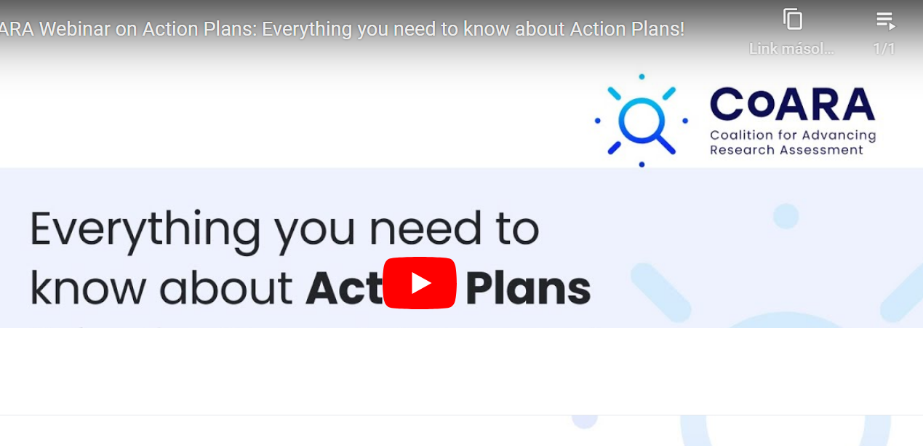
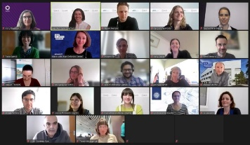
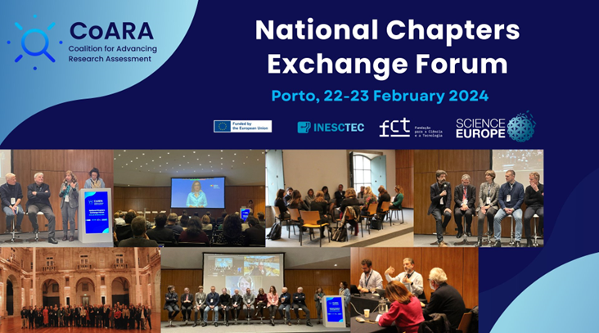
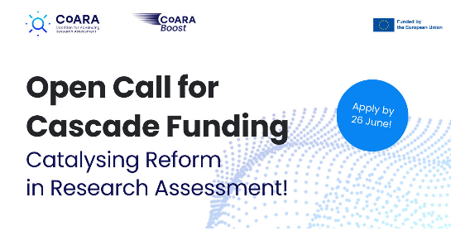
CoARA – Paving the way for systemic change
Established corpus
Webinar and other support mechanisms
National level discourse
Commitments reflected in action plans
Consultations and events
First outputs
Regular updates via the website and newsletter
Active Working Groups
16 National Chapters
Local implementation communities
Liaising with ministries, outreach work, support to action plans
Growing number of National Chapters
Grants for institutions to implement the ARRA
80+ applications received for the first round and 25 projects selected
Cascade Funding
Online and hybrid
Call for hosting events for CoARA members
CoARA Events

Slide 11
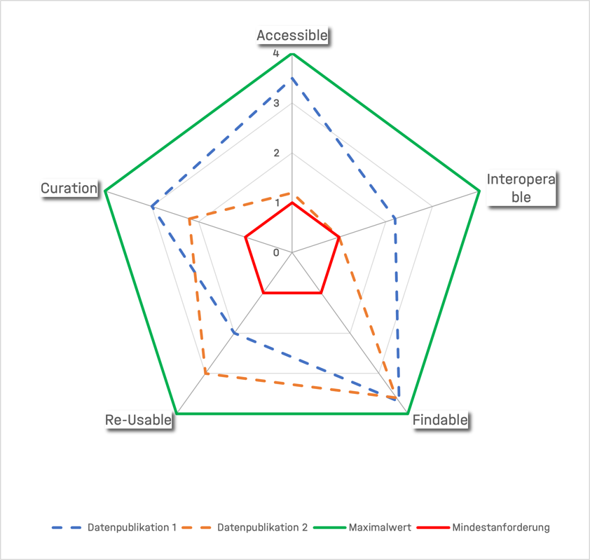
Rethinking Research Assessment at Helmholtz
How does the Helmholtz Open Science Office support this?
Developing responsible metrics for research outputs
Task Group Helmholtz Quality Indicators for Data and Software Products
Membership in CoARA, Working Groups, and National Chapter
Providing Helmholtz Centers with opportunities for exchange on developments re. DORA/CoARA/Research Assessment.
Starting next week: Helmholtz Task Group on Research Assessment
Notes:
11

Slide 12
Keep in touch
open-science@helmholtz.de
https://os.helmholtz.de
Open Science Newsletter
Social Media: LinkedIn | Mastodon
Publications and recommended readings: Zotero
All texts in this presentation, except citations, are licensed under Attribution 4.0 International (CC BY 4.0): https://creativecommons.org/licenses/by/4.0/deed.de

