Slide 2
Introduction to the European Spallation Source
...with focus on control system
PRESENTED BY Timo Korhonen

Slide 3
Agenda
1 The European Spallation Source
2 Control system of ESS
3 Challenges of a big science facility
4 Conclusions

Slide 4
1
The European Spallation Source (ESS)

Slide 5
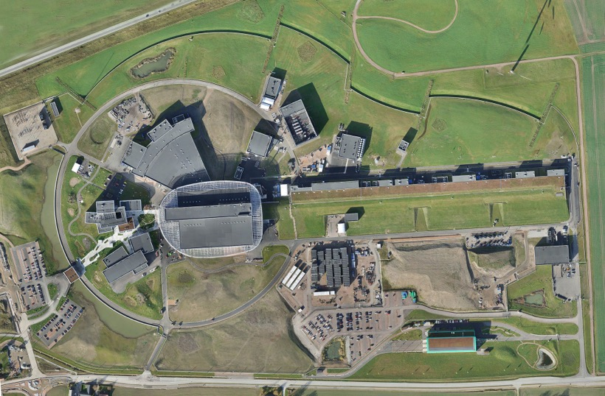
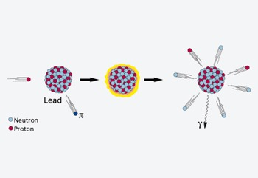
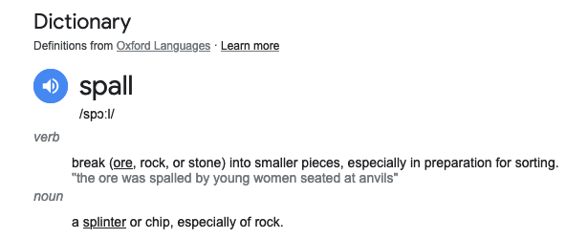
The European Spallation Source
Overview
European Spallation Source, aka ESS is
-an accelerator-based facility to provide neutrons for several areas of research
-”spallation” refers to the process when accelerated protons hit target atoms, and ”spall” neutrons from the atom’s nucleus. ESS uses tungsten as the target material.
The ESS Campus in Lund, southern Sweden.
2024-04-09

Slide 6
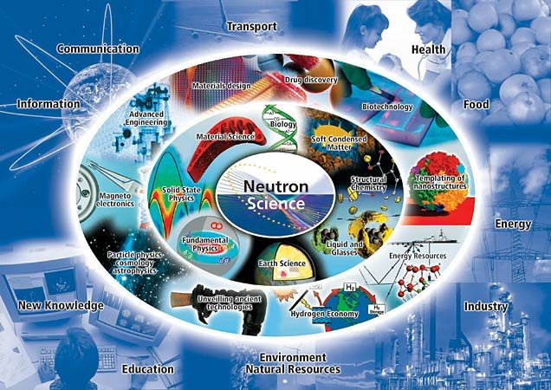
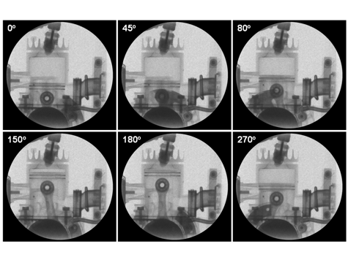
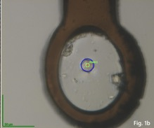
Applications of neutrons
Wide variety of areas that can use neutrons as a tool
Materials and engineering
Life sciences and biology

Slide 7
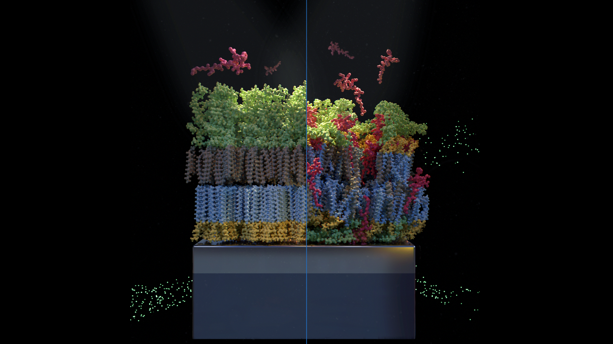

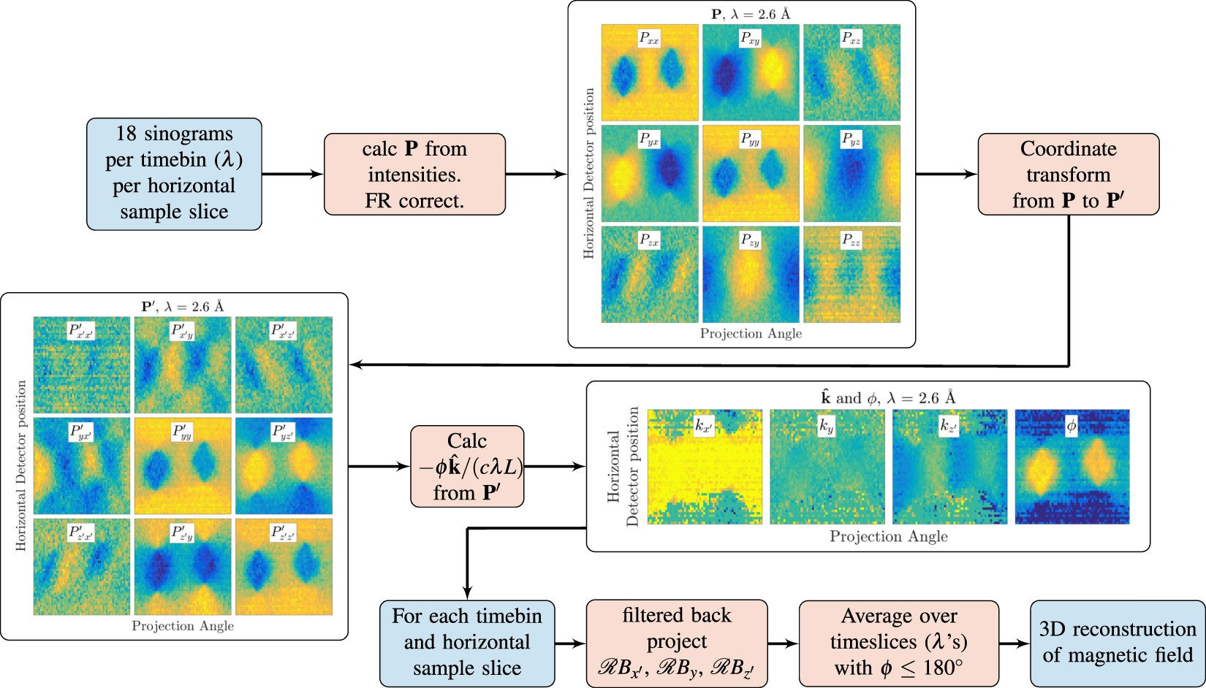
Applications of neutrons
Recent topics in ESS Science seminars
Antibiotics crisis and neutrons
Antimicrobial resistance (AMR) is one of the top global public health and development threats.
The gentle nature of neutrons allows us to study delicate biological systems like bacterial membranes, providing a unique window into the mechanisms of antibiotic action. Understanding these mechanisms is crucial, as bacteria develop resistance faster than we can create new treatments.
The plastic problem
Plastic debris accumulating along a shoreline illustrates the environmental impact of conventional, fossil-based plastics. Biodegradable plastics are promising alternatives to conventional (fossil fuel-based) plastics, with the potential to reduce pollution and limit adverse health effects.
Are they worth switching to? Probably, but research suggests they exhibit inconsistent degradation behaviour in real-world settings, so we need to know more about them.
Peeking into magnetic fields with neutrons
Time-of-flight 3D polarimetric neutron tomography (ToF 3DPNT) is a relatively new method for reconstruction of magnetic fields in materials and devices by measuring the spin precession of polarised neutrons and solving an inverse problem. Applications in electrical engineering, superconductivity, energy materials, battery research and many others.

Slide 8

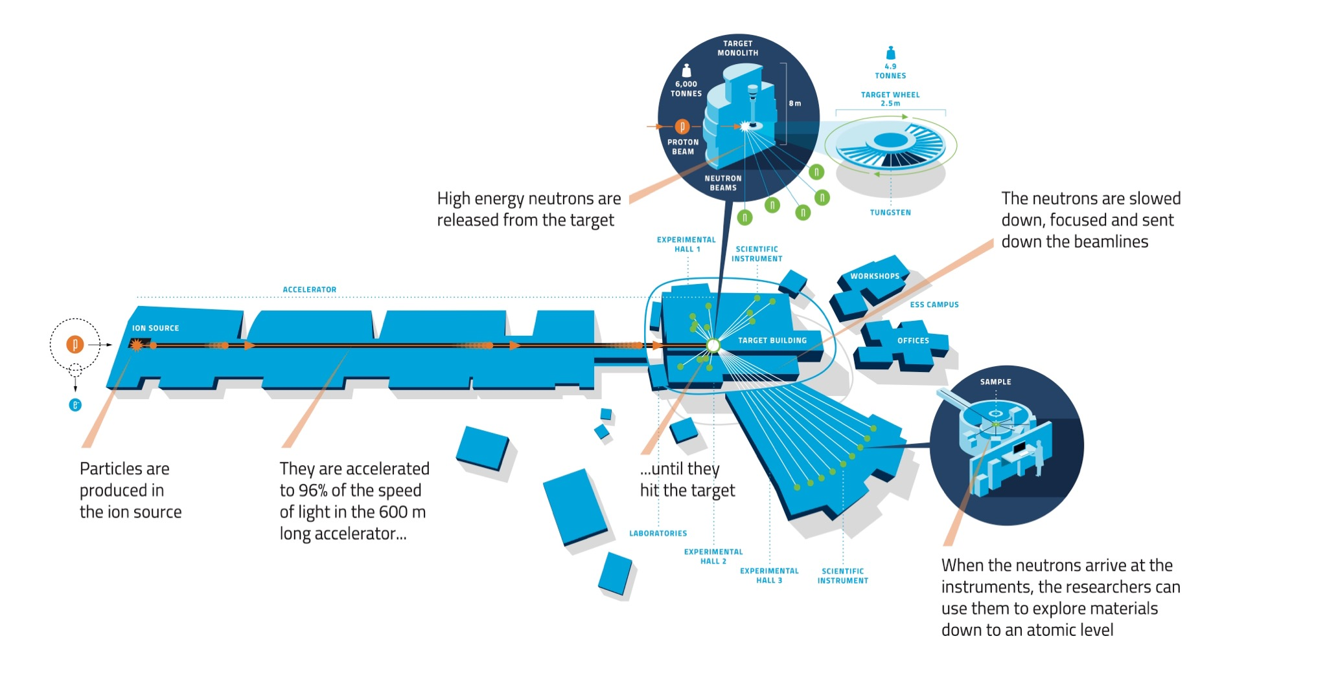
How ESS works
The technology

Slide 9
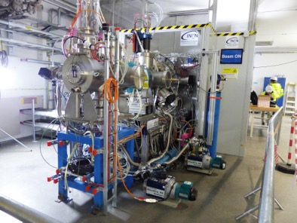
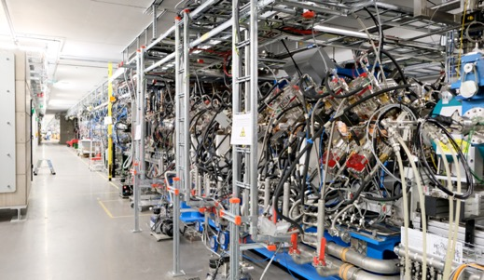
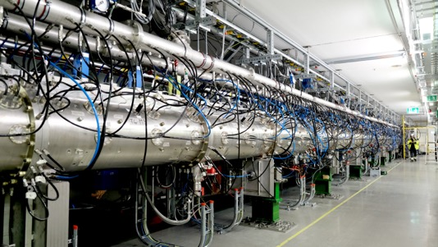

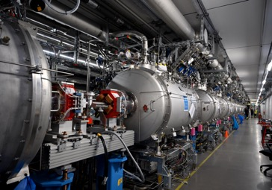
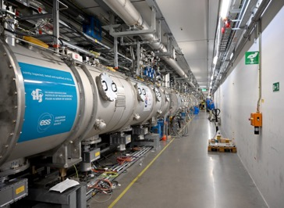
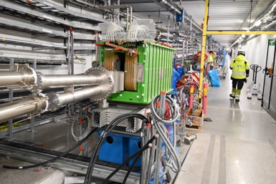
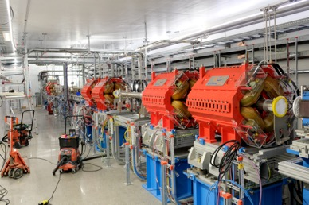
The proton accelerator
Several stages to create, accelerate and focus the beam
Proton source
First accelerating stages
Normal conducting section
First superconducting section, “spokes”
Superconducting linac
Bending magnets
Final beam shaping

Slide 10
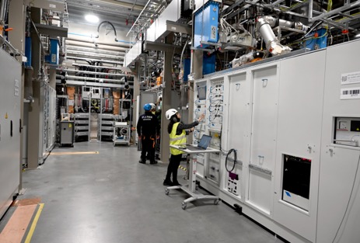
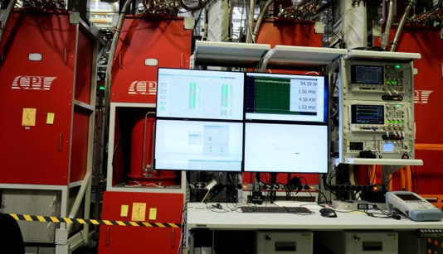
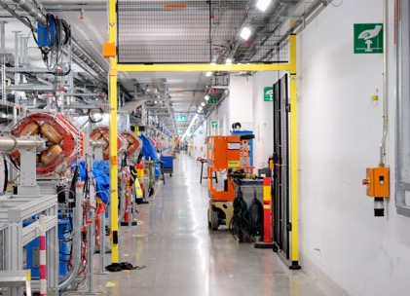
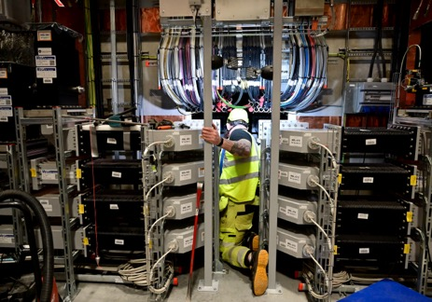
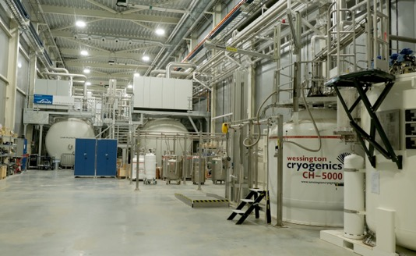
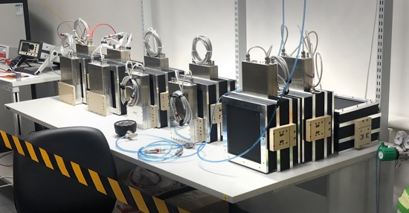
Powering the accelerator
Radio frequency, electromagnets, instrumentation for monitoring

Slide 11
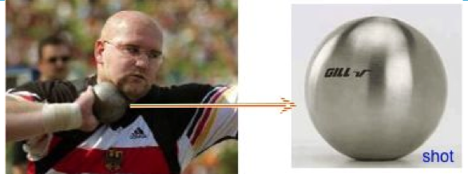
Some trivia knowledge…
The European Spallation Source (ESS) will house the most powerful proton linac ever built.
  The average beam power will be 5 MW (initially, 2 MW)
  The peak beam power will be 125 MW
One beam pulse
  Happens 14 x per second
  Contains ~10¹⁵ protons, weighing about 1.6 nanograms at start.
  After acceleration (peak power at full capacity) has the same kinetic energy as a 7.2kg shot traveling at 1100 km/hour (Mach 0.93)

Slide 12
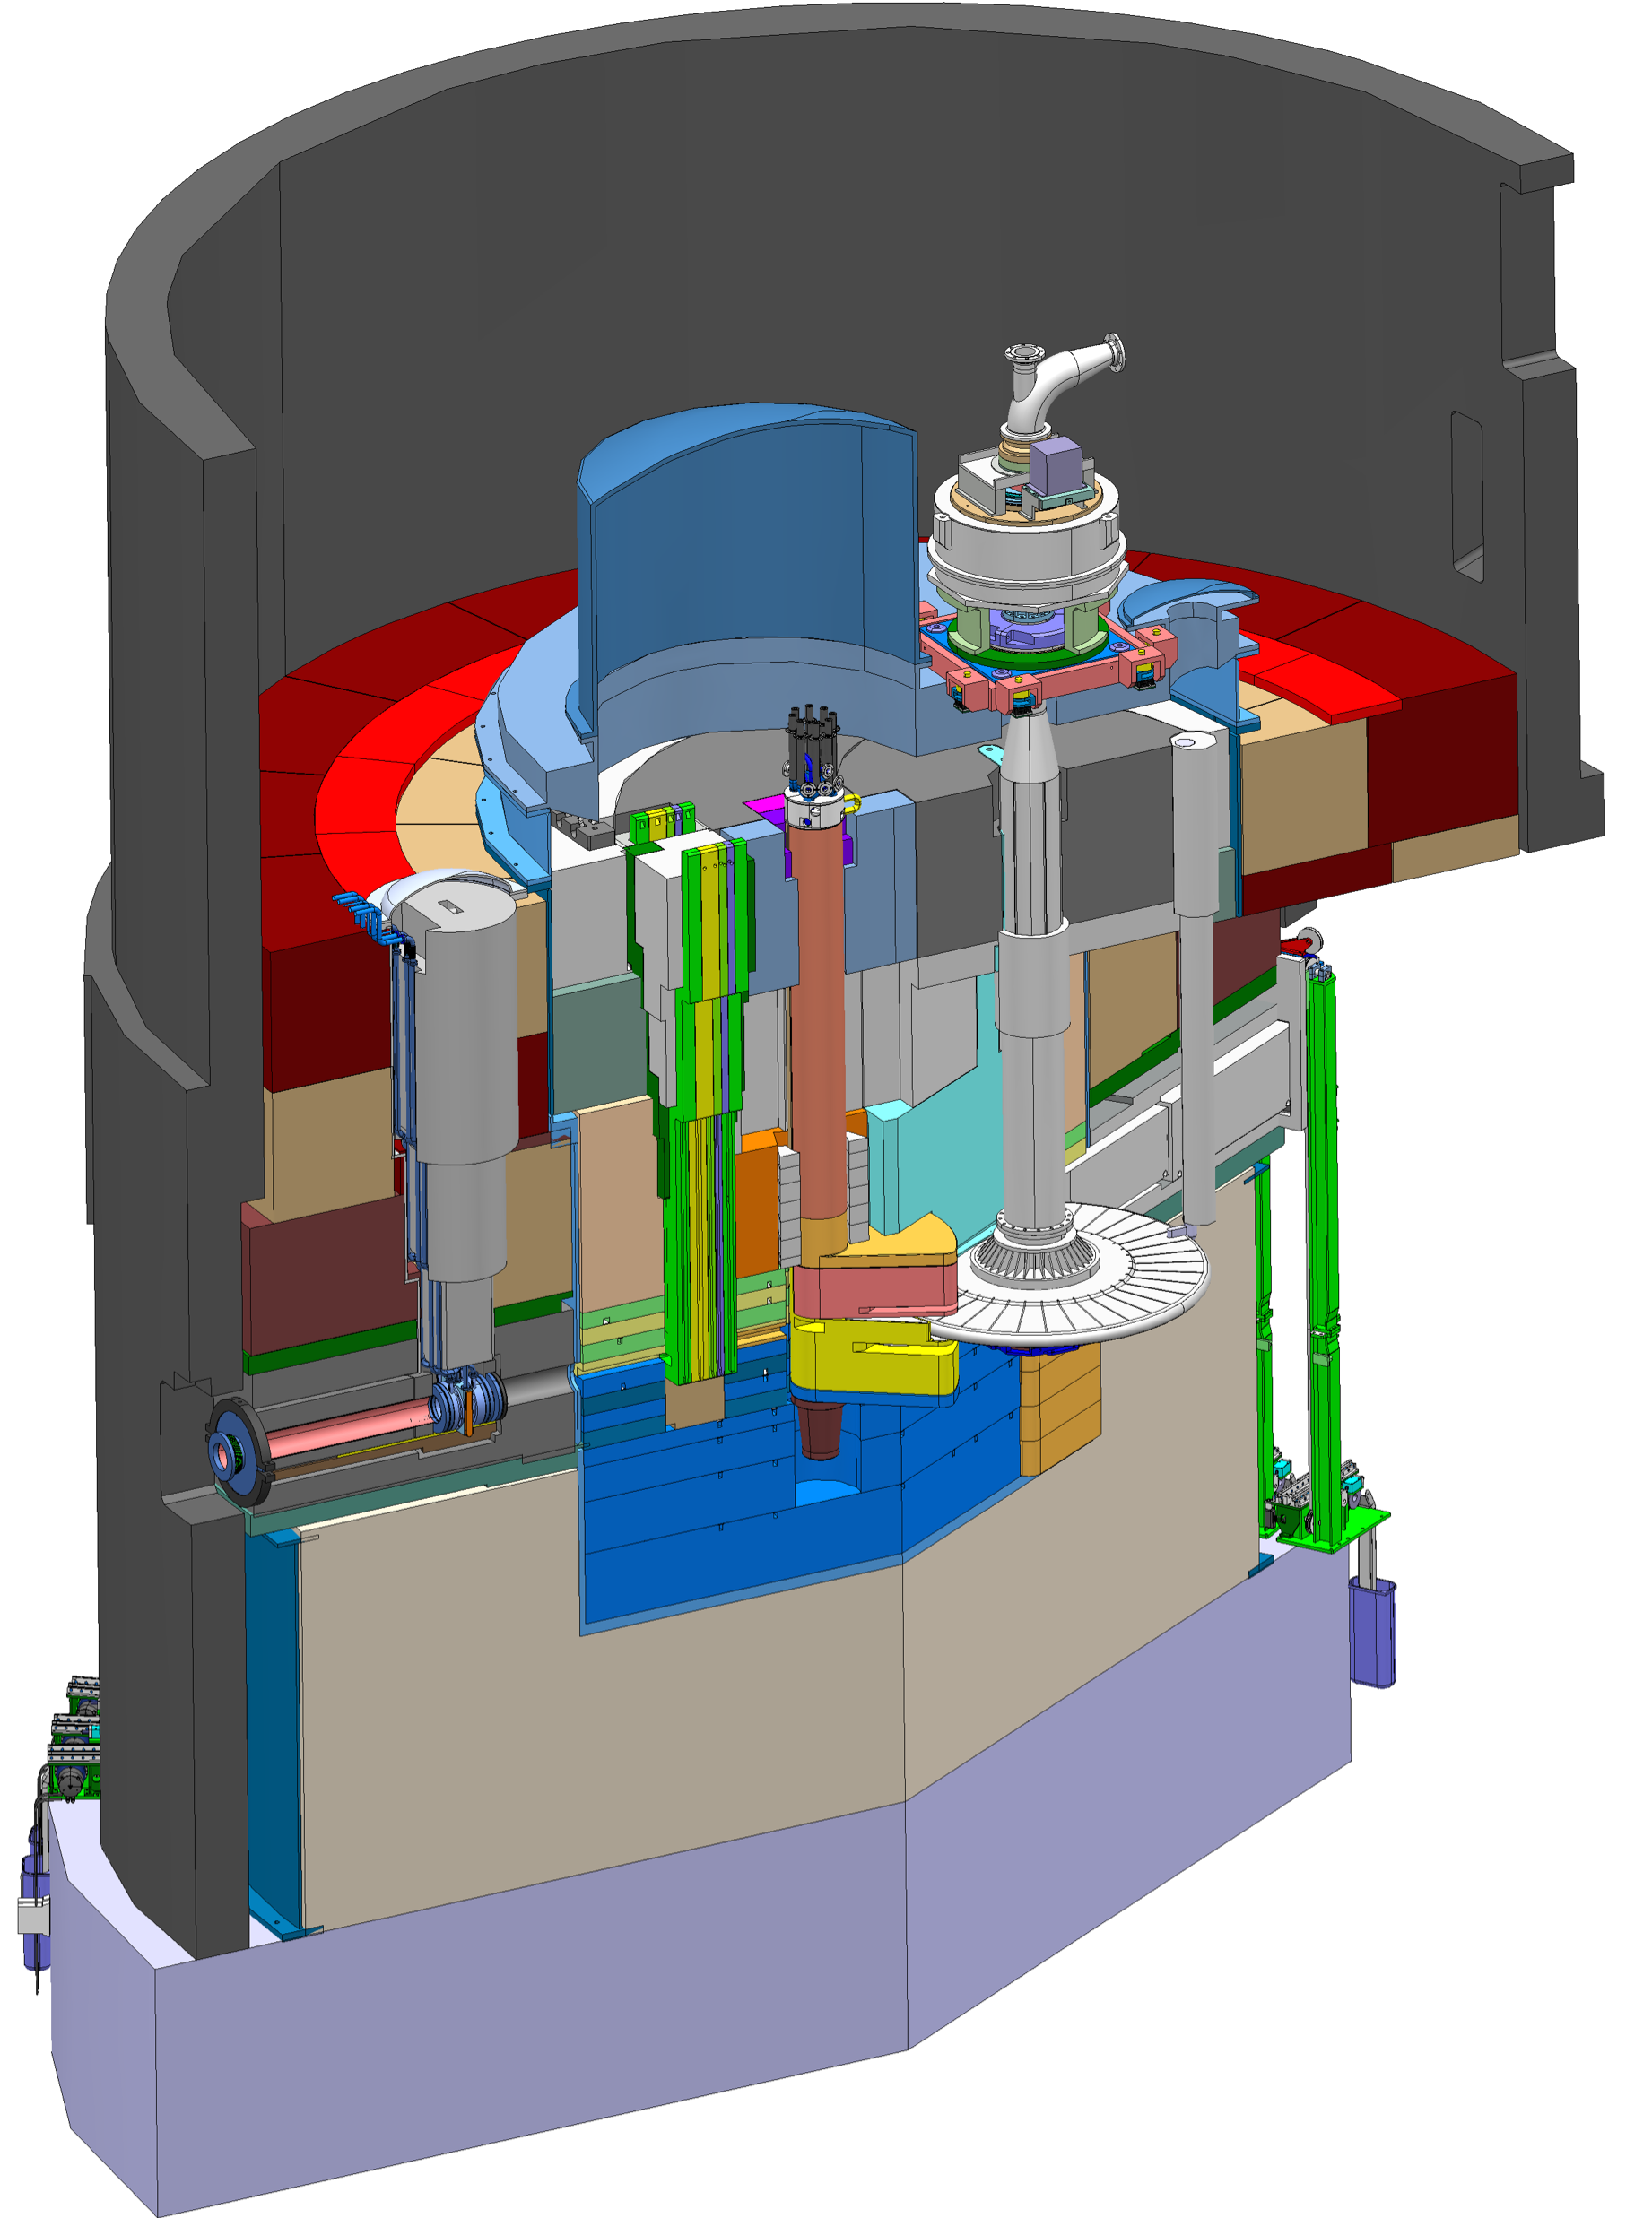
Target station (source of neutrons)
Complicated engineering puzzle
Helium cooling of target material
Mass flow 3 kg/s
Pressure 11 bar
Temperature inlet/outlet 40 °C/240 °C
Moderator and reflector
proton beam instrumentation plug
monolith vessel
Rotating solid tungsten target
36 sectors
Mass, total 11 tonnes, whereof 3 tonnes of W
Rotates 23.3 rpm, synchronized with pulsed proton beam 14 Hz
neutron beam extraction port
Moderators
Locations above and beneath the target wheel
1st MR plug exploits the upper space, offering:
  Cold, 30 mm high, liquid H₂ moderators, 17 K
  Thermal, 30 mm high, H₂O moderator, 300 K
proton
beam
target monitoring plug
proton
beam window
Diagnostics and instrumentation
Fluorescent coating of PBW and target front face
Optical paths, grid profile monitor, aperture monitor
Wheel monitoring including position, temperature, vibration, as well as internal structure
target wheel

Slide 13
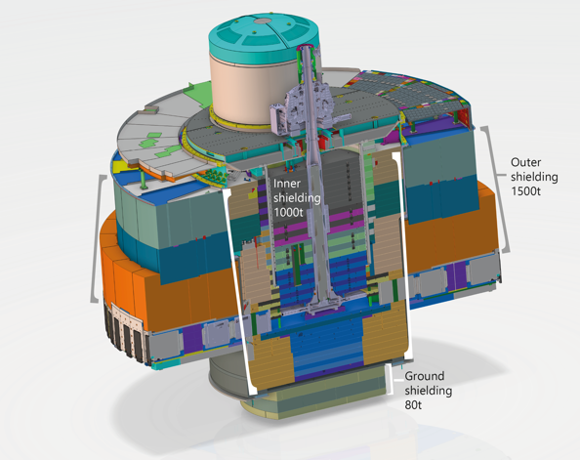
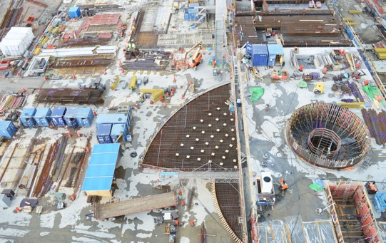
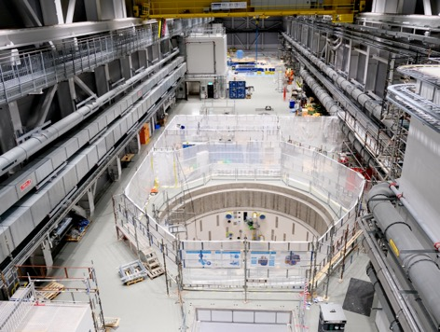
Target station (source of neutrons)
Complicated engineering puzzle
Early construction stage. Photo to demonstrate the scale.
Several layers of components that need to work together.
Target hall ready for installation.

Slide 14
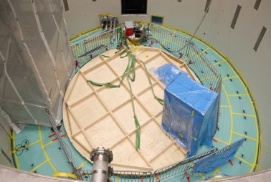
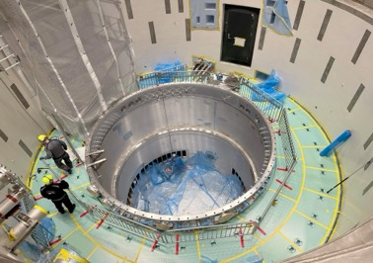
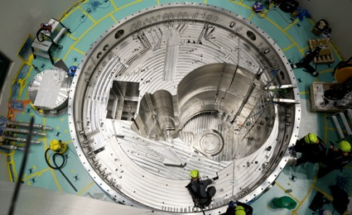
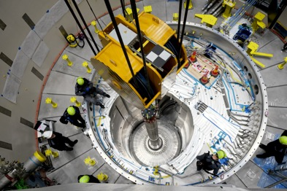
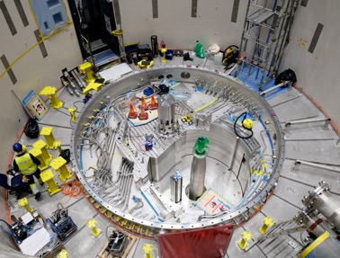
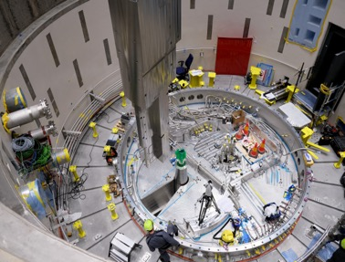
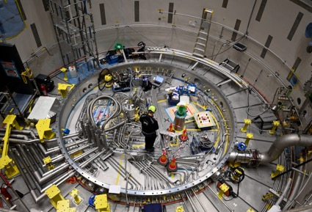
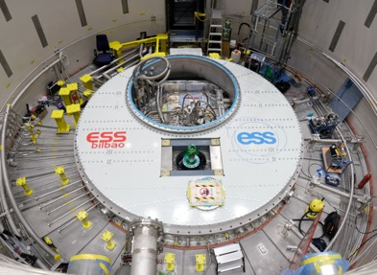
Assembling the target station
Putting the puzzle together

Slide 15
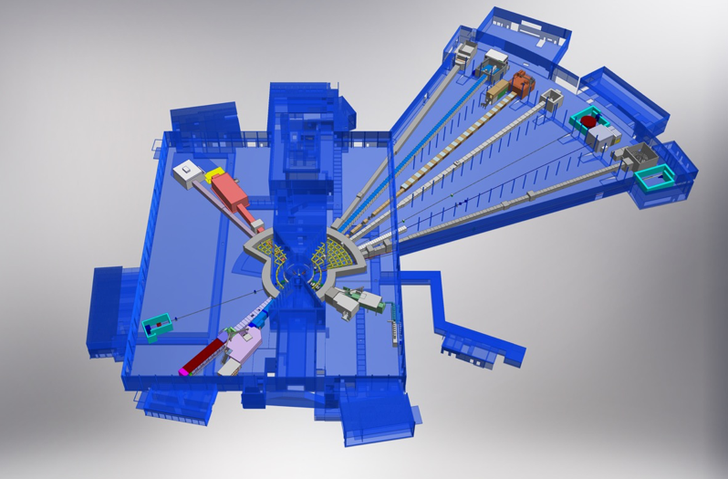
Neutron instruments
First stage instruments (aka neutron beamlines)
Monolith
BEER
NMX
C-SPEC
BIFROST
MIRACLES
MAGIC
ODIN
T-REX
DREAM
HEIMDAL
LoKI
Neutron beam extraction
Offers 42 neutron beam ports
Allows neutron science instruments to view either upper or lower moderator position
VESPA
FREIA
SKADI
ESTIA

Slide 16
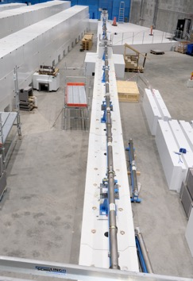
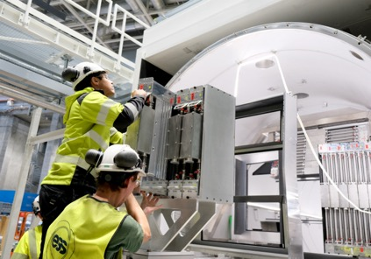
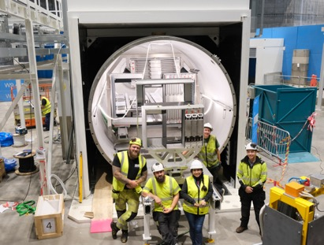
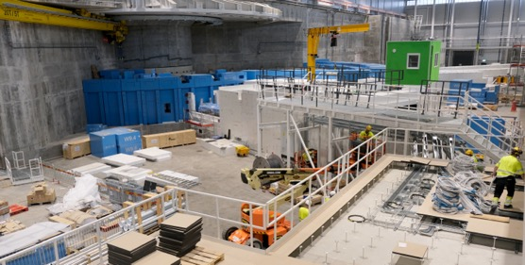
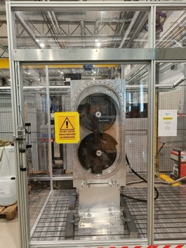
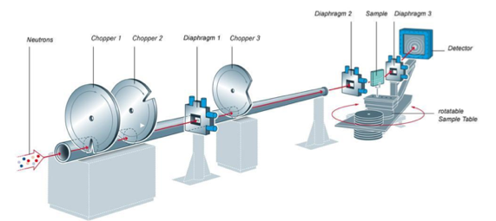
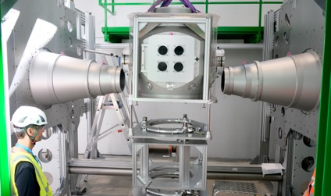
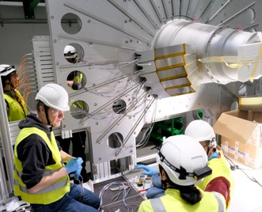
Neutron instrument construction
Science with neutrons happens with this equipment

Slide 17
2
Control System of ESS

Slide 18
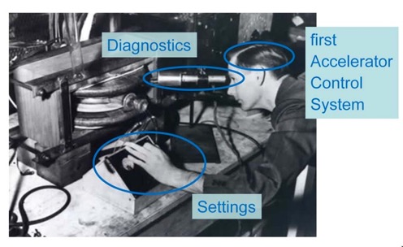
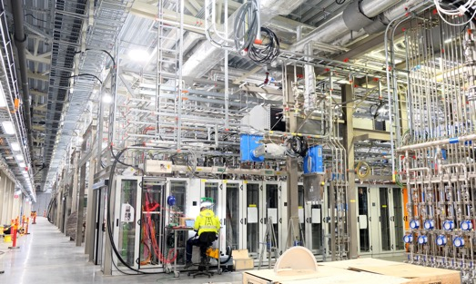
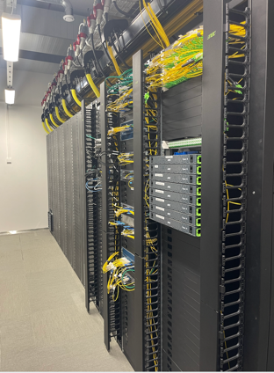
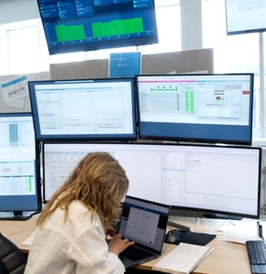
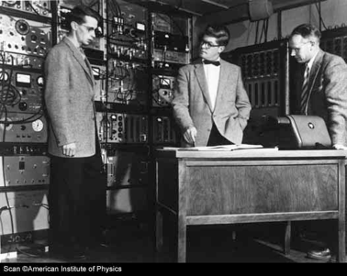
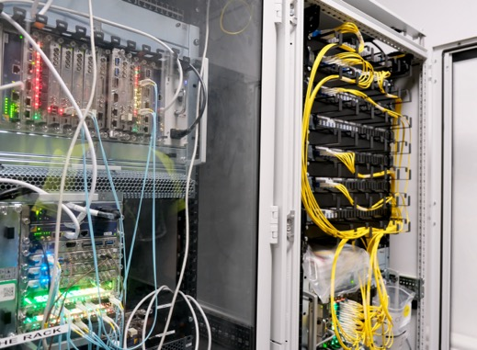

Controlling an accelerator facility
Evolution of control systems

Slide 19
The Integrated Control System
“Integrated” means: all components under one control system
Accelerate protons
Initiate and control acceleration of beam pulses
Measure, display and store beam parameters
Manipulate beam properties (e.g., gradually increase beam power)
Monitor that devices operate correctly
”Spall” off neutrons
Synchronize beam pulses with the target rotation
Handle the heat load, and recycle excess heat
Control cascades of inter-dependent systems.
Monitor performance of target components
Control the experiments
Enable selection of neutron energy (using choppers and timing system)
Inform experiments (in real time) about beam conditions – pulse by pulse.

Slide 20
Some key figures of ESS
Still in construction, numbers are subject to change
Control points, or ”Process Variables”
Early estimates:
~1 million.
At the moment, facility still in construction:
~ 10 million
Likely to exceed 15 million PVs when complete.
Control processes and host computers
Almost 700 host computers (incl. virtual machines) running ~3000 control processes, i.e., EPICS IOCs) – as of time of writing.
Still growing as installation proceeds.
Data storage, processing and networking
Petabyte of on-site storage (to be extended)
Local server room with virtualization clusters.
High-performance network, capable of ~300 Tbytes/sec

Slide 21

Some parameters
Status as of last week (snapshot)
IOCs
IOC Hosts
Number of EPICS records
Archived records

Slide 22

Control and Data acquisition
Integrating the equipment for operation
Large diversity of systems that have to be working as one unit; a ”factory” that produces neutrons.
High requirements for reliability; downtime is costly.
High number of controlled objects requires abstraction while preserving the access to detail information for troubleshooting.
Layered architecture of the ESS Integrated Control System
EPICS Summer School 2025

Slide 23



Field I/O and integration
Integrating the equipment for operation
Signal speed
A custom made microTCA board with a powerful FPGA and a CPU. A FPGA framework constitutes the development environment. The CPU runs EPICS
Backbone of all this is the I/O platforms
  Hardware, firmware, software
  Performance and cost efficiency
    Layered model
A lot of effort goes into device integration
  Device-specific functionality
  Installation effort
10 MHz
1 MHz
100 kHz
Digital platform
10 kHz
1 kHz
EtherCAT I/O modules that are connected to commercial or open-source EtherCAT master controllers which are in turn connected to the EPICS based control system
100 Hz
EtherCAT
10 Hz
Slower signals are handled by industrial automation (PLC) for reliability and cost reasons. The standardized platform for ESS applications comes from Siemens
1 Hz
0.1 Hz
Industrial automation (PLC)
EPICS Summer School 2025

Slide 24


MTCA – Micro TeleCom Architecture
How did it find itself into science?
Modular (multi)computer system
  Plug-in modules (I/O, CPU)
  High data bandwidth
  Multi-CPU systems possible
  High-performance electronics, FPGA (Field Programmable Gate Array) for fast I/O
  Extensive platform management
Development-intensive
  Typically used only where justified by performance needs
MTCA.4 used to be called ”MTCA for physics”, but there are many industrial applications as well.
Enhanced I/O via RTM
Advanced clocking options
Digital I/O on the backplane, for triggering.
Introduced as a standard in 2006, 18 years ago…but the science community is just getting started.

Slide 25



Selected application examples
These all rely on MTCA.4
Controlling the acceleration
  Measure the RF field (amplitude, phase) in the accelerating cavity
  Adjust the RF parameters to stay optimal under various disturbances
  Do this for ~150 cavities in sync.
Measuring the beam properties
  Measure beam current, beam position, beam energy, beam losses
  Various measurement methods, but finally ends to be digitized and processed
Protect the accelerator
  Collect signals from devices along the accelerator
  Switch off beam production in 5-10 µs when a hazard is detected.

Slide 26
3
Challenges of a science facility

Slide 27
Challenges
Continuous improvement
Longevity
Big science facilities are big investments and are planned for a long lifetime.
The planned lifetime for ESS is 40 years.
It is not uncommon that the facilities live long past their planned service life.
Evolution
Science progresses very fast. ”Yesterday’s sensation is today’s calibration and tomorrow’s background. R.P. Feynman(?).”
If scientists lose interest in a facility, it will become obsolete.
Continuous improvement and innovations are necessary to keep a facility relevant.
Investment
Total full-scale replacements of control systems are rarely possible.
Closing the facility for an upgrade risks losing the facility users.
Getting back to track after a big upgrade takes time.

Slide 28



Evolution of facilities
Some selected examples (from other facilities in operation)
Introduction of pulse-to-pulse modulation using sophisticated timing.
K. Furukawa, M. Satoh, Injector LINAC group, KEK, Tsukuba, Japan, ICALEPCS 2023
SuperKEKB, 3000 m circumference dual-ring collider in Japan.
The simultaneous injections improved the collision performance (luminosity) by 237 %
Imagine if one can increase factory output by more than a facto of two!
Power upgrade at Spallation Neutron Source, USA
Fulvia Pilat, HB2023
(ESS “sister” facility, built in early 2000’s)
Install new RF systems and improve existing systems, to double the beam power.
Do this without long interruptions to user experiments.
Systems need to be adapted to new demands.

Slide 29
Open source and open standards
Why are these important?
Upgrades
To stay relevant, innovations are applied to improve the performance of the machinery along its lifetime.
Modular and interoperable standards make it possible to do partial upgrades.
Add performance and features where it helps the most.
Understanding
Openness enables us to study and understand how the components work, and plan and design improvements.
Issues that arise during operation have to be understood and solved by the local staff.
Knowledge sharing
Science facilities, while being competitive to some extent, thrive based on knowledge sharing. Solutions that are found to work in one place often find use in other institutes, enlarging the market.

Slide 30

Conclusions
After 11 years of construction, ESS is getting close to start of science operations.
Long time, but there have been a lot of challenges on the way:
  Building a totally new organisation
  Change of safety requirements
  Covid…
  But when completed, ESS will serve science for many years, hopefully with many discoveries and contributions to solve critical challenges of the mankind.

Slide 31
Thank you for your attention!

