Slide 1

EPICS and the EPICS Collaboration
Ralph Lange

Slide 2
What is EPICS?
Organisationally,
An active world-wide collaboration (>100 user installations on all continents, ~1000 people on the main mail exploder)
Technically,
A control system / SCADA toolset, with three major parts:
  The highly scalable distributed EPICS Process Database,
  ported to dozens of target architectures/OSes
  Two highly efficient network protocols, Channel Access and pvAccess
  A huge number of client tools and interfaces

Slide 3
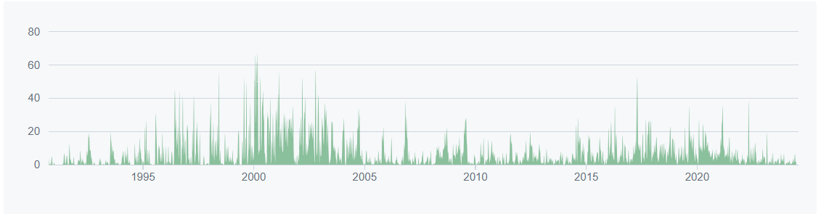
A Very Short History of EPICS
1980s | The US Department of Energy strongly proposes a collaboration on Control System Development between the DoE funded labs: LANL (Los Alamos, NM) and APS (Argonne, IL) start EPICS in 1990
1990s | More labs in the US join, followed by European and Asian labs Strong competition between EPICS and Tango (developed at ESRF) Portability across many platforms: EPICS v3.13 (since 1998)
2000s | The EPICS Collaboration is growing substantially Modularization and build system updates: EPICS v3.14 (since 2002)
2010s | Code reorganization, many unit tests added: EPICS v3.15 (since 2014) New network protocol (pvAccess): EPICS 7 (since 2017)

Slide 4
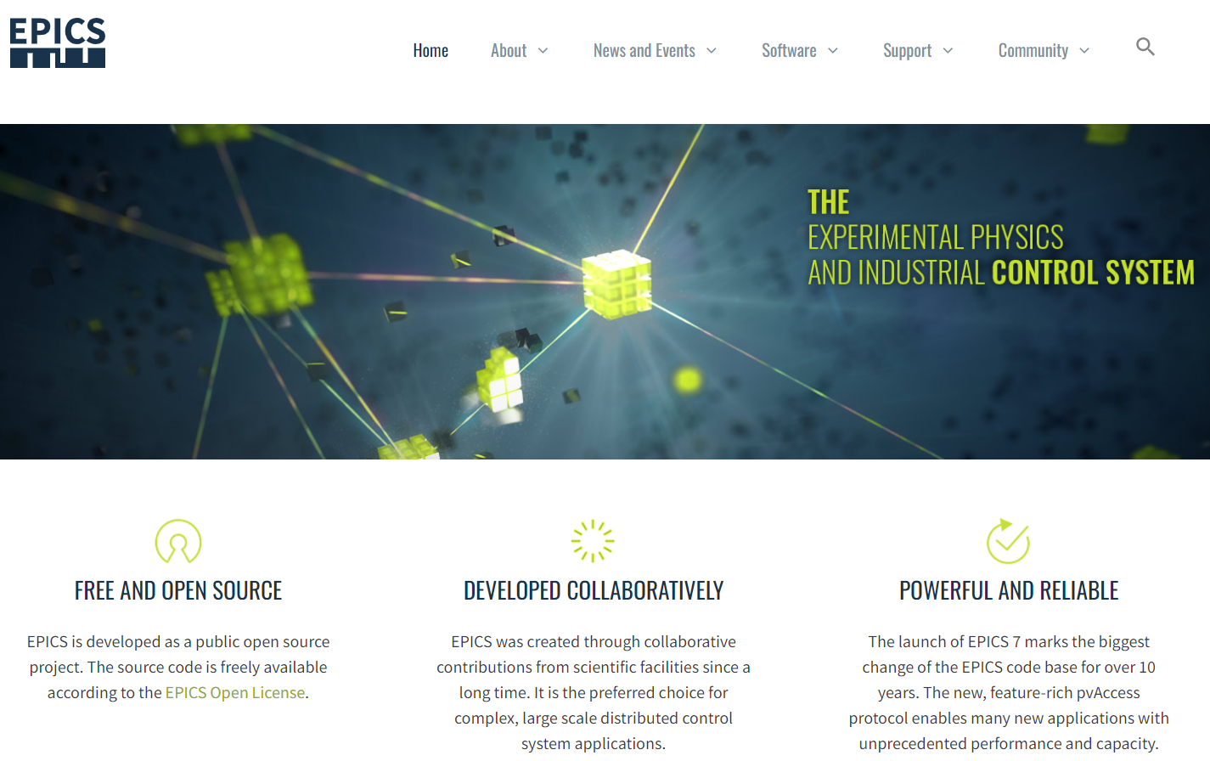
Who is the EPICS Collaboration?
Probably around 150 installations world-wide (on all continents),
controlling many different types of machines:
  Light Sources (Synchrotrons, FELs) and their Beamlines
  Particle accelerators and their Detectors
  Telescopes
  Fusion Devices
  Lasers
  DIY Projects: e.g., Bee-Hives,
  Home-Brewing Setups
Scalability: between 10 and 5-10 million PVs
EPICS Web Site: https://epics-controls.org/

Slide 5
How does the EPICS Collaboration Work?
5-10 EPICS Core Developers are responsible for the EPICS code base and infrastructure
Some labs directly contribute manpower for EPICS infrastructure work, other labs hire contractors to contribute
Code-a-thon events, where developers travel to a one-week coding sprint managed by the EPICS Core Developers
(next: planned end of Feb 2026 at Diamond, UK)
Two EPICS Collaboration Meetings per year (alternating: US, EUR, Asia) give opportunity to show, discuss failures and ask questions
(next: 20 Sep 2025, Chicago, IL, USA; spring 2026: CEA Saclay, Paris)
Communication:
Tech-Talk mailing list (~1000 recipients) with a searchable archive
EPICS Chat (based on Matrix) for smaller scope discussions
The governing EPICS Council is representing the largest contributors

Slide 6
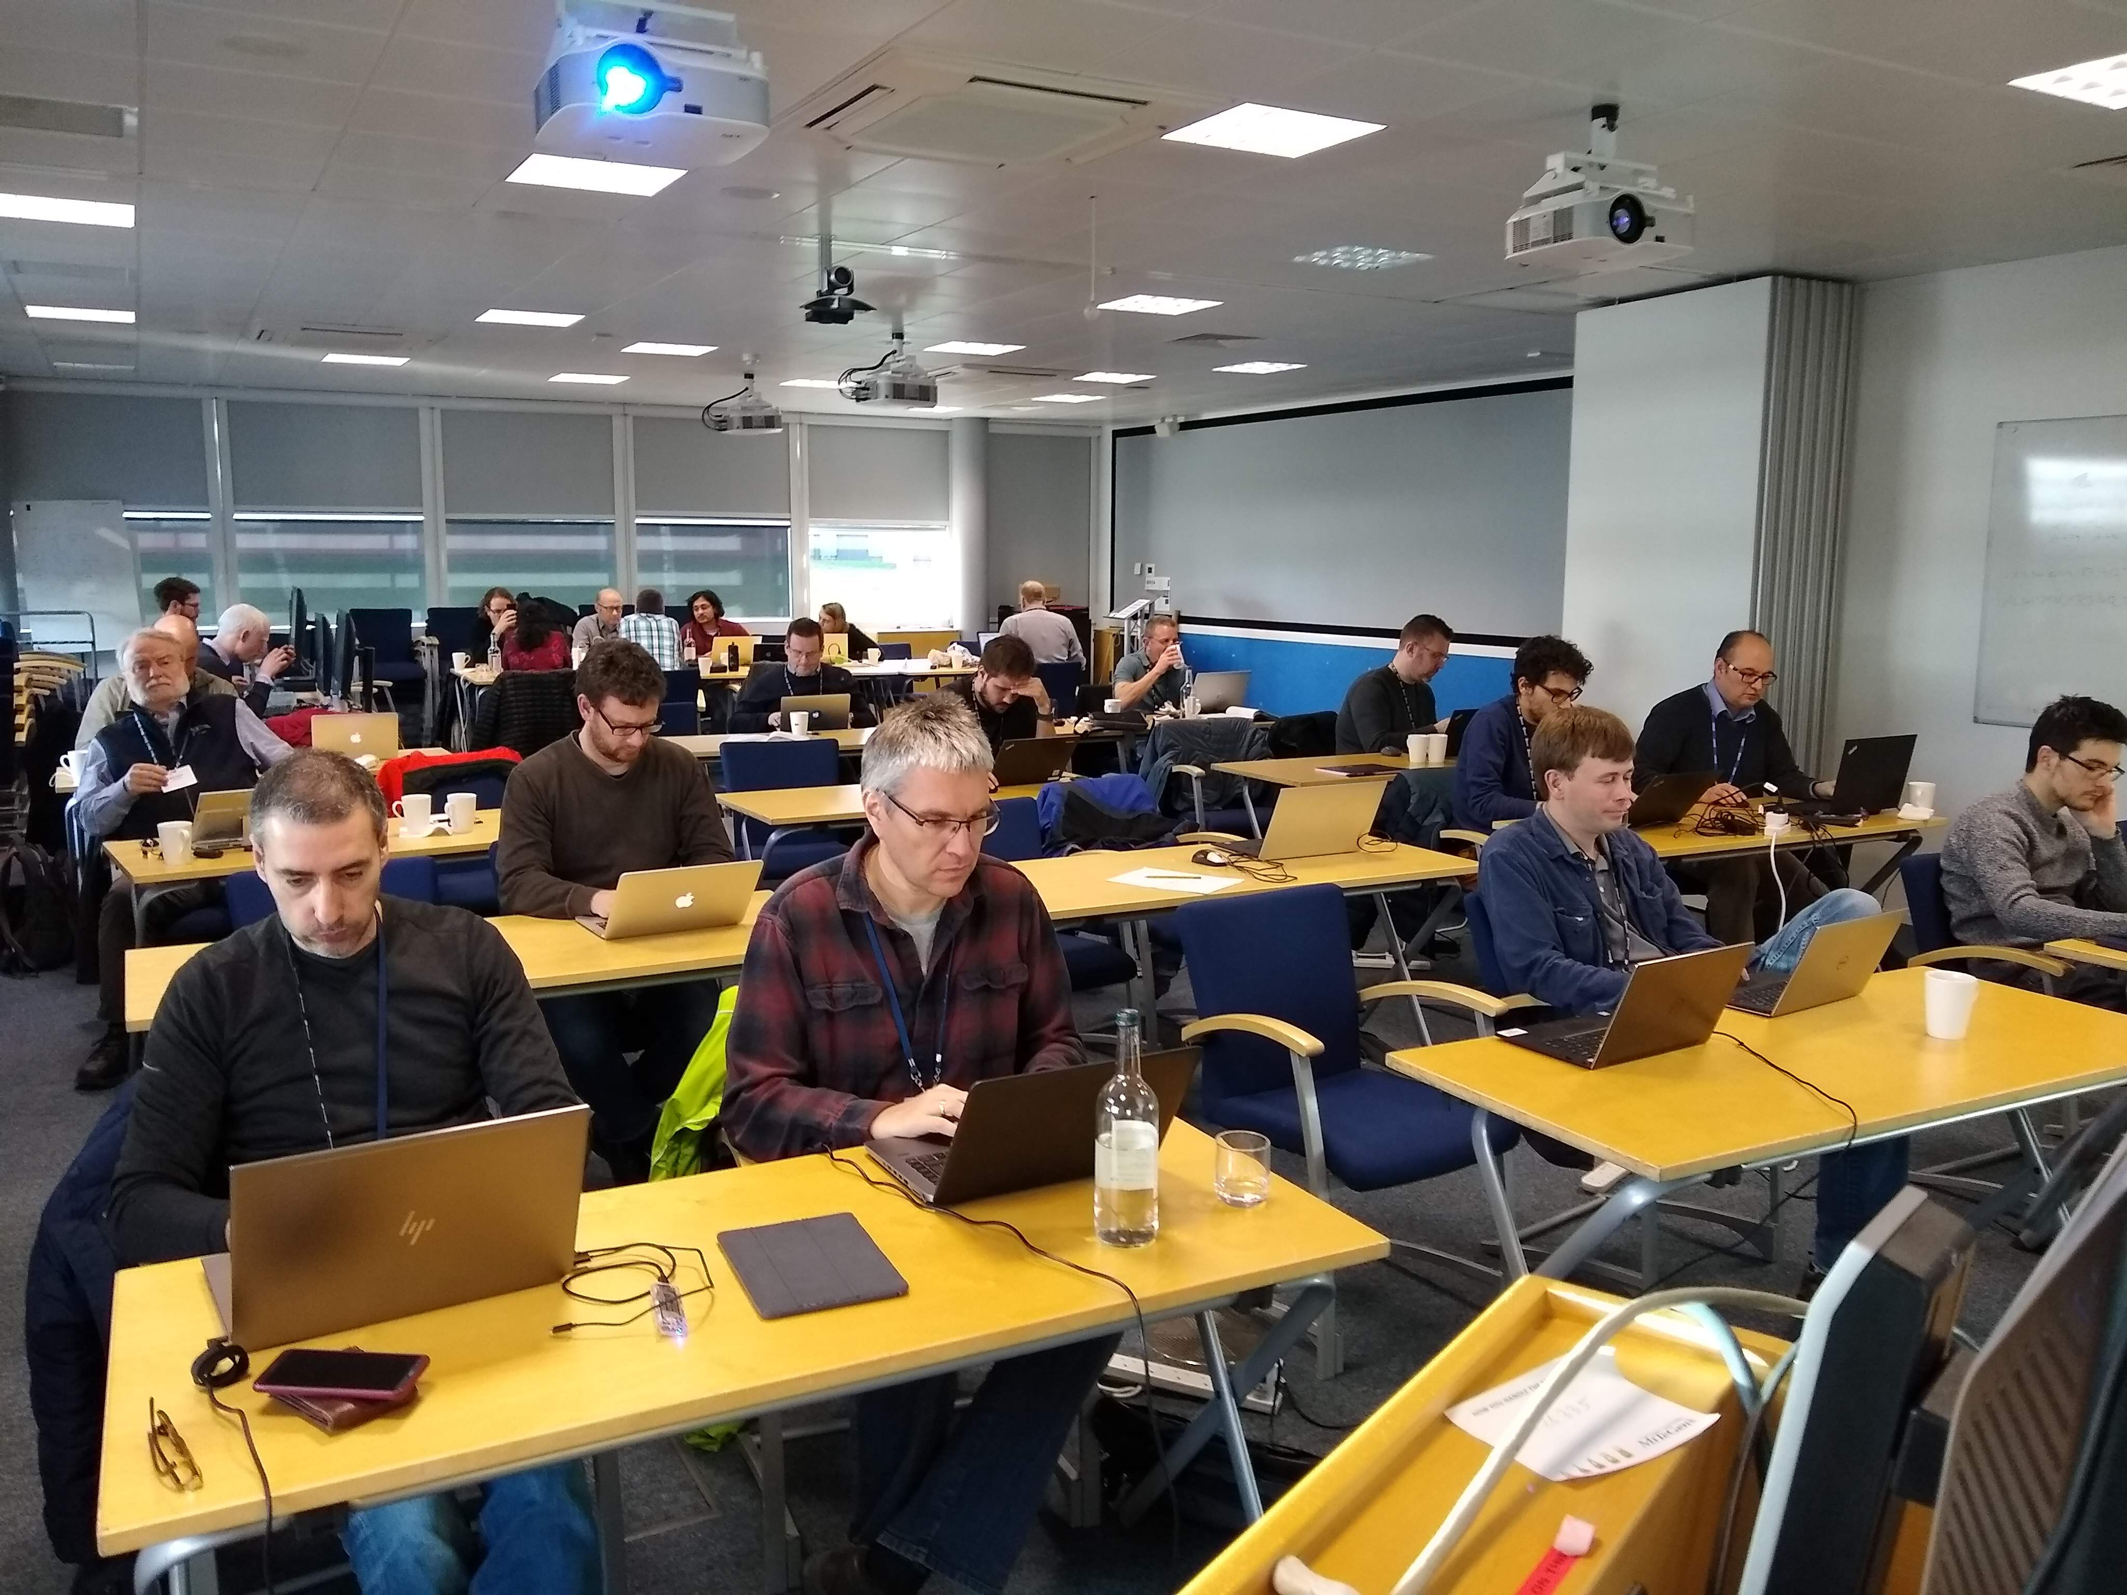

EPICS Code-a-thons

Slide 7
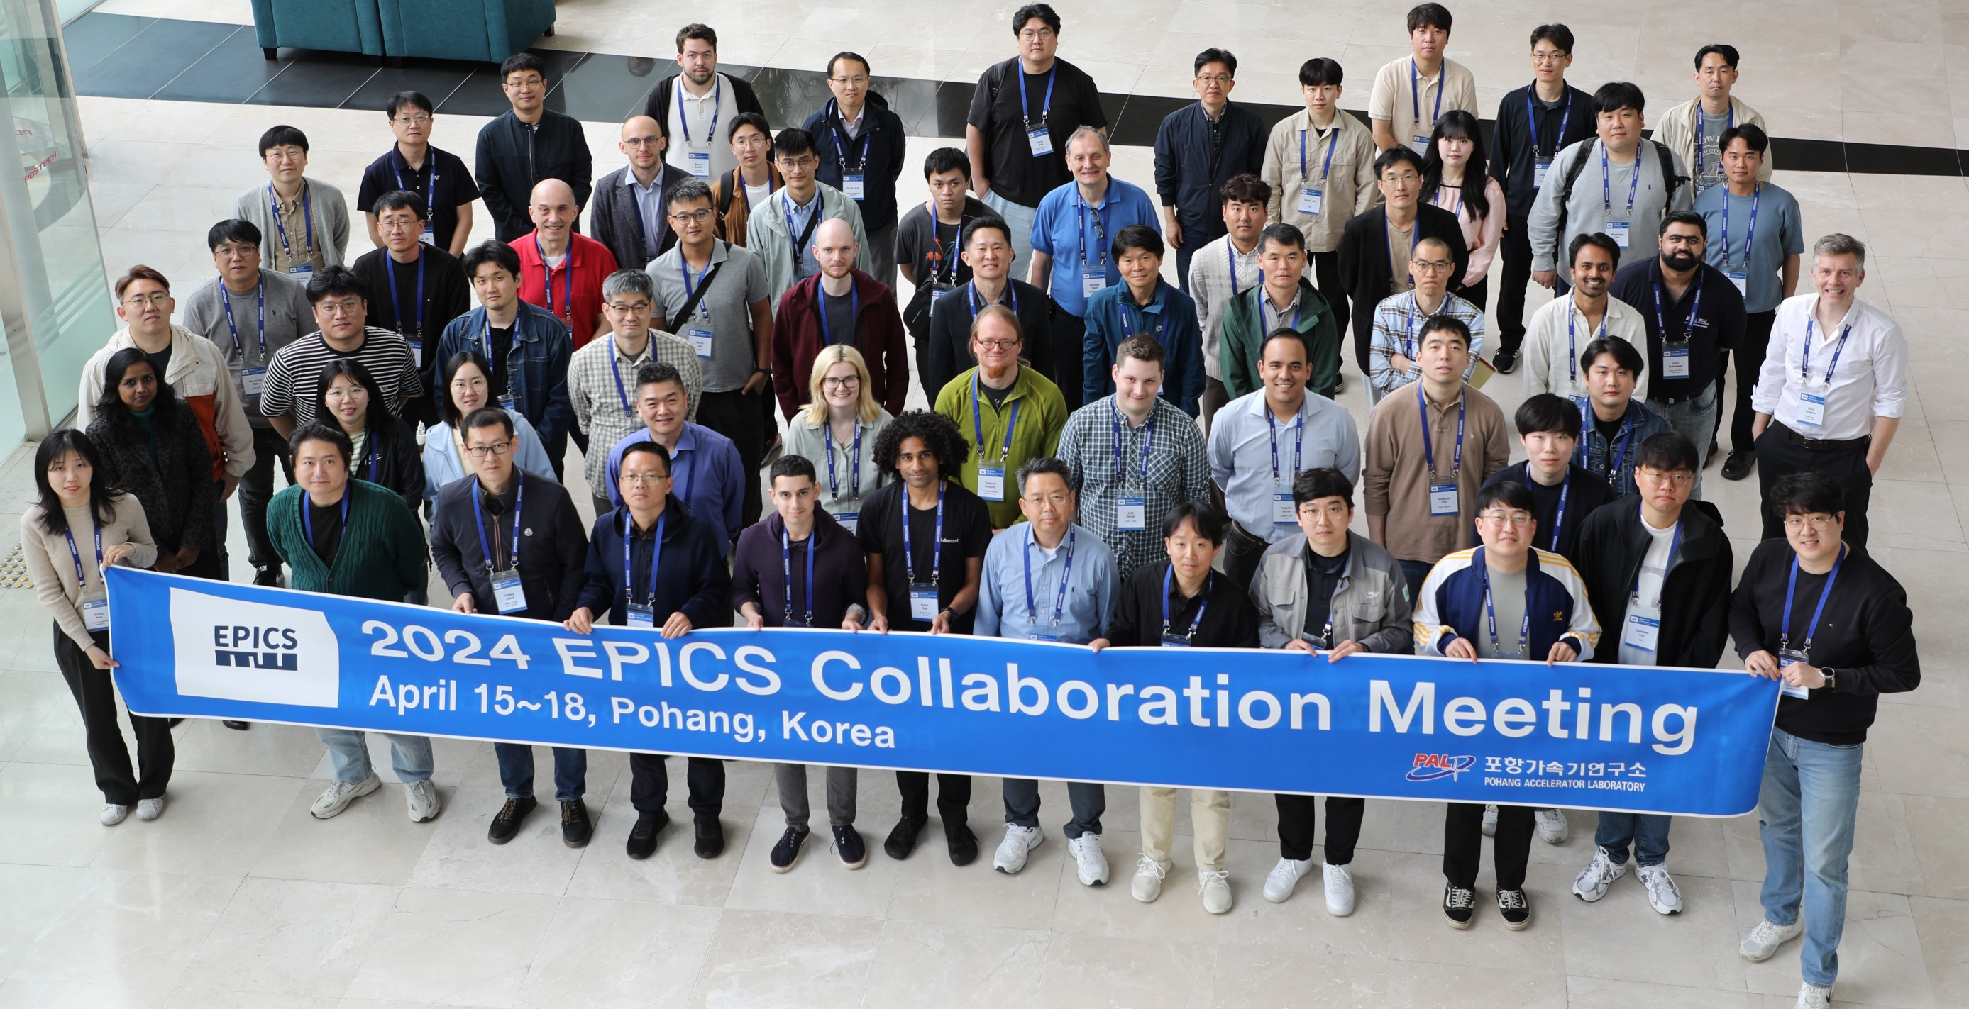
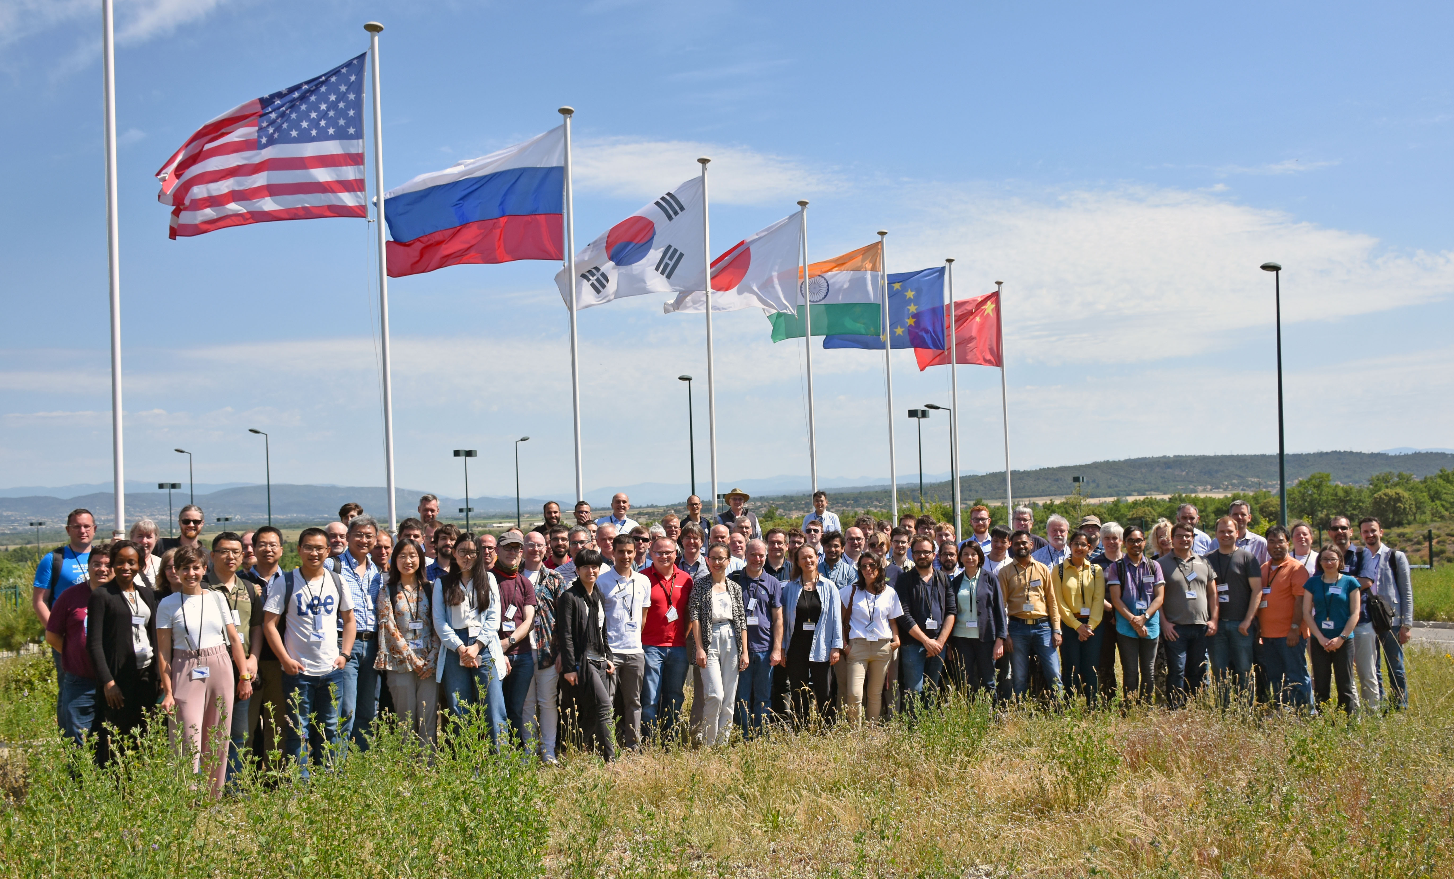
EPICS Collaboration Meetings

Slide 8
The EPICS Process Database
IOCs (Input/Output Controllers) read ASCII files that describe
Records for each atomic piece of data (“process variables”)
Records can link to hardware or to other records
Device Support interfaces record types to specific hardware
Algorithmic record types add math, data manipulation, …
Configuration before coding
  If you use hardware with existing EPICS drivers, no coding is needed
  EPICS has drivers for many standard protocols, e.g.,
  SCPI (ASCII over serial/TCP), Modbus, OPC UA, MQTT
  EPICS has subsystems/frameworks for image processing, motion control

Slide 9
Channel Access (CA) and pvAccess (PVA)
CA is the original protocol, PVA is relatively new (8 yrs)
CA uses a fixed set of compound (structure) types,
PVA allows to access arbitrarily structured data
and adds a “remote procedure call” flow
Both are:
  Based on TCP/IP
  High-performant and highly scalable
  Robust against IOC or client restarts/reboots

Slide 10
Existing Clients and Client Side Interfaces
Operator Interfaces (displays)
Archiving (long-term and for persistence)
Alarm handling
Snapshot save/restore
Directory services
State-machines, procedures, orchestration
Frameworks that combine (m)any of the above
C/C++, Java, Python, Perl, contributed: Node.js, C#
MatLab, LabVIEW, IDL, …

Slide 11

Conclusions (by Bob Dalesio, from „30+ years of EPICS“)
Technologies change every ~10 years…
like fashion – just a bit slower
Architecture is more important than technologies.
Good architecture encourages collaboration.
People are more important than architecture.
A community of engineers produces better results than a single team with a single funding source.
“If you want to go fast, go alone. If you want to go far, go together.” African proverb (mentioned by Katy Saintin)

