Slide 1
HELP project
Guideline against discrimination, harassment, (cyber) bullying and abuse of power
Laura Jensen (on behalf of the HELP project team)
GFZ Helmholtz Centre for Geosciences
PhD Assembly, 24 March 2025

Slide 2
HELP project (2023/12 – ongoing)
Background:
“Each center creates firm, transparent and effective procedures for dealing with non-scientific misconduct (in particular discrimination, sexual harassment, bullying and abuse of power).” From the Helmholtz Association's Guideline on Diversity and Inclusion
Solid foundation at GFZ already established, e.g.:
signing the Diversity Charter
service agreement on dealing with social misconduct
conflict prevention and conflict management
Clear definition of processes and concrete advice still needed.
→ bottom-up initiative to create a guideline

Slide 3
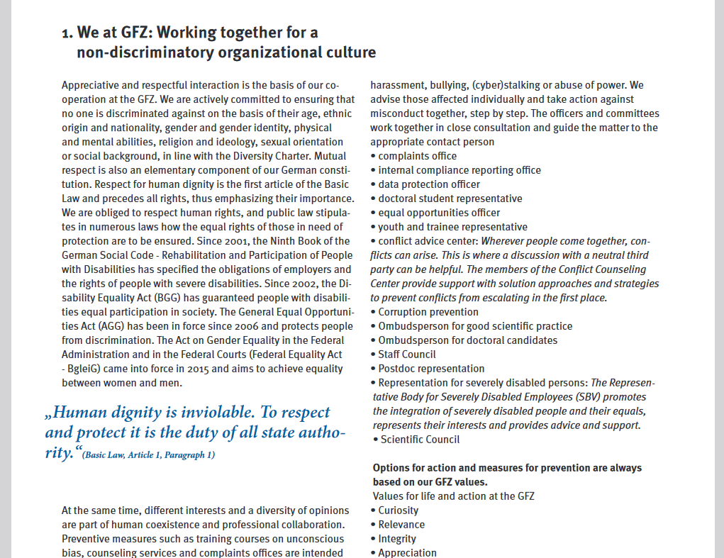
HELP project (2023/12 – ongoing)
With respect and appreciation for a strong community at the GFZ - Guideline against discrimination, harassment, (cyber) bullying and abuse of power
Goals
Raise awareness of conflict issues among executives and employees at the center, provide prevention information
Establish structured processes and measures for effective crisis management, ensure prompt support
Strengthen a work culture that is characterized by non-discrimination, respect and appreciation
Project team:
Hella Ahrens, Conflict Counselling Team/V2
Christina Camier, Equal Opportunities Officer Team/RIFS
Annett Hüttges, (formerly) Talent management/V1
Laura Jensen, Postdoc Representative/Sec. 1.3
Anke Lerch, Project Lead, Occupational Health Coordinator/V1
Benjamin Männel, Scientific Council/Sec. 1.1
Lena Muhl, PhD Representative/Sec. 4.8
Grit Schwalbe, Staff Council/Communication & Media
Sabine Thiel, Representative Body for Disabled Employees/V4

Slide 4
HELP project (2023/12 – ongoing)
Contents
Definitions & examples (of misconduct in the workplace)
Responsibilities (executive board, group leaders, employees)
Offers of help and contact points (internal/external)
Disciplinary measures in case of misconduct
Behavioral strategies for affected persons, observers and leaders
Brochure printed de/en
Intranet presence especially for those seeking help
Sticker with QR code on all mirrors in the GFZ
Current status:
Content finished
Feedback obtained from different status groups
Awaiting final “GO” to typeset and print from HR & executive board

