Slide 1
Annual PHD Assembly 2025
24.03.2025
phd@gfz.de

Slide 2
Schedule
15:00 Welcome & Annual Report
15:15 The new Graduate Convenor
15:25 The HELP-Brochure
15:35 The GFZ Graduate Program - What is new? What is important?
15:50 Coffee Break & Cookies
16:05 Introduction to the new Helmholtz Juniors
16:15 Annual - Doctoral Researcher's Survey
16:25 Election of new generation of GeoReps
17:00 VIKING‘S CHESS AND BEERS

Slide 3
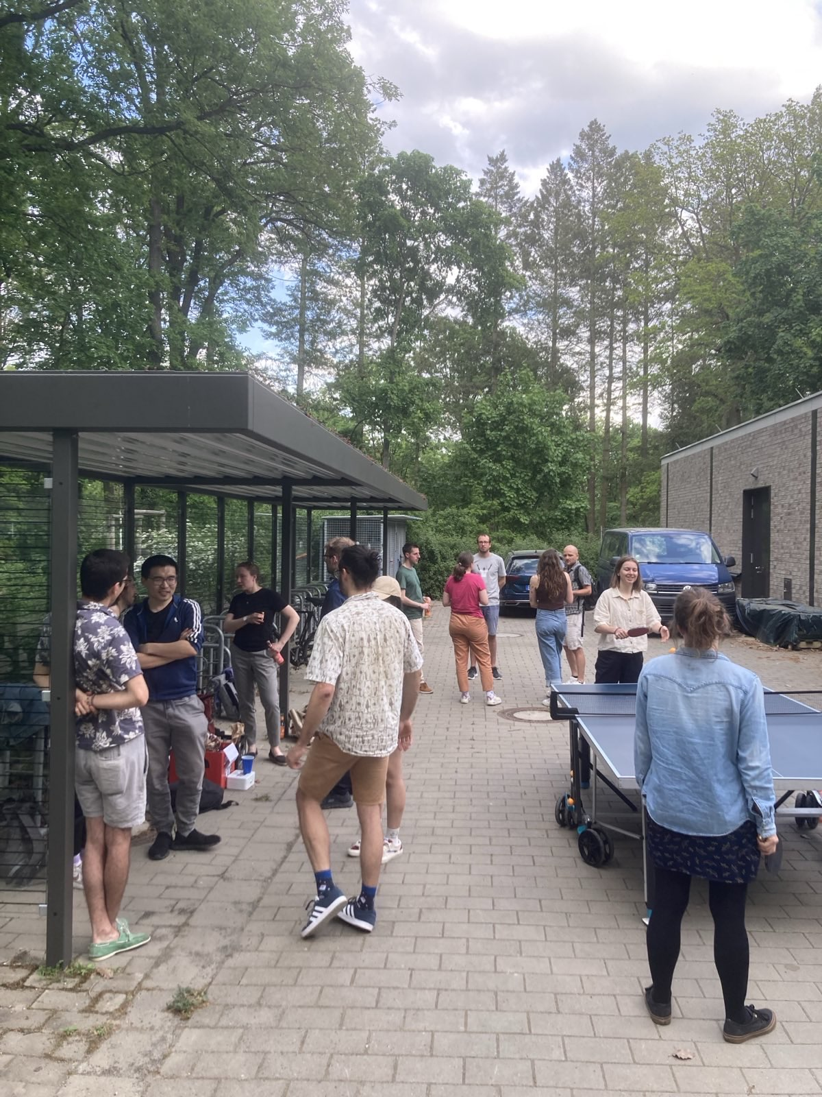
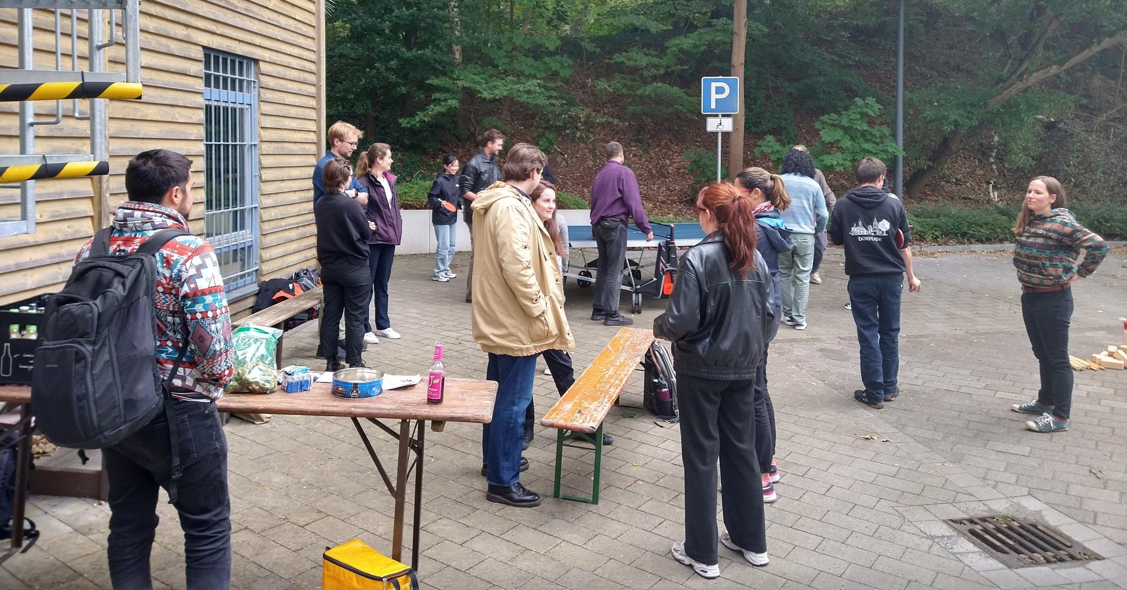
What we do
Doctoral Days: Ice cream, rally around House H
Table tennis events (partly together
with PIK and AWI)
Few additional events (e.g. Christmas market)
EGU poster preparation workshop

Slide 4
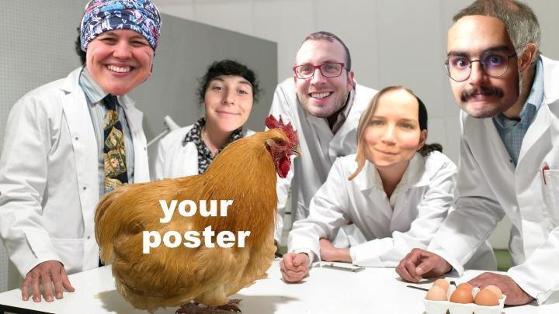
What we do

Slide 5
Working conditions for DRs (GFZ & RIFS)
Discrepancy between contract duration and reality!
Notes:
QUELLE: https://www.dfg.de/de/service/presse/pressemitteilungen/2021/pressemitteilung-nr-09
Nur 18% schlossen PHD in 3 ½ oder weniger Jahren ab.

Slide 6
Our role – DR representatives
Support Doctoral Researchers (DR) community
Focus on organizing small social events
Contact persons for any sort of questions
Representation of DRs in front of Scientific Board
Future: re-design of Graduate Progamme

Slide 7
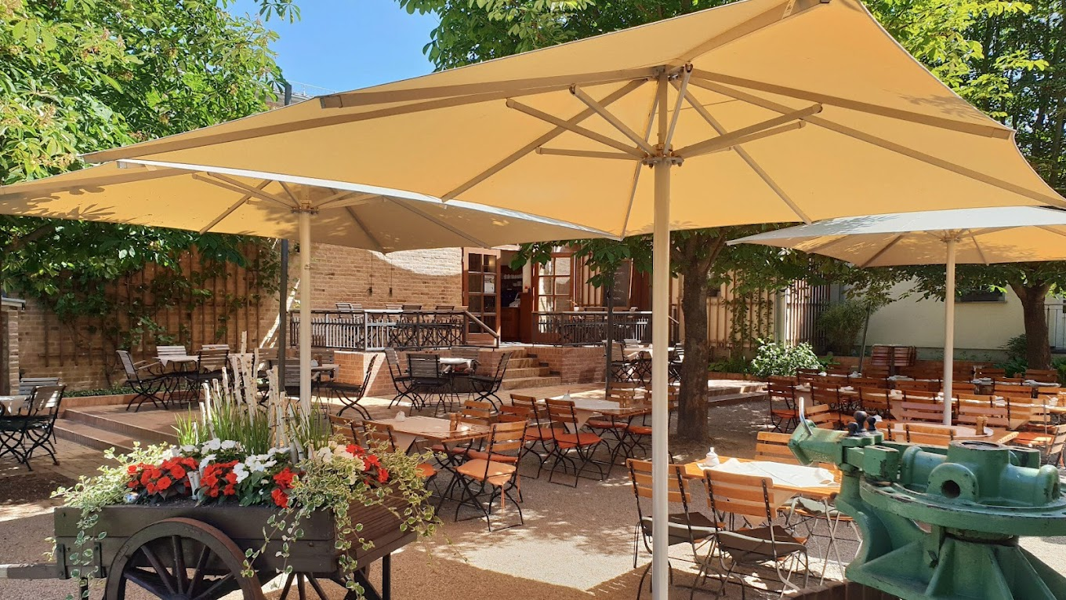
New GeoReps
Planned handover-retreat in april (10 & 11)
Old and new GeoReps
in
in April

