Slide 1

Task 3.3: RF Tunability – M1-M32
• Explore new coating parameters on planar samples and resonators to enhance the mechanical strength in SC A15 films.
• Mechanical film-stability tests with planar samples. → Saclay
• Build cavity tuning system and perform vertical cryo-tests of coated cavities to explore RF performance limits and acceptable tuning without incurring film damage. → HZB
• Devise cavity tuning schemes for Nb3Sn cavities fulfilling the required tuning parameters while taking into account the constraints of Nb3Sn. The implementation of FE-FRT to assist will be considered.
→ See introduction to FRTs by Nick Shipman

Slide 2
Work plan at HZB for WP3
Cavity measurements: Andre Frahm and Julia Köszegi
adapter design RF-measurements
Flux measurements: Felix Kramer, Alex Cierpka and Vincent Strugalla
will occupy ISAS position flux measurement device
QPR and RaSTA measurements: Felix Kramer and Sebastian Keckert

Slide 3
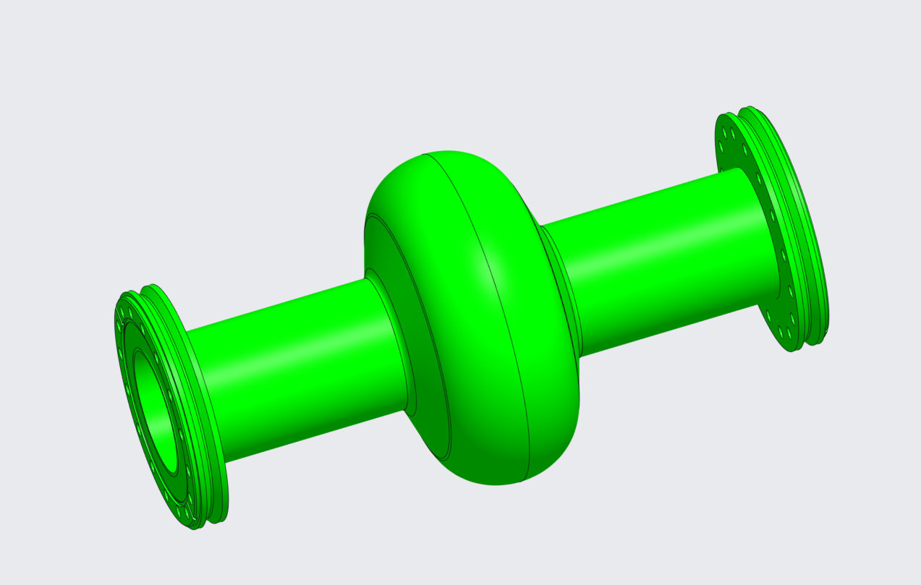

Slide 4
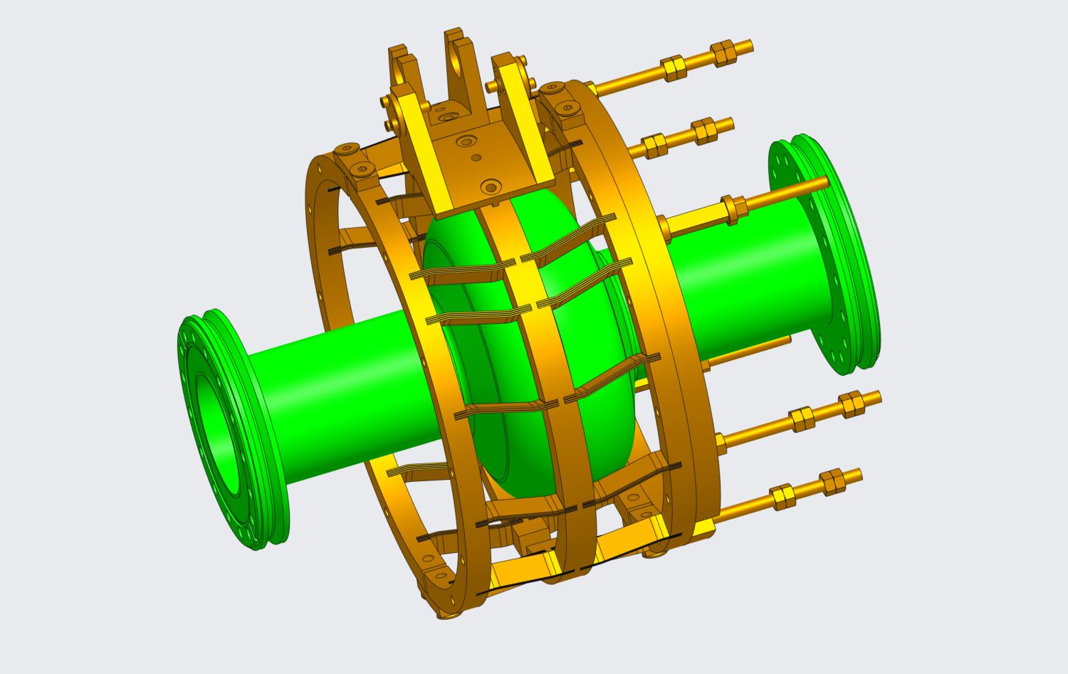

Slide 5
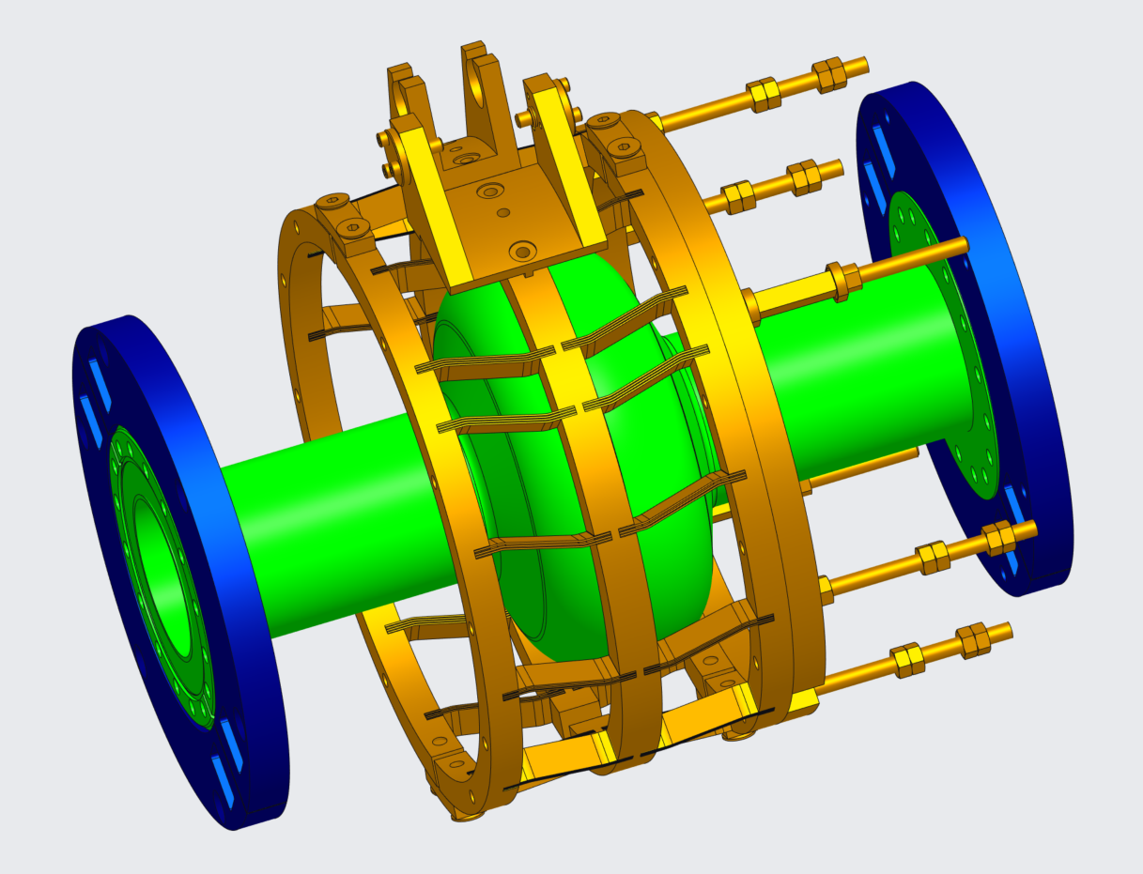

Slide 6
