Slide 1
The 13th I.FAST meeting
Task 9.5: Improvement of mechanical and superconducting properties of RF resonator by laser radiation.
Arturs Medvids
Laboratory of Semiconductor Physics, Institute of Technical Physics, Faculty of Materials Science and Applied Chemistry, Riga Technical University, P. Valdena 3/7, Riga, LV-1048, Latvia
2.12.2024.

Slide 2
Task 9.5: Improvement of mechanical and superconducting properties of RF resonator by laser radiation.
Partners:
1.Riga Technical University(RTU),Dr.A.Medvids;
2.United Kingdom Research and Innovation (UKRI),Dr.R.Valizadeh;
3.Institute of Electrical Enginering (IEE),Dr.E.Seiler;
4.Helmholz-Zentrum Berlin (HZB),Dr.O.Kugeler;
5.Instituto Nazionale di Fisica Nucleare(INFN), Dr.C.Pira.

Slide 3
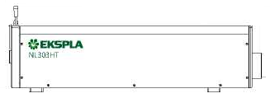
In an Ar gas chamber with an optical window, where a linear stepper motor (Z. coordinate) and a motorized rotating platform (α. coordinate) were installed. A miniature rotation stage for mirror rotation (β. coordinate) is installed.
Figure 1. Principal schematics of Laser facility for irradiation inner surface of RF cavity.

Slide 4
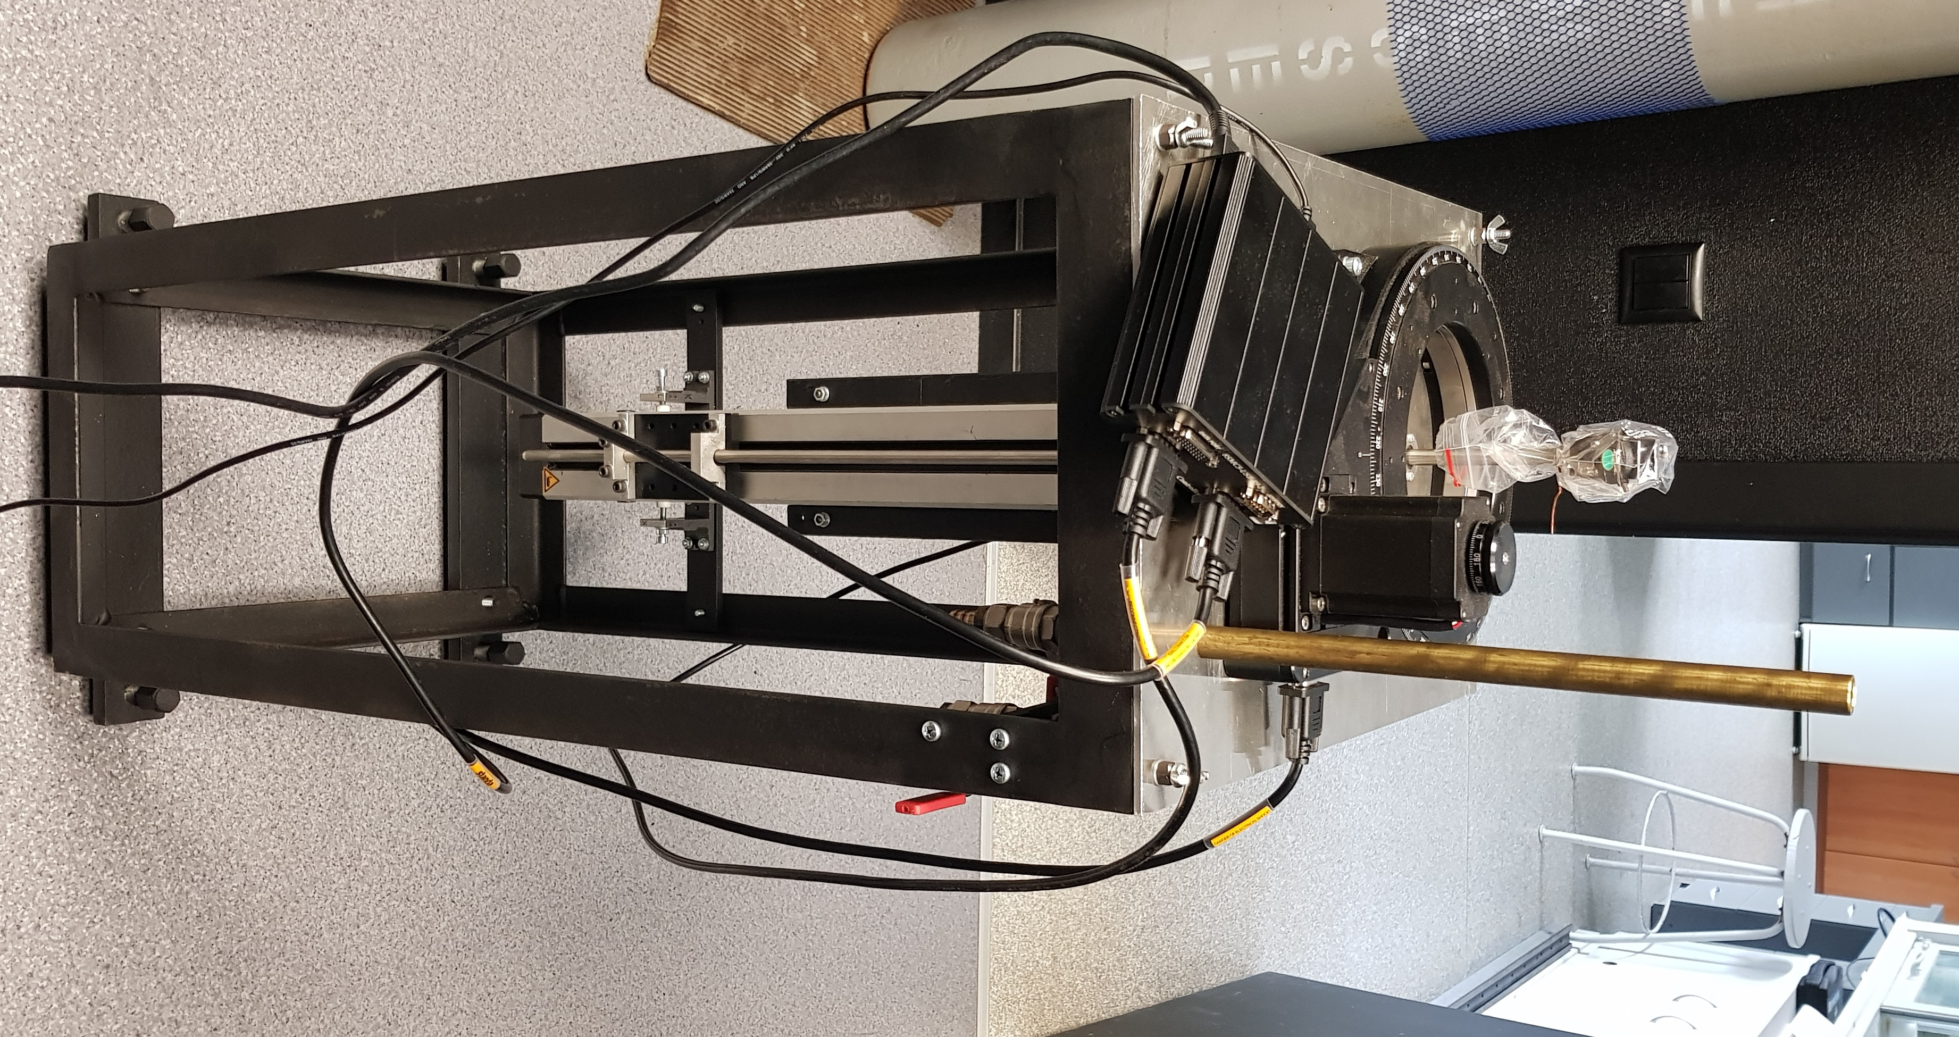
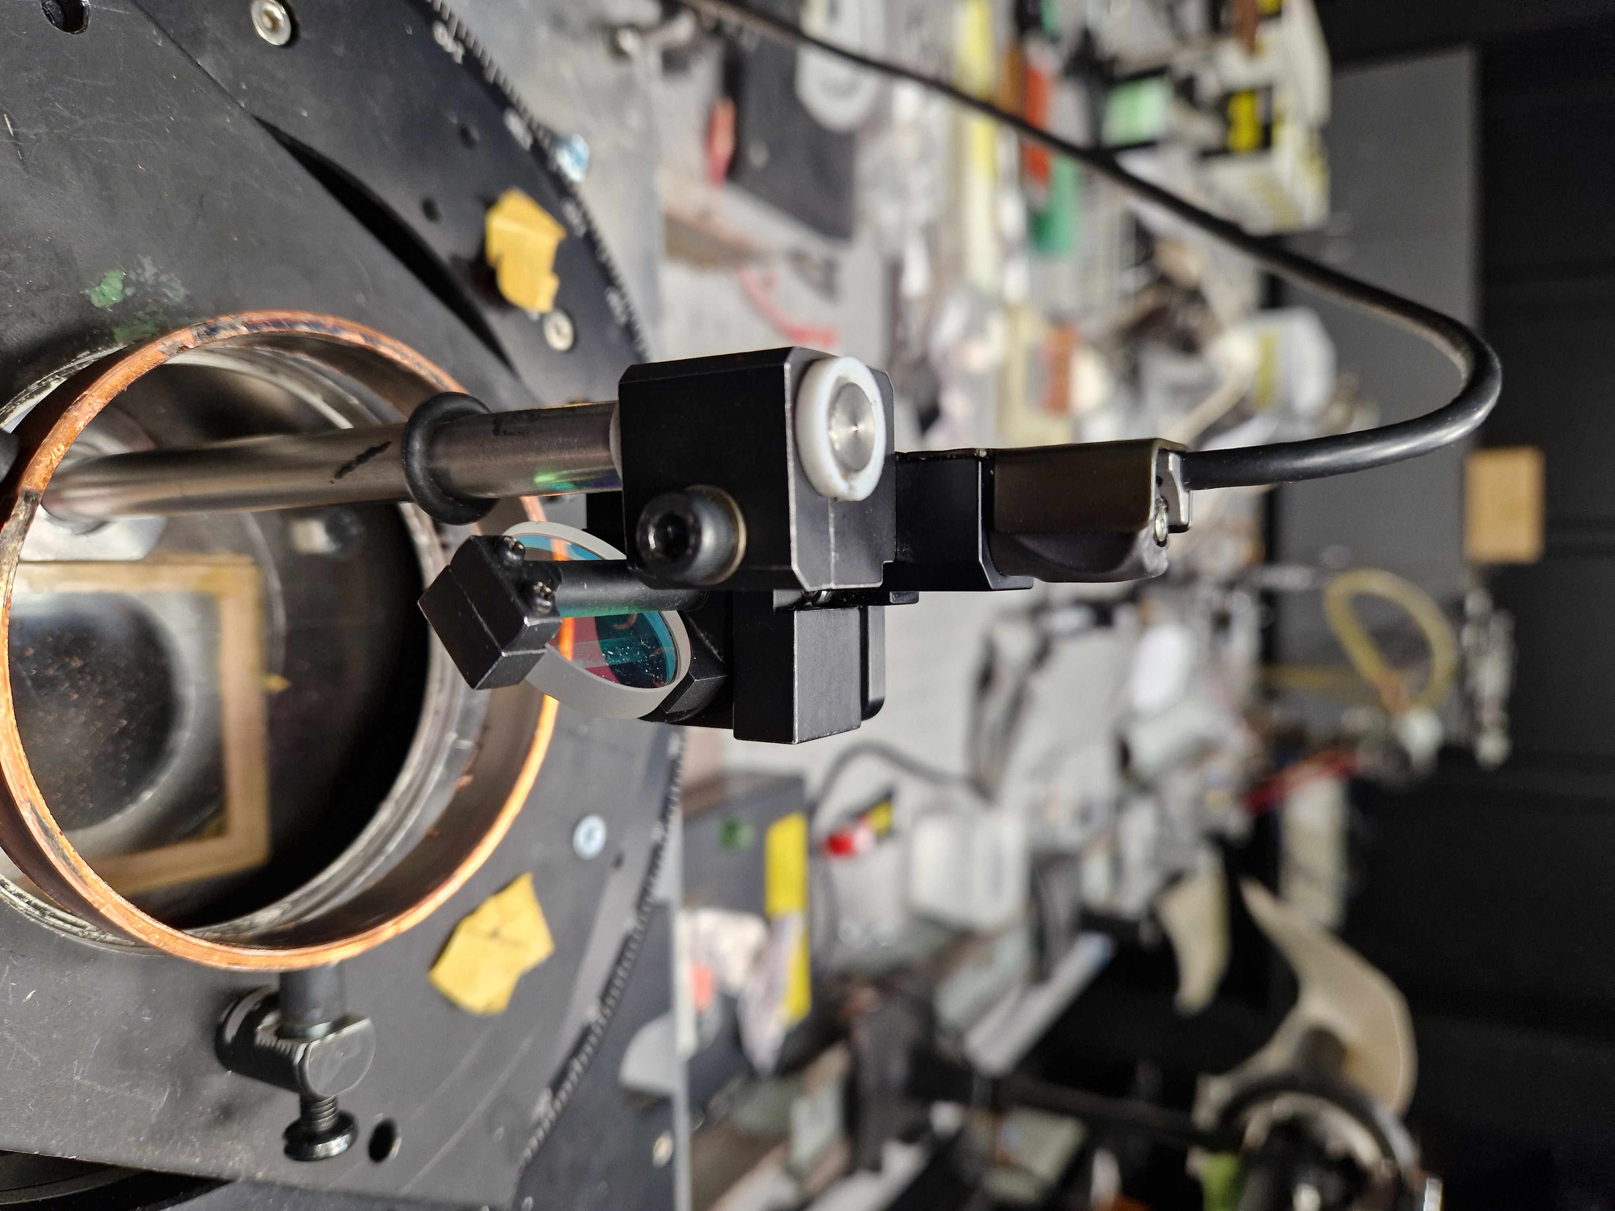
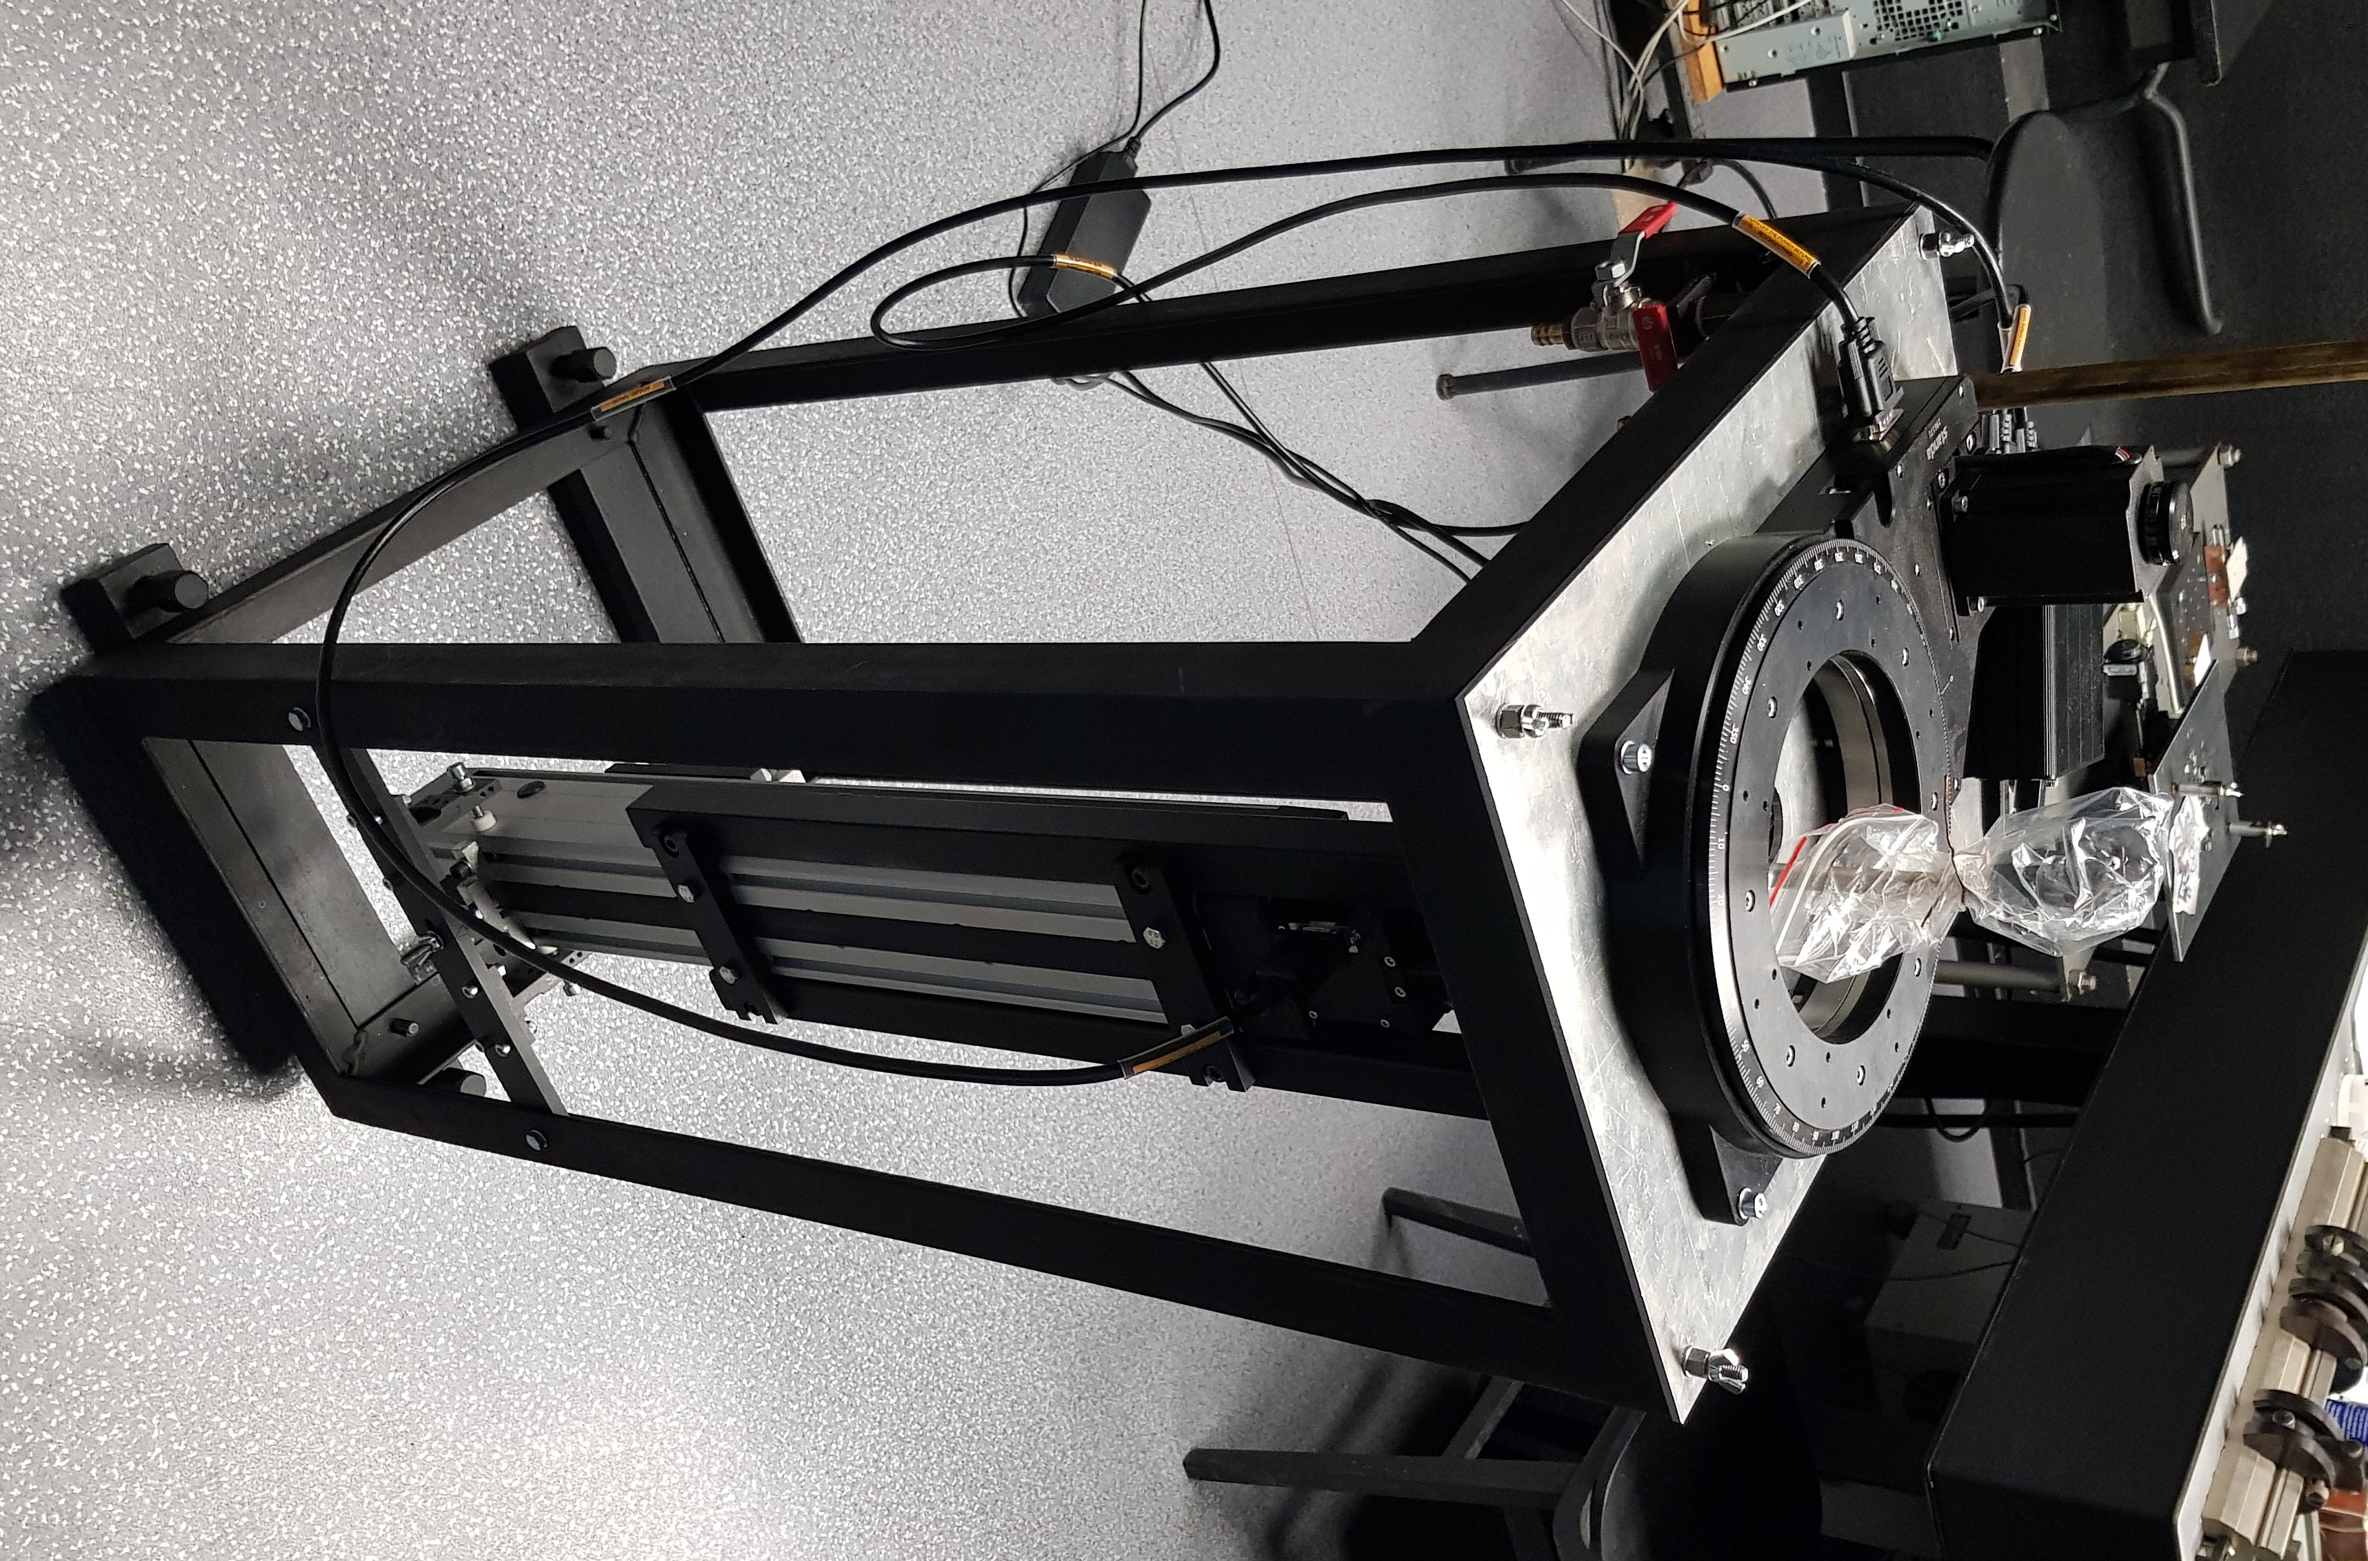

Slide 5
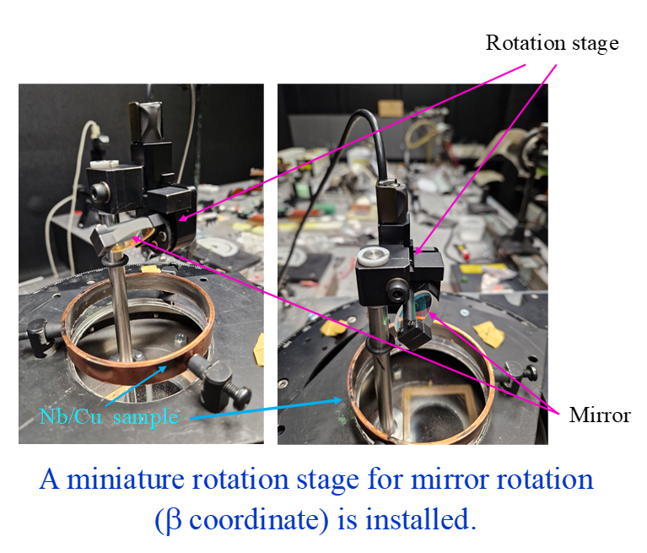
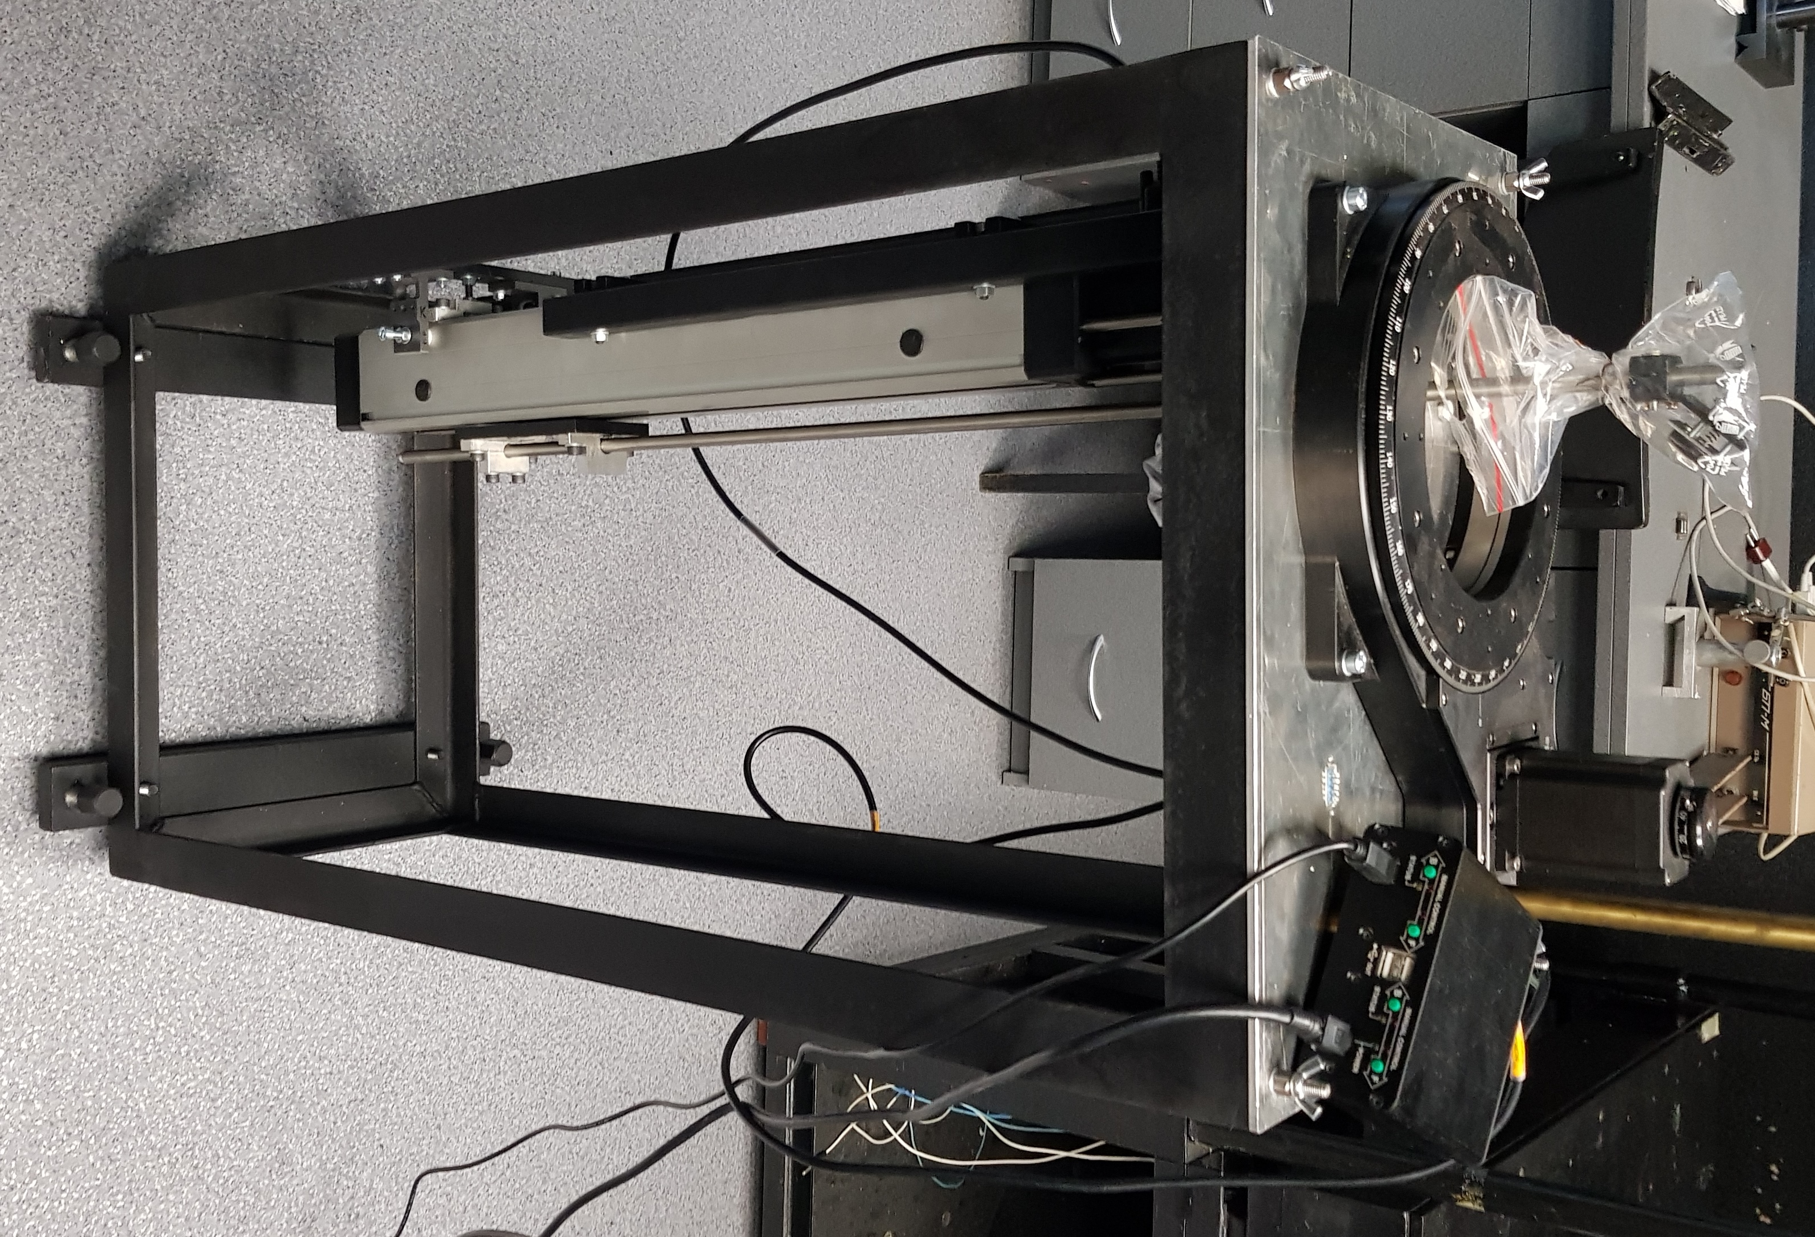
Test with a tubular part of the cavity
Figure 2. Photos of construction of Ar gas chamber with a tubular part of RF cavity.
SOFTWARE
The developed control program for laser irradiation of the RF cavity consists of two parts.
Program for irradiation of the tubular part of the RF cavity. The control is carried out on 2D coordinates Z and α, which provide the movement of the beam along the spiral with the change of the spiral pitch or speed of rotation.
Control program for the spherical part of the RF cavity. The control is also carried out on 3D coordinates Z, α and β. Provide rotation of the RF resonator in the horizontal plane and rotation of the mirror in the vertical plane, which also provides the movement of the beam along the spiral inside the sphere.

Slide 6
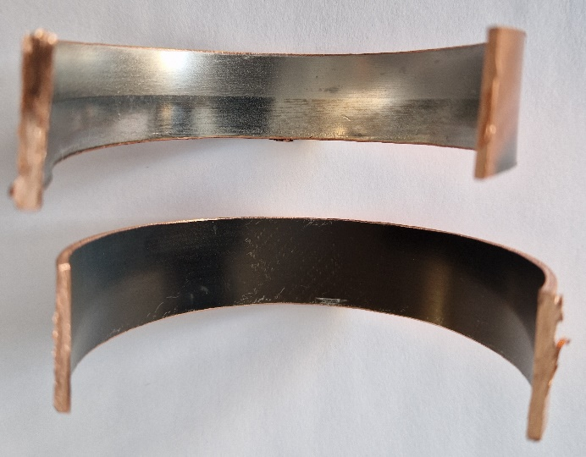
Nonirradiated surface
Irradiated surface:
I _{min}=40 MW/cm²
I _{max}=50 MW/cm²
Figure 3. Photos of nonirradiated surface (upper image) and irradiated by Nb:YAG laser of tubular part of inner surface of RF cavity (under image). After laser irradiation, the roughness parameters Ra decreased by about an order of magnitude from 900 nm to 90 nm.

Slide 7

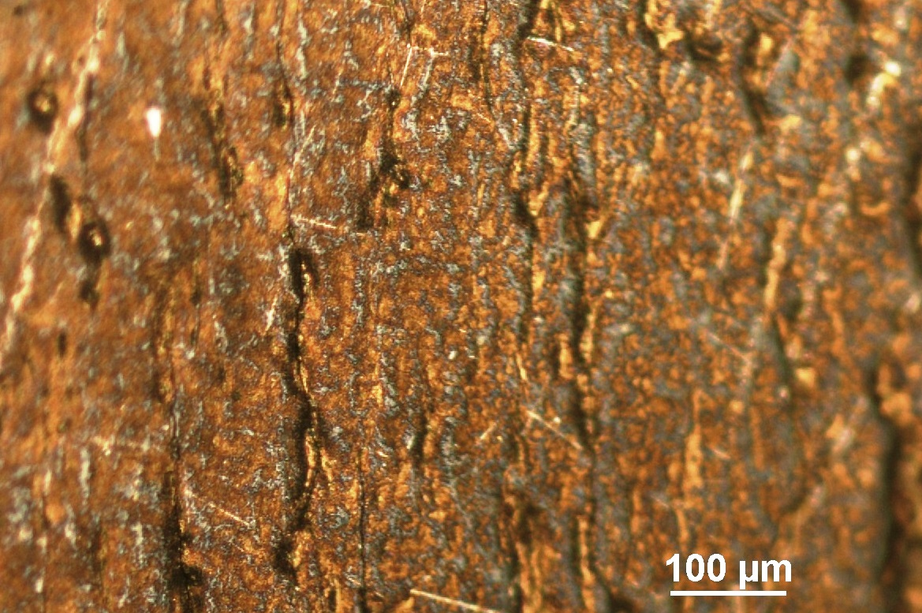
Optical microscope images of Nb surface
2 cm
Figure.1. Optical images of Nd on the inner surface of the tubular part of the RF cavity before laser irradiation.

Slide 8
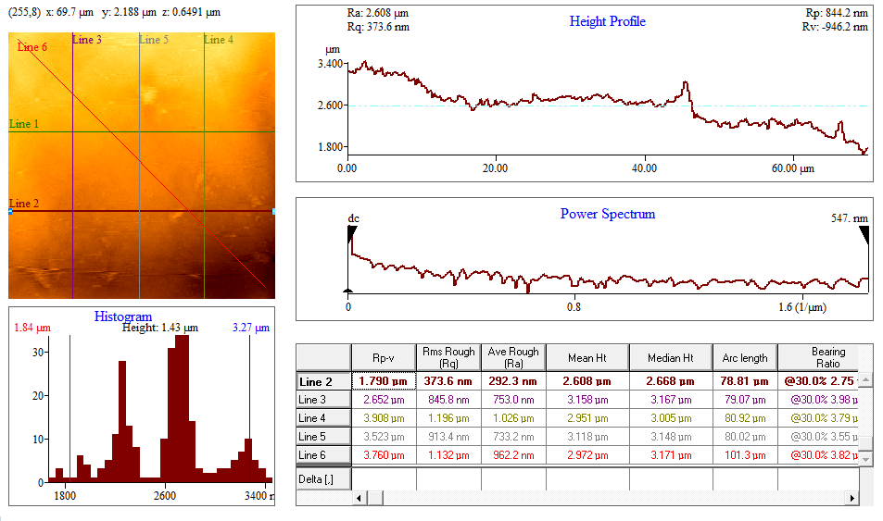
Non irradiated surface texture parameters
The roughness parameters Ra are in the range of a few microns.

Slide 9
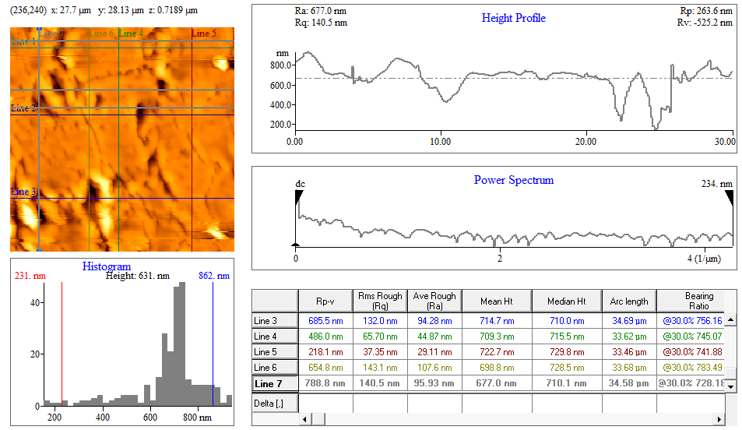
After laser irradiation of Nb on Cu, the roughness parameters Ra decreased by about an order of magnitude.

Slide 10
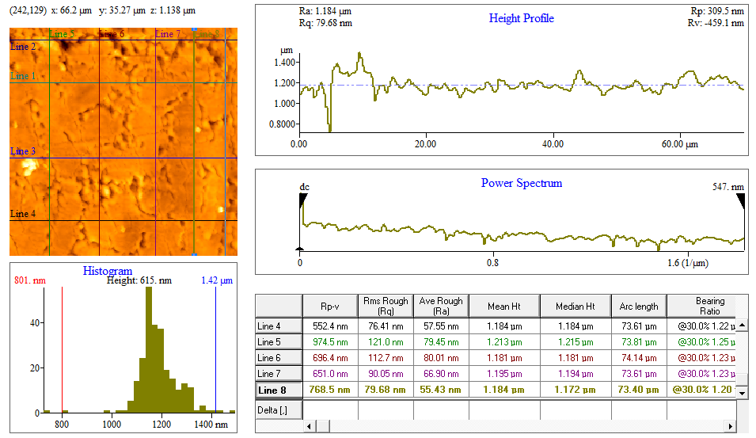

Slide 11
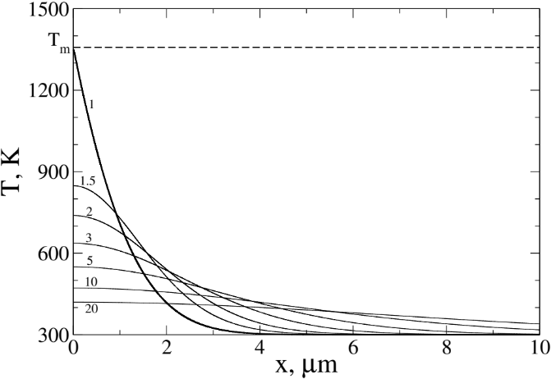
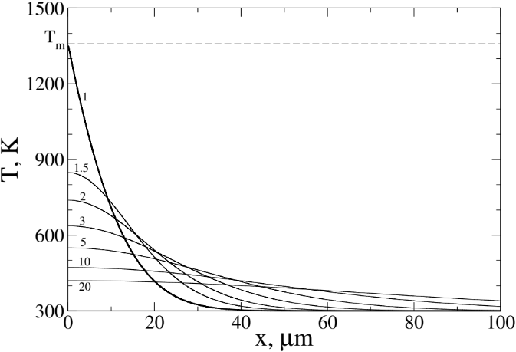
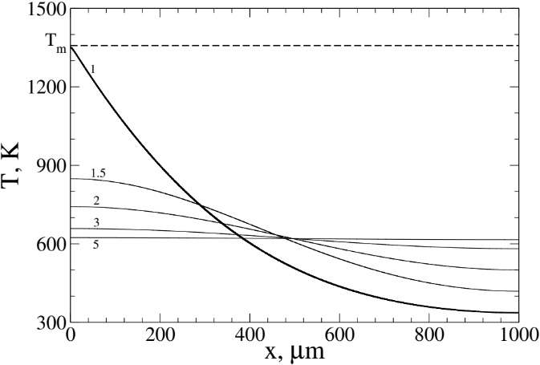
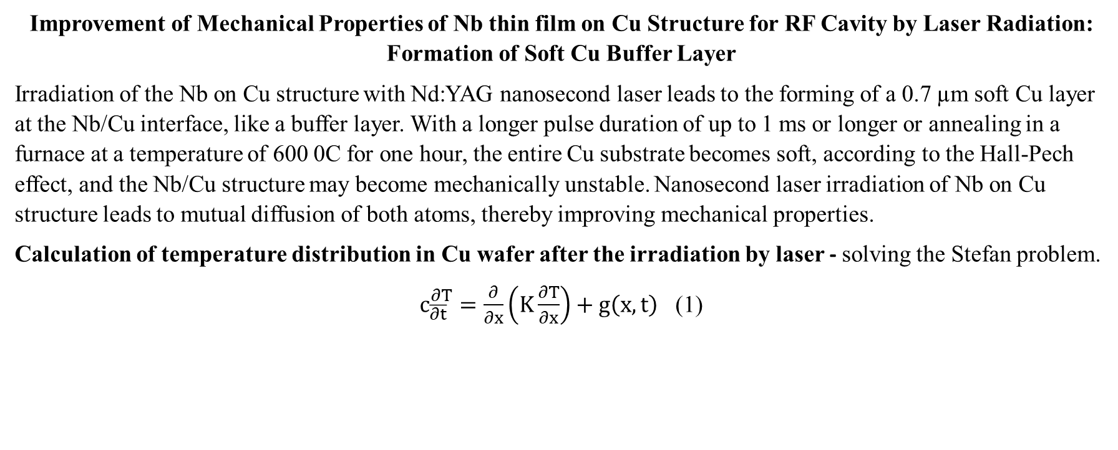
Improvement of Mechanical Properties of Nb thin film on Cu Structure for RF Cavity by Laser Radiation: Formation of Soft Cu Buffer Layer
Irradiation of the Nb on Cu structure with Nd:YAG nanosecond laser leads to the forming of a 0.7 µm soft Cu layer at the Nb/Cu interface, like a buffer layer. With a longer pulse duration of up to 1 ms or longer or annealing in a furnace at a temperature of 600 0C for one hour, the entire Cu substrate becomes soft, according to the Hall-Pech effect, and the Nb/Cu structure may become mechanically unstable. Nanosecond laser irradiation of Nb on Cu structure leads to mutual diffusion of both atoms, thereby improving mechanical properties.
Calculation of temperature distribution in Cu wafer after the irradiation by laser - solving the Stefan problem.
$c_{\overline{∂t}}^{∂T}=\frac{∂}{∂x}\left(K\frac{∂T}{∂x}\right)+g\left(x,t\right)$ (1)
Figure 1. The calculated temperature distributions at different time moments after laser pulse: t = 1.5τ, 2τ, 3τ, 5τ, 10τ and 20τ in a 1-mm thick Cu substrate for pulse durations: (a) 10 ns, (b) 1µs and (c) 1 ms.

Slide 12
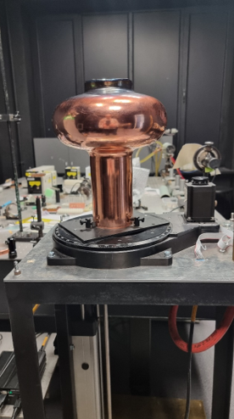
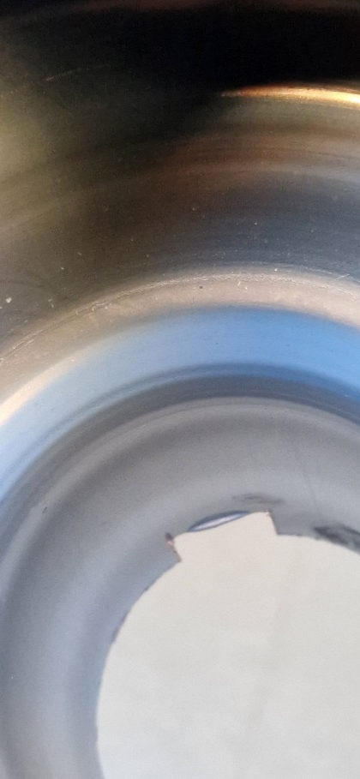
    Test with a spherical part of the RF cavity
Thin Nb layer.
Cu is seeing through of Nb thin film.
Irradiated Nb/Cu layer
Thick Nb layer
Irradiation of the 3D spherical part of the RF cavity by the laser shows that the deposition of Nb thin film on the Cu substrate is nonhomogeneous. Nb coating on the 2D tubular part of the RF cavity is thick, but on the 3D spheric part, it is too thin, less than 1 mk. Therefore, the 3D spheric part has not changed.
Figure 4. Photo of construction of Ar gas chamber with controlling 3D coordinates for laser treatment of the RF 1.3 GHz cavity with Nb thin film in the inner surface.
Figure 5. Photo of inside part of RF cavity after irradiation by Nd:YAG laser

Slide 13
CONCLUSION
Irradiation of the 3D spherical part of the RF cavity by the Nd:YAG laser shows that the deposition of Nb thin film on the Cu substrate is nonhomogeneous. Therefore, it is necessary to prepare the RF cavity with homogeneous Nb deposition on Cu at low temperature and Nb thickness from 3µk to 10 µk.
We have shown that the optical properties of the Nb/Cu structure depend on the laser intensity: the reflection index (R) of the unirradiated surface is R=30% and after irradiation are R=95% at I max, and R=82% at I min. This indirect dependence of hardness and adhesion on R can be used for nondestructive control of the mechanical properties of the RF resonator.

Slide 14
Thank you very much for your attention!

