Slide 1

Institute of Electrical Engineering SAS
Eugen SEILER, (Rastislav RIES)
SC characterization at IEE Bratislava
IFAST WP9 Meet (Berlin), 2 Dec 2024

Slide 2
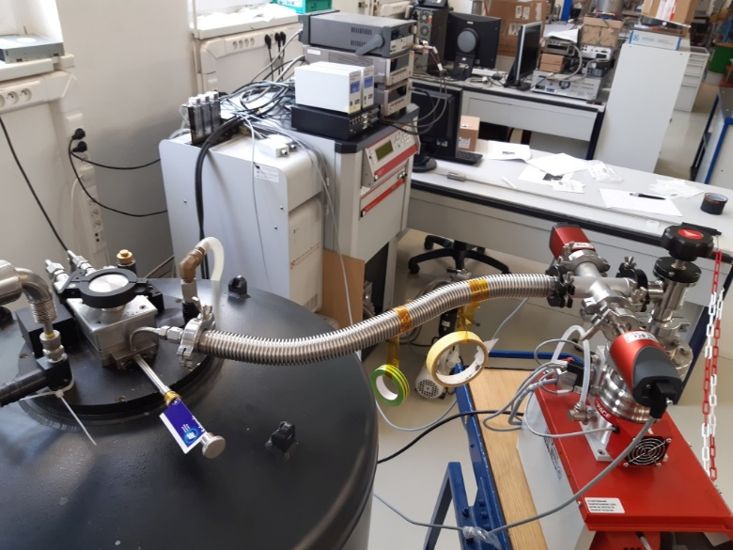
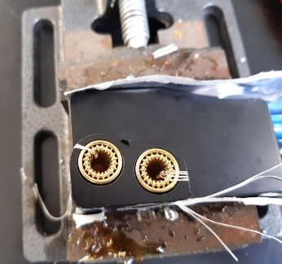
IEE OVERVIEW
All delivered sample batches were finalised by mid-July
Uni Siegen:
● NbTiN films on Si substrate – 23.11.2023 series
Bag 1, Bag 4, Bag 5
STFC Daresbury:
● Nb₃Sn , Nb films on Cu substrate – 12.1.2024 series
● Nb , (Nb₃Sn , NbTiN) films on Cu substrate – 23.2.2024 series
INFN Legnaro:
● Nb₃Sn films on Cu, Cu+Nb and Sapp substrates – 8.2.2024 series
Run#33, Run#36
After maintenance, repairs & tests (Aug-Oct), PPMS now fully operational again

Slide 3
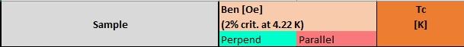
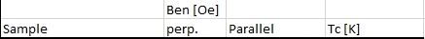
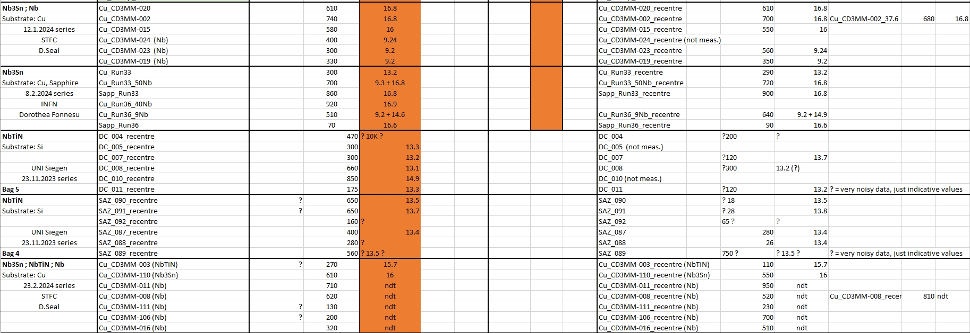
Table-summary

Slide 4
Magnetization loops’ Overview & Comparison

Slide 5
Nb₃Sn / Cu,Cu+Nb,Sapp INFN (Run 33, 8.2.2024 series)
Standard centering (35mm)
Nb₃Sn/Nb50um/Cu
Sapphire
Cu
zoom
Loop norm
Virgin norm
Run 33: deposition 600°C, Nb₃Sn-1μm
Sapphire sample – ‘Smash-cleaving’

Slide 6
Nb₃Sn / Cu+Nb,Sapp INFN (Run 36, 8.2.2024 series)
Standard centering (35mm)
Nb9um/Cu
Nb₃Sn/Nb40um/Cu
Sapphire
zoom
Virgin norm
Loop norm
Run 36: deposition 600°C, Nb₃Sn-0.6μm
Sapphire sample – ‘Smash-cleaving’
6

Slide 7
Nb₃Sn/Cu , NbTiN/Cu STFC (from 23.2.2024 series)
full Loops
Nb₃Sn
NbTiN
Virgin norm
Loop norm

Slide 8
Nb / Cu STFC (from 23.2.2024 series)

Slide 9
NbTiN / Si SiegenUni (23.11.2023 series) Bag 5 , Bag 4
Standard centering (35mm)
full Loops
recentre (32mm)
Bag 5
Bag 5
Bag 4
Bag 4

Slide 10
Thank you for your attention

