Slide 1

Task 9.3 Progress @
Liquid Tin Diffusion system progress
13th iFAST WP9 meeting – HZB, 02 December 2024
Davide Ford – INFN Legnaro National Laboratories

Slide 2
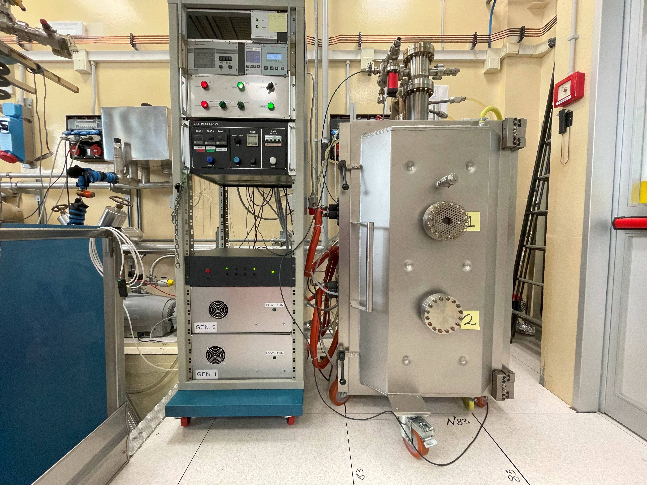
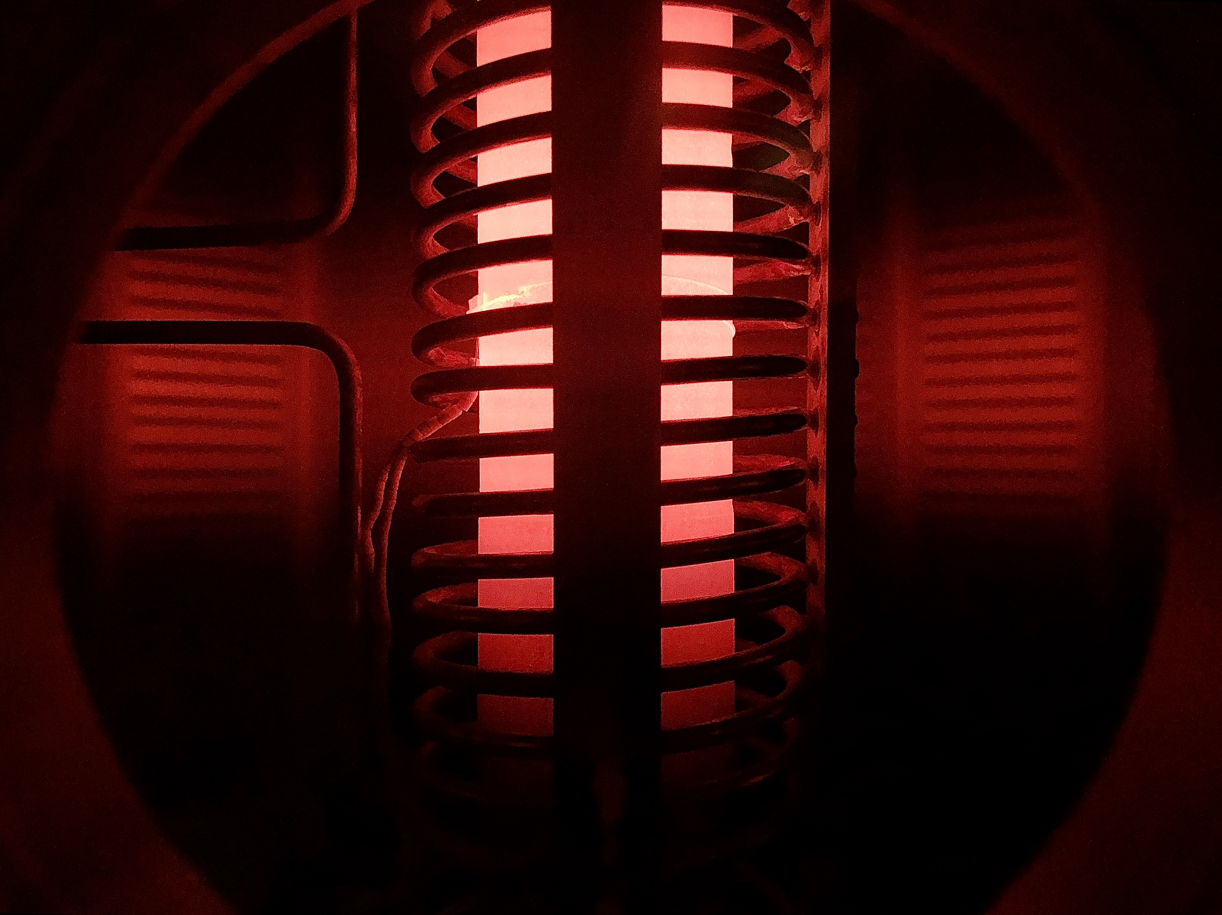
First tests of the LTD system
Upper part of Nb chamber at 600 °C

Slide 3
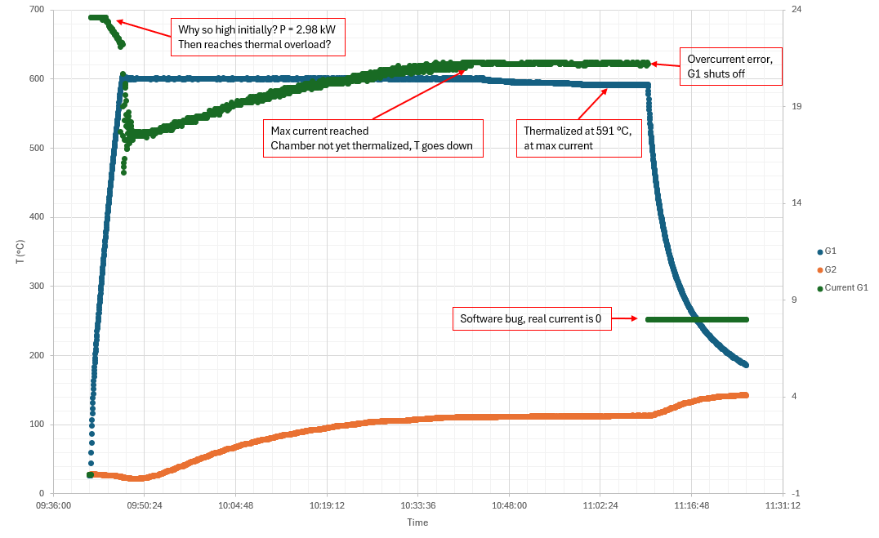

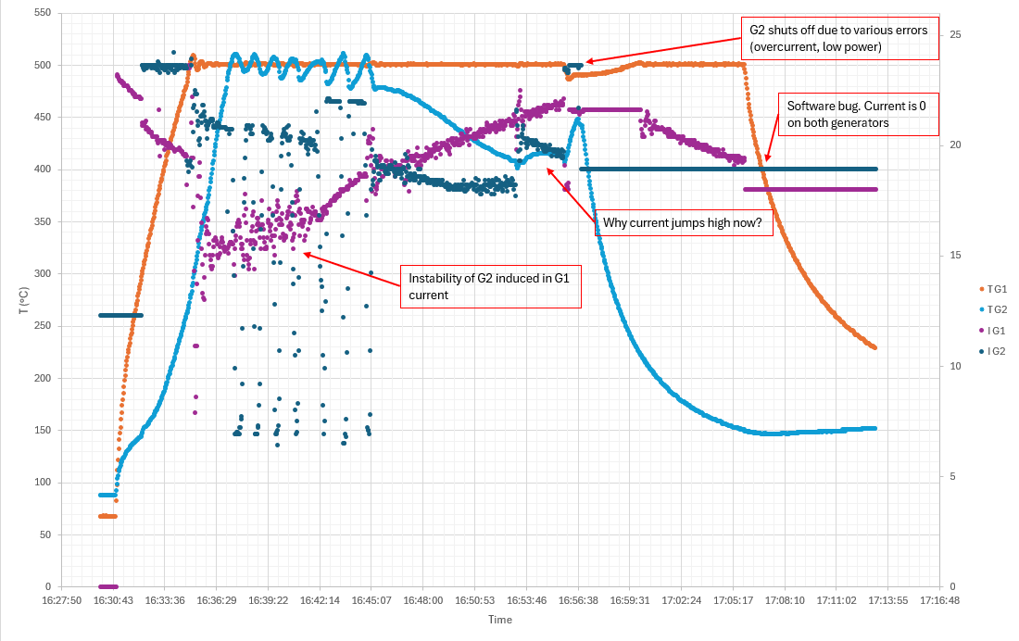
Problems and delays…
Only 600 °C reached (target T ≥ 1100 °C)
Extensive indipendent testing done resulting in generators being severely underpower.
Initial company simulations not consistent with experimental results.
Company already contacted (06/24) and still waiting for new generators (double the power) to be manufactured and tested by them.
Expected to have a full test with a 6 kW generator within end of december.

Slide 4
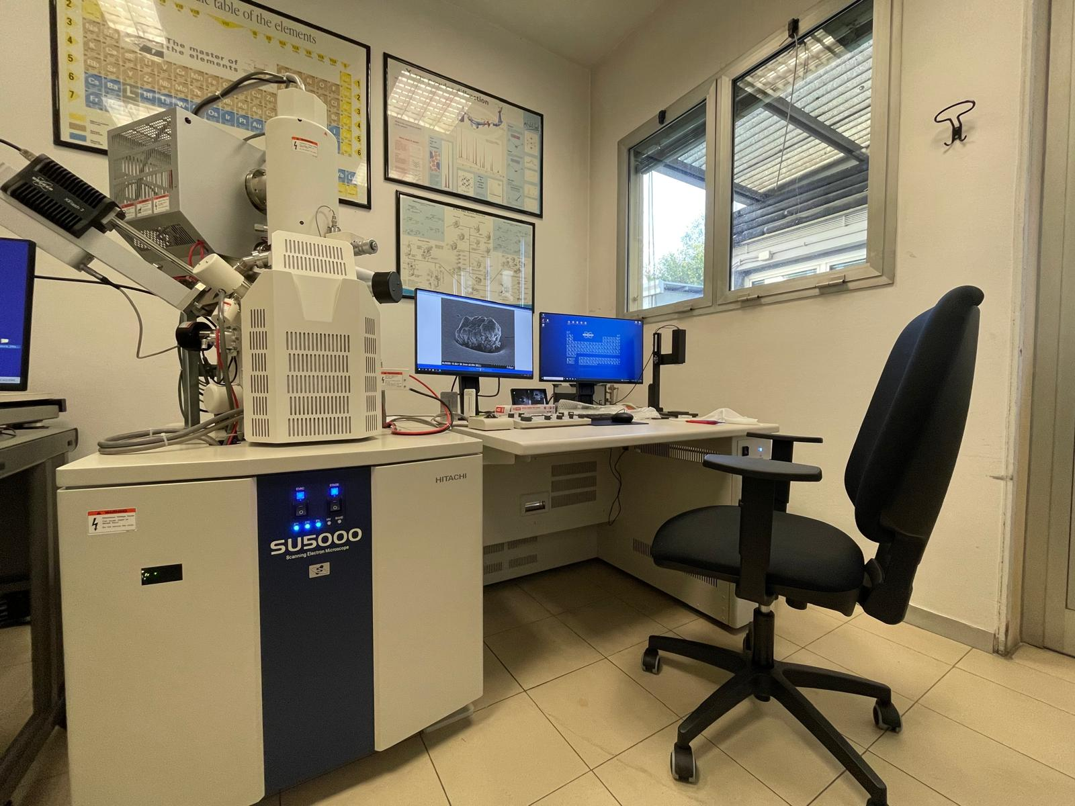
New FE-SEM arrived!

Slide 5

davide.ford@lnl.infn.it
Thanks for your attention

